Slide 1

感恩遇见，相互成就，本课件资料仅供您个人参考、教学使用，严禁自行在网络传播，违者依知识产权法追究法律责任。
更多教学资源请关注
公众号：溯恩高中英语
知识产权声明

Slide 2
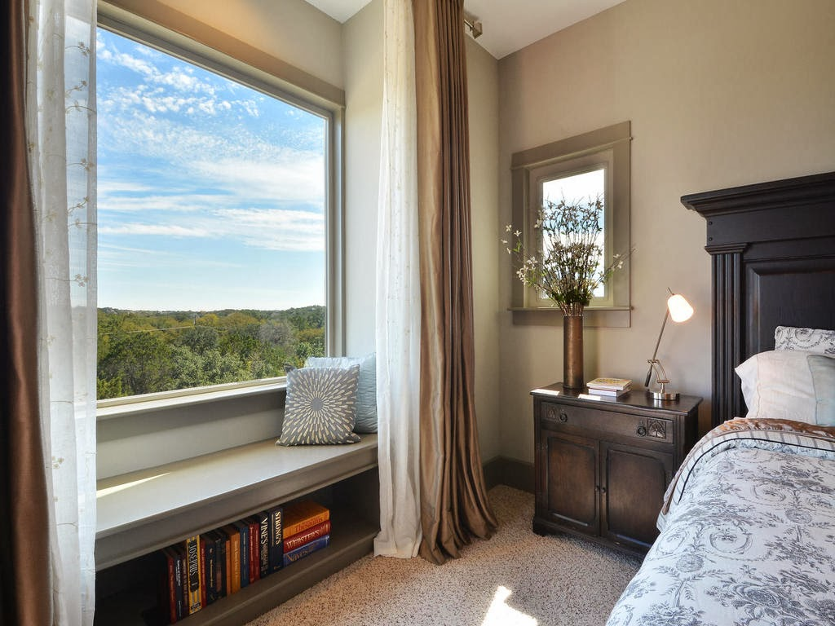
The Crystals 萨曼萨的晶体实验
Jacqueline Crompton Ottaway
(New Zealand)
Act 2

Slide 3
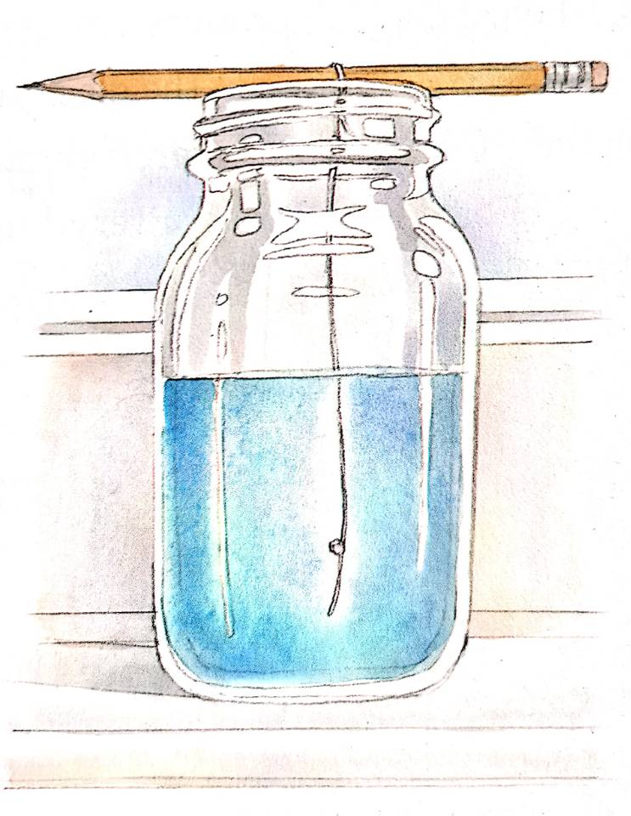
Revision:
I. Describe the scene:
II. 动词三连 （… did A and, doing B, did C）
e. g.
Samantha put down the wooden egg and, picking up the jar, went into the kitchen.
I spotted a book about the Beatles and, picking it up, began to read it attentively.
____________________________________________________________________________________________________________
Illustrated by Gary Undercuffler
Attached to the pencil, a thread dangled into a jar of bright blue solution.

Slide 4
2 _______________________
⁵At least it was peaceful up there though she‘d had to fight to keep the room for herself独占. She could still hear Thomas carrying on about it.
⁶“Sam‘s a real introvert内向的人 -- always hiding in her bedroom upstairs, sitting around reading or playing the violin. She should be downstairs with the rest of us. It’s a pity Sam‘s not more social合群的."
⁷Samantha took a sip啜饮 from her glass, savouring品尝 the cool, fresh taste, and leant倚靠 her forehead against the window frame窗框. It was strange the way things had worked out. Mum had been devastated使极为悲痛 after Dad had left them. But then, a few months later when she got a job at the public library, she had started going to the movies and to concerts with Thomas. Mum had begun to enjoy life again.
⁸Samantha looked out of the window at the green leaves on the almond杏 tree outside. What fickle无常的 twist of fate命运的捉弄 had driven Thomas to visit the city library and to bump into邂逅 her mother? Imagine Mum falling for爱上 a fitness健身 freak怪人! It was worse than that, thought Samantha. She'd actually married him. Now Samantha never seemed to have any time with her mother.
⁹Samantha looked at her watch -- 16:20. It was her turn to cook dinner. Mum had told her to make chicken paprika香辣鸡, with baked potatoes, peas and a tossed salad生菜色拉. Jodie and Jon had gone out for the evening. Of course they had, thought Samantha wryly嘲弄地. They were the extroverts性格外向的人 in the family.
〇 Where was Samantha in the room? What was she doing there? What was she drinking?
Can you find word(s) opposite to “introvert”?
According to what we have learned, can you figure out what role this part play in the story?
Was Samantha close to Jodie and Jon?
In the bedroom
Samantha was (sitting on the windowsill) in her bedroom, drinking her glass of apple juice.

Slide 5
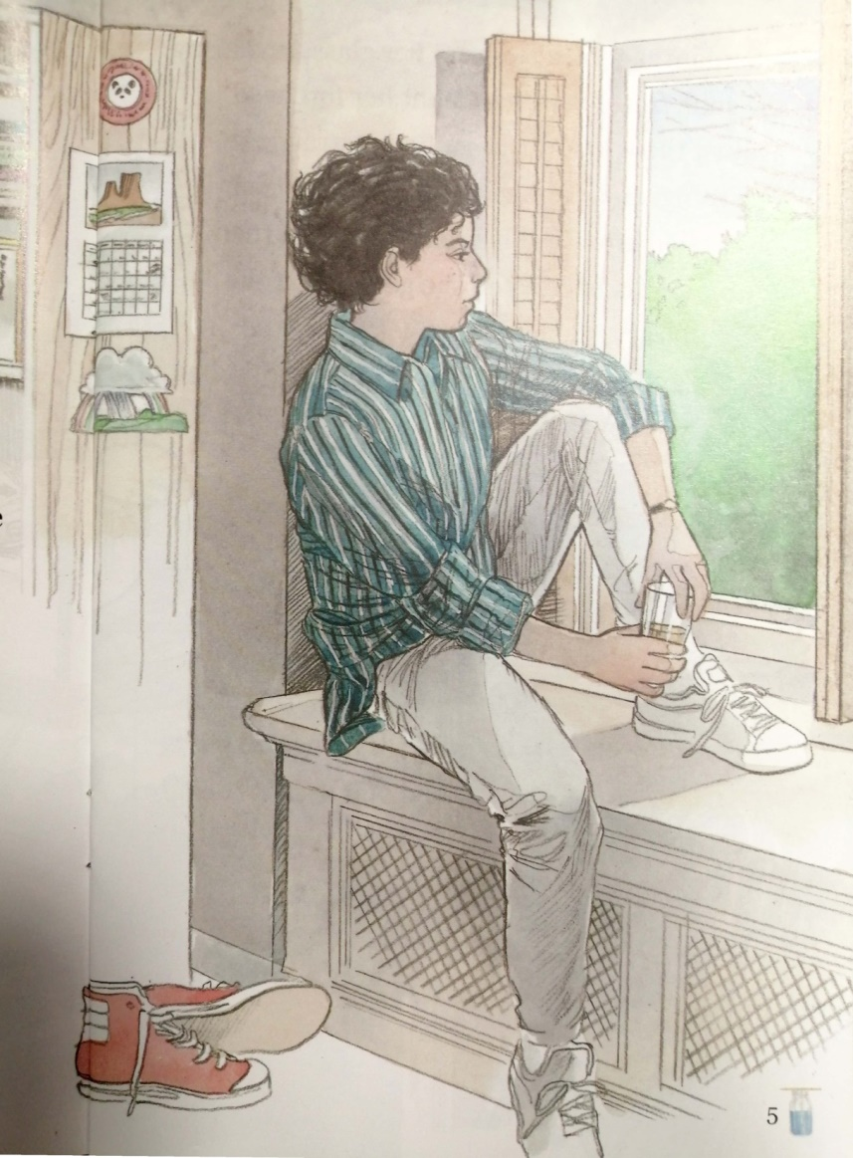
With the help of these expressions, can you describe what was happening or what would happen in this scene?
主
take a sip, …, and lean …
savour …
… forehead … window frame
次
Samantha took a sip from her glass, savouring the cool, fresh taste, and leant her forehead against the window frame.
rhetorical
A ____________ question?
What (a) fickle _____________命运的捉弄 had driven Thomas to visit the city library and _____________ 邂逅 her mother?
twist of fate
(to) bump into

Slide 6
情境造句。参照以下句子，进行类似描述：
小明看着窗外腊梅树(plum tree)上的绿叶。
Xiaoming looked out of the window at the green leaves on the plum tree ourside.
比那还要糟糕，小亮心想。他事实上根本没有做那个作业。
It was worse than that, thought Xiaoliang. He actually did not do his homework.
他看了看手表—— 21:30。轮到他扫地了。
He looked at his watch – 21:30. It was his turn to sweep the floor.
For your reference:
Samantha looked out of the window at the green leaves on the almond杏 tree outside.
It was worse than that, thought Samantha. She'd actually married him.
Samantha looked at her watch -- 16:20. It was her turn to cook dinner.

Slide 7
⁵At least it was peaceful up there though she‘d had to fight to keep the room for herself独占. She could still hear Thomas carrying on about it.
⁶“Sam‘s a real introvert内向的人 -- always hiding in her bedroom upstairs, sitting around reading or playing the violin. She should be downstairs with the rest of us. It’s a pity Sam‘s not more social合群的."
⁷Samantha took a sip啜饮 from her glass, savouring品尝 the cool, fresh taste, and leant倚靠 her forehead against the window frame窗框. It was strange the way things had worked out. Mum had been devastated使极为悲痛 after Dad had left them. But then, a few months later when she got a job at the public library, she had started going to the movies and to concerts with Thomas. Mum had begun to enjoy life again.
⁸Samantha looked out of the window at the green leaves on the almond杏 tree outside. What fickle无常的 twist of fate命运的捉弄 had driven Thomas to visit the city library and to bump into邂逅 her mother? Imagine Mum falling for爱上 a fitness健身 freak怪人! It was worse than that, thought Samantha. She'd actually married him. Now Samantha never seemed to have any time with her mother.
⁹Samantha looked at her watch -- 16:20. It was her turn to cook dinner. Mum had told her to make chicken paprika香辣鸡, with baked potatoes, peas and a tossed salad生菜色拉. Jodie and Jon had gone out for the evening. Of course they had, thought Samantha wryly嘲弄地. They were the extroverts性格外向的人 in the family.
Can you find word(s) opposite to “introvert”?
According to what we have learned, can you figure out what role this part play in the story?
Was Samantha close to Jodie and Jon?
Extrovert, social.
It tells us the background of the story, i. e., why the story develop that way.
Maybe not. Because she was introvert and they were extrovert. She cooked the dinner and they were outside.

Slide 8
What we learned today?
What expressions?
What structures?
What else?
Can you prepare a dinner? What would you say over it with your family members?

