Slide 1

感恩遇见，相互成就，本课件资料仅供您个人参考、教学使用，严禁自行在网络传播，违者依知识产权法追究法律责任。
更多教学资源请关注
公众号：溯恩高中英语
知识产权声明

Slide 2
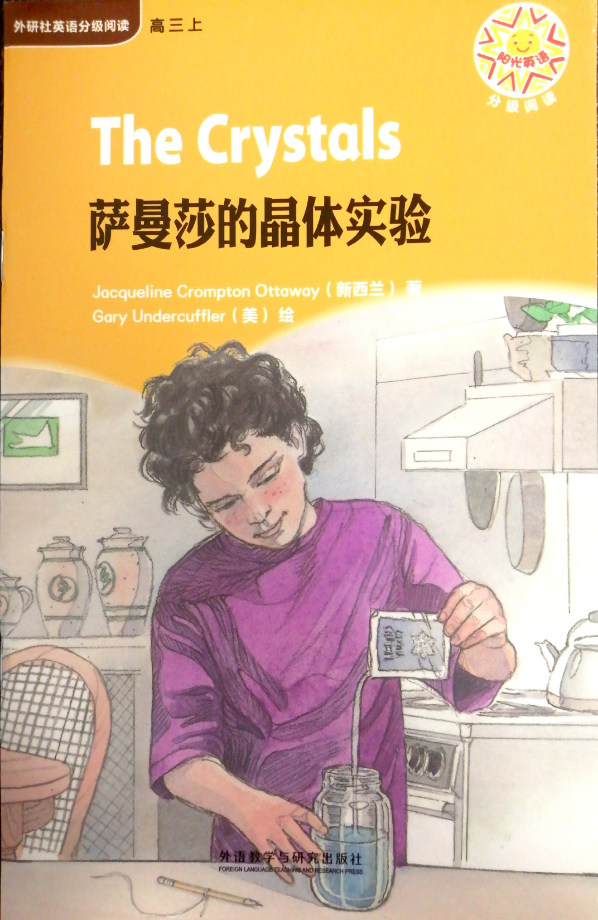
The Crystals 萨曼萨的晶体实验
Jacqueline Crompton Ottaway (New Zealand)
Illustrated by Gary Undercuffler

Slide 3
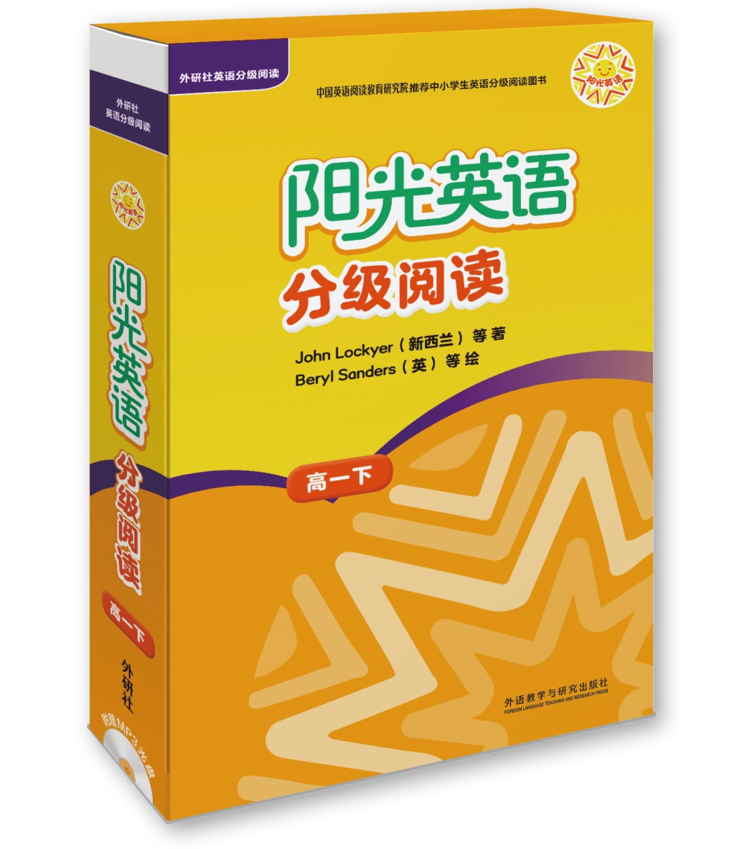
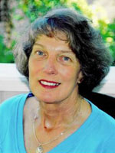
Name: Jacqueline Crompton Ottaway
Date of birth: 23 October 1950
Place of birth: Auckland
Now living in: Auckland
https://my.christchurchcitylibraries.com/new-zealand-childrens-authors/jacqueline-crompton-ottaway/
新西兰经典阅读品牌 Sunshine Classics

Slide 4
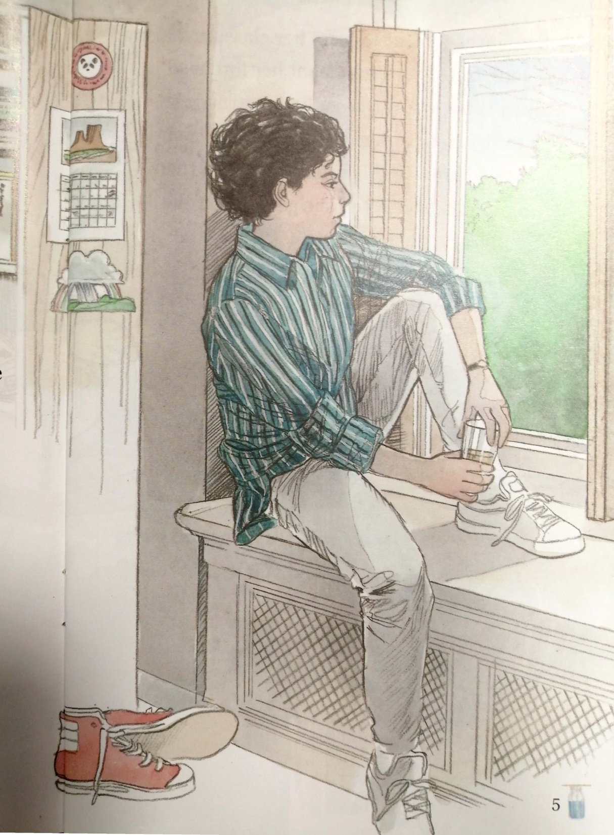
11 acts
Act 1 In the living room
Act 2 In the bedroom
Act 3-4 Scrubbing the potatoes (in the kitchen)
& Chatting with Mum while preparing the dinner
Act 5-7 At the table
Act 8 Before washing the dishes
Act 9-10 Talk after dinner
Act 10-11 Talk after dinner & the next morning
Can you find the heading for each act?

Slide 5
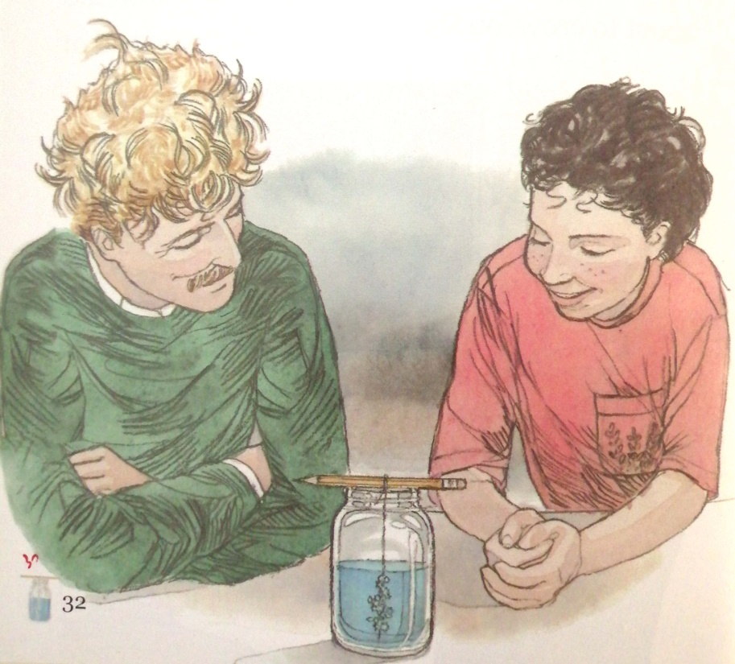
Enjoy your reading!

