Slide 1

感恩遇见，相互成就，本课件资料仅供您个人参考、教学使用，严禁自行在网络传播，违者依知识产权法追究法律责任。
更多教学资源请关注
公众号：溯恩高中英语
知识产权声明

Slide 2
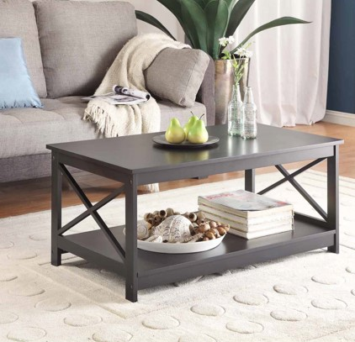
The Crystals 萨曼萨的晶体实验
Jacqueline Crompton Ottaway
(New Zealand)
Act 1

Slide 3
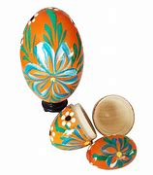
In the living room
1___________________
¹Samantha lifted the pencil and sighed. Attached to连着 the pencil, a thread dangled悬挂 into a jar广口瓶of bright blue solution溶液. She shook her head. The seed crystal籽晶 seemed to have dissolved溶解altogether全部.
²Today was Friday. Her science assignment任务 was due到期的 on Monday. How could she face Miss Newman with a project on copper sulphate硫酸铜 crystals结晶体, when she hadn’t produced even one measly很小的 crystal? Samantha put the glass jar down on the coffee table and stared glumly闷闷不乐地 at the piece of bald光秃的blue thread. Everything seemed to be going wrong lately.
³Samantha put down the thread and picked up a polished擦亮的wooden egg from the collection sitting in a bowl on the coffee table. She turned the smooth wooden surface of the egg slowly around in the palm手掌of her hand. It felt cool, familiar and reassuring令人放心的, reminding her of the way life used to be.
⁴Samantha put down the wooden egg and, picking up the jar, went into the kitchen. She put the jar on the windowsill窗台, opened the fridge and poured herself a glass of apple juice. Then she retreated缩回 upstairs to her bedroom.
〇 Where was Samantha before she went into the kitchen?
What was Samantha’s trouble?
What do you think Samantha’s life used to be? Was it really great?
How many rooms was Samantha in in this part?

Slide 4
a coffee table

Slide 5
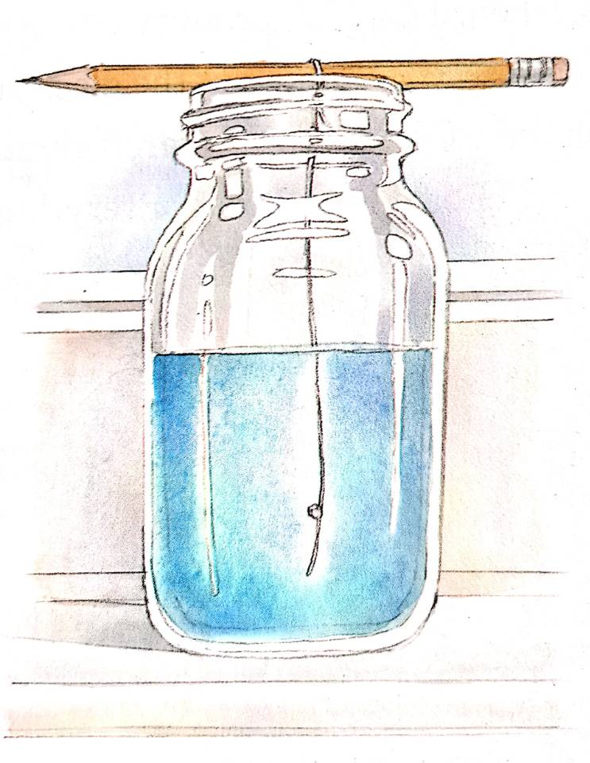
Can you describe this scene?
a pencil
a glass jar
a thread
bright blue solution (copper sulphate )
the windowsill
Attached to the pencil, a thread dangled into a jar of bright blue solution.
She put the jar on the windowsill, opened the fridge and poured herself a glass of apple juice
Illustrated by Gary Undercuffler

Slide 6
情境造句。参照以下句子，进行类似描述：
小明打开背包叹了一口气。在背包里，几张试卷被放在一堆书中间。他摇了摇头。
Xiaoming opened his backpack and sighed. Inside the backpack, several exam papers were put among a pile of books. He shook his head.
她如何能用一篇仅写三句话的作文面对孟老师，当她没有好好写出对这件事的评价。
How could she face Mr. Meng with a passage containing only 3 sentences, when she hadn’t make a good comment on this issue.
他放下遥控板，拿起了手机/平板，走进他的房间。
He put down the remote control, picking up the phone/ tablet, and went into his room.
For your reference:
Samantha lifted the pencil and sighed. Attached to the pencil, a thread dangled into a jar of bright blue solution. She shook her head.
How could she face Miss Newman with a project on copper sulphate crystals, when she hadn’t produced even one measly crystal?
Samantha put down the wooden egg and, picking up the jar, went into the kitchen.
①
②
③

Slide 7

¹Samantha lifted the pencil and sighed. Attached to连着 the pencil, a thread dangled悬挂 into a jar广口瓶of bright blue solution溶液. She shook her head. The seed crystal籽晶 seemed to have dissolved溶解altogether全部.
²Today was Friday. Her science assignment任务 was due到期的 on Monday. How could she face Miss Newman with a project on copper sulphate硫酸铜 crystals结晶体, when she hadn’t produced even one measly很小的 crystal? Samantha put the glass jar down on the coffee table and stared glumly闷闷不乐地 at the piece of bald光秃的blue thread. Everything seemed to be going wrong lately.
³Samantha put down the thread and picked up a polished擦亮的wooden egg from the collection sitting in a bowl on the coffee table. She turned the smooth wooden surface of the egg slowly around in the palm手掌of her hand. It felt cool, familiar and reassuring令人放心的, reminding her of the way life used to be.
⁴Samantha put down the wooden egg and, picking up the jar, went into the kitchen. She put the jar on the windowsill窗台, opened the fridge and poured herself a glass of apple juice. Then she retreated缩回 upstairs to her bedroom.
What was Samantha’s trouble?
What do you think Samantha’s life used to be? Was it really great?
How many rooms was Samantha in in this part?
Her assignment would be due but she didn’t got a satisfactory result yet.
And she was not used to her life now.
This part didn’t tell us about it,
so we don’t know whether it’s great or not.
She went into 3 rooms successively先后, i. e., the living room, the kitchen and her bedroom.

Slide 8
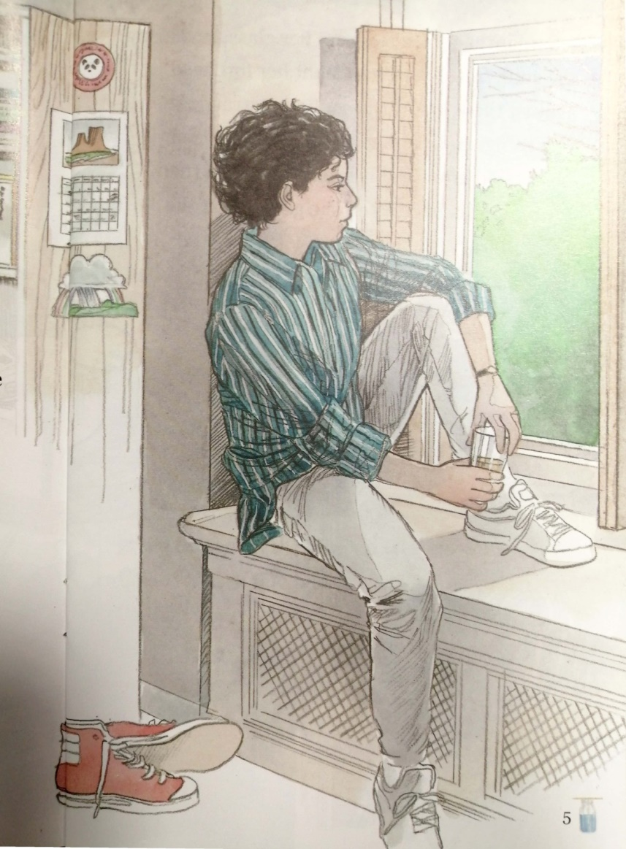
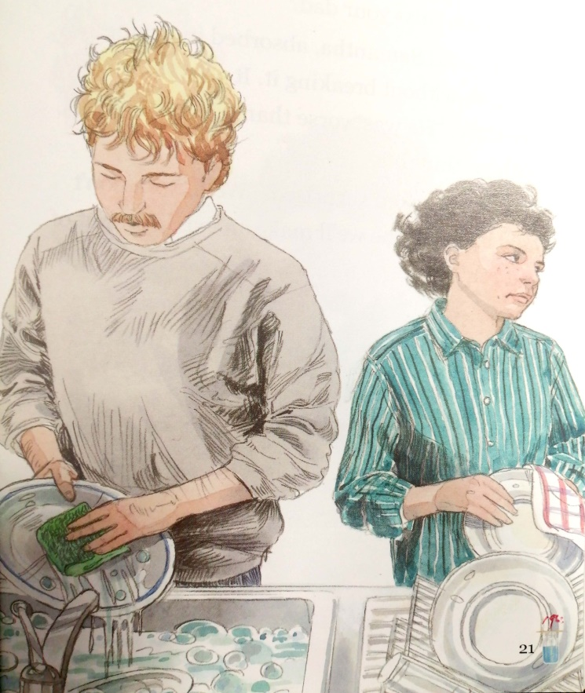
What would he do in his bedroom?
…

