Slide 1

感恩遇见，相互成就，本课件资料仅供您个人参考、教学使用，严禁自行在网络传播，违者依知识产权法追究法律责任。
更多教学资源请关注
公众号：溯恩高中英语
知识产权声明

Slide 2
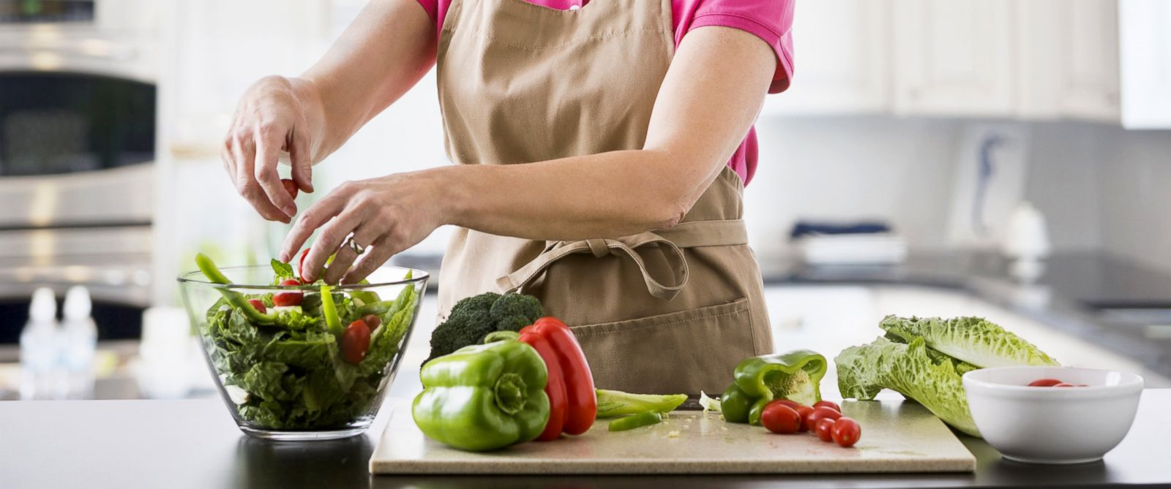
The Crystals 萨曼萨的晶体实验
Jacqueline Crompton Ottaway
(New Zealand)
Act 3-4

Slide 3
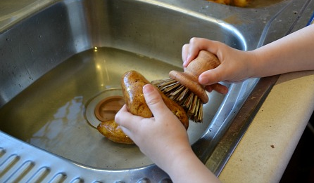
Scrubbing the potatoes (in the kitchen)
3________________________________
¹⁰“Don‘t forget to scrub用力擦洗 the potatoes, Samantha, and brush a little oil over them. That’s how Thomas likes them,” Mum had instructed指导 her as she went to work. Not only was Thomas a fitness freak, he was also a health fanatic极端分子!
¹¹The thing was that Mum seemed really happy with him. The only thing they fought about was Samantha‘s introverted(性格)内向的 behaviour.
¹²"Well, what do they expect?” Samantha asked herself as she scrubbed the potatoes fiercely狠狠地." I was an only child for 12 years and then, whamo! I'm suddenly handed a stepfather, a stepbrother and a stepsister. And I'm expected to bend over backwards竭尽全力(取悦某人) being nice and polite to everyone.“ (109 words)
〇What was she doing here?
Did Mum think Samantha had problems with her character? Did Thomas agree with Mum?
Did Samantha consider herself introverted? What did being an extrovert mean to her?
Whose perspective does the story develop from?
情境造句。参照蓝色字体句子，进行类似描述：
小明不但是一个努力的学生，也是一个运动的健将。
Not only is Xiaoming a hardworking student, he is also a talented athlete.
她的父母竭尽全力(去)讨她欢心。
Her parents bend over backwards to please her.

Slide 4
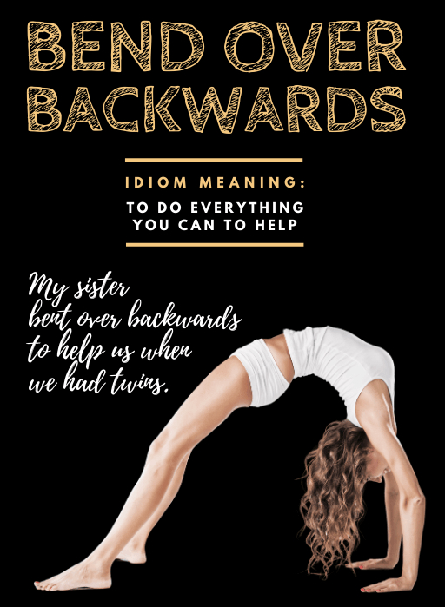
¹⁰“Don‘t forget to scrub用力擦洗 the potatoes, Samantha, and brush a little oil over them. That’s how Thomas likes them,” Mum had instructed指导 her as she went to work. Not only was Thomas a fitness freak, he was also a health fanatic极端分子!
¹¹The thing was that Mum seemed really happy with him. The only thing they fought about was Samantha‘s introverted(性格)内向的 behaviour.
¹²"Well, what do they expect?” Samantha asked herself as she scrubbed the potatoes fiercely狠狠地." I was an only child for 12 years and then, whamo! I'm suddenly handed a stepfather, a stepbrother and a stepsister. And I'm expected to bend over backwards竭尽全力(取悦某人) being nice and polite to everyone.“ (109 words)
Did Mum think Samantha had problems with her character? Did Thomas agree with Mum?
Did Samantha consider herself introverted? What did being an extrovert mean to her?
Whose perspective does the story develop from?
No, she don’t think so, or she would not fight with Thomas about it.
Maybe not, because when she complained, she said she was still
young and considered being an extrovert was a way in which
she pleased the others.
From Samantha’s perspective.

Slide 5
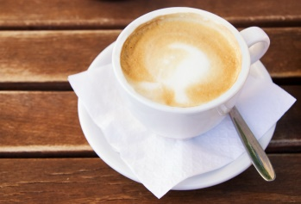
4________________________________
¹³Just as she was putting the potatoes into the oven烤箱, she heard her mother pull up停车 in the car. Great! She was home earlier than usual. Perhaps they'd have time for a chat.
¹⁴"Hi, Mum! Like a cup of coffee?”
¹⁵“Coffee would be wonderful. Thanks, Samantha."
¹⁶“Have a good day?” Samantha called over her shoulder回头 as she filled the kettle水壶 with water and then plugged it in接上电源.
¹⁷“Not bad. How was school?”
¹⁸“Boring as usual."
¹⁹Mum laughed, tossing her dark hair back甩到脑后 as she spoke.
²⁰“Samantha, I'd completely forgotten that I have a library meeting tonight. I'll have to go out right after dinner.”"
²¹Samantha handed Mum her cup of coffee. She felt more depressed沮丧的 than ever比以往更. Now she was stuck with被缠住 Thomas for the evening. No doubt, she thought as she turned the chicken pieces over, he'd expect her to make brilliant, extroverted conversation, just like Jodie and Jon would!
²²“Here,” said Mum, draining喝光 her cup of coffee. “I'll help you make the salad. There's only three of us. We'll have dinner at the kitchen table."
²³Mum grabbed（匆忙地）拿 chives细香葱, carrots胡萝卜, radishes小红萝卜, tomatoes and lettuce生菜 out of the fridge. As she washed and scraped刮干净 and peeled削皮 the vegetables, she told Samantha about an eccentric古怪的 borrower who had been caught trying to shuffle拖着脚走 out through the library‘s turnstile十字转门 with six books smuggled偷带 under his overcoat.
²⁴“Imagine wearing a heavy overcoat like that in mid-summer,” said Mum, laughing as she diced up切成小块 another radish." It was a dead giveaway彻底的暴露!"
²⁵Samantha started laughing, too. (252 words)
〇What was Samantha doing in this part? (tip: 2 things)
What were Samantha and Mum talking about in this part?
How many dishes did they prepare?
Can you figure out Samantha prefer what they prepared in the kitchen?
Chatting with Mum while preparing the dinner

Slide 6
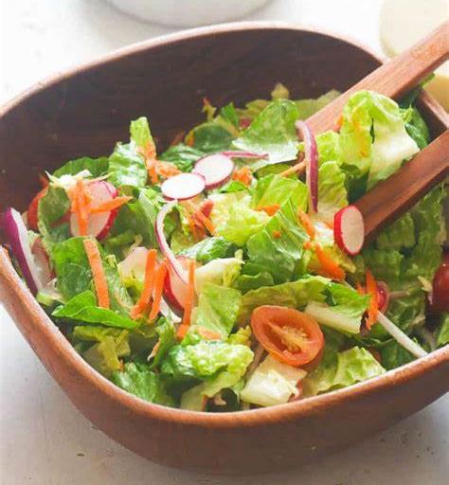
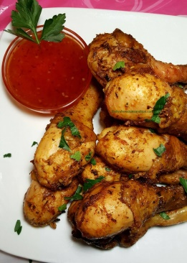
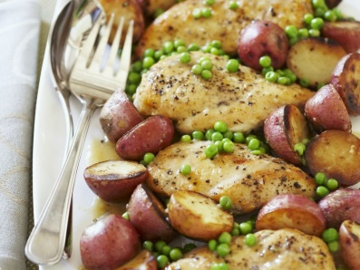
What do people do to prepare a dinner in the kitchen?
Let’s collect expressions of this type in this part.
From the expressions, can you figure out which they prepared?
c. Match the pictures with the expressions
a tossed salad
chicken paprika
①put the potatoes into the oven
②fill the kettle with water and then plugged it in
③handed Mum her cup of coffee
④turn the chicken pieces over
⑤drain her cup of coffee
⑥grab … out of the fridge
⑦wash and scrape and peel the vegetables
⑧dice up another radish
⁹Samantha looked at her watch -- 16:20. It was her turn to cook dinner. Mum had told her to make chicken paprika, with baked potatoes, peas and a tossed salad….
¹⁴"Hi, Mum! Like a cup of coffee?”
⑥
⑦
⑧
④
baked potatoes, and peas
a cup of coffee
②
③
⑤
①
情境造句。参照以下句子，进行类似描述：
Samantha called over her shoulder as she filled the kettle with water and then plugged it in.
Mum laughed, tossing her dark hair back as she spoke.
“…” said Mum, laughing as she diced up another radish. “…”
小明回头答道，一边把书本整理好然后放进书包里。
Xiaoming answered over his shoulder as he put his books away and then put them into the backpack.

Slide 7
4________________________________
¹³Just as she was putting the potatoes into the oven烤箱, she heard her mother pull up停车 in the car. Great! She was home earlier than usual. Perhaps they'd have time for a chat.
¹⁴"Hi, Mum! Like a cup of coffee?”
¹⁵“Coffee would be wonderful. Thanks, Samantha."
¹⁶“Have a good day?” Samantha called over her shoulder回头 as she filled the kettle水壶 with water and then plugged it in接上电源.
¹⁷“Not bad. How was school?”
¹⁸“Boring as usual."
¹⁹Mum laughed, tossing her dark hair back甩到脑后 as she spoke.
²⁰“Samantha, I'd completely forgotten that I have a library meeting tonight. I'll have to go out right after dinner.”"
²¹Samantha handed Mum her cup of coffee. She felt more depressed沮丧的 than ever比以往更. Now she was stuck with被缠住 Thomas for the evening. No doubt, she thought as she turned the chicken pieces over, he'd expect her to make brilliant, extroverted conversation, just like Jodie and Jon would!
²²“Here,” said Mum, draining喝光 her cup of coffee. “I'll help you make the salad. There's only three of us. We'll have dinner at the kitchen table."
²³Mum grabbed（匆忙地）拿 chives细香葱, carrots胡萝卜, radishes小红萝卜, tomatoes and lettuce生菜 out of the fridge. As she washed and scraped刮干净 and peeled削皮 the vegetables, she told Samantha about an eccentric古怪的 borrower who had been caught trying to shuffle拖着脚走 out through the library‘s turnstile十字转门 with six books smuggled偷带 under his overcoat.
²⁴“Imagine wearing a heavy overcoat like that in mid-summer,” said Mum, laughing as she diced up切成小块 another radish." It was a dead giveaway彻底的暴露!"
²⁵Samantha started laughing, too. (252 words)
What were Samantha and Mum talking about in this part?
How many dishes did they prepare?
Can you figure out Samantha prefer what they prepared in the kitchen? Any reason?
Chatting with Mum while preparing the dinner
They talked about what happened this day.
3 dishes and a cup of coffee.
She must prefer the cup of coffee since she could chat with Mum over the cup of coffee.

Slide 8
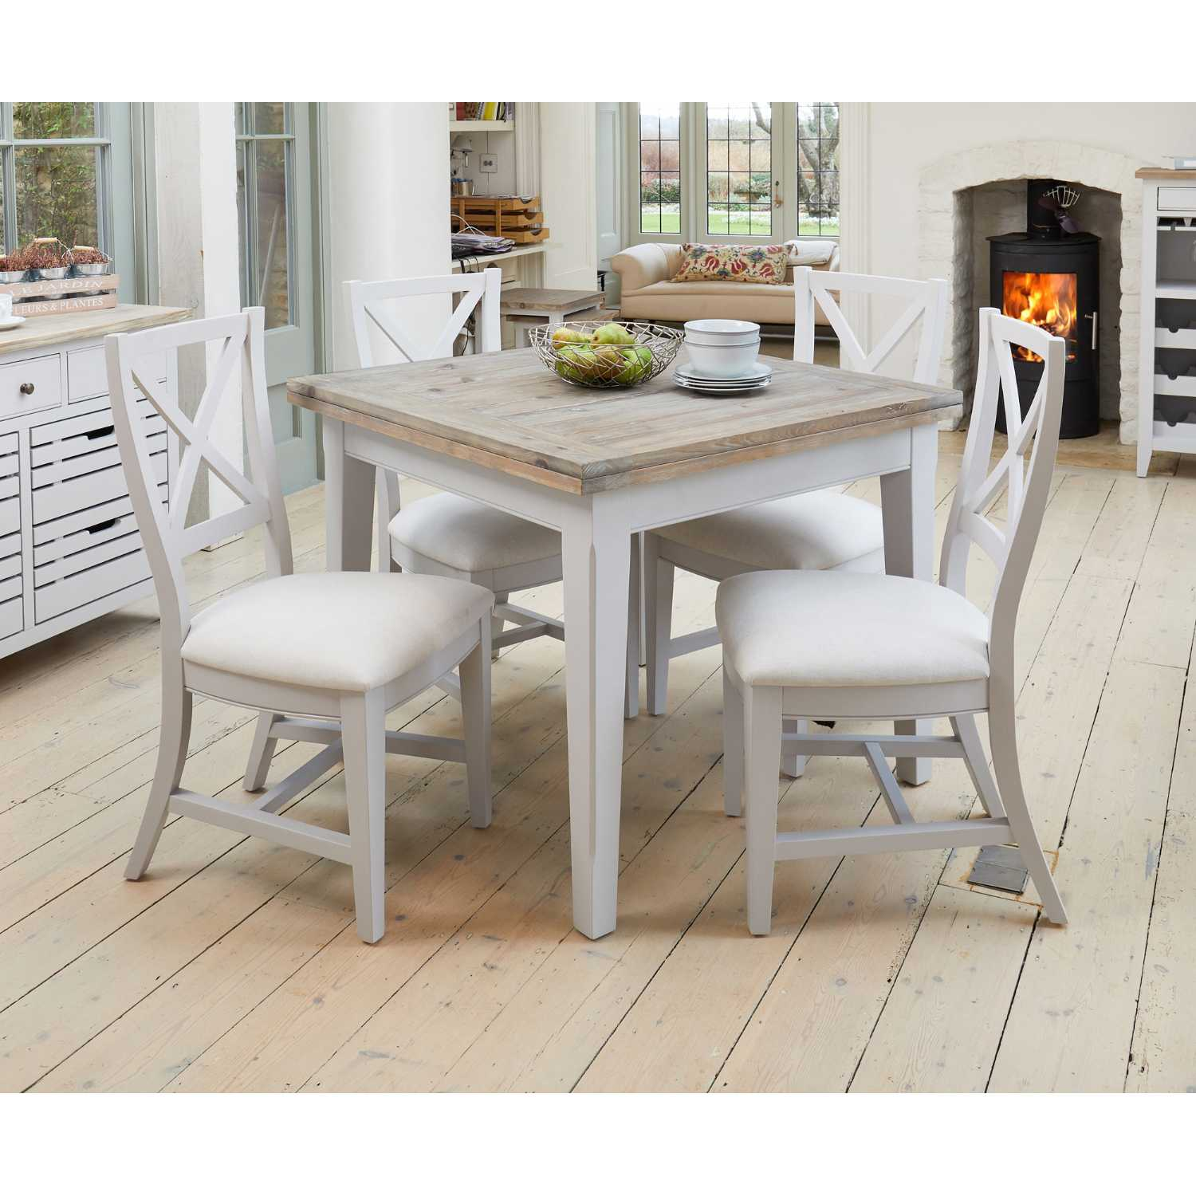
What other expressions do you find most impressive? Can you underline them?
In the next part what would they talk about over dinner? Does the story miss the point?

