Slide 1

感恩遇见，相互成就，本课件资料仅供您个人参考、教学使用，严禁自行在网络传播，违者依知识产权法追究法律责任。
更多教学资源请关注
公众号：溯恩高中英语
知识产权声明

Slide 2
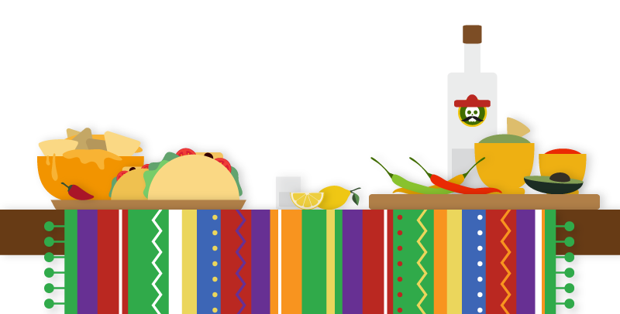
The Crystals 萨曼萨的晶体实验
Jacqueline Crompton Ottaway
(New Zealand)
Act 5-7 At the table

Slide 3
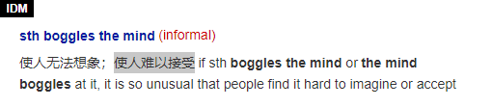
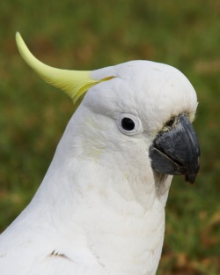
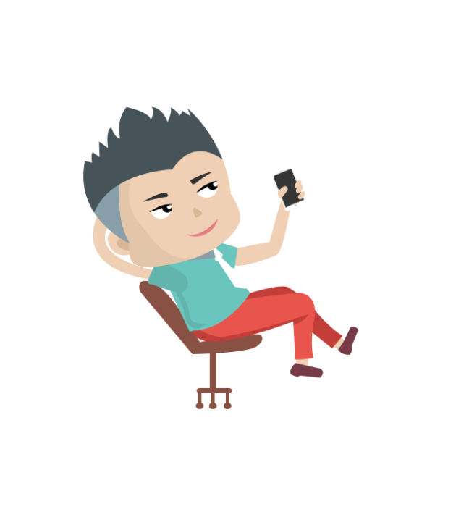
First sight of Thomas
5_____________________
²⁶“"What's so funny?”
²⁷Samantha turned around. Thomas was standing in the doorway在门口. She suppressed抑制a giggle吃吃地笑. His crisp干净利落的, curly卷曲的 blond金发的 hair stood ruffled捏皱的 on end竖着地. He looked like a startled受惊吓的 cockatoo凤头鹦鹉.
²⁸Mum smiled lovingly深情地 at Thomas. “Just telling Samantha some of the highlights最精彩的部分of life at the central library. Riotous喧闹的 stuff东西.”
²⁹“The mind boggles使人难以接受的事,” said Thomas, leaning back往后靠 in a cane chair藤椅, his hands behind his head. "What's for dinner? I'm starving!“
〇which character is described in this part? What of him is described?
From the description of Thomas’s appearance and behaviour, can readers conclude that he is a serious man?
Did Mum tell Thomas what had happened in the library?
情境造句。参照蓝色字体句子，进行类似描述：
Xiaoming
leant back in a chair, (with) one hand behind his head and another holding a phone.
No. On the contrary, he is quite casual.
No, she didn’t tell it a second time. And we can tell that the way she treated Thomas is different from what she did with Samantha.

Slide 4
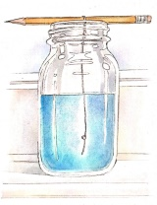

Thomas’s first mention of the jar
6________________________________
³⁰In the middle of在...的中途 dinner, Thomas put down his fork and looked up at the kitchen window. He gesticulated用手势表达wildly with his knife. "What's that blue muck脏东西sitting on the windowsill窗台?”
³¹“Copper铜sulphate硫酸盐 crystals结晶体.”
³²Thomas peered仔细看 at the jar.
³³“Can't see any crystals."
³⁴“Didn't work.” Samantha concentrated on her chicken pieces. Thomas had better keep his smart comments to himself独自承受, she thought, glaring怒目而视 hard at her plate.
〇Did Samantha tell Thomas what happened to her crystals? How did she feel then?
Usually how is the atmosphere in the middle of a meal?
From Thomas gesture手势, can you tell his personality? Why did he mention the jar then?
“Concentrate …” what did Samantha try to forget?
What do the 4 expressions in blue have in common? 请补全下列句子：
1 Cabe tried to _________ the young officer with hatred and found he couldn't.
2 When Harry had finished, he merely continued to _________ them through his spectacles.
3 More of our children should be able to __________ night and see that the Milky Way is …
4 Her worry makes it impossible for her to ____________ her work
glare at
peer at
look up at
concentrate on

Slide 5
³⁰In the middle of在...的中途 dinner, Thomas put down his fork and looked up at the kitchen window. He gesticulated用手势表达wildly with his knife. "What's that blue muck脏东西sitting on the windowsill窗台?”
³¹“Copper铜sulphate硫酸盐 crystals结晶体.”
³²Thomas peered仔细看 at the jar.
³³“Can't see any crystals."
³⁴“Didn't work.” Samantha concentrated on her chicken pieces. Thomas had better keep his smart comments to himself独自承受, she thought, glaring怒目而视 hard at her plate.
Usually how is the atmosphere in the middle of a meal?
From Thomas gesture手势, can you tell his personality? Why did he mention the jar then?
3. “Concentrate …” what did Samantha try to forget?
It is usually relaxing
He must be an open-minded people. He was trying to find a topic and communicate with Samantha.
She tried to forget her failure.
²⁶“"What's so funny?”
²⁷Samantha turned around. Thomas was standing in the doorway在门口. She suppressed抑制a giggle吃吃地笑. His crisp干净利落的, curly卷曲的 blond金发的 hair stood ruffled捏皱的 on end竖着地. He looked like a startled受惊吓的 cockatoo凤头鹦鹉.
²⁸Mum smiled lovingly深情地 at Thomas. “Just telling Samantha some of the highlights最精彩的部分of life at the central library. Riotous喧闹的 stuff东西.”
²⁹“The mind boggles使人难以接受的事,” said Thomas, leaning back往后靠 in a cane chair藤椅, his hands behind his head. "What's for dinner? I'm starving!“

Slide 6
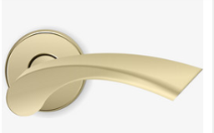
7______________________
³⁵“Help! Look at the time,” shrieked尖声说 Mum as she glanced at瞥一眼 the clock. Samantha smiled to herself. Mum was always running运转 late.
³⁶“I‘d better be off.” Mum grabbed her handbag and kissed Thomas goodbye -- a lingering依依不舍的 kiss that infuriated使极为生气 Samantha. What the heck究竟 did Mum see in him?
³⁷“Bye, Samantha.” It was her turn to be kissed now, a brief peck啄 on the cheek. “I shouldn‘t be home too late.” And with a clatter撞击声 of heels鞋跟 and the slam猛关（或撞等）的声音 of the back door, Mum was gone.
〇What happened here?
Like father, like son. From the expressions in green and what we read about Samantha, what conclusion can we draw about her practical ability?
The departure of Mum
Mum left in a hurry.
She must be good at practice.
¹⁹Mum laughed, tossing her dark hair back甩到脑后 as she spoke. …
²²“Here,” said Mum, draining喝光 her cup of coffee. …
²³Mum grabbed（匆忙地）拿 … out of the fridge. As she washed and scraped刮干净 and peeled削皮 the vegetables, she told Samantha about …
²⁴“…,” said Mum, laughing as she diced up切成小块 another radish." It …"
情境造句。参照粗体字句子，进行类似描述：
在滴答的钟声和我嘭嘭的的心跳声中，考卷被发了下来。
With the tick of the clock and the beat of my heart, our exam papers were handed out.

Slide 7
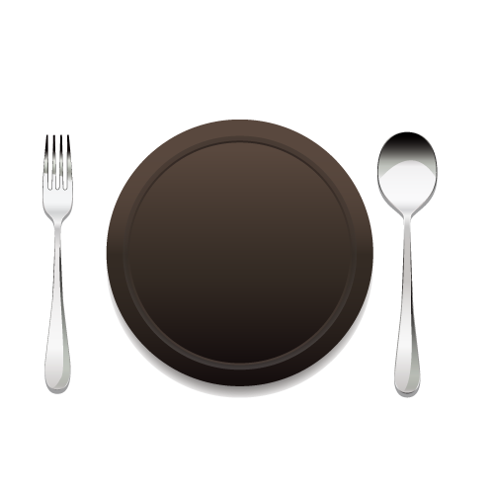
What would Thomas and Samantha talk about?
Could he help her?

