Slide 1

感恩遇见，相互成就，本课件资料仅供您个人参考、教学使用，严禁自行在网络传播，违者依知识产权法追究法律责任。
更多教学资源请关注
公众号：溯恩高中英语
知识产权声明

Slide 2
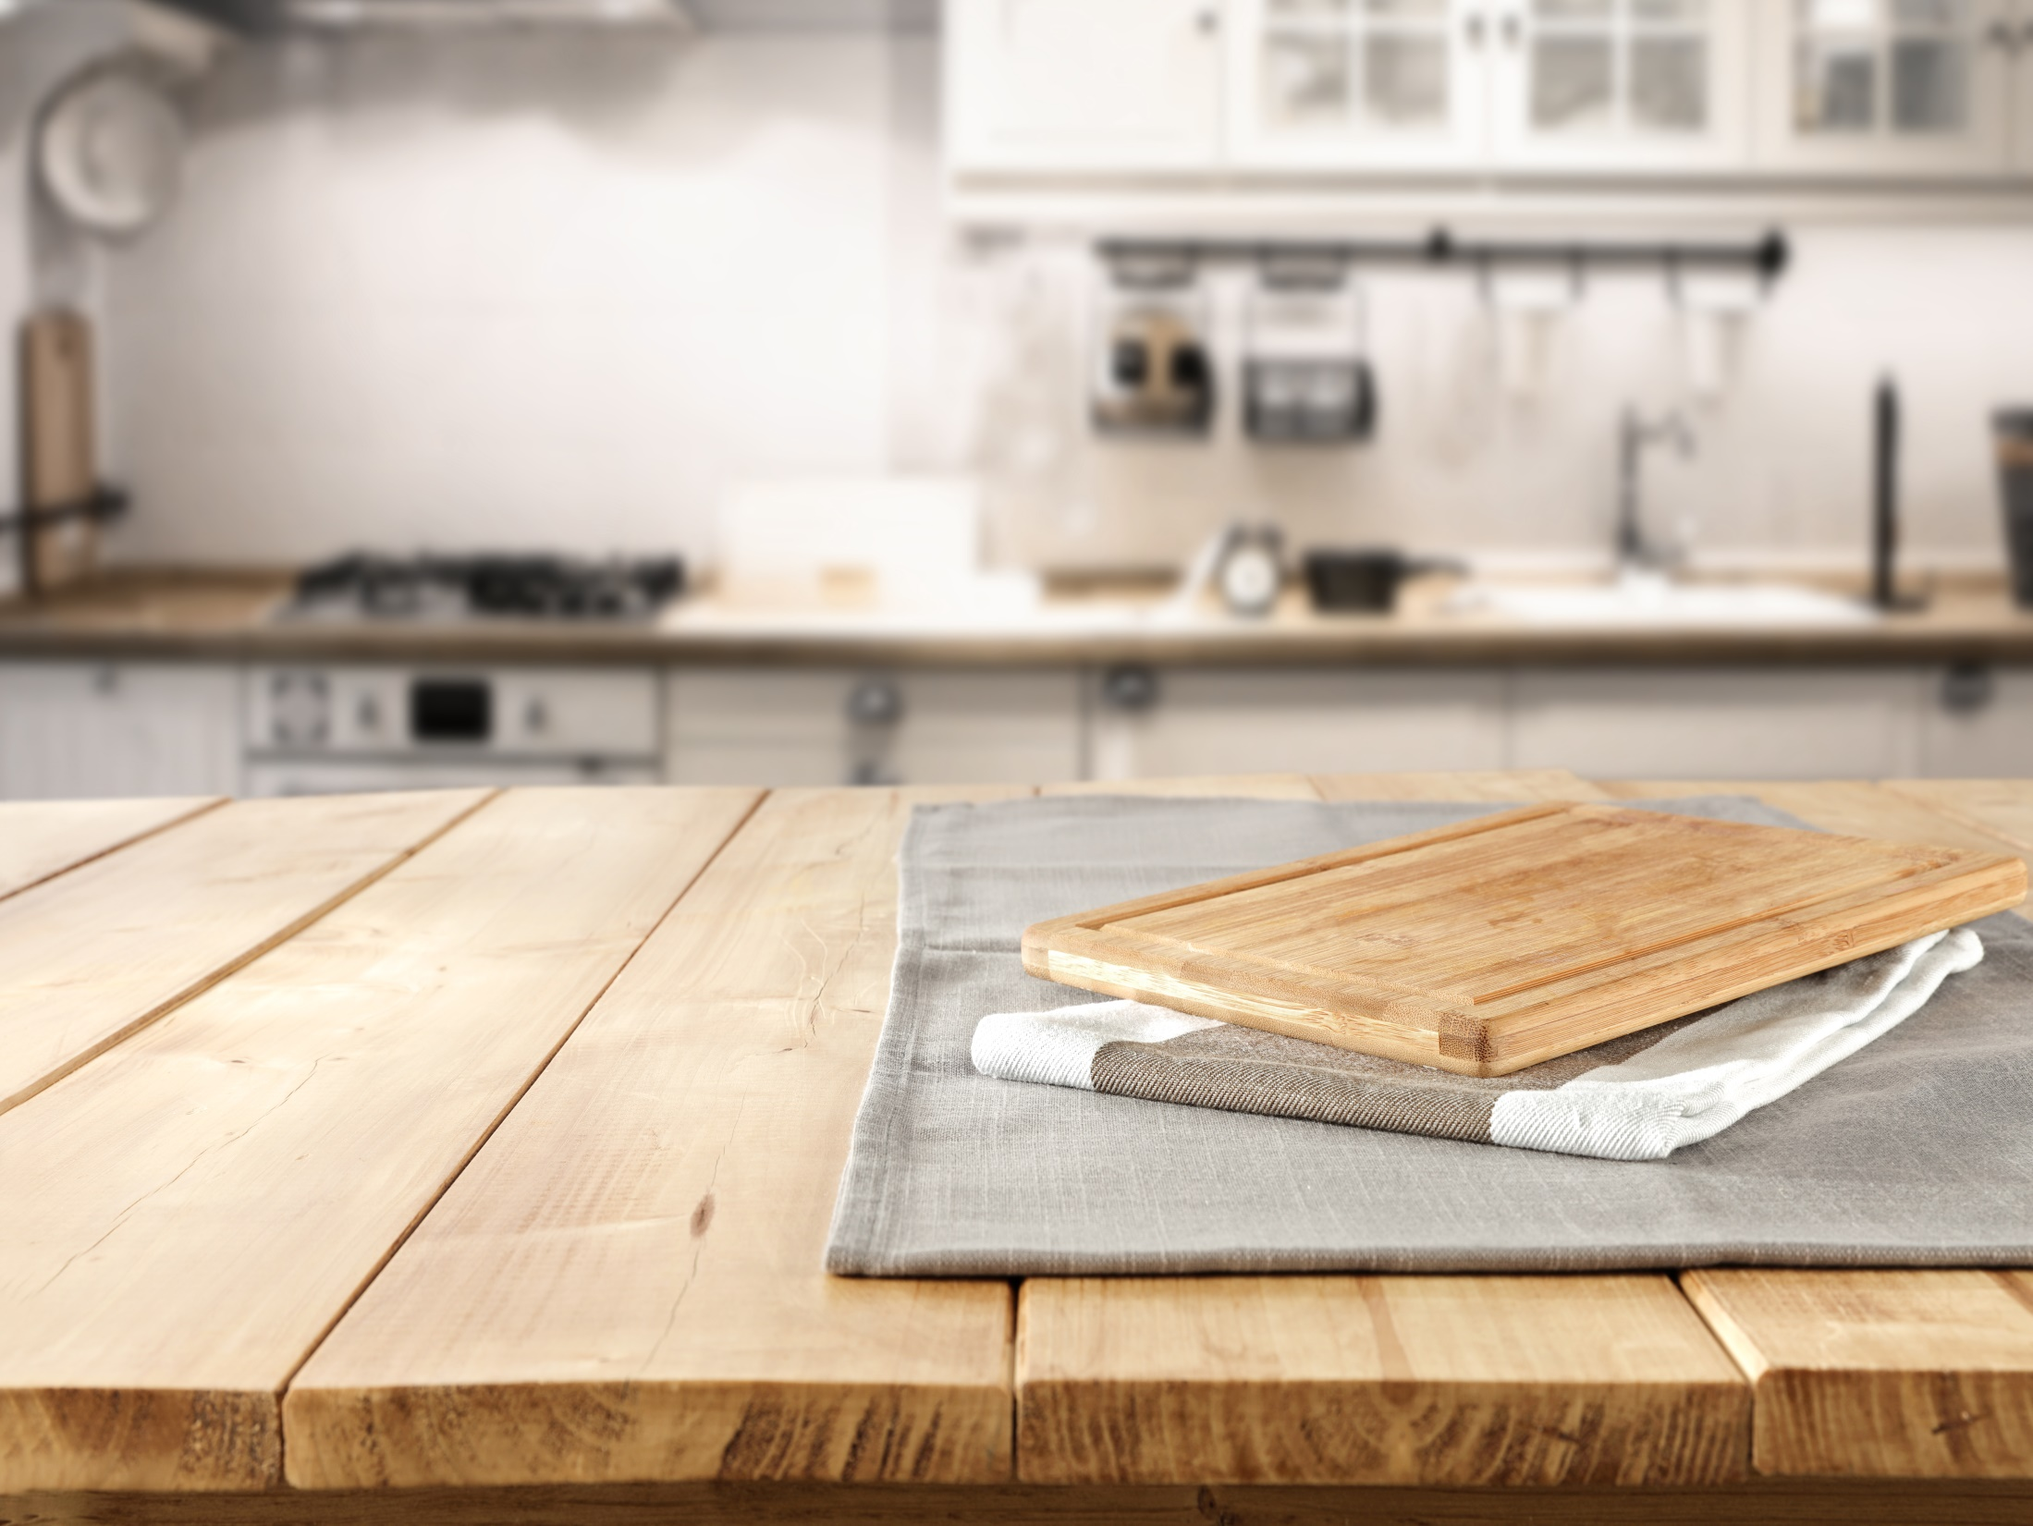
The Crystals 萨曼萨的晶体实验
Jacqueline Crompton Ottaway
(New Zealand)
Act 8

Slide 3

Before washing the dishes
⑧________________________
³⁸Samantha stared at the three dirty dinner plates餐盘 and the clutter一堆杂物of pots, pans平底锅 and serving dishes装菜的盘子. She never could work out why it took so long to prepare a meal and just a few minutes to eat it!
³⁹“I'll help you clean up this mess, Sam.” Thomas stood behind her, stacking up把…堆起 the plates and whistling a medley混成曲from a Beatles' album. He was crazy about the Beatles.
⁴⁰Samantha often thought he was like some lanky瘦长而行动笨拙的, overgrown成长过快的hippie嬉皮模样的年青人 -- a relic from the 1960s who'd never grown up. The way he kept calling her “Sam” really annoyed her. One day she'd tell him so, too. She wiped the table in silence.
⁴¹Thomas pushed up his sleeves and plunged the plug塞子into the sink水槽. "I'll wash, Sam. You dry."
⁴²Thomas whistled the opening bars开头几个小节of “Yesterday” as he squirted喷detergent洗涤剂 into the running water and frothed起泡沫 it up. Samantha picked up a dish towel. (157/1960 words)
Did Samantha regret preparing the meal. If not, what was she unhappy about?
Did Samantha dislike the Beatles? Or did she dislike Thomas then?
Did Thomas often do household chores like this? How can you tell?
〇 Was Thomas really a lanky hippie?

Slide 4
³⁸Samantha stared at the three dirty dinner plates餐盘 and the clutter一堆杂物of pots, pans平底锅 and serving dishes装菜的盘子. She never could work out why it took so long to prepare a meal and just a few minutes to eat it!
³⁹“I'll help you clean up this mess, Sam.” Thomas stood behind her, stacking up把…堆起 the plates and whistling a medley混成曲from a Beatles' album. He was crazy about the Beatles.
⁴⁰Samantha often thought he was like some lanky瘦长而行动笨拙的, overgrown成长过快的hippie嬉皮模样的年青人 -- a relic from the 1960s who'd never grown up. The way he kept calling her “Sam” really annoyed her. One day she'd tell him so, too. She wiped the table in silence.
⁴¹Thomas pushed up his sleeves and plunged the plug塞子into the sink水槽. "I'll wash, Sam. You dry."
⁴²Thomas whistled the opening bars开头几个小节of “Yesterday” as he squirted喷detergent洗涤剂 into the running water and frothed起泡沫 it up. Samantha picked up a dish towel. (157/1960 words)
Did Samantha regret preparing the meal. If not, what was she unhappy with?
Did Samantha dislike the Beatles? Or did she dislike Thomas then?
Did Thomas often do household chores like this? How can you tell?
〇 Was Thomas really a lanky hippie?
She didn’t actually regret it. From what’s learned in the former part, she was unhappy with her mother’s departure.
Not really. From the previous parts, we know that she had trouble with her homework and family life, so she was unhappy and didn’t know how to deal with them. While Thomas came to help her with her trouble like washing dishes, she began to express herself before she knew it.
He must do a lot of household chores regularly. We can tell from his familiarity with the process
Of course not.

Slide 5
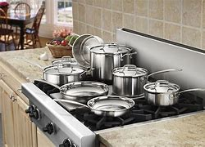
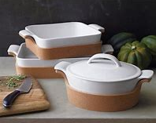
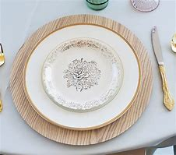
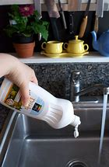
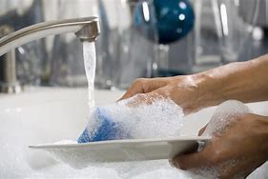
After reading this part, can you tell these people see in the kitchen:
pots
pans
serving dishes
dinner plates
What people do in these 2 pictures?
How?
running water
People prepare to wash dishes here.
the sink
a dish towel
Before that,
plunge the plug into the sink
squirt detergent
, and then
froth it up

Slide 6
他从来都想不通为什么他们花那么长时间准备考试却仅用几十分钟就完成了它！
He could never______________________________________________________________
____________________________
(tip: prepare the exam <出考卷准备考试>；prepare for the exam <复习准备考试>)
work out why it took so long to prepare for the exam but only several tens
of minutes to finish it!
小明一直叫小亮“胖子”的样子使小亮恼火。有一天他也会对他这么说的。小亮（一边）沉默的擦着黑板。
___________________________________“Pangzi” _________________.
__________________________________________________________________.
The way Xiaoming kept calling Xiaoliang
really annoyed him
One day he would tell him so, too. Xiaoliang wiped the blackboard in silence
For your reference:
She never could work out why it took so long to prepare a meal and just a few minutes to eat it!
The way he kept calling her “Sam” really annoyed her. One day she'd tell him so, too. She wiped the table in silence.

Slide 7
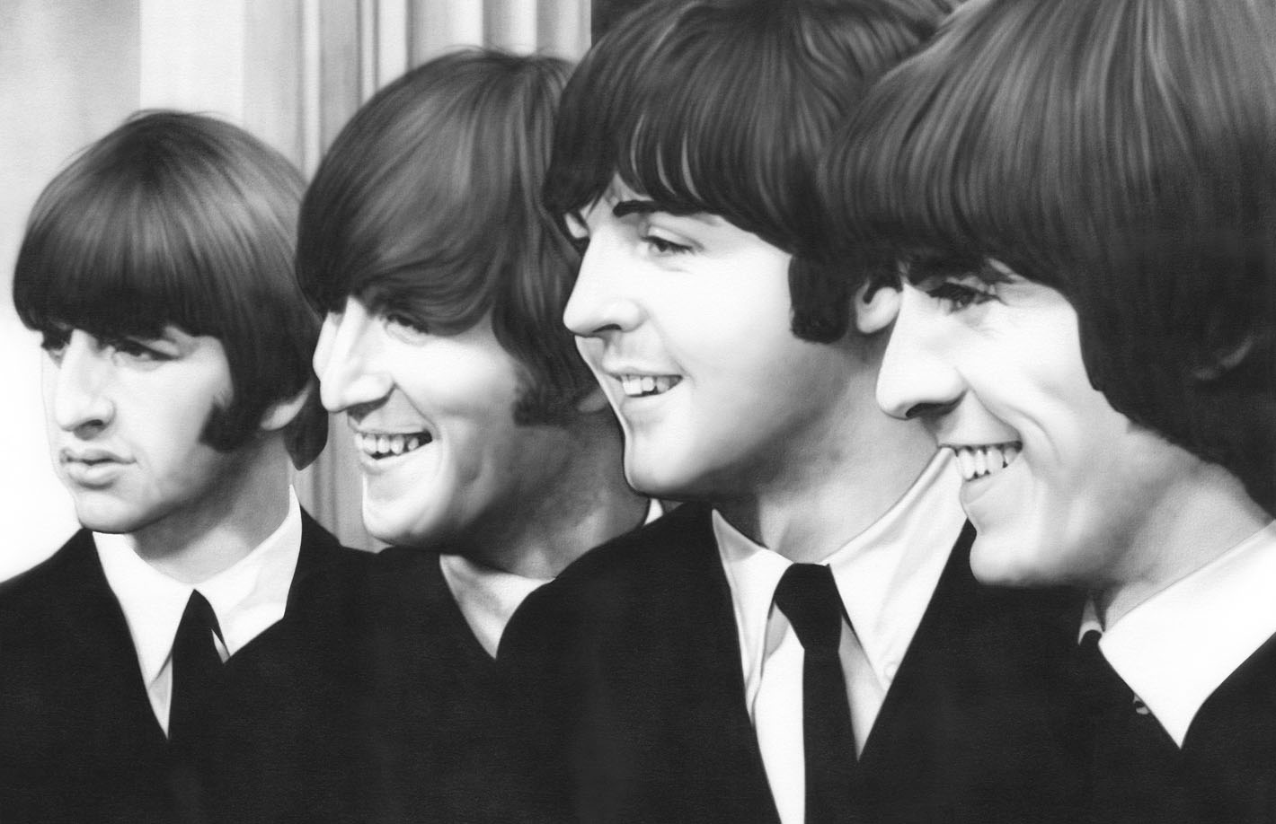
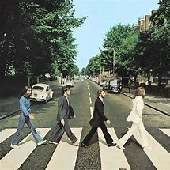
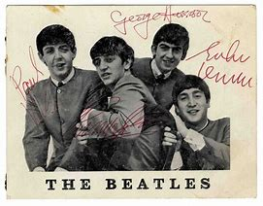
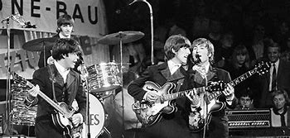

The Beatles were an English rock-pop band, started in Liverpool, England in 1960. The members were John Lennon, Paul McCartney, George Harrison, and Ringo Starr.
Most people say they are the most successful and
influential band in the history of popular music.
The group were a main part of the creation of 1960s
counterculture非主流文化.
Quoted from the internet
beetles

Slide 8
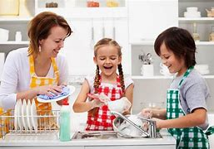
What next?
Can you figure out what happened next while they were washing dishes? What would they talk about?

Slide 9
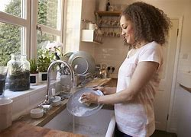
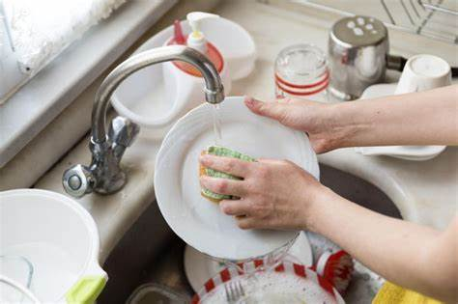
Do you ever help to wash dishes at home? Can you describe it?

