Slide 1

感恩遇见，相互成就，本课件资料仅供您个人参考、教学使用，严禁自行在网络传播，违者依知识产权法追究法律责任。
更多教学资源请关注
公众号：溯恩高中英语

Slide 2
2021年秋季
第
开
课
学
一
How to strive for happiness as Chinese students
杭州二中树兰高级中学 郭合英

Slide 3
CONTENTS
The height
of happiness
The length
of happiness
The width
of happiness
How to strive
for happiness

Slide 4
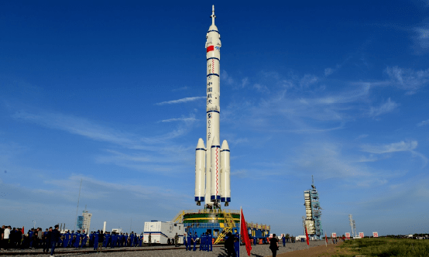
The height of happiness
---Manned space mission
载人航天

Slide 5
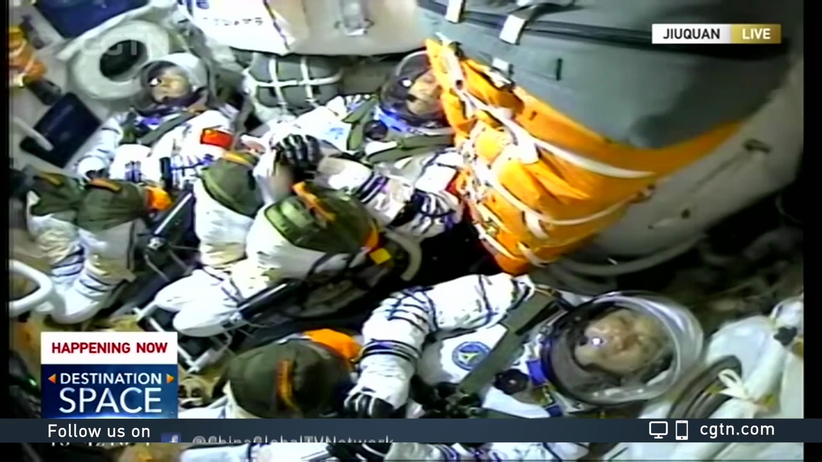

Slide 6
1-I，2-II，3-III，4-IV，5-V
6-VI，7-VII，8-VIII，9-IX，10-X
11-XI，12-XII，13-XIII，14-XIV，15-XV
16-XVI，17-XVII，18-XVIII，19-XIX，20-XX
50-L，60-LX，70-LXX，80-LXXX，90-XC，100-C
400-CD，500-D，1000-M
China launched the Shenzhou XII spacecraft, its seventh manned spaceflight, on Thursday morning, sending three astronauts—Nie Haisheng, Liu Boming and Tang Hongbo, to the core module1 of its permanent space station.The spacecraft, atop a Long March-2F carrier rocket, blasted off at 9:22 am at the Jiuquan Satellite Launch Center in northwestern China.
6月17日9时22分，搭载神舟十二号载人飞船的长征二号F遥十二运载火箭，在酒泉卫星发射中心点火发射。三名航天员聂海胜、刘伯明、汤洪波将乘坐神舟十二号载人飞船到达我国永久空间站核心舱。神舟十二号载人飞船是我国第七次载人飞船任务。
普及一下罗马
数字中常用的表达方式
【知识点】
在英文报道中，无人航空飞行器、卫星、火箭等(unmanned space vessels /satellites/ rockets) ,其编号一般用阿拉伯数字,载人飞行器（manned spacecraft）的编号一般用罗马数字。
比如，“嫦娥五号”的英文是Chang'e-5，而我国首个载人飞船“神舟五号”的英文是Shenzhou V。

Slide 7
神舟十二号载人飞行任务总体安排，三名航天员聂海胜、刘伯明和汤洪波在轨期间将主要完成四个方面的工作，计划开展两次出舱活动（extravehicular activities）及舱外作业（extravehicular operations）。
Relative expressions
四项主要任务包括：
First, they will operate and manage the complex, including the in-orbit test of the Tianhe module, verification of the recycling and life support system, testing and operation training of the robotic arm, as well as management of materials and waste.
开展核心舱组合体的日常管理。包括天和核心舱在轨测试、再生生保系统验证、机械臂测试与操作训练，以及物资与废弃物管理等。
1. complex [ˈkɔmpleks]
n. 综合建筑群、相关联的一组事物
2. in-orbit
adj. 在轨道内的
3.verification [ˌverifiˈkeiʃən]
n.证实;确定;查核。
4. robotic [rəʊ'bɒtɪk]
adj.机器人的;像机器人的。

Slide 8
Second, they will move, assemble and test extravehicular spacesuits and perform two extravehicular activities for work including assembling an extravehicular toolbox, lifting the panoramic camera and installing extended pump sets.
开展出舱活动及舱外作业。包括舱外服在轨转移、组装、测试，进行两次出舱活动，开展舱外工具箱的组装、全景摄像机抬升和扩展泵组的安装等工作。
Relative expressions
1. assemble [əˈsembl] vi.集合;聚集
vt.集合;聚集;召集;调集;收集;装配
2. extravehicular [ˌekstrəviːˈhikjələ]
adj.太空船外的;座舱外的
3. panoramic [ˌpænəˈræmik]
adj.全景的,全貌的
语言协同微写作：
你在山顶可一览城市的全景。
You get a panoramic view of the city from the top of the mountain.

Slide 9
Third, they will carry out space science experiments and technology experiments, as well as public outreach activities.
开展空间科学实验和技术试验，以及有关科普教育活动。
Relative expressions
1. carry out vt. 实行(执行,实现)
语言协同微写作：他要执行他的计划。
He will carry out his plan.
2. outreach[ˈaʊtˌriːtʃ]
vt.超过；超越;使伸出；使展开；使达到;
n.伸出；展开；外展服务
Eg. an outreach programme
外展服务计划
语言协同微写作：电力仍是供不应求。
The demand for electrical power continues to outreach the supply.
Fourth, they will manage their own health through daily life care, physical exercise, and regular monitoring and assessment of their own health status.
按计划开展日常的生活照料、身体锻炼，定期监测、维持与评估自身健康状态。
3. monitoring [ˈmɒnɪtərɪŋ]
n.监视;控制;监测;追踪
语言协同微写作：空气污染监视
air monitoring
语言协同微写作：你的估计基本正确。
4. assessment n.评价, 评定， 评估
Your assessment is substantially correct.

Slide 10
Based on project plans, the Tianzhou 3 cargo ship will be launched in September to dock with Tianhe and the next month, another three-crew team will fly with the Shenzhou XIII to the module to stay there for six months.
按照计划，今年9月，将发射天舟三号货运飞船，升空后与天和对接；10月，另外3名航天员将搭乘神舟十三号飞船抵达核心舱，并驻留6个月。
语言协同：基于一个真实的爱情故事，他把它改编成了一部电影。
语言协同：爱迪生的想法是建立在科学实验的基础上的.
语言协同：那故事是根据现实生活而写的
Relative expressions
1. base A on B 以……为根据
A be based on B 以……为根据； 根据……；基于……
Edison based his ideas on scientific experiment.
Based on a true love story, he adapted it into a film.
The story is based on real life.
语言协同：宇宙飞船在空间与卫星对接。
2. dock with 与……对接
The spaceship docked with the satellite.
In 2022, two large space labs will be launched to connect with the core module. Moreover, two manned missions and two robotic cargo flights will be made that year to continue construction of the Tiangong station, which is scheduled to become complete and start formal operation around the end of 2022.
2022年，将发射两个大型太空实验室，与核心舱对接。之后还将发射两次载人任务和两次货运飞船任务，继续推进天宫空间站的建设。到2022年底，空间站有望完成组装，开始正式运行。
语言协同：我们上个月发射了另一颗卫星。
3. launch [lɔːntʃ] n. 发射
vt.发射;开办;发动;投入;丢掷
We launched another satellite last month.
4. be scheduled to 计划做某事
语言协同：他按计划将去游泳。
He's scheduled to go swimming.

Slide 11
航天英语词汇积累
嫦娥二号 Chang e-2
神舟七号 Shenzhou VII
航天飞船 space ship
火箭 rocket
倒数 the countdown
航天基地 space station
地心引力 gravity
登月舱 lunar module
上升段 ascent stage
下降段 descent stage
指令舱 command module
发射卫星launch a satellite
发射台launch pad
多级火箭 multistage rocket
第二级 second stage
第三级 third stage
服务舱 service module
回收舱 return capsule
轨道舱 obital capsule
航天员 astronaut
航天服 space suit
接口盖 access flap
舱口 hatch
扶梯 ladder
轨道 orbit
人造卫星 artificial satellite
通信卫星 telstar
天线 antenna
太阳电池 solar cell
航天器 spacecraft
登月舱 lunar module

Slide 12
登月舱机动火箭 LM-maneuvering rockets
着陆架 landing pad
定向天线 directional antenna
天舟一号 Tianzhou-1
长征七号 Long March-7
酒泉卫星发射中心 Jiuquan Satellite Launch Center
文昌卫星发射基地 Wenchang Satellite Launch Center
西昌卫星发射中心 Xichang Satellite Launch Center
应急供氧装置 emergency oxygen apparatus
生命维持系统 life support system
载人航天事业 manned spacecraft engineering
主发动机喷嘴 nozzle of the main engine
应急供氧装置 emergency oxygen apparatus
生命维持系统 life support system
载人航天事业 manned spacecraft engineering

Slide 13
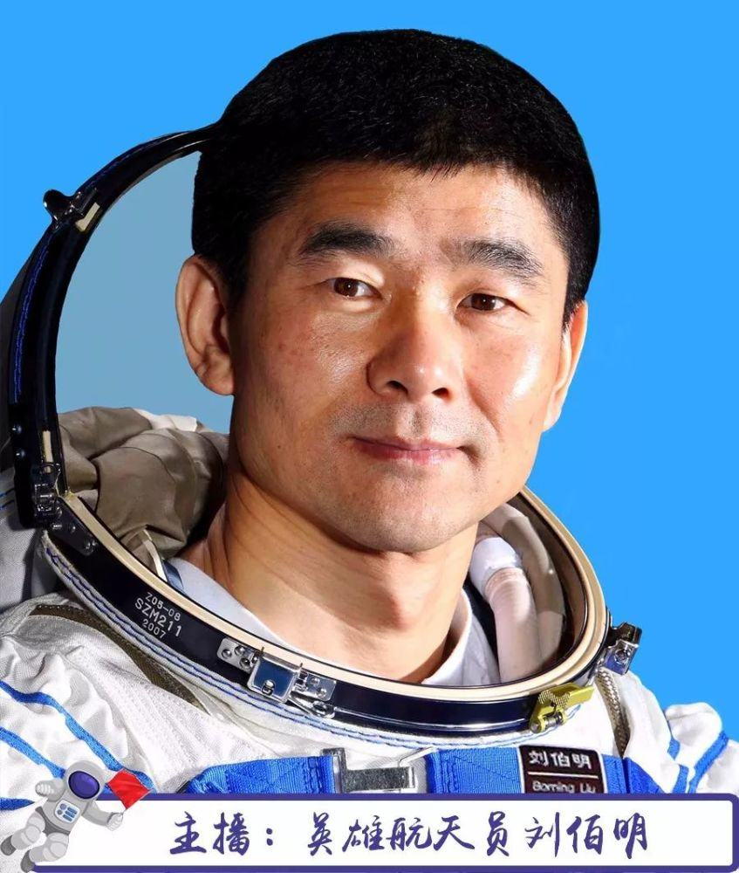
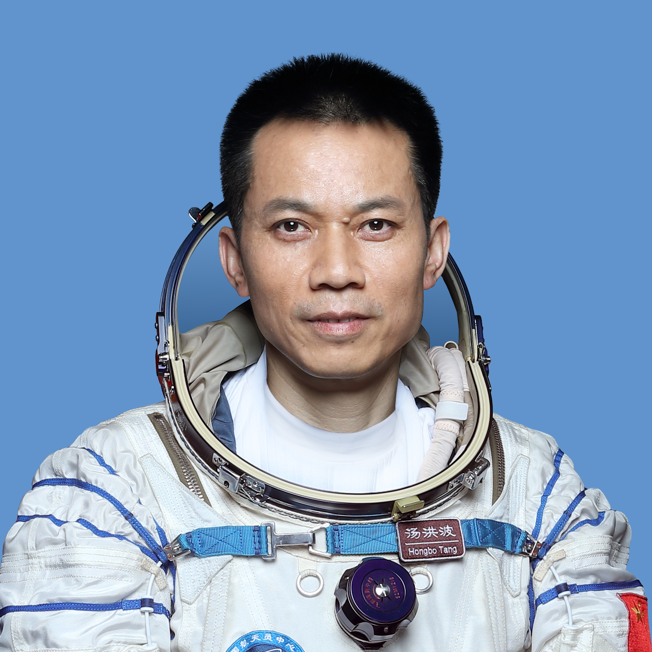
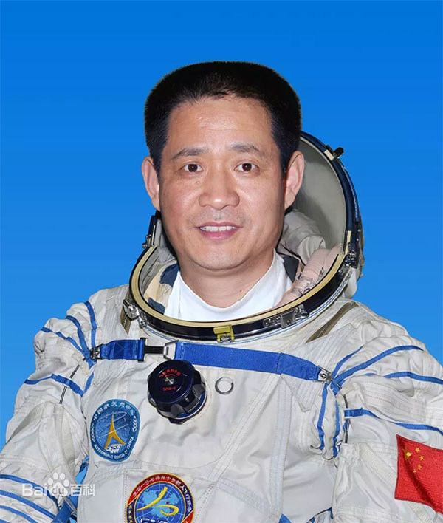
飞向“天河”的三名航天员
聂海胜
刘伯明
汤洪波

Slide 14
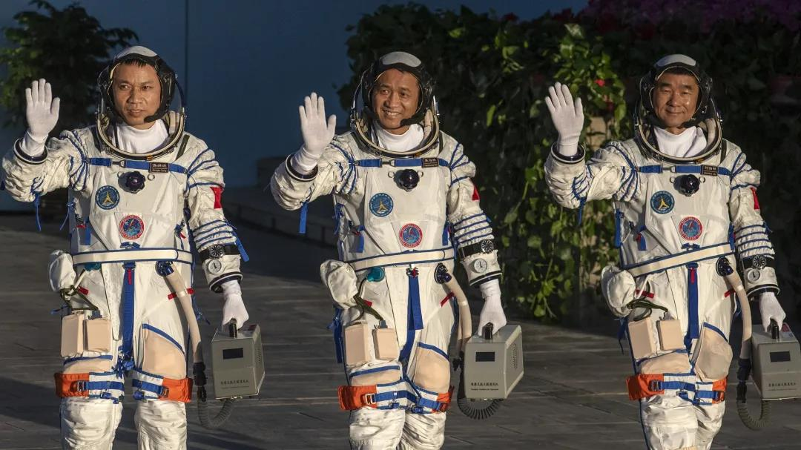
Discuss ?
How to become an excellent taikonaut?

Slide 15
Comprehension: Choose the best answer
For Shenzhou-12 mission, three taikonauts, namely Nie Haisheng, Liu Boming and Tang Hongbo, became the first to enter the Chinese space station.
"I think the trio is a great combo," said Huang Weifen, deputy chief designer of the astronaut system of China's manned space program. "We chose Nie as the captain for his two-time space flight experience and Liu Boming for his previous experience in extravehicular activity, while Tang is the backup taikonaut for Shenzhou-11 mission and he excelled in every area."
The qualification criteria includes basic, physical, mental and overall evaluations.The selection has been made based on 43 aspects such as age, height, education and professional background just in basic evaluation," said Huang. The synergy (协同作用) or compatibility（兼容性）among different members is also a big factor.
She said physical evaluation is just to test endurance and adaptation to the space environment.Testing of the vestibular function (前庭功能) is also one of the physical checks. Huang explained candidates who have weak vestibular function can become very dizzy and even vomit.

Slide 16
After over two decades of practice, China has set up a complete process to select taikonauts. "It's a process to select from 'the best of the best,'" said Huang. She said engineers and payload specialists have different requirements, less strict but still many.
Huang led the team to develop over a hundred types of training in eight categories in various fields, such as medicine, physics, psychology, science and engineering. She also trained the Shenzhou-12 taikonauts under water to mimic the microgravity environment as there are extravehicular activities for the mission this time.
The astronauts are exposed to the pull of hypergravity (超重) when spaceships ascend and return. During the hypergravity period, the blood moves to the legs, causing possible loss of vision and consciousness. So, the training on tolerance to hypergravity, or high-G training, is also essential.
Huang said all taikonauts have to pass the 8G criterion, which means they should be able to bear eight times the gravity force of their own body weight. " The taikonauts go through it once every half a year."
"As long as they are professional astronauts, it's their duty to keep going through the training, ready for the mission calls, until the moment they retire," Huang said.

Slide 17

1. Which of the following is true?
A. China has set up a complete process to select taikonauts within twenty years.
B. The male taikonauts go through the 8G criterion every half a year.
C. The choice of the engineers and payload specialists is not strict.
D. The testing of the vestibular function is to check whether the taikonauts become faint
and upchucked.
2. The last paragraph mainly tells us about .
A. The mission of the taikonauts B. The retirement of the taikonauts
C. The weakness of the taikonauts D. The qualification criteria of the taikonauts
3. What does the underlined word “trio” in Paragraph 1 mean?
A. 四人一组 B. 三人一组 C. 五人一组 D. 二人一组
4. What can be a suitable title for the text?
A. The process of training the taikonauts B. The mission of Shenzhou-12
C. The significiance of the Shenzhou-12 D.The qualification criteria of the taikonauts

Slide 18
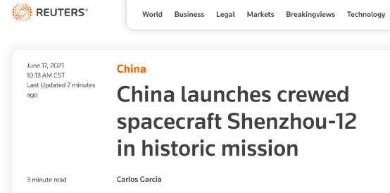
我们看看外媒是怎么报道中国航天的
路透社
crewed [kruːd] 是一个过去分词，来自于crew的动词用法。
crewed spacecraft“载人飞船”。
crew n.乘组，机组
crew v.担任机／乘组成员
Eg. She was already a keen and experienced sailor, having crewed in both Merlin and Grayling.
她在“默林”号和“格雷林”号上都当过船员，已经是一个头脑敏捷、经验丰富的水手了。
Relative expressions
路透社的标题说：China launches crewed spacecraft Shenzhou-12 in historic mission。意思是，中国发射神舟十二号载人飞船，这次飞行任务具有重要历史意义。

Slide 19
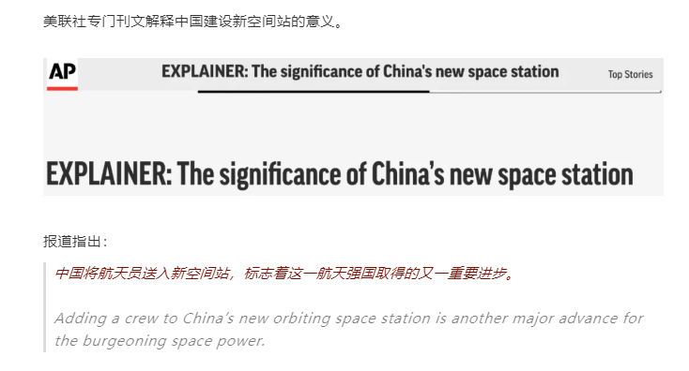
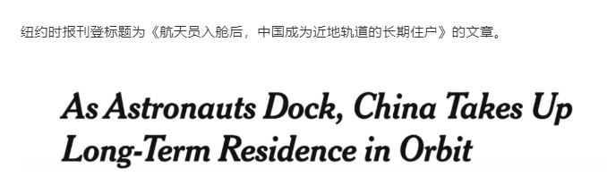
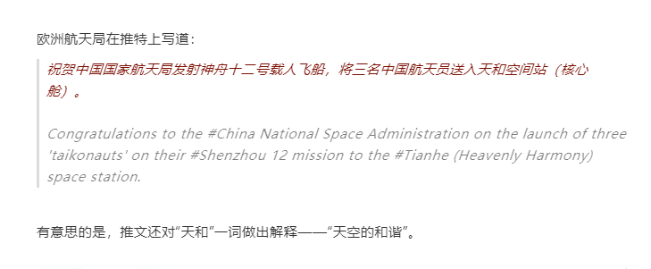
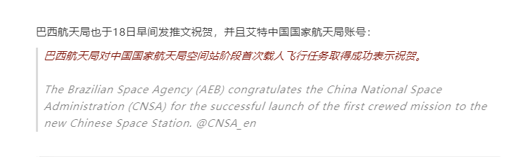
美联社
纽约
时报
欧洲
航天局
巴西
航天局

Slide 20
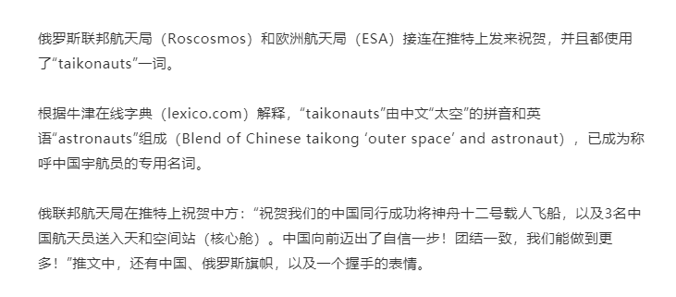
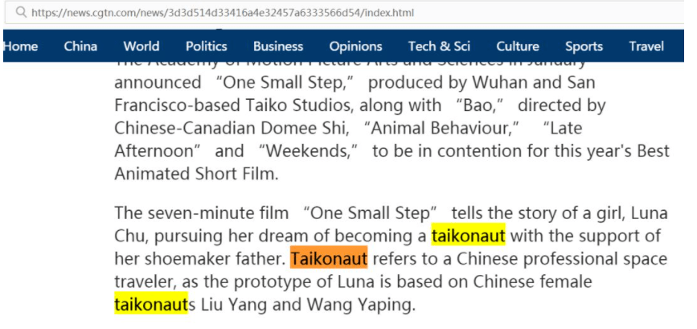
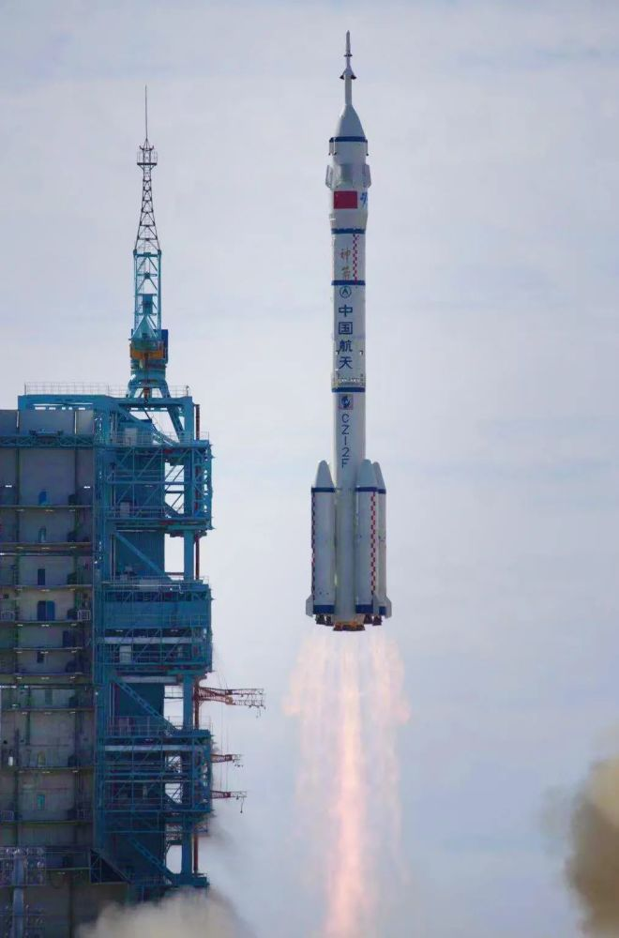
俄罗斯
联邦局
欧洲
航天局
taikonaut 中国宇航员
n. （汉）中国宇航员（由汉语拼音taikong和astronaut缩合而成）

Slide 21
Astronaut, cosmonaut or taikonaut?
Some Chinese are so proud of the latest achievements that they revived the topic of how 1 (name) people in space.
The naming problem emerged in the Cold War, when Soviet Union named their space
2 (hero) "cosmonauts" while the U.S. called 3 (they) "astronaut."
Later, the word "taikonaut" 4 (coin) using the Mandarin equivalent of the word space – taikong – and the common suffix "-naut". Oxford and Longman dictionaries listed the word taikonaut and said it 5 (mean) a Chinese astronaut. Some Chinese see the popularity of the word 6 a sign of China's growing influence in space.
Now the three taikonauts are unpacking the supplies on Tianzhou-2, 7 (set) up Wi-Fi connections and other 8 (equip) on the space station.
They will live in the station for at least three months and conduct 9 (vary) technology test and science experiments, during 10 spacewalks involving robot arms will also be performed.
to name
heroes
theirs
was coined
means
as
setting
equipment
various
which

Slide 22


Slide 23
我们看看外媒对载人航天的评价
正确的表达应为：
1. China build a space station seems as easy as making a cup of tea.
中国建设空间站好像泡茶一样轻松。
虽然此句从语法角度来说是错的，但这句看似简单的比喻却写出了外国人对中间航天技术的钦佩和羡慕：中国好样的！
That China built a space station seems as easy as making a cup of tea.
此句靓点：主语从句+比喻
语言协同微写作：
Mary轻松地完成了作业好像喝咖啡一样的容易。
That Mary finished her work seems as easy as drinking a cup of coffee.
2. Congratulations to China, and the Chinese crew.
congratulations to sb. on sth. 意为：因某事而向某人表示祝贺。
语言协同微写作：
她向我的成功表达了祝贺。
She expressed her congratulations to me on my success.

Slide 24
Discuss:
What is your feelings about the comments?
幸福是什么？
幸福是一种炫耀，
来自与航天的炫耀，
来自于中国科学技术的炫耀，
来自与中国航天精神的炫耀！
happy
excited
proud
……
What is happiness?
Happiness is show- off ,
coming form the blue sky，
coming form China's scientific and technological progress，
coming form the astronauts spirit!

Slide 25


The communist party of China 100th anniversary
Remain true to our original aspiration and keep our mission firmly in mind
(不忘初心 牢记使命)
The length of happiness

Slide 26

Comrades and friends,
Today, the first of July, is a great and solemn day in the history of both the Communist Party of China (CPC) and the Chinese nation. We gather here to join all Party members and Chinese people of all ethnic groups around the country in celebrating the centenary of the Party, looking back on the glorious journey the Party has traveled over 100 years of struggle, and looking ahead to the bright prospects for the rejuvenation of the Chinese nation.
Speech at a Ceremony Marking
the Centenary of the
Communist Party of China
习近平 Xi Jinping
2021年7月1日July 1
New words:
1. solemn [ˈsɔləm] a.隆重的;严肃的;神圣的
2. ethnic [ˈeθnik] n.少数民族的成员 adj.人种的;民族的;民族特有的
3. centenary [senˈtiːnərɪ] n.一百周年；百周年庆祝活动; adj.百年的
4. rejuvenation [riˌdʒuːviˈneiʃən] n.返老还童;恢复青春;恢复活力

Slide 27

The course of the Party's hundred-year struggle
党的百年奋斗历程
百年弹指一挥间
中华民族是世界上伟大的民族，有着5000多年源远流长的文明历史，为人类文明进步作出了不可磨灭的贡献。1840年鸦片战争以后，中国逐步成为半殖民地半封建社会，国家蒙辱、人民蒙难、文明蒙尘，中华民族遭受了前所未有的劫难。
The Chinese nation is a great nation. With a history of more than 5,000 years, China has made indelible contributions to the progress of human civilization. After the Opium War of 1840, however, China was gradually reduced to a semi-colonial, semi-feudal society and suffered greater ravages than ever before. The country endured intense humiliation, the people were subjected to great pain, and the Chinese civilization was plunged into darkness.
1. indelible [ɪnˈdelɪbl] adj. 抹不掉的；不可磨灭的;洗不掉的;
2.opium [ˈəʊpɪəm] n.鸦片;起麻痹作用的事物；麻醉剂；镇静剂;
3.be subjected to 经受,服从,遭受
4.be plunged into 陷入（主观地）

Slide 28
To save the nation from peril, the Chinese people put up a courageous fight. As noble-minded patriots sought to pull the nation together, the Taiping Heavenly Kingdom Movement, the Reform Movement of 1898, the Yihetuan Movement, and the Revolution of 1911 rose one after the other, and a variety of plans were devised to ensure national survival, but all of these ended in failure. Only the CPC made it.
为了拯救民族危亡，中国人民奋起反抗，仁人志士奔走呐喊，太平天国运动、戊戌变法、义和团运动、辛亥革命接连而起，各种救国方案轮番出台，但都以失败而告终。只有共产党成功了。
1. peril [ˈperɪl] n.冒险；危险；威胁;
2. courageous [kəˈreɪdʒəs] adj. 勇敢的；有勇气的；无畏的
3.noble-minded adj. 高尚的；高洁的
4.devise [dɪˈvaɪz] vt.遗赠; vi.想出；策划
n.遗赠;遗赠的不动产;

Slide 29

With the salvoes of Russia’s October Revolution in 1917, Marxism-Leninism was brought to China. In July 23-31 July ,1921, The 1st National Congress of the Communist Party of China was held in Shanghai and Jiaxing Nanhu, Zhejiang Province. The meeting was to proclaim the founding of the Communist Party of china.
十月革命一声炮响，给中国送来了马克思列宁主义。1921年7月23日晚,中国共产党第一次全国代表大会在上海举行。最后一天，会议转移到浙江嘉兴南湖举行，由此中国产生了共产党。

Slide 30
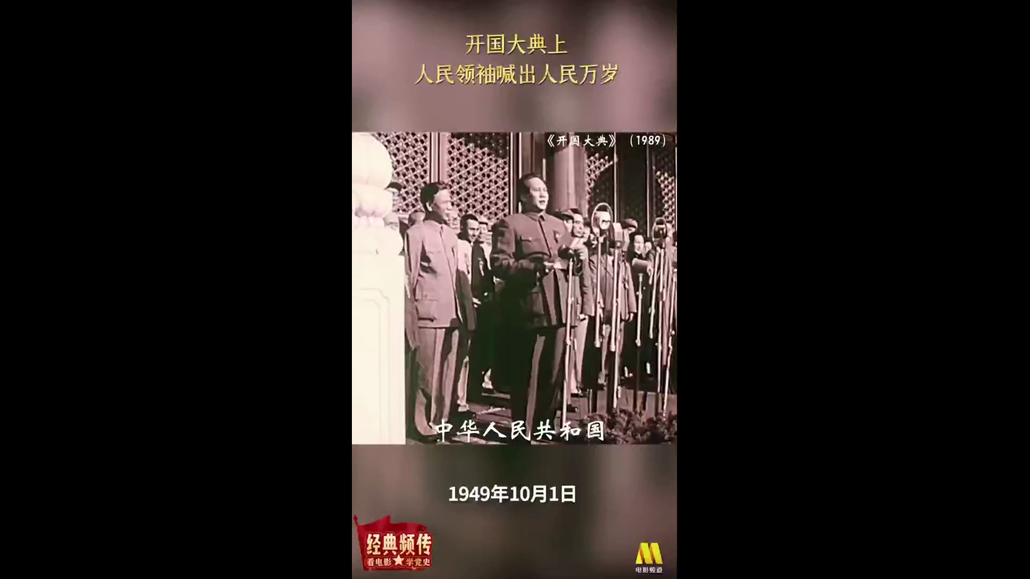
百折不挠，终赢解放
After twenty-gight years of struggle, victory was finally achieved. On October1, 1949, the first five -star red flag rose on the Tiananmen square, and President Mao Zedong announced to the people of the world, “People’s Republic of China was founded today.”

Slide 31
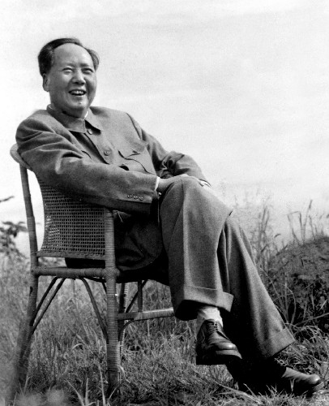
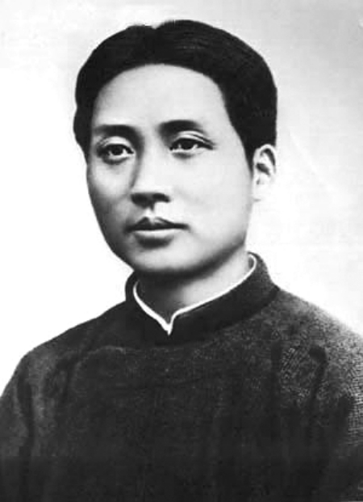
俱往矣,数风流人物,还看今朝
All are past and gone!
For truly great men
Look to this age alone.
Mao Zedong was a great Marxist, proletarian（无产阶级的） revolutionary, strategist and theorist, and the main founder and leader of the Communist Party of China (CPC), the Chinese People's Liberation Army (PLA) and the People's Republic of China.

Slide 32
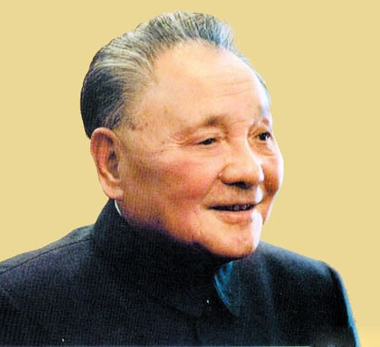
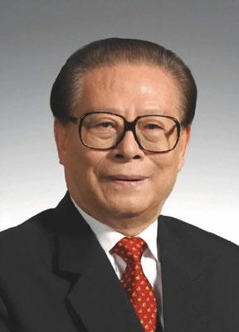
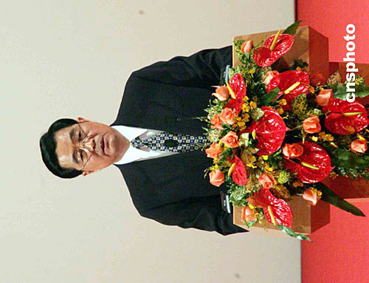
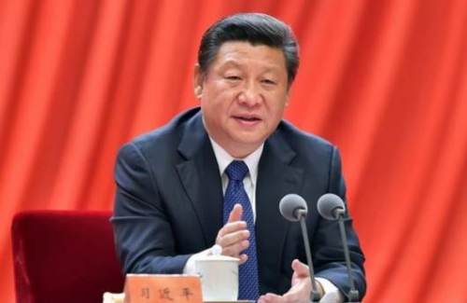
The main leader in China
邓小平为代表
江泽民代表
胡锦涛为代表
习近平为代表
He has systematically addressed the major question of our times—what kind of socialism with Chinese characteristics the new era requires us to uphold and develop and how we should uphold and develop it, thus giving shape to Xi Jinping Thought on Socialism with Chinese Characteristics for a New Era.
习近平主席系统地回答了新时代坚持和发展什么样的中国特色社会主义、怎样坚持和发展中国特色社会主义这个重大时代课题，创立了习近平新时代中国特色社会主义思想。
Under the leadership of the Party, great changes have taken place in China!
On the basis of the new demands of development they forged a deep understanding of and answered major questions, including what kind of development to pursue and how to pursue it in a new situation, thus forming the Scientific Outlook on Development, which puts people first and calls for comprehensive, balanced, and sustainable development.
根据新的发展要求，深刻认识和回答了新形势下实现什么样的发展、怎样发展等重大问题，形成了以人为本、全面协调可持续发展的科学发展观。
He shifted the focus of the whole Party’s work onto economic development and introduced reform and opening up, gradually formulated the line, principles, and policies for building socialism with Chinese characteristics and thus established Deng Xiaoping Theory.
实现全党工作中心向经济建设的转移，实行改革开放，逐步形成了建设中国特色社会主义的路线、方针、政策，创立了邓小平理论。
He deepened the understanding of what socialism is and how to build it, and what kind of party to build and how to build it, and gathered valuable new experience in governing the Party and the country, thus forming the Theory of Three Represents.
加深了对什么是社会主义、怎样建设社会主义和建设什么样的党、怎样建设党的认识，积累了治党治国新的宝贵经验，形成了“三个代表”重要思想。

Slide 33
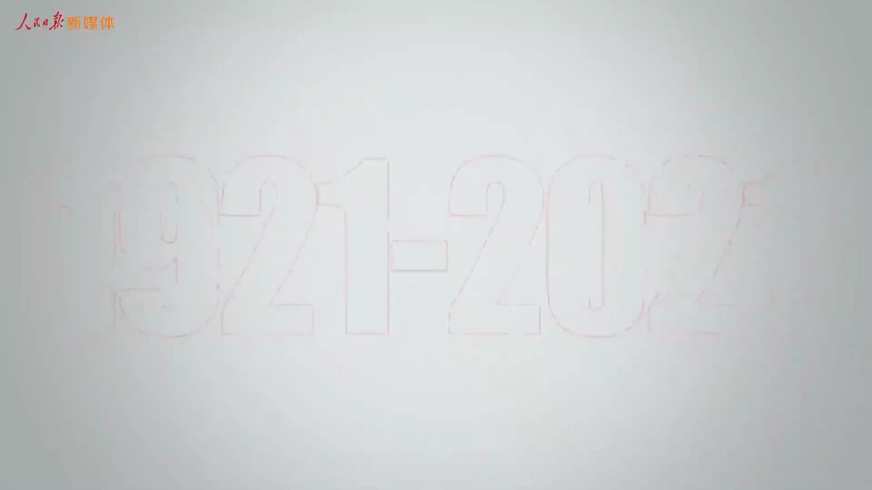
回顾党的百年奋斗史

Slide 34
新生的中华人民共和国如虎添翼，百废待兴
In 1964, our country succeeded in exploding the first atomic bomb;
In 1967,our country succeeded in exploding the first hydrogen bomb;
In 1970, our country successfully launched the first man-made satellite.
In July 1997, Hongkong's return to the motherland.
In December 1999, People's Republic of China resumed the exercise of sovereignty over Macao.
In 2003, the shenzhou five launch that China already occupy a space for one person in the field of aerospace, after the successful launch of Shenzhou VI, the seven gods are chinese people that going free from arrogance and impetuosity.
In 2008， Chinese held the olympic games, which fully demonstrated the economic achievements and the promotion of comprehensive national strength.
In 2010, we held the World Expo, attracted a large number of Chinese and foreign tourists.

Slide 35
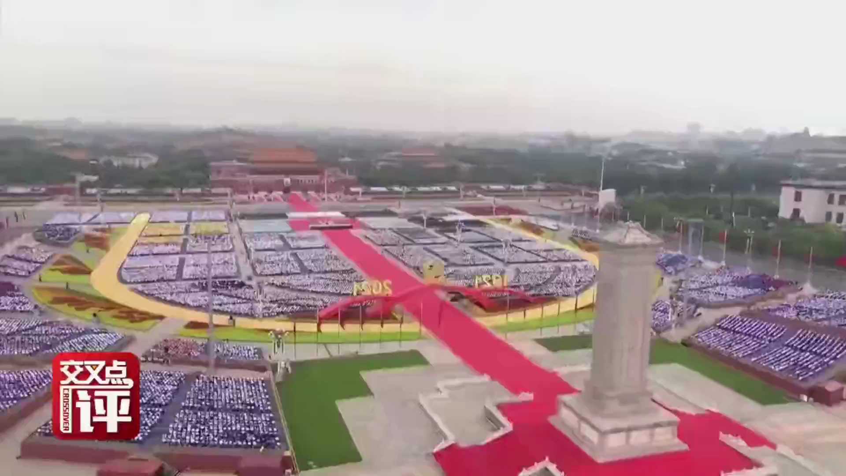
外媒眼中的中国

Slide 36
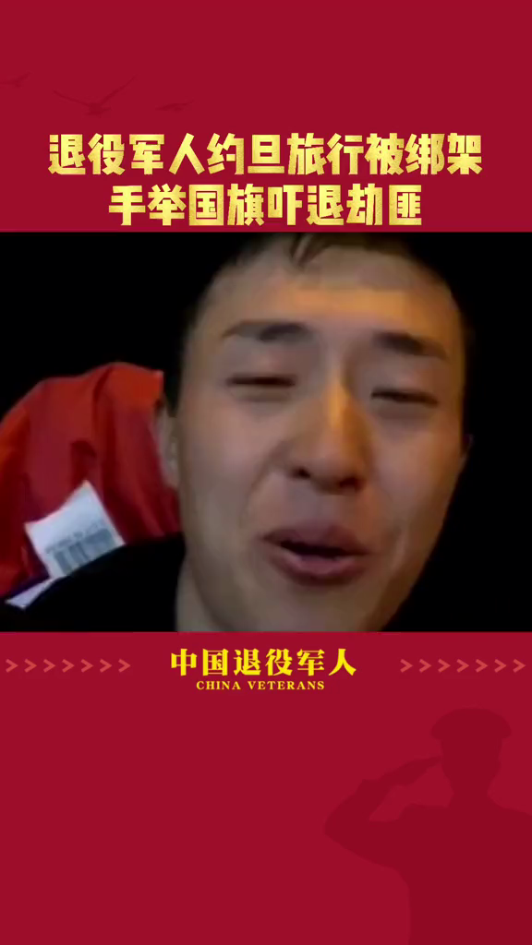
Discuss
1. What made him have a narrow escape ？
2. What does it show?
3. What makes China what it is now?

Slide 37
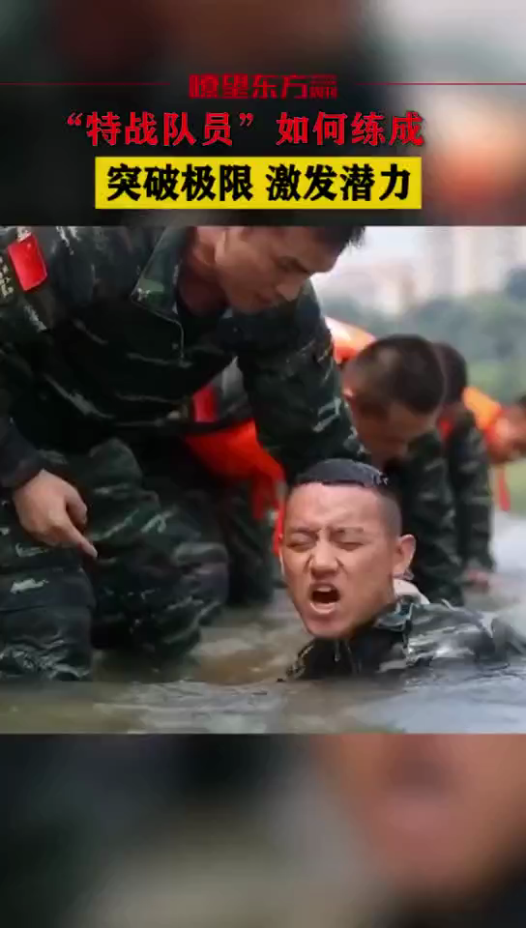
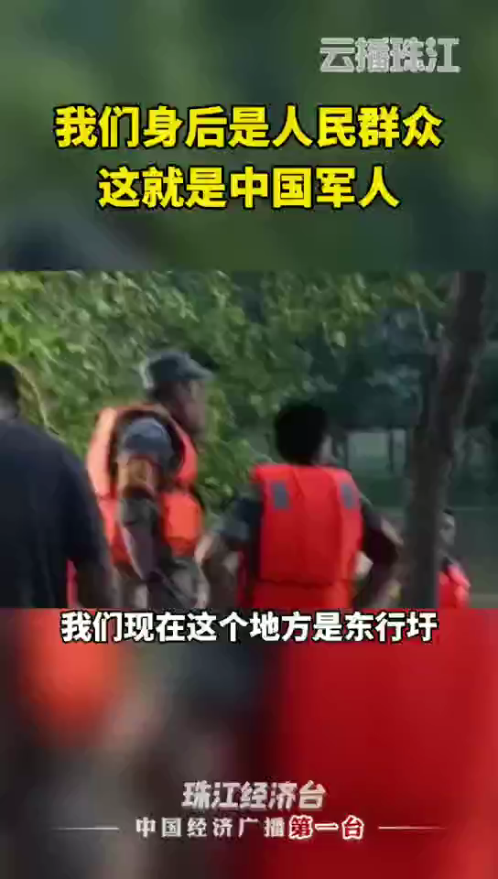
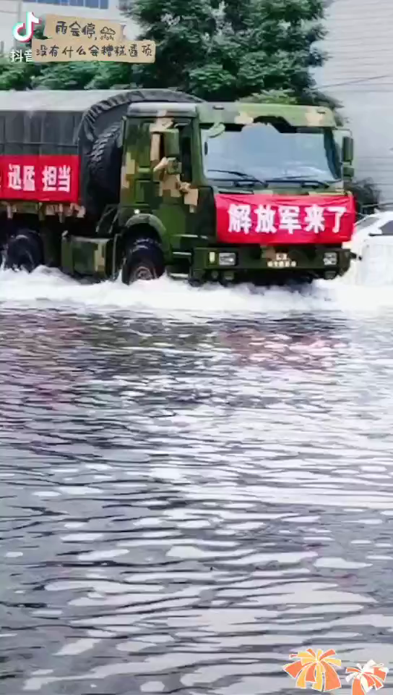
The performance of the People's Army under the leadership of the Communist Party
It is that they are loyal to the country and people that makes our country become stronger and stronger.
Let us remember them forever!

Slide 38
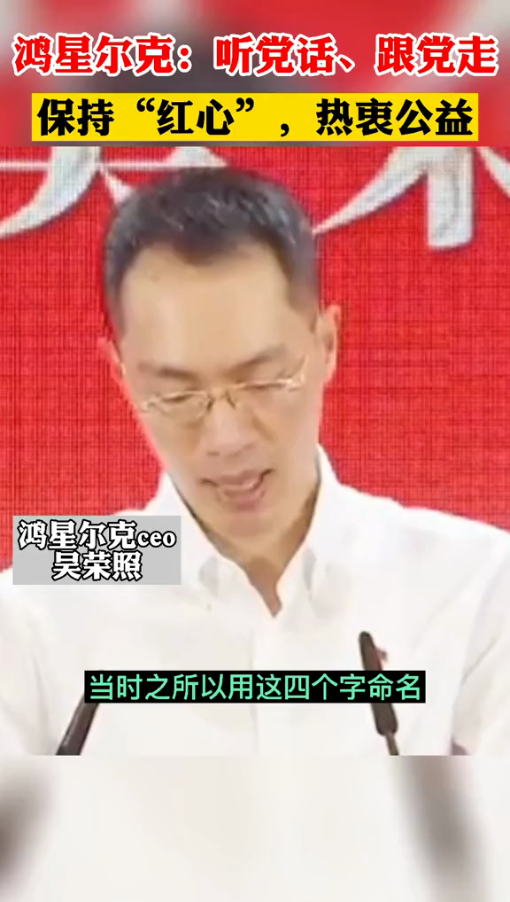

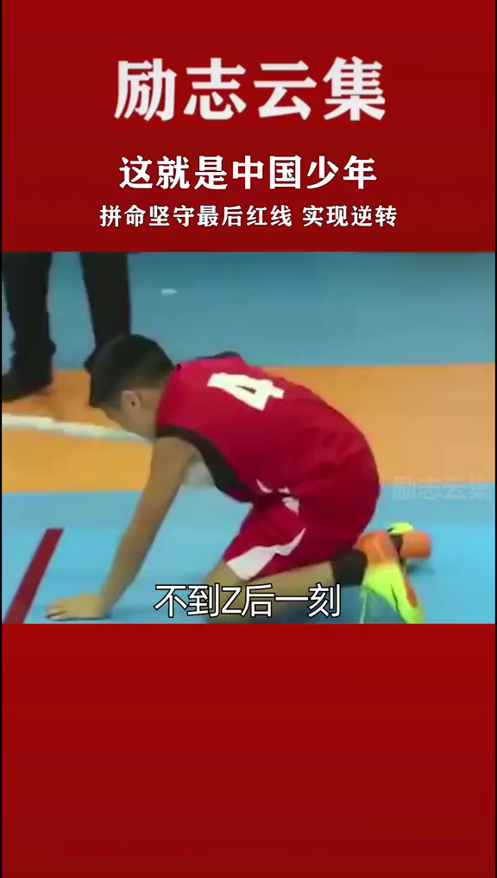
The performance of the common people
under the leadership of the Communist Party
It is that they combine the interests of individuals with the development of the motherland that makes our country become stronger and stronger.

Slide 39

The foreigner’s opinion
我泱泱华夏，一撇一捺都是脊梁，
我神州大地，一思一念皆是未来，
我浩浩九州，一文一墨均是骄阳，
此生无悔入华夏，来世还做中国人！
What is your feelings now?
Proud of our country!
What is happiness?
.
The happiness is pride as a Chinese!

Slide 40
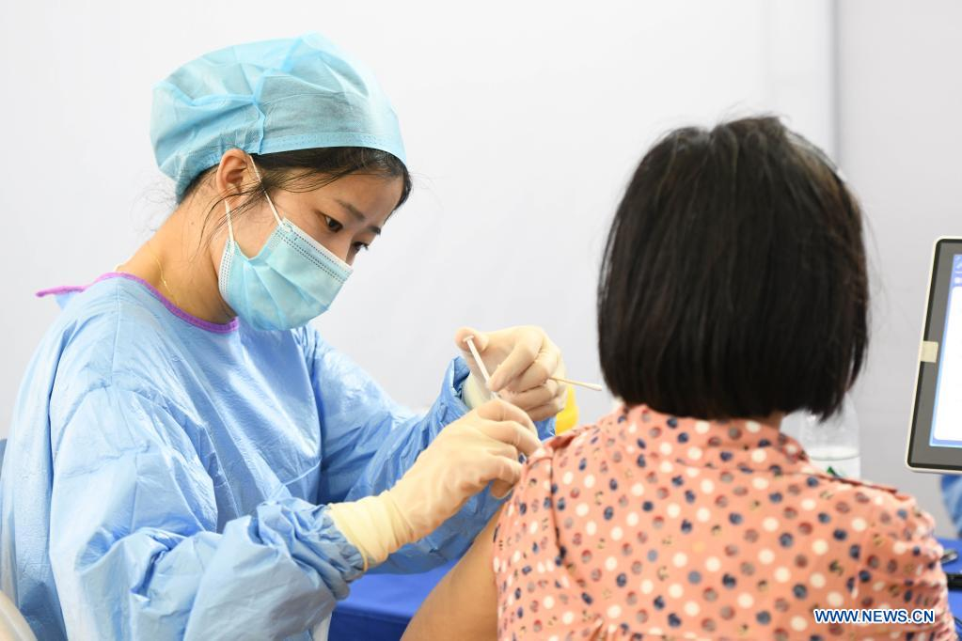
The width of happiness

Slide 41
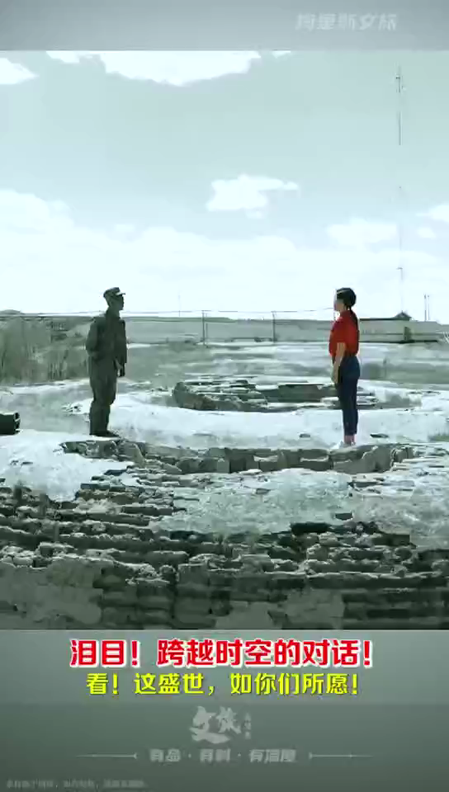

Slide 42
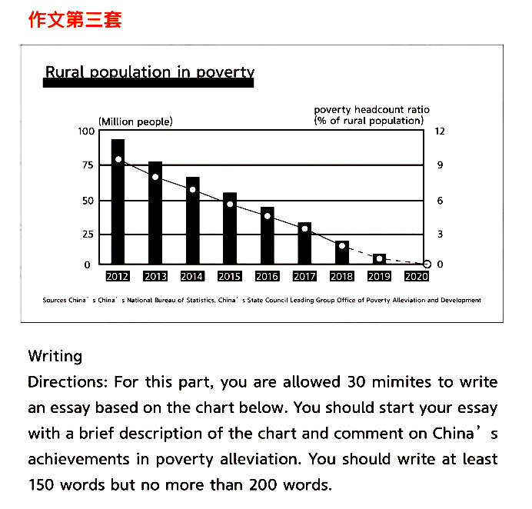
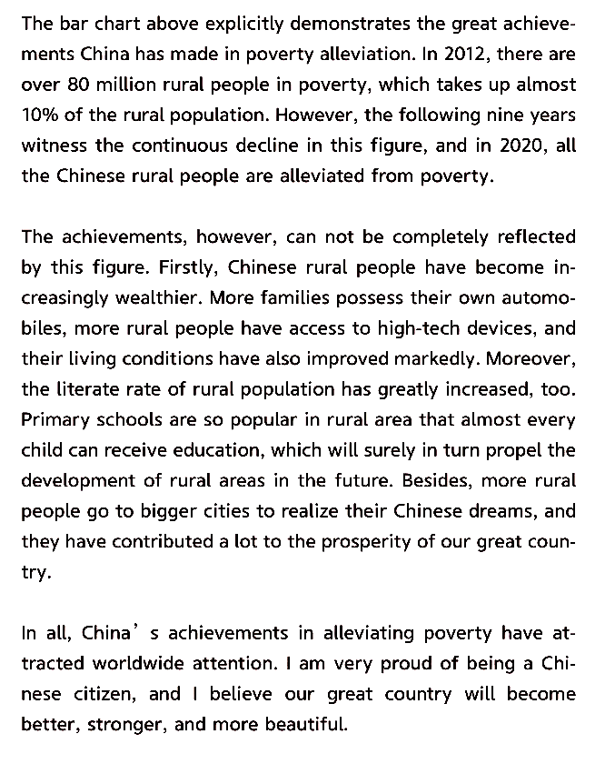
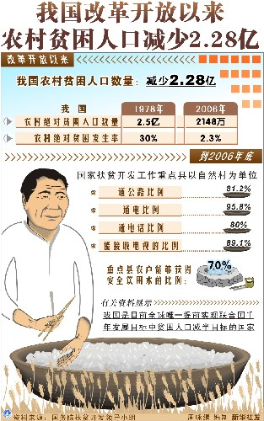
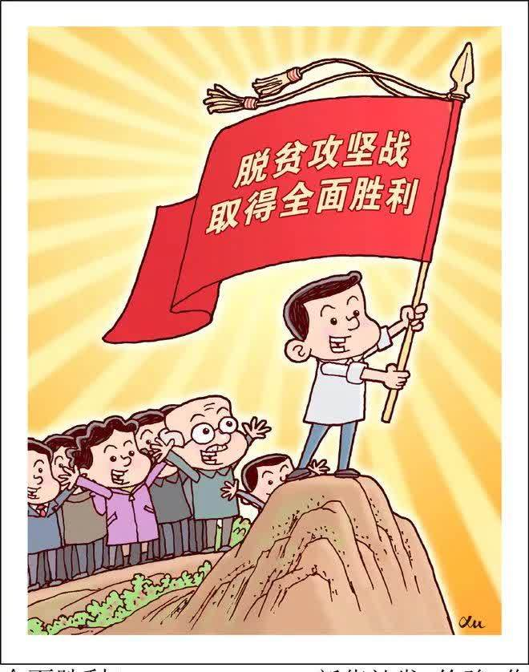
Look, the world is what you want！--- Out of poverty
看，这盛世如你所愿---我们脱贫啦！
【知识点】 精准扶贫、精准脱贫
targeted poverty alleviation and elimination
targeted poverty alleviation and eradication
to take targeted measures to reduce and eradicate poverty
alleviation[əˌliːvɪˈeɪʃən] n.减轻;缓和;
eradication [ɪˌrædɪˈkeɪʃən] n.根除;消灭
elimination [ɪˌlɪmɪˈneɪʃən] n.被淘汰；出局;
【知识点】 全面建成小康社会
to build a moderately prosperous society in all respects
to achieve moderate prosperity in all respects throughout the country
to complete a moderately prosperous society in all respects
moderately [ˈmɒdərɪtlɪ] adv.不过分地；
适度地;温和地；不激进地;

Slide 43
脱贫攻坚战全面胜利 complete victory in the fight against poverty
【重要讲话】
我们始终坚定人民立场，强调消除贫困、改善民生、实现共同富裕是社会主义的本质要求。
China upholds the principle of putting people first and emphasizes that ending poverty, improving people's well-being and realizing common prosperity are the essential requirements of socialism.
——2021年2月25日，习近平在全国脱贫攻坚总结表彰大会上的讲话
脱贫摘帽不是终点，而是新生活、新奋斗的起点。
Shaking off poverty is not the finish line, but the starting point of a new life and new endeavor.
——2021年2月25日，习近平在全国脱贫攻坚总结表彰大会上的讲话
【相关词汇】
uphold [ʌpˈhəʊld] vt.维护；拥护；支持;
well-being [wel'bi:ɪŋ] n. 幸福；生活安
宁； 福利
common prosperity 共同富裕
shake off 摆脱
endeavor [ɪn'devə] n.尽力;努力
v.尽力;努力;力图

Slide 44
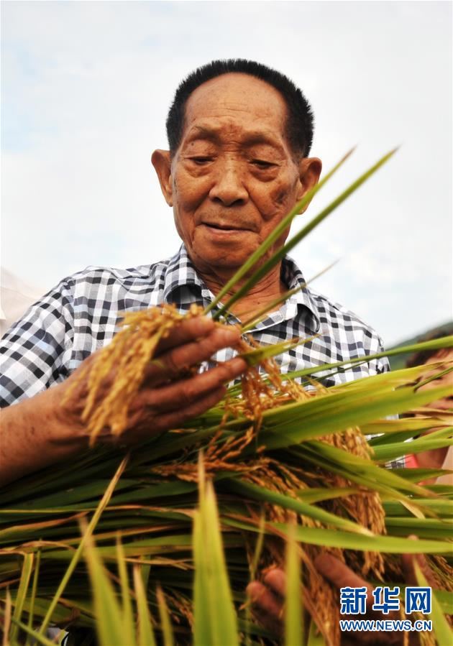

Look, the world is what you want！--- out of famine
"My life goal is to help all people stay away from hunger."
As a young teacher in Hunan's countryside, Yuan witnessed the devastation brought by a nationwide famine, immersed himself in rice hybridization experiments, despite many calling him a "chairwarmer." In 1973, he cultivated the world's first high-yielding hybrid rice strain, which could reach a yield of over 500 kg per mu (0.067 hectares) from previous 300 kg. In July, 2020, the goal with a yield of 1530.76 kg per mu was achieved.
Father of hybrid rice
devastation [ˌdevəˈsteɪʃən] n.（大面积的严重）破坏
famine [ˈfæmɪn] n.饥荒;（物品）奇缺;严重的饥饿感
immerse [ɪˈmɜːs] vt.浸；泡；使浸没;给…施浸礼
hybridization[ˌhaɪbrɪdaɪˈzeɪʃən] n.杂交
chairwarmer [ˈtʃeəˌwɔːmə] n. 懒虫；在其位不谋其职的人

Slide 45
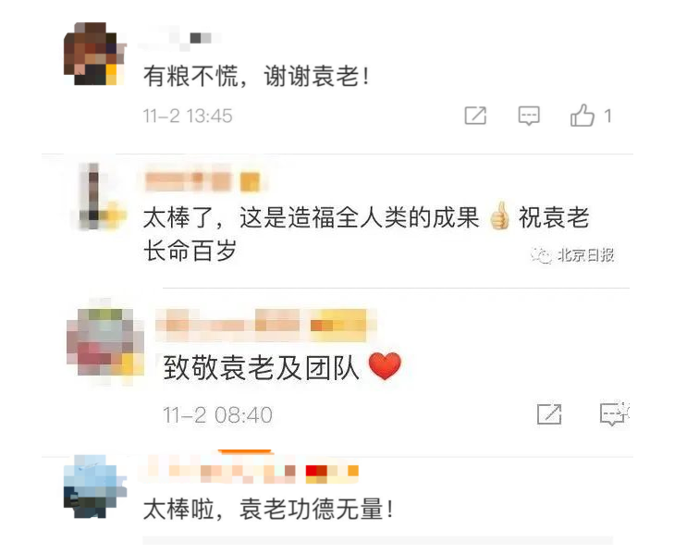
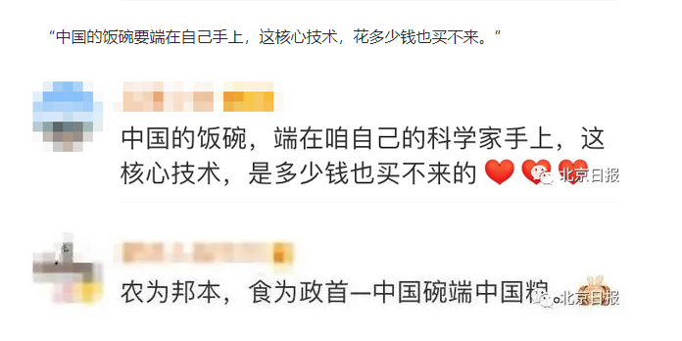
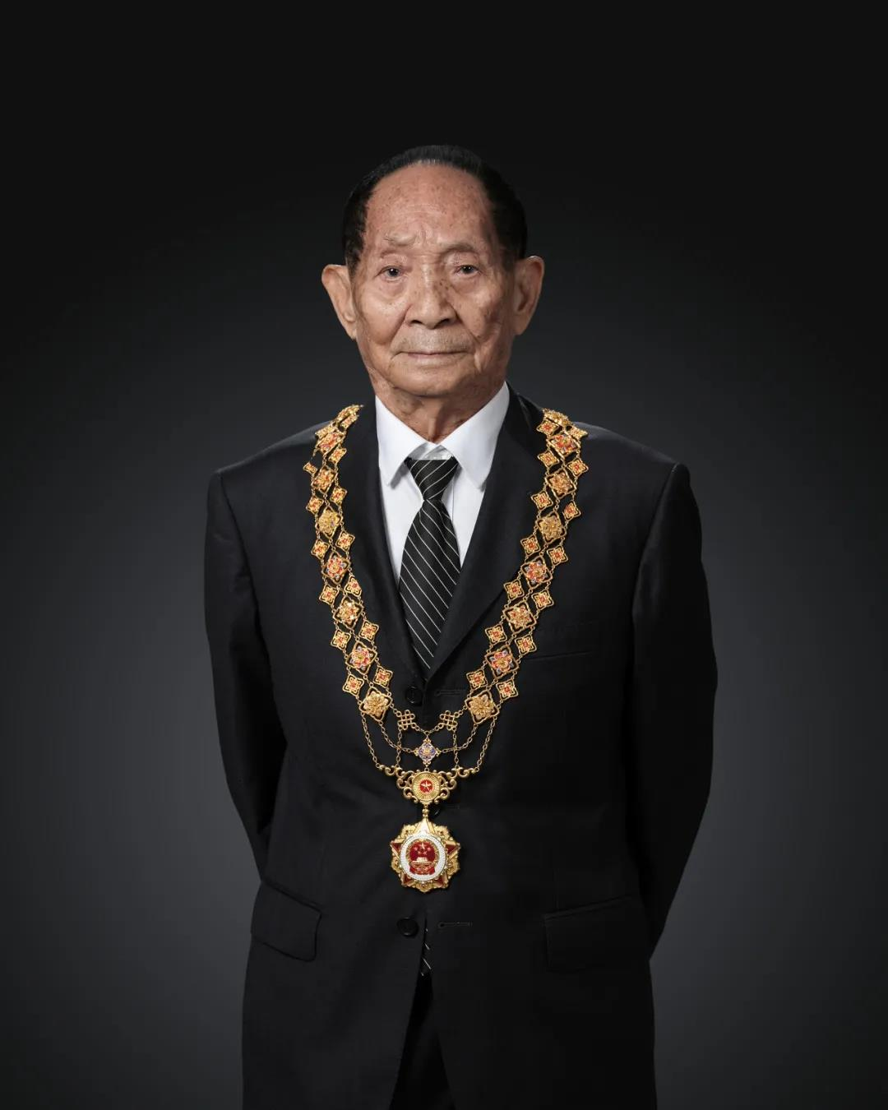
来自于人民的心声
In 2019, Yuan, academician with both the Chinese Academy of Engineering and the U.S. National Academy of Sciences, was awarded with Medal of the Republic, China's highest honor, for his groundbreaking research.
Nowadays, the hybrid rice is grown in almost half of China's rice paddies and its yield makes up for 60 percent of the country's total rice production. The hybrid rice yields 20 percent more than the common breeds, the annual increase of which feeds up to 100 million people.
Yuan’s two dreams
Yuan once said he had two dreams： to "enjoy the cool under the rice crops taller than men" and that hybrid rice could be grown all over the world to help solve the global food scarcity.
A portrait of Yuan Longping after receiving the Medal of the Republic on September 28, 2019.

Slide 46
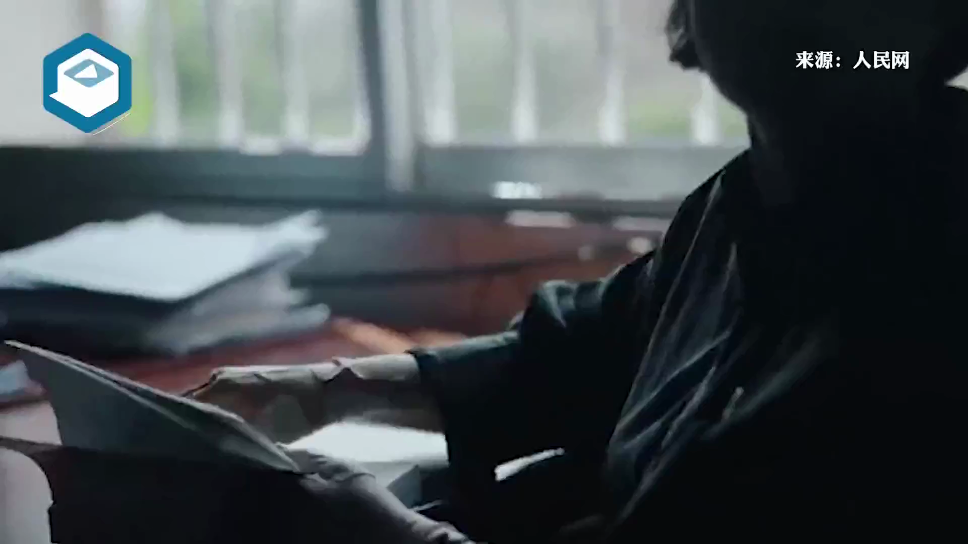
Look, the world is what you want！---- educational aspect
A role model for poverty alleviation through education---Zhang Guimei
脱贫路上铸丰碑 大山深处创一流--“时代楷模”张桂梅

Slide 47
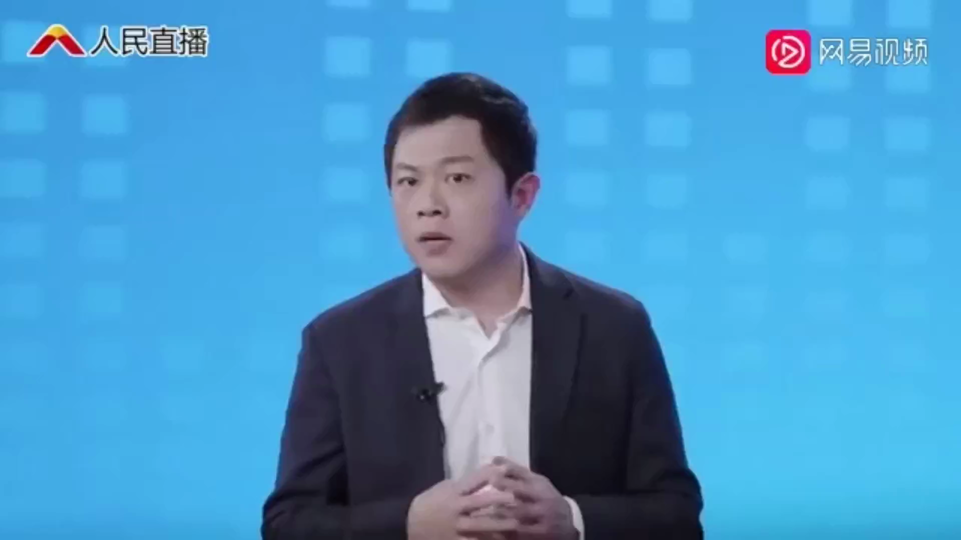
The heart-shaking motto
震撼人心的校训
我生来就是高山而非溪流
我欲于群峰之巅俯视平庸的沟壑
我生来就是人杰而非草芥
我站在伟人之肩藐视卑微的懦夫！
I was built to be a mountain, not a creek, rising to the high peaks with the small valleys at my feet.
I was born to be great, not worthless, standing on the shoulders of the giants, the petty cowards beneath me.
a picture of 17-year-old
President of the Huaping High School for Girls in Lijiang
华坪女子高中校长

Slide 48
Zhang Guimei, the principal of Huaping High School for Girls, based in Lijiang city, Southwest China's Yunnan province, has been granted the title "Role Model of the Times" in recognition of her dedication to the education for girls from poor families.
为表彰其为贫困家庭女孩教育所做的贡献，云南省丽江市华坪女子高级中学校长张桂梅日前被授予“时代楷模”称号。
This year is the time to secure a decisive victory in building a moderately prosperous society in all respects and achieve the goal of poverty alleviation. Teachers across the country devoted their love and wisdom to stopping poverty from being passed on to the next generation and inspiring millions of rural children to pursue their dreams, which demonstrates the noble ethics and sense of responsibility of contemporary teachers.
今年是决胜全面建成小康社会、决战脱贫攻坚之年，全国广大教师用爱心和智慧阻断贫困代际传递，点亮万千乡村孩子的人生梦想，展现了当代人民教师的高尚师德和责任担当。

Slide 49

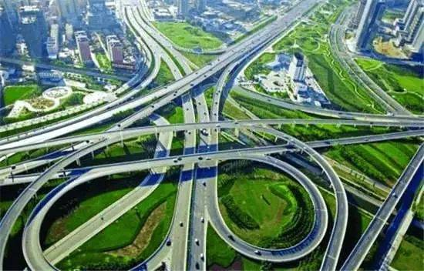
Look, the world is what you want！--- motorway
Turn-around highway in Yunnan
The development of freeway in China
1988年，the first highway called Hujia expressway (泸嘉高速)；
1990年，Shenda expressway (沈大高速)；
1993年，Jingjintang expressway(京津塘高速)；
1993年，Jiqing expressway(济青高速)；
1995年，Chengyu expressway (成渝高速)；
1996年，Huning expressway (泸宁高速)；
1998年，Ranking the fourth in the world with the expressway
covering 8733 kilometers；
1999年，Nearly ranking the third in the world with the
expressway covering 10 thousand kilometers；
2000年底， Ranking the third in the world with the
expressway covering 16,000 kilometers；
2010年,The expressway reaches more than 4,000 kilometers,
ranking the second in the world.
2018年，Ranking the first in the world with the expressway
covering 140,000 kilometers;
By the end of 2020,the Chinese highway total course has amounted to 5,198,100 kilometers, including 161,000 kilometers.
2020年，全国公路总里程519.81万公里，其中高速公路里程16.1万公里。

Slide 50
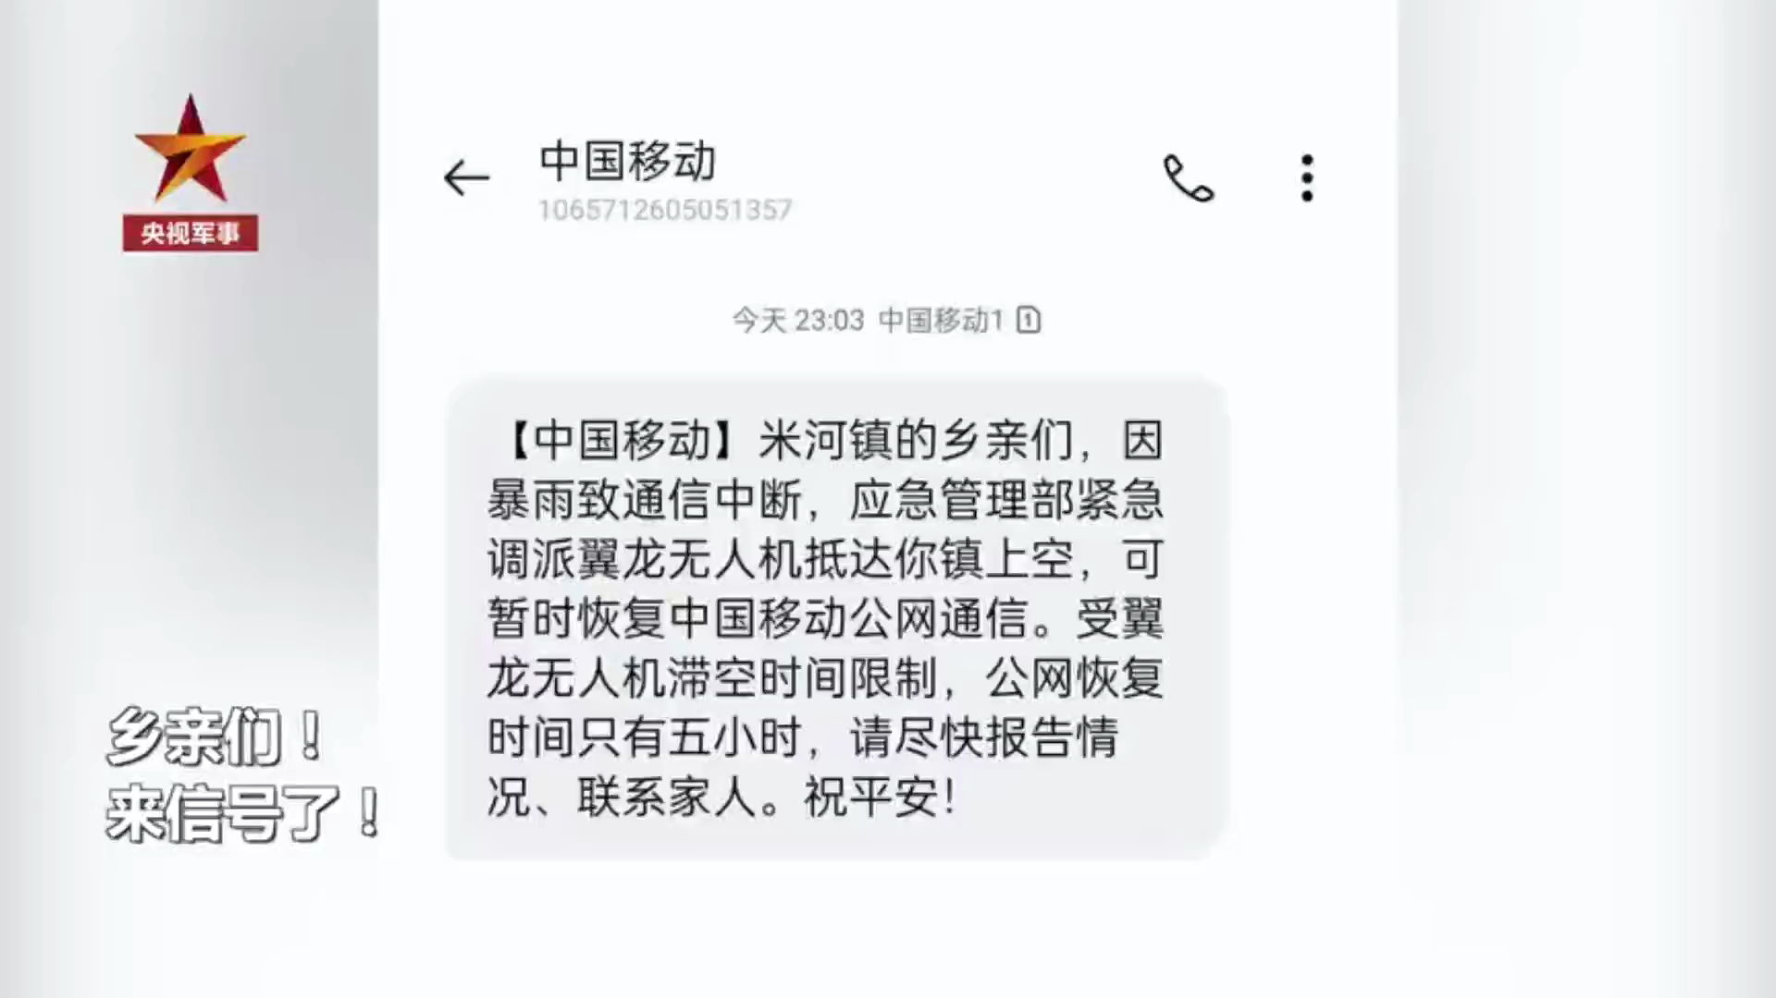
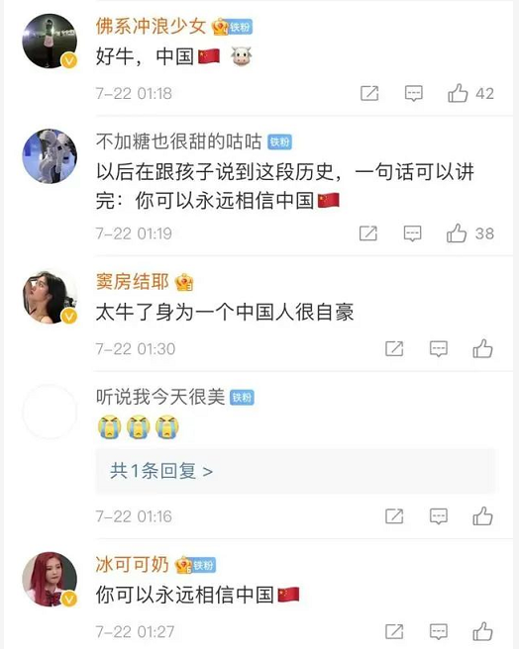
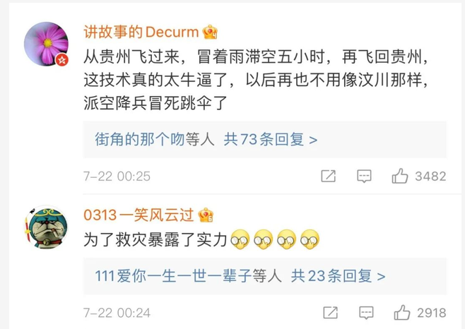
Look, the world is what you want！--- advanced technology
At 6:21 pm July21st Wednesday in Henan, the drone entered the areas where telecom services had been disrupted and started to provide stable and continuous mobile signal coverage for an area of about 50 square kilometers.
As of 23:20, the air base station has connected a total of 3,572 users, generating traffic of 2,089.89M, with a single maximum access of 648 users.
Restoring the mobile public network signal for residents in the disaster area allows individuals to report their situation in real time, and opens up a lifeline for emergency communications.
【知识点】
无人机学名全称为unmanned aerial vehicle，简称UAV，在口语中一般称为drone。

Slide 51
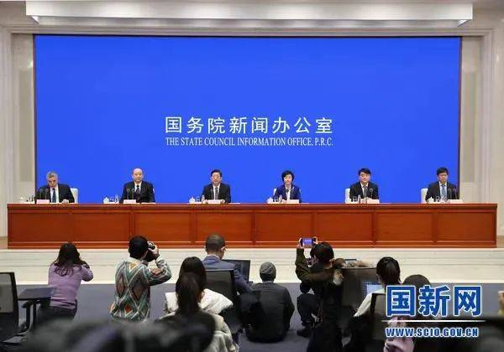
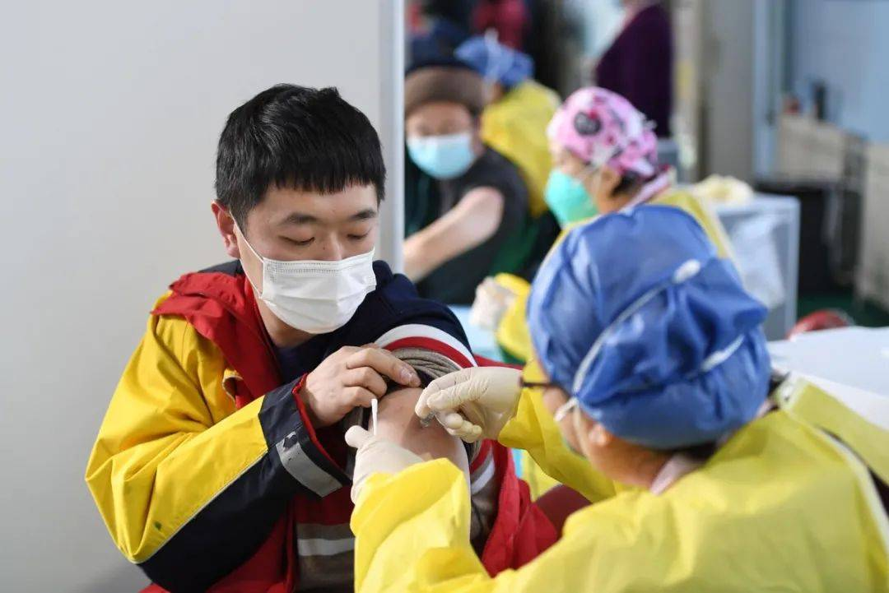
Look, the world is what you want！--- medical aspect
看，这盛世，如你们所愿！---医疗方面
The cost of COVID-19 vaccination will be covered by medical insurance fund and government fiscal, rather than individuals, said Li Tao, deputy director of the National Healthcare Security Administration.
国家医疗保障局副局长李滔表示， 接种费用将由医保基金和财政共同负担，居民个人不负担费用。
China has administered over 9 million shots of COVID-19 vaccine since Dec 15 to people deemed at high risk of contracting the disease, senior health officials said on Saturday.

Slide 52
知识点
1.vaccination
3. jab
接种疫苗 administer/have the vaccine have
vaccinate [ˈvæksɪˌneɪt] vt.给…接种疫苗
E.g. We should be vaccinated against COVID-19.
我们要打疫苗预防新冠病毒。
vaccination则是指疫苗接种的过程。
口语中，常用jab来表达疫苗接种。如：
I had the jab yesterday. 我昨天打疫苗了。
jab n. 注射；接种；预防针 v.戳、刺
get jabbed 在相关语境下，可理解为打了一针，。
4. shot
2. inoculation [ɪnˌɒkjʊˈleɪʃən] n.接种
shot: an injection of a drug（一次注射）。
Over half of its population has received at least one shot of vaccine.
常见短语是 a shot in the arm（强心针），something that makes you more confident or more successful（让你更加自信，鼓舞你获得成功的事情）。
除了vaccine，inoculation/inoculate的出现频率也很高。
inoculate用法与vaccinate相似：
An inoculation against cholera is recommended.
建议接种预防霍乱的疫苗。

Slide 53
关于“疫苗”的实用好句
The emergency vaccinations were given to people with high exposure risks on the premise of voluntary, informed consent.
在自愿、知情同意的前提下，对高危人群进行紧急接种。
Although the COVID-19 vaccine is safe and effective, people still need to maintain personal hygiene and protection, including wearing masks, washing hands and practicing social distancing.
虽然新冠疫苗是安全有效的，要继续维持个人卫生和防护措施，包括戴口罩、勤洗手、保证社交距离等。
After strict monitoring and observation, no serious adverse reactions took place.
经过严格的不良反应监测和追踪观察，未出现严重不良反应。
With COVID-19 vaccines officially approved to enter the market or the yield of vaccines improving steadily, China will put more vaccines into use, inoculating the eligible population as widely as possible.
随着疫苗获批上市，疫苗产量逐步提高，中国将会有更多的疫苗投入使用，符合条件的群众都能实现“应接尽接”。

Slide 54
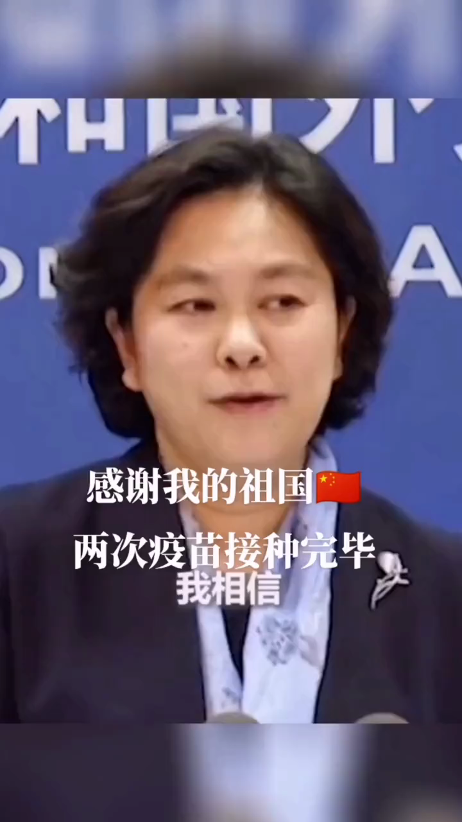
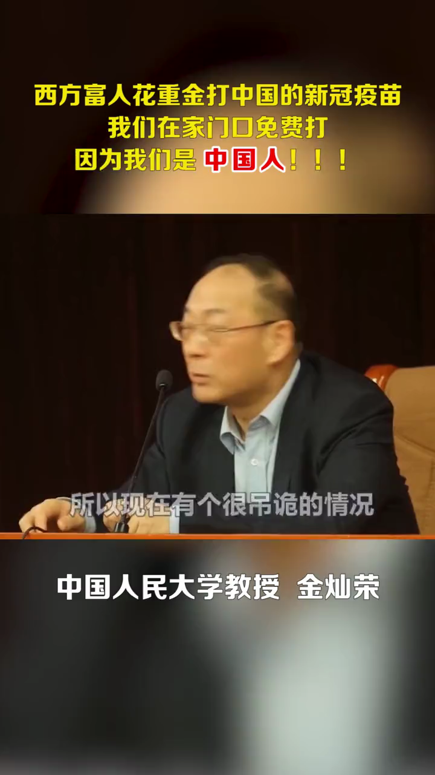
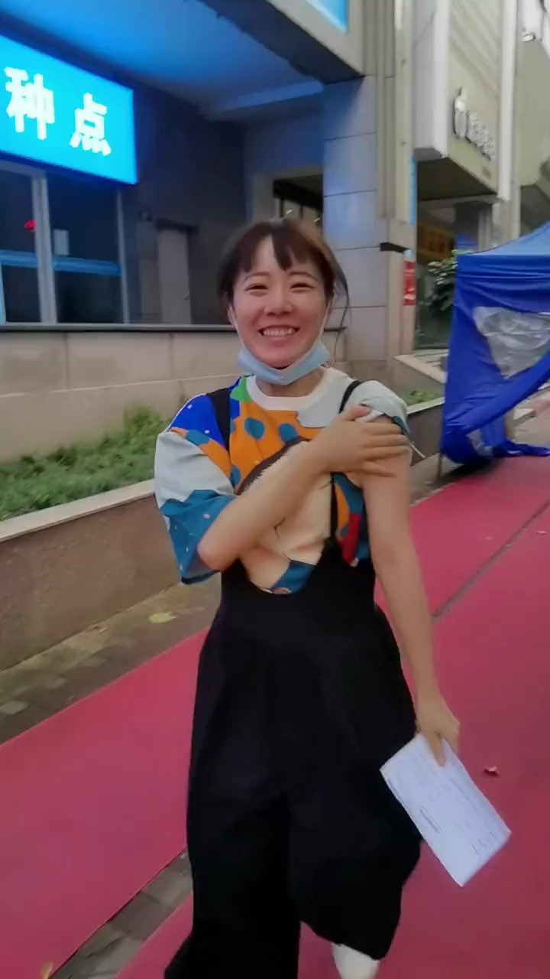
Why is the vaccination free for the people in our country?
The free vaccination scheme "is conducive to maximally safeguarding the fundamental interests of the people," and it fully demonstrates China's commitment to putting people's health and life first.

Slide 55

To ensure more than 2,000 Chinese people will be vaccinated，China has donated 100,000 doses of vaccine to Sultanate of Oman on condition that the Chinese get it first.
The Chinese government see to it that the wandering descendants of the Chinese Nation people health and safety.
为确保2000多中国人能打上疫苗，中国向阿曼苏丹捐赠10万支疫苗，条件是必须中国人先打。为了能够让在外漂泊的华夏儿女健康安全，中国政府一直在默默保驾护航。
这样的祖国,如何不叫人热泪盈眶！
为祖国点赞！

Slide 56




钟南山
李兰娟
李文亮
陈薇
How do you feel about it now ?
Happiness is gratutide.
Happiness is … ？
感恩生在盛世中国，没有战乱，没有饥寒，没有颠沛流离，有的是富足，有的是安全，有的是更多平台去成就自己，有的是白日里看青山绿水，夜晚间看流光溢彩，神州处处，勃勃生机。

Slide 57
How to strive for happiness at the beginning of school

Slide 58

Brainstorming
What is happiness to them?
Happiness is……
Happiness is to save the lives of the wounded, the treatment of difficult diseases.
幸福是救死扶伤，治疗疑难杂症

Slide 59

What is happiness to them?
Happiness is……
Happiness lies not only in imparting knowledge, but also in educating people.
幸福是教书育人

Slide 60

What is happiness to them?
Sprinter Su Bingtian made history by becoming the first Chinese athlete to reach the Olympic 100m final. Su Bingtian said, "For me, through so many years of hard work, I can finally stand on the 100m (final) track. I think I have fulfilled not only the dream of mine, but also the dream of our predecessors!"
Su ran into the record books at the Tokyo 2020 Games on Sunday when he became the first Chinese athlete to qualify for the men's 100-meter sprint final at an Olympics, setting a new Asian record on the way.
Happiness lies in breaking the world record and won honour for our country.
打破世界记录，为国争光

Slide 61

Happiness is reading hard .
幸福在于努力读书
Happiness lies in struggling tenaciously.
幸福在于是奋斗拼搏
Happiness is achieved through hard work.
幸福是奋斗出来的
Happiness lies in the belief that resouceful youths lead to a resourceful nation; strong youths lead to a strong country.
少年富则国富,少年强则国强

Slide 62



The importance of reading
孔子
A young idler, an old beggar.
少壮不努力，老大徒伤悲
岳飞
Don't idle away your time when you are young, otherwise you will feel sad and regretful when you are old.
莫等闲，白了少年头，空悲切
Learning without thinking leads to confusion; thinking without studying results in tardiness.
学而不思则罔
思而不学则殆

Slide 63



The greatness is achieved through diligence and retarded by laziness.
the deed is accomplished through thinking and destroyed by idleness.
业精于勤荒于嬉；
行成于思毁于随
The road ahead will be long and our climb will be steep.
路漫漫其修道远兮，
吾将上下而求索
Learn for the construction
of a prosperous China.
为中华之崛起而读书

Slide 64


Strong youths lead to a strong country.
少年强则国强

Slide 65



Why did we study hard?

Slide 66
What should we do as students?
Nobody in this world can succeed easily. If you want to shine in front of people, you must make efforts hundredfold behind them. You have to know that success is fair to everyone: it rewards those who are hardworking and can spare no efforts, and punishes those who are lazy and negative. Let's go all out for our dreams in a new day.
这世上从来没有轻轻松松就能成功的人。要想在人前发一分光，就得在人后付出百倍的努力。你要明白，成功对于每个人而言都是公平的：它奖赏勤劳和努力，惩罚懒散和消极。新的一天，为梦想全力以赴。
Come on, Chinese boys!

Slide 67



