Slide 1
新人教选择性必修Book 1
Unit 1 Using Language 2
Introduce someone you admire

Slide 2
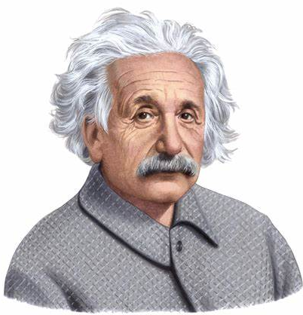
Lead in—Guessing
Guess who the person is according to the clues.
1. a Jewish
2. Nobel prize winner
3. The theory of relativity
Albert Einstein

Slide 3
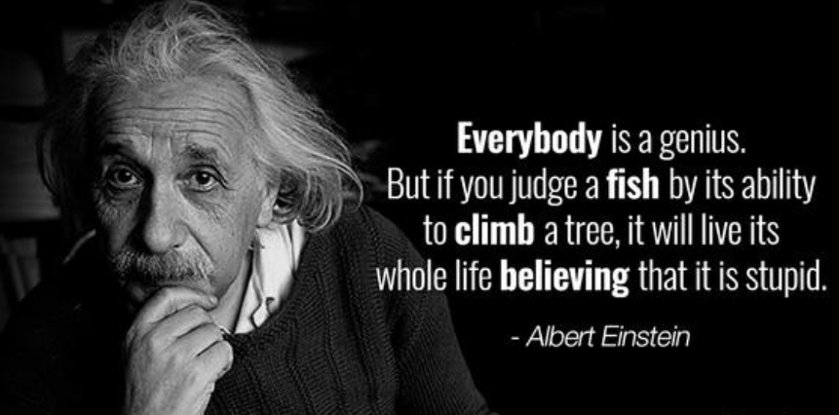
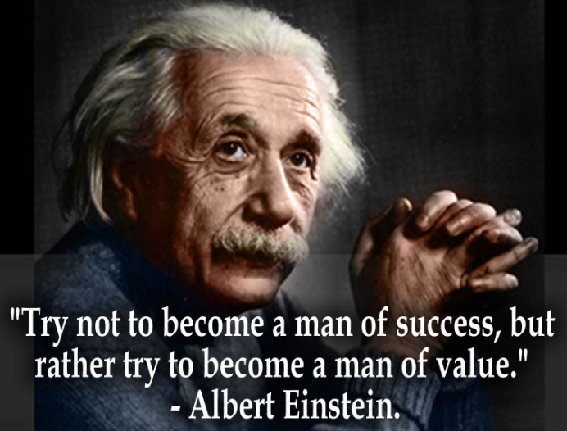
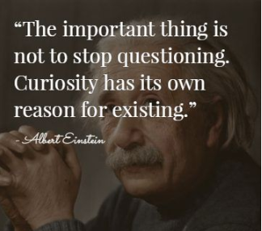
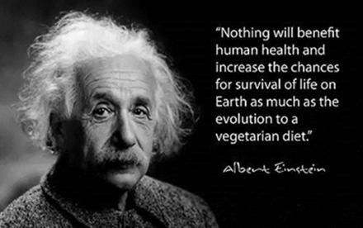
Some famous quotations
from Albert Einstein

Slide 4

Video Time: Albert Einstein

Slide 5

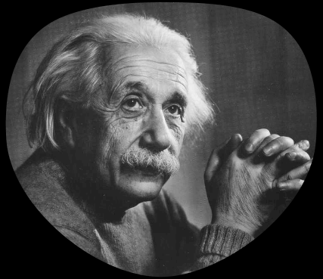
Reading For genre
Biography
What's the genre of the text?
A. Exposition B. Narration
C. Argumentation D. Practical writing

Slide 6
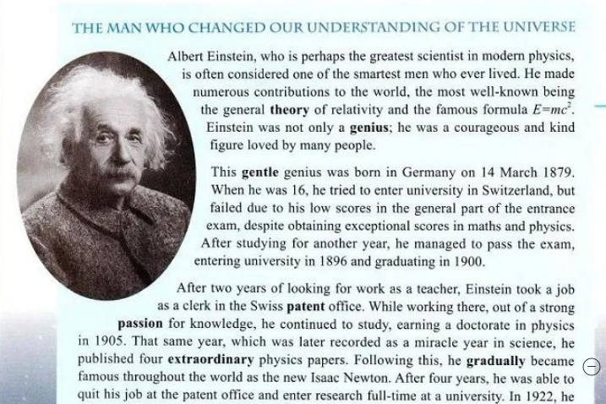
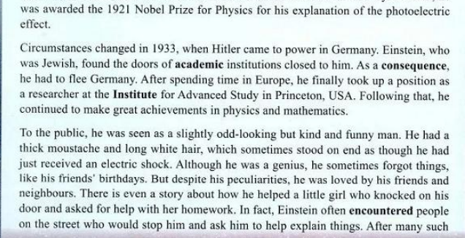
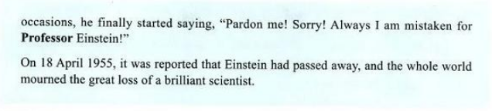
Reading for the structures
Title
Lead
Body
End

Slide 7

Title
1. Let the reader know the content directly or arouse the readers' interest by giving some information.
2. A good title can be brief but eye-catching, indicating the content.

Slide 8
Lead
What’s the main idea of the text?
Albert Einstein ,who is perhaps the greatest scientist in modern physics ,is often considered one of the smartest men who ever lived. He made numerous contributions to the world , the most well-known being the general theory of relativity and the famous formula E= mc². Einstein was not only a genius ; he was a courageous and kind figure loved by many people.
The text mainly talks about Einstein’s _________ and ______________.
life story
achievements
Lead：
1. Introduce the topic of the passage.
2.General introduction of Albert Einstein and his great contributions.

Slide 9
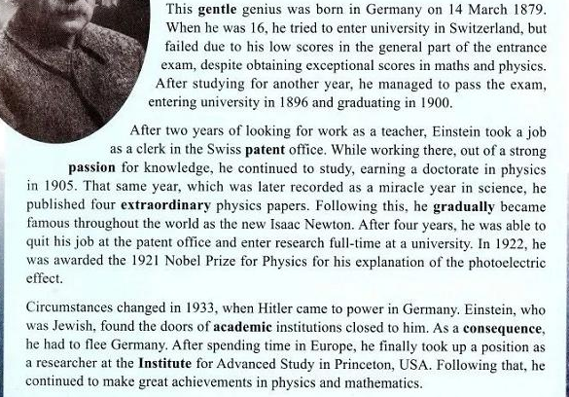
Body
How does the writer develop the text?
In chronological order.
(按年代次序地)

Slide 10
Activity-Make a timeline of his life
Making a timeline that shows when different events happened can help you understand how the events are connected to each other.
Took a job
as a clerk in the Swiss patent office
Able to quit his job at the patent office and enter research full-time at a university
Born in Germany
Entered university
Had to flee
Germany
1895
1900
1905
1922
1955
1879
1896
1902
1909
1933
Earned a doctorate in physics
Tried but failed to enter university in Switzerland
Graduated from university
Awarded the Nobel Prize for Physics
Died in the United States

Slide 11
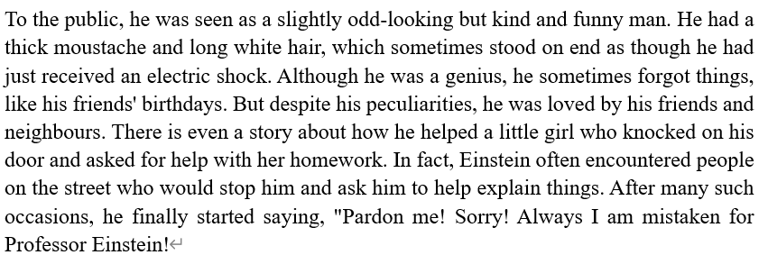
End
Find the descriptions that tell us what Einstein looked like and what kind of person he was.
The descriptions of Einstein's appearance
The descriptions of Einstein's
qualities.

Slide 12
Activity-What kind of person is Einstein?
a genius
a courageous and kind figure loved by many people
a slightly odd-looking but kind and funny man
a smart and diligent man
sometimes peculiar and forgetful....

Slide 13
Analysing language features
What rhetorical devices(修辞手法) are used in the passage?
Example:
(P3) Following this, he gradually became famous throughout the world as the new Isaac Newton----(analogy类比);
He had a thick moustache and long white hair，which sometimes stood on end... (personification );
...as though he had just received an electric shock.(simile明喻);
On 18 April 1955，it was reported that Einstein had passed away.(euphemism委婉语;委婉说法);

Slide 14
Post-reading -Summary
General Introduction to Einstein
General Introduction to Einstein
Review: not only a 1. ______, but a 2.________ and kind figure
Contribution: the theory of relativity
and the famous formula E=mc².
genius
couragous
He 3. ________ to enter university in Switzerland after studying for another year in 1896 and graduating in 1900.
managed
The life as a student

Slide 15
Out of 5. ______ for knowledge, he continued to study and earned a 6. ________ in physics.
He published four 7. ___________
four physics papers and became famous throughout the world.
He was 8. ________ the 1921 Nobel Prize for Physics.
passion
The life as a 4. ____ in Swiss patent office
doctorate
clerk
extraordinary
awarded
Because he was Jewish and found the doors of academic institutions closed to him, he had to flee Germany.
The reason of fleeing Germany

Slide 16
He had a thick moustache and long white hair.
He was loved by his friends and neighbours despite his 9.__________.
He was 10._________ to ask for help.
Einstein's character and funny stories
peculiarities
encountered
The loss of the greatest scientist

Slide 17
After reading-Summary
What aspects are included while writing a biography or introduction of a certain person?
Brief introduction
Personality
Appearance
Achievements
Impressive story
Comments on the person

Slide 18
Writing
Use what you have learnt to write an introduction about someone you admire.
Step 1 Choose a person you're going to write.
Step 2 Make a list of things you're going to
write.
Step 3 Finish and revise your draft with your
partner.
Step 4 Share your writing.
A great person in some way or an ordinary person, such as a parent, a relative, or a friend.

Slide 19
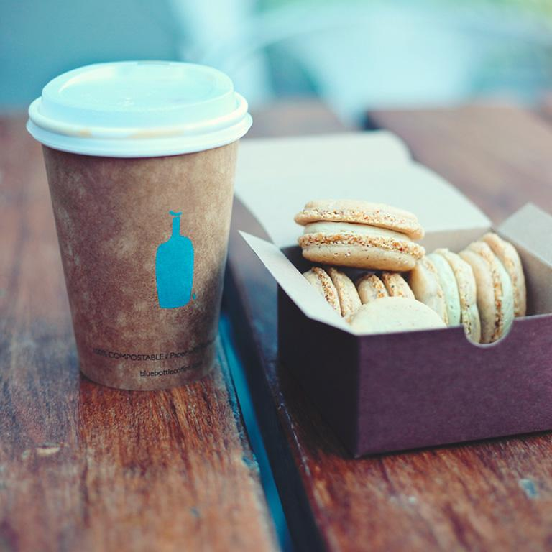
Exchange your draft with a partner.
The checklist may help you...
Does the writer describe the person's appearance and personality?
Does the writer tell an impressive story of the person's life?
Does the writer say why the person is great?
Does the writer sum up how he/she feels about this person?

Slide 20
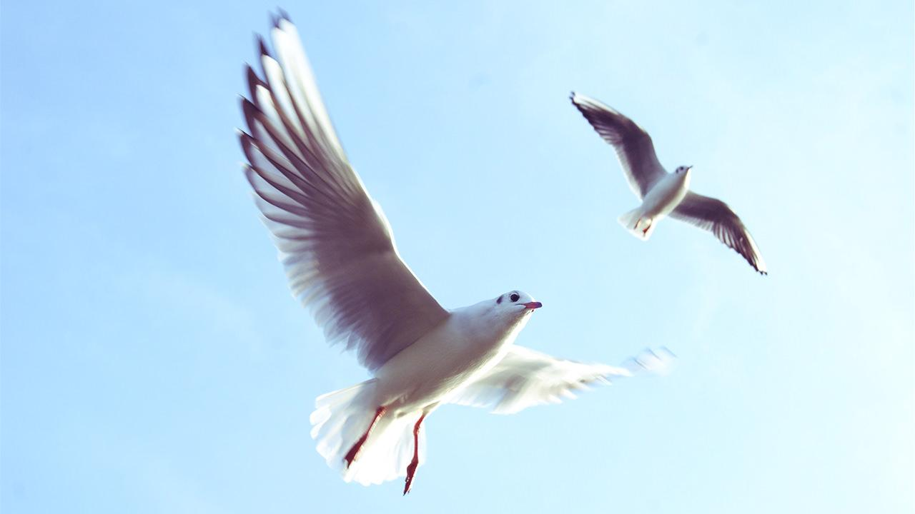
Show time

Slide 21
Homework
你校英语俱乐部将举办主题为“My Hero”的讨论活动。请你用英语写一篇发言稿，介绍你心中的英雄。
要点包括：
1. 他/她的职业；
2. 他/她可称为hero的理由；
3. 你对hero的理解。
注意：1. 词数80左右；
2. 开头和结尾已给出。
Good afternoon, everyone
____________________________________________
That's all. Thank you!

Slide 22
Sample
Good afternoon，everyone.
My hero is a middle­aged woman named Li Dan. She isn't beautiful or rich，and she is just an ordinary street cleaner.
So why is she my hero？First，I admire her because of her deep devotion to her common but useful work， which requires her to work for more than nine hours a day，rain or shine. Second，she has a kind heart and always manages to return the wallets or cellphones she finds while working to the owners. There's a lot that I should learn from her.
In short，my heroes are those who do small things in life，because it's the small things that count.
That's all.Thank you！

Slide 23
Thanks!

