Slide 1

感恩遇见，相互成就，本课件资料仅供您个人参考、教学使用，严禁自行在网络传播，违者依知识产权法追究法律责任。
更多教学资源请关注
公众号：溯恩高中英语
知识产权声明

Slide 2

高
中
英
语
应
用
文
约稿信 a letter of reservation
杭州二中许丽君

Slide 3
学习目标： Learning Goals
After learning this lesson, students will
3. Use advanced expressions and sentence patterns to write a letter of Reservation.
5. write an appropriate letter of Reservation, especially pay attention to the tone and language.
learn about the structure and contents of letters of Reservation;
02
04
2. write the points completely and clearly.
01
03
4. know what a good letter of Reservation is like.
05

Slide 4

Lead in:
When do you need to write letters of Reservation?
Reserve a manuscript

Slide 5


一、【约稿信题型解读】
PART
01
约稿信属于书信的一种，它指的是报纸、杂志、文化栏目等媒体邀请别人写稿的信件。
CONTEST

Slide 6
二、约稿信之谋篇布局
2. 主题、时间等约稿的具体要求
3. 期待参加并希望及时回复
1.点明约稿意图

Slide 7
三、【约稿信写作步骤】
第一步：点明写信的目的-约稿；
约稿信写作步骤
第二步：介绍约稿的具体内容；
第三步：期待回复并表示感谢。

Slide 8
四、【约稿信写作要求】
【约稿信写作要求】
信件一般要求写80词左右，所以内容要写简洁一些，不要长篇大论、过于详细。若担心篇幅不够，可以适当增加少许细节和串接词。语言在流畅的基础上要适度组合和运用高级词汇。

Slide 9
Writing preparations
一、必备短语
1. the articles written by
由… 写的文章
2. write something about …
写点关于……的文章
3. some requirements about the article 稿件的一些要求
4. as/so long as 只要
5. interesting and informative
（内容）既有趣又充实, 寓教于乐
6. be expected/required to do要求做
7. have a title made up by yourself 题目自拟
8. within 400 words 不超过400字
9. subscribe/have your article 交稿
10. be due on / The deadline is…/by+日期 截止到
11.carry articles written by ... about...登载由……写的关于……的文章
12. anything relevant/concerned 任何相关内容
13. the ... section in our newspaper
我们报纸的……栏目
14. extend the deadline
延长最后期限
15. on display 展示，陈列

Slide 10
二、➢常用语块 Writing help: Useful phrases and expressions
invite/ask sb. to do sth. 邀请某人做某事
write an article for 为……写一篇文章
in order to 为了
make/help sb. know sth. about使某人了解
with the purpose/aim of 为了
6. It’s popular with… 受到…欢迎
7. I would like to ask you to write an article for…
我想请你为……写一篇文章。
8. You can write something about…
你可以写一些关于……
9. …is very popular among…
……是很受……欢迎的。

Slide 11
三、 套用句式
 如何写约稿信的开头
Part 1: Beginning【首段-引人入胜开头句】
Purpose of writing the letter【写信意图+点明写信的目的-约稿】
（1）约稿信篇首：简单问候，表明写信的目的
1. I’d like to invite you to write an article for the English newspaper.
我想请你为英文报写一篇文章。
2. I wonder if you could write something about Chinese poems.
我想知道你是否可以写一些关于中国诗歌的文章。
3. Can you write something about your school life?
你能写点关于你的学校生活的内容吗？

Slide 12
三、 套用句式
 如何写约稿信的开头
Part 1: Beginning【首段-引人入胜开头句】
Purpose of writing the letter【写信意图+点明写信的目的-约稿】
（1）约稿信篇首：简单问候，表明写信的目的
4. You can write anything relevant so long as it’s interesting and informative.
你可以写与之相关的任何东西，只要它寓教于乐。
5. It would be better if we could have your article before June 1.
我们在6月1日之前能收到你的文章会更好。
6. Would you please write something about/regarding…?
你能写点关于……东西吗?

Slide 13
 如何写约稿信的正文
Part 2: Body Arrangements【主体段落➔画龙点睛篇中句➔介绍约稿的具体内容】
（2）篇中介绍栏目特点和受众范围+约稿的内容要求+栏目设立的目的
1.Your article is supposed to be within 300 words. / 300 words would be
fine. 你的文章的字数应控制在300字以内。/300字就够了。
1
2. If you make contributions for us, we would like you to make your article lively and interesting. 如果你向我们投稿，我们将会使你的文章生动有趣。
2
3
3. Here are some requirements about article. 以下是关于稿件的一些要求。
4
4. The article mainly talks about __________ 稿件主要是关于…..

Slide 14
 如何写约稿信的正文
Part 2: Body Arrangements【主体段落➔画龙点睛篇中句➔介绍约稿的具体内容】
（2）篇中介绍栏目特点和受众范围+约稿的内容要求+栏目设立的目的
5
5. You’d better send your article to me next Sunday and about 120 words would be fine.
你最好下星期日把你的文章发送给我，字数约120就好。
6
6. Could we /I have your article before _______? 我们在……之前能收到你的文章吗？
7. It carries articles written by foreign students concerning the culture of their home.
它包括由外国学生写的关于他们自己国家文化的文章。
7
8
8. We wonder if it is practical to have it before ……?
我们想知道在……之前得到它是否可行？

Slide 15
如何写约稿信的结尾
Part 3: Ending【尾段-言简意赅篇尾句-表达希望得到对方的答复】
篇尾写希望得到的结果➔期待回复并表示感谢
Looking forward to your early reply. 盼望着您的尽快答复。
2. Looking forward to your confirmation soon.盼望着您尽快确认。
3. Looking forward to your response. 期待你的回复

Slide 16
Dear 被约稿人 ，
I’d like to ask you to write an article for ________ (某媒体 ). The “ ____________” (某栏目) section in our ___________(某媒体 ) is very popular among ____________ (某些媒体受众) to ____________ (做某事) . It carries articles written by ______________ (某些别的被约稿人) about/concerning the___________ (某些话题). Would you please write something about _______________? (某些话题A方面and B方面). You can write anything relevant so long as it’s interesting and informative. (某数量) words would be fine. Could we have your article before ________(某日期)?
I’m looking forward to hearing from you.
Yours,
写信人名字
【约稿信英语作文模板一】：

Slide 17
【约稿信英语作文模板二】：
Dear Peter
I’d like to ask you to write an article for _________ (某媒体) . The “_________（某栏目）” column/section provides a nice platform for _________（某媒体受众）to _________（做某事）. In this section there are a wide variety of materials available to ______________（这些媒体受众）. And here are some relevant details about the articles we are eager for. To begin with, not only can you write something about _____________（A方面）, but also you can focus on _________________（B方面）.What’s more, your article can have a title made up by yourself with a vocabulary of _________（某数量）or so.
Last but not least, you are supposed to subscribe your article by ________（某日期 ）I am looking forward to your reply at your earliest convenience.
Yours faithfully,
写信人名字

Slide 18
Evaluation:
Work in groups of four. Each student read the article and others comment on others’ article. Then choose the best one to present in the class. When you are discussing, you can pay attention to the following hints.
Teaching Goal | Have you made the purpose clear?
Frame/ structure | Does the structure conform to the requirements?
Language | Are the sentences concise and accurate?
Main points | Have you included all the points of view?
Proper details | Are the details suitable?
three Criteria of reservation Letters | Does the letter meet three Criteria of reservation Letters-To be appropriate/concise/To get to the point?

Slide 19
应用文写作—约稿信题型训练&实战演练
参考范文

Slide 20

约稿信题型训练1【关于外国校园生活向美国笔友Tom约稿】
第一节: 应用文写作（满分15分）
假定你是李华，为了让你校学生能够了解外国的校园生活，你校英文报打算出一期关于外国校园生活的报纸。请给你的美国笔友Tom写信约稿。内容包括：
1. 稿件主题;
2. 稿件长度：400词左右;
3. 投稿邮箱：campuslife@article.com;
4. 截稿日期：2020年6月18日
注意: 1. 词数80左右;
2. 可以适当增加细节, 以使行文连贯;
3. 开头语已为你写好。

Slide 21
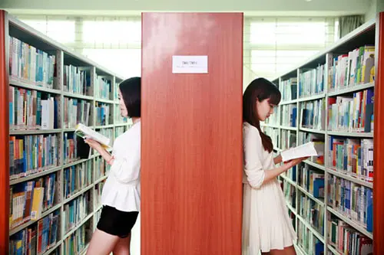
约稿信1参考范文【关于外国校园生活向美国笔友Tom约稿】
【Writing Sample：】Possible version:
Dear Tom,
I am writing to invite you to contribute an article for our school’s English newspaper. For enabling our school’s students to learn more about the life in foreign high schools, we intend to publish a new edition of newspaper concerning foreign campus life. Would you please write something about your school life? About 400 words would be fine. If possible, please add several photos in it, which will be particularly welcome. Please send your article to campuslife @ article.com. It would be better if we have your article before June 18 in 2020.
I would appreciate it if you could give me a reply as soon as possible.
Yours,
Li Hua

Slide 22

约稿信题型训练2
【“外国文化”栏目介绍节日风俗和中学生生活向美国朋友彼得约稿】
2015 年全国卷 I
第一节: 应用文写作（满分15分）
假定你是李华，你校英文报“外国文化”栏目拟刊登介绍美国节日风俗和中学生生活的短文。请给美国朋友彼得写信约稿, 要点如下：
1、栏目介绍；
2、稿件内容
3、稿件长度：约400词
4、交稿日期：6月28日前
注意: 1. 词数80左右;
2. 可以适当增加细节, 以使行文连贯;
3. 开头语已为你写好。

Slide 23
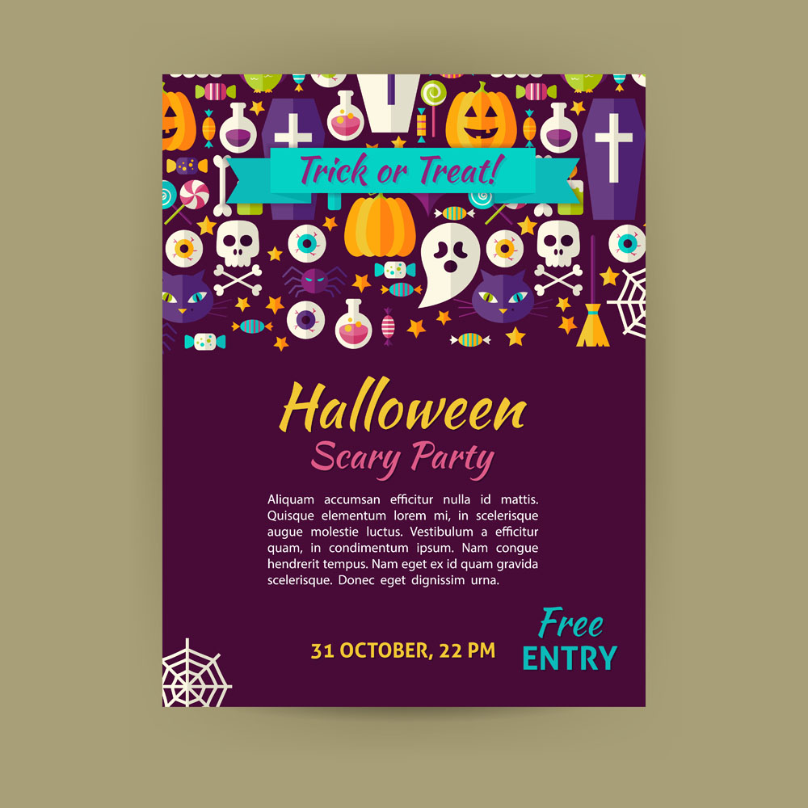

约稿信题型训练2
【“外国文化”栏目介绍节日风俗和中学生生活向美国朋友彼得约稿】
【写作提示】
对于书信作文强调两点，简单&通用。还需要注意书信作文三段论，把中间段的要点部分用出彩的过渡词做链接，就能写出漂亮的文章。

Slide 24

约稿信题型训练2
【“外国文化”栏目介绍节日风俗和中学生生活向美国朋友彼得约稿】
【写作提纲 】
根据题目的要求和注意点，列出提纲：
第一段：问候+写信背景（我校办杂志）+写信目的
第二段：主题句+拓展句1（介绍外国生活）+拓展句2（介绍外国节日）+拓展句3（不少于400字）+拓展句4（6.28前交）
第三段：我希望（你能帮助我）；我相信（大家会喜欢你的文章）；感谢你（读我的信）。请回信！

Slide 25

约稿信题型训练2
【“外国文化”栏目介绍节日风俗和中学生生活向美国朋友彼得约稿】
【第一段---学靓丽开头和高级表达：】
It is well-known that …. is extremely important in …, through which we can …. efficiently.
众所周知，……在某方面是及其重要的，通过它我们能有效地做……
2. More and more people accept the importance of……
越来越多的人接受……的重要性。
3. There is a growing acceptance of the importance of A. 对A的重要性人们逐渐接受。
4. We felt very excited. 我们感到非常兴奋。
5. There was great /tremendous/enormous excitement/joy/delight.
大家感到及其开心。

Slide 26

约稿信题型训练2
【“外国文化”栏目介绍节日风俗和中学生生活向美国朋友彼得约稿】
【第三段---学经典句式和精彩结尾： 】
Taking all these factors into consideration, we naturally come to the conclusion that…
把所有这些因素加以考虑,我们自然会得出结论……
2. Hence/Therefore, we’d better come to the conclusion that …
因此,我们最好得出这样的结论……
3. It is high time that we put an end to the (trend).
该是我们停止这一趋势的时候了.
4. Obviously, …, If we want to do something …, it is essential that …
显然, 如果我们想做某事, 很重要的是…
5. Only in this way can we … 只有这样，我们才能……
6. Undoubtedly，doing sth. will contribute to /lead to/result in ……
毫无疑问，做某事会导致……的结果。

Slide 27

约稿信2参考范文
【“外国文化”栏目介绍节日风俗和中学生生活向美国朋友彼得约稿】
【Writing Sample：Possible version 1:】
Dear Peter,
I’d like to ask you to write an article for our school’s English newspaper. In order to make students know more about American culture, our school has decided to set up a column to publish some articles written by American students. Hearing the news, I was very happy. I couldn’t wait to tell you about it. As far as I know you are very good at writing and you always dream of becoming a writer in the future. I think it’s a good opportunity that you are eager to get.
Here are some more requirements about the article. Firstly, you are expected to write about American festivals and middle school student’s everyday life. Most important of all, you are required to hand in your article before June 28th. In my opinion, by doing so not only can you improve your writing skills but also can you become popular in China. I hope you can finish it as soon as possible.
I’m looking forward to hearing from you soon.
Yours,
Li Hua

Slide 28

约稿信2参考范文
【“外国文化”栏目介绍节日风俗和中学生生活向美国朋友彼得约稿】
【Writing Sample：Possible Version 2】：
Dear Peter,
I’d like to ask you to write an article for our school’s English newspaper. In order to enrich our after-school life, we would especially welcome articles about how Americans spend their holidays and festivals, and the life of American high school students. so long as it’s interesting and informative, it’s up to you to choose anything relevant to write about. You are expected to finish the article before June 28th, with about 400 words.
Hopefully, you could do me the favor, and I have the confidence that everyone will like your article. Thanks for reading my letter in such a hot summer.
I’m looking forward to your reply and your article.
Yours,
Li Hua

Slide 29

约稿信2参考范文
【“外国文化”栏目介绍节日风俗和中学生生活向美国朋友彼得约稿】
【Writing Sample：Possible Version 3: 】
Dear Peter,
I’d like to ask you to write an article for our school’s English newspaper. The “Foreign Cultures” section in our newspaper is very popular among us students. It carries articles written by foreign friends about the cultures of their home countries. Would you please write something about the culture in your part of the United States? And we would especially welcome articles about how Americans celebrate their holidays and festivals, and the life of American high school students. You can write anything relevant so long as it’s interesting and informative. 400words would be fine. Could we have your article before June 28?
I’m looking forward to hearing from you.
Yours,
Li Hua

Slide 30

约稿信2参考范文
【“外国文化”栏目介绍节日风俗和中学生生活向美国朋友彼得约稿】
【Writing Sample：Possible Version 4: 】
Dear Peter,
How are you doing? (问候) Recently, our school newspaper will start a column about western life and culture in order to cultivate our interests, broaden our horizons and enrich our after-school life.（写信背景）. As a result, I am writing to ask you to write an article on it. （写信目的） Here are some details about it. (经典主题句) To begin with, you may talk about your life in your middle school, so that we Chinese students can know more about you. (简单句+目的状语从句) Besides, you can introduce a western festival, such as the Christmas Day, the New Year or the Thanksgiving Day, which must be not only meaningful but also interesting. (简单句+平行并列结构+定语从句) What’s more, your article should be at least 400 words. （简单句，不用升级，以便“长短结合”）
Finally, I hope you would be so kind as to send it to me before June 28th, so that it can be published in time. (求助信套话+目的状语从句) Hopefully, you could do me the favor. （六大结尾句之一）I have the confidence that everyone will like your article. (六大结尾句之二）Thanks for reading my letter in such a hot summer. (书信必备结尾句）I’m looking forward to your reply and your article. (书信必备结尾句).
Best wishes!
Yours,
Li Hua

Slide 31
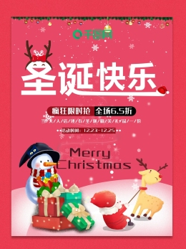
约稿信2参考范文
【“外国文化”栏目介绍节日风俗和中学生生活向美国朋友彼得约稿】
【Writing Sample：Possible Version 5: 】
Dear Peter,
I’d like to ask you to write an article for our school’s English newspaper. The “Foreign Cultures” section provides a nice platform for us students to learn more about foreign cultures. In this section there are a wide variety of English materials available to English learners. And here are some relevant details about the articles we are eager for. To begin with, not only can you write something about the life of American high school students, but also you can focus on the ways you Americans spend your festivals. What’s more, your article can have a title made up by yourself with a vocabulary of 400 or so.
Last but not least, you are supposed to subscribe your article by June 28th. I am looking forward to your reply at your earliest convenience.
Yours,
Li Hua

Slide 32

约稿信2参考范文
【“外国文化”栏目介绍节日风俗和中学生生活向美国朋友彼得约稿】
【Writing Sample：Possible Version 6: 】
Dear Peter,
I’d like to ask you to write an article for our school’s English newspaper.
Recently, our school newspaper has started a column “The Foreign Cultures”, designed to introduce American customs and the school life of the students. I believe this is a wonderful opportunity for you to share your own experience. The subjects are about western festivals and customs, and you can also write about the students’ daily life. The article should be limited to 400 words or so. What you should keep in mind is that you have to submit your article before 28th, June.
If you would like to make contributions for our newspaper, please send me your article before the deadline. Looking forward to your reply.
Yours,
Li Hua

Slide 33
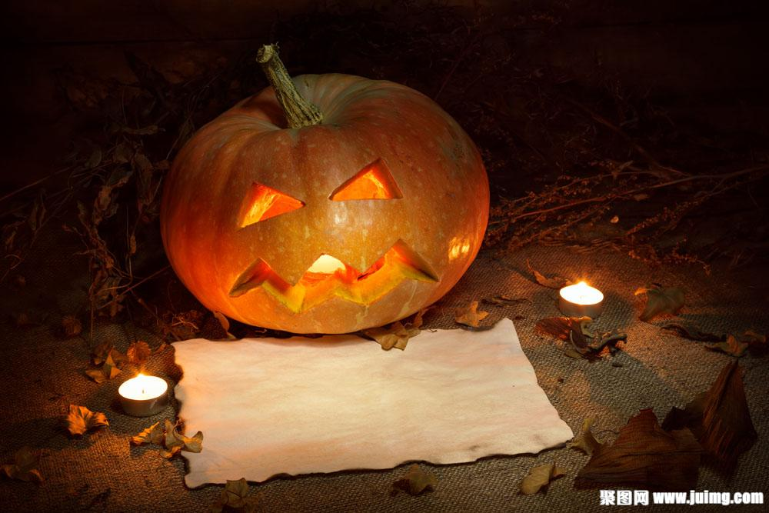
约稿信2参考范文
【“外国文化”栏目介绍节日风俗和中学生生活向美国朋友彼得约稿】
【Writing Sample：Possible Version 7: 】
Dear Peter,
I’d like to ask you to write an article for our school’s English newspaper. The topics of this column are American customs and the life of American high school students.
Here are some requirements. First of all, you talk about American customs and festivals because Chinese students are interested in them. For example, how Americans celebrate Christmas and Thanksgiving Day, what they eat, and what activities they participate in during these festivals. Besides, the life of American high school students is a good choice because Chinese students are curious about the school life of American students. The article you write should contain 400 words or so. The last important thing you should remember is that you have to send the article to me before June 28th.
I hope you enjoy writing for our newspaper. Looking forward to your reply.
Yours,
Li Hua

Slide 34

约稿信2参考范文
【“外国文化”栏目介绍节日风俗和中学生生活向美国朋友彼得约稿】
【Writing Sample：Possible Version 8: 】
Dear Peter,
I’d like to ask you to write an article for our school’s English newspaper.
The new column “Foreign Culture”, aiming to introduce western cultures to the students, needs articles about American holiday customs and the life about high school students.
As far as I’m concerned, as a native speaker, you have no difficulty letting us know about the custom and culture of your country, which helps us broaden our horizons. Just tell us how you celebrate your traditional holidays and what you usually do at school. One thing you should bear in mind is that you should write your article within approximately 400 word and send it to me until June 28th.
Looking forward to your reply.
Yours,
Li Hua

Slide 35


Thank you !

