Slide 1

感恩遇见，相互成就，本课件资料仅供您个人参考、教学使用，严禁自行在网络传播，违者依知识产权法追究法律责任。
更多教学资源请关注
公众号：溯恩高中英语
知识产权声明

Slide 2
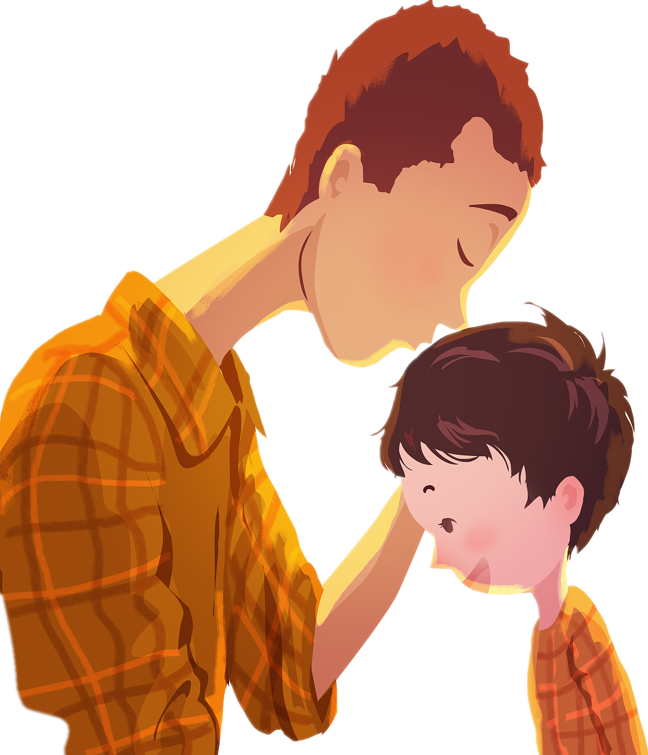

基于协同效应提升表达能力的读后续写讲评
（以2021年6月浙江读后续写“第一次打工赚钱”为例）
My first paycheck
by doing a temporary job
第一次打工赚钱
杭州二中树兰高级中学 郭合英

Slide 3

第88届奥斯卡最佳动画短片提名
奥斯卡最佳动画合集 《桑杰的超级战队》
一部关于父子代沟的电影，文化上的差异和人与人之间的差异，我们都要互相理解！

Slide 4
读后续写原文：
My dad, George, only had an eighth grade education. A quiet man, he didn’t understand my world of school activities. From age 14, he worked. And his dad, Albert, took the money my dad earned and used it to pay family expenses. I didn’t really understand his world either： He was a livestock trucker, and I thought that I would surpass（超过）anything he had accomplished by the time I walked across the stage at high school graduation. Summers in the mid-70s were spent at home shooting baskets, hitting a baseball, or throwing a football, preparing for my future as a quarterback on a football team. In poor weather, I read about sports or practiced my trombone（长号）. The summer before my eighth grade I was one of a group of boys that a neighboring farmer hired to work in his field. He explained our basic task, the tractor fired up and we were off, riding down the field looking for weeds to spray with chemicals. After a short way, the farmer stopped and pointed at a weed which we missed. Then we began again. This happened over and over, but we soon learned to identify different grasses like cockleburs, lamb’s-quarters, foxtails, and the king of weeds, the pretty purple thistle. It was tiring work, but I looked forward to the pay, even though I wasn’t sure how much it would amount to.

Slide 5
At home, my dad said, "A job’s a big step to growing up. I’m glad you will be contributing to the household." My dad’s words made me realize that my earnings might not be mine to do with as I wished. My labors lasted about two weeks, and the farmer said there might be more work, but I wasn’t interested. I decided it was not fair that I had to contribute my money. 注意：
1. 所续写短文的词数应为150左右； 2. 至少使用5个短文中标有下划线的关键词语； 3. 续写部分分为两段，每段的开头语已为你写好； 4. 续写完成后，请用下划线标出你所使用的关键词语。
Paragraph 1: When I brought my paycheck home — it was $119 — my dad wanted to talk to me. _____ Paragraph 2: I was surprised that my dad allowed me to use the money as I wished. ________

Slide 6
1. 文本解读
My dad who only had an eighth grade education was a livestock trucker. He didn’t comprehend my circle of school activities. He worked for money at the age of fourteen.
1 , all his money made by him had to pay family expenses. I 2 (firm) reckoned that I would surpass anything he 3 (complete) by the time I walked across the stage at high school graduation. The summer before my 4 (eight) grade, I 5 (take) on to work as one of jobbers in a neighboring farm. Our task is to look for weeds to spray with chemicals, soon we 6 (learn) to identify different grasses. It was tiring work, but I hankered for the pay, even though I wasn’t sure how much it would amount 7 . However, my father told me to use the money made by me 8 (pay) family expenses. My dad’s words made me realize that my earnings might not be 9 ( me) to do with as I wished. Though the farmer told me there might be more work, I wasn’t ___10____ (interest). I concluded it was unfair that I had to contribute my money.
However
firmly
had completed
eighth
was taken
learning
to
to pay
mine
interested

Slide 7
2 理清脉络
?
my father ,I
and the farmer
how
who
Elements of
the story
at home
and
on the farm
why
where
My father wanted me to contribute the money made by me.
I made use of the holiday to make money on the farm.
when
what
summer holiday

Slide 8
3 What is synergy？什么是协同
所谓协同，就是指所产出的语言与所理解的语言趋于一致，是语言输出向语言输入看齐的一种方式。王初明（2012）
在读后续写中，要扮演好两个身份：原文作者和续文作者。
原文的语篇特征就是后续文章的语篇特征，所以要好以下几方面的协同：
主题协同
冲突协同
语言协同
人设协同
情节协同
情感协同

Slide 9
(1) Thematic synergy 主题协同
读后续写：
My dad, George, only had an eighth grade education. A quiet man, he didn’t understand my world of school activities. From age 14, he worked. And his dad, Albert, took the money my dad earned and used it to pay family expenses.
……
At home, my dad said, "A job’s a big step to growing up. I’m glad you will be contributing to the household." My dad’s words made me realize that my earnings might not be mine to do with as I wished. My labors lasted about two weeks, and the farmer said there might be more work, but I wasn’t interested. I decided it was not fair that I had to contribute my money.
Theme: family responsibility
在续文中，作者要紧紧围绕着该主题进行：体现出“我”已经“长大”，应该承担起自己的责任。

Slide 10
(2) Conflicting synergy 冲突协同
My dad, George, only had an eighth grade education. A quiet man, he didn’t understand my world of school activities. From age 14, he worked. And his dad, Albert, took the money my dad earned and used it to pay family expenses. I didn’t really understand his world either： He was a livestock trucker, and I thought that I would surpass（超过）anything he had accomplished by the time I walked across the stage at high school graduation.
……
At home, my dad said, "A job’s a big step to growing up. I’m glad you will be contributing to the household." My dad’s words made me realize that my earnings might not be mine to do with as I wished. My labors lasted about two weeks, and the farmer said there might be more work, but I wasn’t interested. I decided it was not fair that I had to contribute my money.
secondary contradiction
在续文中要做好这两个矛盾的协同：冲突1：父子俩互相理解；冲突2：儿子愿意拿出这笔钱用作家庭的开销。
principal
contradiction

Slide 11
silent
(3) Public persona synergy 人设协同
My dad, George, only had an eighth grade education. A quiet man, he didn’t understand my world of school activities. From age 14, he worked. And his dad, Albert, took the money my dad earned and used it to pay family expenses.
I didn't really understand his world either: He wan a livestock trucker, and I thought that 1would surpass ( 超过) anything he had accomplished by the time I walked across the stage at high school graduation.
…… After a short way, the farmer stopped and pointed at a weed which we missed. Then we began again. This happened over and over, but we soon learned to identify different grasses like cockleburs, lamb's-quarters, foxtails, and the king of weeds, the pretty purple thistle. It was tiring work , but I looked forward to the pay, even though I wasn't sure how much it would amount to.
At home, my dad said, "A job's a big step to growing up. I'm glad you will be contributing to the household. " My dad's words made me realize that my earnings might not be mine to do with as I wished.
My labors lasted about two weeks, and the farmer said there might be more work , but I wasn't interested. I decided it was not fair that I had to contribute my money.
honest
续文的人设要与原文的人设保持一致
1.在续文中，尽可能把父亲憨厚老实的性格特征体现出来；父亲是个不善言辞的人，续文中父亲的话不要过多的出现，而且不要出现文绉绉的话，否则与父亲憨厚老实的农民身份不符合。
2.儿子的性格是聪明伶俐、自信、倔强又有点不负责任，所以才会出现不理解父亲。按照正能量原则，儿子最终会理解父亲，并愿意上交这笔钱，承担起男子汉养家的责任。续文中最好交代清楚他最初不愿意上交这笔钱的原因，比如他想用这笔钱去买他最爱的长号。
confident
irresponsible
clever
selfish
headstrong

Slide 12
(4) Emotional synergy 情感协同
expected/
hopeful
……
The summer before my eighth grade I was one of a group of boys that a neighboring farmer hired to work in his field. He explained our basic task, the tractor fired up and we were off, riding down the field looking for weeds to spray with chemicals. After a short way, the farmer stopped and pointed at a weed which we missed. Then we began again. This happened over and over, but we soon learned to identify different grasses like cockleburs, lamb's-quarters, foxtails, and the king of weeds, the pretty purple thistle. It was tiring work , but I looked forward to the pay, even though I wasn't sure how much it would amount to.
At home, my dad said, "A job's a big step to growing up. I'm glad you will be contributing to the household. " My dad's words made me realize that my earnings might not be mine to do with as I wished. My labors lasted about two weeks, and the farmer said there might be more work , but I wasn't interested. I decided it was not fair that I had to contribute my money.
通过分析可以知道，小男孩的情感非常丰富，所以续文中也要把小男孩丰富的情感淋漓尽致地表达出来，做到情节和情感两条线同时走,让读后续写的情感丰盈饱满。
小男孩最初的不情愿
受到某件事的触动，让他受到了感动
学会从父亲的角度考虑问题
心甘情愿地拿出这笔钱补贴家用
desired
渴望的
unwilling
disappointed
失望的
moved
downheartd
心灰意冷
nurse a grievance against sb
对某人不满或怨恨
considerate
willing

Slide 13
(5) Plot synergy 情节协同
Paragraph 1: When I brought my paycheck home — it was $119 — my dad wanted to talk to me.
Paragraph 2: I was surprised that my dad allowed me to use the money as I wished.
启下
My feelings? My reaction?
What did my dad say?
What did my father do when he saw my reaction?
Why did my dad allow me to use the money at last?
承上
启下
My feelings? My reaction?
+
What did I do?
What made me moved and understand my dad?
secondary contradiction
I was willing to contribute the paycheck.
principal contradition
Sublimate the subject (升华主题)
Theme + positive energy

Slide 14
(6) Language Synergy 语言协同
同位语
定语从句
My dad, George, only had an eighth grade education. A quiet man, he didn't understand my world of school activities. From age 14, he worked. And his dad, Albert, took the money my dad earned and used it to pay family expenses. I didn't really understand his world either: He was a livestock trucker, and I thought that I would surpass ( 超过) anything he had accomplished by the time I walked across the stage at high school graduation. Summers in the mid-70s were spent at home shooting baskets, hitting a baseball, or throwing a football, preparing for my future as a quarterback on a football team. In poor weather, I read about sports or practiced my trombone ( 长号). The summer before my eighth grade I was one of a group of boys that a neighboring farmer hired to work in his field. He explained our basic task, the tractor fired up and we were off, riding down the field looking for weeds to spray with chemicals. After a short way, the farmer stopped and pointed at a weed which we missed. Then we began again. This happened over and over, but we soon learned to identify different grasses like cockleburs, lamb's-quarters, foxtails, and the king of weeds, the pretty purple thistle. It was tiring work , but I looked forward to the pay, even though I wasn't sure how much it would amount to. At home, my dad said, "A job's a big step to growing up. I'm glad you will be contributing to the household. " My dad's words made me realize that my earnings might not be mine to do with as I wished. My labors lasted about two weeks, and the farmer said there might be more work , but I wasn't interested. I decided it was not fair that I had to contribute my money.
语言协同
内容要创造，语言要模仿（王初明）。原文为续文提供了语境，续文是原文的延续，自然要遵循原文的语言风格和特点。所以，续文的语言未必是越高级越好，而是要遵循原文语言的风格和特点，做到语言的协同。
通过分析原文的语言特点，可知原文用到了同位语、定语从句、
宾语从句、非谓语、主语从句及一些好的词汇，句式和句型相对来说还是比较丰富的。续文作者也要遵循这一原则，做到与原文语言的无缝衔接。
非谓语
本篇用到的高频词
宾语从句
it 形主
that 真主

Slide 15
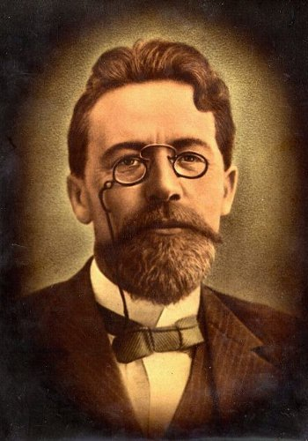
To show, not to tell – 增加写作代入感的最强法则
Language Synergy 语言协同
定义
正如契诃夫说的一句话，“不要告诉我月亮闪闪发亮，给我看碎玻璃上闪烁的光。”（Don’t tell me the moon is shining. Show me the glint of light on broken glass.）
这句话的意思就是，当你在陈述一件事情的时候，不要只是说一些结论性的陈述（states），而是给出一些具体化的例子（illustrates）；比起你生硬地说出来的话，让读者自己产生你想要的体会，才是更为高级的写作技巧。
例子
Showing: As his mother switched off the light and left the room, Michael tensed. He huddled under the covers, gripped the sheets, and held his breath as the wind brushed past the curtain.
Telling: Michael was terribly afraid of the dark.
在这个例子中，我们不仅仅是说出Michael很怕黑，我们说出了他怕黑的一个实际场景。读者能够从这段话中推导出同样的结论，但是整段话的说服力更强。
总的来说，showing能够将读者带入你的故事中，它不仅完善了整个故事，而且给读者留下了想象的空间。

Slide 16

useful expressions
生气的表达：
wailing 呜咽
pull a long face 拉长脸
smile wryly at
为……发出苦笑
growled 怒吼道
discolored 面容失色的
fly into a rage 暴跳如雷
fly into a fury 勃然大怒
on the point of exploding
快要气炸了
curl one’s lips 撅起嘴唇
go into a rage 大发脾气
heart-breaking 令人心碎的
storm off 怒气冲冲地走了
a sharp pain of misery 极为难过
make sb. hot under the collar
怒火冲天/ 勃然大怒
I felt the loss deeply.
我非常难过。

Slide 17

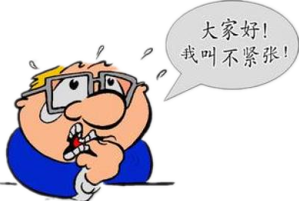
useful expressions
高兴的表达：
紧张的表达：
A cackle escaped my throat.
我不禁咯咯地笑了。
make a chuckling noise 轻声地笑
grin from ear to ear 笑得合不拢嘴
lift me up 让我高兴
sigh with relief 舒了一口气
set my heart racing 使某人心跳不已
restless 坐立不安
pace up and down 走来走去
gulp nervously 紧张地吸了一口气
break out in a sweat 突然出了一身汗

Slide 18
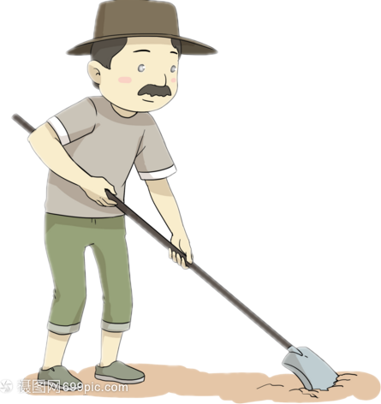
useful expressions
形容人的：
a nut-brown man 一个褐棕色皮肤的人
a plain man 一个朴实的人
an honest sort 一个老实人
a plain-speaking man 一个有话直说的人
a sharp-looking man 看起来很严肃的人
a poor old wreck 一个又穷又老的废物
get off his knees 站了起来
raising himself on his elbow 用手肘支起身体
puffing on his pipe 吸着他的烟斗
grim-faced 面目狰狞的
bloodshot eyes and swollen lips
眼睛充血，眼睛肿胀
lose one’sfooting 失去平衡
stopp in his tracks 停住了脚步
hobble 一瘸一拐地走
ambling 步履蹒跚的
stumped off 步履沉重地走开了

Slide 19
useful expressions
备用词汇：
loom up ahead of me 浮现在我眼前
at the idea of 一想到
gawp at 直愣愣地看着
look at me with hope in his eyes
充满希望地看着我
for all we were worth 拼命，竭尽全力
waste money terribly 大肆挥霍
my courage sank 我渐渐失去了勇气
ring in my ears 在我耳边回想
set foot in my house 踏进我的房间
pluck up courage 鼓起勇气
to one’s dismay 使某人惊讶的是
Inside his head thoughts raged like a storm.
种种念头令他的脑海风起云涌。
speak our minds freely to each other
彼此畅所欲言
pangs of conscience 良心的折磨
a shred of guilt 一丝负疚
His mind was riddled with guilt.
他的心中充满了内疚。
be beside oneself 情绪失控
come to think of it 想起来了
Eg. Come to think of it, that's smart advice even for job hunters who aren't lawyers.
想想看吧，这确实是一条非常明智的建议，即便是对于不做律师的求职者来说，也同样有用。

Slide 20
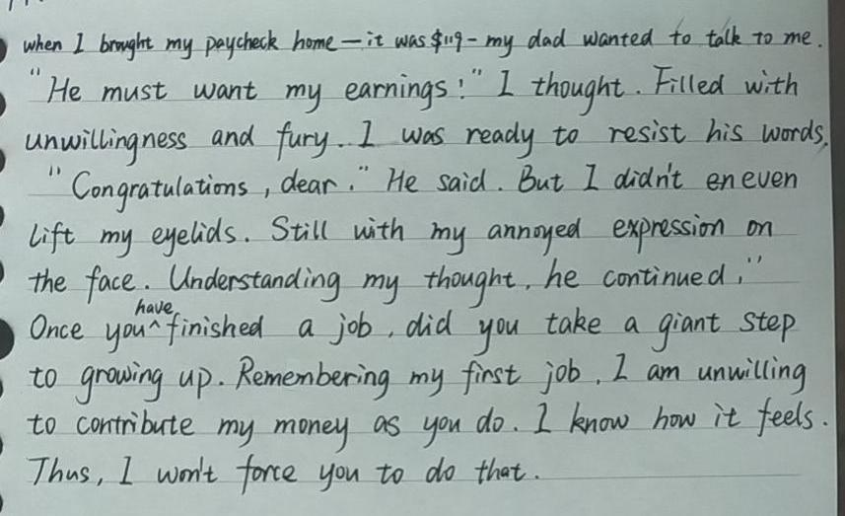
Students’ composition analysis
范文分析
优点：
1. 该生用到了3个非谓语，1个with的符合结构及原文的一些高频词汇，在语言上做到了语言的协同。
2. 该生衔接比较自然。
用心理活动与给出句衔接，方式独特，比较好
非谓语
with的符合结构
非谓语
原文语言产出，非常好
非谓语

Slide 21
“Students’ composition analysis
此段中父亲的话有点“多”，这与原文中父亲是 “a quiet man”的人设不相符合, 建议把这些话改成语言描述或者心理活动。如：Seeing the everything that I showed, he seemed to read my minds. He sat on the chair as if lost in thought, smoking with the smoke spiraling up and saying nothing. Maybe he refelected on the sence that he had to contribute his first money made by himself, which made him sad. Ultimately, he said with firm, “ I won’t force you to do that.”
范文分析
学生存在的问题：
1.父亲人设不协同。
2. 存在语法错误。
3. 学生忘记画下划线了。
将“.”改为“，”
①与②之间缺少过渡句，让情节显得有点突兀。建议改为“Seeing the everything that I showed, he seemed to read my mind.”
将“Once”改为“Only”
将“am”改为“was”
①
②

Slide 22
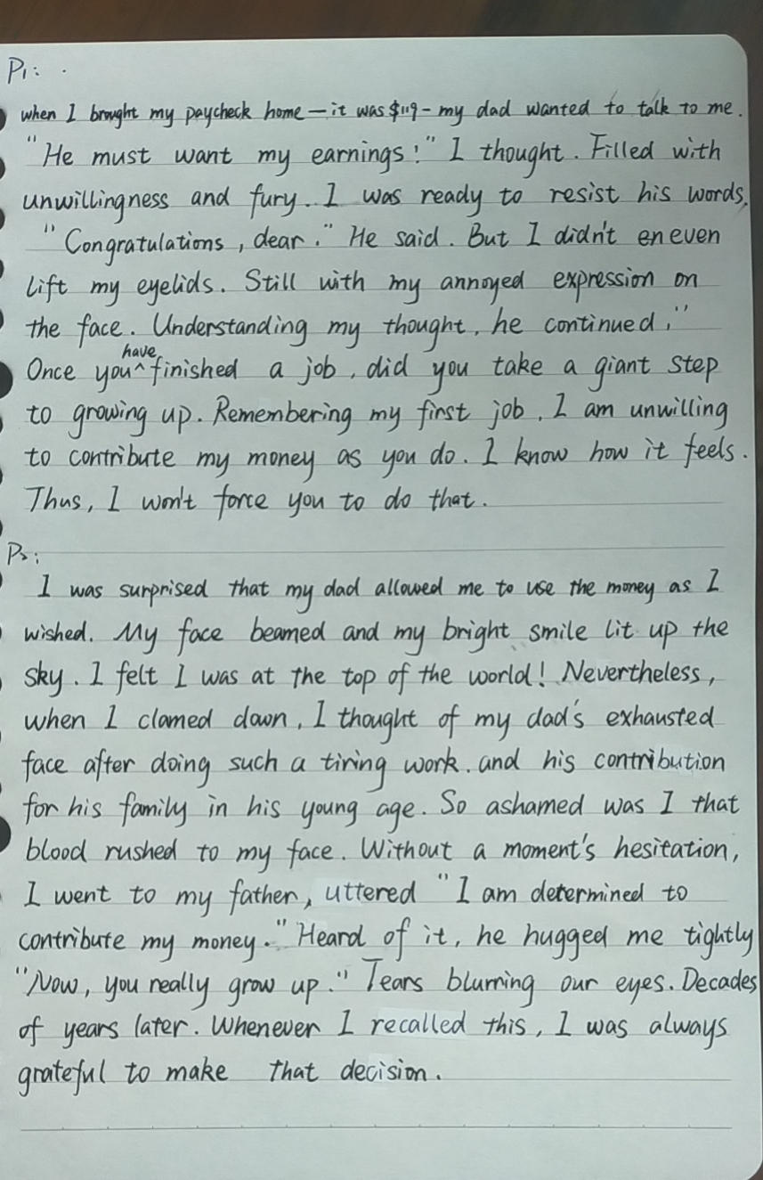
承上启下，衔接自然
上文最后一句话：
从面部表情开始，写出了听到消息后的开心，衔接自然。
范文分析
优点：1.句式丰富，在语言上做到了语言的协同。2. 解决了两个矛盾。
3. 有心理活动描写。
4. 回忆式结尾，升华主题。
缺点：语言缺少鲜活性。有语法错误。
地道语言
心理活动
将“uttered”改为“uttering”
倒装句
将“Heard”改为“Hearing”
解决主要矛盾
将“blurring”改为“blurred”
解决次要矛盾
回忆式结尾，升华主题

Slide 23
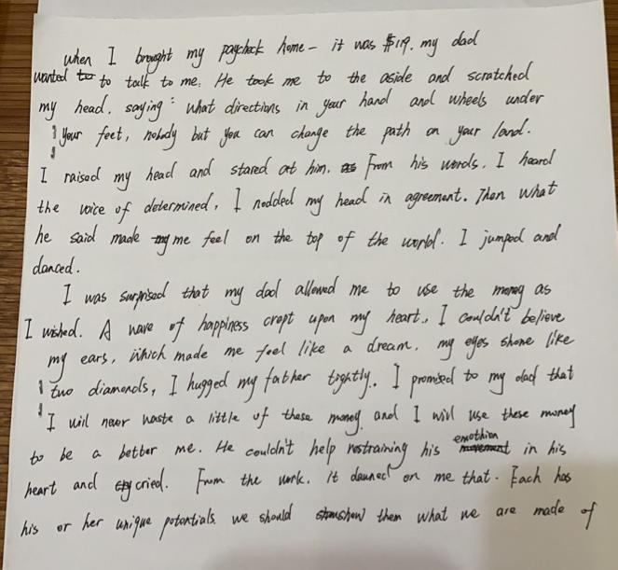
Students’ composition analysis
人设协同失误：原文：My dad, George, only had an eighth grade education. A quiet man, he didn’t understand my world of school activities. 从这里知道父亲文化不高，而且不善言辞，这里父亲说的话与原文人设不符。
衔接比较自然
情感协同失误：上文兴高采烈，开心的手舞足蹈，这与下文给出句“I was surprised”不符合，中间缺少情节铺垫，给读者“出戏”的感觉。
情节协同失误：从父亲说的话里，我们看不出他同意儿子用这笔钱。这与原文“my dad allowed me to use the money as I wished”出现情节协同失误。
给出句与续写句的衔接比较自然
矛盾协同失误：主要矛盾的解决体现了儿子的“selfish”, 这不符合正能量原则。
次要矛盾协同失误：父亲压抑着自己的情感，父子俩没有互相理解，让儿子的“自私”升级，这也没有体现正能量。
主题协同失误：学生的升华偏离原文主题，导致风马牛不相及的情况。

Slide 24
adj. 最不愿意的
v. (心脏等的)跳动
a possible version： 原创
adj. 老的；苍老的
When I brought my paycheck home--it was$119--my dad wanted to talk to me. It was the last thing that I wanted to talk. with my heart pounding just like a deer, I had intended to slip back to my bedroom tiptoeing, when an aged voice set my heart racing, “Congratulations to you on the paycheck”, which made me thrown into a dark world and sank into hopelessness. The thought that I had been yearning for future trombone loomed up ahead of me again, tears beginning to blur my vision. Reluctantly, I moved inch by inch towards him ,curling my lips. Father gawped at me, lost in thought. So quiet was he that he said nothing. Maybe his first money rang a bell. Like a bolt out of the blue, he blurted out, “You can use the money as you wish, my son! ” With the words, he stumped off.
I was surprised that my dad allowed me to use the money as I wished. In a flash, my depression gave way to well-being. I grinned from ear to ear as if floating on the air. I determined to buy a new trombone without delay. However, when I looked out, gazing at my father’s receding figure with his legs hobbling, moving from side to side like a duck, a shred of guilt crept upon on me. My father worked his fingers to the bones to support the family, I shouldn’t have been so selfish. Moved by his figure, I rushed out and hugged him tightly, sobbing, “Dad, I am willing to contribute my money. I’ve grown up. I’ll share the family expenses with you.” Hearing this, my father smiled with tears in his eyes. From then on, we spoke our minds freely to each other.
vi.隐约呈现；赫然耸现.
v. 渴望
v. 模糊
vt.弄卷;使弯曲
(俚语)（某事物）听起来耳熟
v.呆望
v. 脱口而出
vi.脚步沉重地走；步履艰难地走
vi.跛行；一瘸一拐地走;蹒跚前行；艰难前行;
v. 露齿而笑
vi.停止生长;秃顶； 向远处延伸
n. 少量；些许;

Slide 25
with的复合结构
a possible version： 原创
定语从句
When I brought my paycheck home--it was$119--my dad wanted to talk to me. It was the last thing that I wanted to talk. with my heart pounding just like a deer, I had intended to slip back to my bedroom tiptoeing, when an aged voice set my heart racing, “Congratulations to you on the paycheck”, which made me thrown into a dark world and sank into hopelessness. The thought that I had been yearning for future trombone loomed up ahead of me again, tears beginning to blur my vision. Reluctantly, I moved inch by inch towards him ,curling my lips. Father gawped at me, lost in thought. So quiet was he that he said nothing. Maybe his first money rang a bell. Like a bolt out of the blue, he blurted out, “You can use the money as you wish, my son! ” With the words, he stumped off.
I was surprised that my dad allowed me to use the money as I wished. In a flash, my depression gave way to well-being. I grinned from ear to ear as if floating on the air. I determined to buy a new trombone without delay. However, when I looked out, gazing at my father’s receding figure with his legs hobbling, moving from side to side like a duck, a shred of guilt crept upon on me. My father worked his fingers to the bones to support the family, I shouldn’t have been so selfish. Moved by his figure, I rushed out and hugged him tightly, sobbing, “Dad, I am willing to contribute my money. I’ve grown up. I’ll share the family expenses with you.” Hearing this, my father smiled with tears in his eyes. From then on, we spoke our minds freely to each other.
独立主格结构
非谓语
地道俚语
倒装
修辞表达
无灵表达

Slide 26
a possible version： 原创
nervous
When I brought my paycheck home--it was$119--my dad wanted to talk to me. It was the last thing that I wanted to talk. with my heart pounding just like a deer, I had intended to slip back to my bedroom tiptoeing, when an aged voice set my heart racing, “Congratulations to you on the paycheck”, which made me thrown into a dark world and sank into hopelessness. The thought that I had been yearning for future trombone loomed up ahead of me again, tears beginning to blur my vision. Reluctantly, I moved inch by inch towards him ,curling my lips. Father gawped at me, lost in thought. So quiet was he that he said nothing. Maybe his first money rang a bell. Like a bolt out of the blue, he blurted out, “You can use the money as you wish, my son! ” With the words, he stumped off.
I was surprised that my dad allowed me to use the money as I wished. In a flash, my depression gave way to well-being. I grinned from ear to ear as if floating on the air. I determined to buy a new trombone without delay. However, when I looked out, gazing at my father’s receding figure with his legs hobbling, moving from side to side like a duck, a shred of guilt crept upon on me. My father worked his fingers to the bones to support the family, I shouldn’t have been so selfish. Moved by his figure, I rushed out and hugged him tightly, sobbing, “Dad, I am willing to contribute my money. I’ve grown up. I’ll share the family expenses with you.” Hearing this, my father smiled with tears in his eyes. From then on, we spoke our minds freely to each other.
hopeless
grieved
reluctant
silent
thoughtful
surprised
happy
guilty
moved
willing
happy

Slide 27
a possible version： 原创
父亲话不多，而且朴实无华，符合父亲的人设。
（性格quiet, 身份livestock trucker）
When I brought my paycheck home--it was$119--my dad wanted to talk to me. It was the last thing that I wanted to talk. with my heart pounding just like a deer, I had intended to slip back to my bedroom tiptoeing, when an aged voice set my heart racing, “Congratulations to you on the paycheck”, which made me thrown into a dark world and sank into hopelessness. The thought that I had been yearning for future trombone loomed up ahead of me again, tears beginning to blur my vision. Reluctantly, I moved inch by inch towards him ,curling my lips. Father gawped at me, lost in thought. So quiet was he that he said nothing. Maybe his first money rang a bell. Like a bolt out of the blue, he blurted out, “You can use the money as you wish, my son! ” With the words, he stumped off.
I was surprised that my dad allowed me to use the money as I wished. In a flash, my depression gave way to well-being. I grinned from ear to ear as if floating on the air. I determined to buy a new trombone without delay. However, when I looked out, gazing at my father’s receding figure with his legs hobbling, moving from side to side like a duck, a shred of guilt crept upon on me. My father worked his fingers to the bones to support the family, I shouldn’t have been so selfish. Moved by his figure, I rushed out and hugged him tightly, sobbing, “Dad, I am willing to contribute my money. I’ve grown up. I’ll share the family expenses with you.” Hearing this, my father smiled with tears in his eyes. From then on, we spoke our minds freely to each other.
主要矛盾的解决（是否愿意上交这笔薪水），又是主题的协同及升华（作为家中的“男子汉”应该承担起相应的责任。）
衔接自然
次要矛盾：父子俩“冰释前嫌”，互相理解

Slide 28
