Slide 1
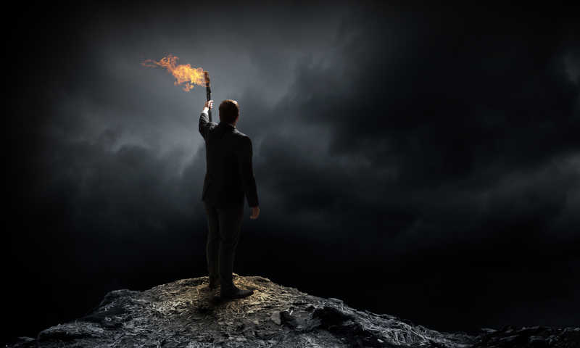
People of Achievement
Unit 1
Using language 1
-- Yu Yue, Shengzhou Senior High School

Slide 2

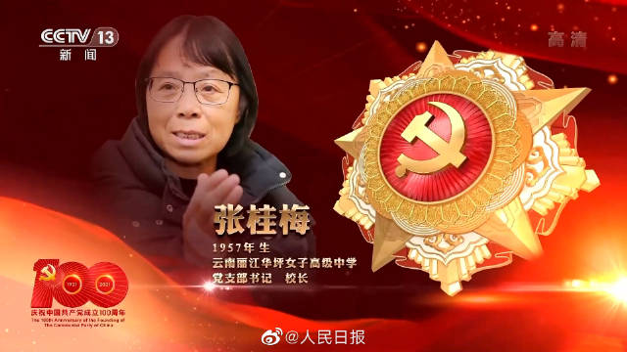
Admire the people of achievements
Who is she?
How much do you know about her?
She is _________________, the Party branch secretary and principal of Huaping Senior High School for Girls in Lijiang, Yunnan.
She started ___________________with ________or admission requirements.
On July 1, 2021, she was awarded ____________________
for her great achievements.
Zhang Guimei
a girls-only school
no fee
the July 1st Medal

Slide 3
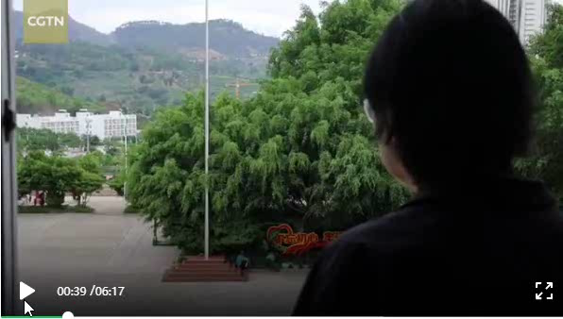
What did she do?
Why was she awarded the July 1st Medal？

Slide 4
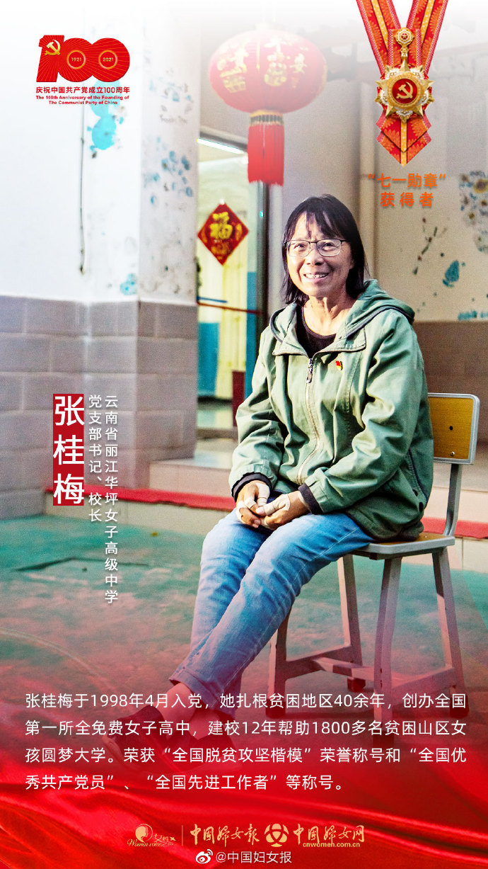
What did she do?
Why was she awarded the July 1st Medal？
Zhang started a girls-only school with no fee or admission requirements to removes many obstacles to their education as possible.
Even though penniless and childless, she still worked hard to educate students to be responsive, focused and persistent. Thanks to her efforts, over the past 13 years, her school has sent 1800 girls to university.
She makes positive contributions to the society and enlightens others.

Slide 5
Strongly believing in the power of knowledge, Zhang brought education to poor mountainous areas. What she does is like a torch, lighting up girls' dreams and their way forward.
Besides Zhang Guimei, what other people of achievements do you know?

Slide 6
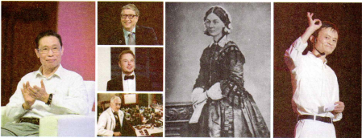
Look at the pictures on P6. Do you know who they are?
Bill Gates
Elon Musk
Florence Nightingale
Zhong Nanshan
Alexander Fleming
Jack Ma

Slide 7

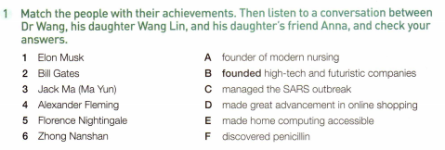
Can you match the people with their achievements? Then listen to the tape to check your answers.
Main idea:
______ speakers are talking about _____ they admire and ____they admire him or her.
Three
who
why

Slide 8

Listen to the conversation. Who does each speaker admire? Tick in the table below.
Name | Dr. Wang | Wang Lin | Anna Smith
Elon Musk
Bill Gates
Jack Ma
Zhong Nanshan
Florence Nightingale
Alexander Fleming
Dr. Wang

Slide 9
Listen carefully and try to fill in the blanks.
language fillers
Dr. Wang:
Well, you two, it’s great that they’ve been able to become so successful and make all that money, but 1. ___________________. Just look at people like Alexander Fleming, who 2.________
penicillin, and Florence Nightingale,3._________________________, and my own 4.___________, Dr Zhong Nanshan, who managed the SARS outbreak– they never made millions of dollars, but their contributions to 5.__________ have saved 6.__________lives.
money isn’t everything
discovered
the founder of modern nursing
personal hero
health care
countless
Q: Why does Dr. Wang say ”money is not everything”?
Because he doesn’t believe that money alone is a true measure of success.

Slide 10
Listen carefully and try to fill in the blanks.
language fillers
Anna Smith:
Yes, exactly! And Dr Wang, I think you 7._______________ just now. I agree with you. I like those people because they 8.__________________to achieve their goals and have positive contributions to 9.______. It’s not just 10.________ how much money they make. Elon Musk, for example, is trying to help 11.____________________, and Bill Gates has given us home computers. I think we need 12.____________ people like them.
misunderstood me
have worked so hard
society
due to
the future of humankind
more creative
Q: What is the real reason Anna admires the famous people, and what examples does she give?
Because they have worked so hard to achieve their goals and have positive contributions to society. She mentions Elon Musk and Jack Ma.

Slide 11


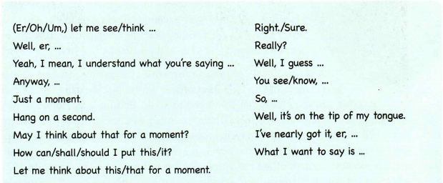

Language fillers
Language fillers refer to some unimportant words used to complete the sentences in order to give yourself time to think while talking.

Slide 12
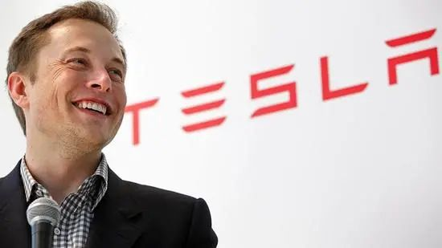

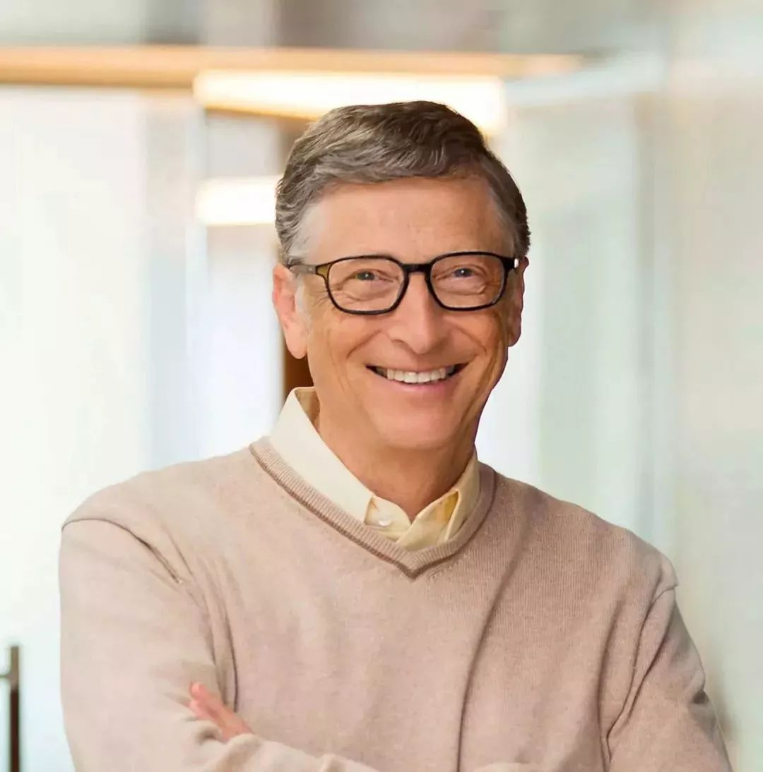
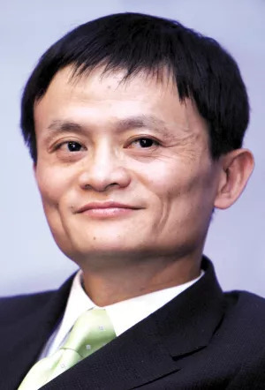
Think further
Do you think Elon Musk, Bill Gates and Jack Ma are successful? Why or why not?
What do you think of the idea that money is not everything?
In your idea, what is the meaning of greatness?

Slide 13
Try to become not a man of success, but try rather to become a man of value.
-- Albert Einstein

Slide 14

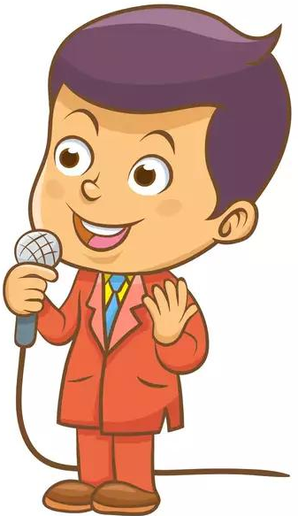
discussion
There is a mini-speech competition titled “the Person I admire”. You should introduce who you admire, what he/she did and your inspiration from him/her.
Your speech should be within 3 minutes.
Use some expressions from what we have learn today.
Try to pronounce clearly and correctly. Attention to being coherent and logical.

Slide 15
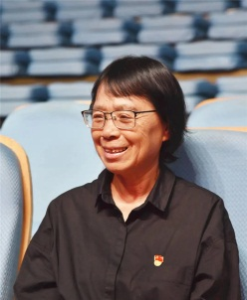
possible version
The Teacher Fighting for Girls’ Education
The person who I admire most is Zhang Guimei, the headmaster of Huaping Senior High School for girls in Yunnan Province. She devoted herself to the fight for girls’ education and enlightened thousands of girls’ dreams and new life.
46 years ago, Zhang was sent to remote area to support education with her husband. In numerous home visits, she saw a lot of girls dropping out of school due to poverty. Zhang was shocked and heart-broken. With the help of government, she started a girls-only school with no fee, because she knew that one educated women could end the inter-generational transmission of poverty and change destinies of generations. Therefore, she determined to create the high school for girls or free to light up the dreams of kids in the poverty stricken areas. Since then, Zhang has been working hard to train and help students, even though sick, penniless and childless. More than 2000 girls are admitted into colleges and delightedly, most of them now are helping others and passing down the kindness.
I admire Zhang Guimei for her deep love to the country, her selfless devotion to her students and her persistence for the education career. As Albert Einstein once said: “Try to become not a man of success, but try rather to become a man of value”, a person should follow the national calls and tries to make contributions to the society. During the process, no matter how hopeless or hard the situation seems, we should insist on doing and never give up.

Slide 16

Thank you!

