Slide 1


感恩遇见，相互成就，本课件资料仅供您个人参考、教学使用，严禁自行在网络传播，违者依知识产权法追究法律责任。
更多教学资源请关注
公众号：溯恩高中英语
知识产权声明

Slide 2

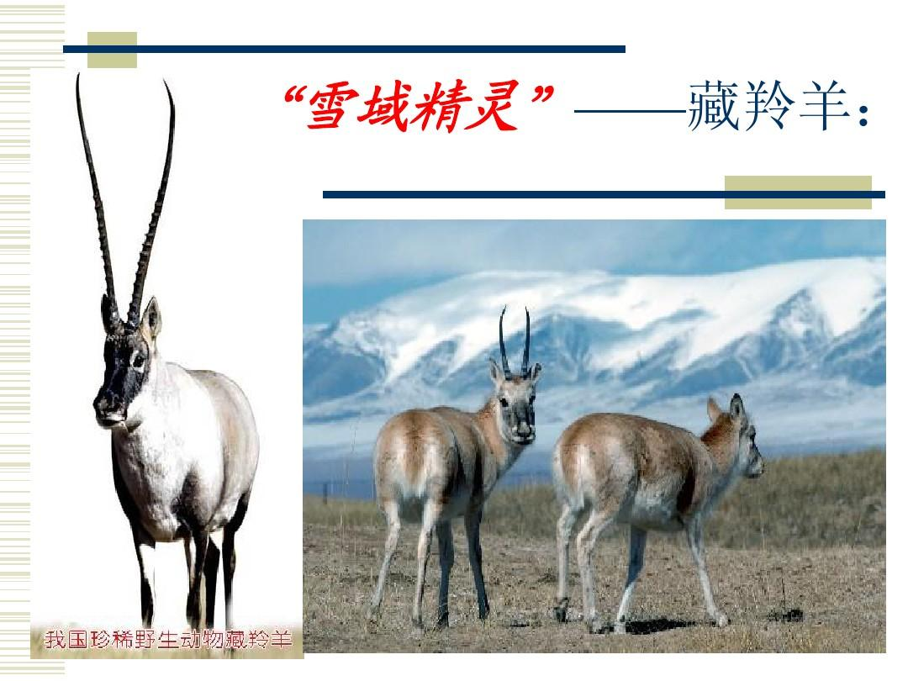
新人教版必修2 Unit 2
wildlife Protection
Reading and Thinking
A day in the clouds
杭州二中许丽君

Slide 3
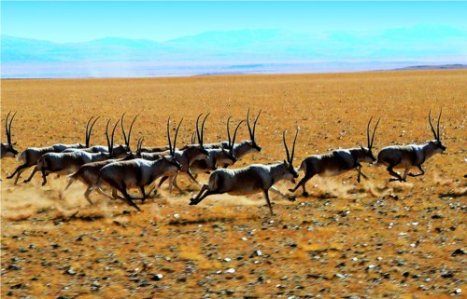
Teaching Objectives
In this class, students will
To read and learn the difficult situations the Tibetan antelope once faced;
To learn about the present situation of the Tibetan antelope；
To know the bad times of the Tibetan antelope and what people have done to protect them from distinction；
To think how we can change our way of life and live in harmony with wildlife;
To identify the literal meaning or implied meaning of some sentences;
To be able to grasp the reading style and the structure.
To be able to write a summary.
1
2
3
4
5
6
7
Notes:
Students will---students are, 或者下面的每一个to 去掉

Slide 4

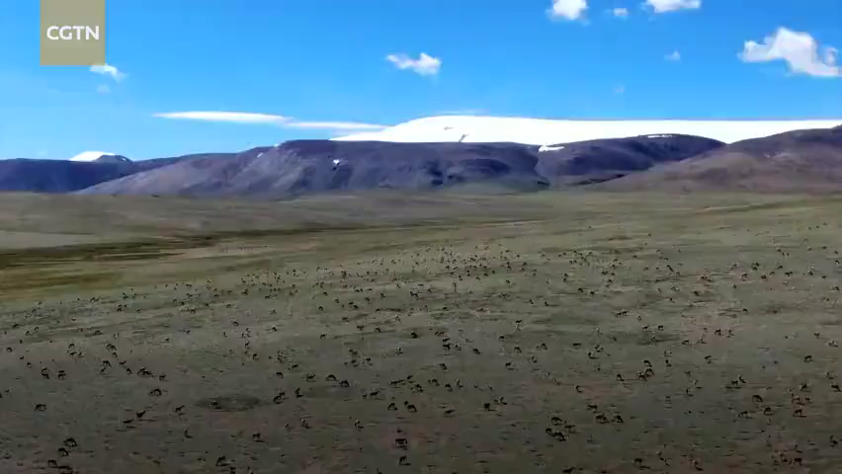
Lead-in：Enjoy a video
Let’s watch a video about Qiangtang National Nature Reserve.

Slide 5
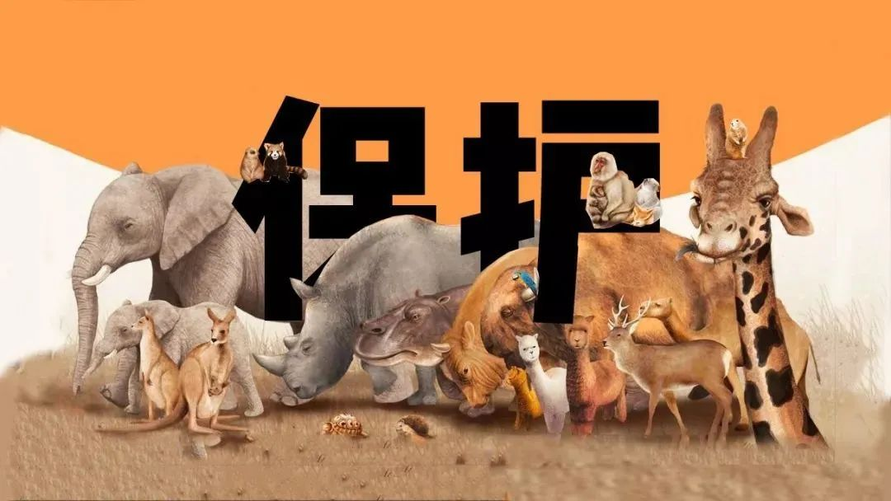
Pre-reading( learning about protecting endangered animals)
本单元的话题
Wildlife Protection
人与自然,人与动植物
拯救濒危动物
濒危动物物种
学会如何关爱野生动物
A Day In The Clouds （云端的日子）
拯救濒危动物的计划和措施
本课介绍了作者观察藏羚羊的经历和羌塘自然保护区， 藏羚羊曾经濒危的事实与原因，政府为保护藏羚羊采取的措施与取得的成就。
现在进行时态的被动语态

Slide 6
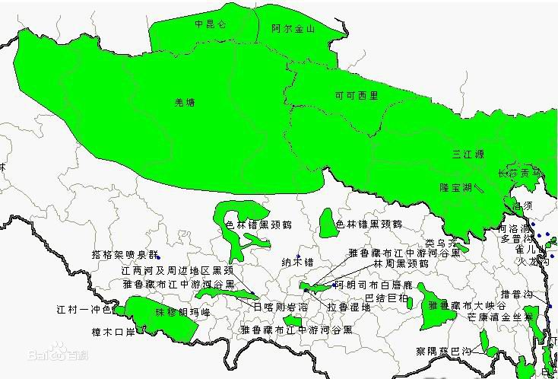
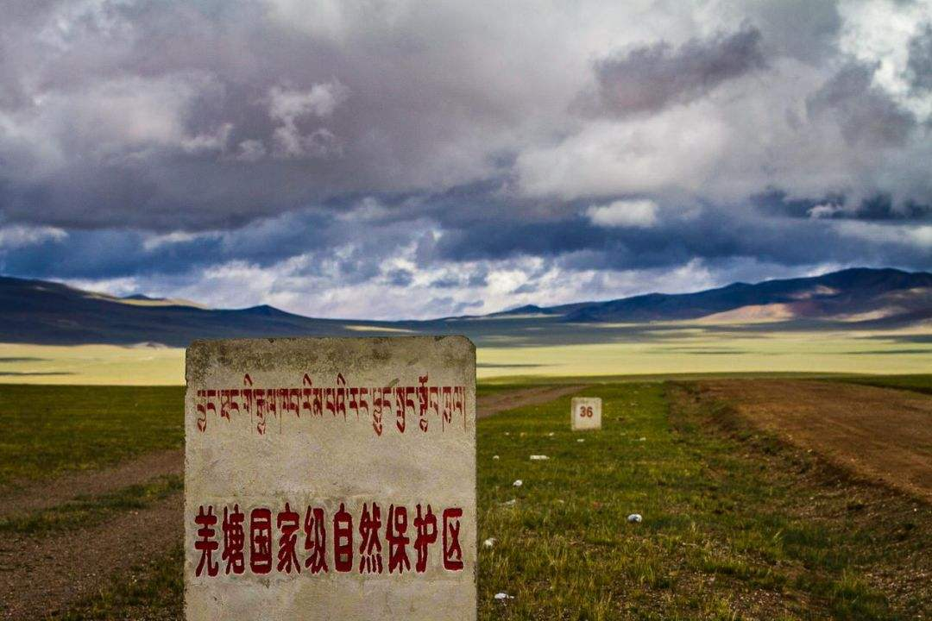
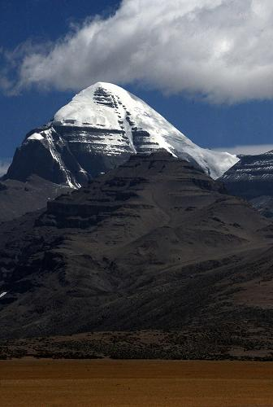
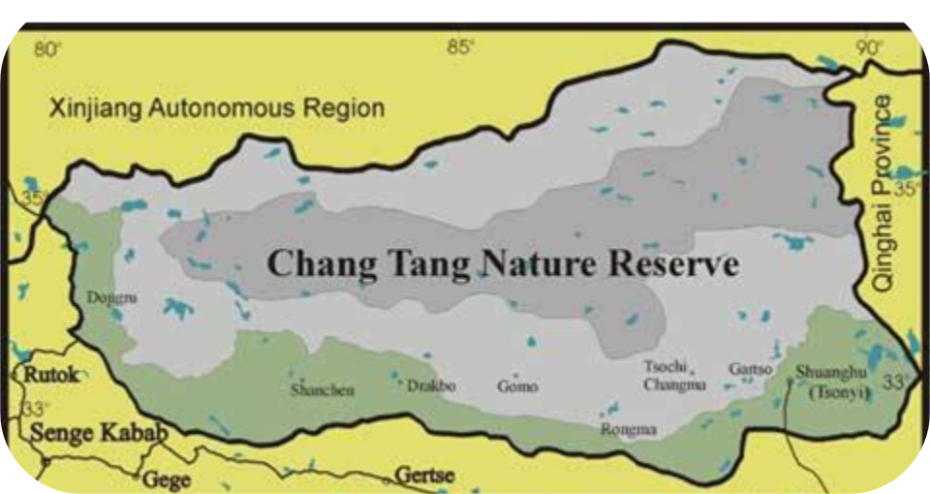
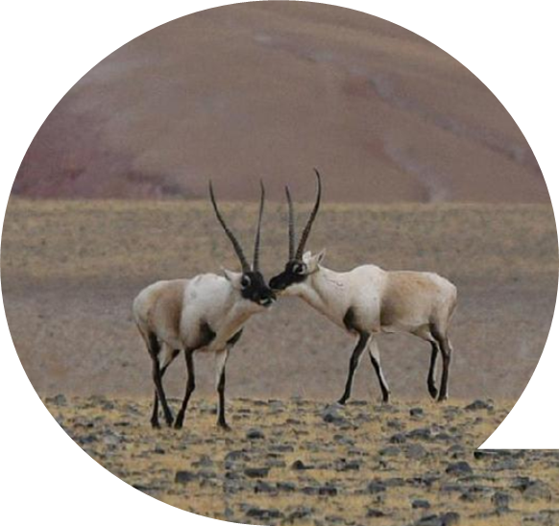
羌塘自然保护区Qiangtang National Nature Reserve
snow-covered mountains
Tibetan antelopes

Slide 7

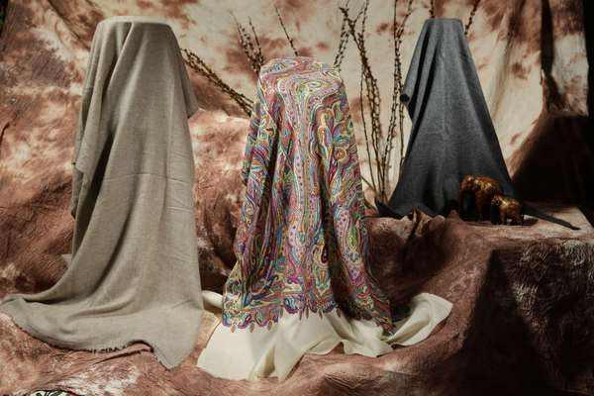

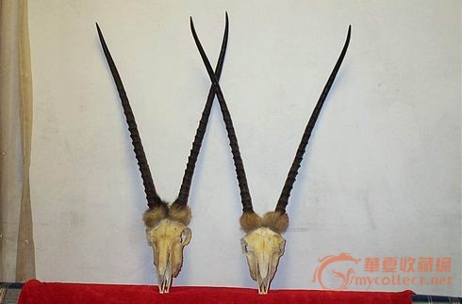
Pre-reading：
The reason for illegal hunting
1. the rapid international demand for Tibetan antelope cashmere shahtoosh in the last decades of 20th century(藏羚羊绒毛织成的披肩)
2. for their meat and horns
沙图什
藏羚羊角

Slide 8
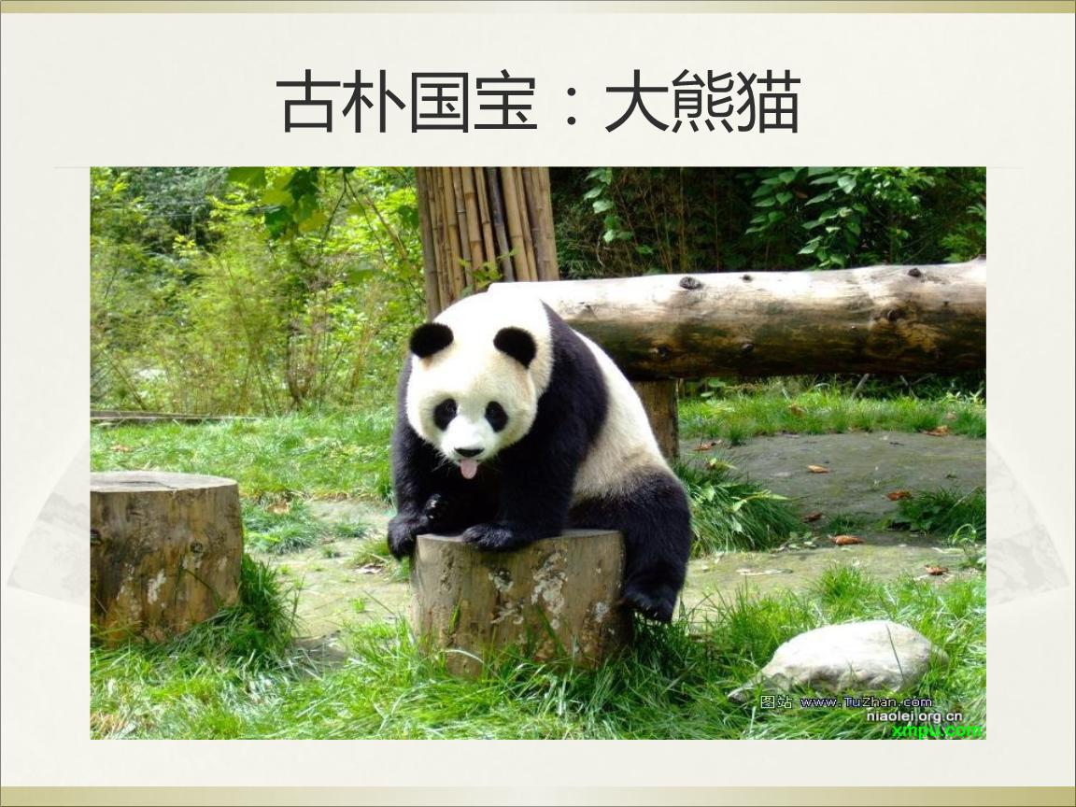
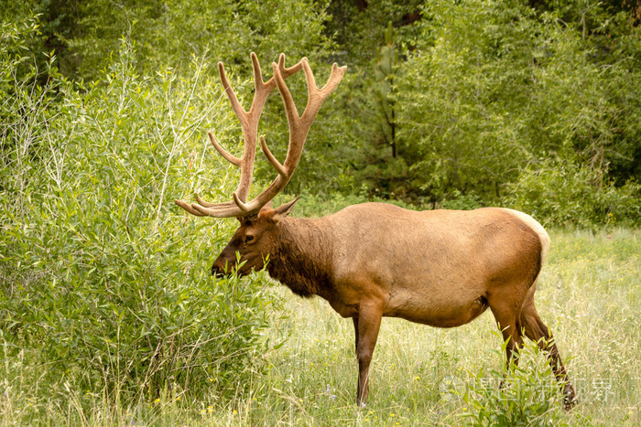
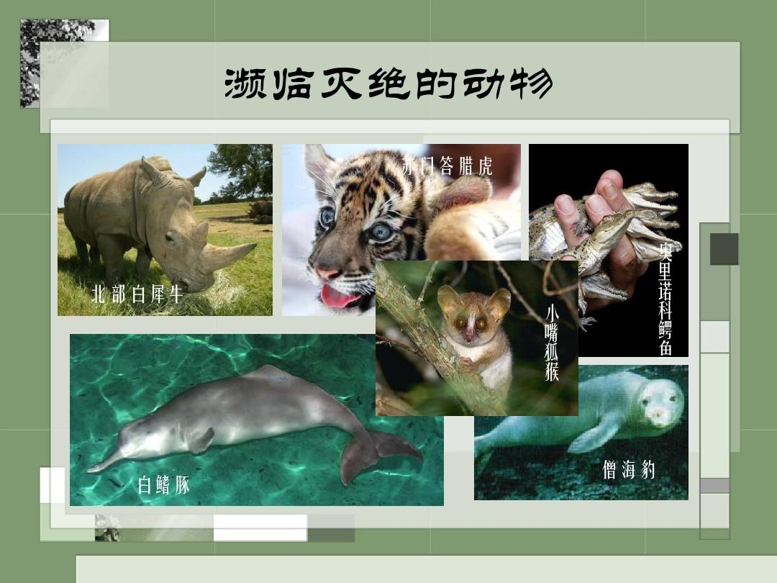
Pre-reading：Brainstorm
Can you name some wildlife and endangered wildlife?
kangaroo
elephant
Milu deer
Panda
shark
Golden monkey
dolphin
Antelope
wildlife
tiger
Endangered wildlife
South China Tiger
koala
yak
African elephants
blue whale
giraffe
rhino
Bactrian camel

Slide 9

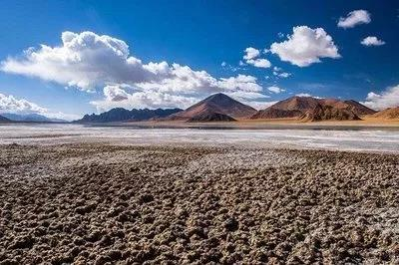

Pre-reading： Predicting the style of the passage
Q: Guess what kind of passage it is.
A. Argumentation
B. Exposition
C. Narration
Read the 1st and last paragraph and find out what type of the text it is.
An introduction
A report
A travel journal
a short novel
advertisement

Slide 10
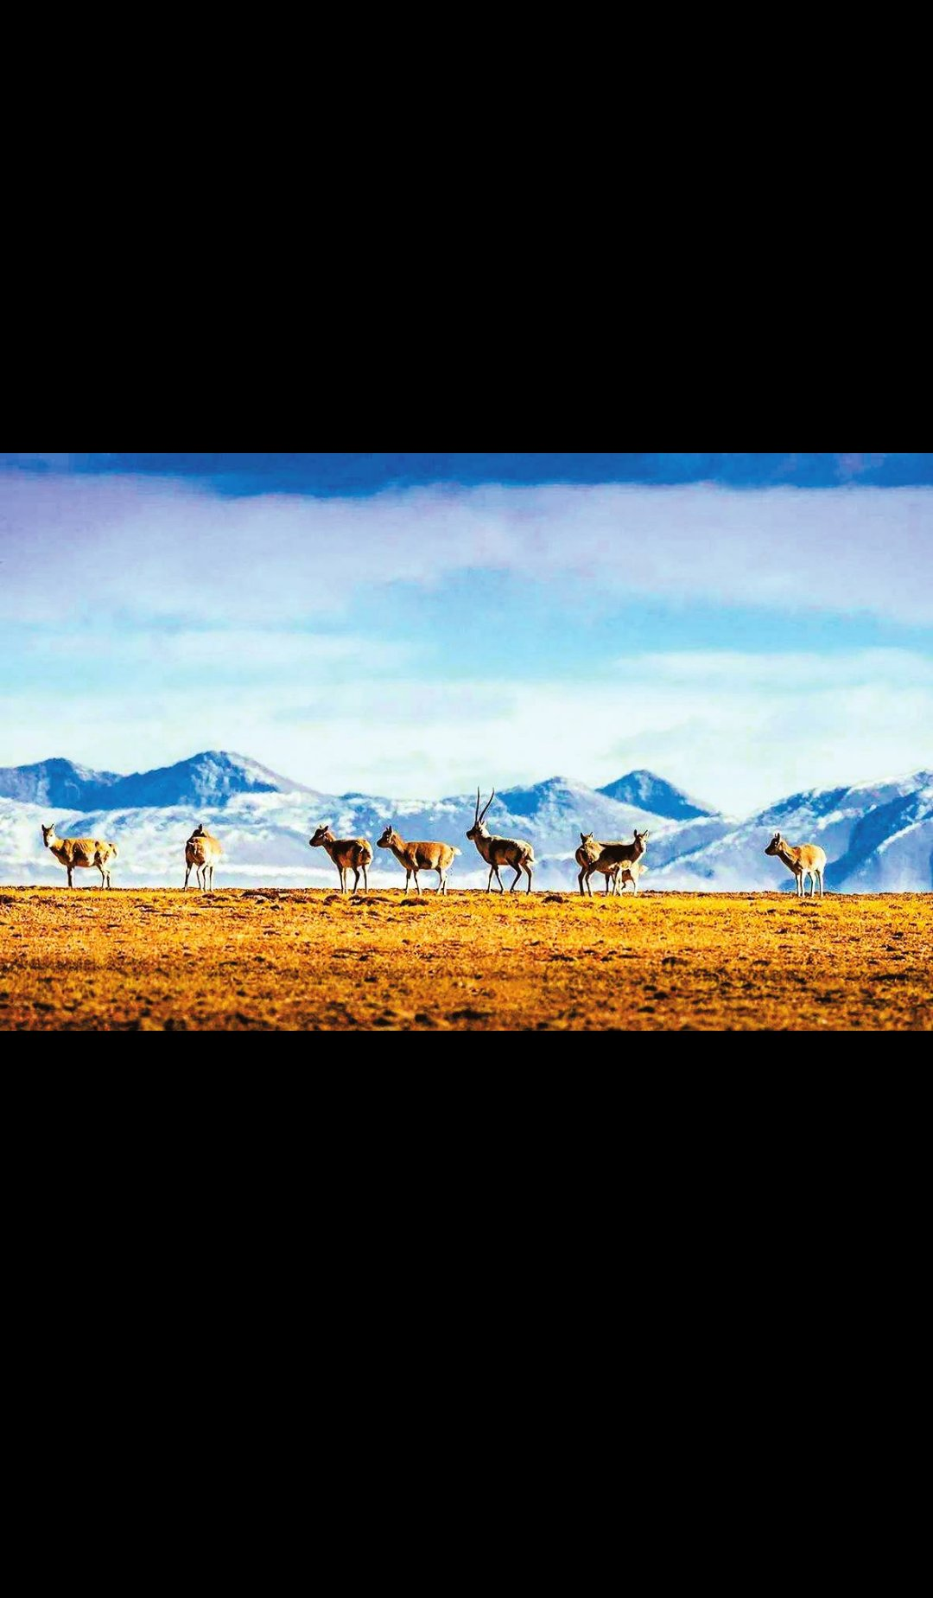

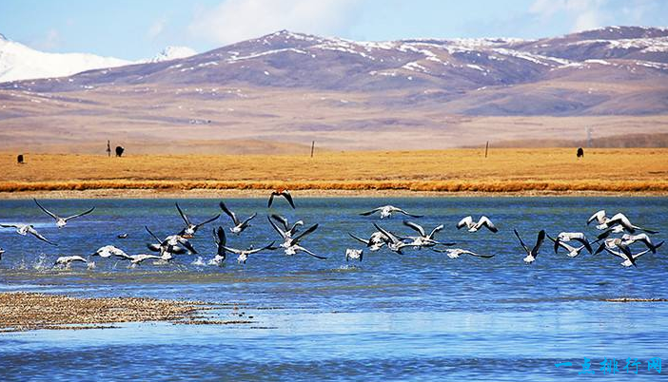
Read the text and get the main idea of the text.
General Idea:
Read for
The text is mainly about Tibetan antelopes and wildlife protection..
Q：What’s the main idea of the passage?
A． The Changtang National Nature Reserve.
B． The protection of Tibetan antelopes.
C． Snow-covered mountains.
D． Some effective measures.

Slide 11
General Idea:
Read for
purpose of going there
To observe Tibetan antelopes
antelopes’ living conditions
in danger, being hunted illegally
saving the animals actually means saving ourselves
guide Zhaxi and his work
key points
antelopes’ bad times
population dropped by human’s destruction
government measures
national protection
results of measures
recovered and removed from the list
thinking more
exist in harmony with nature

Slide 12
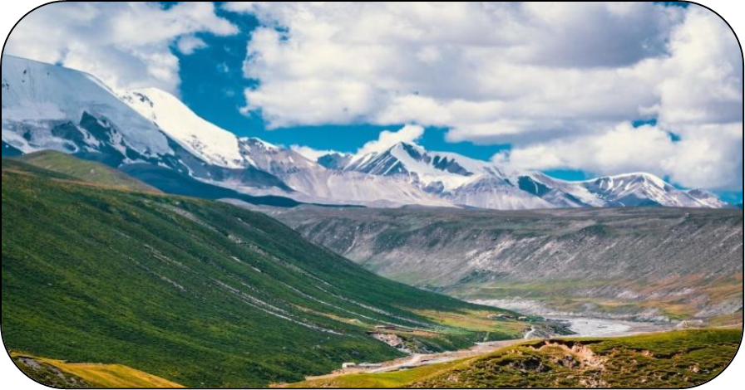
Match the main idea with each paragraph.
Para. 1
Para. 2
Para. 3
Para. 4
Para. 5
Para. 6
Para. 7
A. The bad times for the Tibetan antelope.
B. The guide, Zhaxi, and the Changtang
National Nature Reserve.
C. Measures were taken to save this
species from extinction.
D. We should learn to exist in harmony
with nature.
E. Tibetan antelopes are in danger.
F. The reason why we observe Tibetan
antelopes.
G. The good effects the measures have had.

Slide 13


Fast reading-Read for organization
Para1:Introduction
Para 2:Why-the present problem
A
Para1
Para 3: who-A protector
Para 2
Para 3
Para 4
Para 5
Para 6
Para 4: The bad times
Para 5: How- take protective measures
Para 7
Para 6: Results and effect
Para 7: Refection: More to do

Slide 14
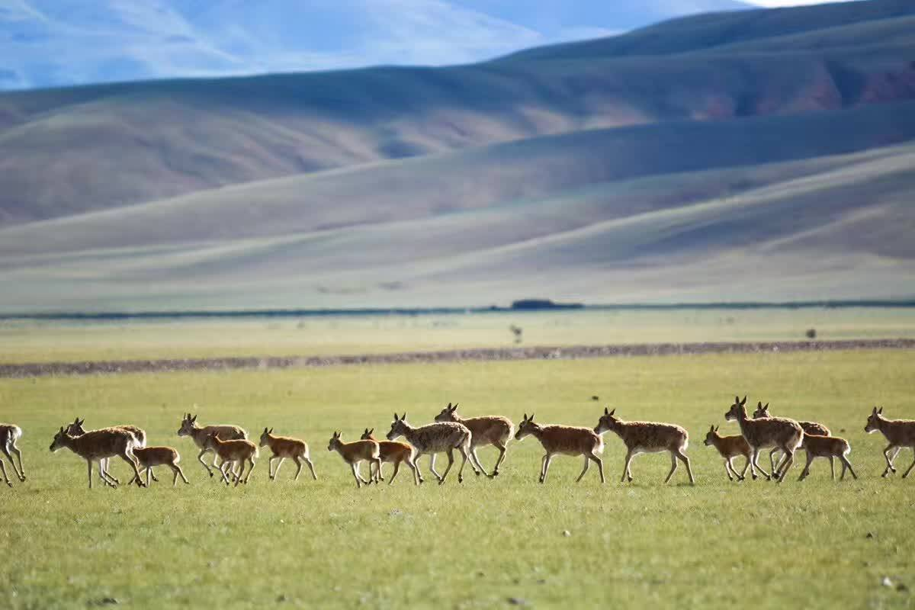
Read for detailed information
Para.4
Q：What happened to the Tibetan antelope in the 1980s and 1990s?
The 1980s and 1990s
population
50%
hard times
habitats
smaller
hunters
Reasons
roads and railways

Slide 15
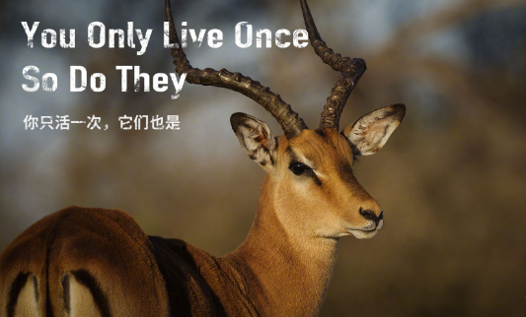
Read for detailed information
Para.4&Para.6
Q1: Do you know how bad their situation was in the 1980s and 1990s?
Q2: What are some other possible causes of the Tibetan antelopes’ bad situation?
Notes:
这里的问题没有回答

Slide 16
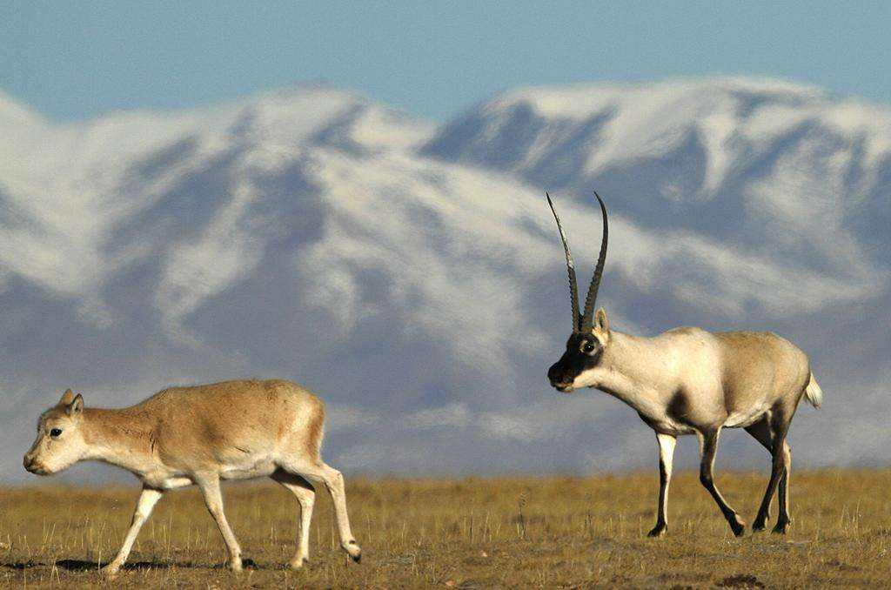
Read for detailed information
Para.2-Para.6
Why | To make profits ---for their valuable fur
Why | Hunters were shooting them to make profits.
What | National protection, added bridges and gates to keep them safe from cars and trains.
Why | Protecting animals is protecting ourselves.
why | Because the threats have not yet disappeared.
Why were Tibetan antelopes hunted?
Why was the population of the antelopes becoming smaller and smaller?
What did the government do to protect the antelopes from extinction?
Why must we protect animals?
Why didn’t the Chinese government stop the protection program after the population has recovered ?

Slide 17
Read for detailed information
Nation joint efforts
What can we do to help protect Tibetan antelopes? (Para3,5,6,7)
Chinese Government
placed it under national protection
Official
participation
Intend to continue to protect the antelopes
works
protects
saves
watched over
The things he does
keep them safe from attack
Zhaxi
The feelings he has
The land is sacred and protecting the wildlife is a way of life.
Individual
participation
The idea he expresses
We are not trying to save the animal. Actually, we're trying to save ourselves.
Human being's
？
change our way of life
Individual’s participation
exist in harmony with nature

Slide 18
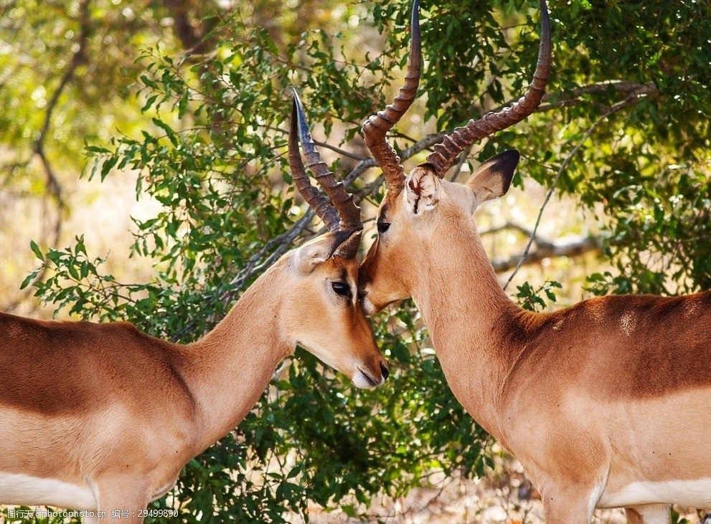
Read for detailed information
Author's Experience
Para.1-Para.7
His experience as a traveller
During the journey
After the journey
feeling
struck by their beauty: happy
reminded of the danger
being hunted illegally: worried
snow-covered mountains
clouds
plain
a herd of graceful animals
move slowly across the green grass
beautiful antelopes
guide (Zhaxi)
seeing
hearing
bad times for the Tibetan antelope
effects achieved after years of protection
thinking
changing our way of life
existing in harmony with nature

Slide 19



Read for detailed information
Para.5-Para.7
What else did the government and the volunteers do to save the antelopes from extinction?
Should we stop our protection of the antelope?
What was the effect?
According to the writer, what should we do?
What did the government do to save them from extinction?

Slide 20
Read for detailed information
Para.1-Para.7
The population dropped greatly and became endangered
The graceful and beautiful Tibetan antelopes
iIlegal hunting
Habitat loss
The government’s efforts
The volunteers’ efforts
We must change our way of life
The antelope population recovered and was removed from the endangered species list
Threats still exist

Slide 21
Read for detailed information
plains
• live on the ______ of Tibet, Xinjiang, and Qinghai
in danger of
• be ____________ being hunted, illegally, for their valuable fur
Tibetan antelopes
Complete the mind map and then retell the text according to it.
problems☹(bad times)
• hunters were shooting antelopes to
___________
• their ______ were becoming smaller
solutions:
1. the Chinese government placed it under _________________
2. Volunteers watched over the antelopes
result:
the measures were ___________
make profits
effective
habitats
national protection
population
• the __________
has recovered
• it was removed from the __________
_____________
endangered species list
harmony
Only when we learn to exist in ____________ with nature can we stop being a threat to _________ and to our _______.
wildlife
planet

Slide 22

Activity-The process and experience of the author’s travel
What I see
snow covered mountains
a herd of graceful animals
What I hear
antelopes are being hunted
What did he experience during the day in the clouds?
What I learn
to protect the wildlife is a way of life
exist in harmony with nature
What I think
✵ I’m struck by their beauty.
the land is sacred
What I reflect
change our way of life
?

Slide 23
Activity -Build an information chain.
Tibetan antelopes’ protection
past
now
We go to observe Tibetan antelopes.
Zhaxi’s description of Tibetan antelopes:
being hunted illegally
The bad times of Tibetan antelopes:
Population dropped, shot…to make profits, smaller habitats
Measures to save Tibetan antelopes: placed…under national protection, watched over…day and night, added bridges and gates
Result of measures/effect:
Population recovered, was removed from the list
The writer’s thinking about wildlife protection

Slide 24


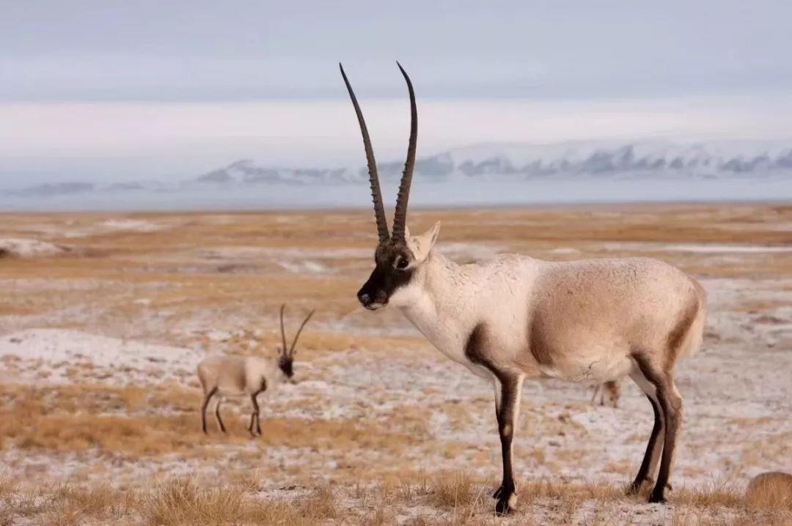
Critical reading: Learn to think critically
Q：But how can we stop being a threat to wildlife?
A: We must change our way of life and learn to exist in harmony with nature.
to observe
present problem
bad times
measures
effect
reflection

Slide 25
Critical reading: Learn to think critically
Read the sentences below, and decide if each idea is the literal meaning [L] of the text or only implied [I] by the text.
EXAMPLE
___ The Tibetan antelope lives high above sea level.
(This is implied by “The air is thin”.)
I
Identify literal and implied meaning
Literal meaning is the usual, basic meaning of the words,
i.e. exactly what the words say.
Implied meaning is suggested but not directly expressed,
i.e. you guess the meaning based on what you know.
1. ___ When they first saw the antelopes, they were very
far away.
2. ___ We should not buy goods made from endangered
animals.
3. ___ Human activities are threatening animals and plants.
4. ___ The Tibetan antelope is not an endangered species
now.
I
I
I
L
Notes:
此处1，2，3的infer的含义也可以像例句里一样给出来

Slide 26
Critical reading: Learn to think critically
reflect
To Zhaxi, the land is sacred and protecting the wildlife is a way of life. “We’re not trying to save the animals,” he says. “Actually, we’re trying to save ourselves.”
What can we infer from the passage?
What is implied in the passage?
Which one is the implied meaning in the passage?
We’re not only trying to save the animals but to save ourselves.
To protect animals is to protect ourselves.
literal meaning
implied meaning
Which one is the implied meaning?
Products made of animal fur were popular.
Zhaxi is one of the volunteers who are protecting the Tibetan antelopes.
implied meaning
literal meaning

Slide 27

Discussion
Protecting the nature is protecting ourselves.
Q : What can we human beings and individuals do to protect wildlife?
Don’t buy goods made from wild animals;
Don’t destroy their habitats;
Spread the news about the illegal hunting and protection of wildlife.
We human beings and
individuals can do to protect wildlife
Raise our awareness of protecting wildlife.
Report any illegal hunting or trading the wildlife.
Join a volunteer protection group.

Slide 28
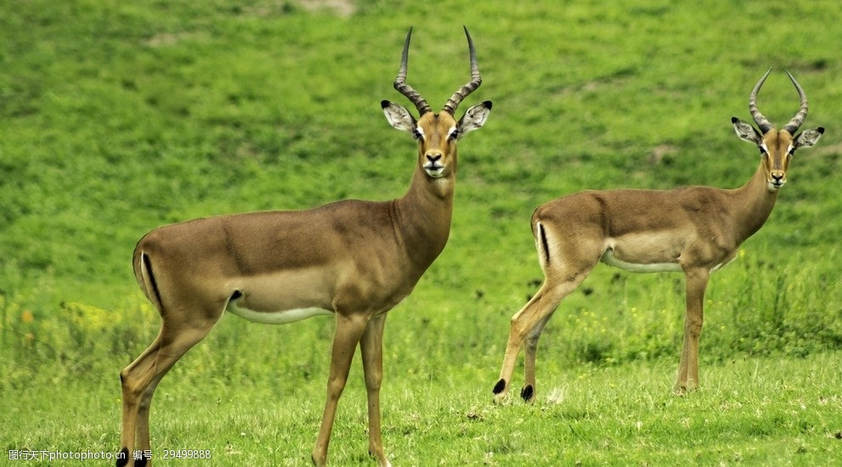

Discussion
Protecting the nature is protecting ourselves.
Q: What do you think we should do to change our way of life to protect the endangered animals and live in harmony with nature?
A: Stop buying goods made from endangered animals because when the buying stops, the killing can too.
Do remember :
Together, individuals can make a big difference. So all of us, take action now from ourselves! We can do it!
To protect the endangered animals is to protect ourselves!
To save wildlife and our planet is to save ourselves!
Notes:
和上一张几乎是重叠的吧？

Slide 29
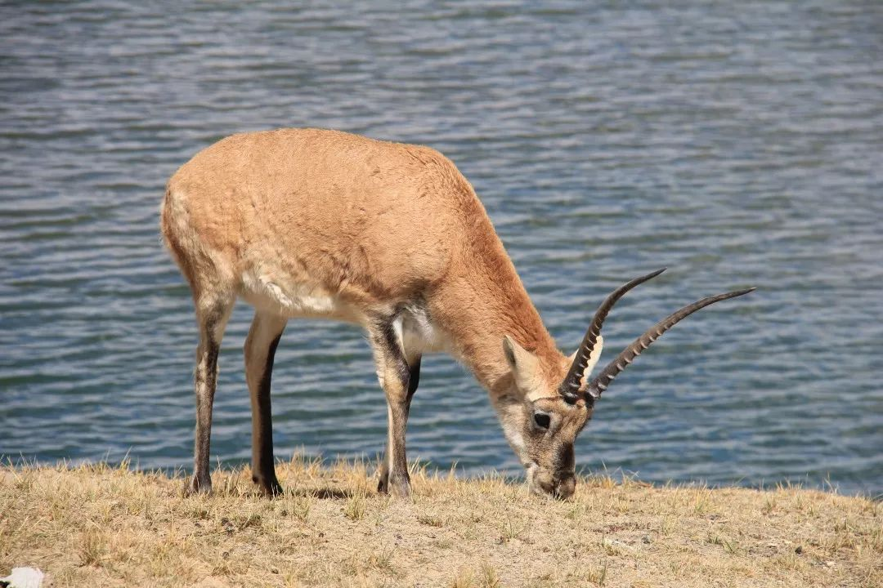
Summary---The thinking mode of the article
the subject/topic
reason
problem
result
reflection
solution

Slide 30
Summary - Review the text with the help of the Mind map
Tibetan antelopes live on the plains of Tibet, Xinjiang, and Qinhai.
We make out graceful animals.
They have valuable fur.
Hunters were shooting them to make profits.
Their habitats were becoming smaller.
Why
What
Protecting the Tibetan Antelope
How
More to do
If we really want to save the planet, we must change our way of life.
We stop being a threat and learn to exist in harmony with nature.
The Chinese government placed it under national protection.
Volunteers watched over them day and night.
Bridges and gates were added to let them move easily and safely.
Results
The antelope population has recovered.
In June 2015, they were removed from the endangered species list.

Slide 31



Assignment：
1. Polish your summary and add it to your notes. “
2. Try to practice the skills about summary writing after class.
3. Make a poster about the Tibetan antelopes and add it to English Corner.

Slide 32
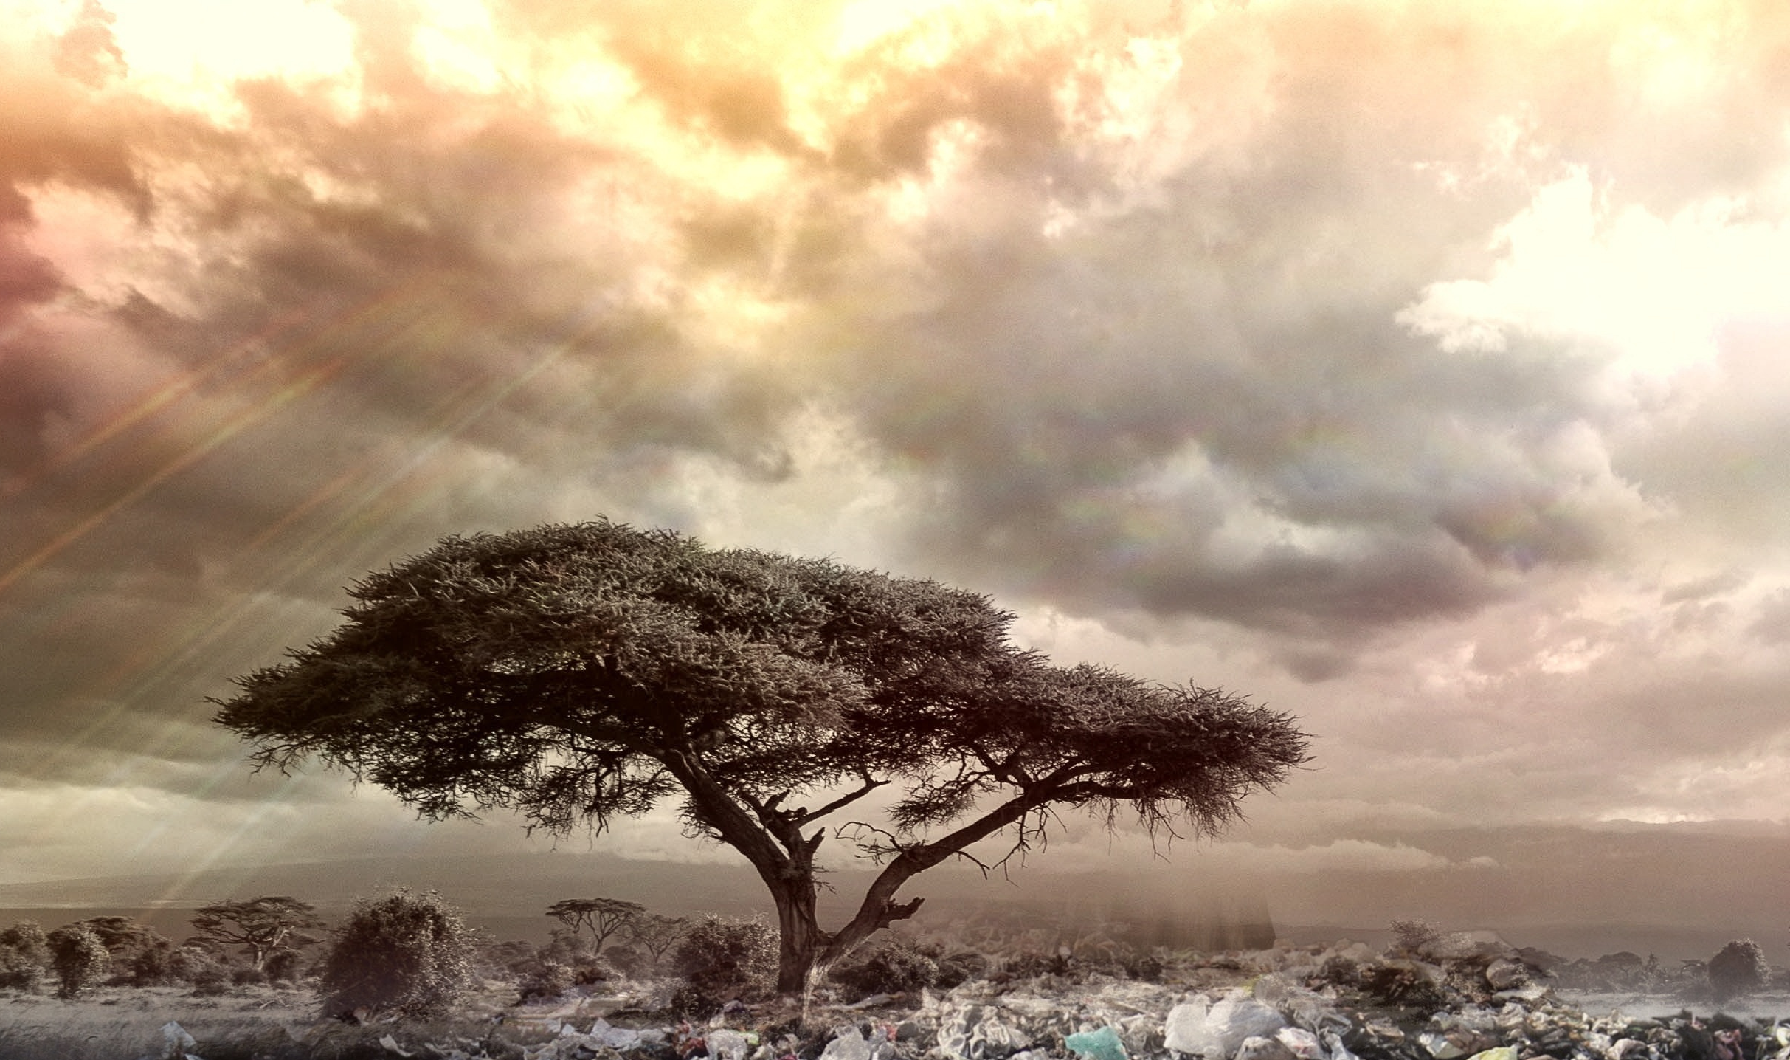
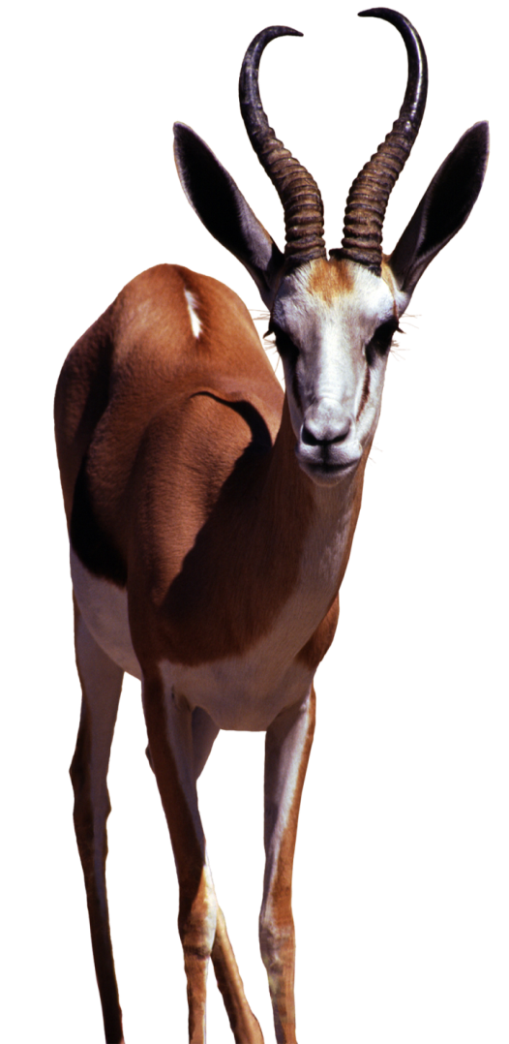

Thanks for your attention!

