Slide 1

感恩遇见，相互成就，本课件资料仅供您个人参考、教学使用，严禁自行在网络传播，违者依知识产权法追究法律责任。
更多教学资源请关注
公众号：溯恩高中英语
知识产权声明

Slide 2
选择性必修一Unit 1
People of Achievement
Using Language:
Introduce someone you admire
嵊州市高级中学 尹 娟

Slide 3
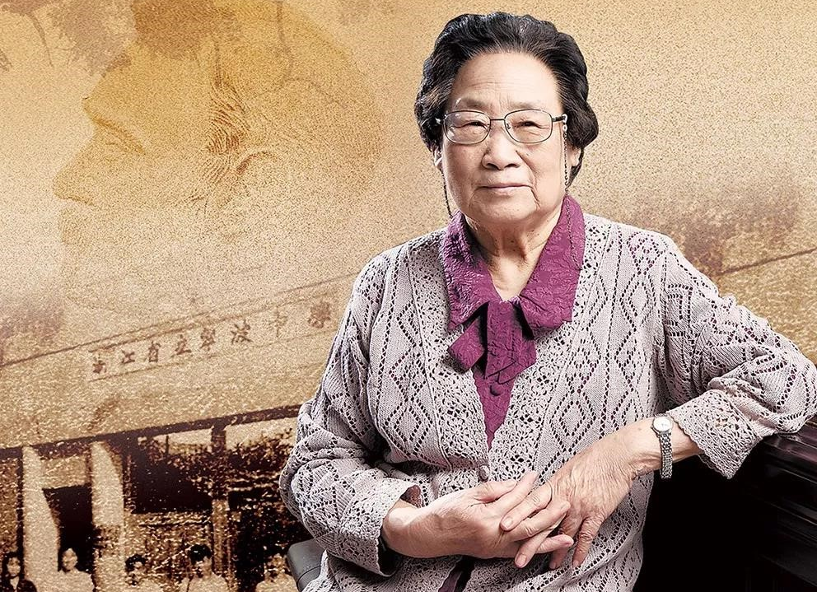
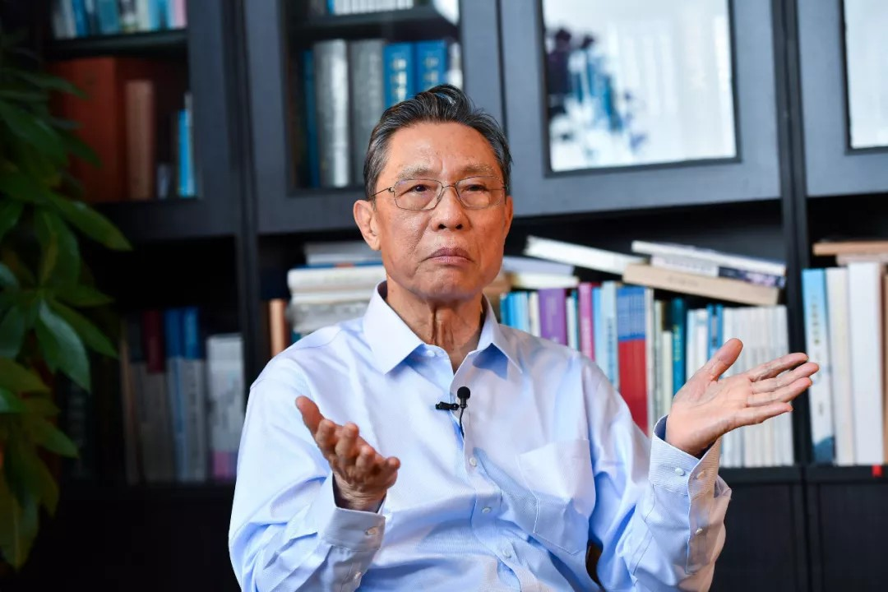
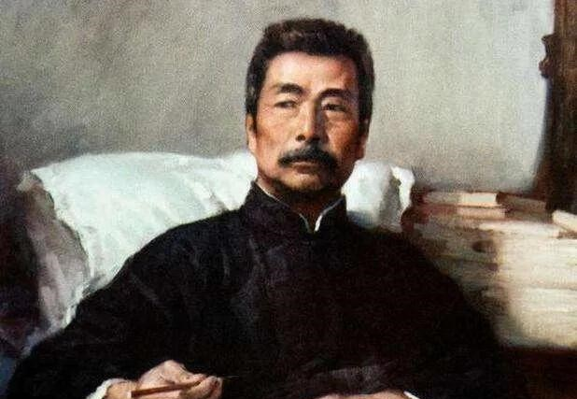
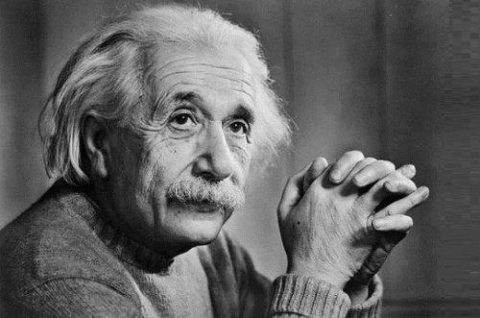
Brainstorm: Introduce someone you admire
Tu Youyou
, who was awarded Nobel Prize for Physiology or Medicine, is a commited and patient scientist.
Zhong Nanshan
, who managed the outbreak of SARS and
2019-nCov, was a national hero.
Lu Xun
, who contributed to the New Culture Movement, was one of the greatest modern writers.
Albert Einstein
, who was awarded the 1921 Nobel Prize for Physics, is often considered one of the smartest men.

Slide 4
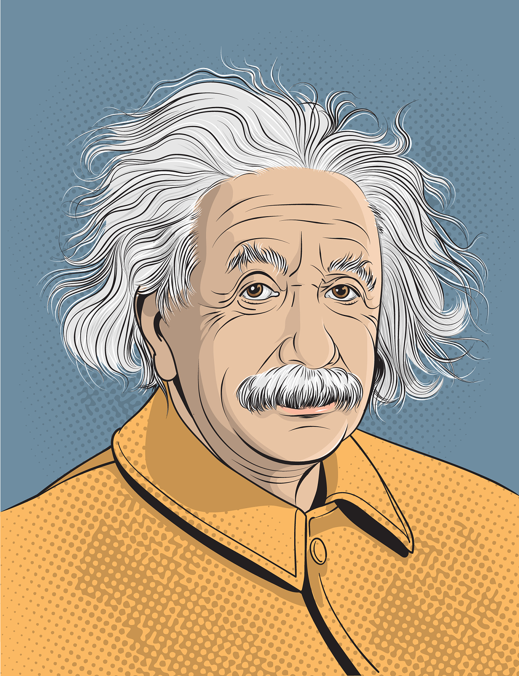
Discuss: If you want to introduce someone you admire in detail, which aspects will you include in your introduction?
Appearance
Achievement
3
4
Education
2
5
Personality
1
6
Anecdotes
General introduction

Slide 5
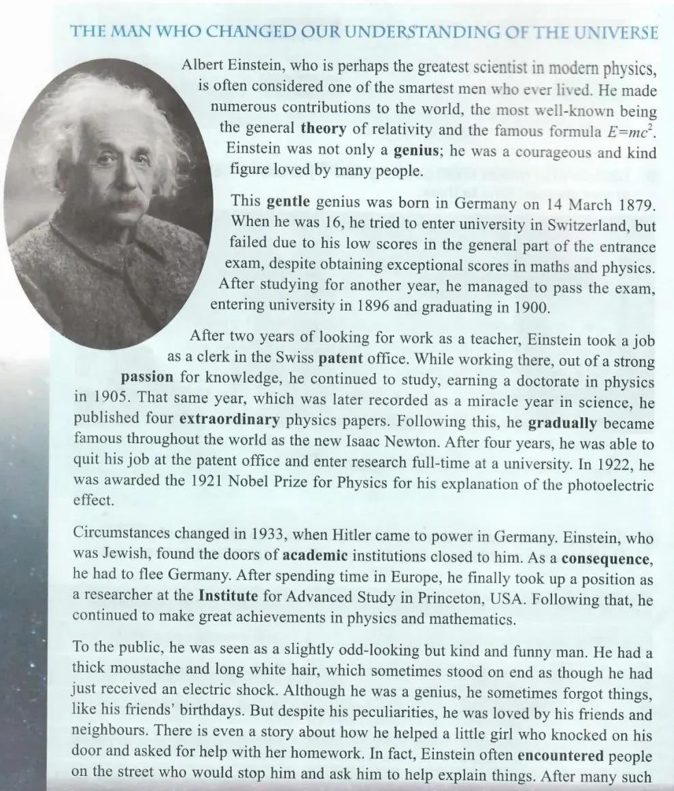
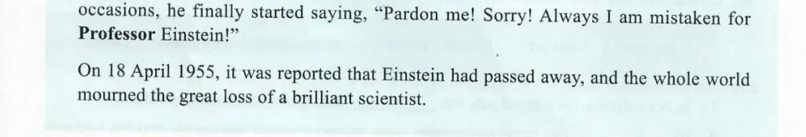
Read for the main idea & key words of each paragraph
Para1:
General introduction
Para2:
Early life/Education
Para3:
Work experience & achievement
Para4:
Turbulent mid-life
Para5:
Appearance & anecdotes
Para6:
Death

Slide 6
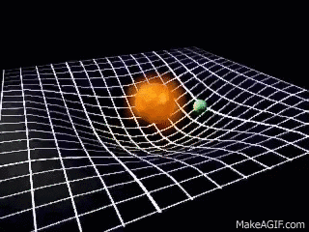
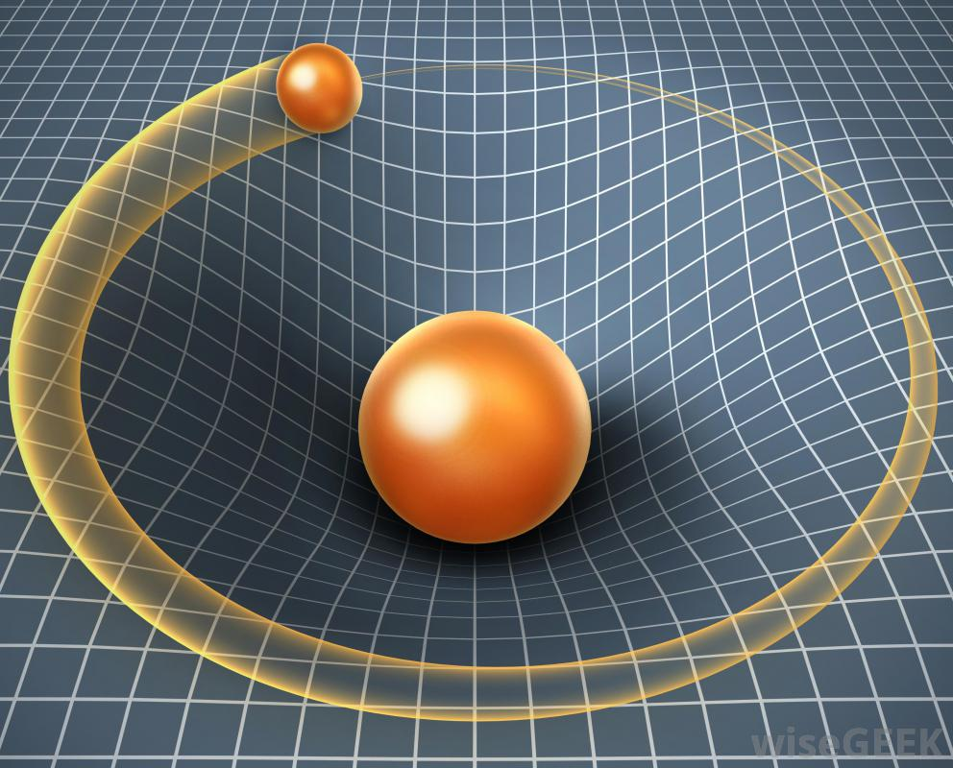
Read for the detailed information about Albert Einstein
P1: Find out various descriptive words to know Albert Einstein
the greatest
the smartest
numerous
the most well-known
famous
genius
courageous
kind
loved by many people
P1: How can you understand Albert Einstein changed our understanding of the Universe?
the general theory of relativity
the famous formula E=mc²

Slide 7
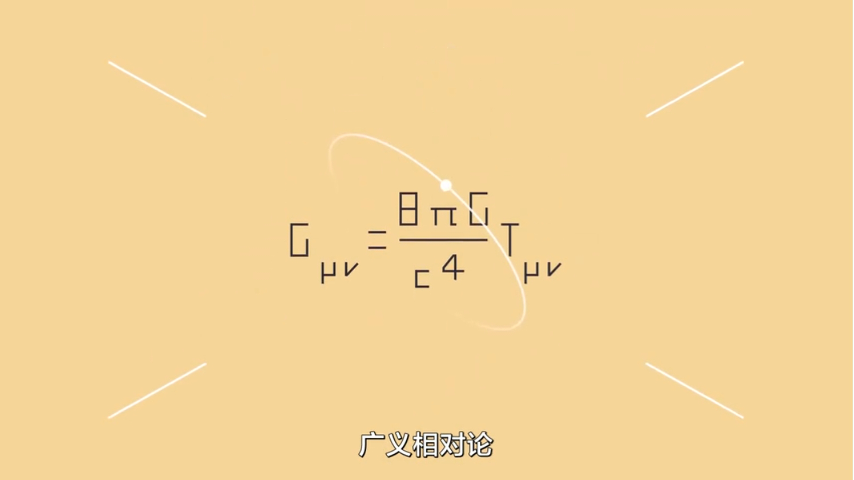
What is Albert Einstein’s general theory of relativity?

Slide 8
Read the Para2-4 & Para6, and complete the timeline about Albert Einstein
1879
1895
1896
1900
1902
Born in Germany
Failed to enter university
Entered university
Graduated from university
Took a job as a clerk
Quit his job & entered research
Earned a doctorate in physics
Died in the USA
Had to flee Germany
Awarded the Nobel Prize
1955
1933
1922
1909
1905

Slide 9
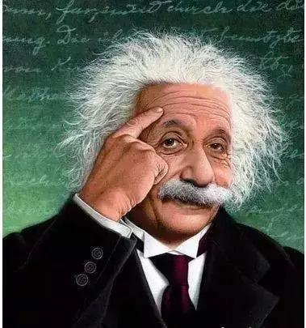
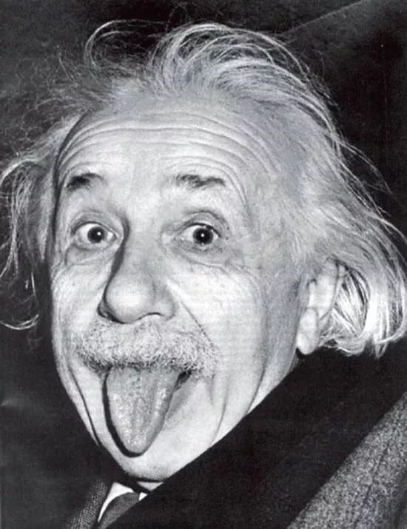
Read the Para5 & describe Albert Einstein's appearance & personality.
 | Key words | Supporting details
Appearence
Personality
a thick moustache
slightly odd-looking
long white hair, which sometimes stood on end
sometimes forgot things
helped a little girl with her homework
kind, funny & forgetful
encountered people and help explain things
“Always I am mistaken for Professor Einstein!”

Slide 10
Read the whole passage & figure out the rhetorical devices used in it.
1. Following this, he gradually became famous throughout the world as the
new Isaac Newton.
Analogy(类比)
2. Einstein, who was Jewish, found the doors of academic institutions closed
to him.
Mataphor(隐喻)
3. He had a thick moustache and long white hair, which sometimes stood on
end as though he had just received an electric shock.
Simile(明喻)
Personification
(拟人)
4. On 18 April 1955, it was reported that Einstein had passed away.
Euphemism(委婉语)

Slide 11
Read the whole passage & figure out how the writer expresses how he/she feels about Albert Einstein.
THE MAN WHO CHANGED OUR UNDERSTANDING OF THE UNIVERSE
The title: Show the feeling of respect & admiration
Albert Einstein, who is perhaps the greatest scientist in modern physics，is often considered one of the smartest men who ever lived.
Einstein was not only a genius; he was a courageous and kind figure loved by many people.
The beginning: Show the feeling of worship & love
On 18 April 1955, it was reported that Einstein had passed away, and the whole world mourned the great loss of a brilliant scientist.
The end: Show the feeling of sadness & grief

Slide 12

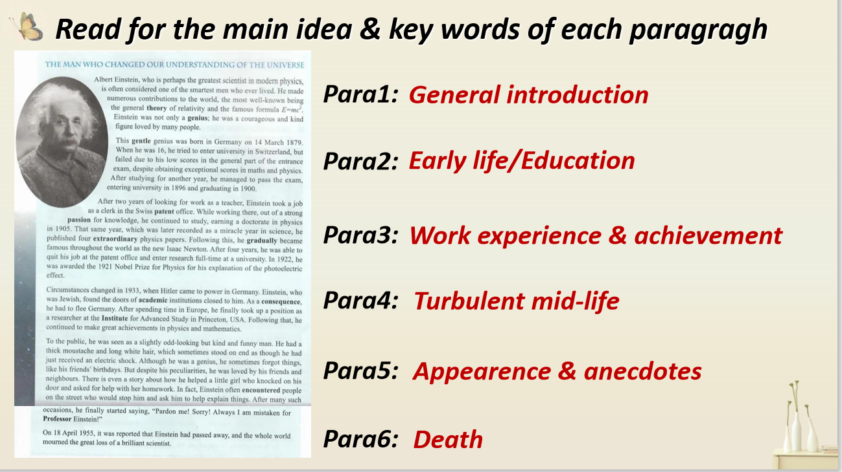
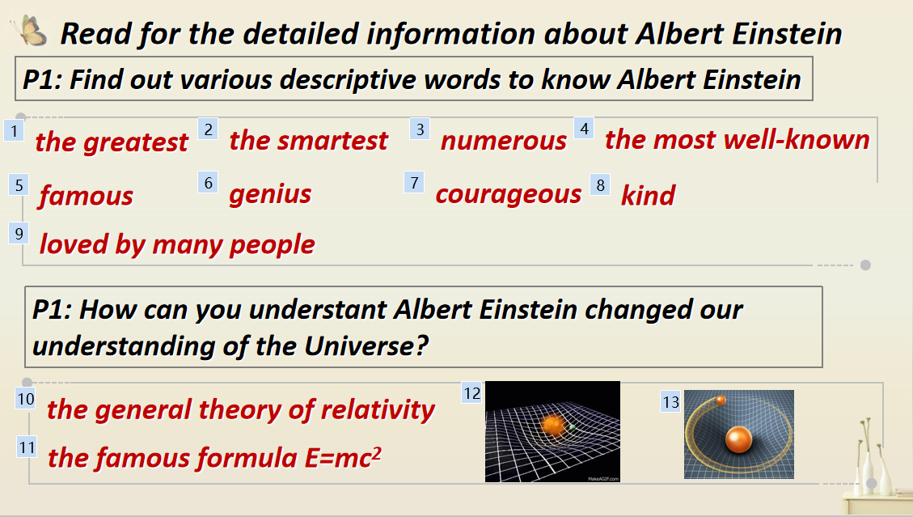
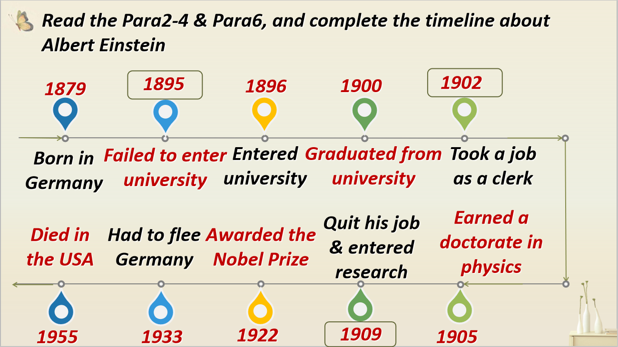
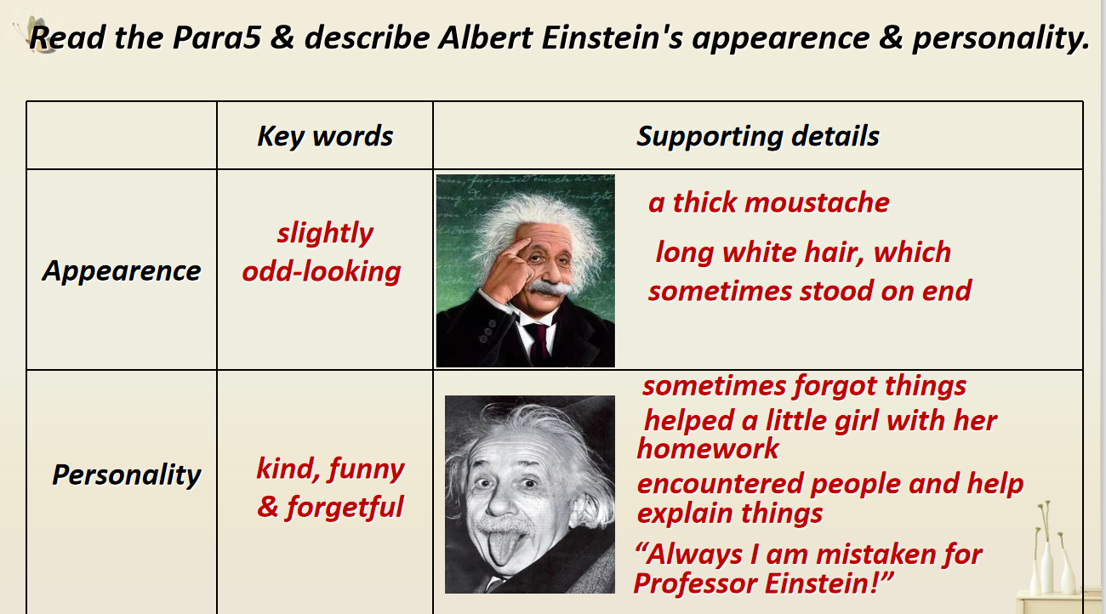
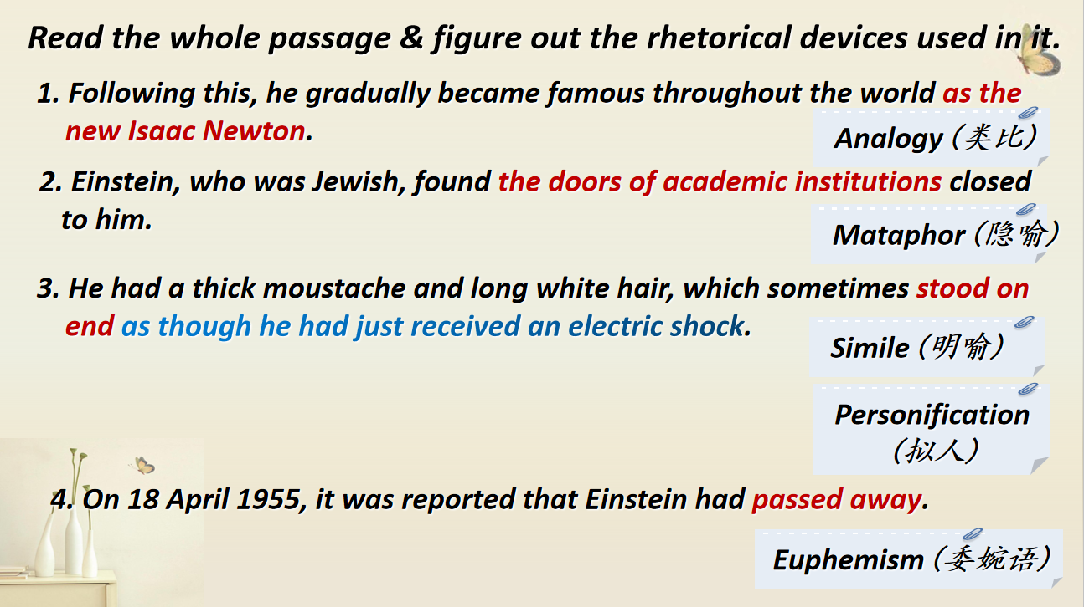
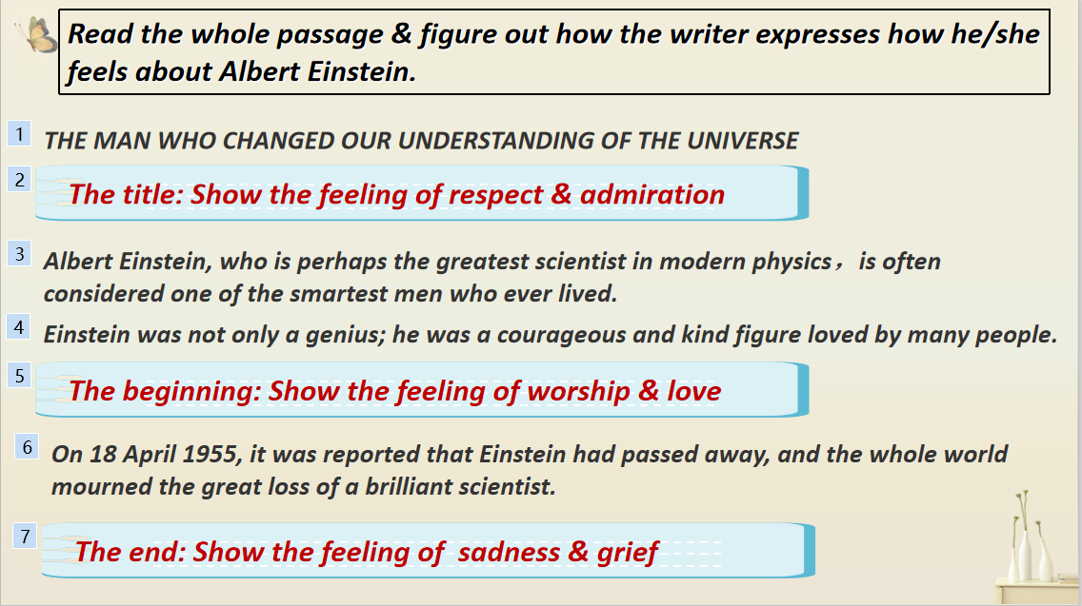
How can you introduce someone you admire?
Tip 1. Decide on the aspects of the person you want to
introduce & write down the key words to make an outline.
Tip 2. Use descriptive words to make the introduction of the
person vivid.
Tip 3. Adopt the timeline to introduce the person's life
experience.
Tip 4. Choose appropriate expressions and anecdotes to
portray the person's appearance & personality.
Tip 5. Use various rhetorical devices to describe the person
strikingly & vividly.
Tip 6. Express the feelings about the person appropriately
and sincerely.

Slide 13

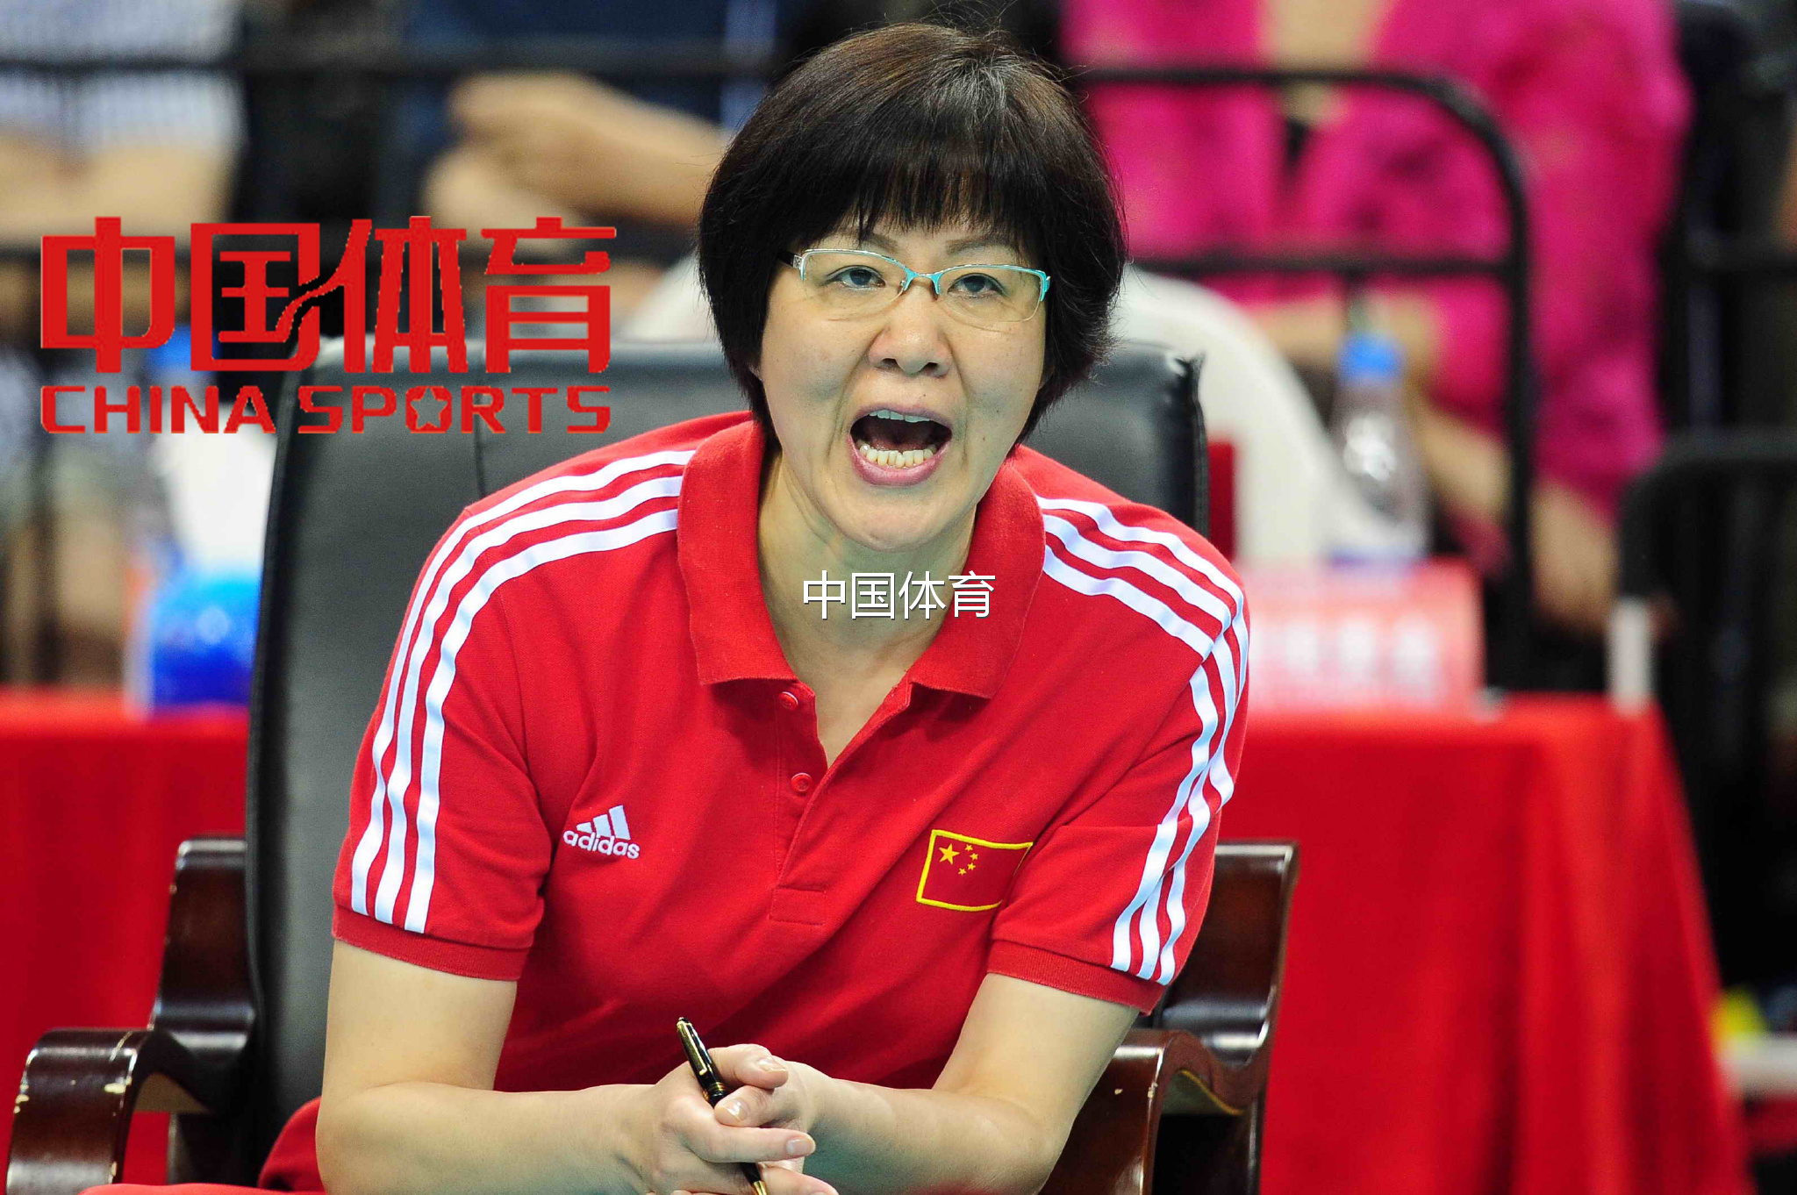
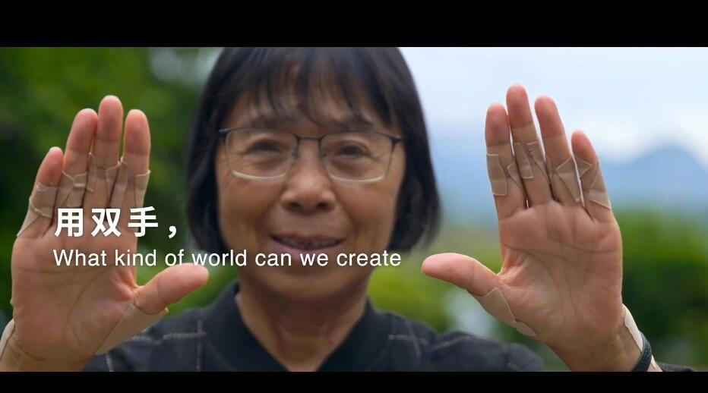
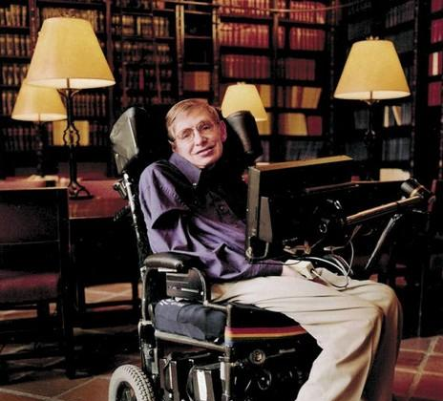
Introduce someone you admire

Slide 14
Writing Sample
Legend of Volleyball
Lang Ping, a professional volleyball player and great coach, is loved by fans both at home and abroad. Undoubtedly, she is considered the legend of volleyball.
Lang Ping, known as the "Iron Hammer", was born in Tianjin, China, on 10 December 1960. She started playing volleyball when she was 13, and in 1978, she was selected into the national team. Three years later, she led the China women's volleyball team to the first championship in World Cup Women’s Volleyball Games. After that, she gained more medals at world championships and the Olympics.
As a coach, Lang Ping belived in all her players and gave them lots of encouragement. When the Chinese team was preparing for the 2015 World Cup, her determination was tested. The team that Lang Ping had built was falling apart. One of the best players had been injured, and the team captain had to leave because of heart problems. Losing two important players was a big challenge, but Lang Ping did not lose heart. She had faced difficulties before, and she knew that her young players could win if they worked together as a team. Two weeks later, they were world champions! Then in 2016, Lang Ping led her volleyball team to Olympic gold in Brazil.
Lang Ping has contributed a lot to the creation of Chinese Women’s National Volleyball Team Spirit, which represents self-improvement and indomitable fighting spirit.

Slide 15
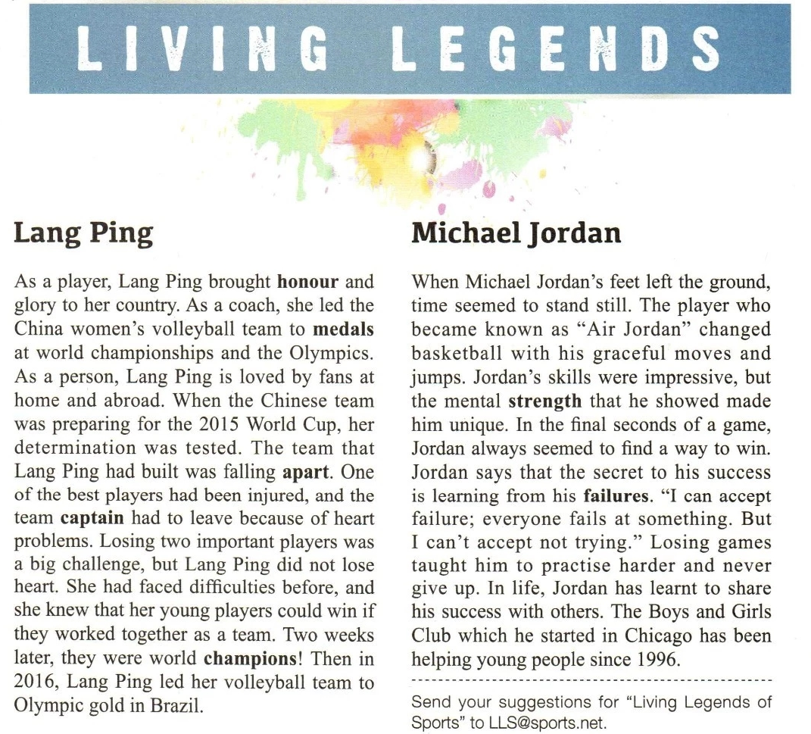
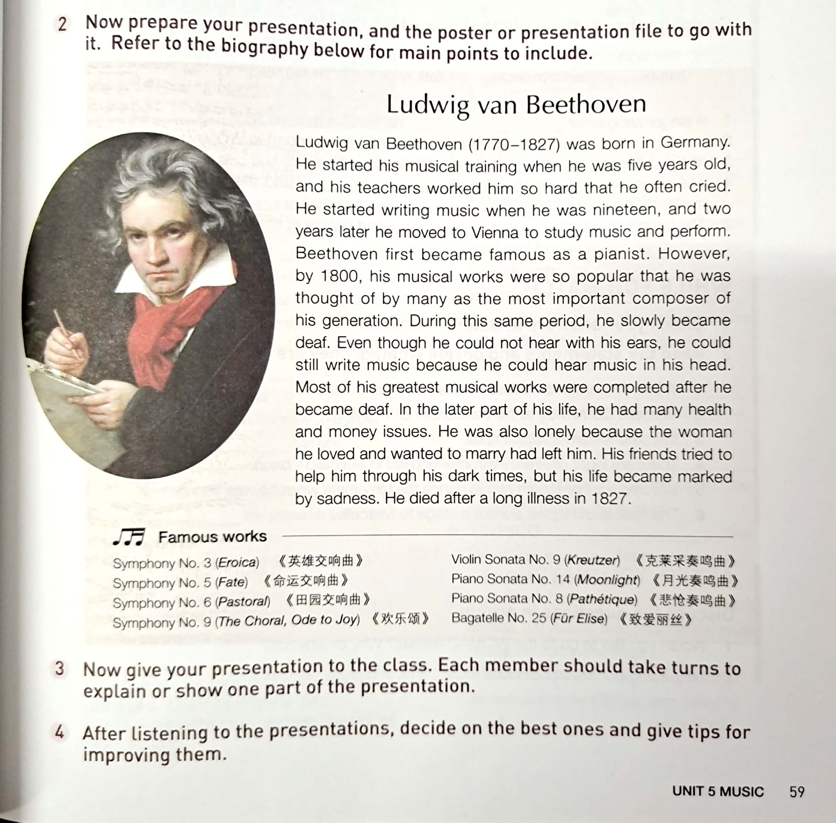
Other biographies in the textbook
新人教版必修 Book 1 Unit 3 P38
新人教版必修 Book 2 Unit 5 P59

Slide 16
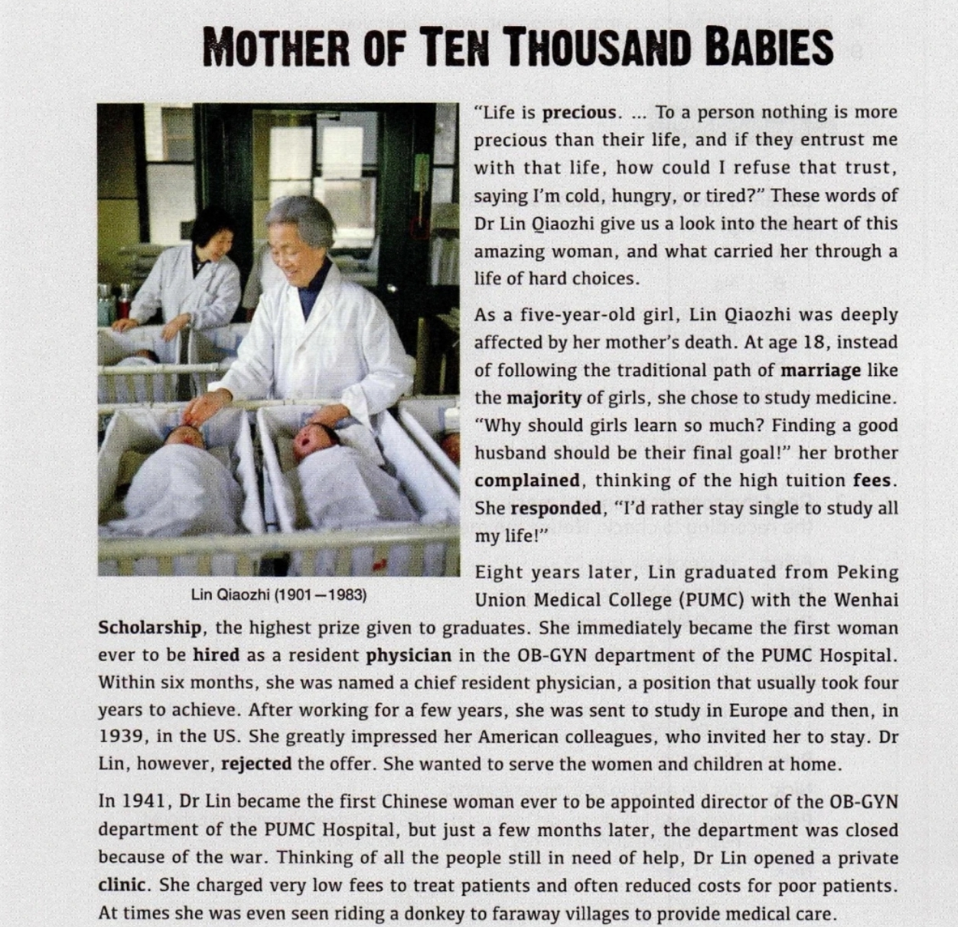
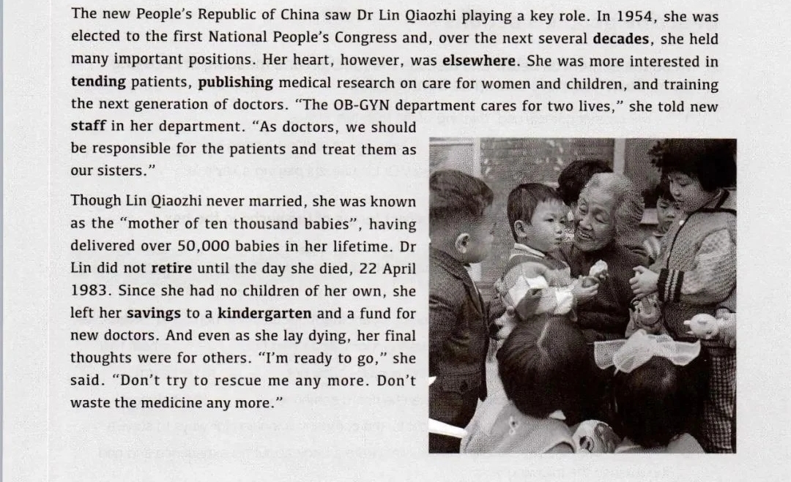
Other biograghies in the textbook
新人教版必修 Book 3 Unit 2 P16-17

Slide 17
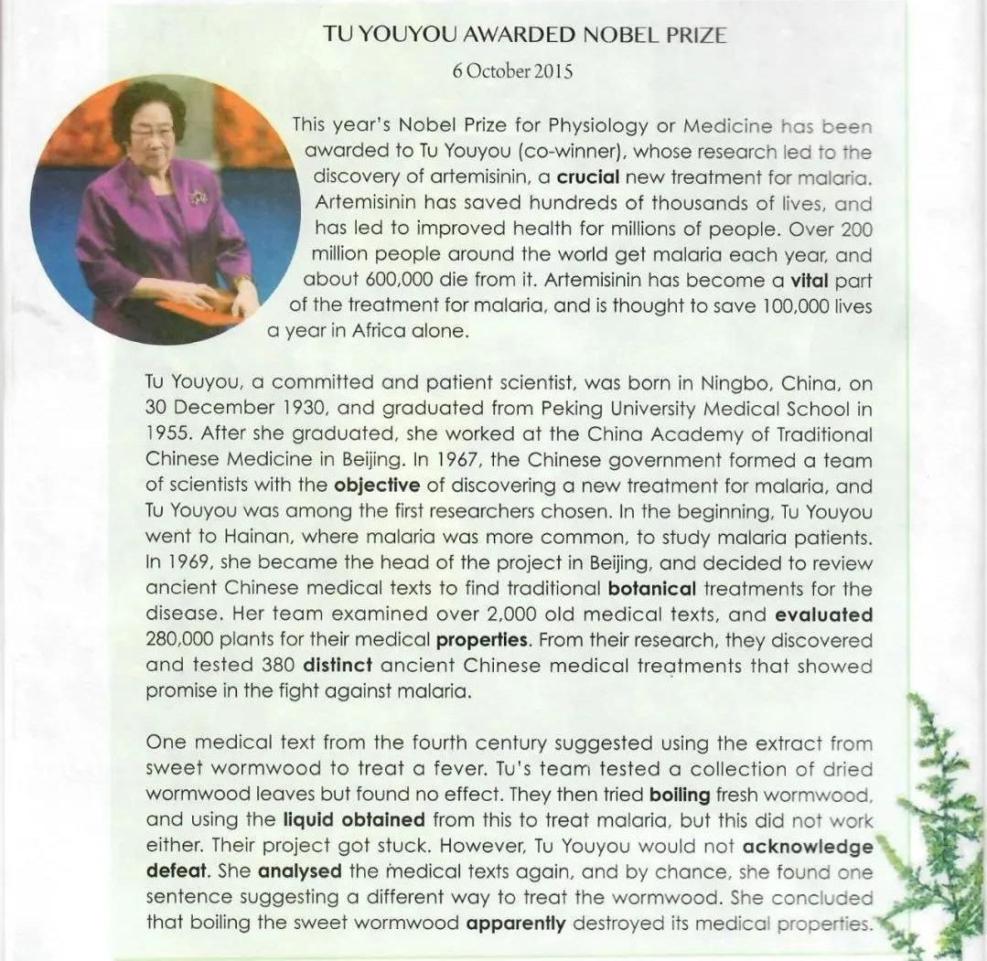
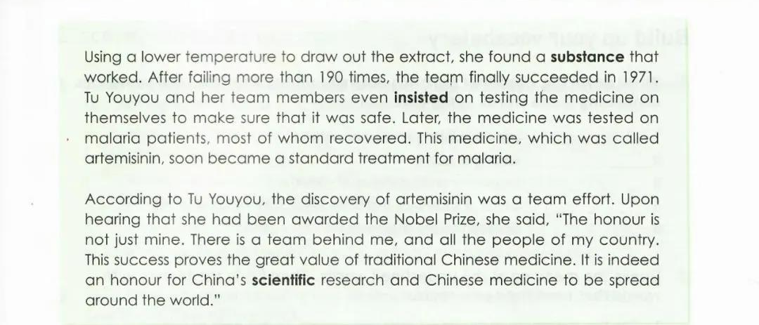
Other biographies in the textbook
新人教版选修 Book 1 Unit 1 P2-3

Slide 18
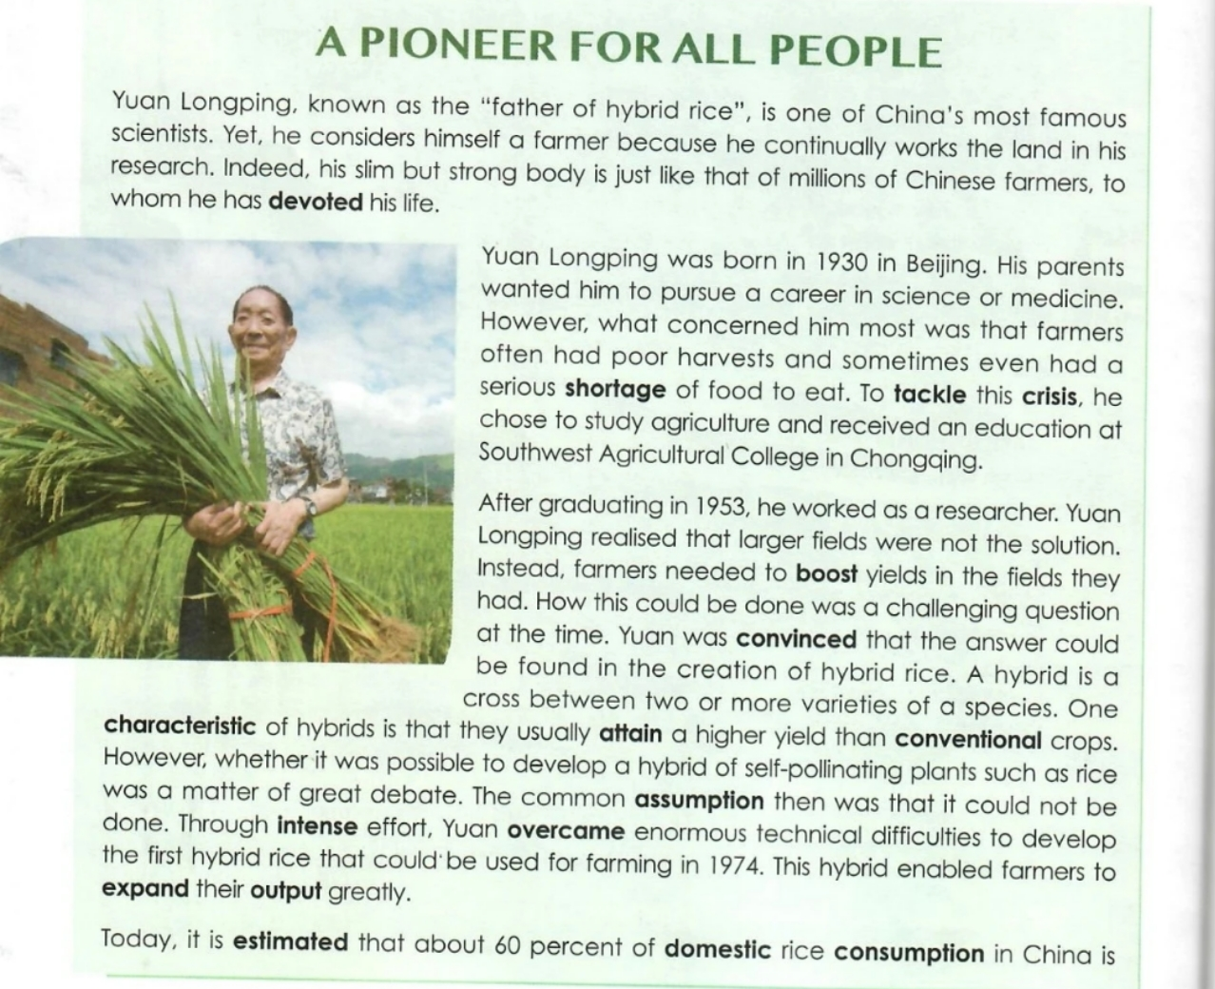
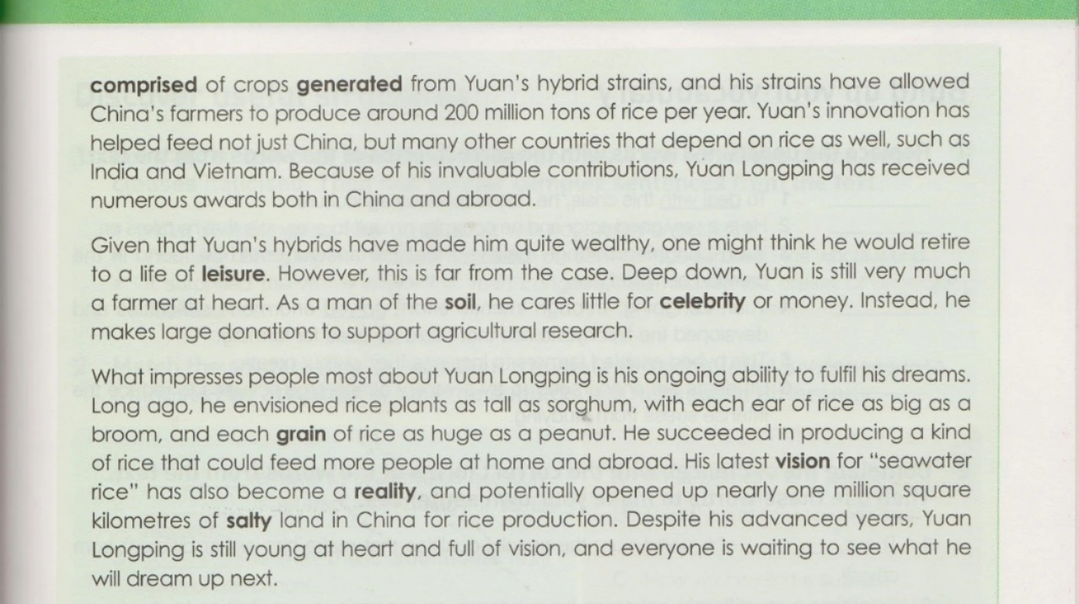
Other biographies in the textbook
新人教版选修 Book 1 Unit 5 P50-51

Slide 19
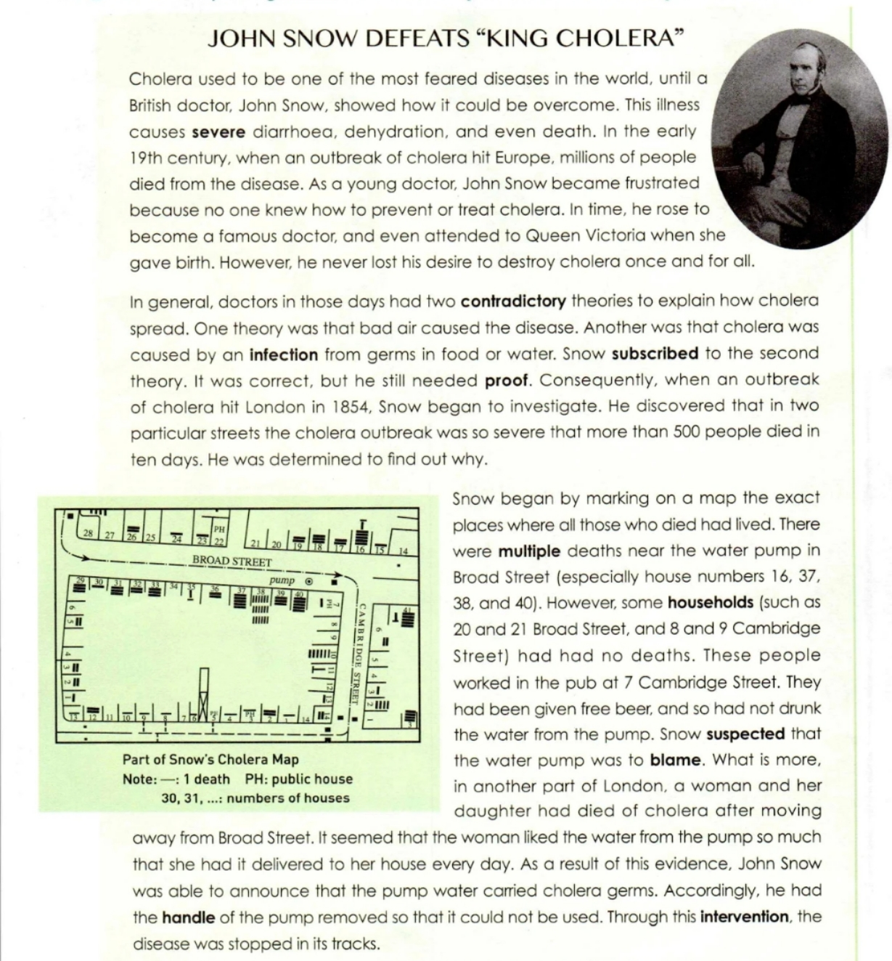
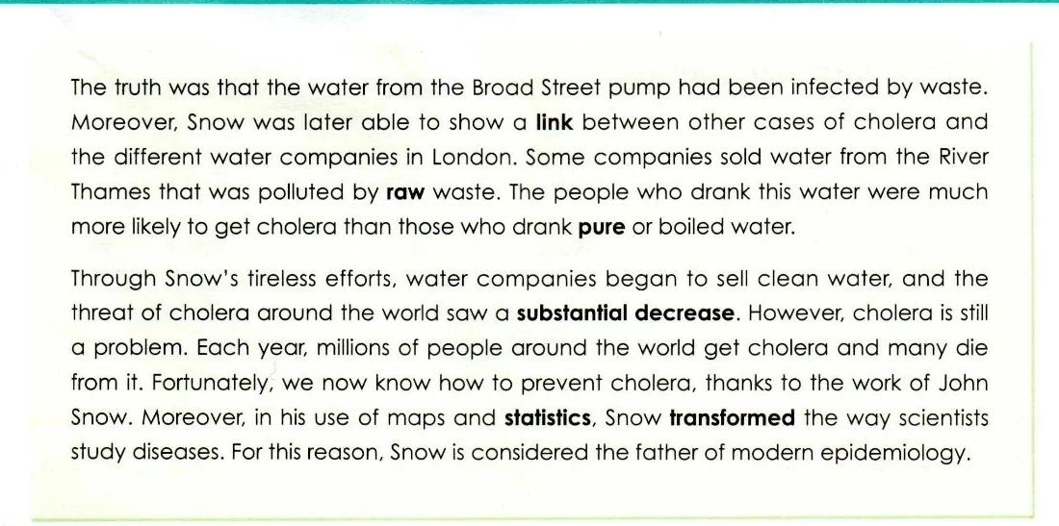
Other biographies in the textbook
新人教版选修 Book 2 Unit 1 P2-3

Slide 20
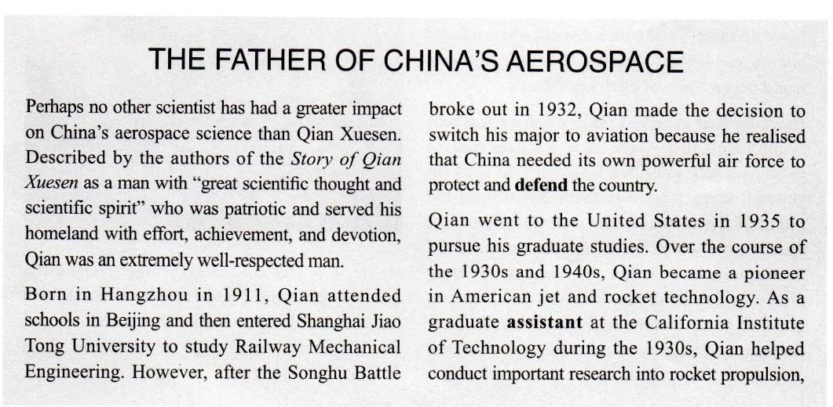
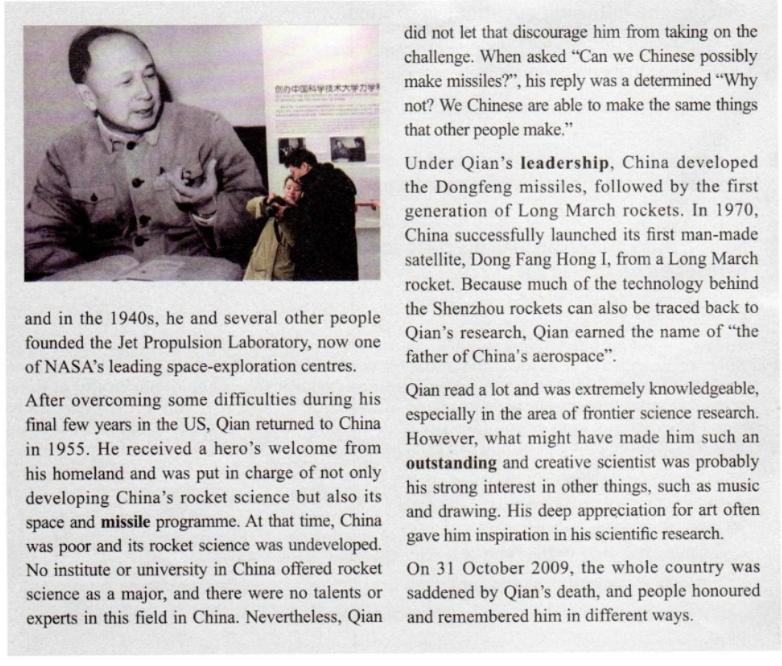
Other biographies in the textbook
新人教版选修 Book 2 Unit 1 P7-8

Slide 21
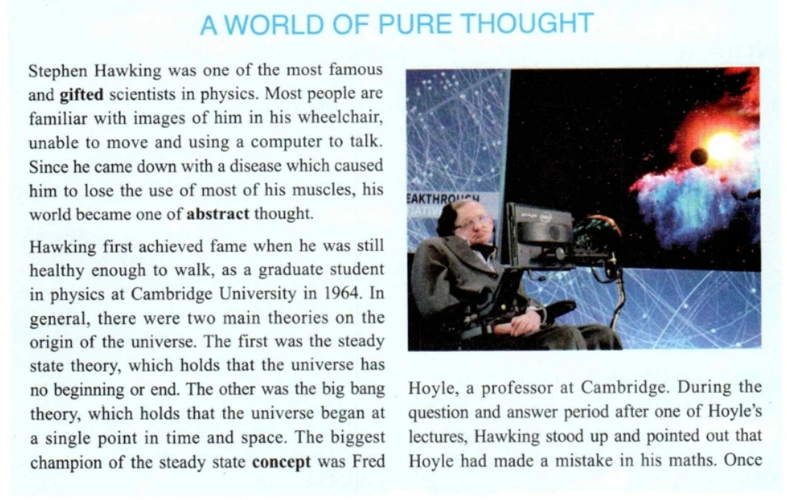
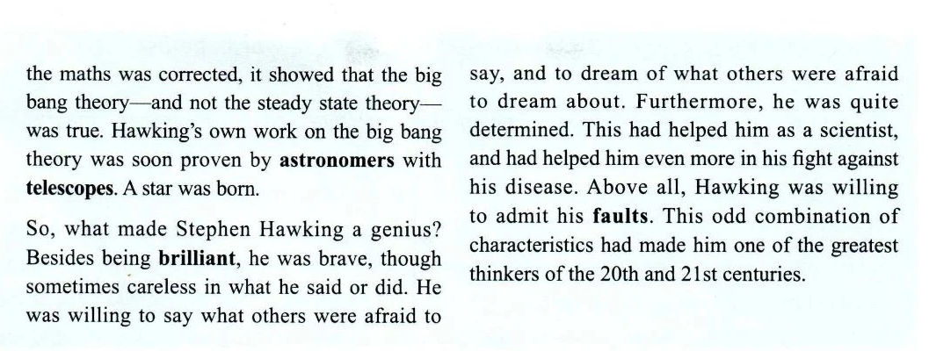
Other biographies in the textbook
新人教版选修 Book 2 Unit 1 P8-9

Slide 22
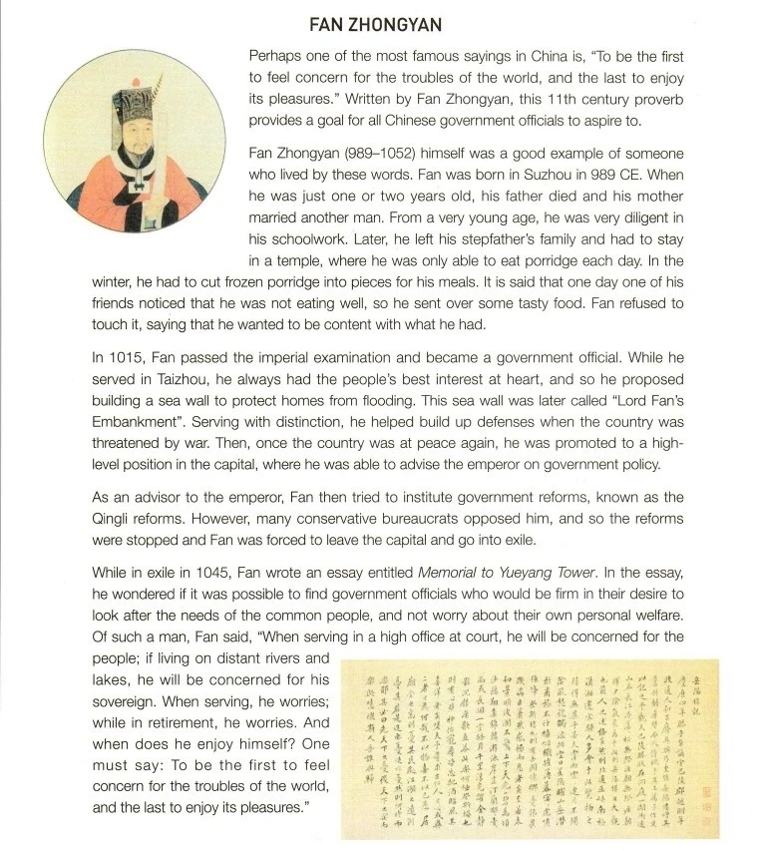
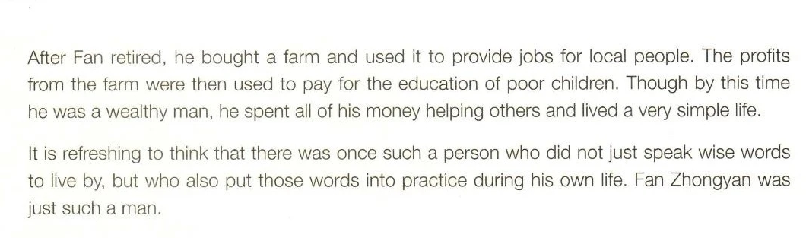
Other biographies in the textbook
新人教版选修 Book 3 Unit 4 P85-86

Slide 23
Thank you!

