Slide 1

感恩遇见，相互成就，本课件资料仅供您个人参考、教学使用，严禁自行在网络传播，违者依知识产权法追究法律责任。
更多教学资源请关注
公众号：溯恩高中英语
知识产权声明

Slide 2
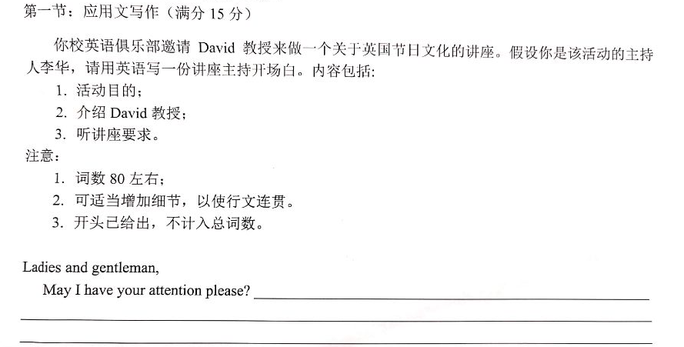
主题
Who
What
How
invite
I (校英语俱乐部的活动主持人李华)
Professor David
一个关于英国节日文化的讲座
一份讲座主持开场白
(演讲)
(口头通知)
…
语篇类型
(交际目的)：

Slide 3
Sample Writing
你校英语俱乐部邀请David 教授来做一个关于英国节日文化的讲座。假设你是该活动的主持人李华，请用英语写一份讲座主持开场白。
Ladies and gentleman,
May I have your attention please? I’m the host Li Hua. Festivals help to open many doors related to fun activities and various aspects of culture. To deepen our understanding of British festivals and its culture, we are now gathering here to attend the lecture by Professor David Brown. He once worked for British Consulate General Shanghai but currently is hosting a series of lectures on cross-cultural communication in Zhejiang University. Please mind your manners while listening. Turn all electronic devices off and never talk unless you are invited to. Thanks! So now, let’s welcome Professor David and begin our cultural journey.
1．活动目的;
2．介绍 David教授;
3．听讲座要求。

Slide 4

一、文化类
1、文化多元化: cultural diversity
2、文化冲突: cultural conflict
3、文化震撼：cultural shock
3、跨文化交流: cross-cultural communication
4、文化传统: cultural traditions
5、弘扬民族文化: carry forward national culture
6、文化差异性: cultural differences
7、文化全球化: cultural globalization
8、融合交汇: integration and interaction
主题语料

Slide 5
主题语料
二、教育类
1、培养想象力: nurture imagination
2、丰富某人知识: enrich one' s knowledge
3、开阔视野: widen/broaden (one’s) horizon(s)
4、激发兴趣: inspire/stimulate (one’s) interest
5、发展/激发潜力:develop/stimulate (one’s) potential
6、为将来打下坚实的基础: lay a solid foundation for the future
7、对将来的发展有益: benefit future development
8、扩大知识面:expand one’ s knowledge
9、学术诚信: academic integrity
10、有理想、有道德、有文化、有纪律: with lofty ideals, integrity, knowledge and a strong sense of discipline
11、从学习中获得乐趣: derive pleasure from one’ s studies
12、把学习放在第一位: place the study ahead of anything else

Slide 6
主题语料
三、必备素材句
1、在我看来，文化多样性对国家的发展和繁荣至关重要。
In my view, multi-cultures are extremely vital in ensuring a community’s future development and prosperity.
2、经济全球化带来的不仅有机遇，也有严峻的挑战，中国传统文化面临前所未有的冲击。
Economic globalization brings not only opportunities for development but also challenges. Chinese traditional culture is now experiencing unprecedented shock.
3、中国古老的文化是人类文明的伟大财富之一。
The ancient culture of China is one of the great treasures of human civilization.
4、随着世界各国间交流的增多，我们迫切需要学习不同的文化知识。
With increased interaction between the world’s nations, there is a great urgency for us to absorb different cultures.
5、中国传统文化不仅一定可以继续存在下去，而且—定会繁荣发展。
Chinese traditional culture is not only certain to survive, but, in fact, is destined to thrive and prosper.

Slide 7
可参考功能性语料
Functional expressions for your reference
说明通知缘由的句式:
To make . ..,we have decided to hold/organize ...
With the aim of /Aimed at ...，... will be organized/scheduled.
We are glad to tell you that there will be . . . to help you ...
告知具体事项的句式:
... will cover various activities，including ...
All the . .. are required to . ..
You'd better prepare ... in advance.
表达活动目的或收获的词汇:
improve ... ability，enrich ... activities，have a further knowledge of，develop... skills，leave a good memory to， feast one's eyes on，have great fun，understand the importance of， harvest a lot，prove to be a useful experience
表示欢迎或期待的句式:
Those who are interested in it are warmly welcome.
We are expecting your attendance/participation.
We believe you will benefit a lot and gain much progress in ...
Ref:《新高考英语写作梯级训练》

Slide 8
可参考功能性语料
Functional expressions for your reference
说明演讲主题的句式:
What I am going to talk about today is …
It's a great pleasure for me to be here and share ... with you.
Today I am honoured to have the chance to make a speech about ...
表示积极措施或影响的词汇:
take the responsibility to，devote . .. to, do one's bit for，try effective methods to，get actively involved in，have a profound influence on，be the guarantee of ，arouse one's awareness，make a difference, mean a great deal to
进行总结或提出希望的句式:
I sincerely hope what is mentioned above might be helpful to you.
I earnestly hope everyone can pay more attention to . ..From what has been discussed above，we can safely draw the conclusion that ...
表达感谢的句式:
Thank you very much for being here.
I deeply appreciate your careful listening.
Thank you for your support and your kind attention.
Ref:《新高考英语写作梯级训练》

Slide 9
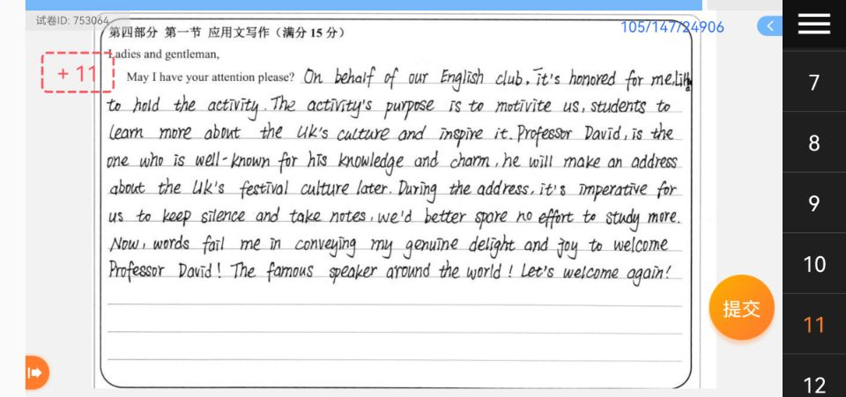
?1
★
◡◡◡◡◡◡◡◡◡◡◡◡◡
?2
★
★
◡◡◡◡◡◡◡◡◡◡◡◡◡◡◡◡◡◡◡◡◡◡◡◡◡◡◡◡
◡◡◡◡◡◡◡◡◡◡◡◡◡◡◡◡◡◡◡◡◡◡◡◡◡◡◡◡◡◡◡◡◡◡◡◡◡◡◡◡◡◡◡◡◡◡◡◡◡◡◡◡◡◡◡◡◡◡◡◡◡◡◡◡◡◡◡◡◡
?3
Are the messages conveyed with good language?
The use of words and expression – any grammar mistakes?
The choice of expressions – are they suitable enough here?

Slide 10
?1
It has been a great honour your coming to visit me.
您来访问我,不胜荣幸
I〔We〕 am〔are〕 honoured在客套语中,多用来表示说话人对某件事的态度,其后可接动词不定式或从句。
We shall be honoured to talk the matter over with you .
我们很愿意和你们详细地讨论一下这件事。
On behalf of our English club, it’s an honour for me, Lihua, to host the event.

Slide 11
?2
a formal speech that is made in front of an audience
He delivered an address of thanks (to sb). 他致答谢词。
He gave a congratulatory address. 他致祝贺词
His lecture covered various aspects of language.
他的讲课涉及到语言诸方面的问题
She ran over her notes before giving the lecture.
她讲课前把讲稿匆匆看了一遍
He lectured to his students on modern writers.
他给学生们讲了关于现代作家的一课
He will give a lecture covering/ concerning/ about the festival culture in the UK, during which we are required to keep silence and …

Slide 12
?3
Let's have a good round of applause for him/ our distinguished professor.
Let’s rise to applaud the speaker.
…
More:
quiet
keep quite
listen ∧ him
be greatful to you
你必须首先达到一些要求
向这位教授致敬
listen to him
grateful to you
First of all, there are some requirements for you to meet.
… give/ pay (our) respect to the professor.

Slide 13

Assignment:
After reading the sample writing, the concerned language chunks and the example from our fellow student (we need to give our thanks to this generous buddy), can you find some way to make your own work better? Please rewrite it to see if you can make any progress!
p. s. Underline the highlighted expressions in your passage.

