Slide 1

感恩遇见，相互成就，本课件资料仅供您个人参考、教学使用，严禁自行在网络传播，违者依知识产权法追究法律责任。
更多教学资源请关注
公众号：溯恩高中英语
知识产权声明

Slide 2





David Copperfield
Shengzhou Senior High School
Zheng Qiaoyan

Slide 3

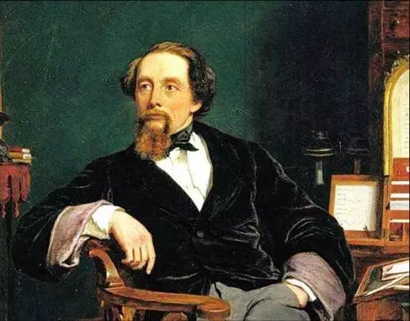
About the author
Charles Dickens (1812-1870) the most popular British novelist of the Victorian era
Created some English literature's most iconic characters
remains popular

Slide 4
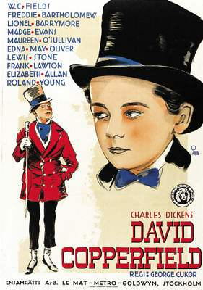
Plot summary
The story traces the life of David Copperfield from childhood to maturity.
With the pet of his mother Clara and faithful nursemaid Peggotty, David lives an delightful life for the first few years of his life, even though his father died 6 months before his son's birth. David's happy childhood is over by the arrival of his stepfather, and David suffers both physical and mental abuse from his new guardian.

Slide 5
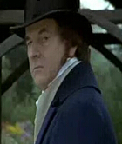
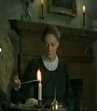
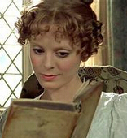
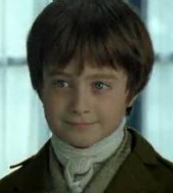
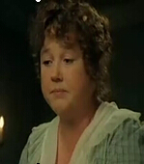
Characters and relationship
stepfather: Mr. Edward Murdstone
great-aunt: Miss Betsay Trotwood
mother: Clara Copperfield
stepfather’s sister:
Jane Murdstone
David Copperfield
housekeeper: Clara Peggotty
housekeeper’s brother: Daniel Peggotty
housekeeper’s niece: Little Emily
Housekeeper’s
nephew: Ham

Slide 6
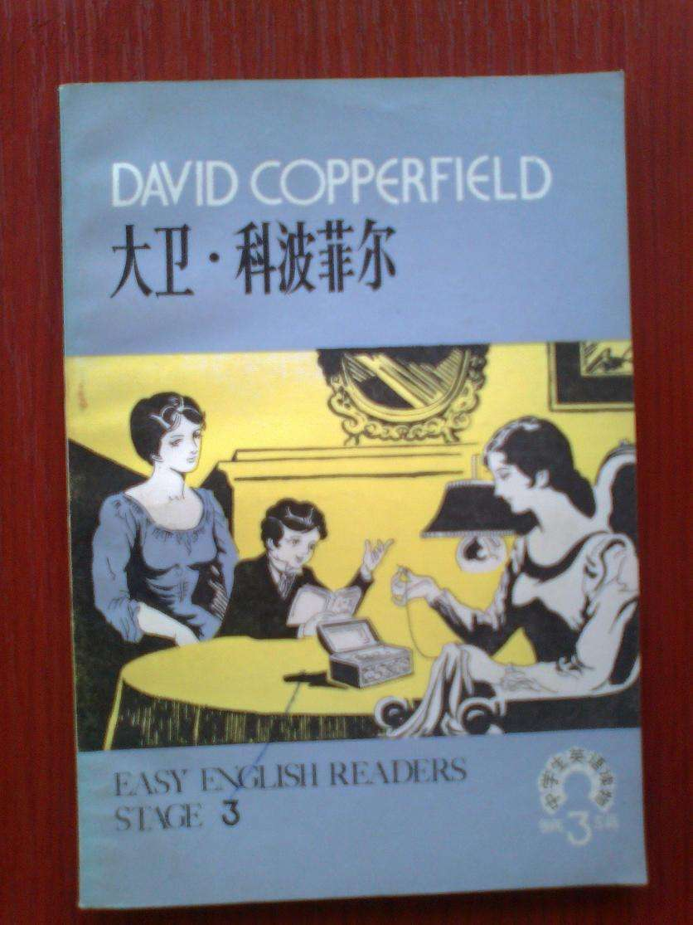

Main idea
Para.1. –Para.8
Part1:
Part2:
The _______ early childhood
happy
Para9. –Para37.
miserable
The ____________life after the arrival of Mr. Murdstone

Slide 7
The beginning
Read & Appreciation
My life has been full of ups and downs, and during my childhood the downs seemed to rain on me like a never-ending storm. When I look back on those years, I can't believe that any grown-up would behave in that way to a child. But they did.
What can we infer from the first paragragh?
What do “they”refer to in Chapter One?
My life is ______________________________________
not easy,miserable,full of twists and turns
“They” refer to the Murdstones.
起伏
twists and turns
ups and downs
rain on me like a never-ending storm
look back on
像一场永无休止的暴风雨倾泻在我身上
回顾；回忆

Slide 8
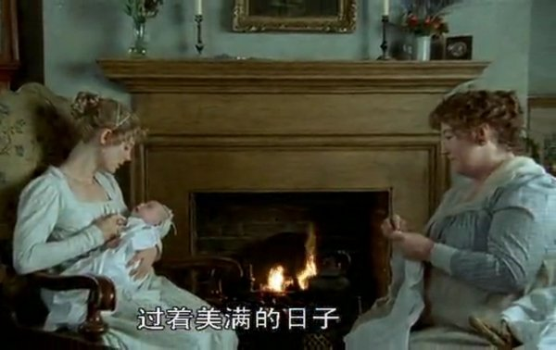
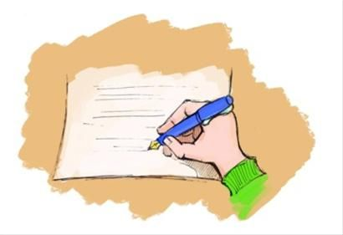
My birth
unwelcome
undesirable
fatherless
unfortunate
My story starts in Suffolk with the first noise I ever heard 一 the slamming of our front door. My great-aunt, Betsey Trotwood, had been quite sure I was going to be a girl. When she was told I was a boy, she got up in a rage and stormed out. My poor mother! She was all alone in the world, except for me and our housekeeper, Peggotty. My father had died six months before I was born.
slam v. 砰地关上
get up in a rage and stormed out 愤怒地站起来，怒气冲冲地走了
仿写1. (How to express anger)
说着那些话，他愤怒地站起来，砰地关上门，怒气冲冲地走了。
With these words he got up in a rage, slammed the door, and stormed out.

Slide 9
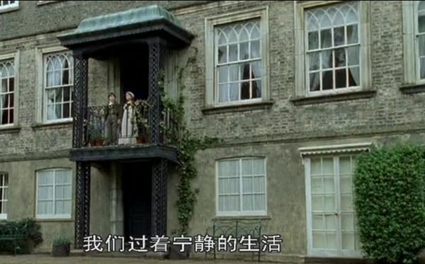
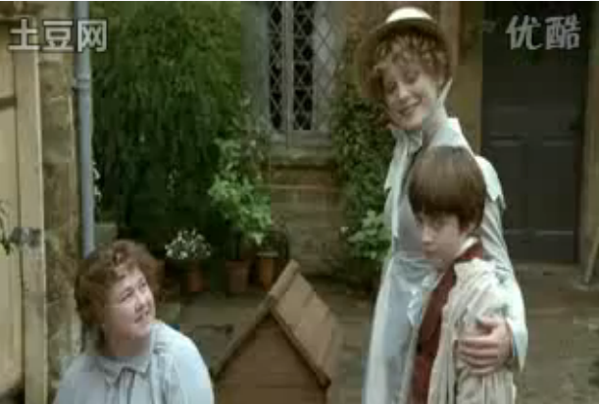
My happy early childhood
(Para3-8)
waddle
1. ……watch geese _________around our back yard
2. Peggotty took me on a holiday to the seaside where I __________ Dan Peggotty’s house, in an upside-down boat—
a large black barge, with an iron funnel blowing out chimney smoke.
3. I also fell in love with his little orphaned niece, Emily, who lived with him. She was bold and pretty with a wildness that completely ________________(捕获我的心).
4. ________(最好的是), I loved playing on the beach with little Emily.
fell in love with
captured my heart
Best of all

Slide 10
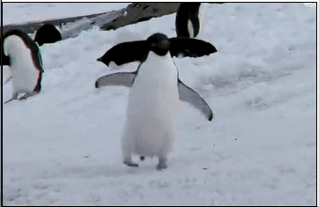
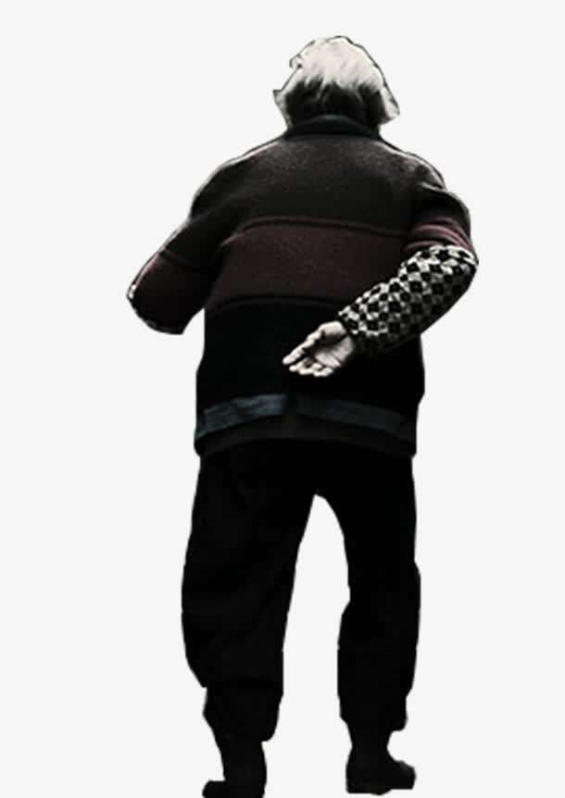
Detailed description
waddle v. /n.摇摇摆摆地走，蹒跚而行
adore vt. 崇拜；爱慕；喜爱
仿写2.在极地公园，看到很多企鹅摇摇摆摆德朝我们走来，小女孩开心地咯咯地笑了出来。她简直太喜爱它们了。
仿写3. 老人迟疑了一下，摇摇头，终于蹒跚地离开了。
2.Watching the penguins waddling towards us at the Polar Park, the little girl giggled. She simply adored them.
The old man hesitated, shook his head, and waddled away at last.

Slide 11

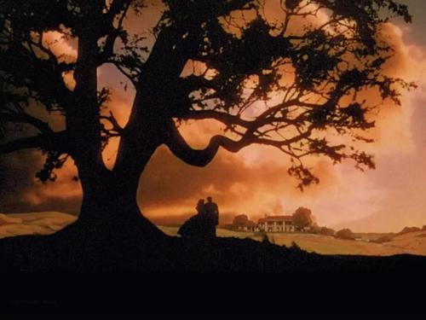
Detailed description
a large black barge, with an iron funnel blowing out chimney smoke.
一艘巨大的黑色驳船，带有一个铁烟囱，喷出烟囱烟
仿写4.《飘》一开始放映时，白色的塔拉庄园进入视线，那高耸的大树，广阔的田野，夕阳下的喷烟的烟囱，看起来优美神秘，一下子捕获我的心。
At the beginning of “Gone with the Wind”, the white Tara came into sight. The towering trees, vast fields and chimneys blowing out smoke under the setting sun looked beautiful and mysterious, which captured my heart at once.

Slide 12
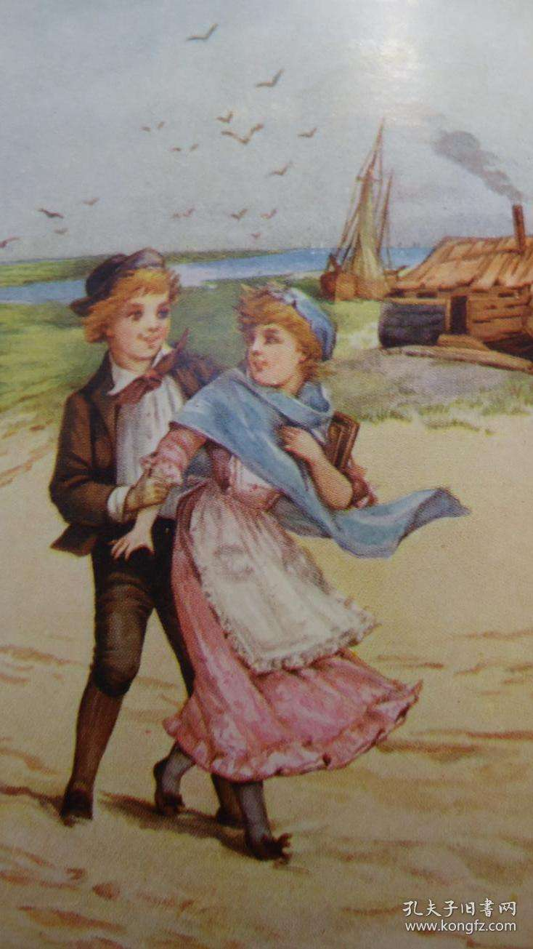
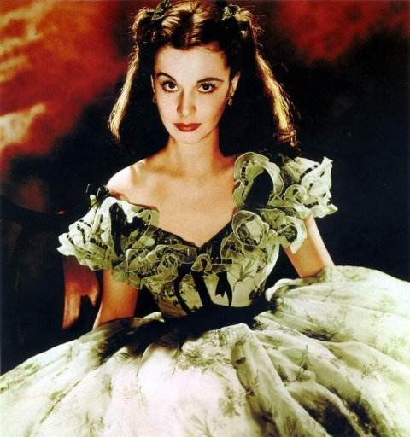
Detailed description
She(Emily) was bold and pretty with a wildness that completely captured my heart.
她(艾米丽)大胆漂亮，野性十足，完全俘获了我的心。
仿写5. 斯嘉丽与一般的女孩不同，她大胆漂亮，野性十足，难怪她能轻易捕获男孩的心。
Scarlett was different from the average girl, who was bold and pretty with a wildness. No wonder she could easily capture boys’ heart.

Slide 13

Mr. Murdstone & Miss Murdstone
Appearance description
He had black hair and a hard, cold, handsome face.
Before long, this unpleasant man began to visit our house more and more often.
After Mr Murdstone's coldness, the friendliness of Dan's family made me very happy.
Her face was full of gloom and cruelty.
阴暗和残忍
仿写6.Claire 打开门。一个有着黑头发，一张冷酷、冷漠、英俊的脸的男人进来了。“你好，我是Tony!”随着一声冷漠刺耳的声音，他抬起了阴暗和残忍的脸。 Claire不禁害怕得发抖。
Claire opened the door. In came a man with black hair and a hard, cold, handsome face. “Hello, It‘s Tony!” With a harsh, cold voice he raised his face full of gloom and cruelty. Claire trembled/shivered with fear.

Slide 14
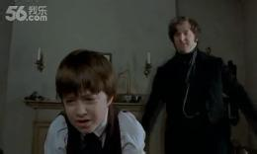
Mr. Murdstone
Behavior description
1.He ordered my mother around and bullied her until I couldn't bear to watch.
欺负；威吓
2.I saw he was gripping a thin cane in one hand. “You must be extra careful today, he warned me, twitching the cane.
我看见他一手握着一根细手杖。“你今天一定要格外小心，”他警告我，一边摇晃着手杖。
3.Mr Murdstone's heavy footsteps followed right behind me. As soon as we entered my bedroom he shut the door.
摩德斯通先生沉重的脚步紧跟在我身后。我们一进我的卧室他就把门关上了。

Slide 15
Mr. Murdstone
Behavior description
4. No sooner had these words left my mouth than he grabbed hold of my head and began slapping me.
这些话刚一出口，他就抓住我的头开始扇我耳光。
No sooner had sb. done sth. than sb. did sth.一……就……
5. The next instant he rushed at me, hitting me with both hands on my head, on my back, on my chest. I held my arms over my face, dizzy with pain and shock.
接着他向我冲来，双手朝我的头上、背上、胸口打去。我用胳膊捂着脸，疼痛和震惊让我头晕目眩。
The next instant/the moment/the minute+时间状语从句(when/as soon as）
6. By the time he finished, I collapsed in a heap on my bedroom floor.
collapse: fall down suddenly
in a heap瘫倒，成堆的
等他说完，我就瘫倒在卧室的地板上。

Slide 16

linguistic description
be firm with：be strict/severe with
crush: to press or squeeze sth. so hard that
it is damaged or injured, or loses its shape
1.“Don’t be so weak, Clara. You must be firm with the boy.”He said I was a bad child and that he was determined to crush me.
2.He and Miss Murdstone would stand over me, frowning and telling my mother to be firmer.
frown
皱眉
3. “David,” he said one day, beckoning me over to him, “what do you think I do if I have a dog or a horse that doesn't do what I tell them.”
招呼我过去
4. “I beat it,” he replied, with an evil glint in his eyes.
他的眼里闪着邪恶的光芒。

Slide 17

Conclusion
What kind of person is Mr. /Mrs. Murdstone?
malicious(恶毒), greedy, strict, cruel, rude, pitiless, merciless, cold-blooded, heartless, evil
How to describe a bad person?
By his appearance, his behavior and his words.

Slide 18
Imitation
仿写7.他握着一根细手杖紧跟着想欺负小男孩，可怜的男孩躲进了教室砰地关上门，喘着粗气。
仿写8. 他皱了皱眉，招呼小男孩过去，眼里闪着邪恶的光芒。
Gripping a thin cane in one hand， He followed behind to bully the little boy. The poor boy hid himself into the classroom, slamming the door behind him and breathing heavily.
He frowned and beckoned the little boy over, with an evil glint in his eyes.

Slide 19
Imitation
仿写9.他一靠近就抓住小男孩的头开始扇他耳光。
仿写10. 阿塞夫把那可怜的孩子打倒在地。
几乎把他压碎，然后咧嘴一笑，手放在屁股上，扬长而去。
No sooner had he approached than he grabbed hold of the boy’s head and began slapping him.
Assef knocked the poor boy to the ground and he almost crushed him. Then he grinned and left with hands on his hips.

Slide 20
My feelings towards Mr. Murdstone
1.Even though I was very young, I could tell Mr. Murdstone didn't like me at all. And I didn't like him.
2.But nothing could have prepared me for the awful news that was waiting for me.但是，对于等待着我的可怕消息，我什么也没有准备好。
3.I felt as if the air had been strangled out of me. Mr. Murdstone was the kind of man that smothers all hope and happiness. v.
strangle把……勒死；使哽咽，使窒息
4. “I don't know,”I whispered nervously.
5.I shivered with fear, knowing that if I gave him the slightest excuse, he would beat me.
6.As I read, I imagined myself as the hero of each story and the Murdstones as the evil characters, always getting into trouble.
7.I walked up the stairs with my knees trembling.

Slide 21
8.I shook with terror. I had to give an answer, but the only one I could think of was the true one and I knew it would end in disaster.
9.‘I...I...can’t do my work,’I spluttered
splutter结结巴巴说话不连贯
10.1 had to fight back - I had to. All those weeks of bullying and loneliness exploded in me.
I sank my teeth deep into his right hand - the one holding my neck - and tasted the salty and sour texture of his skin. He yelped in pain and sprang backwards, letting go of my head in shock. He stared down in horror at the deep bite marks on his hand.
我不得不反击——我不得不。那几个星期的欺凌和孤独在我心中爆发了。我用牙齿深深地咬着他的右手——握着我脖子的那只——品尝着他皮肤上酸涩的味道。他痛得大叫，向后一跳，放开了我的头。
11.I held my arms over my face, dizzy with pain and shock.
我用胳膊捂着脸，疼痛和震惊让我头晕目眩。

Slide 22
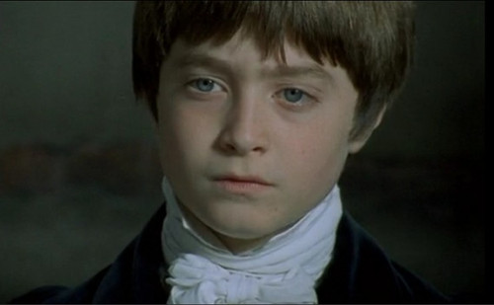
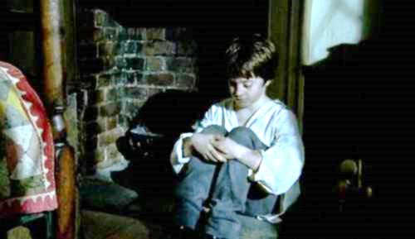
Conclusion
What kind of person is David?
Kind-hearted, unyielding(不屈), diligent, smart, strong will-power, have confidence and courage to face difficulties

Slide 23
How to express fear and anger
shiver with fear, whispered nervously, with my knees trembling , shake with terror , splutter(结结巴巴说话),explode
Mr. Murdstone 是如此严厉以致于我一看到他就害怕得发抖。
我正埋头玩手机，老师让我站起来回答问题。我的膝盖颤抖着站起来，紧张地低声说不知道。老师重新问我，我结结巴巴地说对不起。老师怒气一下子爆发了。
Mr. Murdstone was so severe/harsh/sterner that I trembled/shivered/shook with fear at the sight of him.
I was buried / immersed in my mobile phone when the teacher asked me to stand up to answer a question. I stood up with my knees shaking and whispered nervously that I didn't know. The teacher repeated and I spluttered sorry. The teacher’s anger exploded.

Slide 24
My mother
1.My poor mother! She was all alone in the world, except for me and our housekeeper, Peggotty. My father had died six months before I was born.
2.My mother seemed to light up in his company.
3. She was totally in his power. I could never get my mother on her own any more.她完全在他的控制之下。我再也不能让我的母亲独自生活了.
4.My poor mother now had two jailers instead of one. The Murdstones scolded her day and night. I never saw my mother again, unless she had first checked with those two that they agreed.
speak one’s mind说出某人的想法
5.My mother started crying and reached out towards me.
6.My mother fell silent as Mr Murdstone turned his steely gaze on me.
fall silent沉默
turn his steely gaze on sb. 冷漠地盯着我
7.I heard my mother and Peggotty screaming on the stairs outside my room, begging Mr Murdstone to stop.

Slide 25
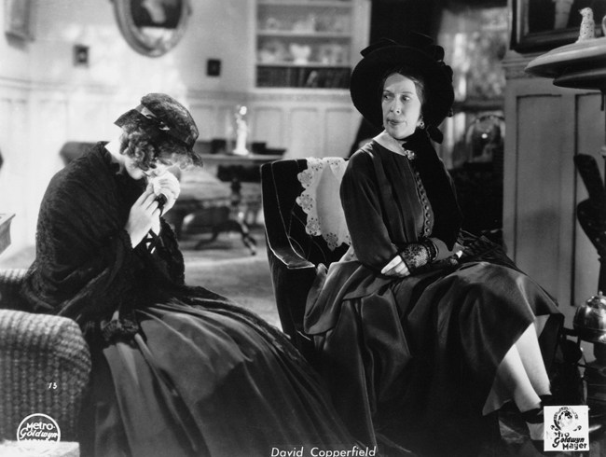
Mother
Conclusion
Poor, weak ,helpless, incompetent

Slide 26
Conclusion:
How to make your characters stand out
By describing appearance and environment
By describing behaviors and words
By describing different feelings

Slide 27
Homework:
Continuous writing with the following beginnings
Para1. “Tomorrow I will be sent to a boarding school?” Squatting in the corner, I thought with mingled feelings of sorrow and delight.
Para2. A sharp pain gripped me. I felt dizzy. After A long time there was a soft knock at the door.

Slide 28
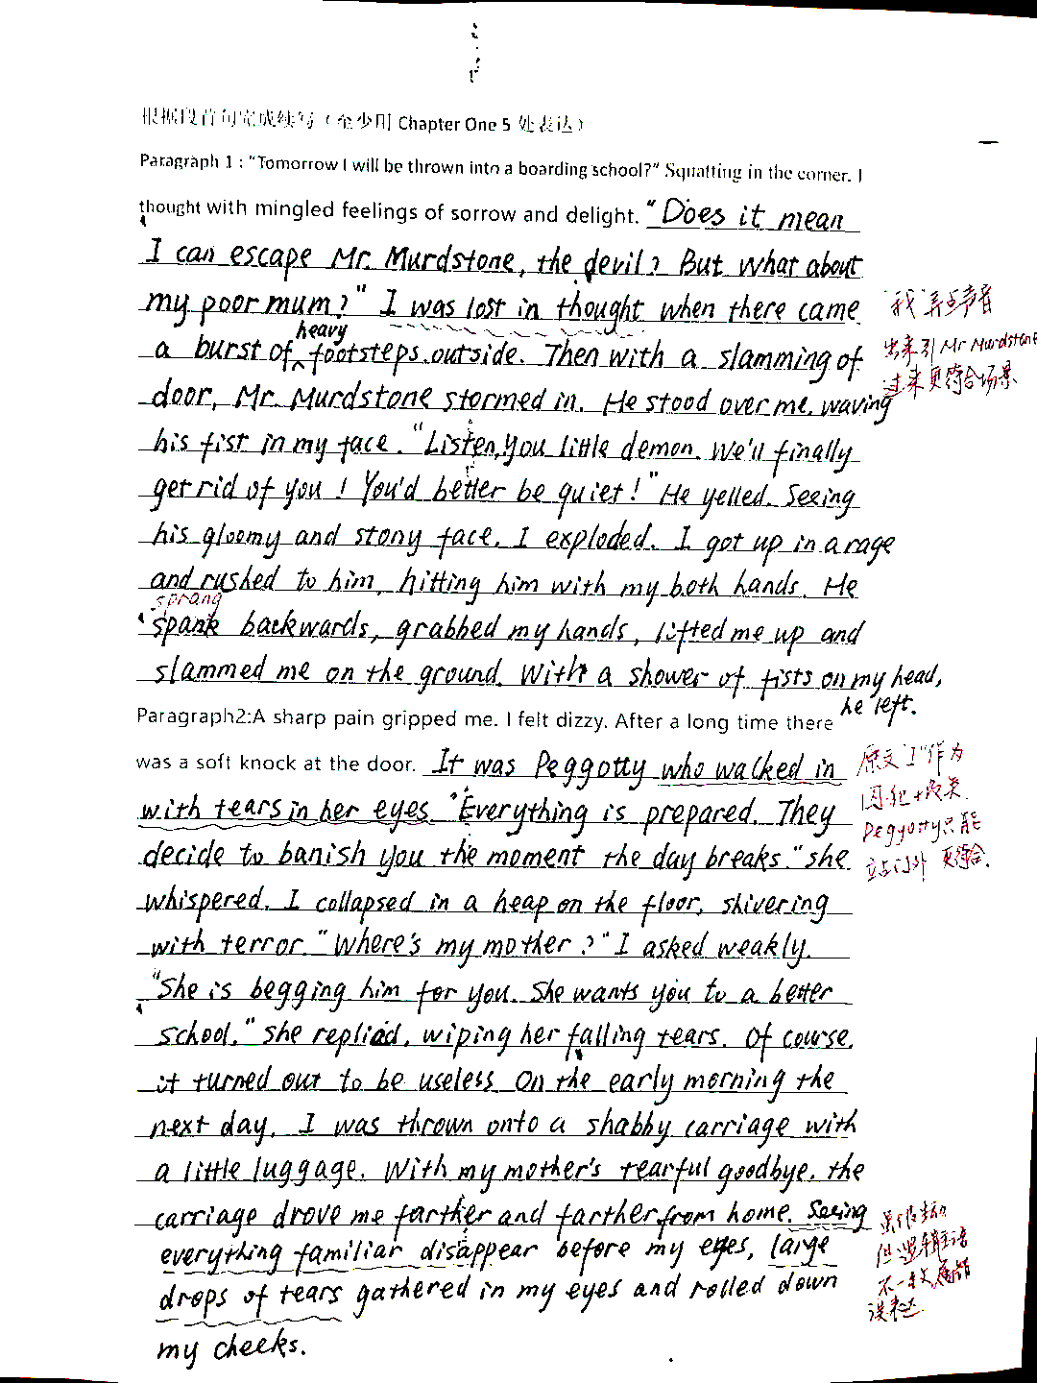
学生作文
教师评语：
内容：
从整体内容上来看，与上文和两个段首句衔接得较好。虽然有两处小瑕疵，如我被关在自己的房间，如果只是be lost in thought, 安安静静呆着，大概率Mr.Murdstone不会突然出现，改为“I began to beat the door.”更贴切，又如第二段Peggotty... walked in... ,“I”被锁着，同情我的Peggotty应该没有钥匙，上文她就站在门外，因此此处悄悄站在门外更符合，而在屋内最好描写耳朵听到的声音。
语言： 能很好地学习课堂上的各种好的表达，语言风格与原文一致。 人物的动作、语言与人物的身份非常贴切自然。动作描写生动形象，充满画面感。如stormed in, wave his fist, yelled, exploded, grabbed, slammed, whispered, collapsed in a heap, shiver with terror, gathered, rolled down等， 句式丰富多变，准确使用了倒装句， 强调句，分词结构， with短语等。当然，最后的分词的使用出现了逻辑主语不一致的错误。

Slide 29
教师下水作文
Para1. “Tomorrow I will be sent to a boarding school?” Squatting in the corner, I thought with mingled feelings of sorrow and delight. I began to tremble at the thought that I would never see my mother and Peggotty. I sprang to my feet, dashed to the door and slammed the door with all my strength. Unexpectedly, there was a roar of anger along with the sound of heavy footsteps. The moment the door was open, a face full of gloom and cruelty came into my sight. Waving his cane in one hand, Mr. Murdstone shut the door behind him , “You’d better keep quiet, or I’ll crush you.” He sneered, with an evil glint in his eyes. I lifted my arms, trying to defend myself. He erupted suddenly, jumping at me and slapping me. After a thousand slaps in the face, I collapsed in a heap on the floor. All I could hear was a slamming of the door and my mum and Peggotty’s screaming.
Para.2 A sharp pain gripped me. I felt dizzy. After A long time there was a soft knock at the door.“It‘s me.” It was Mum who was sobbing outside, “you can’t stay with me any longer, my boy.” I struggled to the window which was shut.“That is not a good place,”Then came Peggotty’s low voice, “but you’d better take good care of yourself. Just look at this……”she whispered. With a rustling sound, a few crumpled bills slipped through the crack of the window. I held the bills in my hands, “I hate him! I want to…” I said, grinding my teeth.“We have to leave!” With everything becoming silent again, my dream of escaping was shattered. The next morning, despite my tearful mother’s begging, I was thrown into a shabby carriage and finally I arrived in front of the boarding school, a humble , square , brick building.

