Slide 1

感恩遇见，相互成就，本课件资料仅供您个人参考、教学使用，严禁自行在网络传播，违者依知识产权法追究法律责任。
更多教学资源请关注
公众号：溯恩高中英语
知识产权声明

Slide 2
Unit 2 Looking into the Future
新人教选择性必修Book 1
Using Language1
-by Lily, 2021

Slide 3
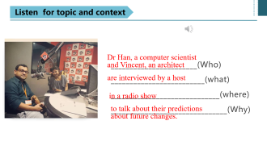
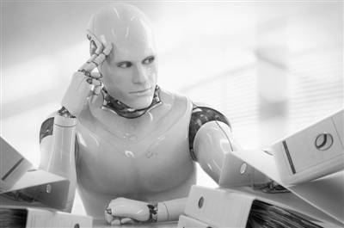
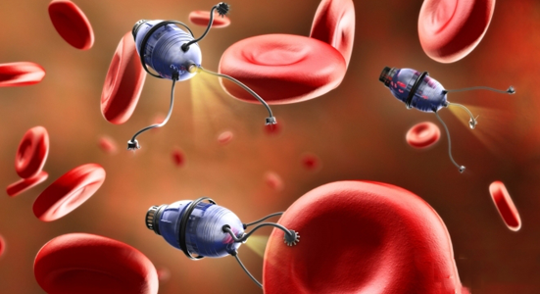
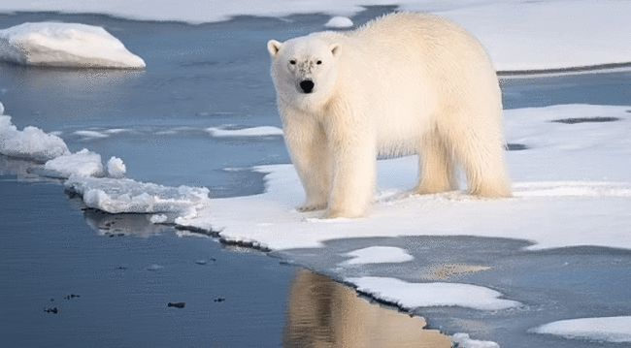
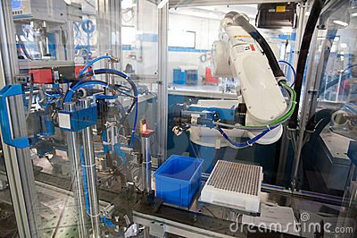
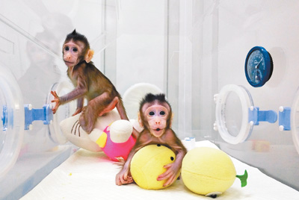
Do you know the stories behind the pictures?
What do these pictures imply?
artificial intelligence (AI)
challenges & opportunities
1
2
nanobots
automation
5
global warming
3
cloning
4
Notes:
_automation_nanobots
___global warming
___Artificial Intelligence
___cloning
More nanobots will be created to help doctors to find out the root of a disease and make operations more accurately.

Slide 4
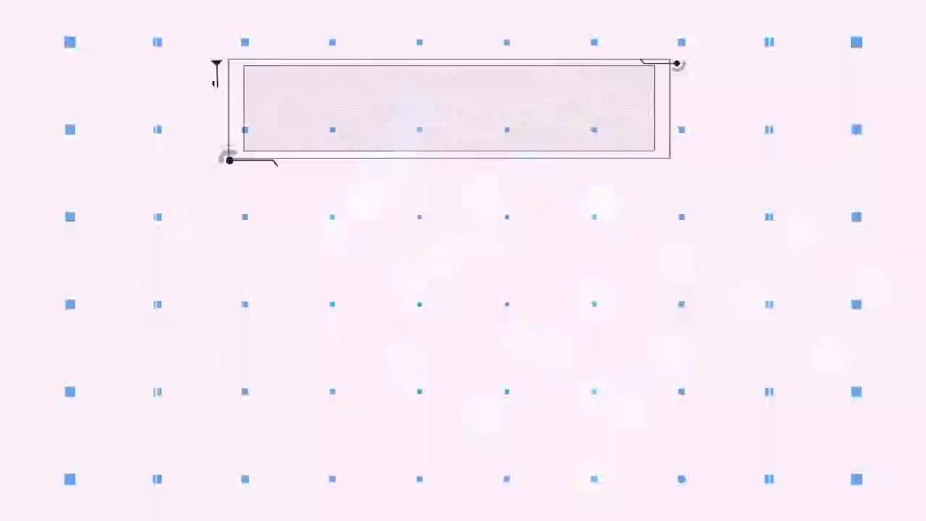

AI
Artificial Intelligence
What is AI?
1

Slide 5
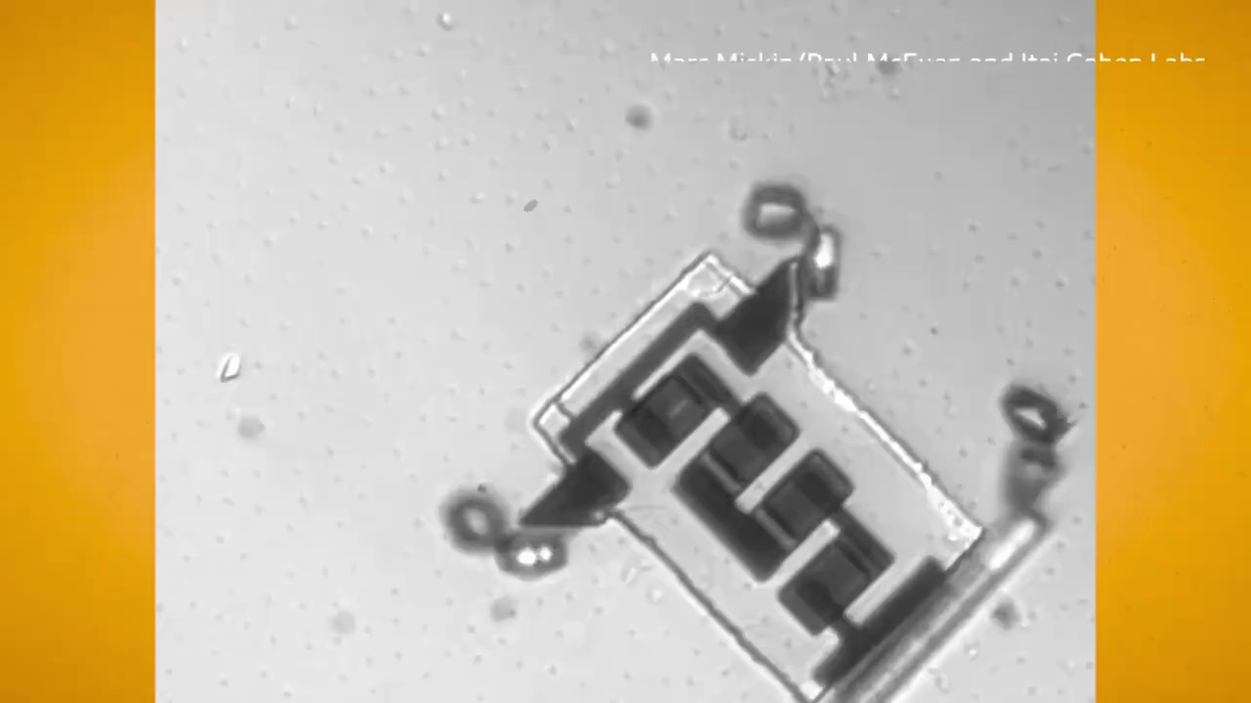
Nanobots
Pic2 is an artist’s rendering of nanobots in the human bloodstream. A nanobot is a microscopic robot. While they are still in the development stage, it is thought that nanobots can be used within the human body to deliver carefully targeted doses of medicine to areas in the body that need them and to repair human tissues and cells.
2

Slide 6
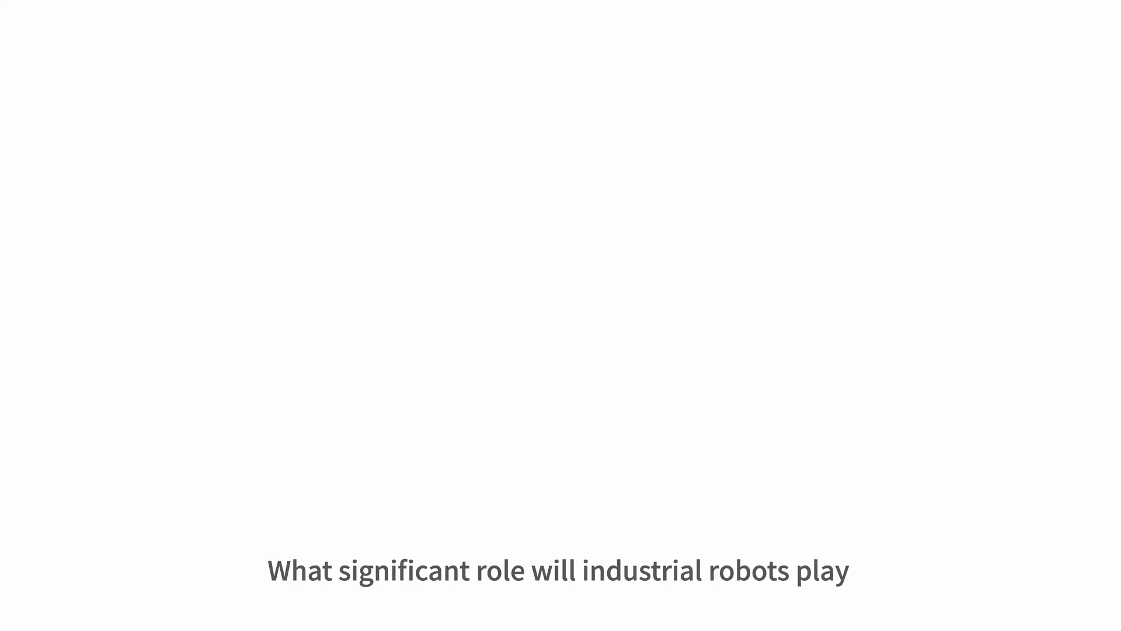
Automation: A robot arm
Pic3 A robot arm used to assemble parts in a factory, which promotes the automation of manufacturing.
3

Slide 7

Cloning
Pic4 The two monkeys are Zhong Zhong and Hua Hua, two crab-eating macaques which were produced by the Chinese Academy of Science
in Shanghai through cloning. They were the first successfully cloned primates.
4

Slide 8
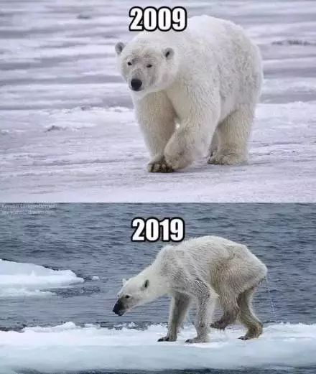
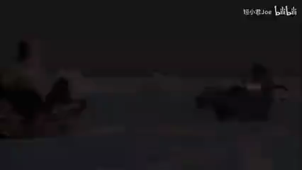
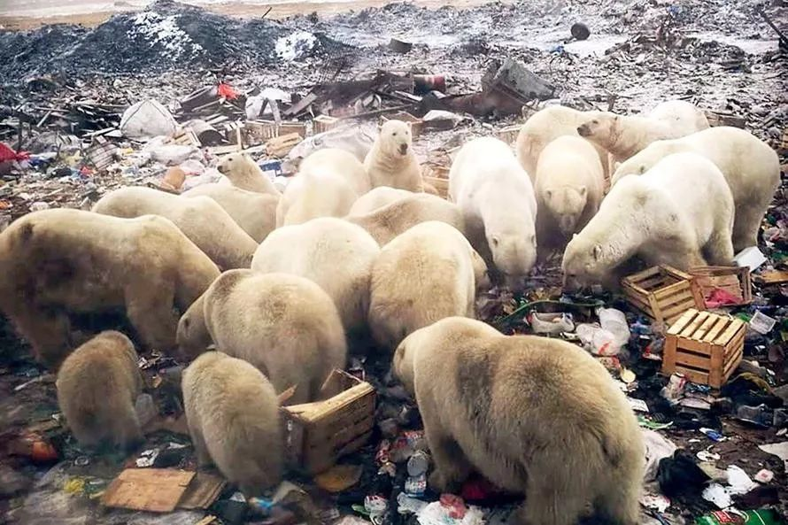
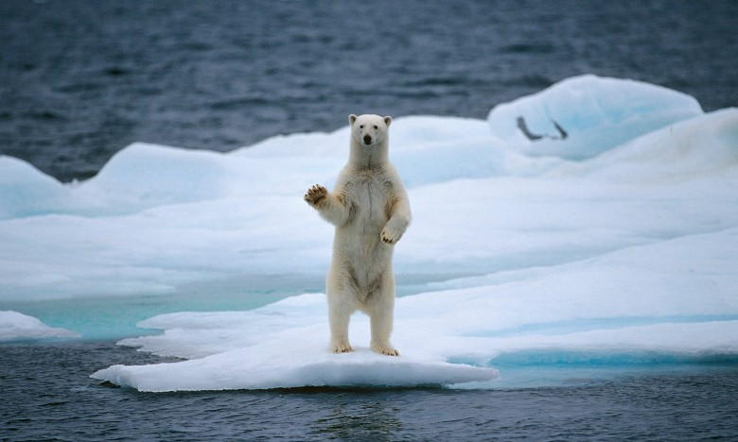
Global warming
Pic5 The polar bears suffer hunger, loss oh habitat caused by global warming.

Slide 9

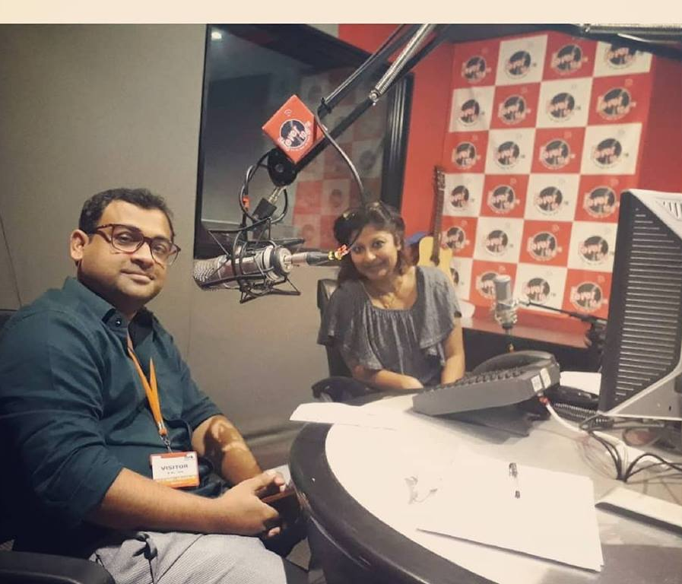
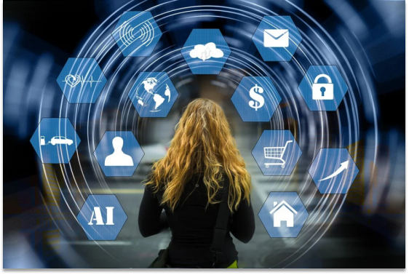
Listen for topic and context
_______________________(Who)
_________________________(what)
_____________________________(where)
_______________________________(Why)
Dr Han, a computer scientist and Vincent, an architect
are interviewed by a host
in a radio show
to talk about their predictions about future changes.

Slide 10
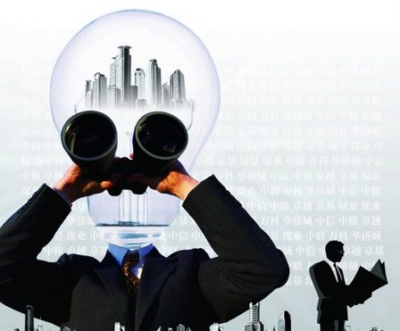
Listen for predictions
When listening for predictions, you should listen for the use of the future tense, in particular the future tense with will or will be doing. Words such as predict, prediction, and forecast, are also used quite often when making predictions.

Slide 11
Listen for Predictions
Listening Target | Dr Han | Vincent Black
Future Problems
Possible Solutions
Possible Effects
Computers will be cleverer than us.
With global warming causing polar ice to melt, the sea level will rise by many meters.
Nanobots will be put into our bodies to increase our abilities.
Cities floating on the water will be built.
Our abilities will be increased.
People don’t need to move away from the sea.

Slide 12

Listen for expressions
Q: What language did they use to make predictions?
Host: On today's episode of “Future Changes”, we talk
with two experts from different fields, Dr Han and
Vincent Black, to hear their predictions about the
future. First, Dr Han, could you please tell our
audience what you do?
Dr Han: Certainly. I'm a computer scientist.
Host: And could you please tell us your prediction?
Dr Han: Yes, well, I forecast that computers will be
cleverer than us in the future. I think that
people will also be programming computers to
think like humans.
Host: That's very interesting, but aren't you worried
that such computers would be dangerous?

Slide 13
Dr Han: Not at all. This is because we'll be programming
them to not think in ways that may harm humans.
In fact, we'll also be creating machines to help
people internally. For example, I think scientists
will put some small intelligent machines, called
nanobots, inside our bodies to increase our
abilities.
Host: Wow! That would make each one of us
superhuman! And Vincent, could you please tell
us about your job?
Vincent Black: Certainly. I'm an architect, I design buildings.
Host: And what is your prediction about the buildings
of the future?
Vincent Black: It's about the cities of the future, actually.

Slide 14
I believe that cities floating on water are part
of the world's future.
Host: Oh, really? What might make us want to do that?
Vincent Black: Yes. With global warming causing polar ice
to melt, the sea level rising by many meters
is a very realistic prospect. Instead of moving
people away from the sea, I think that people
could move into housing in cities that float.
Host: That sounds very innovative. Could you
please give us more details?
Vincent Black: Sure. Well, I've developed a plan by designing
a city that borrows many ideas from the giant
water lily, a flower that floats on water.
Moreover...

Slide 15

How to make predictions
phrases & sentence patterns | tense (future tense)
I think/believe/predict that in the future ...
My prediction is that ...
I can imagine / forecast ...
I doubt / don't think that ...
By 2030, we will ...
In the (distant) future there will ...
One challenge will be.…
We will have the opportunity to ...
We will be doing …
We are going to ...

Slide 16
Thinking
1. Do you agree with Dr Han and Vincent Black’s predictions and why or why not?
2. In your opinion, what challenges or opportunities will the new technology bring to us?
Notes:
I think Dr Han’s prediction is impossible. Computers can never be cleverer than us. Because they are programmed by humans.
I think Vincent Black’s predication is likely to happen, because global warming, the sea level is rising. Some places will be flooded and the land is getting smaller. Hence, it is a good idea to build houses above the sea

Slide 17
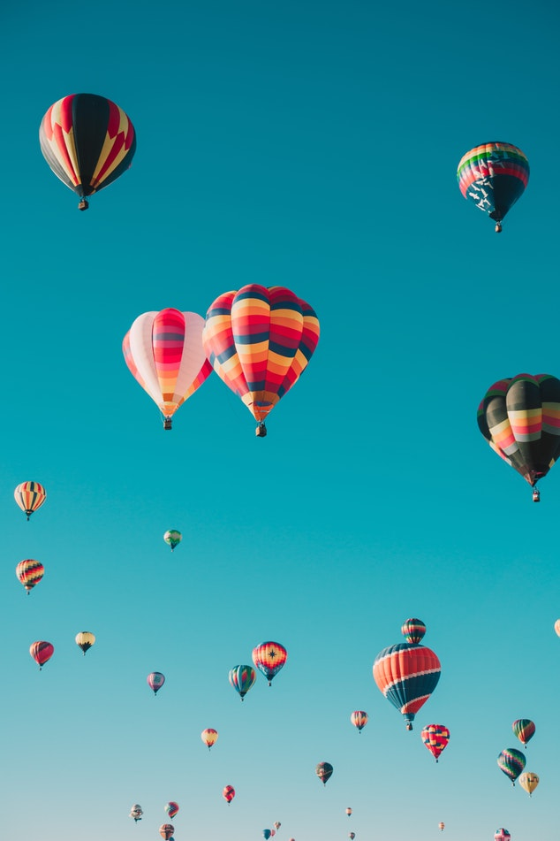

Talking
Topics
Imagine that you have a job that makes you an expert in the future. In pairs, interview each other about your jobs and predictions.

Slide 18
Talking
EXAMPLE
—What will the endangered wildlife be like then?
—My prediction is that people will spare their effort to live harmony with the endangered wildlife. So I don’t doubt that the wildlife will be protected well. And we may have the opportunity to enjoy the nature with them together.
—Thank you.

Slide 19
Talking
EXAMPLE
—Good afternoon, Miss Zhang. Thank you for agreeing to do this interview.
—I'd love to.
—First, we want to know whether the global warming will threaten our earth in the near future.
—Well, it seems that global warming is a big challenge now, but I can predict that by 2050, we will be able to decrease the carbon dioxide emission not only because humans already realized the necessity of protecting our climate but also because we will be using the environmental products which can replace the usage of coal and gas.

Slide 20
Thank You!
-by Lily, 2021

