Slide 1

感恩遇见，相互成就，本课件资料仅供您个人参考、教学使用，严禁自行在网络传播，违者依知识产权法追究法律责任。
更多教学资源请关注
公众号：溯恩高中英语
知识产权声明

Slide 2


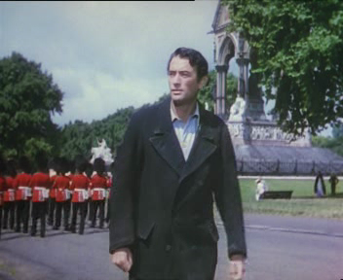
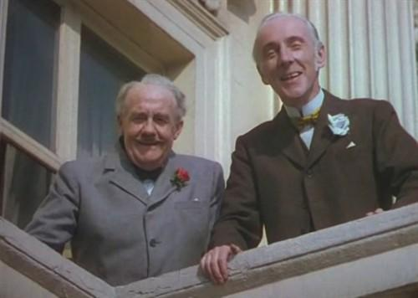
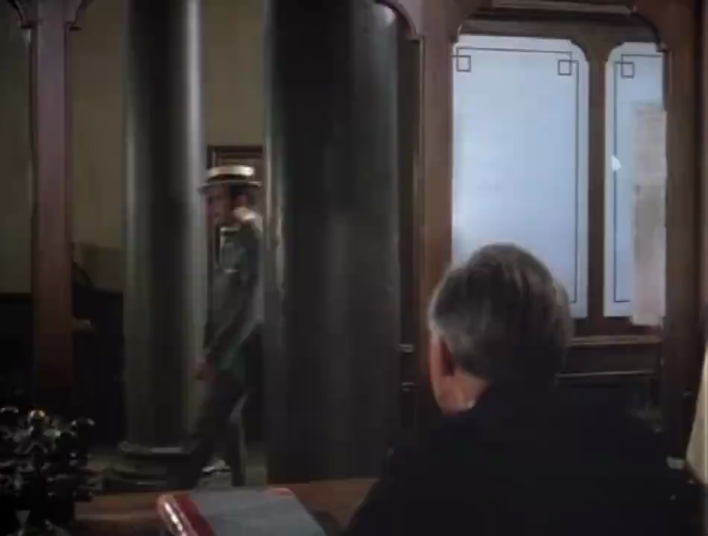
Lead-in
Watch and retell the scene in the video.
1. Where did the clip come from?
When a man was walking along the street,
2. Who were these men?
he was stopped and invited to a house by two wealthy men.
3. Why did the weathy men invite the young man to their house? And what happened in the house?

Slide 3
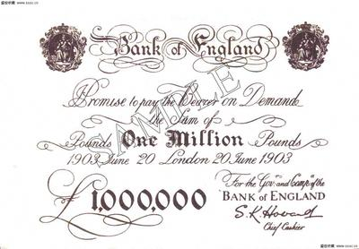
M3U5 The Value Of Money
The Million Pound Bank Note

Slide 4
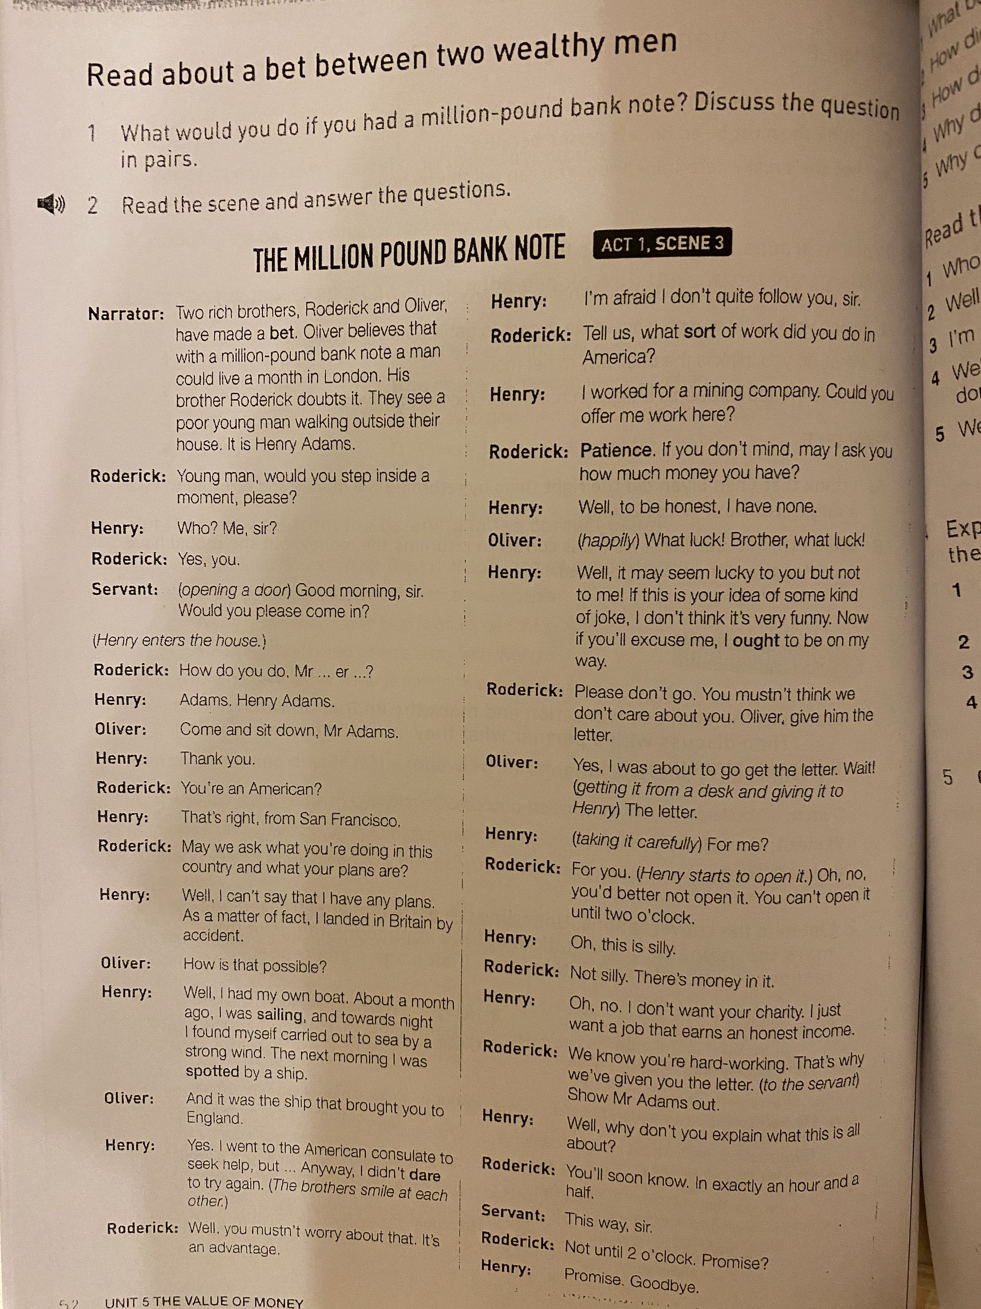

Prediction
戏剧中，Act（幕）:一个情节的发展
1幕3场
title of play
戏剧中，scene（场）:时/空间切换
What writing style is the text?
In a play，an act usually contains/consists of several scenes
narration（旁白）
back-
ground
A. a narration
B. an exposition
C. an argumentation
D. a play
In conclusion, a play is a story performed on a stage. It has a plot, settings, characters, actions and dialogue.
dialogue
stage direction
（舞台说明）
lines(台词）
characters
How do you know?

Slide 5
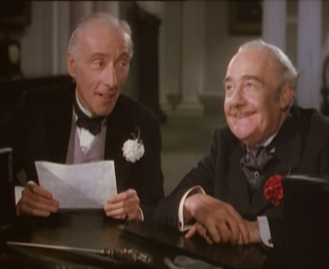
Read for characters
wealthy
brothers
Can you rearrange the timeline of Henry’s experience?
made a bet
e
walked
Now, Henry ________ in London streets.
About a month ago Henry Adams was ________ out of the bay.
___________he found himself carried out to sea by a strong wind.
The ship brought him England. Then he went to the American consulate __________help, but got nothing.
_____________________he was ________ by a ship.
on Henry
Why could Henry be chosen?(thinking)
a
sailing
Oliver who _______ a man could live a month _____ a million pound bank note
Roderick who _______ the idea.
believes
b
doubts
Towards night
with
How did Henry’s feeling change in the play?
d
to seek
Henry, an _________ who _______in Britain ____ accident
Henry didn’t come to Britain by_________.
American
design
c
The next morning
spotted
landed
by

Slide 6
Read for reasons
Why could Henry be chosen?(thinking)
How did Henry’s feeling change in the play?
Reading Tip 1
Hidden message
Narrator: Two rich brothers, Roderick and Olive have made a bet. Oliver believes that with a million-pound bank note a man could live a month in London. His brother Roderick doubts it. They see a poor young man walking outside their house. It is Henry Adams.
Roderick: Young man, would you step inside a moment, please?
Henry: Who? Me, sir?
Roderick: Yes, you.
Feeling of Henry
When the wealthy brother were making a bet, Henry happened to pass by in front of their house. Then he was chosen.
You can get the hidden message and the emotions of characters from their lines.
strange
surprised
confused
——Right moment(恰当的时机）

Slide 7

Read for reasons
Henry: Yes. I went to the American consulate to seek help, but... Anyway, I didn't dare to try again.
Roderick: Well, you mustn't worry about that. It’s an advantage.
1. Roderick:You're an American?
Roderick: Patience. If you don't mind, may I ask you how much money you have?
Henry: Well, to be honest, I have none.
Oliver: (happily) What luck! Brother, what luck!
Why could Henry be chosen?(thinking)
2. They see a poor young man walking outside their house.
1. A right moment
Reading Tip 1
3. Henry: Well, I can’t say that I have any plans. As a matter of fact, I landed in Britain by accident.
Henry: I worked for a mining company. Could you offer me work here?
Can you work out the hidden message and feelings of the following sentences?
And it was the ship that brought you to England.
You mustn’t worry about that. It’s an advantage.
What luck! Brother, what luck!
I don’t want your charity. I just want a job that earns an honest income.
Oh, this is silly.
2. Henry’s personal background
You can get the hidden message and the emotions of characters from their lines.
( foreigner,
young,
in a poor situation,
without aim,
without help
understand
without job,
hard-working,
without money）
Henry: Oh, no. I don’t want your charity. I just want a job that earns an honest income.
Henry: Well, it may seem lucky to you but not to me! If this is your idea of some kind of joke, I don't think it's very funny. Now if you'll excuse me, I ought to be on my way.
Henry: … Could you offer me work here?
Roderick: Patience…
How did Henry’s feeling change in the play?
Henry: (taking it carefully) For me?
Henry:I'm afraid I don't quite follow you, sir.
surprised/strange
confused
desired
determined
unwilling
confused
annoyed(climax)

Slide 8
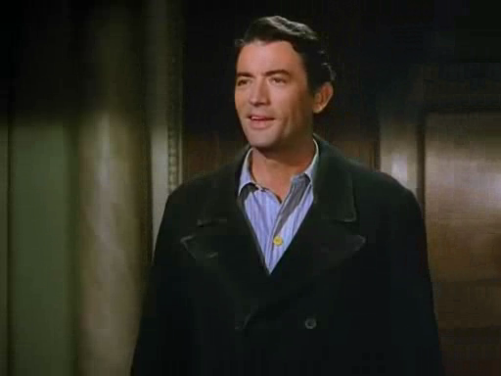
Read for Personalities
polite
2. Adams. Henry Adams.
A gentleman makes money in a right way.
1. Who? Me, sir?
Reading Tip 2
3. Thank you.
4. I’m afraid… sir.
Can you find the lines that show the two brothers’ personalities?
In a play, the lines are usually personalized to show the inner world of the characters.
honest/frank
1. I can’t say I have any plans. As a matter of fact…
2. I worked for a mining company.
3. Well, to be honest, I have none.
straightforward
1. Could you offer me work here?
What’s Henry’s view of money?
2. Well, it may seem lucky to you but not to me…
3. Oh, this is silly.
4. I don’t want your charity. I just want a job that earns an honest income.

Slide 9
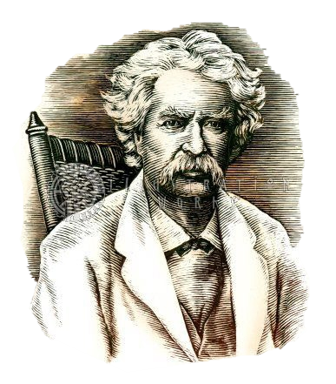



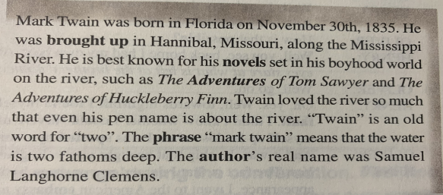
Learn About The Writer
谎言走遍天下，真理寸步难行
A lie can travel halfway around the world, while the truth is putting on its shoes.
Real name
Meaning the pen name
Birth date
Birthplace
Place where he grew up
His famous stories
Mark Twain
1835-1910

Slide 10
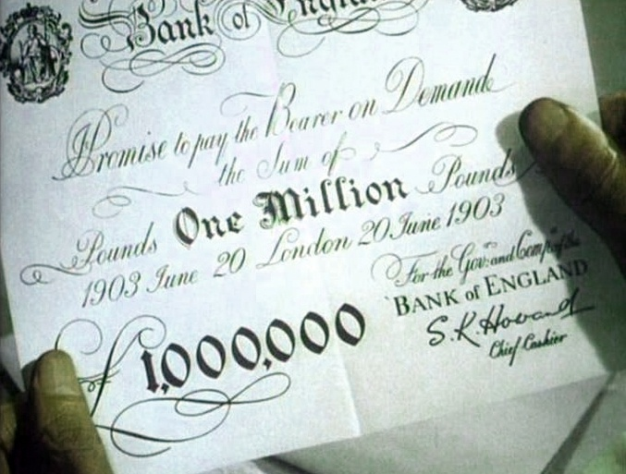
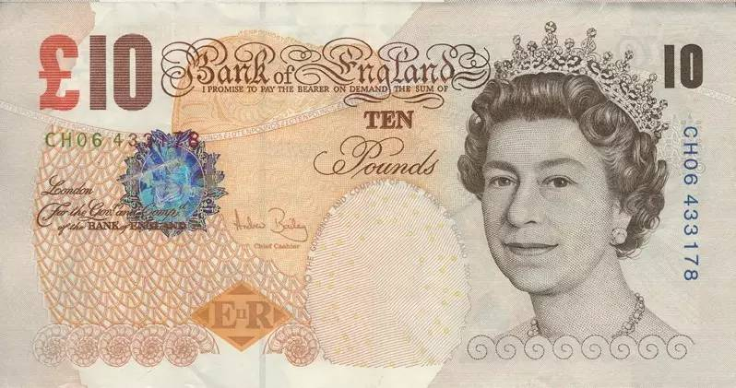
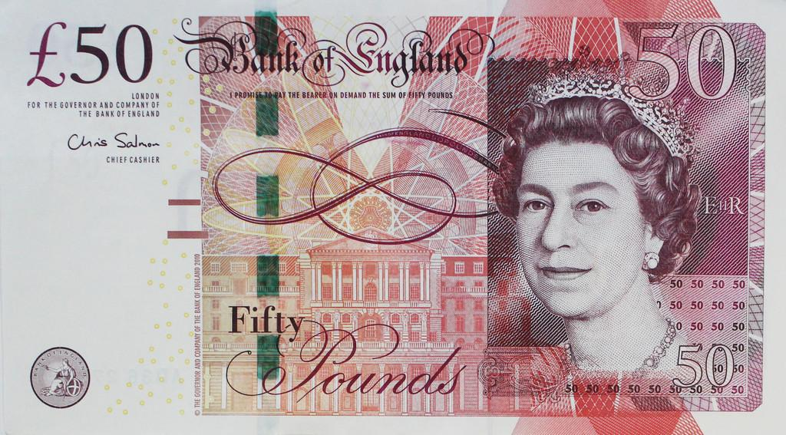
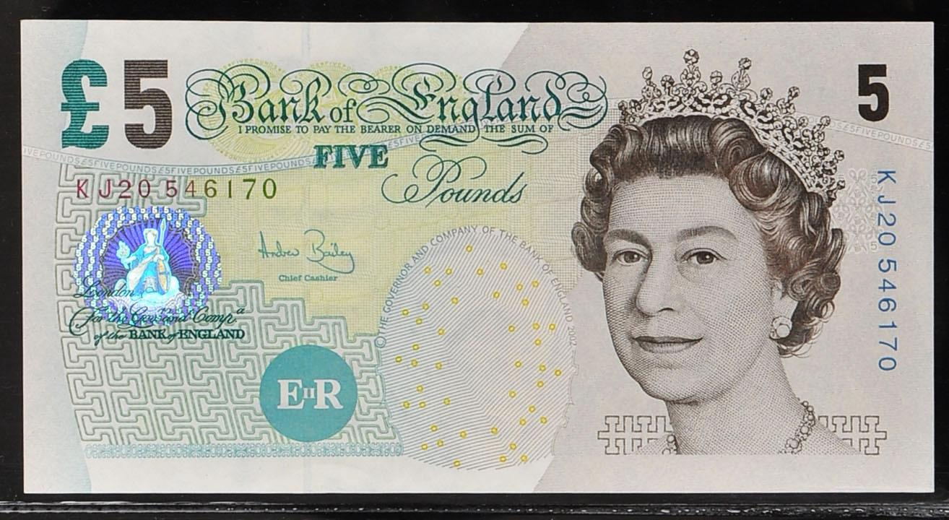
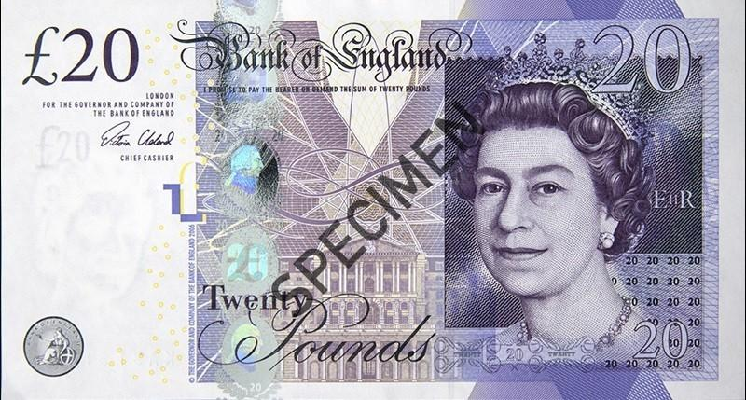
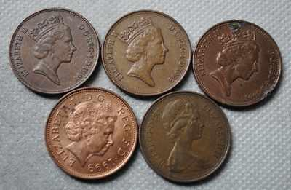
About Million Pound Bank Note
The Bank of England once issued two notes of a million pounds, each to be used for a special purpose connected with some public transaction with a foreign country.
For some reason or other, only one of these had been used and canceled; the other still lay in the bank.

