Slide 1

感恩遇见，相互成就，本课件资料仅供您个人参考、教学使用，严禁自行在网络传播，违者依知识产权法追究法律责任。
更多教学资源请关注
公众号：溯恩高中英语
知识产权声明

Slide 2
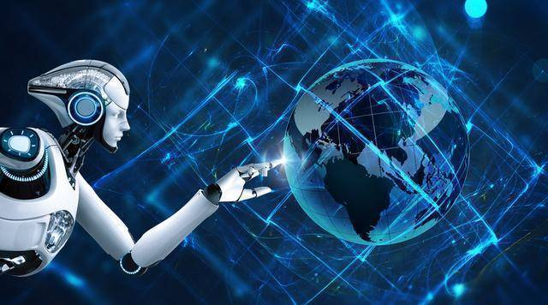
Unit 2 LOOKING INTO THE FUTURE
Reading and thinking
Smart homes to make life easier
The best way to predict
the future is to create it.
－Peter Drucker
杭州二中许丽君

Slide 3
Learning Objectives：
By the end of this period, you will be able to…
1. learn how smart homes make our life easier.
2. learn about the advantages and disadvantages of technology in the future.
3. analyze the structure of the article and summarize the main idea for each
paragraph.
4. express your opinions on smart homes.
5. figure out the structure of the passage and learn about smart homes and what they can do in the future.
6. infer the writing purpose and intended audience of this passage.
7. know the convenience brought by smart homes in the future.

Slide 4
Lead in:
➢➢Enjoy a video
Let’s watch a video about smart homes and think about the following questions?
Q1: What is “Smart”?
Q2: What might be talked about in this unit?
Q3: How do you understand the quote?
Q4: What’s the possible connection between the quote and the picture?
Q5: What’s the relationship likely to be between man and technology in the future?
Q6: What are your predictions about the future?
Q7: What might be some of the advantages and disadvantages of technology in the future?
Q8: What changes will technology bring us in the future?
Q9：What are your opinions on these changes?
Q10: How should we face such a future?

Slide 5
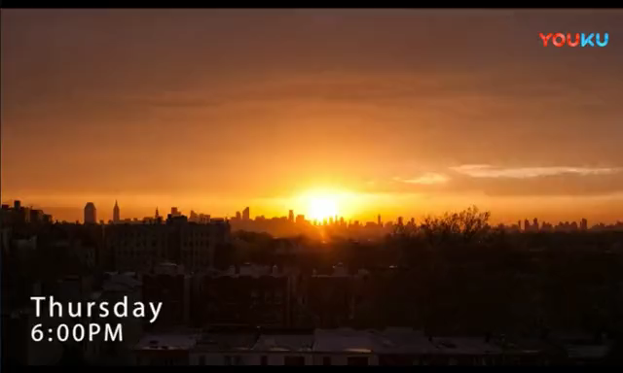
Lead in:
➢➢Enjoy a video
Let’s watch a video about smart homes and think about the following questions?

Slide 6
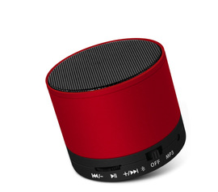
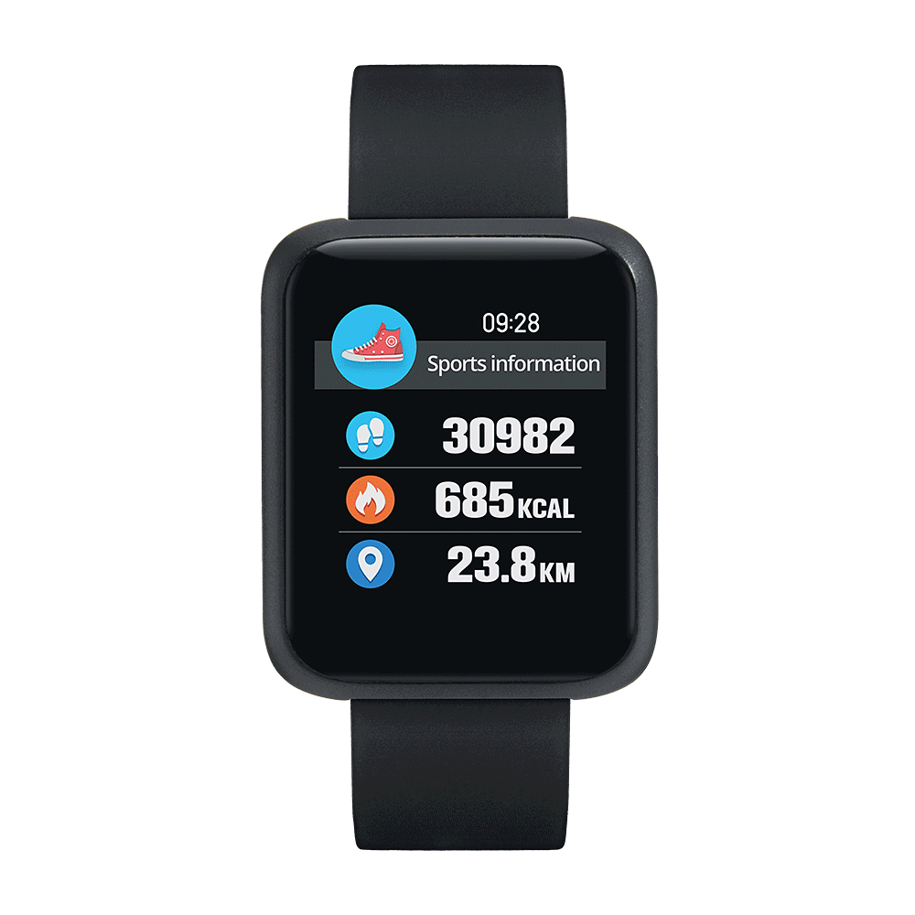

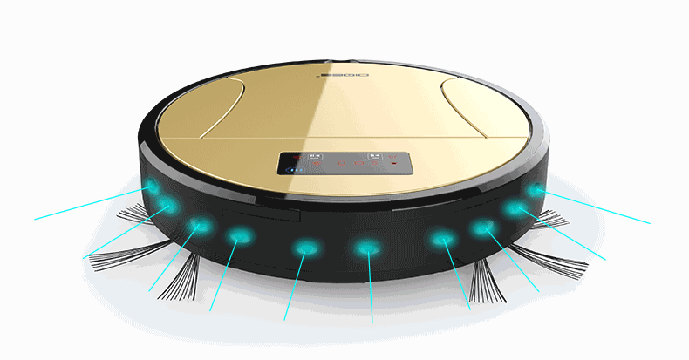
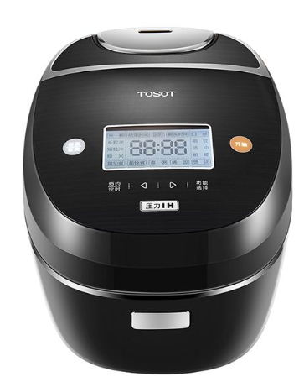
Warming up: Prediction
Lead in:
Q：Do you have any “smart” things? What are they?
Smartphones, smart watches, smart speakers…
What other smart devices do you know?
How can cell phones become so smart nowadays?
What else?
Smart Devices
...

Slide 7

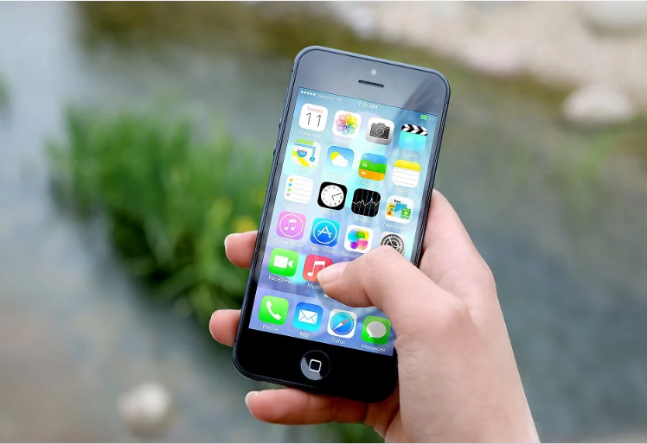
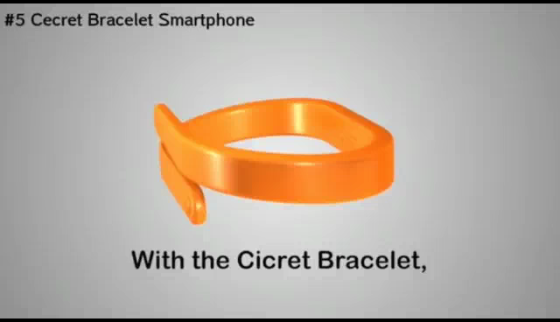
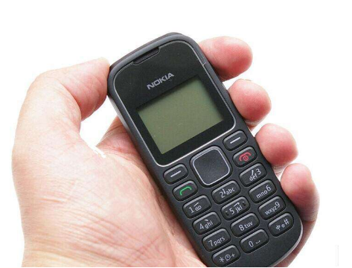
Warming up: Prediction
Lead in:
Do you know any other smart products? If so, what are they?
What smart phone will
look like in the future?
Something is smart means that it can make decisions on its own without a human telling it what to do, and that it can also learn how to do things itself.
mobile phone
smart phone
What does it mean when we say that something such as a phone is “smart”?

Slide 8
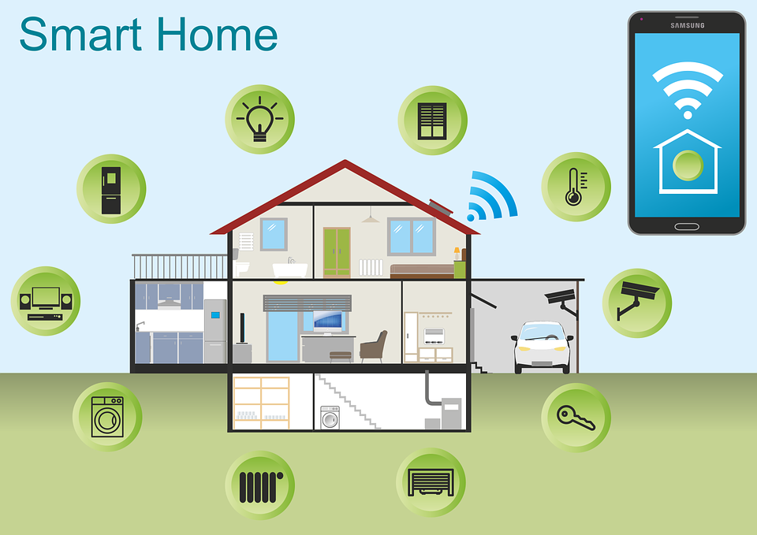
Warming up: Prediction
Lead in:
Q: How do smart homes make life easier in the future?
For example, a smart home could control room temperature and lights.
What do you think a “smart” house can
do that other houses cannot?

Slide 9
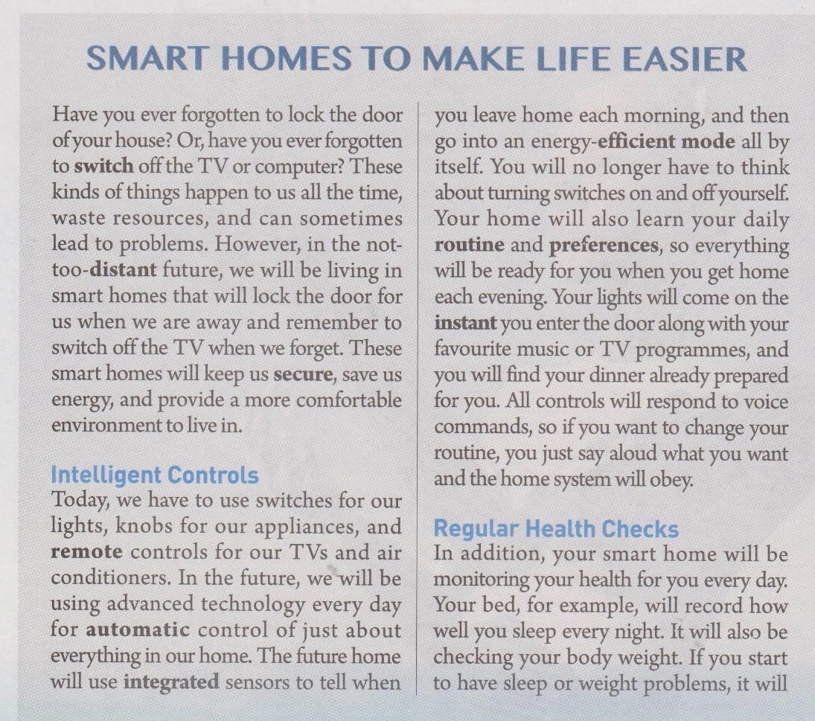
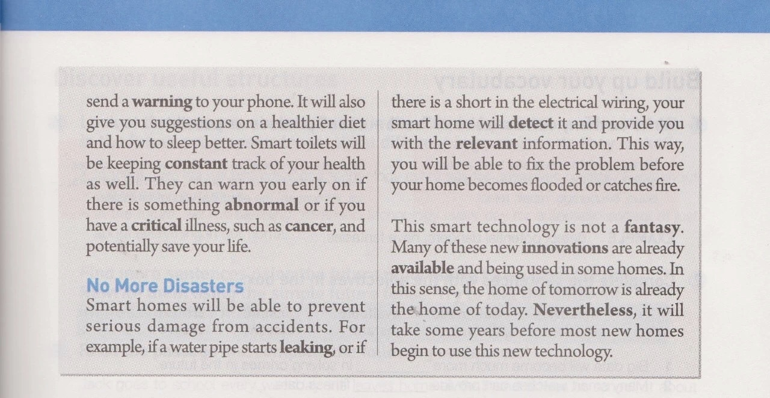
pre-reading : read for views on smart homes
What’ s the type of the text?
Brief and attractive title
a popular science article (科普说明文)
Before you read, discuss these questions in groups：
Q1.What does it mean when we say that something such as a phone is “smart” ?
Q2.What do you think a “smart” house can do that other houses cannot?
To say that something is smart means that it can make decisions on its own without a human telling it what to do, and that it also learns how to do things itself.
I would expect that a smart house could control room temperature and lights, for example.

Slide 10
pre-reading : read for structure
General statement
(Para.1)
Detail 1
(Intelligent controls)
Detail 2
(Regular health checks)
Detail 3
(No more disasters)
Conclusion
(Para.5)

Slide 11
pre-reading : Analyse the discourse structure
Smart homes to make life easier
Para1:General introduction to the advantages of smart home
1.General statement
Para 2:Intelligent Controls
Para 3:Regular Health Checks
Para 4: No More Disasters
2. Supporting details
Para5. This smart technology is not a fantasy.
3. Conclusion

Slide 12


General Idea and its type::
Read for
Q. What's the main idea of the text?
A. Smart home will focus on people’s health issues.
B. Smart home is a new but controversial technology.
C. Smart home will make our life easier in many ways.
D. Smart home will make human beings lazy.
Q：What genre is the text? What are its features?
A. A narration (记叙文)
B. A popular science exposition (科普说明文)
C. An argumentation (议论文)
D. A science fiction story (科幻故事)
Features: A brief and eye-catching title;
Explaining general concepts in a simplified way;
Emphasizing on main events
Using quotes, metaphors (比喻), analogies (类比) to explain difficult or abstract scientific concepts.

Slide 13


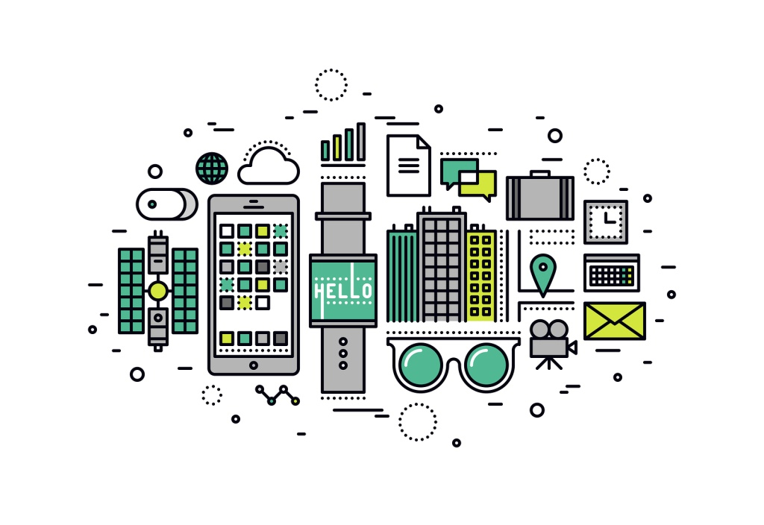
Skimming
Reading Comprehension
Skimming
Skim the text and answer the questions below.
1. What is the purpose of the text?
The purpose of the text is to introduce and get people excited about the idea of smart homes.
To give us a brief introduction about the future smart homes.
To tell us what the future home will be like.
To tell people how smart homes make life easier.
2. Who do you think is the intended audience of this text?
Home owners or common people who are interested in the advanced technology or smart homes.
People who welcome smart homes or new technology.

Slide 14

While-reading : read for details
1. Where is the text likely to be taken from?
A. A science magazine B. A research report
C. A health magazine D. A book review
2.When you live in a smart home, ______.
A. you will be warned early on if you have a deadly illness
B. you have to change your daily routine according to the command of the home system
C. you will not be forgetful any longer
D. you will be protected from any disasters
3.What does the word “monitoring” (Para.3) most probably mean?
A. Watching. B. Entertaining.
C. Treating. D. Recovering.

Slide 15
While-reading : read for details
Q4：What do we know about this smart technology from the last paragraph?
A. It is a fantasy at present.
B. It has already been used widely.
C. It is being used in some homes.
D. It will never be realized.
What's the author's attitude toward the new technology?
A. Doubtful. B. Confident.
C. Unclear. D. Opposed.
√
Q5：What is the writer's attitude towards smart homes? How do you know that?
Optimistic, positive, hopeful , supportive.
Q 6: What writing techniques are used in this article?
➢By means of classification, examples and comparison.
Q7: Where can you find this kind of passage?
➢It is usually presented in many forms, including books, magazine articles, web pages, etc. This text is more likely from a magazine.

Slide 16
While-reading : read for main idea of each paragraph
1．Match each paragraph with its topic sentence.
Para.1 A．Smart homes will check people’s health regularly.
Para.2 B．Smart homes will prevent serious damage from accidents.
Para.3 C．Intelligent controls in the home system.
Para.4 D．Smart technology will be used widely in the future.
Para.5 E．Smart homes will bring us safe, energy-saving and
comfortable life in the future.

Slide 17
While-reading : read for details
Structure:
Smart Homes
Topic
Regular
Health
Checks
Intelligent
Controls
No more
Disasters
Main
functions
Integrated sensors
When you leave home:
energy-efficient mode
When you get home:
Everything will be ready doors, lights, TV ,
dinner.
Monitor your health
Your bed:
sleep, body weight,
Your toilet:
Keep constant track
Warn you early
critical illnesses
Prevent serious damage:
leaking pipes
a short in electric wiring
Detect it
Examples

Slide 18

while-reading : read for details
Para.1
Activity 1: Read paragraph1 and think over the questions.
Q1.Why does the writer start the paragraph with two questions?
A: Because the writer wants to introduce the topic and to arouse readers’ interest.
Q2.What does “these kinds of things” refer to?
A: These kinds of things refer to forgetting to lock the door or switch off the TV or computer and some inconvenience people may have in ordinary homes .
Q3. What will be a smart solution?
A: A smart home will be a solution.
Q4. What’s the difference between ordinary homes and smart homes?
Smart homes
Ordinary homes
save us energy
keep us secure
provide a more comfortable environment
waste resources lead to problems
VS

Slide 19
while-reading : read for details
Para.1
Activity 1: Read paragraph1 and think over the questions.
Q5: What problems do we have in our daily life?
A: You have ever forgotten to lock the door or to switch off the TV or computer.
Q6: How will these problems be solved in the not-too-distant future?
A: We will be living in smart homes that will lock the door and remember to switch off the TV.
Q7:What difference will smart homes make to our life?
A: These smart homes will keep us secure, save us energy, and provide a more comfortable environment to live in.
Q8: How does it introduce the topic?
A: By raising two questions.
Q9: In what ways will such smart homes be helpful?
A: Smart homes will be a solution, and they can keep us secure, save us energy and provide a more comfortable environment to live in.

Slide 20
While-reading : read for details
Para.1
Para.1
To arouse the readers' attention or interest
Have you ever forgotten to lock the door of your house? Or, have you ever forgotten to switch off the TV or computers? These kinds of things happen to us all the time, waste resources, and can sometimes lead to problems.
However, in the not-too-distant future, we will be living in smart homes that will lock the door for us when we are away and remember to switch off the TV when we forget. These smart homes will keep us secure, save us energy, and provide a more comfortable environment to live in.
problems
attitude: positive/excited/favourable
functions
benefits

Slide 21
While-reading : read for details
Para.2
Activity 2. Read Para.2 and answer the following questions.
Q1.What's the topic sentence?
A: The topic sentence is Intelligent Controls in the home system.
Q2.How does automatic control work? Examples?
A: using advanced technology for automatic control. examples: lights, door, TV, dinners.
Q3. With intelligent controls, what can smart homes do, and how does it benefit us?
A: The smart homes will keep us secure, save us energy and provide a more comfortable environment to live in.
Q4. What are the features of intelligent controls? What evidence can you find in the text?
A: Features of intelligent controls are: popular, widely accepted, sensitive, efficient, automatic, environment-friendly, Considerate, relaxing, comfortable, easy to control
Q5: What can you do if you want to change your routine?
A: You just say aloud what you want and the home system will obey.
Q6: What chores do we have to do today?

Slide 22
While-reading : read for details
Para.1-2
Today, we have to use...for....
You will no longer have to ....
In the future, we will be using advanced technology every day for ....
Each morning:
Advantages:
use integrated sensors to tell...
Keep us secure
save us energy
go into an energy-efficient mode...
Each evening:
learn your daily routine and preference
get everything ready: your lights/favourite music or TV programme/dinner
provide a more comfortable environment to live in
Change of routine:
say alound what you want
respond to your voice commands

Slide 23
While-reading : read for details
features
Intelligent Controls
Today, we have to use switches for our lights, knobs for our appliances, and remote controls for our TVs and air conditioners. In the future, we will be using advanced technology every day for automatic control of just about everything in our home. The future home will use integrated sensors to tell when you leave home each morning, and then go into an energy-efficient mode all by itself. You will no longer have to think about turning switches on and off yourself. Your home will also learn your daily routine and preferences, so everything will be ready for you when you get home each evening. Your lights will come on the instant you enter the door and along with your favourite music or TV programmes, and you will find your dinner already prepared for you. All controls will respond to voice commands, so if you want to change your routine, you just say aloud what you want and the home system will obey.
Para.2
popular, widely accepted
sensitive
efficient, automatic, environment-friendly
considerate
relaxing, comfortable
easy to control

Slide 24
While-reading : read for details
Para.3
Regular Health Checks
In addition, your smart home will be monitoring your health for you every day. Your bed, for example, will record how well you sleep every night. It will also be checking your body weight. If you start to have sleep or weight problems, it will send a warning to your phone. It will also give you suggestions on a healthier diet and how to sleep better. Smart toilets will be keeping constant track of your health as well. They can warn you early on if there is something abnormal or if you have a critical illness, such as cancer, and potentially save your life.
Your bed
Smart toilets

Slide 25
While-reading : read for details
Activity 3: Read Para.3 and analyse them with the help of the following questions.
Q1. What's the topic sentence of this paragraph?
A：Smart homes can check our health.
Q2. How will your smart home monitor your health?
A: Smart homes monitor our health with bed recording your sleep and checking your body weight, sending a warning to your phone.
Q3. What smart home functions are mentioned?
A: giving you suggestions and keeping constant track of your health, warning you early on if something is abnormal of if you have a critical illness.

Slide 26
While-reading : read for details
Activity 3: Read Para.3 and analyse them with the help of the following questions.
Q4. What can smart homes do with these functions?
A: Smart homes will monitor our health.
Q5. What advantages can these functions bring?
A: Saving us energy, saving time, monitoring health, and preventing disasters.
Q 6. How does the writer organise the information?
A: By means of classification, comparison and giving examples.
Q7. If you start to have sleep or weight problem, what will your smart bed do?
A: Smart bed will send a warning to your phone.

Slide 27
While-reading : read for details
Para.4
No More Disasters
Smart home will be able to prevent serious damage from accidents.
For example, if a water pipe starts leaking, of if there is a short in the electrical wiring, your smart home will detect it and provide you with the relevant information. This way, you will be able to fix the problem before your home becomes flooded or catches fire.

Slide 28
While-reading : read for details
Para.3-4
Regular Health Checks
No More Disasters
will be able to prevent serious damage from accidents
A general introduction
will be monitoring your health
Examples
Your bed
detect:
record how well you sleep
check your body weight
a water leaking pipe
send a warning to your phone
a short in the electrical wiring
give you suggestions on
provide you with the relevant information
Smart toilet
keep constant track of your health
warn you early on
will be able to fix the problem in time
Advantages
potentially save your life

Slide 29
While-reading : read for details
This smart technology is not a fantasy. Many of these new innovations are already available and being used in some homes. In this sense, the home of tomorrow is already the home of today. Nevertheless, it will take some years before most new homes begin to use this new technology.
these
Para.5
new innovations
The time of smart homes has already come.
high cost, imperfect technology, risk of danger...

Slide 30
While-reading : read for details
Activity 4. Read Para.5 and analyse and answer the following questions.
What's the main idea of this paragraph?
A: Smart technology is not a fantasy, but it will take some years.
2. Is living in a smart home only a fantasy?
A: No, it isn’t.
3. What does “these new innovations” refer to?
A: These new innovations” refer to TVs, computers, water pipes, electrical wires, bed, toilets, favorite music, or TV programmes, lights and air conditioners.
4. What advantages do smart homes have?
A: Saving energy, saving time, monitoring health, and preventing disasters.
5. Why do you know the smart technology is not a fantasy？
A: Because many of these new innovations are already available and being used in some homes.
6. What is the writer’s attitude towards smart homes? How do you know that？
A: optimistic, positive, hopeful

Slide 31
While-reading : read for Mind Map
future life
Introduction
Examples
Conclusion
Advantages of smart homes
Keep us ________
Save us energy
Provide a more _____________environment to
live in
Intelligent Controls
Using advanced technology for _________
control of everything at home
Regular Health Checks
__________ your health
No More Disasters
__________ serious damage from
accidents.
Now: New innovations are available.
Future: It will take some years before
most new homes begin to use
this new technology.
automatic
secure
Monitoring
comfortable
Preventing

Slide 32
While-reading : read for details
Read the text again and fill in the table below.
In the future, what will smart homes do about?
doors | lock the door for us when we are away | dinners | prepare dinner for us
TVs, computers | switch off TVs and computers when we forget | beds | record how well we sleep every night, check our body weight, send a warning to our phones when we have sleep or weight problems, and give us suggestions on a healthier diet and how to sleep better
water pipes, electrical wires | detect if there is a problem and provide us with the relevant information | toilets | keep constant track of our health and warn us early on if there is something wrong
lights, favourite music, or TV programmes |  | come on the instant we enter the door

Slide 33
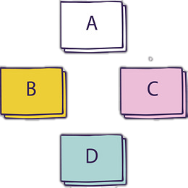

Post-reading : Conclusion
conclude the structure of the text
Read the text again and finish the mind map.
Title
Smart Homes to Make Life Easier
These smart homes will keep us secure, save us energy, and provide a more comfortable environment to live in.
Introduction
Regular Health Checks
Intelligent Controls
No More Disasters
Examples
This smart technology is not a fantasy.
Conclusion

Slide 34
Post-reading : Fill in the blanks with the given words:
课文语法填空，在空白处填入1个适当的单词或括号内单词的正确形式。
Have you ever forgotten to lock the door of your house or switch off the TV? These kinds of things often happen to us, which can lead_________problems. However, in the near future, we_____________ ( live) in smart homes that will lock the door and switch off the TV______________( automatic). These smart homes will provide us with a _________________(comfortable) environment.
Your home will learn your daily routine and ___________ (preference), so everything will be ready
for you when you get home each evening. For example, lights will come on instantly you enter the door along with__________(you) favourite music. All controls will respond to voice commands, so you just say _________you want and the home system will obey. Besides, it will give you suggestions on a healthier diet and how____________( sleep) better.
This smart technology__________(be) not a fantasy. Nevertheless, it will take some years _________ most new homes begin to use it.
to
will be living
automatically
more comfortable
preferences
your
what
to sleep
is
before

Slide 35
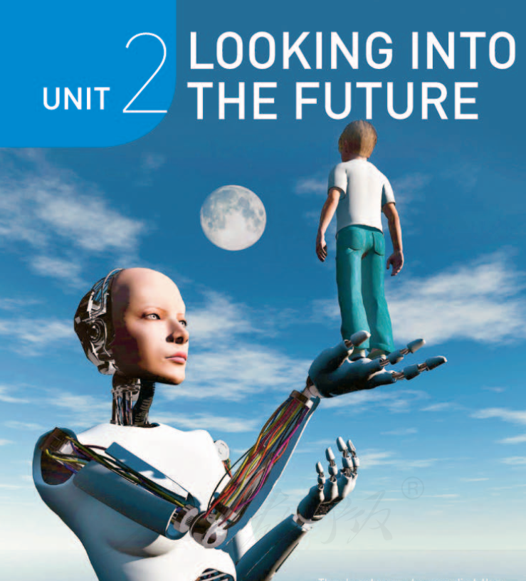
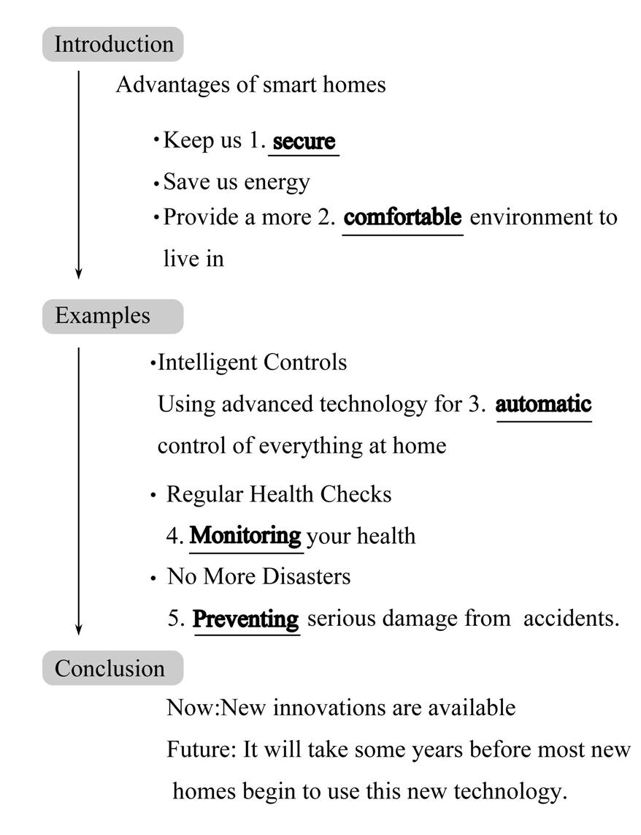

Post-reading : Retell the text with the help of mind map
Read the text again and finish the following tasks.
文本整体理解:
理清文章架构

Slide 36
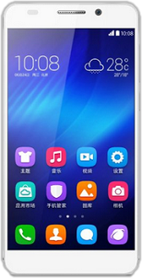
Post-reading : read for explortation
What can we do with smart phone?
1
Benefits:
Having or giving a call
more convenient
6
2
Navigating, shopping...
Playing games
more interesting
5
3
much easier
Listening to music
Watching films
4
...
Studying

Slide 37
Critical reading: Learn to think critically
Question：Why do humans create high-tech products like smart homes since smart technology poses challenges to us?
Q1：Who is actually intelligent? and why do humans create such smart technology?
Answer: We human beings are intelligent. Because we can use it to serve us and make our lives easier.
Answer: Though we should welcome smart homes, we should also be cautious about possible disadvantages. So, we should hold an open but cautious attitude towards them.
Q2：What attitude should we have towards smart homes?
Answer: Some of the disadvantages of smart homes are concerns over their reliability and security.
Q 3: What might be some of the disadvantages of smart homes?

Slide 38

Discussion: Work in groups
➢In what way is the home of tomorrow already the home of today?
Many of the new innovations are already used in some homes today. This is especially true for automatic controls of things such as lights and air conditioners.
➢What might be some of the disadvantages of smart homes?
One disadvantage is that if there is a problem with the system, you may find yourself locked out of the house, or unable to turn your TV off or on.
Security is another big concern, as strangers may be able to hack into the system to collect information about your life and use that for evil purposes.
High cost，risk of leaking personal information，unpopular among most of senior citizens, etc.
➢ What’s the author’s attitude towards smart homes?
The author uses “will be doing” to show his favor to smart homes.

Slide 39
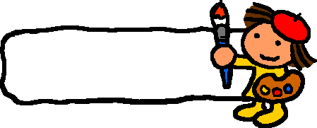
summary
Complete the summary using the correct forms of the words from the text.
A smart home is one that ___________computers into the structure of the building itself. In this way, many of the things that we now do ourselves will become ___________ . For example, the smart home could control the air conditioning and lights so that you would no longer have to turn _________ on and off, making your home more energy-____________ . The smart home could also __________itself to make sure that everything is working as it should, and send you _________if there is a problem. Such smart homes could even be programmed to _________your health problems, and then give you_________ advice as to the food you should eat or if you should see a doctor. So, in a sense, smart homes will lead us to living smarter lives.
integrates
automatic
switches
efficient
monitor
warnings
detect
relevant

Slide 40

Group show
Fill in the table with the words and phrases.
In the future, what will smart homes do about…？
doors
TVs，computers
water pipes，electrical wires
dinners
beds
toilets
light，favourite music，or TV programme

Slide 41
Assignment
1. Introduce smart homes in your mind.
2. Use your own words to briefly summarize the advantages of smart homes and exchange your ideas after class.
3. If you are ready to take part in an English speech contest about “Smarter Homes, Easier Life”. Please write your content.（80词左右）
4. If you are able to create a smart device, what will you create? Write about your creation. You are supposed to include:
1) a name indicating the device;
2) a general introduction to the new device;
3) examples illustrating its new functions;
4) the benefits the new device can bring.

Slide 42
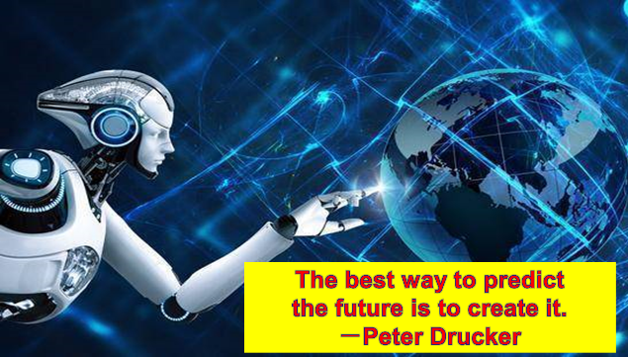
Thank you !

