Slide 1

感恩遇见，相互成就，本课件资料仅供您个人参考、教学使用，严禁自行在网络传播，违者依知识产权法追究法律责任。
更多教学资源请关注
公众号：溯恩高中英语
知识产权声明

Slide 2

选择性必修一
Unit 3 Fascinating Parks
Reading and Thinking
SAREK NATIONAL PARK
- EUROPE’S HIDDEN NATURAL TREASURE

Slide 3
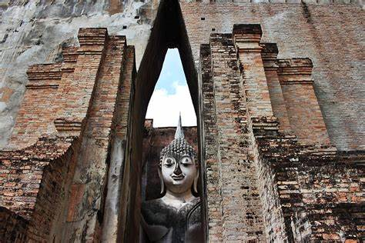
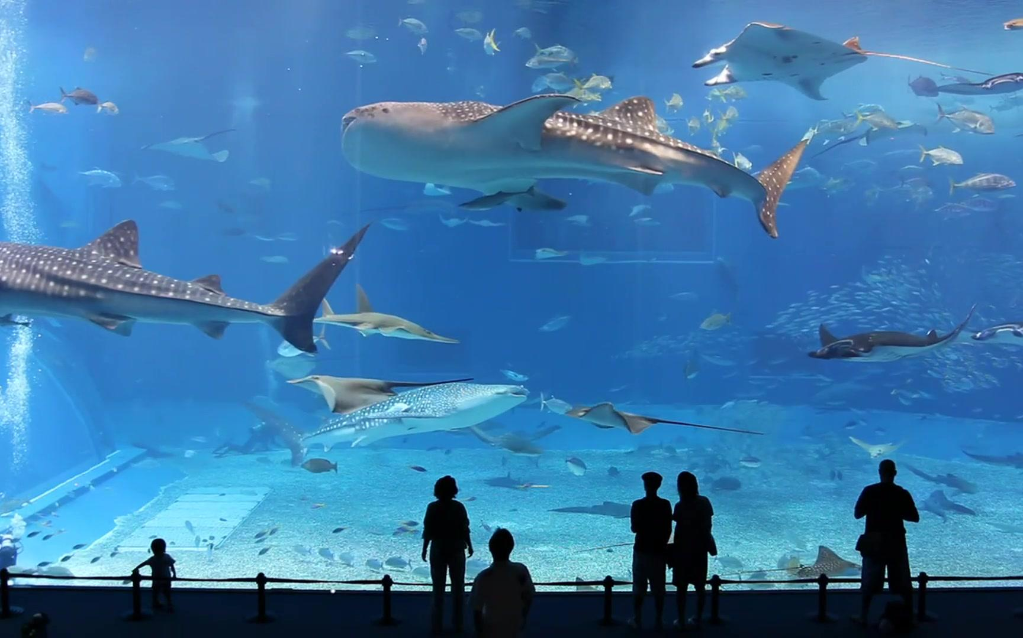
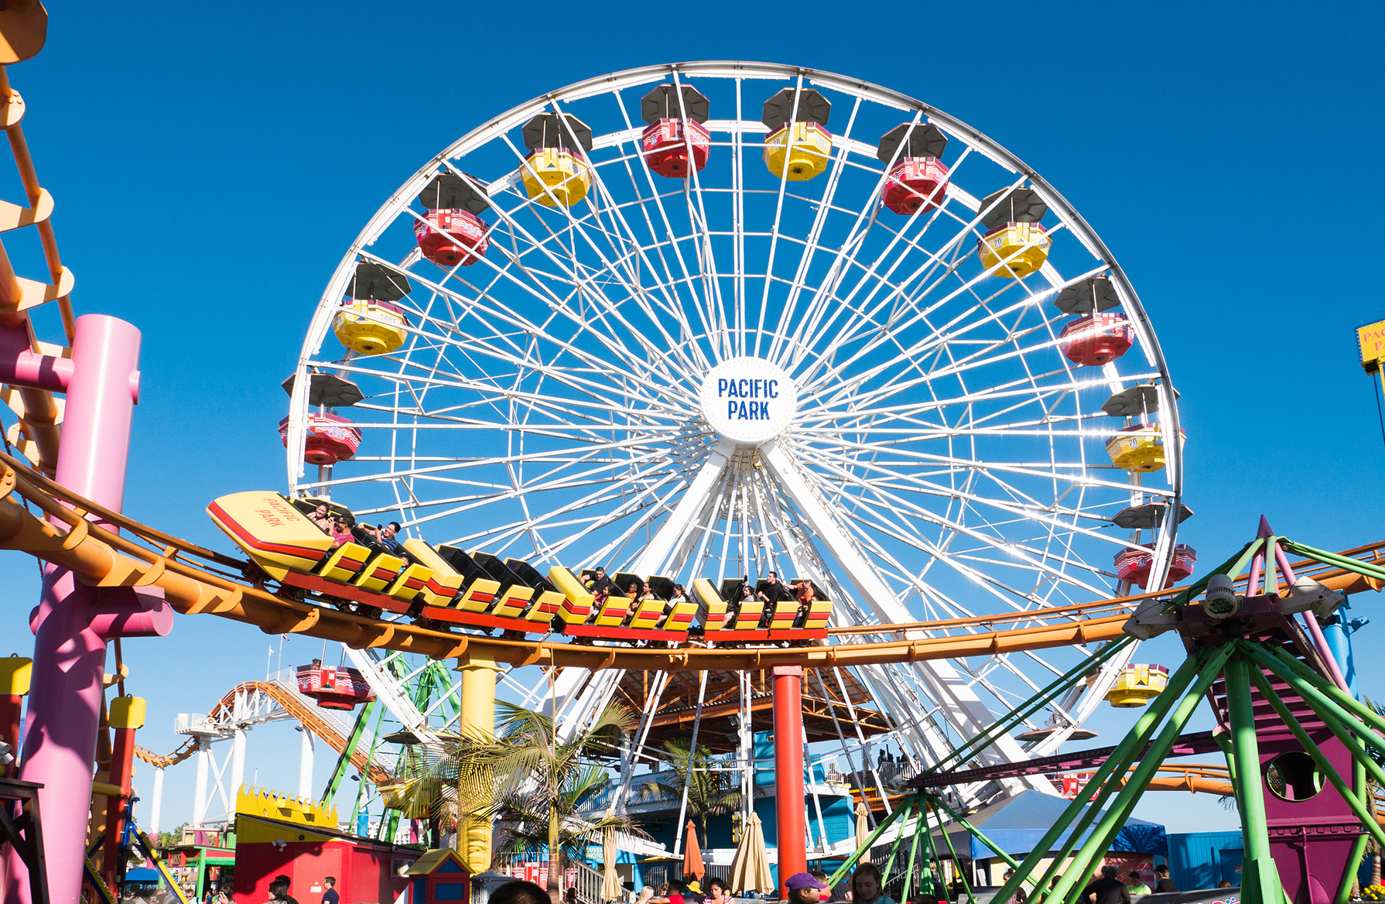
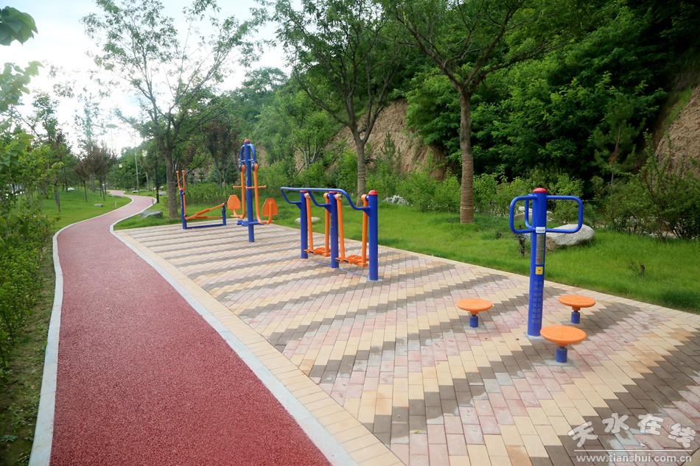
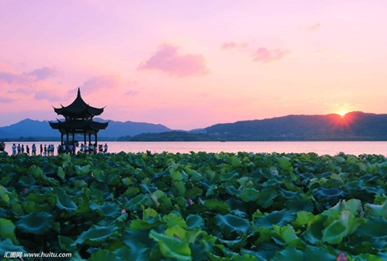
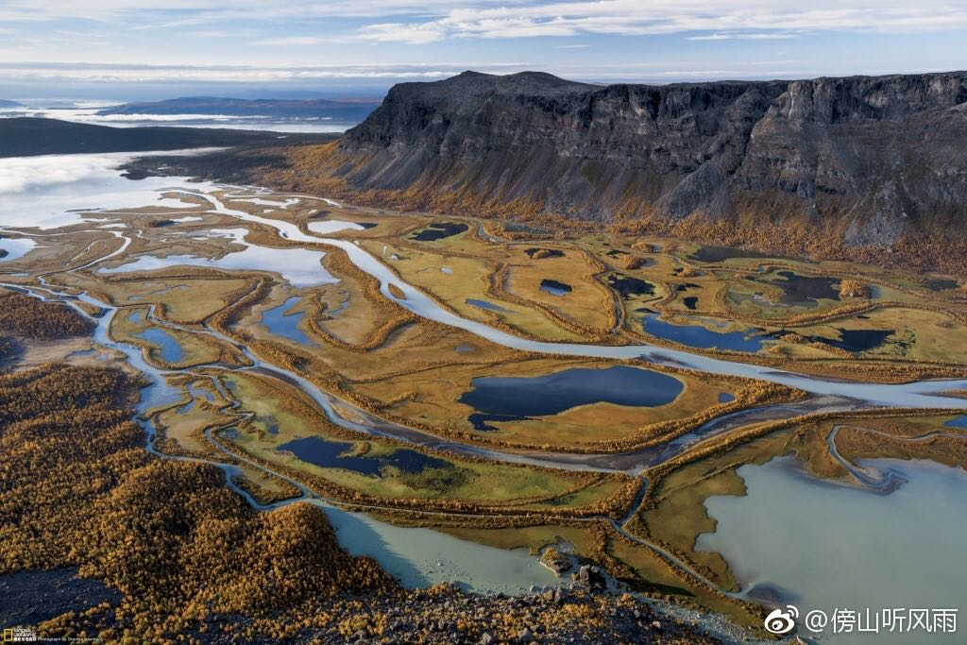
What kinds of parks have you been to? What were they like?
history parks
aquariums
amusement parks
sports parks
city parks
◆ enrich knowledge
◆ broaden our horizon
◆ relax ourselves
◆ appreciate diverse culture
◆ relieve our pressure
◆ take exercise
◆ have some recreation with fresh air
◆ enjoy the beautiful scenery …
Functions of parks
national parks

Slide 4
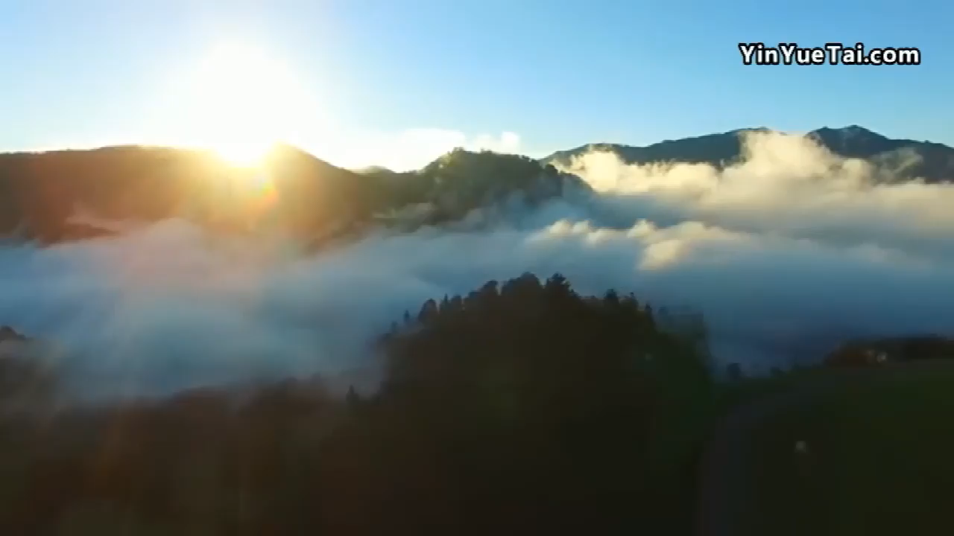
When you think of national parks, what comes to mind first?
Sarek
National
Park

Slide 5
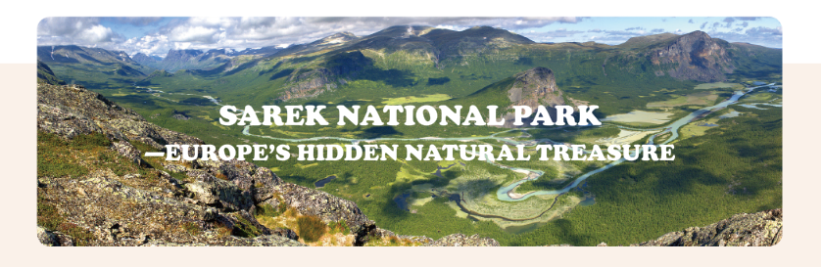
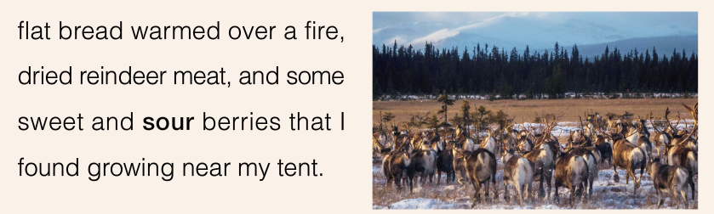
Features of Sarek National Park:
________ mountains
melting
lush/ misty
_______ glaciers
______ trees/ forests
dense
wild
_______ animals
green
______ grasses
winding
___________ streams
A national park is an area of land that is protected by the government for people to visit because of its natural beauty and historical or scientific interest.

Slide 6
Reading for the text type
Q1: Look at the title and the pictures on this page. Where would you most likely read this passage?
To make the trip memorable.
A travel journal.
Q2: In what person is the passage written?
The first person.
To get closer to the readers.
To make the narration authentic, impressive, convincing and persuasive.

Slide 7
Reading for the structure
Match the subheadings with the paragraphs.
Para.1
A Land of Mountains and Ice
Good subheadings:
catch readers’ eyes
make the structure and key points clear
Para.2
Man at Peace with Nature
Para.3
A Land of Adventure
3
looking after reindeer… the Sami
1
in summer the sun never sets
2
mountains…covered…vast sheets of ice
4
enjoying this great adventure
Para.4
A Summer Where the Sun Never Sleeps

Slide 8
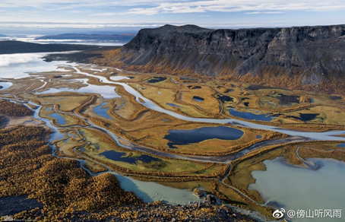
Reading for the information
Para.1 A Summer Where the Sun Never Sleeps
Time
Weather
Location
Sight
7:30 a.m.
windy, sunny
above the Arctic Circle, in the remote far north
of Sweden in Sarek National Park
branches of the Rapa River flow through the valley
How many hours a day does the sun shine in summer in Sarek?
24 hours a day.

Slide 9

Para.2 A Land of Mountains and Ice
Sarek was made a national park to keep the land in its natural state
be covered by vast sheets of ice
reindeer arrived
used to
soon after
in 1909
In the order of ___________
Time
around 9,000 years ago
following
the Sami people made this territory their home
history,
development
ice melted, leaving behind glaciers

Slide 10
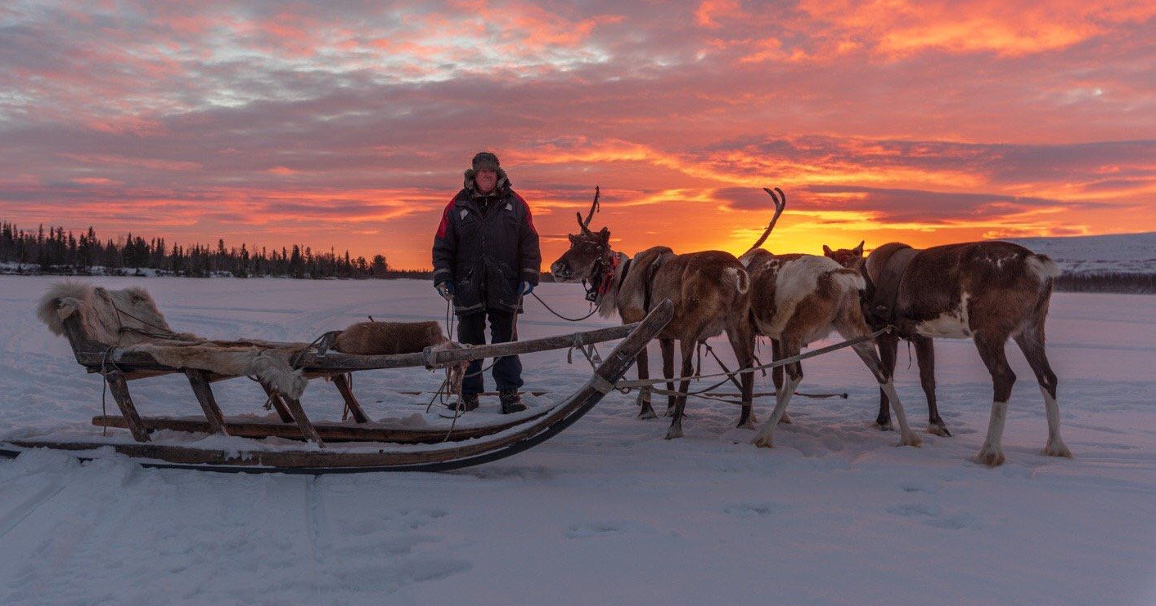
What steps has the Swedish government taken to keep Sarek in its natural state?
It was made a national park, no one besides the Sami can live there, and new development is banned.

Slide 11
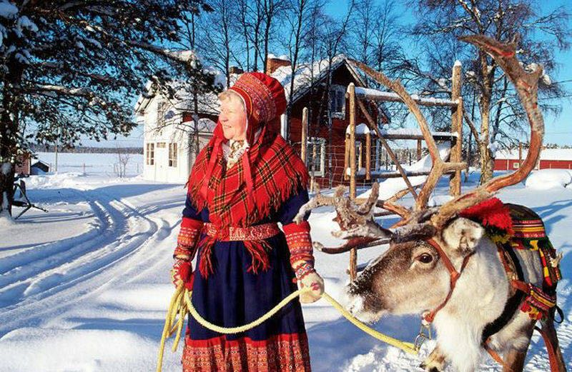
Para.3 Man at Peace with Nature
looked after reindeer
for hundreds of years
used the reindeer’s meat…bones…skin…
Changes of the Sami’s lifestyle
picked up their tents and accompanied them
most Sami: have houses…live a modern life…
today
a small number of Sami: follow their reindeer…enjoy their traditions

Slide 12
Para.4 A Land of Adventure
After breakfast, I pack my bag and set out again. Since I must carry all of my food and supplies with me, my bag weighs about 30 kilograms. today is anything like yesterday, it will be full of sweat and hard work as I hike over this difficult land to my destination on the other side of the valley. However, I cannot complain, Being in such a beautiful and wild place makes me feel blessed to be alive. Here I am, alone under this broad sky, breathing the fresh air, and enjoying this great adventure. What could be better?
hard, tough, tired, difficult, blessed, delighted…
the writer’s feelings: _____________________________

Slide 13

Critical thinking
SAREK NATIONAL PARK
-EUROPE’S HIDDEN NATURAL TREASURE
I’m in the remote far north of Sweden in Sarek National Park, a place with no roads or towns. (Para.1)
Getting here is quite difficult, so apart from the Sami very few people have ever seen Sarek…Though the Sami are allowed to continue their traditional way of life in the park, no one else can live here, and all new development is banned within park boundaries. (Para.2)
wild animals, historical and scientific value, beautiful and natural scenery, local cultures and customs, ideal habitats…

Slide 14

The significance of building a national park
◆ keep the land in its natural state
protect the
treasure
◆ promote ecological protection
◆ leave behind the natural resources for future generation
◆ pursue the harmony between humans and nature
◆ preserve the environment for historical and scientific interest

Slide 15
Reading for the language features
Sense words
Sight | Touch | Smell | Taste | Sound

Slide 16
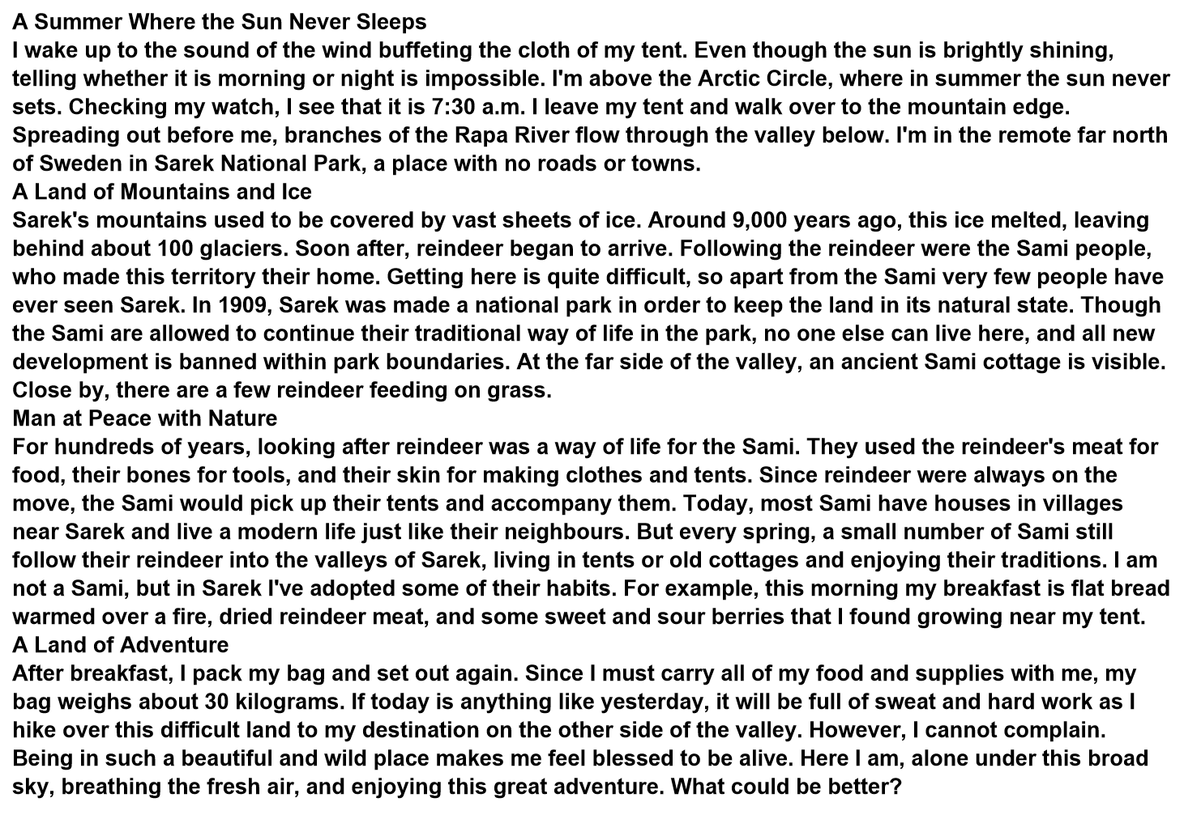
Sight Touch Smell Taste Sound
Sound
Sight
Sight
Taste
Touch
Smell

Slide 17
What rhetorical devices are used in the text?
1. …the wind buffeting the cloth of my tent
Personification
It can add vividness to expression.
2. They used the reindeer’s meat for food, their bones for tools, and their skins for making clothes and tents.
Repetition
It can stress a particular point of view and draw the audience's attention.

Slide 18
Writing
What aspects are included while writing a travel journal?
time, weather, location, sight
1
2
history/ development
3
local people/ activities
4
feelings
Who accompanied you?
How did you get there?
What did you do?
…

Slide 19
Assignment
Write a travel journal with the sense words and useful expressions in the text.

Slide 20
One possible version:
Last weekend, my friend and I paid a visit to Xixi National Wetland Park. The moment we walked through the main gate, we could smell the fragrant flowers in the spring breeze. We enjoyed walking for a little while until we reached the nearest pier, where we spotted many traditional bamboo boats. We rented one and asked the boatman for rowing the boat ourselves. It was hard work and I felt the sweat on my back after 10 minutes. After the boat tour, we went to Hezhu Street for various local snacks. I really liked the sticky rice cakes. But my friend said it was too sugary. He liked the salty fried fish best which tasted crunchy. It was amazing to see the Hezhu Tower cast a lengthening shadow against the setting sun.

Slide 21
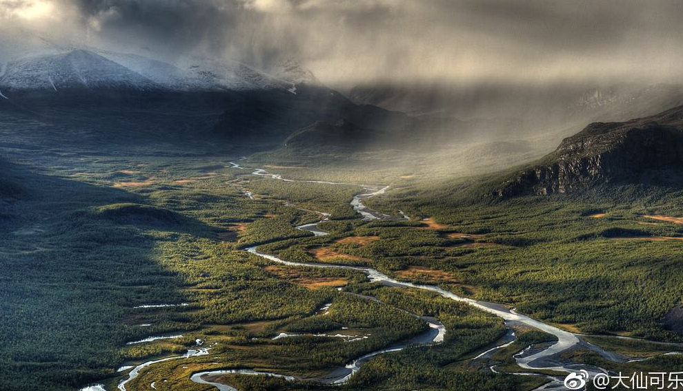
Thank you!

