Slide 1

感恩遇见，相互成就，本课件资料仅供您个人参考、教学使用，严禁自行在网络传播，违者依知识产权法追究法律责任。
更多教学资源请关注
公众号：溯恩高中英语
知识产权声明

Slide 2

Space Exploration
Listening and speaking

Slide 3
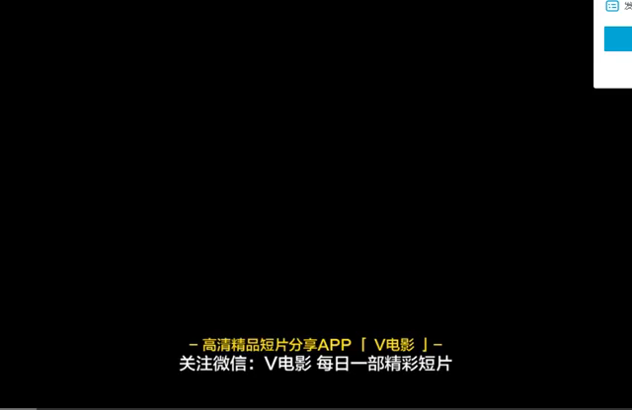
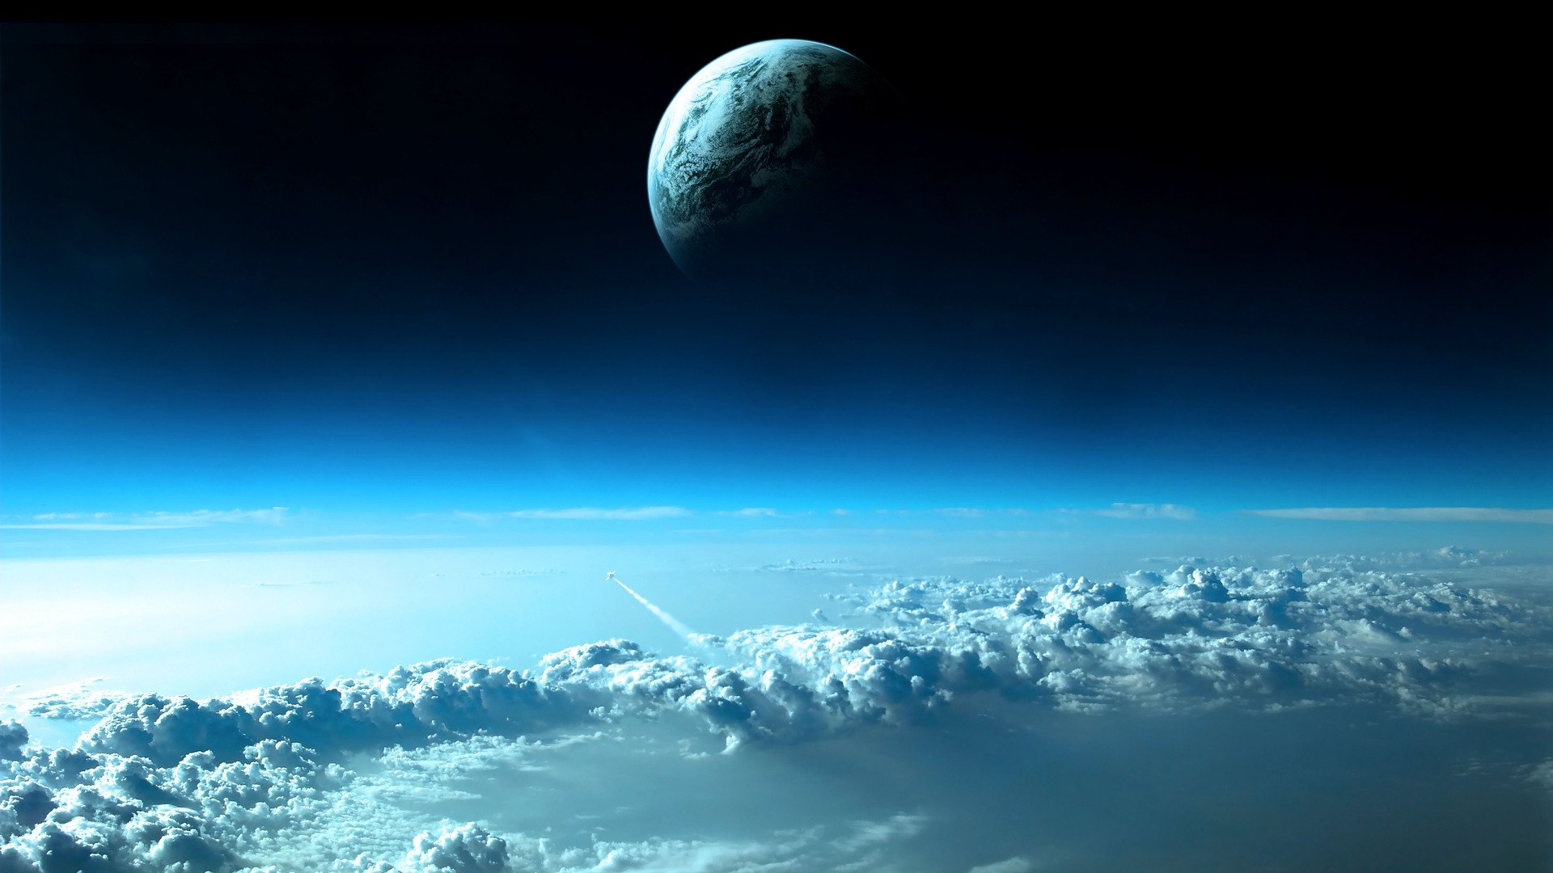
    P
01
PART
Lead-in

Slide 4
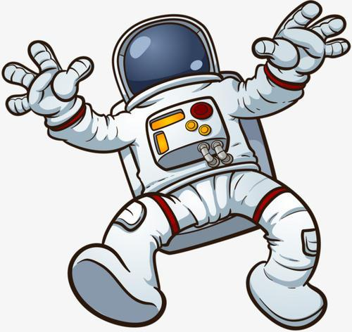
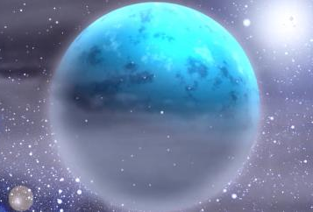
Lead-in
How can we “make friends” with it?
What is your impression on the universe/ space?
The universe is ________.
giant
astronaut
dangerous
mysterious
beautiful
attractive

Slide 5
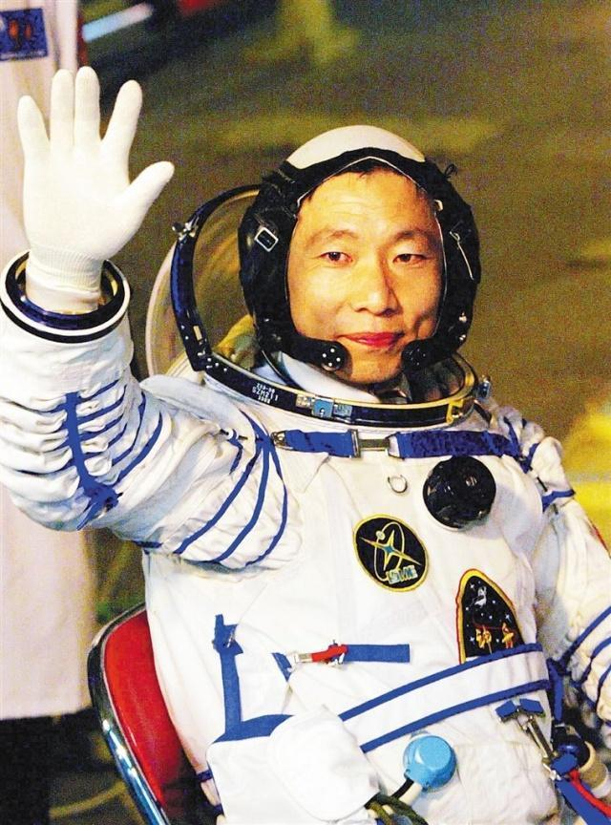
Lead-in
Can you recall some astronauts at home or abroad?
This is because there is no gravity in the universe.
Thus, Yang cannot adapt to the gravity on earth immediately.

Slide 6
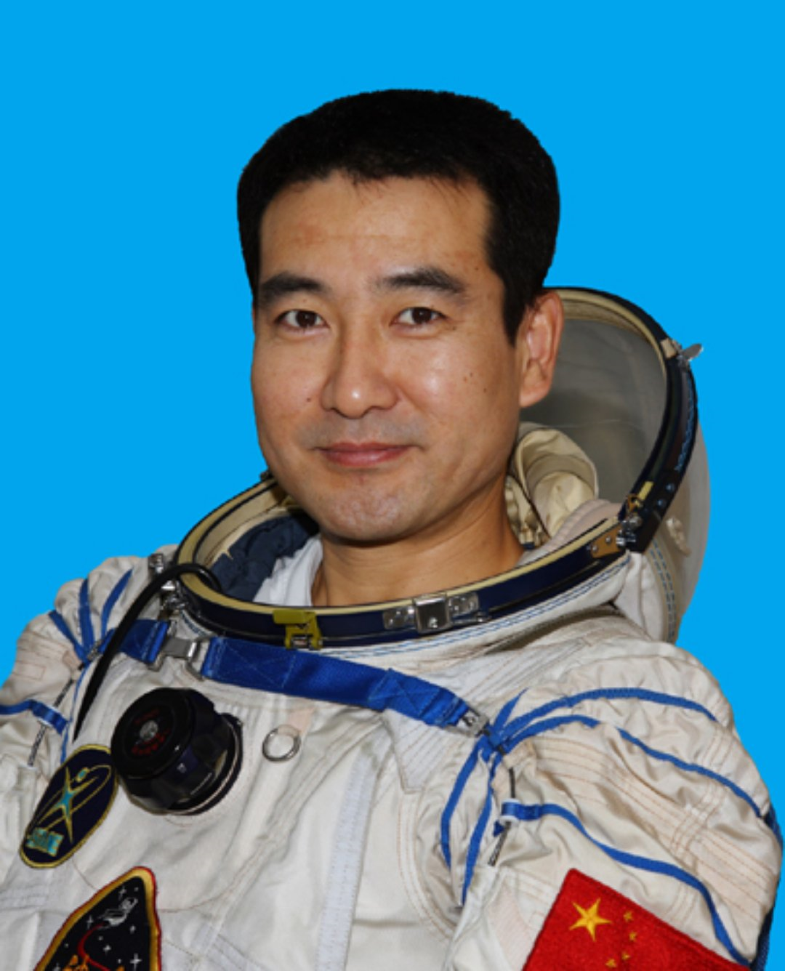
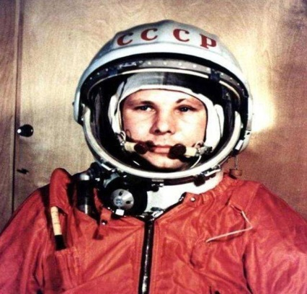
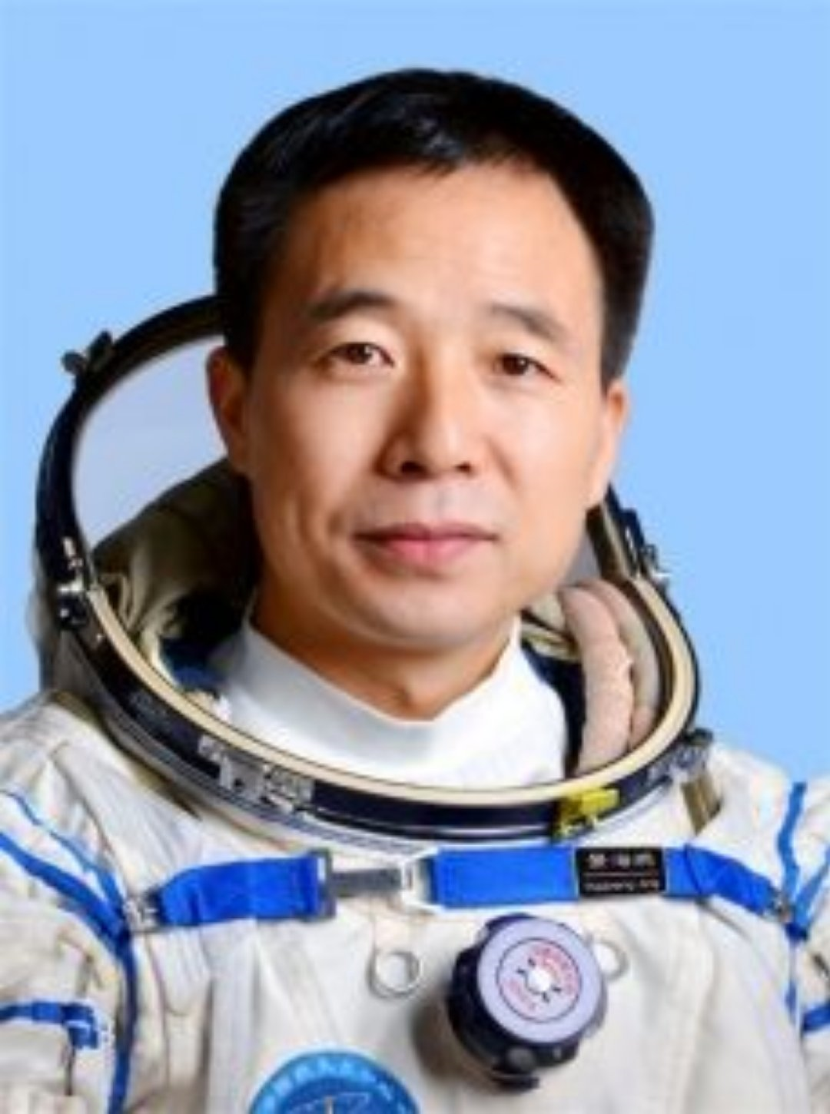
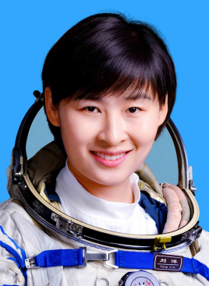
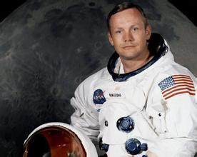
Lead-in
Can you recall some astronauts at home or abroad?
What’s your attitude to the job of “astronaut”?
Good education?
flying experience?
excellent health?
rich knowledge ?
special training?
Liu: the first female astronaut in 2012
Neil: the first man landing on the moon in 1967
What’s the selection procedure for astronauts? Make a list of the requirements.
charming
challenging
Zhai: the first Chinese astronaut to walk in space.
Yuri Gagarin: the first man going into the space
missionary
Jing: the only Chinese astronaut to go into space for three times.

Slide 7
    P
02
PART
Listening

Slide 8

Listening
Listen for the basic information
1. The conversation happened in a stadium.
2. The audience is curious about how Yang Liwei became the first Chinese astronaut.
3. Mr Yang always believed that he would become an astronaut one day.
3. Mr Yang was selected to attend pilot training with 13 other people.
4. To become an astronaut in China, you have to have 1,350 hours of flying experience.
5. Astronauts not only had to learn how to use space equipment, but also had to do a lot of mental and physical training.
f
Welcome to our show.
studio
t
F
never
I never thought...
t
Altogether, 14 of us were chosen from...
F
I had 1350 hours ..., which I think really helped me.
T

Slide 9
Listening
Listen for the detailed information
1. Yang Liwei graduated from college at the age of ____.
2.Before he joined China’s space programme, Mr Yang trained as a fighter pilot for ___years.
3.Mr Yang was one of the ____ pilots who were chosen to train for space flights.
4.At the time when Mr Yang entered the space programmes, astronauts had to shorter than ____cm in height and less than ___kg in weight.
5.Mr Yang became China’s first astronaut when he was ___ years old.
22
10
Attention:
Pay special attention to big numbers as well as those that sound quite similar such as thirteen and thirty, fourteen and forty, etc.
14
172
70
38

Slide 10
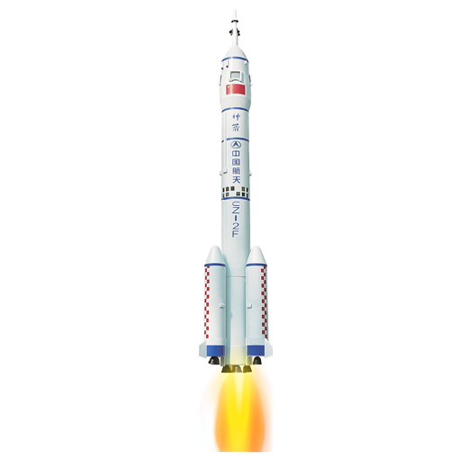
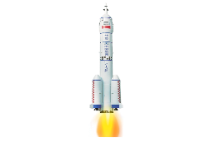
Listening
Listen for the requirements
1. What degree should an astronaut get?
A. high school degree B. college degree C. master degree
2. What experience should an astranaut have?
A. 1,350 hours of flying experience
B. be a master
C. rich experience of fighter
3. How many courses should an astronaut learn?
A. 2 B.3 C.4
4. What special training should an astronaut experience?
A. using space equipment B. physical and mental training C. both A and B
5. To be an astronaut, the following health condition shoule be contained, except ?
A. physical health B. mental health C. proper body shape D. good appearance

Slide 11
    P
03
PART
Discussion

Slide 12
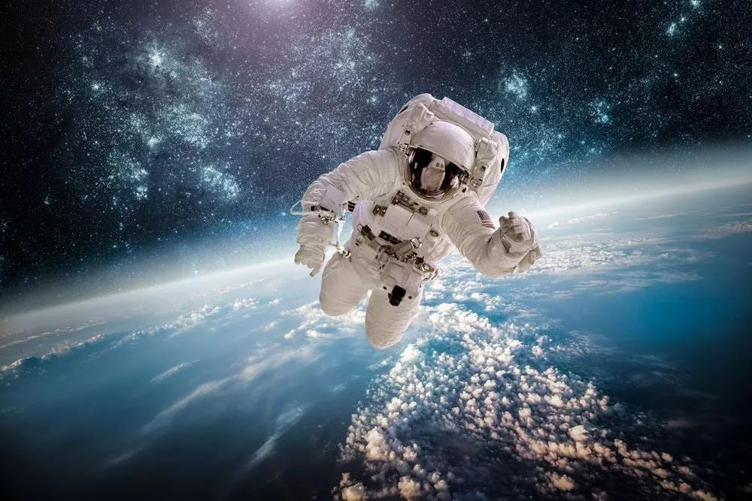
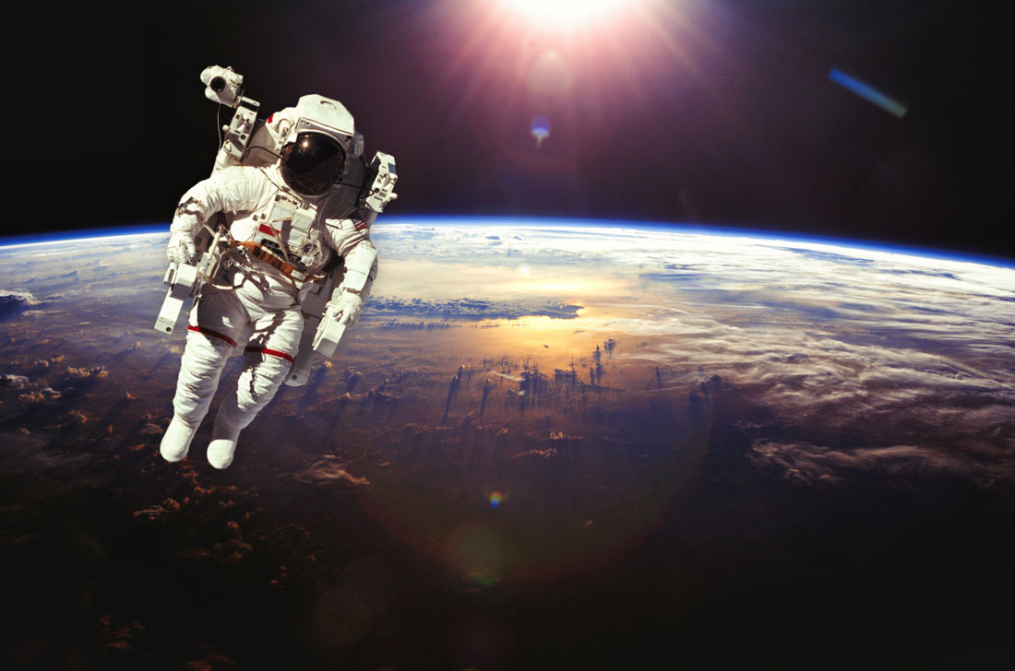
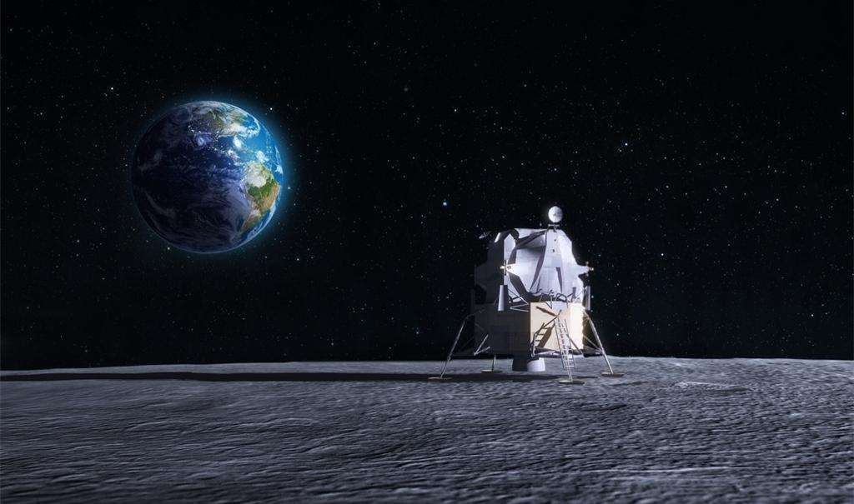
Discussion
1. We know it is extremely difficult to be an astronaut, but why are there still many people are making efforts to be an astronaut?
2. Do you want to be an astronaut? Why?(based on the requirements)
3. To be or to be like an astronaut, what should we do now?

