Slide 1

感恩遇见，相互成就，本课件资料仅供您个人参考、教学使用，严禁自行在网络传播，违者依知识产权法追究法律责任。
更多教学资源请关注
公众号：溯恩高中英语
知识产权声明

Slide 2

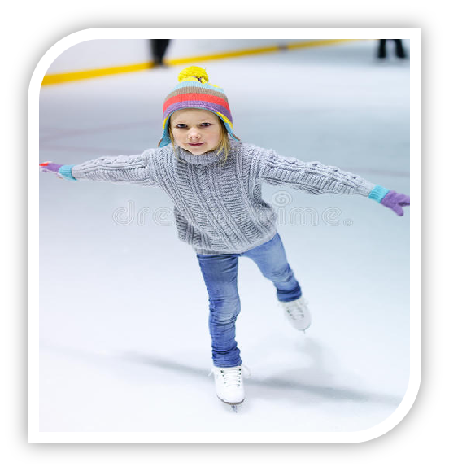
基于冲突和解决（conflict---solution）模式的读后续写讲评
Cali学会了滑冰
——2021年9月“七彩阳光”返校考
临安区昌化中学 李冬琴；纪莹

Slide 3
Wrapping paper flew everywhere as Cali opened her gift. The box had a picture of a pretty girl. She was wearing white ice skates and turning around a frozen pond.
Cali looked up at her aunt and uncle with her big brown eyes. “Figure skates? Wow! How nice of you! But,” the little girl hesitated, “… but I don’t know how to skate.” She looked embarrassed.
“Don’t worry,” said Aunt Lisa. “That’s the fun part — learning how to do it!”
“That’s right,” said Uncle George. “We will take you to the ice rink (冰场) and all go skating together.
“I don’t know…” said Cali. She wasn’t too sure she was going to be able to do it. Sometimes she had a hard time learning new things. She looked again at the happy girl on the box. It did look like fun. Cali imagined herself moving and turning on the ice like a real figure skater. “Okay,” she agreed. “Let’s do it!”
The next day Cali went to the skating rink with her aunt and uncle. Her eyes twinkled and her face lit up with excitement as she looked at the other skaters around her. She sat down on the bench and slipped her feet into the skates. Holding the strings in her fingers, she could not figure out how to tie them up. “I don’t know how to do it,” she said. She felt sad that this was another thing she couldn’t do.
“Let me show you.” Her aunt bent down on one knee, explaining how to put the strings around the small hooks (钩子). Then she tied them into a tight bow. “Now, you do the other skate yourself. I’ll help you if you need it.” Cali bent over the skate and did what her aunt had showed her. Her tongue stuck out of the side of her mouth as she paid attention. After a few tries, she worked out how to cross the strings around the hooks. Her aunt helped make sure the strings were nice and tight. “You did it!” smiled her aunt, patting Cali on the back.
Paragraph 1: “Time to hit the ice,” her uncle said. 。
Paragraph 2: Oof! She fell down, hard. 。

Slide 4
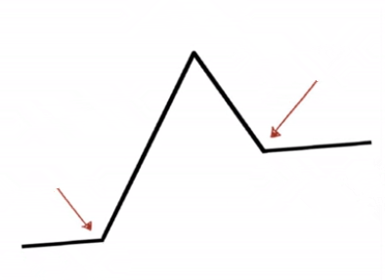
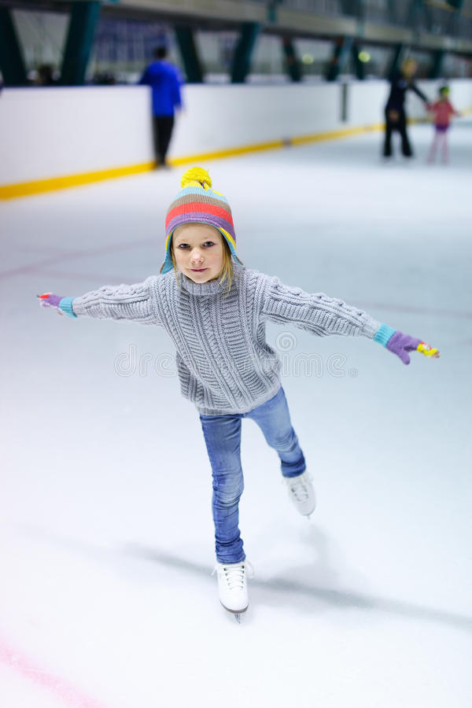
Step1. Read for the plot & emotional change
She looked at other skaters around her in the rink.
excited
She found some things that she couldn’t do.
She imagined that skating might be fun.
sad&unconfident
interested
?
Time to hit the ice.
Rising action
She didn’t know how to skate.
?
Ending
hesitant & embarrassed
She fell down.
development
happy
beginning/setting
Cali opened the gift from her aunt and uncle and found it a pair of figure skate.

Slide 5
Step2.Read for the Conflict
Principle: Conflict-Solution
... the little girl hesitated, “… but I don’t know how to skate.” She looked embarrassed.
Conflict 1:
The girl didn’t know how to skate.
“Don’t worry,” said Aunt Lisa. “That’s the fun part — learning how to do it!”
“That’s right,” said Uncle George. “We will take you to the ice rink (冰场) and all go skating together.”
Solution 1:
Cali’s uncle and aunt took her to the rink for learning how to skate.
Paragraph 1: “Time to hit the ice,” her uncle said. _______________________________________
Cali learn how to skate with the help/encouragement of his uncle and aunt)

Slide 6
Step2: Read for the Conflict
Principle: Conflict-Solution
Conflict 2: The girl didn’t know how to tie the strings up, feeling sad.
... Holding the strings in her fingers, she could not figure out how to tie them up. “I don’t know how to do it,” she said. She felt sad that this was another thing she couldn’t do.
Solution 2: Cali’s aunt taught her to tie the strings up.
“Let me show you.” Her aunt bent down on one knee, explaining how to put the strings around the small hooks (钩子). Then she tied them into a tight bow. “Now, you do the other skate yourself. I’ll help you if you need it.” Cali bent over the skate and did what her aunt had showed her. Her tongue stuck out of the side of her mouth as she paid attention. After a few tries, she worked out how to cross the strings around the hooks. Her aunt helped make sure the strings were nice and tight. “You did it!” smiled her aunt, patting Cali on the back.
.
Language learning:
bent down on one knee 单膝跪地 tie strings into a tight bow 把鞋带系成蝴蝶结
Her tongue stuck out of the side of her mouth. 舌头从嘴里伸了出来
pat sb on the back 拍某人后背

Slide 7
Step2 : Read for the Conflict
Principle: Conflict-Solution
Solution 1:
Cali learn how to skate with the help /encourage of his uncle and aunt)
Paragraph 1: “Time to hit the ice,” her uncle said. ___________________________________
Solution1:
How did Cali feel when first set her feet on the rink?
How did her uncle and aunt helped me ?
How did she perform my first steps of ice-skating?
What made Cali Lost her balance？
Conflict 3:
The girl fell down when skating.
Paragraph 2: Oof! She fell down, hard._______
Solution 3:
How did Cali feel ?
How did she stand up again?
By herself or with the help of her uncle&aunt?
She finally learned how to skate. How did she make it by herself?

Slide 8
Step3 : Accumulate the language
学习新运动或者新技能时候的紧张、兴奋描写
双腿颤抖、双掌冒汗，她把她的一只脚小心翼翼地伸到光滑的冰面上。
Legs trembling and palms sweating_{（独立主格结构）}, she put one of her feet cautiously on the smooth surface of the rink.
2. 看着其他人自由地滑着和这光滑的冰面，她的内心充满了既兴奋又紧张。
As she looked at the smooth surface and other skaters’ gliding freely, a mixture of excitement and nervousness struck into her heart.
Looking at the smooth surface and other skaters’ gliding freely, she could feel a roller coaster of excitement and nervousness flickering in her heart.
(用高级句式开始自己的续写首句，立刻赢得阅卷老师的青睐)

Slide 9

Step3 : Accumulate the language
学习新运动或者新技能时候的紧张 (nervousness 从头到脚)
A flood/burst of nervousness(fear) crept in my mind/ swept over me.
A bead of sweat popped out of my forehead.
My lips trembled.
My throat tightened.
My heart skipped a miss and then raced.
My heart was beating wildly.
My heart almost jumped out of my throat.
My stomach was full of butterflies.
My stomach began to churn (搅动)
My stomach tightened into a baseball.
My hands/palms were sweaty./ grew clammy (湿漉漉的)
My knees felt shaky.

Slide 10
Step3 : Accumulate the language
学习新运动或者新技能时候的紧张 (nervousness 从头到脚)
Her legs trembled/ shivered.
Ｉcan’t help wriggling(扭动)my toes nervously.
I stood rooted to the spot, motionlessly.
I stood glued to the ground and couldn’t move an inch.
I was seized by a flood of fear.
I was quivering（颤抖)from my head to toe.
My mind went blank and every part of me was plunged(陷入) into fear.

Slide 11
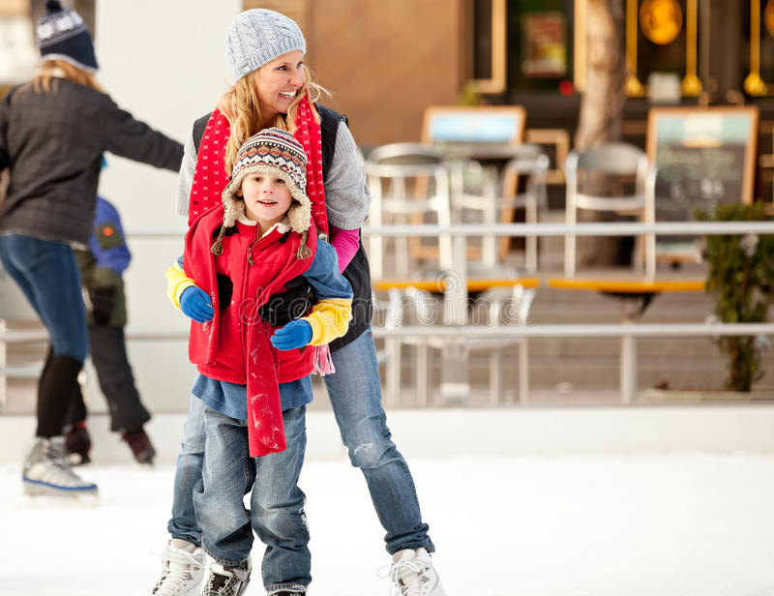
Step3 : Accumulate the language
鼓励新学者动作和语言描写
She cast me an encouraging smile/grin（咧嘴笑）
and comforted me .
She patted me smoothly on the shoulder/back，
saying, “...”
She gave me a pat on my shoulder/back.
She stroked (抚摸)my head and said, “Be brave! Give it a try.”
She wrapped/folded/held me into her arms and whispered, “my girl, we will make it”
She wrapped/folded her arms a little tighter around me and soothed(安慰) me，“It’s ok”

Slide 12
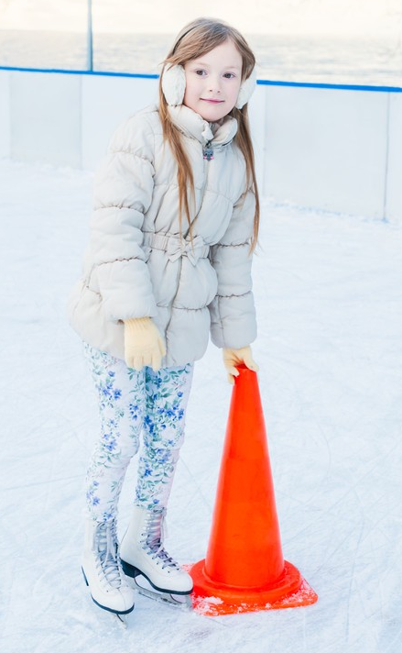
Step3 : Accumulate the language
学习新运动或者新技能时候的想起别人鼓励的语言
Aunt’s words flashed into/echoed in my mind.
阿姨的话闪过我的脑海/在我脑海回响。
My inner voice told me to keep moving .
我的内心告诉我要继续！
学会后的高兴&满足感
I was enveloped with overwhelming delight.
A sense of fulfillment welled up from the bottom of my heart.
I was beaming ( 喜气洋洋)wholeheartedly this time.
This time, I had tasted the charm /fun/ joy of learning new things.

Slide 13
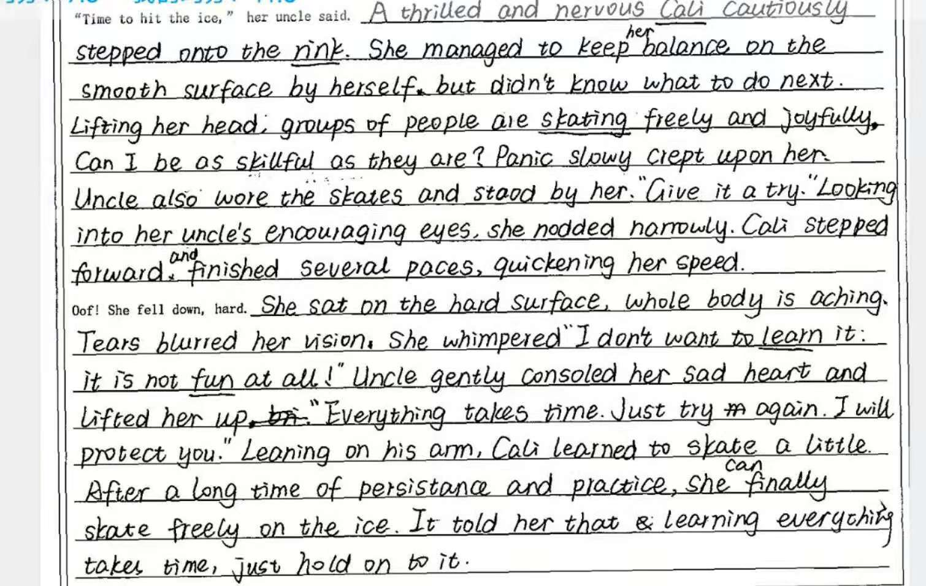
With a mixture of thrill and nervousness
学生习作点评：
本文充分利用短文中的关键词语构建了与上文合情合理的情节结构。文中描述了其他skaters的表现用以作为对比，也用了恰到好处的心理描写将故事情节进行推动。结尾深化了文章主旨，点明了中心，起到了正能量的导向作用。
She saw
was
whispered
文中语言灵活丰富，如manage to do; creep upon; tears blurred her vision等表达、副词的灵活运用和lifting her head; looking into her uncle’s encouraging eyes等-ing形式作状语。

Slide 14
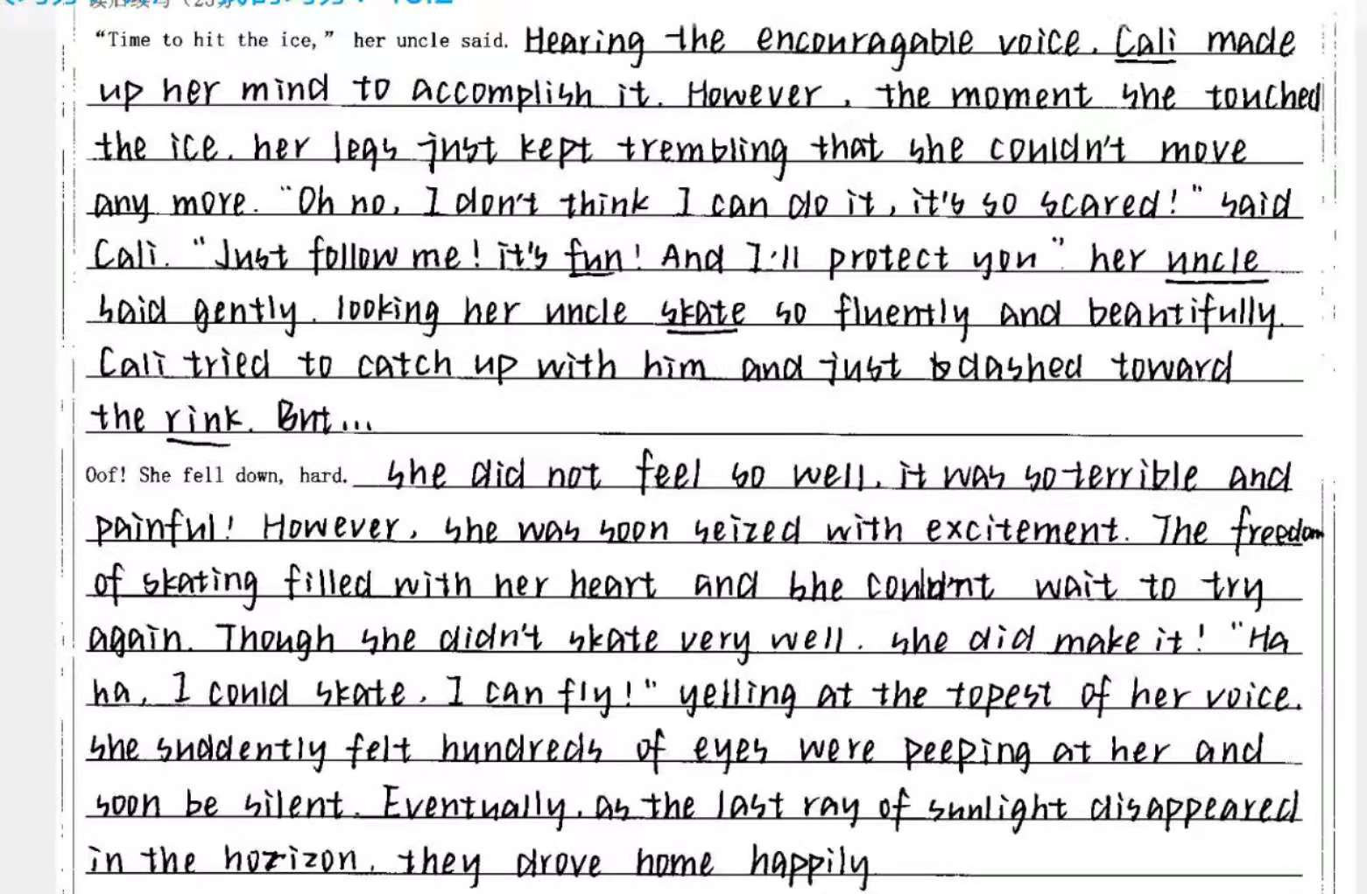

学生习作点评：
本文情节与原文融洽度较高，作者充分利用了所给出的两段的段首句，合理地发挥了想象，构思巧妙，行文自然。原文中较多笔墨描写了aunt对Cali的鼓励和帮助，本文中接着描写了uncle的作用，使故事情节更加饱满。结局圆满，富有正能量；字迹清晰端庄。
文中语法错误较少，语言灵活丰富，有如the moment作连词; dash toward; was soon seized with excitement等表达、副词的灵活运用和-ing形式作状语的高级表达。

Slide 15
One possible version
Paragraph 1:
“Time to hit the ice,” her uncle said. Legs trembling and palms sweating(独立主格), Cali put one of her feet cautiously on the smooth surface of the rink. “Don’t worry ! We will hold your hands and you stand between us.” Cali gradually grabbed their hands and made her first step onto the smooth ice. She grinned(咧嘴笑着) and tried taking a few steps. “Good, Cali. Now try to glide（滑）for a bit longer.” suggested her aunt. Then her uncle skated in front of her while her aunt guided her from behind. “Skate to your uncle now,” she said, pushing her on the back a little to get more speed. ③ Cali glided unsteadily towards her uncle, taking small steps and fighting for balance（分词做伴随）. At that moment , a skater was zooming past her . She started to get nervous again and lost her balance. (就在那时，一个溜冰者从她身边疾驰而过,她又开始紧张，失去了平衡。)
高分范文欣赏：
该范文语言结构严谨，情节跌宕起伏，续写第一段对练习滑冰的动作描写较多，生动地描写了uncle对Cali学习滑冰过程中起到的重要作用。该段语言结构多样，采用了独立主格结构、分词作伴随结构，也同样灵活地运用了副词对动作描写进行修饰。

Slide 16
One possible version
Paragraph 2:
Oof! She fell down, hard. ④ It hurt so much . She closed her eyes and tried not to cry but tears rolled down her cheeks uncontrollably. Aunt’s words echoing in her mind(独立主格结构), Cali struggled to her feet and took a deep breath,determined to give it another try “Be brave. Keep going. Small steps. Yes!” Minutes ticking away （时间滴滴答答地流逝），she could skate almost all the way around the rink by herself! Her aunt caught up to her and took her hand.“Look at you! You are working so hard and doing so well. We’re proud of you.” With a sense of fulfillment welling up form her bottom （with 结构）, Cali had tasted the charm of learning new things for the first time.
高分范文欣赏：
该范文续写第二段同样是动作描写居多，采用了独立主格结构，还恰当运用了with结构，使行文流畅自然。结尾与原文中“Sometimes she had a hard time learning new things”相呼应，对文章主旨进行了升华，起到了积极的人生启示作用。

Slide 17
参考范文
One possible version
高分范文欣赏：
该范文运用了大量动作描写，一个认真练习滑冰的女孩跃然纸上；同样也通过对aunt的语言描写推进了故事的发展-Cali在滑冰中一点点取得了进步。
“Time to hit the ice,” her uncle said. As he helped her walk to the edge of the rink, he said, “We will hold your hands and you stand between us.” Cali took their hands in hers and made her first step onto the smooth ice. She grinned and tried taking a few steps. “Good, Cali. Now try to glide on one foot for just a second longer on each foot as you walk,” suggested her aunt. Then her uncle skated in front of her while her aunt guided her from behind. “Skate to your uncle now,” she said, pushing her on the back a little to get more speed. Cali glided unsteadily towards her uncle, taking small steps and fighting for balance. When she reached her uncle, he encouraged her to try it on her own. Cali wasn’t too sure about that. It seemed like everyone else was zooming past her. She started to get nervous. She lost her balance.

Slide 18
参考范文
One possible version
高分范文欣赏：
该段语言流畅，最后通过对aunt的语言描写点明文章主旨，层层递进，表现Cali实现了对自我的挑战。
Oof! She fell down, hard. It hurt. She closed her eyes and tried not to cry. In a moment, her uncle was helping her back on feet. He smiled into her eyes. “Everyone falls down the first few times. You just have to get back up again.” Cali took a deep breath. “Okay, I can do this.” She skated away from her uncle toward the crowd. As she wobbled, she talked to herself. “Be brave. Keep going. Small steps. Yes!” She had skated almost all the way around the rink by herself! Her aunt caught up to her and took her hand.“Look at you! You are working so hard and doing so well. We’re proud of you,” said Aunt Lisa.

Slide 19

Thank you!

