Slide 1

感恩遇见，相互成就，本课件资料仅供您个人参考、教学使用，严禁自行在网络传播，违者依知识产权法追究法律责任。
更多教学资源请关注
公众号：溯恩高中英语
知识产权声明

Slide 2
新人教选择性必修Book 1
Unit 2 Learning About Language
Discover useful structures
The future continuous tense

Slide 3
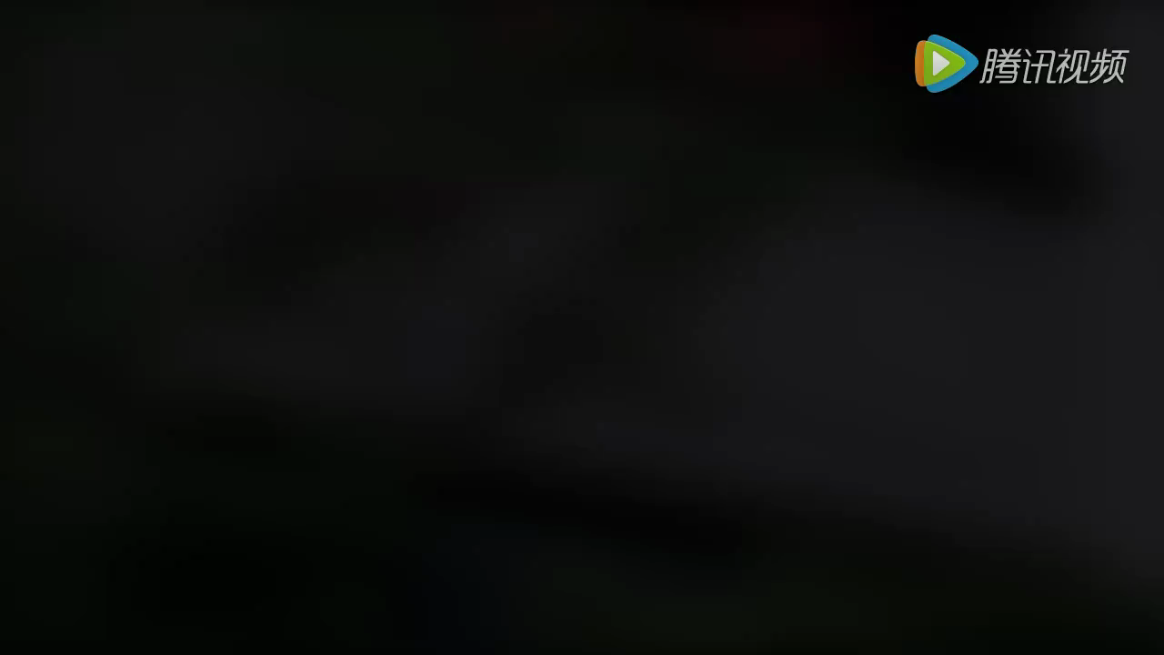
Lead in
Life in the future
1. In the not-too-distant future, we will be living in smart homes that will lock the door for us when we are away and remember to switch off the TV when we forget.
2. In the future, we will be using advanced technology every day for automatic control of just about everything in our home.
prediction to the life in the future

Slide 4

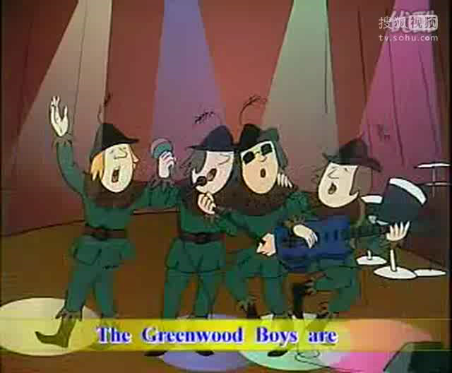

Slide 5
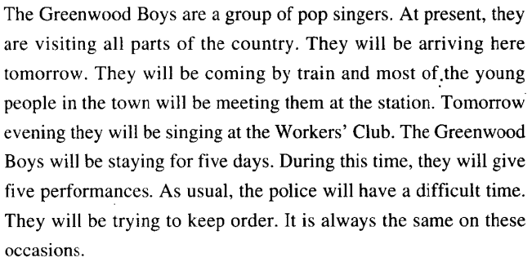

Slide 6
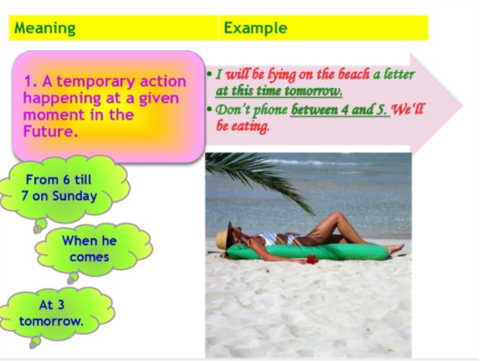
Observe and Discover 1
Describe an on-going action which will occur at some time in the future。
e.g. What will you be doing at this time next Monday?

Slide 7
practice 1
单句语法填空
1.I (do) my homework at ten tomorrow evening.
will be doing
2.We (fly) to the United States this time next week.
will be flying
3.You can call me at 8 in the evening.I (not sleep) then.
will not be sleeping
4.At 5:00 pm,the boys (practice) football on the playground.
will be practicing
5.The headmaster (meet) some parents at 3:00 this afternoon.
will be meeting

Slide 8
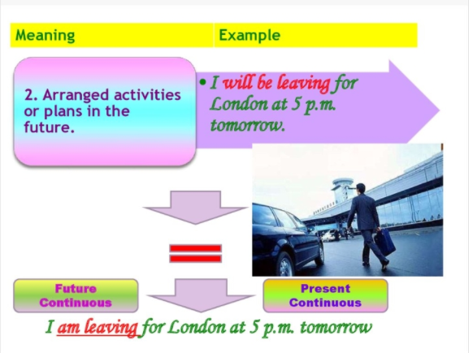
Observe and Discover 2
Expessing the intention , arranged activities or plans for the future。
e.g. Tomorrow I will be flying to Bombay.

Slide 9
practice 2

Slide 10
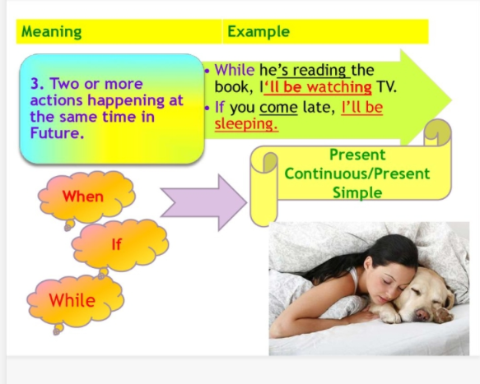
Observe and Discover 3
Describing the two actions happening at the same time in the future。
e.g.When he comes to my house tomorrow, I will be writing the report.

Slide 11


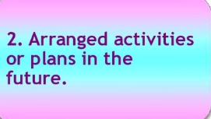
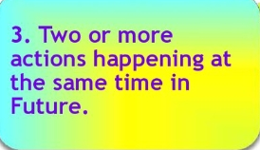
Definition
Talking about an event that will be taking place at a spercific time in the future。
Form
will / shall + be + V-ing
Usage

Slide 12


Compare and discover
一般将来时 VS 将来进行时
Future simple tense describes an action that will occur in
the near future：subject+will/be going to do.
⑴ I am going to Beijing next Sunday.
⑵ What will you do tomorrow?
(3) I will be sleeping at 12:00p.m.。
(4) I will be studying in university at the age of 20.
Future continuous tense describes an action in progess at a spercific time in the future.

Slide 13
practice 3

Slide 14
Both can express future but future continuous tense can
ask questions more politely.
⑴ When will you finish these letters?
你什么什候处理完这些信件？
(直接询问，如上司对下属)
⑵ When will you be seeing Mr White?
你什么时候见怀特先生？
(委婉地询问，如下属对上司)

Slide 15
Pactice and Apply1
A. It is great to hear that you are coming home.I____________(wait ) for you at the airport at 10o'clock as we agreed .Peter can't come with me because he _____________(do) an exam at that time. He _________________(finish) the exam by midday so we can meet him then.
will be waiting
will be doing
will have finished
B.The flat I'm living now is really small and horrible but I _______________(find ) a better place before you arrive. I expect I ______________(share )a flat with one of my cousin.
will have found
will be sharing
C.The next time you visit me I __________________(be)in Australia for nearly 3 years.I ______________________(improve) my English by then so I _________________________(probably /work ) as a translator.
will have been
will have improved
will be probably working

Slide 16
Pactice and Apply2
Read the passage and complete the following sentences.
Jack goes to school every weekday. He leaves home at 6:45 and arrives at school at about 7:30. His morning classes begin at 8 o’clock and continue until 12:15. Then he has lunch, which takes about half an hour. His classes begin again at 1:30 in the afternoon and end at 3:50. He goes to the school's football club at 4:30 and finishes practice at 6:00. He arrives home at about 6:45. Every day he follows the same routine and tomorrow will be no exception.
1. At 6:30 a.m. tomorrow, …
A. he'll be leaving the house. B. he'll be at home.
2. At 8:10 a.m. tomorrow, …
A. he'll be having a class. B he'll have a class.
3. At 12:30 tomorrow, …
A. he'll be having lunch. B. he'll have lunch.
4. At 5:00 p.m. tomorrow, …
A. he'll be practising football. B. he'll practise football.
5. At 6:45 p.m. tomorrow, …A. he'll be arriving home. B. he'll arrive home.

Slide 17
Work in pairs. Read the travel plan and make up a conversation using the future progressive tense.
Pactice and Apply3
Monday | Fly to Beijing from Melbourne,arrive at 10:00 a.m.;Visit the Summer Palace in the afternoon
Tuesday | Morning:visit the Palace Museum;Afternoon:go to Wangfujing Street
Wednesday | Go to the Great Wall,three hours’ drive there and back
Thursday | Go sightseeing in Shichahai;Visit National Museum of China
Friday | Trip to Zhangjiakou
Saturday | Back to Beijing in the afternoon;Watch Beijing Opera at the Mei Lanfang Theatre
Sunday | Return to Melbourne
完成活动4

Slide 18
Sample Dialogue :
Jane: So do you have your plan for the trip?
Sam: Oh, yes. It's all been organised.
Jane: When will you be arriving in Beijing?
Sam: Around ten in the morning. Then I'II be visiting the Summer Palace.
Jane: After such a long trip? You'll be pretty tired.
Sam: Yeah, but I can't wait to go. And then on Tuesday, I’ll be visiting the Palace Museum in the morning, and I’ll be buying souvenirs in Wangfujing Street in the afternoon.
Jane: When will you be climbing the Great Wall?
Sam: Wednesday. Since it takes three hours to drive there and back, I won't have other arrangement that day.
Jane: Then what will you be doing on Thursday?
…

Slide 19
Thanks!

