Slide 1

感恩遇见，相互成就，本课件资料仅供您个人参考、教学使用，严禁自行在网络传播，违者依知识产权法追究法律责任。
更多教学资源请关注
公众号：溯恩高中英语
知识产权声明

Slide 2
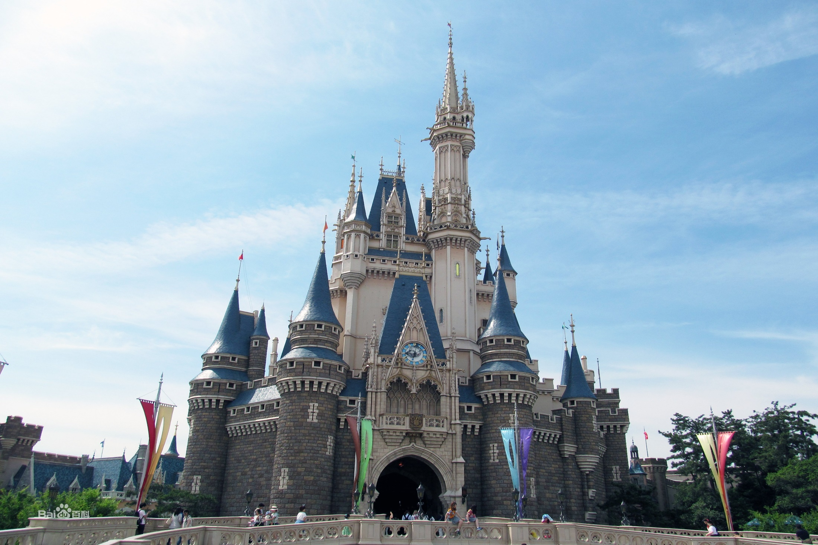
选择性必修 1 UNIT 3 Fascinating Parks
Using Language
Theme Parks
Fun and More Than Fun
杭州二中许丽君

Slide 3


Teaching objectives
Teaching objectives:
By the end of this period, you will be able to…
1. Listen to the tape and figure out which activities Jake, Linlin and Yuhui are going to do.
2. Draw the route that they will take on the book and introduce it to your partners.
3. Take turns giving directions to different places in the school.
4. Summarize the main idea of the text and analyse its writing purpose.
5. Figure out the structure and the language features of the text.
6. Talk about the theme park impressing you most and write an introduction about a theme park you like.
7. Discuss and share what theme parks bring them.

Slide 4

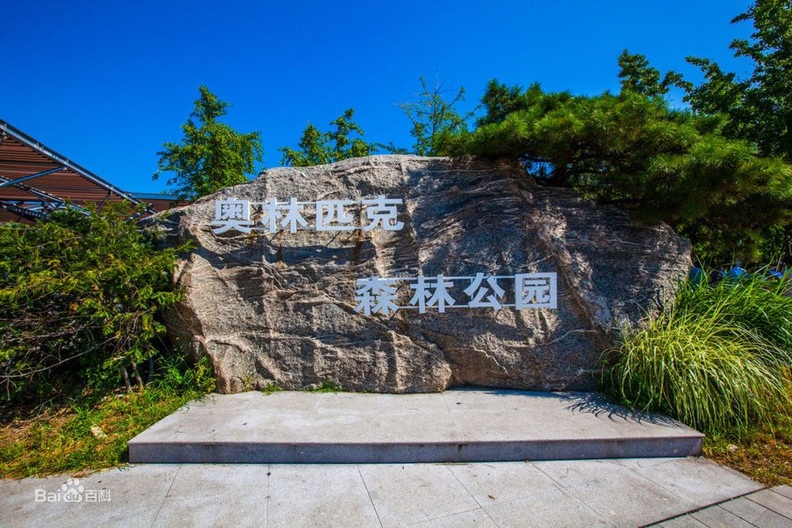
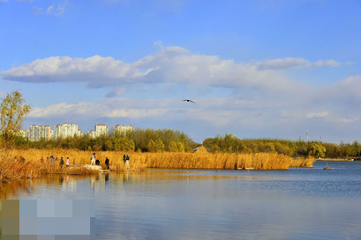
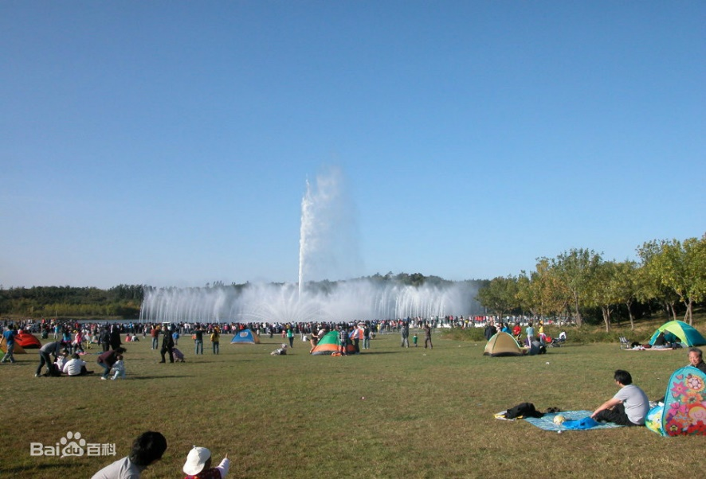
Enjoy some pictures about Beijing Olympic Forest Park and visit a city park:

Slide 5
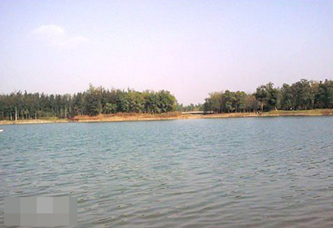
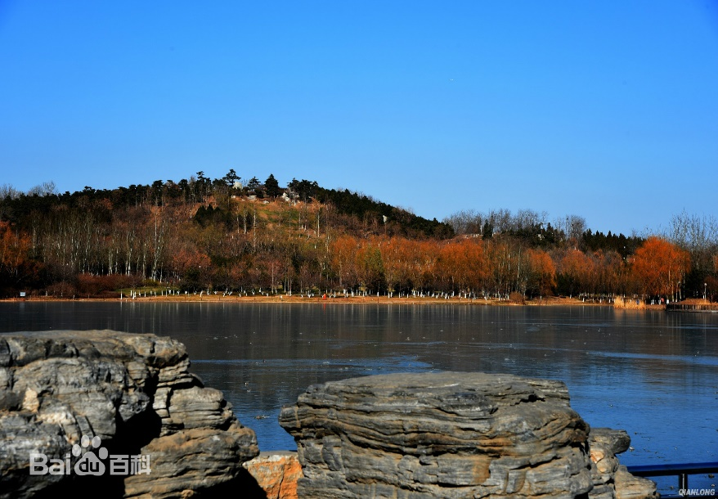
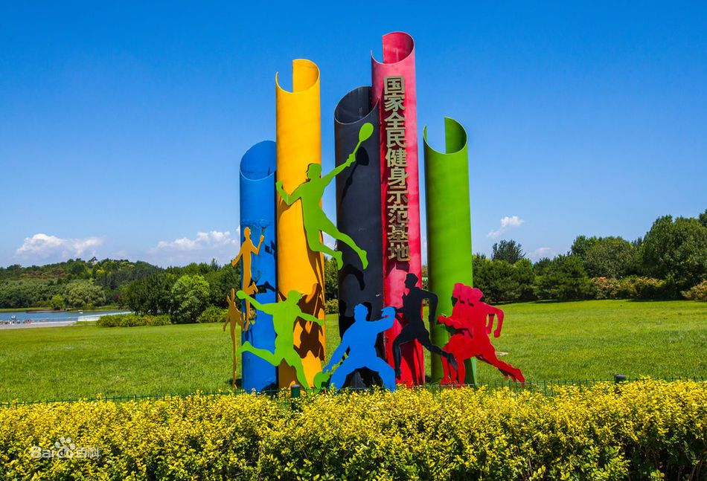
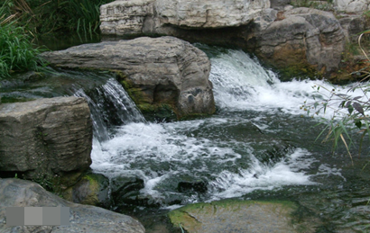
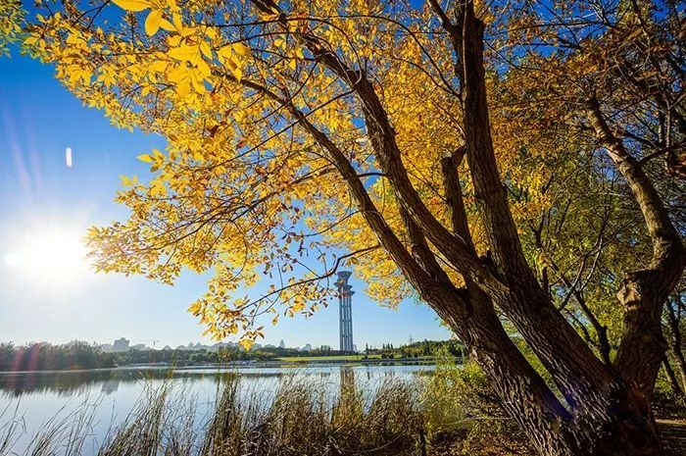
Enjoy some pictures about Beijing Olympic Forest Park and visit a city park:

Slide 6
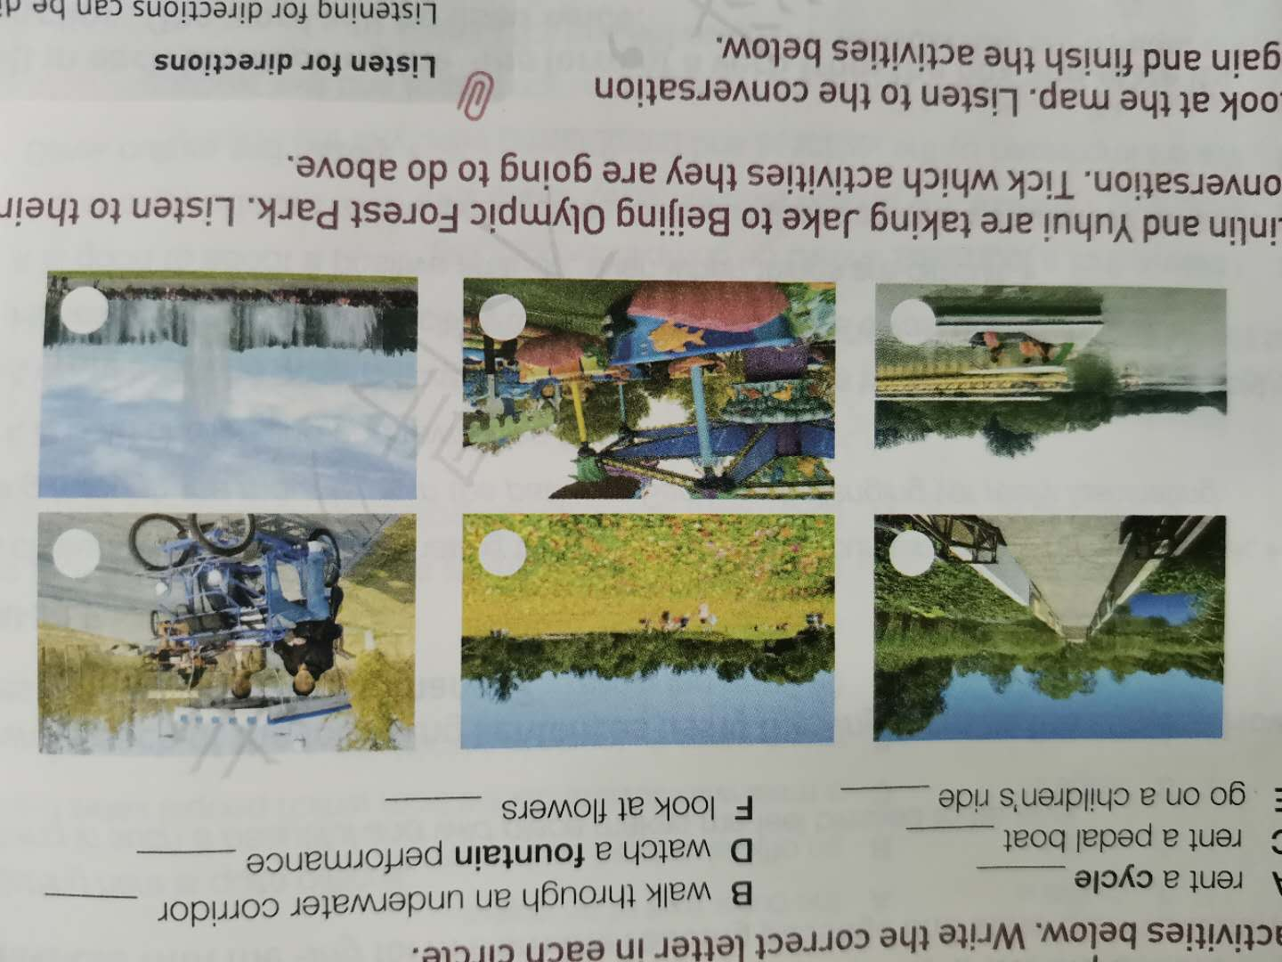
Lead in: visit a city park
If you are to visit Beijing Olympic Forest Park, what activities would you like to take part in?
Look at the photos taken in Beijing Olympic Forest Park. Match them with the activities below. Write the correct letter in each circle.
A rent a cycle __________ B walk through an underwater corridor ______
C rent a pedal boat __________ D watch a fountain performance __________
E go on a children’s ride __________ F look at flowers __________
B
F
A
C
E
D

Slide 7
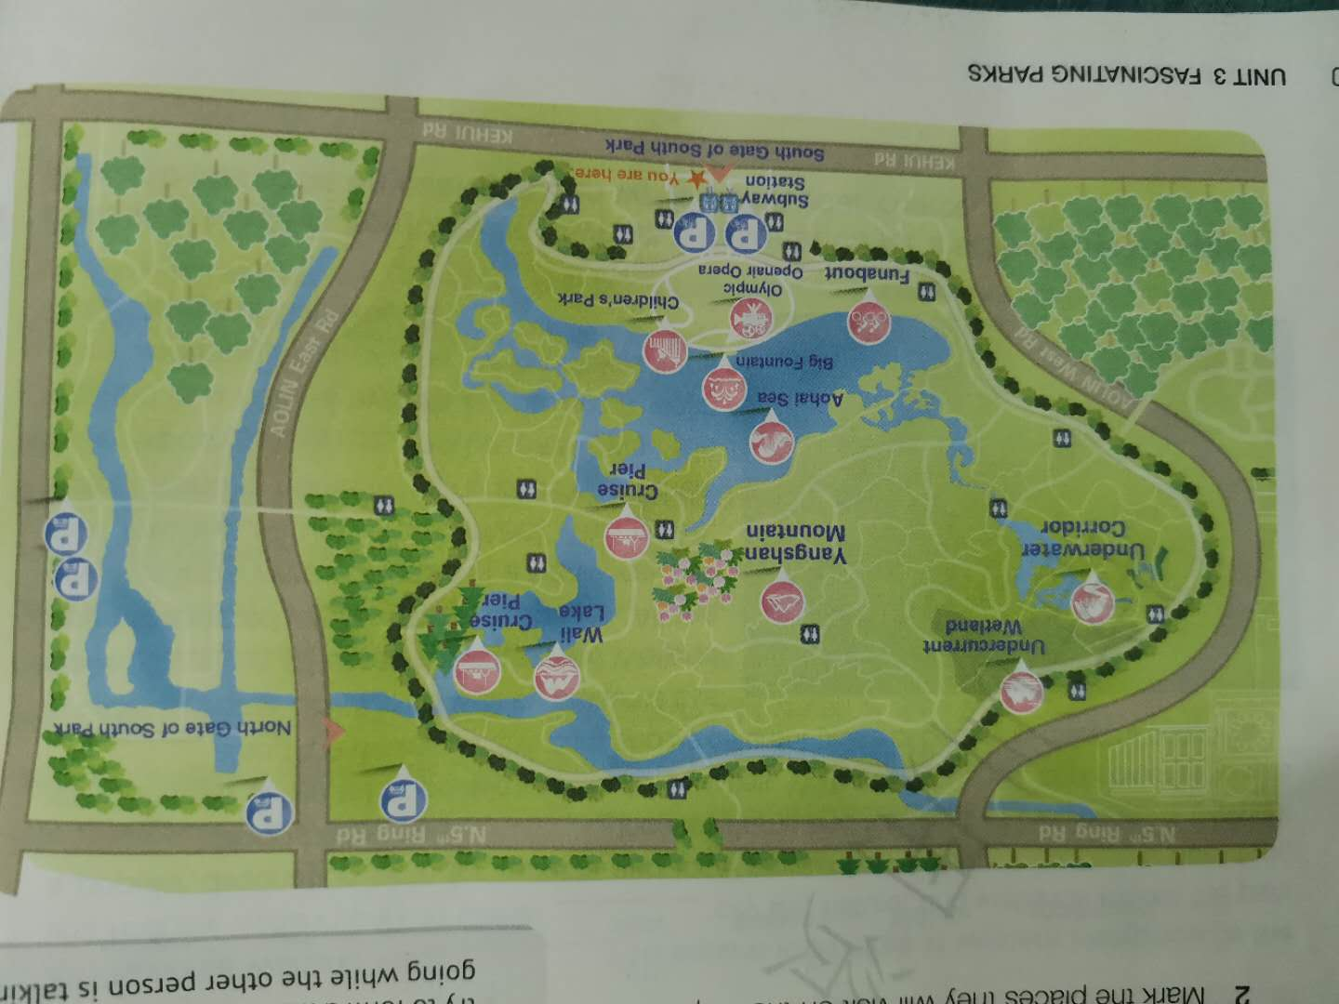
1.Look at the map with students to get them be familiar with the places.
Subway station, Funabout,
Olympic Openair Opera, Children’s Park,
Aohai Sea,
Big Fountain,
Cruise Pier,
Yangshan Mountain, Undercurrent Wetland, Underwater Corridor, Wali Lake,
Cruise Pier

Slide 8
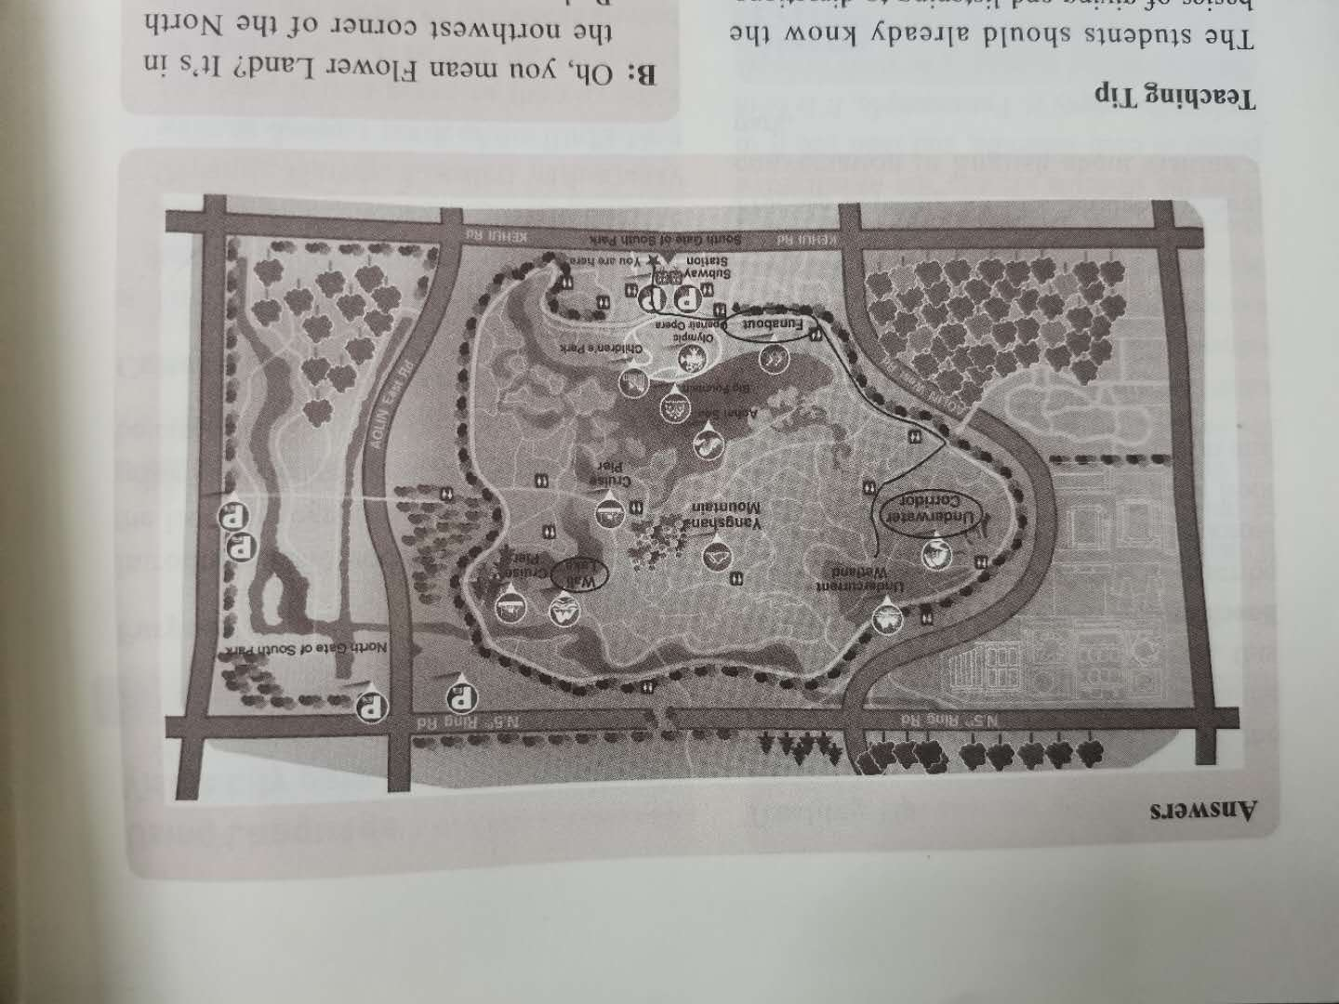
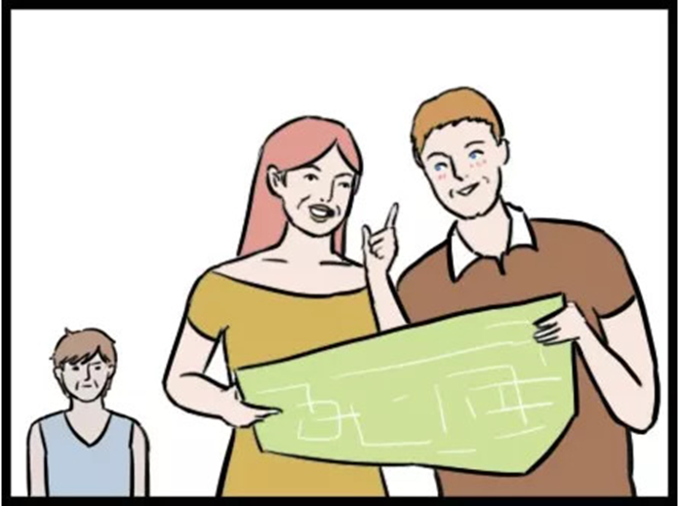
Listening for main idea and details
Listen to the conversation to summarize the main idea of it.
Jake, Linlin and Yuhui designed their best visit route according to the map.
Listen to the conversation again and finish the activities below.
(1) Draw a route that Jake, Linlin and Yuhui will take.
(2) Mark the places they will visit on the map below. Pay attention to the sequence words and direction words.

Slide 9
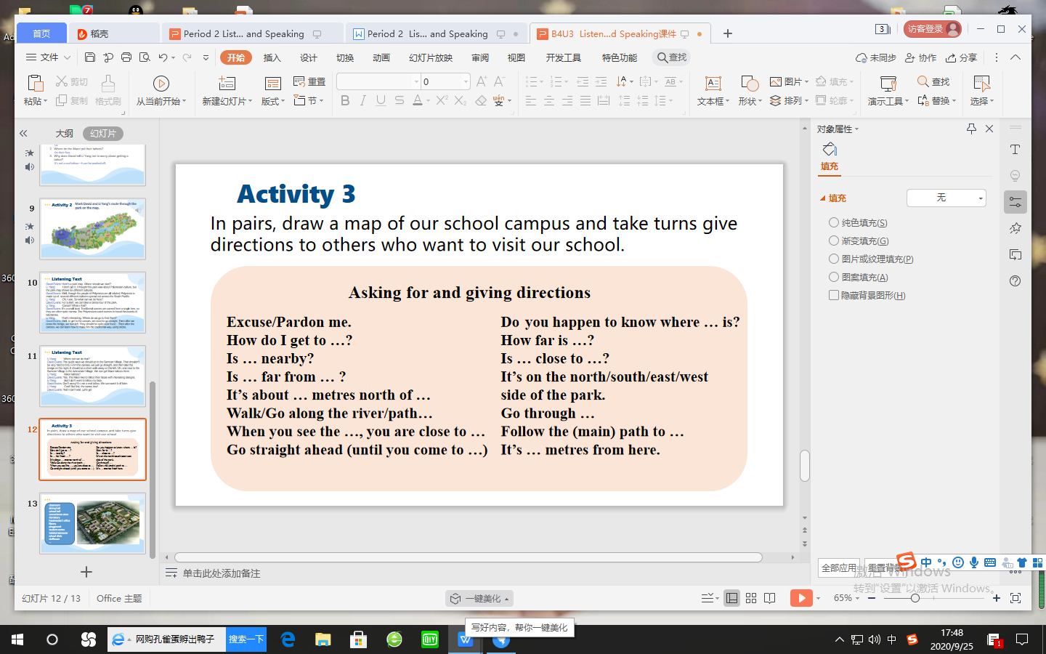
Speaking
Work in pairs. Role-play visiting the park. Take turns giving directions to different places in the park. Use the words and phrases below to help you.

Slide 10

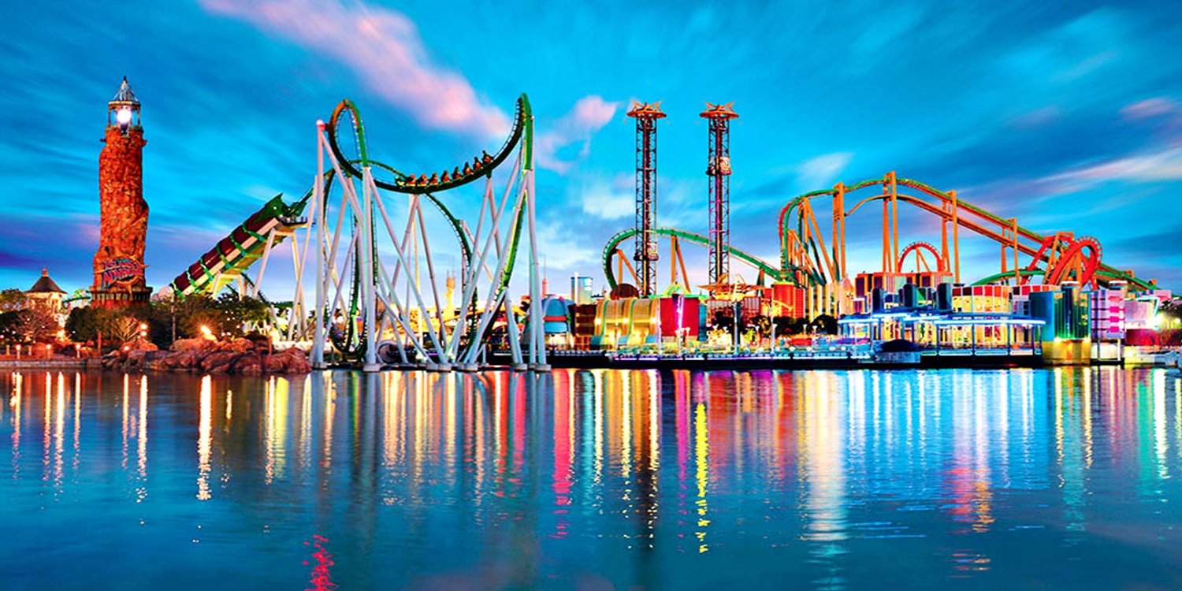
Unit 3 Using Language
Explore theme parks and write about a park

Slide 11
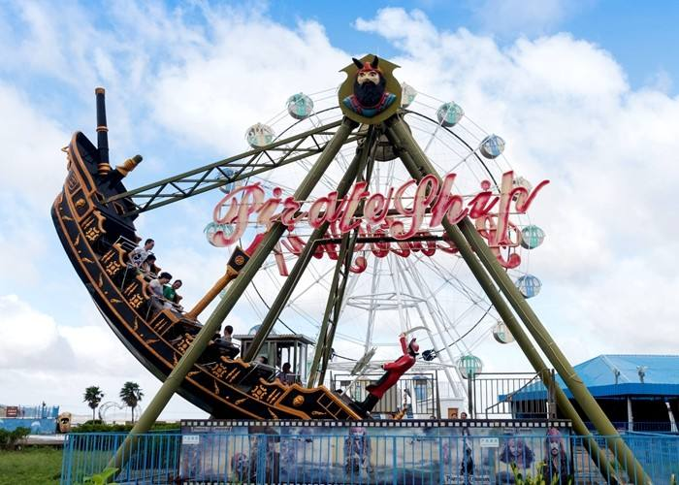
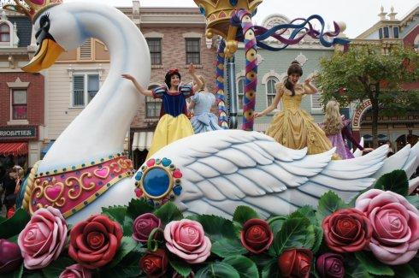
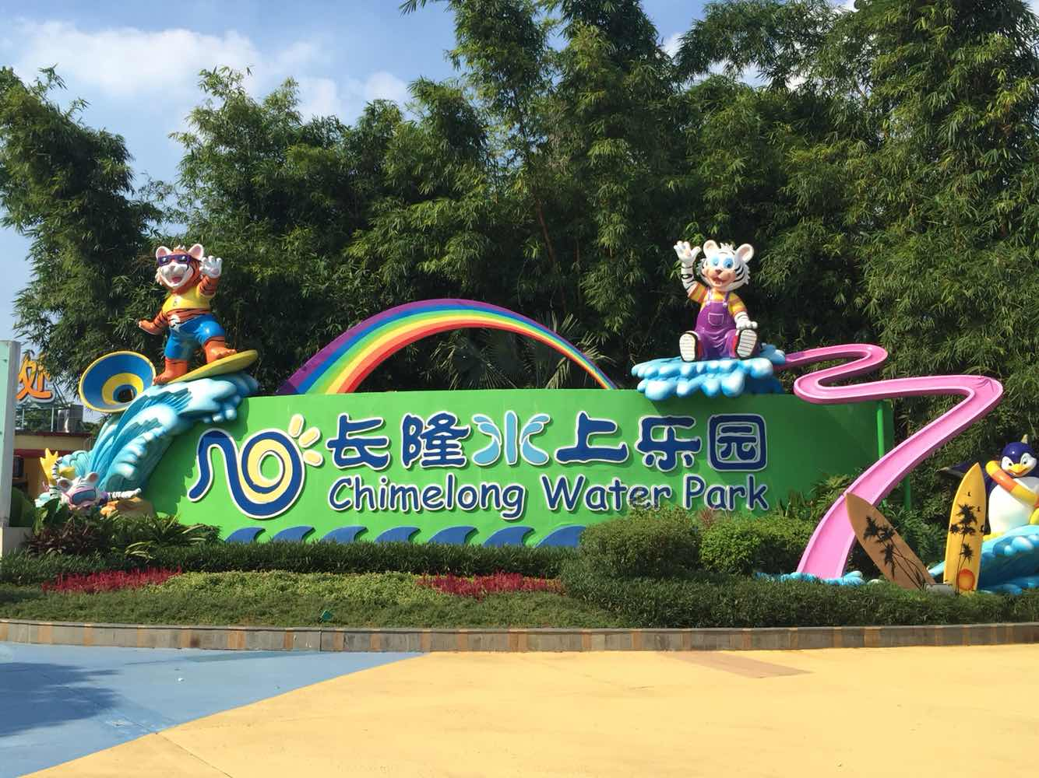
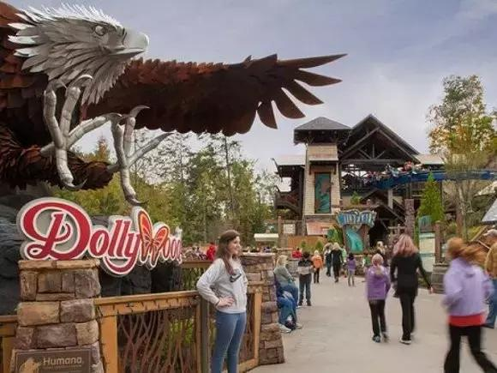
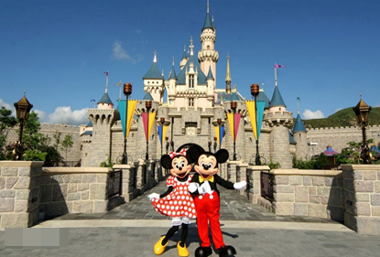
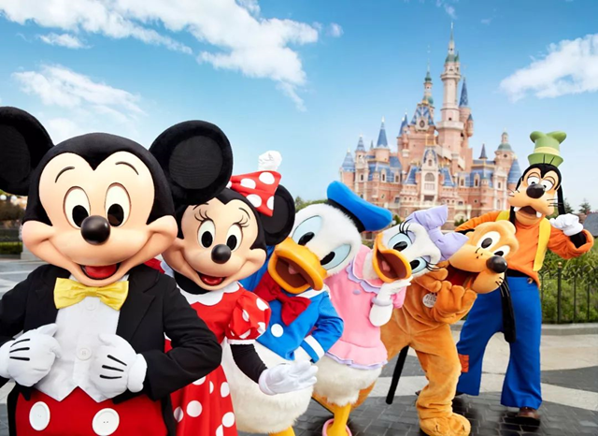
Lead in
Enjoy some pictures of theme Parks，Let's read the text to learn more.

Slide 12
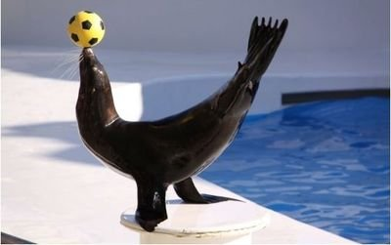
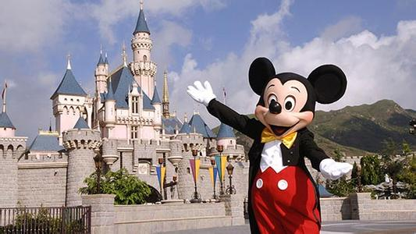
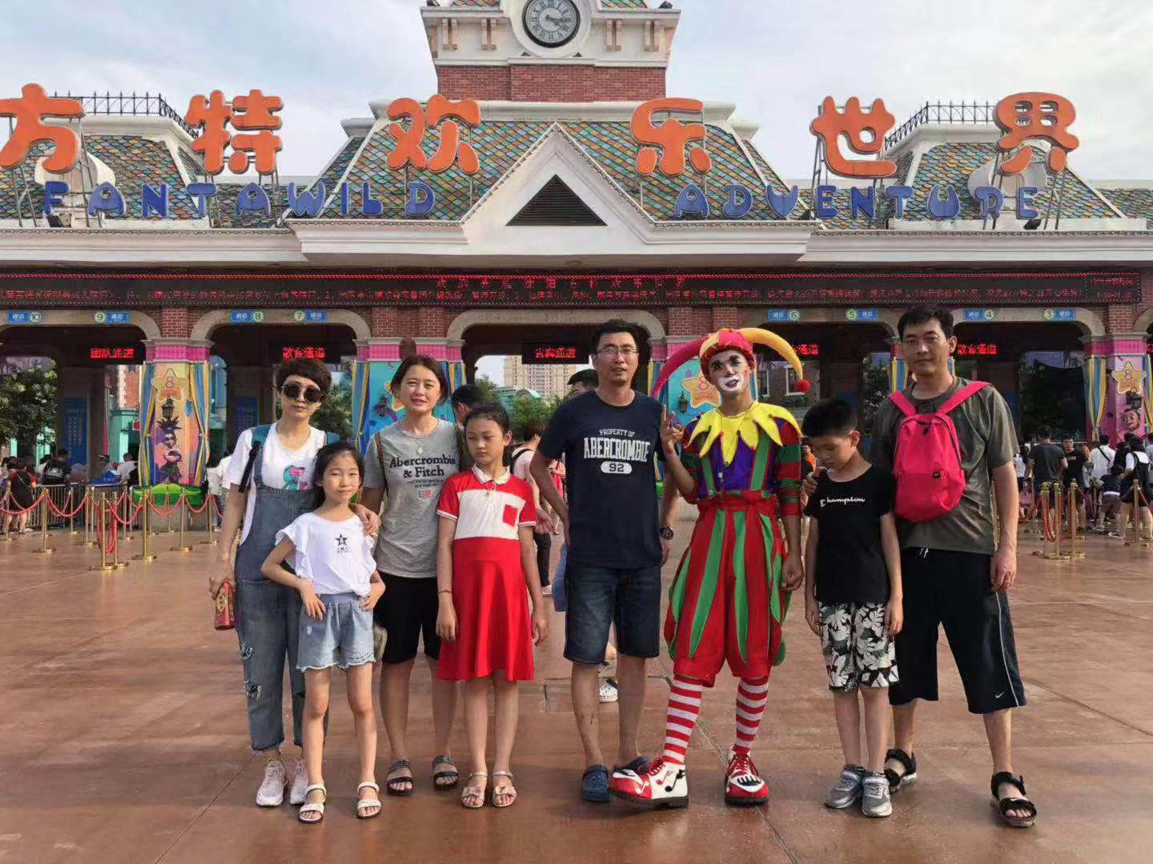
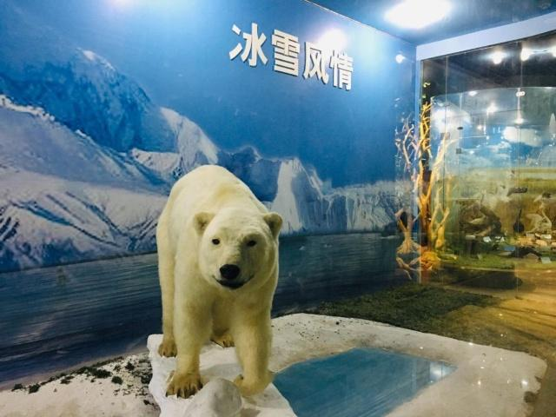
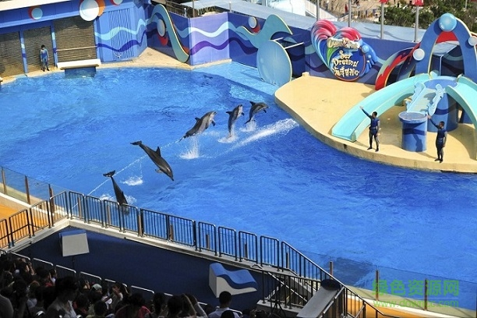
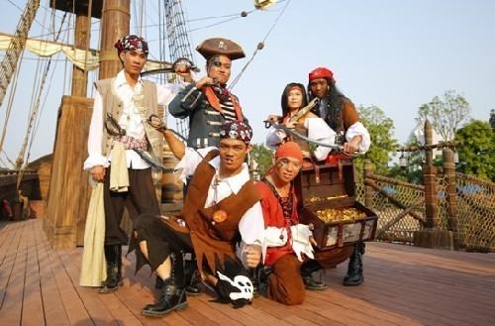
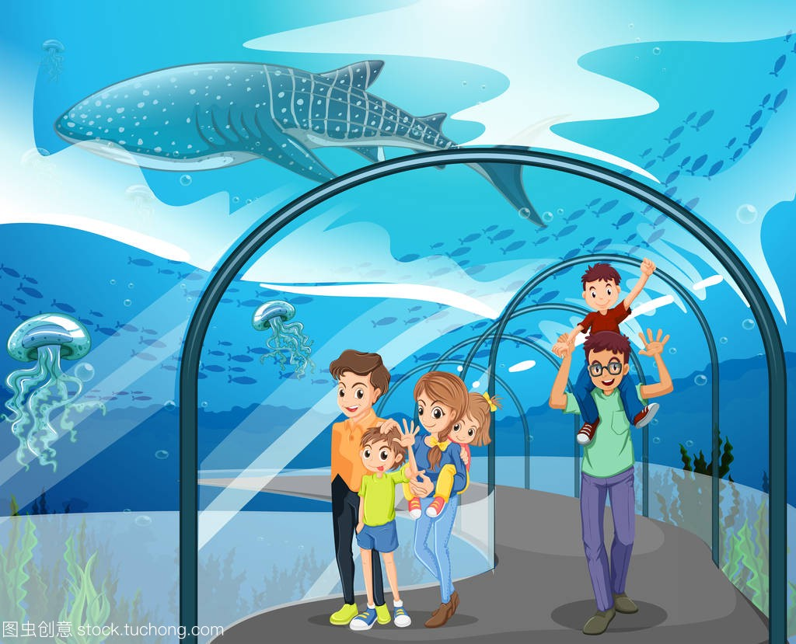
Lead in
Enjoy some pictures of theme Parks，Let's read the text to learn more.
see the polar bears
看北极熊
watch the dolphin and
see lion shows
join a water fight against pirates
walk under the aquarium
在水族馆之下走走

Slide 13

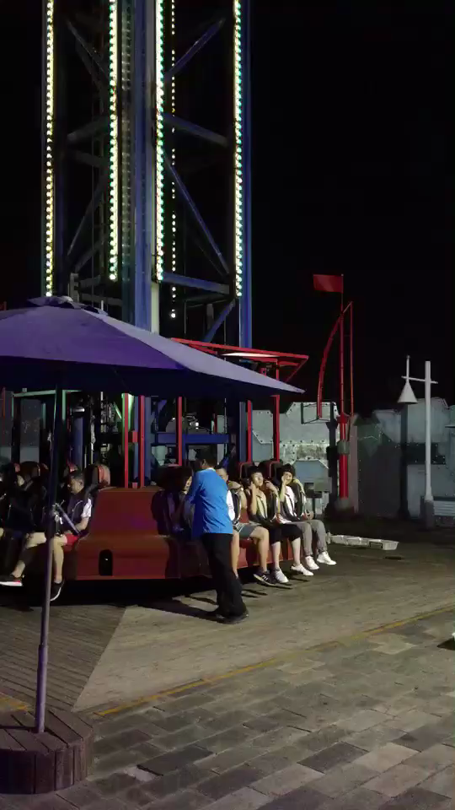
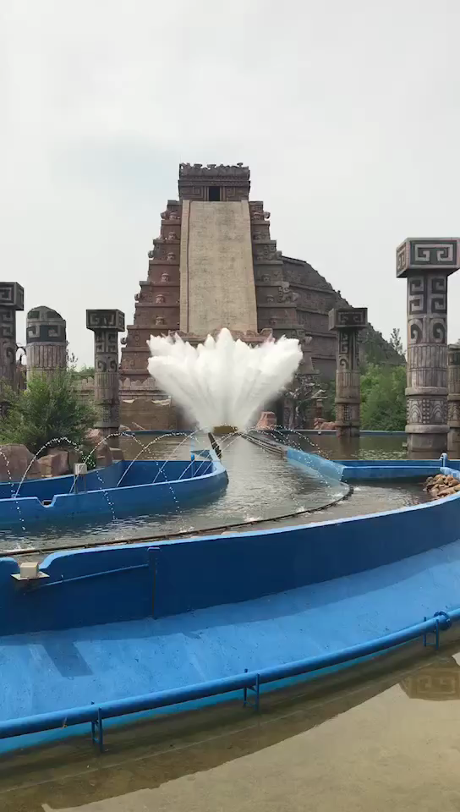
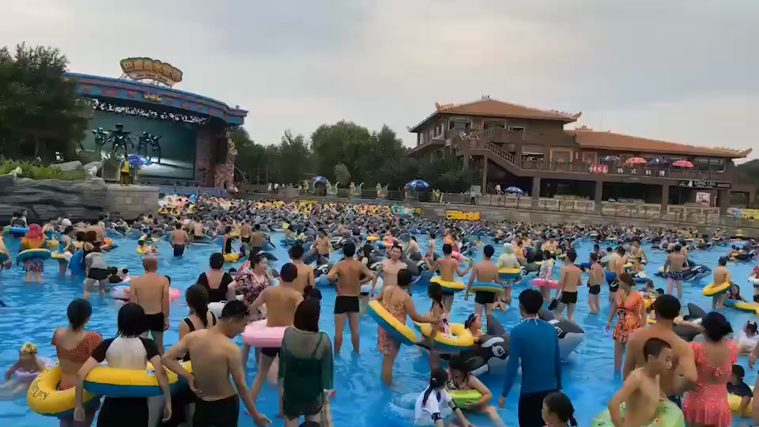
Lead in
Let’s enjoy some videos about theme parks.
Have you experienced the entertainment facilities in the theme parks?
There are many kinds of theme parks in the world with themes such as food, culture, cartoons, science, history…

Slide 14
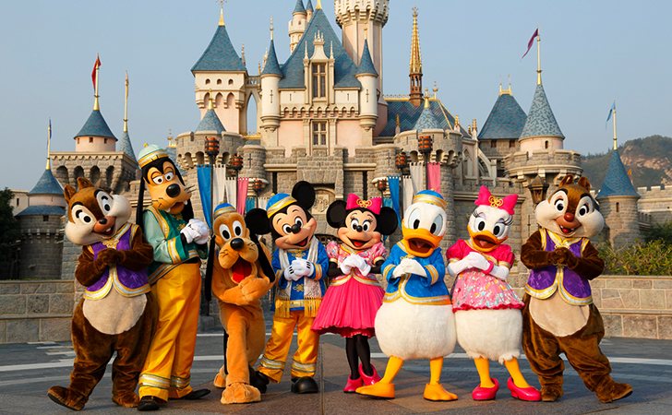
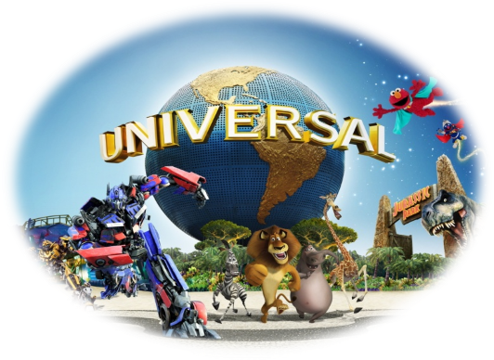
Lead in
Look at the title and pictures to predict what the text will talk about.
1. What does the text mainly talk about?
The passage mainly introduces three theme parks, including their names, locations, attractions, entertainment facilities, food and restaurant.
2. Who are the target readers? What is the writer's purpose of writing this text?
Visitors. The writer's purpose is to appeal to visitors to visit by introducing three theme parks.
3. What’s the type of text?
Expository writing.

Slide 15

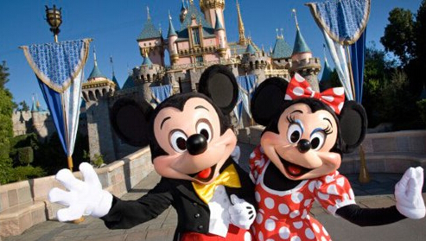
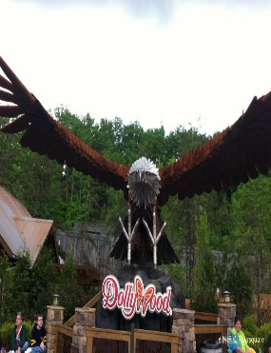
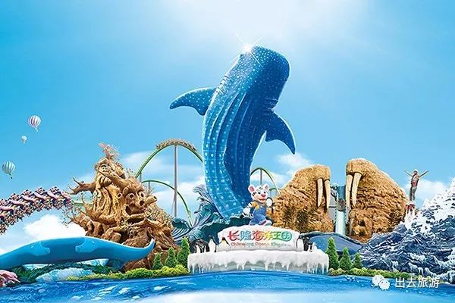
While-Reading:
Look at the title and the three pictures to predict what the text will talk about? What is a theme park? Have you ever been to a theme park? Which theme park have you been to? What kind of activities do you like most?
It will talk about theme parks, the funny things in theme parks and something that is not only funny but also maybe meaningful.
A theme park has a certain idea or a certain theme that the whole park is based on, like sports theme parks, history or culture theme parks, Disneyland theme parks, marine or ocean theme parks, science theme parks and future theme parks …
Theme parks fun and more than fun

Slide 16
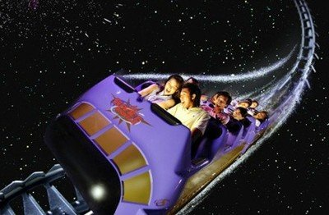
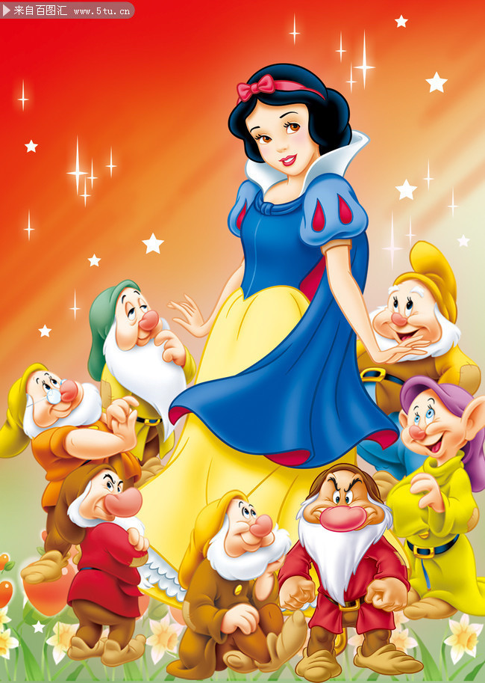
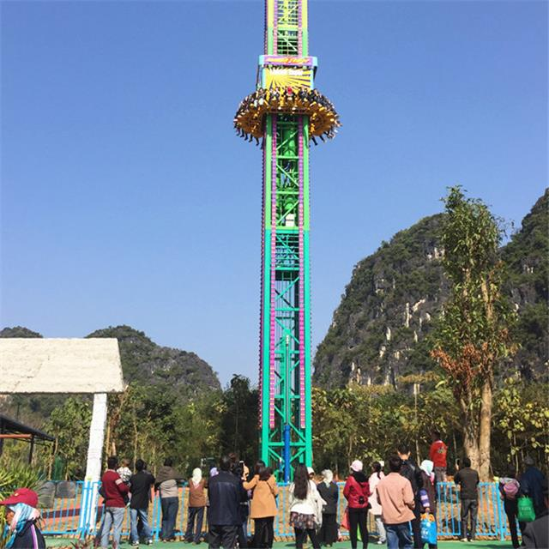
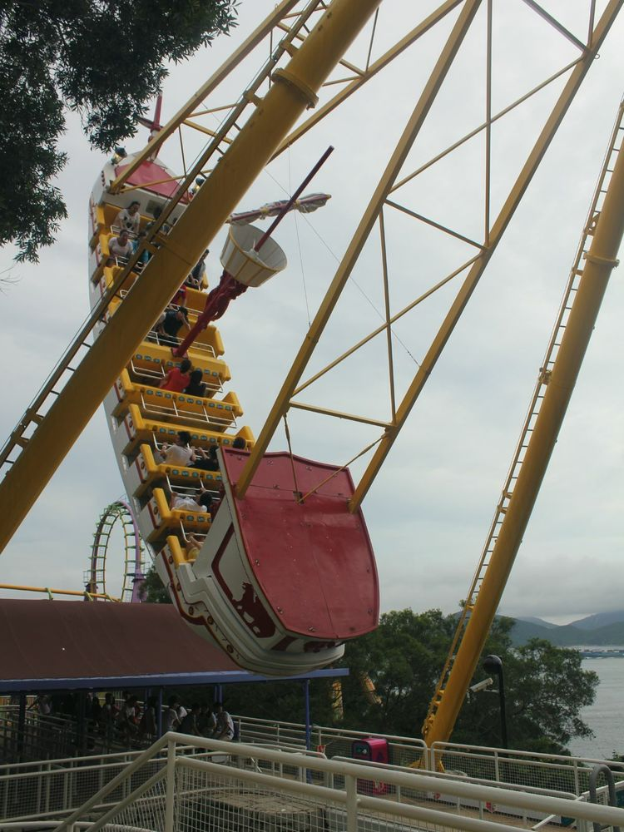
While-Reading: Read for the details of paragraph 2
It is a kind of amusement park which is based on a certain__________.
theme
the name of the park???
free-fall drops
自由落体
Snow White
白雪公主
travel through space
遨游太空
Disneyland
迪士尼乐园
meet an adorable fairytale
遇见可爱的童话
cartoon characters
动画角色
Mickey Mouse 米老鼠
enormous swinging ship
巨大的摇摆船

Slide 17


While-Reading:
Read for the details of paragraph 2
Theme Park fun more than fun
1. What fun activities can people experience in a Disneyland?
2. What impression did Disneyland leave on visitors?
travelling through space | As you wander round the fantansy amusement park
visiting a pirate ship | You may see Mickey Mouse
meeting an adorable fairytale or cartoons | You may see Snow White
2. Disneyland will bring you into a magical world and make childhood dream come true

Slide 18
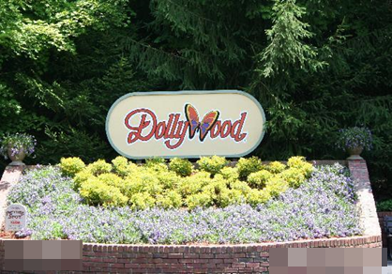
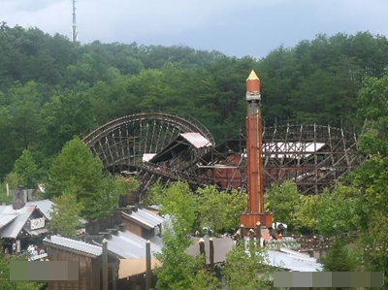
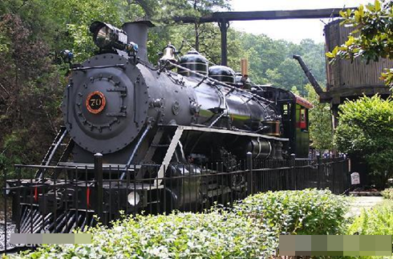
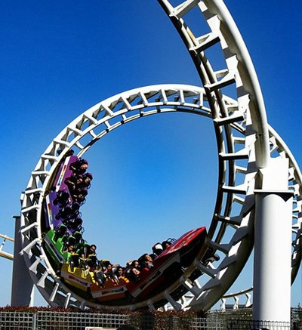
Dollywood
Read for the details of paragraph 3
While-Reading:
get upside down by a roller
coaster 坐过山车上下颠倒

Slide 19
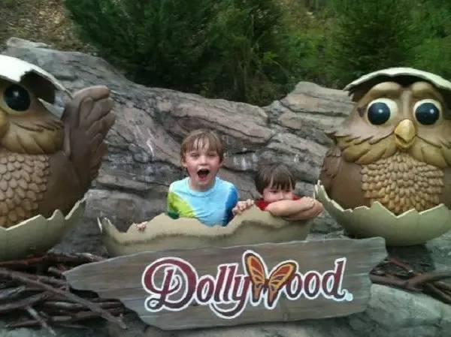
While-Reading:
Read for the details of Paragraph 3
Dollywood in the Smoky Mountains
1. What activities can you do in Dollywood?
2. What is Dollywood's most distinctive feature?
a | Put on music performances
b | traditional southeastern culture
c | riding on the only steam engine
d | walking along the longest track
e | Roller coast, Thunderhead
2. learning about America’s traditional and historical southeastern culture

Slide 20
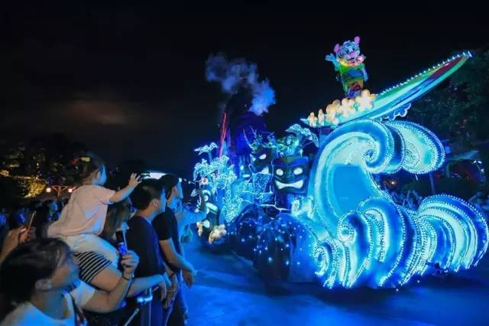
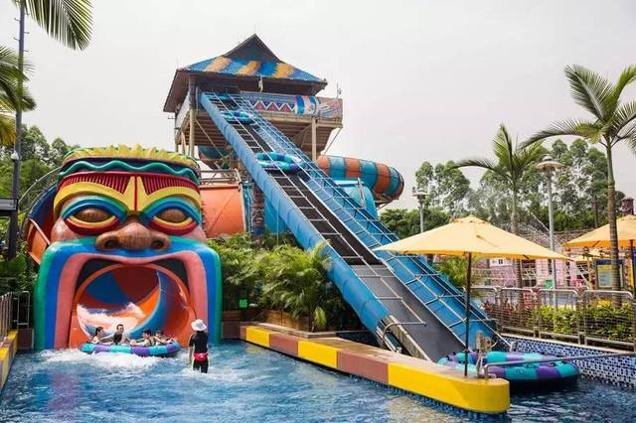
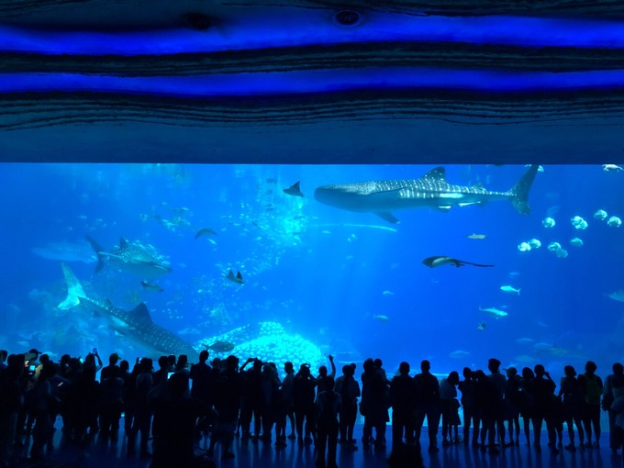
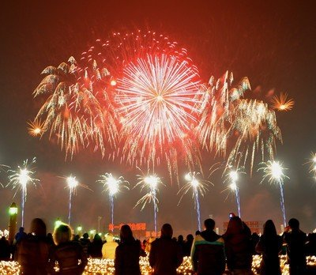
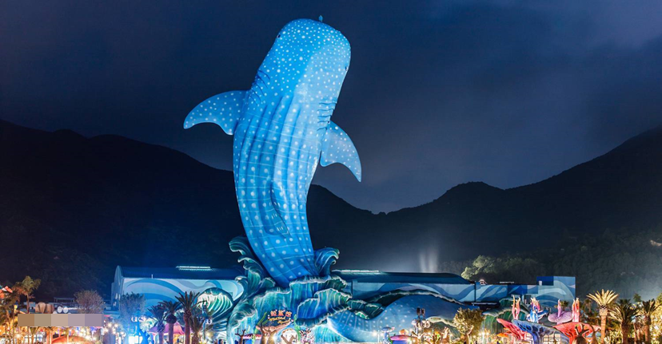
Read for the details of Paragraph 4
While-Reading:
ChimeLong Ocean Kingdom
长隆海洋王国
get wet in the water ride
the name of the park?
see the splendid journey of Lights Parade and fireworks display
看灯光游行和烟花表演

Slide 21



While-Reading:
Read for the details of Paragraph 4
Chimelong Ocean Kingdom in Zhuhai, China
Visit the underwater kingdom

Slide 22
While reading:
Read for the details of Paragraph 4
Chimelong Ocean Kingdom : A leading ocean-themed park
List the attractions and have Ocean entertainment:
Walk under the Whale Shark Acqurium | Get turned upside down by an exciting roller coaster
Watching the dolphin shows | Join a water fight against pirates
Watching the sea lion shows | See the splendid Journey of Lights Parade
polar bears and other animals | fireworks display
 | tasty food for every appetite

Slide 23

While reading:
Read for the structure
1. Focus on the structure
Read the passage again and draw a mind map to figure out the structure and language features of the passage, the students can draw a mind map on their own or use the mind map teacher provides.

Slide 24

While reading:
Read for the structure

Slide 25
While reading:
Read for the details of each paragraph
What attracts you in the theme parks?
A | B | C | D
Disneyland (various locations) | Travel through space; visit a pirate ship; meet an adorable fairytale or cartoon character ; Enormous swinging; Ships, scary free-fall drops | A parade of Disney characters
Dollywood in the Smoky Mountains in the southeastern USA | A superb old wooden roller coaster, thunderhead | Famous country music groups put on performances there
Chimelong Ocean Kingdom in Zhu Hai,China | Water fight against pirates; exciting roller coaster; water rides | Whale Shark Aquarium; Dolphin and sea lion shows; polar bears | Plenty of restaurants with tasty food for every appetite

Slide 26

While reading:
Read for the language features
Study language features
1. What headers would you give for column A to D?
A Name and location
B Theme activities and Rides
C Attractions, culture and history
D Restaurants and tasty food

Slide 27
While reading:
Read for the language features
Focus on language features: Find out the adjectives, if-clauses, imperatives, etc. in the text, talk about what kinds of feelings these expressions bring to the readers, and try to use them in your own writing.
Read the text again and fill in the table below.
Paragraph | Adjective | If-clause | imperative | other
1
2
3
4

Slide 28
While reading:
Read for the language features
Paragraph | Adjective | If-clause | imperative | other
1 | various, different, famous, biggest, longest, incredible | (none) | (none) | Some parks are famous for having the biggest or longest roller coasters, others for showing famous sites and sounds. (动词-ing 形式)
2 | familiar, magical, adorable, possible, exciting, enormous scary, … | If you want to have fun and more than fan, come to Disneyland! | (If you want to have fun and more than fan,) come to Disneyland! | Travelling through space, visiting a pirate ship or meeting an adorable fairytale or cartoon character are all possible at Disneyland. (动词-ing 形式)
3 | beautiful, unique, traditional, famous, old-fashioned, rare only, special, superb, old, world- famous, longest smallest, historical | (none) | Come to Dollywood to have fun learning all about America’s historical southeastern culture! | Visiting the candy shop and trying some of the same kind of candy that American southerners made 150 years ago is a rare experience. Riding on the only steam engine still working in the southeastern United States is a special treat. (动词-ing 形式)
4 | leading, largest, educational, fun , interesting, exciting, splendid, tasty, … | If it is ocean entertainment that you are looking for, come to Chimelong Ocean Kingdom. | (If it is ocean entertainment that you are looking for,) come to Chimelong Ocean Kingdom. | Watching the dolphin and sea lion shows is both educational and fan. (动词-ing 形式)

Slide 29
While reading:
Read for the details of each paragraph
Focus on the title and subtitle
Theme parks | Fun activities | More than fun
Disneyland
Dollywood
Chimelong Ocean Kingdom

Slide 30
While reading:
Read for the details of each paragraph
Focus on the title and subtitle
Theme parks | Fun activities | More than fun
Disneyland | Travel through space; visit a pirate ship; meet an adorable fairytale or cartoon character; A parade of Disney characters | Make your childhood dreams come true
Dollywood | a super old wooden roller coaster; Thunderhead; famous country music groups put on performances there | Have fun learning all about America’s historical southeastern culture
Chimelong Ocean Kingdom | Water fight against pirates; exciting roller coaster; water riders; Whale Shark Aquarium; dolphin and sea lion shows; Polar bears; Plenty of restaurants with tasty food for every appetite | Both educational and fun

Slide 31

Summary：summarize about visiting a city park
1. Choose the park you wish to write about.
2. Make a mind map about the park.
3. Use your notes to write your draft.
adorable, famous, old-fashioned, educational …
Shows
exciting, enormous,
scary, superb, …
tasty …
Food
Rides
Attractions
Other
magical, fantasty, incredible …
(Name of park) in (place)
____________________
…
P33 3

Slide 32

Post-reading：Write an introduction to a theme park

Slide 33
Post-reading：Write an introduction to a theme park
Choose the park you wish to write about, and make a mind map about the park, using your notes to write your draft.
In groups, brainstorm as much information as possible about the theme park you like most and then write an outline of your introduction.
1.What is the name and place of the theme park?
2.What do the attractions and activities appeal to you most?
3.What kind of additional information can you provide?

Slide 34

Post-reading：Retell the text with the help of mind map
Talk about and introduce one of the theme parks in the passage to your groupmates or partners using the mind map you draw to have a better understanding of the topic, and also to be familiar with the language features.
A mind map of a park
Shows
Rides
other
Attractions
Food

Slide 35

Discussion: Discuss what the text mainly talk about.

Slide 36


1.Go through the title and passage quickly to summarize what the text mainly talk about.
2. Read the passage again and draw a mind map.
3. Talk about the theme park impressing you most and write an introduction about a theme park you like.
4. Use what you have learnt to write an introduction to a park.

Slide 37

Thank you !
Have a nice day!

