Slide 1


感恩遇见，相互成就，本课件资料仅供您个人参考、教学使用，严禁自行在网络传播，违者依知识产权法追究法律责任。
更多教学资源请关注
公众号：溯恩高中英语
知识产权声明

Slide 2

Unit 3
FASCINATING PARKS
Discover useful structures
The -ing form as the subject
选择性必修 第一册

Slide 3


can bring you into different world. (参观主题公园)
Lead in
Visiting theme parks

Slide 4
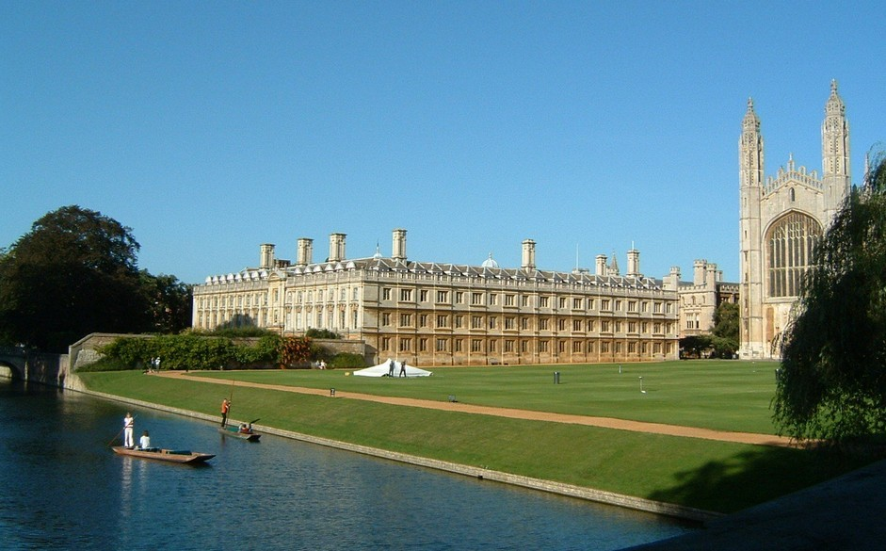
______________________________ is my dream.
Going to the Cambridge University
(去剑桥大学上学)

Slide 5
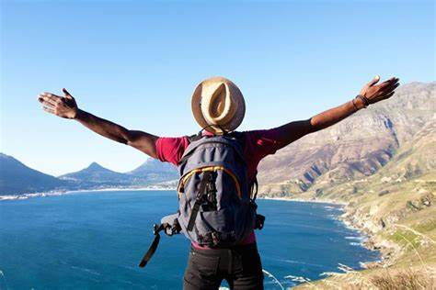
is a good way to relax.
(旅游)
Travelling

Slide 6

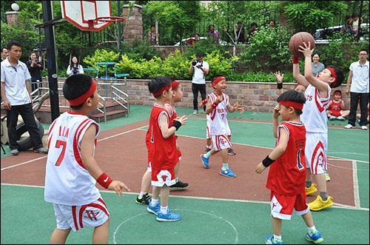
makes me happy.
(打篮球)
Playing basketball

Slide 7

Laughing at others
is impolite.
(嘲笑他人)
。

Slide 8
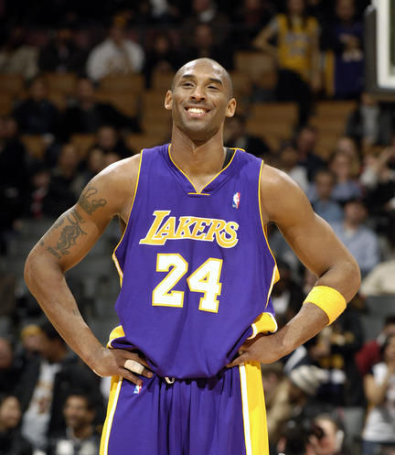
_______________________
_________has been my
life goal.
Becoming a basketball player
like Kobe
(成为科比那样的篮球运动员)

Slide 9
01
Visiting theme parks can bring you into different world.
02
Going to the Cambridge University is my dream.
Travelling is a good way to relax.
03
Playing basketball makes me happy.
04
05
Laughing at others is impolite.
06
Being a basketball player like Kobe has been my life goal.
V-ing form used as the subject

Slide 10
Activity 1
Being in such a beautiful and wild place makes me feel blessed to be alive.
Even though the sun is brightly shining, telling whether it is morning or night is impossible.
Getting here is quite difficult, so apart from the Semi very few people have ever seen Sarek.
For hundreds of years, looking after reindeer was a way of life for the Sami.
Find more sentences with the –ing form as the subject from the reading passage.

Slide 11
Observe and discover1
Playing basketball makes me happy.
主谓一致
Laughing at others is impolite.
Watching TV and reading books ____ interesting.
are
Listening, speaking, reading and writing ____ basic skills of a language.
are
单数
单个v-ing作主语，谓语动词用_____；
两个或两个以上表达不同意义的v-ing作主语，
谓语动词常用_____.
复数

Slide 12
Observe and discover2
ONE
V-ing 和 to do 作主语的区别
Singing is my hobby, and to sing at my friend's birthday party is my dream.
Playing with fire is dangerous.
Be careful! To play with fire will be dangerous.
V- ing 形式和 to do 不定式都可以作主语，但 v-ing 通常表示
___________________ 动作或行为； 而 to do 不定式通常表示
____________ 动作或意义。
习惯性，经常性
某次具体

Slide 13
Observe and discover3
Playing video games
is
a waste of time
.
playing video games
It
is
a waste of time
.
It
is
a waste of time
playing video games
.
形式主语
真正主语
V-ing 形式作主语时常后置,用it作形式主语。

Slide 14


It is no use crying over spilt milk.

Slide 15


Translate the following sentence
It's a waste of time arguing with such a stupid person.
It is a waste of time doing... 做...是浪费时间的
It is / was no good / use doing.. 做... 是没用的
It is /was hardly / scarcely worth doing... 做... 是不值得的
It is worth / worthwihile doing ... 做... 是值得的
VS

Slide 16

Think about it!
His coming made me excited.

Slide 17
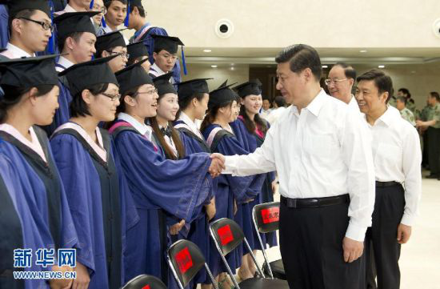
Think about it!
The president's attending
the graduation ceremony
himself gave them a big
surprise.
.

Slide 18
Observe and discover4
His coming made me excited.
A
B
The president's attending the graduation ceremony
gave them a big surprise.
形容词性物主代词
当动名词作主语时，其逻辑主语由___________
或者 ____________ 构成。
名词所有格
Her coming late made the boss angry.
_________________________________
Tom's being so careless caused so much trouble.
———————————————————
她的迟到使得老板很生气。
汤姆这么粗心，引来了不少麻烦。

Slide 19
Practice
Rewrite each of the following sentences using the -ing form as the subject.
EXAMPLE
It is challenging yet really fascinating to hike through the mountains in the pathless Sarek.
Hiking through the mountains in the pathless Sarek is challenging yet really fascinating.
Notes:
Passagetiona

Slide 20
1. It is both challenging and rewarding to study abroad.
2. It would hardly be possible to go on a hiking tour in Sarek in winter due to the extreme cold.
Studying abroad is both challenging and rewarding.
Going on a hiking tour in Sarek in winter would hardly be possible due to the extreme cold.

Slide 21
3. Honestly, it can be both exciting and terrifying to explore a vast unknown land.
4. It is good to adopt a positive attitude, even when things are difficult.
Honestly, exploring a vast unknown land can be both exciting and terrifying.
Adopting a positive attitude is good, even when things are difficult.

Slide 22
5. It is strongly advised to hire local guides, because they can offer accurate knowledge of Sarek culture and history.
Hiring local guides is strongly advised because they can offer accurate knowledge of Sarek culture and history.
Discuss: How does the sentence focus change.
The use of -ing forms as subjects puts the action first, making the sentences seem more dynamic.

Slide 23
Language use Activity 1
Fill in each blank using the -ing form of a verb from the box and state its function. One word will be used twice.
combine cover grow take limit walk experience
covering (attribute)
Xixi National Wetland Perk, ________________ 10 square kilometres In western Hangzhou, Is the first national wetland park in China. __________________ city life, nature, and wetlands makes the park a popular destination both for tourists and local residents. At Xlxi. ______________ a boat lour, ______________ along paths, and __________________ local customs and traditions of the villages in this park are at the top of the list of people’s favourite activities. With trees, bushes, and colourful flowers ________________ along the riversides, the perk shows different sides of beauty in different seasons.
Combining (subject)
taking (subject)
walking (subject)
experiencing (subject)
growing (attribute)

Slide 24
Fill in each blank using the -ing form of a verb from the box and state its function. One word will be used twice.
combine cover grow take limit walk experience
limiting (subject)
In order to better develop as well as preserve this place, _______________ human impact on Xixi Wetland was considered by the park designers. All the now buildings were designed in a traditional way to fit into the natural environment. This green, watery world is home to many birds and fishes. With trees ________________ in the shallows, the wetland is a natural system for providing clean water and producing oxygen, which makes it the “green lungs of Hangzhou”.
growing (attribute)

Slide 25
Language use Activity 2
Translate the Chinese in brackets into English to complete the passage. Use the -ing form where possible.
Travelling to cold, dark, and remote Arctic Norway in mid-winter （在隆冬季节去寒冷、黑暗而偏远的北极圏内的挪威旅游）can be （激动人心的）especially for those （寻求完全不一样的体验）. （意识到）the lack of daylight and difficulties in transport is extremely important. Last January, we found a few mountain passes were closed, so （走动）was not easy, but（欣 赏） the northern lights was an incredible experience.
（在线订交通和宾馆） did help a lot.
（想出如何拍照）in low light actually took us quite some time during our （筹划）stage. Finally （雇一位当地的导游）was necessary and helpful for this trip.
fascinating
looking for totally different experiences
Realising
moving around
appreciating
Booking transportation and hotels online
Figuring out how to take pictures
planning
hiring a local tour guide

Slide 26

Language use Activity 3
Choose a place in your city or town as a destination for a school trip. Use the passage above as an example and write about your choice.
Sample
With the colourful scenery and wonderful hiking trails, taking a trip to Danxia Geothermal Park in Gansu Province is one of the highlights of any trip to the northwestern part of China. You’re welcome to visit! It is near the city of Zhangye in Gansu Province, my hometown and where my school is, and it covers about 510 square kilometres. Forming of the rocks took many millions of years and involved many kinds of erosion such as wind and water on the red sandstone. What encourages thousands of people to come here each year is the natural beauty of the rocks. Walking around the park will allow you to see iridescent tall peaks, deep cave holes, and stone halls. Visiting the colourful, magical rock formations in person will surely be an unforgettable experience and one you will share with friends and family for years to come.

Slide 27

Thanks!

