Slide 1

感恩遇见，相互成就，本课件资料仅供您个人参考、教学使用，严禁自行在网络传播，违者依知识产权法追究法律责任。
更多教学资源请关注
公众号：溯恩高中英语
知识产权声明

Slide 2
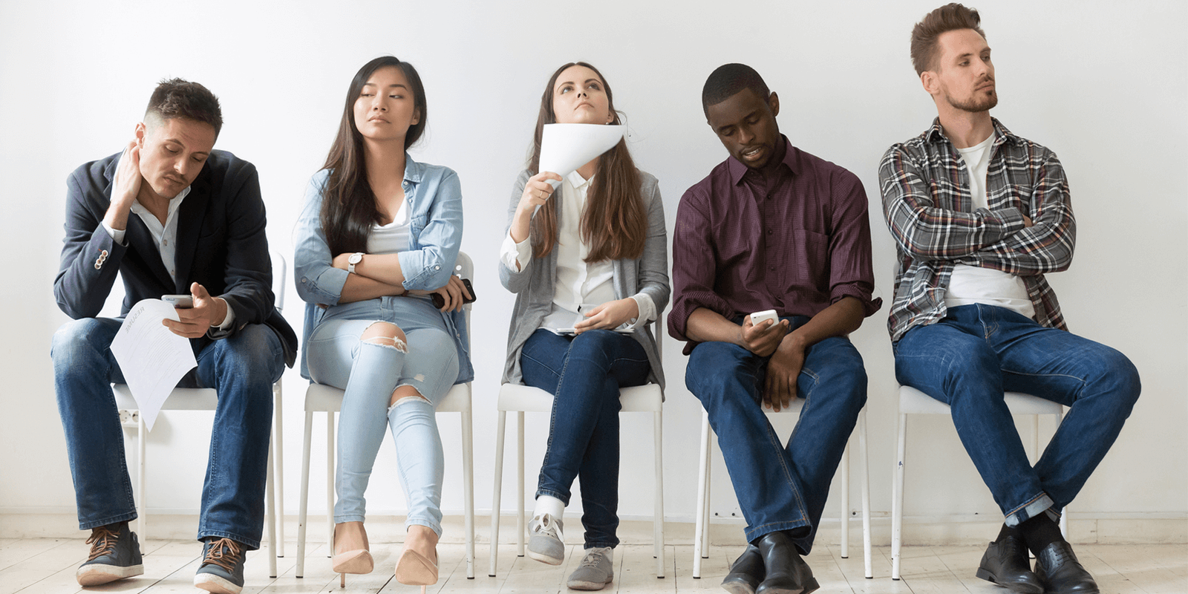
UNIT 4 BODY LANGUAGE
Reading and Thinking
嘉兴一中 马皓

Slide 3

What I hide by my language my body utters.
-- Roland Barthes
[ˈʌtər]出声to make a sound with your voice
我的身体会说出我用语言掩饰的话
● When you say “yes” do you really mean “yes”?
● Do you like English?

Slide 4
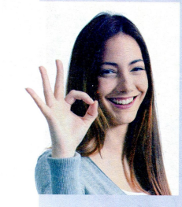
What do you think the young lady might want to convey with her body language?
Where is this picture on this page?
Is this passage probably a narrative? An expository?
Activity 1: read for topic sentences
Go through the passage and try to find the topic sentence in each paragraph with the help of some “signal words”
〇however; but …
●for example; in this place… in that place; at this point … at that point ; when this … when that; different expressions with similar meaning …
◎ both… and …; also; either; by contrast …
What do you think will be talked about in the text?
Listening to How Bodies Talk

Slide 5
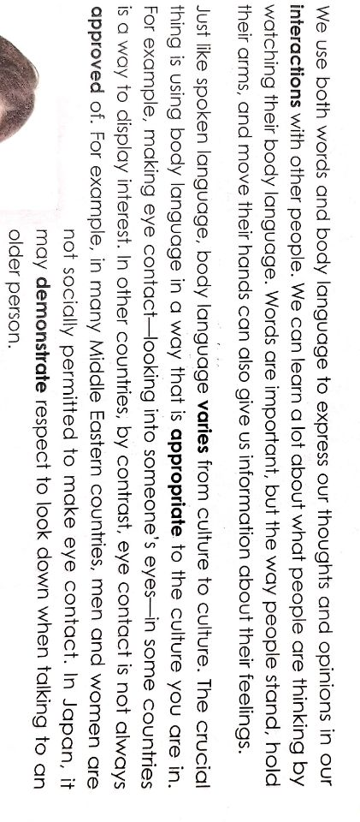
Paragraph 1
Paragraph 2
〇however; but …
●for example; in this place… in that place; at this point … at that point ; when this … when that; different expressions with similar meaning …
◎ both… and …; also; either; by contrast …

Slide 6
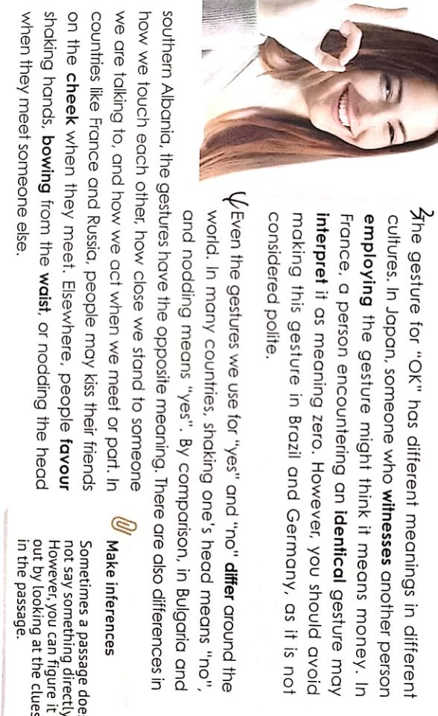
Paragraph 3
〇however; but …
●for example; in this place… in that place; at this point … at that point ; when this … when that; different expressions with similar meaning …
◎ both… and …; also; either; by contrast …
Paragraph 4
Notes:
调整一下动画顺序,paragraph 4 里面

Slide 7
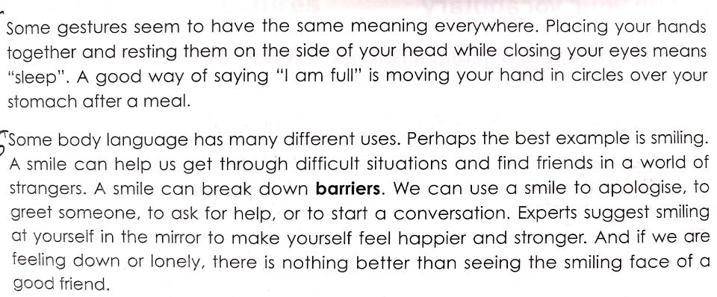
Paragraph 5
different expressions with similar meaning
Paragraph 6
〇however; but …
●for example; in this place… in that place; at this point … at that point ; when this … when that; different expressions with similar meaning …
◎ both… and …; also; either; by contrast …

Slide 8
Activity 2: Tell the main idea and structure
Para 1 | … the way people stand, hold their arms, and move their hands can also give us information about their feelings.
Para 2 | … body language varies form culture to culture. (make eye contact)
Para 3 | The gesture for “OK” has different meanings in different cultures.
Para 4 | Even the gestures we use for “yes” and “no” differ around the world.
Para 5 | Some gestures seem to have the same meaning everywhere.
Para 6 | Some body language has many different uses.
Paragraph | Main idea | structure
1
2-4
5
6
Introduction to body language
Body language with different meaning in different cultures
Body language with the same meaning everywhere
Body language with different uses
general
specific
example

Slide 9
Activity 3: Read for specific information
① Fill in the blanks
Body language/ Gesture | meaning | Country/ region
Eye contact between men and women
Looking down when talking to someone
OK sign
Kissing on the cheek
Placing your hands together and resting them on the side of your head while closing your eyes
Moving you hand in circles over your stomach after a meal
Not polite
A sign of respect
Money
Zero
Not polite
A greeting
I’m sleepy.
I’m full.
Middle East
Japan
Japan
France
Brazil and Germany
France and Russia
Most places

Slide 10
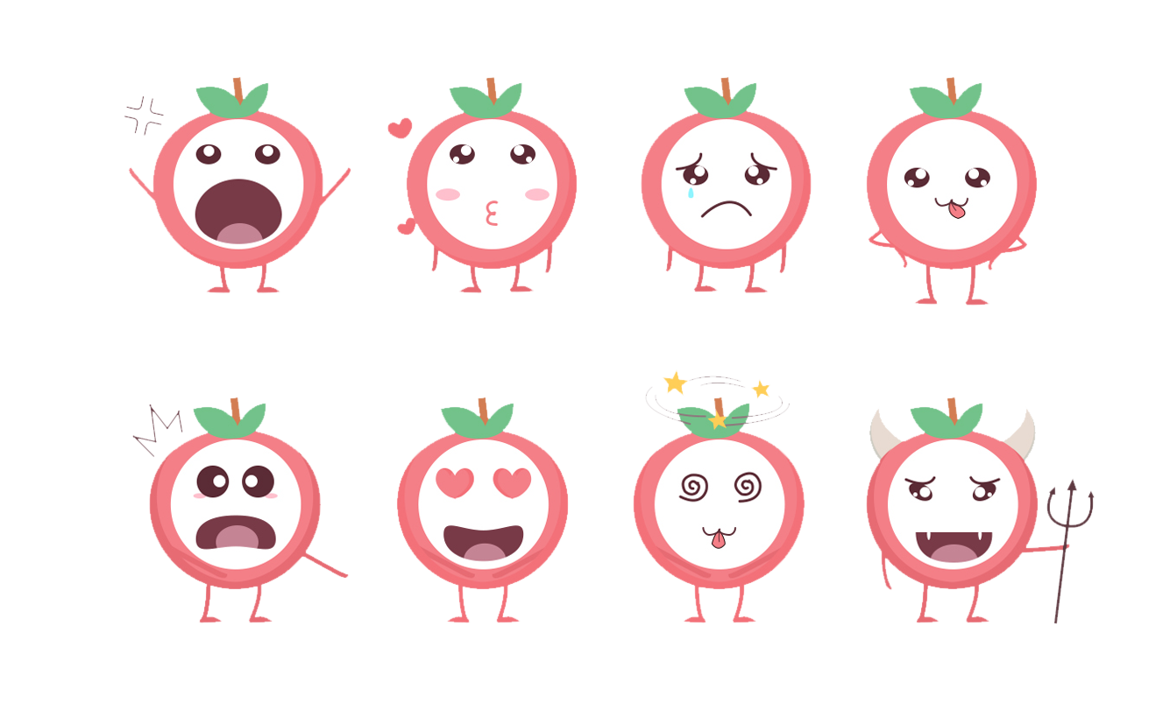
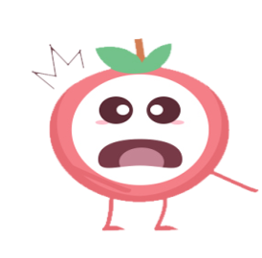
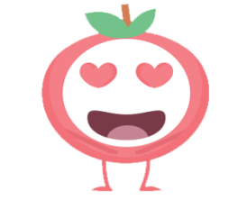



② Answer the questions
What is body language? (paragraph 1)
What could it demonstrate when your make eye contact with the person you talk to? (paragraph 2)
How to display “zero” in France? What does the identical sign mean in Japan? (paragraph 3)
Why doesn’t the passage give some details about the “OK” gesture being impolite in Brazil and Germany?
How does the passage give examples in paragraph 4?
The way people stand, hold their arms, move their hands and so on
It may be a way to display that you are interested.
Make the gesture for “OK” like the girl in the picture.
It could mean “money” in Japan
Probably because it is a cultural taboo (禁忌), and the mere mention of it is not allowed there.
It employs comparison to display the examples.

Slide 11

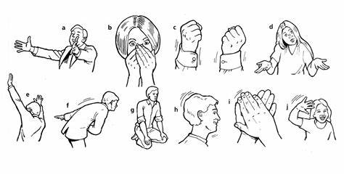
Activity 4: Tell the sentence structures used
1. How does the 6th paragraph tell us the different uses of smile? Can you find out the varied sentence structures?
〇 A smile can …
〇 We can use a smile to …
〇 Experts suggest smiling …
〇 … there is nothing better than seeing …
2. What about these body language signs? Refer to the sentence structures above.
Stretching one’s arms forward
shake one’s fists
can help him express his welcome.
cover one’s mouth with both hands
throw up one’s hands
Notes:
Activity4可以设计一个活动练习一下这几个不同的表达，比如a frown

Slide 12
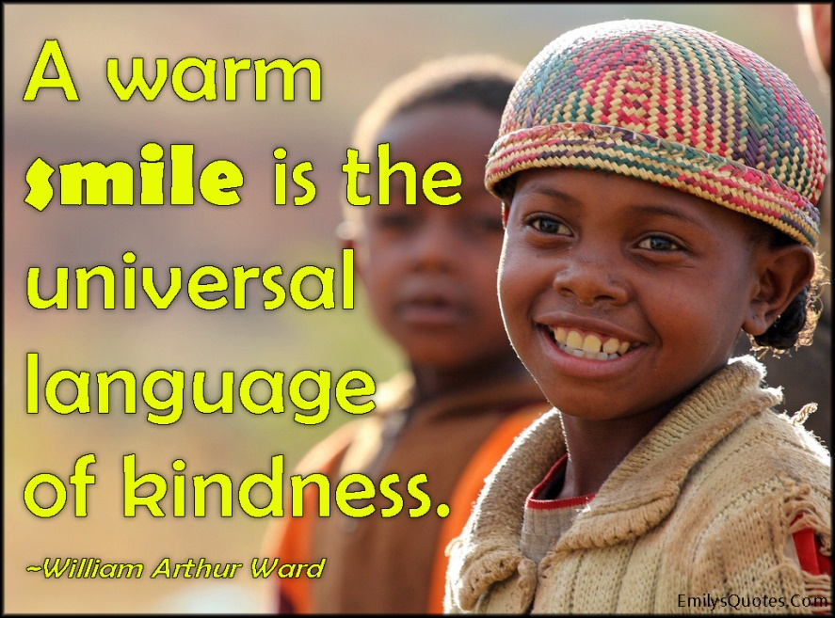
Activity 5: Watch the video and act
1. When we smile or laugh do we always feel happy? How many kinds of laugh are talked about here?

Slide 13
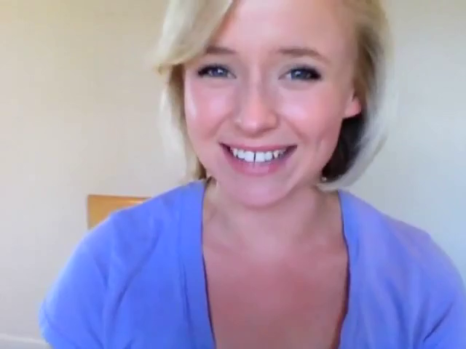
crack up
laugh sarcastically
put on a false smile
smile
mock
giggle
forced smile
2. The picture and sound in the video doesn’t match well? Can you and your partner help to demonstrate these expressions?

Slide 14
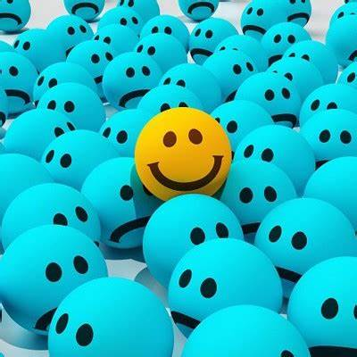
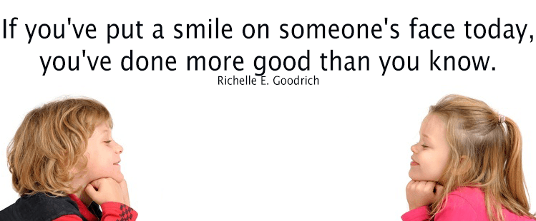
3. Look around. When you put a smile on your own face, do you put on a smile on your friends’ face?
Assignment:
1. Read the passage again and try to figure out the answer to the question: “which is more convincing, your verbal or non-verbal language?”
2. Finish off the concerned exercise in your exercise book.

Slide 15
