Slide 1

感恩遇见，相互成就，本课件资料仅供您个人参考、教学使用，严禁自行在网络传播，违者依知识产权法追究法律责任。
更多教学资源请关注
公众号：溯恩高中英语
知识产权声明

Slide 2
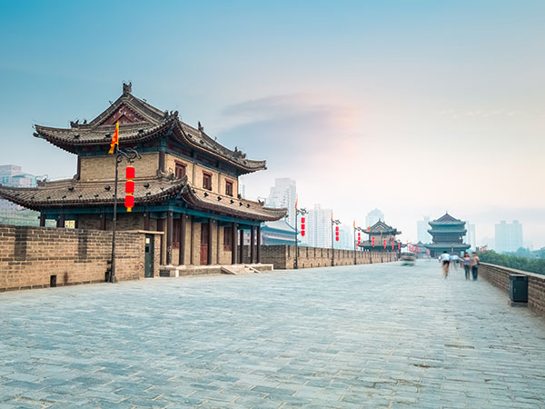
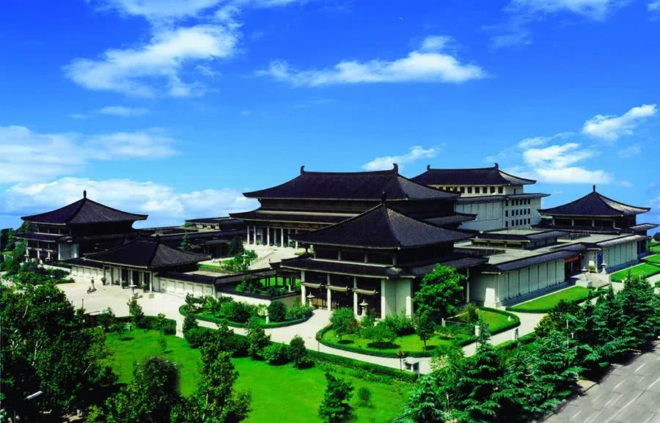
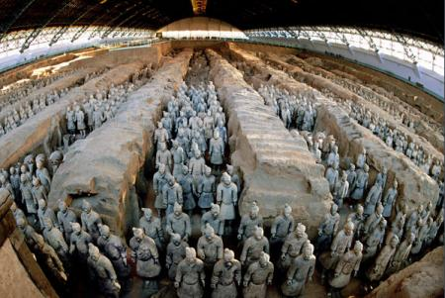
A Travel Plan to Xi’an
-- Jiang Jinli Shaoxing Luxun High School

Slide 3
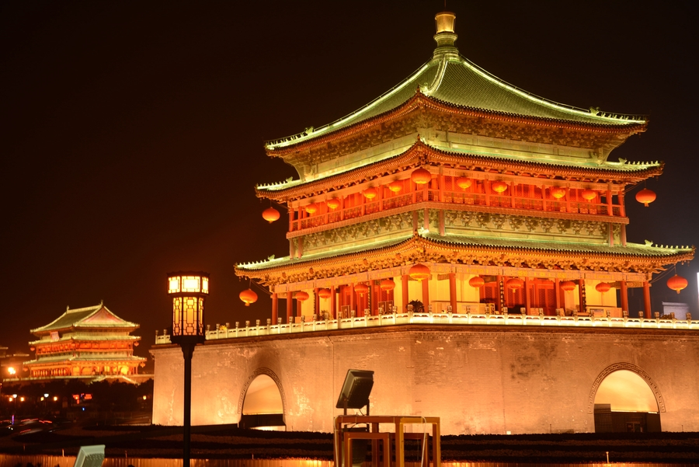
Lead in
Terracotta Army
Xi’an City Wall
Xi’an Bell Tower
Shaanxi History Museum

Slide 4

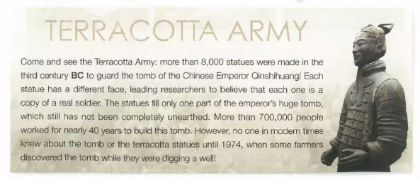
A brochure
What is Terracotta Army?
An army of soldier statues
For what were they made?
To defend the emperor

Slide 5
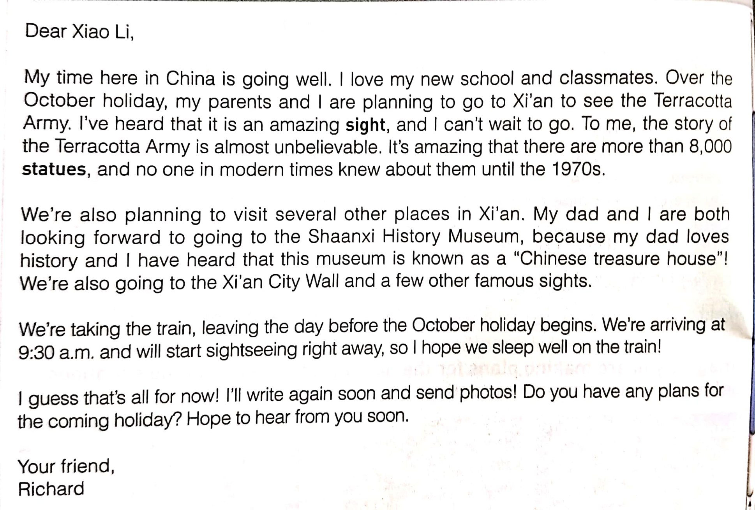
Read for the structure & contents
A travel plan to Xi’an
Main contents
Greeting
Greetings
Purpose
Plans
Main Body
Transport
Thoughts
Signature
Close

Slide 6
Read for the language
Main functions
Useful Expressions
Over the October holiday, …are planning to….
I’ve heard that it’s an amazing sight, and I can’t wait to go.
It’s amazing that….
We are both looking forward to…because…..be known as …
We’re taking the train.
Hope to hear from you.
…
Over the October holiday, my parents and I are planning to go to Xi’an to see the Terracotta Army.
I’ve heard that it’s an amazing sight, and I can’t wait to go. To me, the story…is almost unbelievable. It’s amazing that….
We’re also planning to visit….
My dad and I are both looking forward to…because…this museum is known as…
We’re taking the train, leaving the city before the October holiday begins.
My time here in China is going well....
Hope to hear from you soon.
when
with whom
where
why
what
how
....

Slide 7
Brainstorm
Functions
More Expressions
When
On…/During….
With…coming/approaching….
I intend to pay a visit to/ go on a vacation/journey to ….
I am scheduled/arrange to take a tour of/make a trip to….
I have made a list of the sites I wanted to see in London.
My first delight/attraction/destination is ….
There follows Big Ben.
What interests/impresses me most is….
unbelievable/unique/splendid/ breathtaking/admirable….
be famous for its extraordinary beauty/scenery/view/sight...
go sightseeing/visiting…
admire/appreciate/explore ….
take a flight/ship/boat…hike….
I am thrilled/amazed/shocked by so many wonderful treasures ….
Where
Why
What
How
....

Slide 8
Conclusion
Greetings
I’m very glad/delighted to know everything goes well in your new school life.
Part1
With…coming/approaching….
I arrange/am scheduled to pay a visit to/take a tour of/make a trip to….
I have made a list of the sites I want to see ….
My first delight/attraction/destination is ….
There follows ….
What interests/impresses me most is….
admirable/unique/splendid/ breathtaking….
be famous for its extraordinary view/sight….
take a flight/ship/boat…hike….
go sightseeing/visiting/admire/appreciate….
I am thrilled/amazed/shocked by…
Looking forward to….
Hope to hear from you....
Purpose
A travel plan
Plans
Part2
Transport
Thoughts
Part3
Close

Slide 9
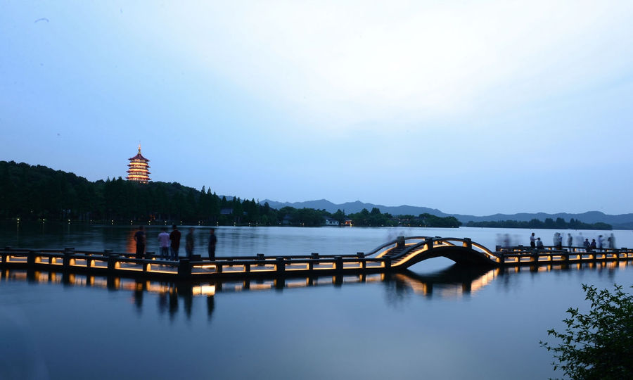
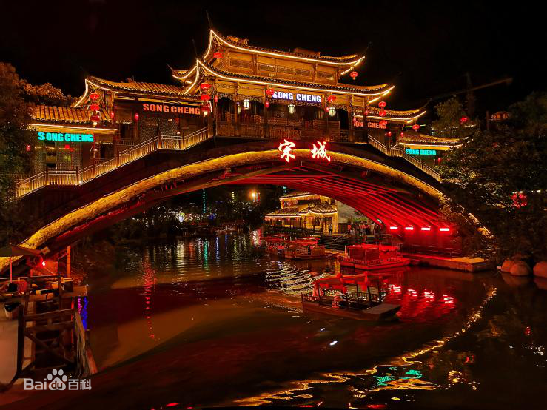
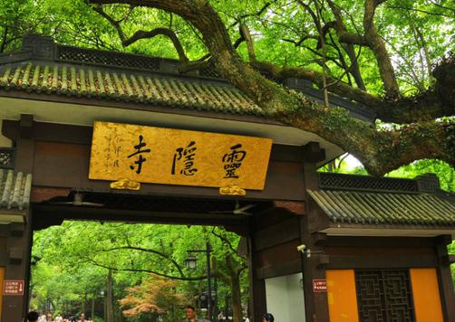
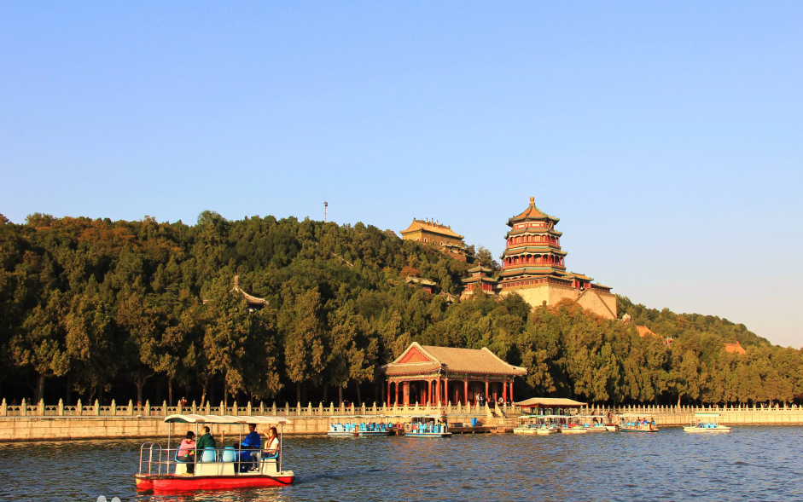
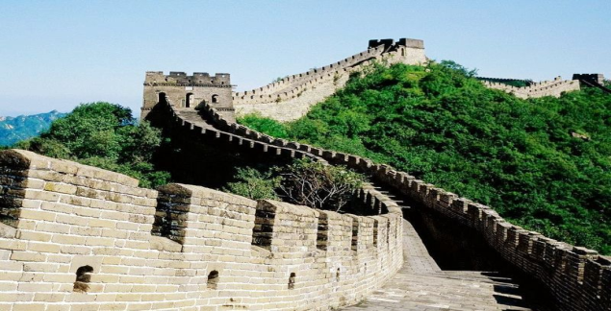
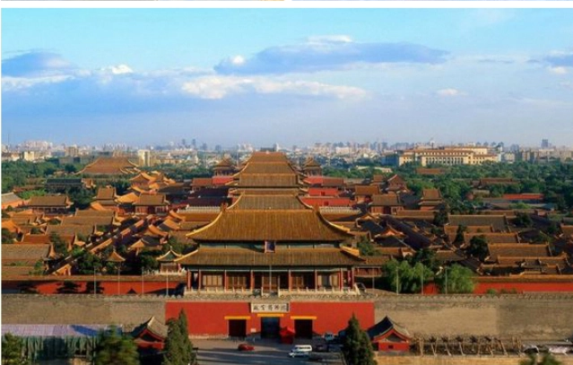
Writing
Write a reply to Richard.
Pick one city and share your travel plan with him. (Words:80-100)
The Summer Palace
Lingyin Temple
The Forbidden City
Song Cheng
The Great Wall
The West Lake

Slide 10
Checklist
Is there a clear structure?
Does the plan include the contents we’ve mentioned?
Do you use the present continuous tense for future plans?
Do you use commas, stops, and question marks correctly?
Are all the words spelt correctly?
Are all the proper nouns capitalized?
Clear Structure
Complete Contents
Correct Language

Slide 11
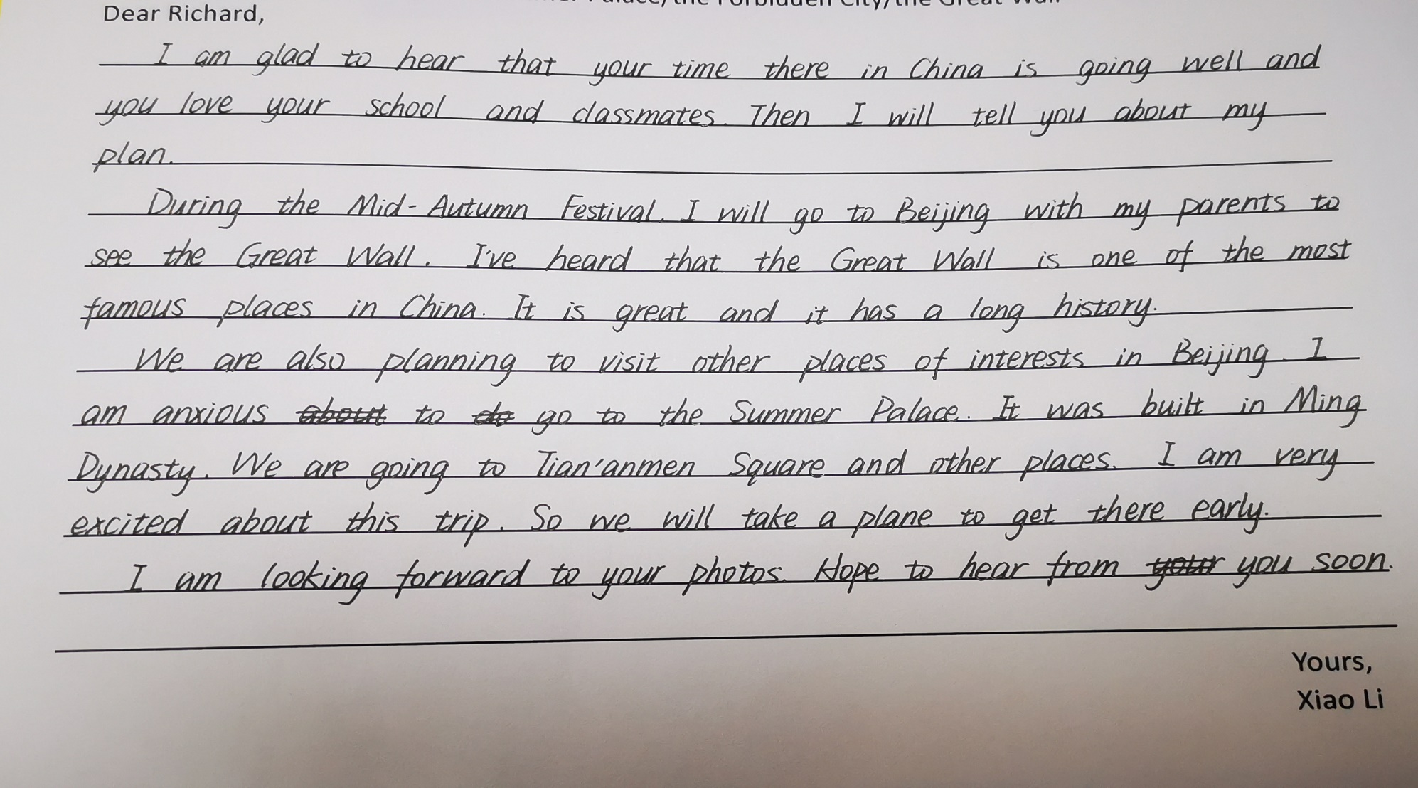

Slide 12
A possible version
Dear Richard,
I’m very glad to know everything goes well in your new school life! My new school life is also amazing. Now, with the National holiday approaching, my parents and I are planning to pay a visit to the Great Wall. It is one of the wonders in the world, famous for its grandiosity(宏伟) as well as historic stories behind. I just can’t wait to see it.
We’re also going to visit other places in Beijing, such as the Forbidden city, and the Summer Palace, both of which are admirable architectures. I believe we will be amazed by its unique culture and extraordinary views. We are taking a flight to go there.
Enjoy yourself and look forward to your beautiful photos.
Yours,
Xiao Li

Slide 13
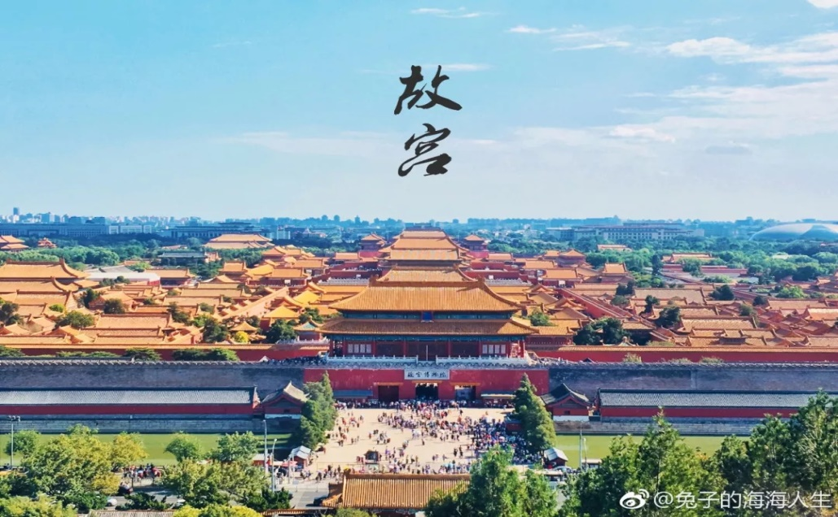
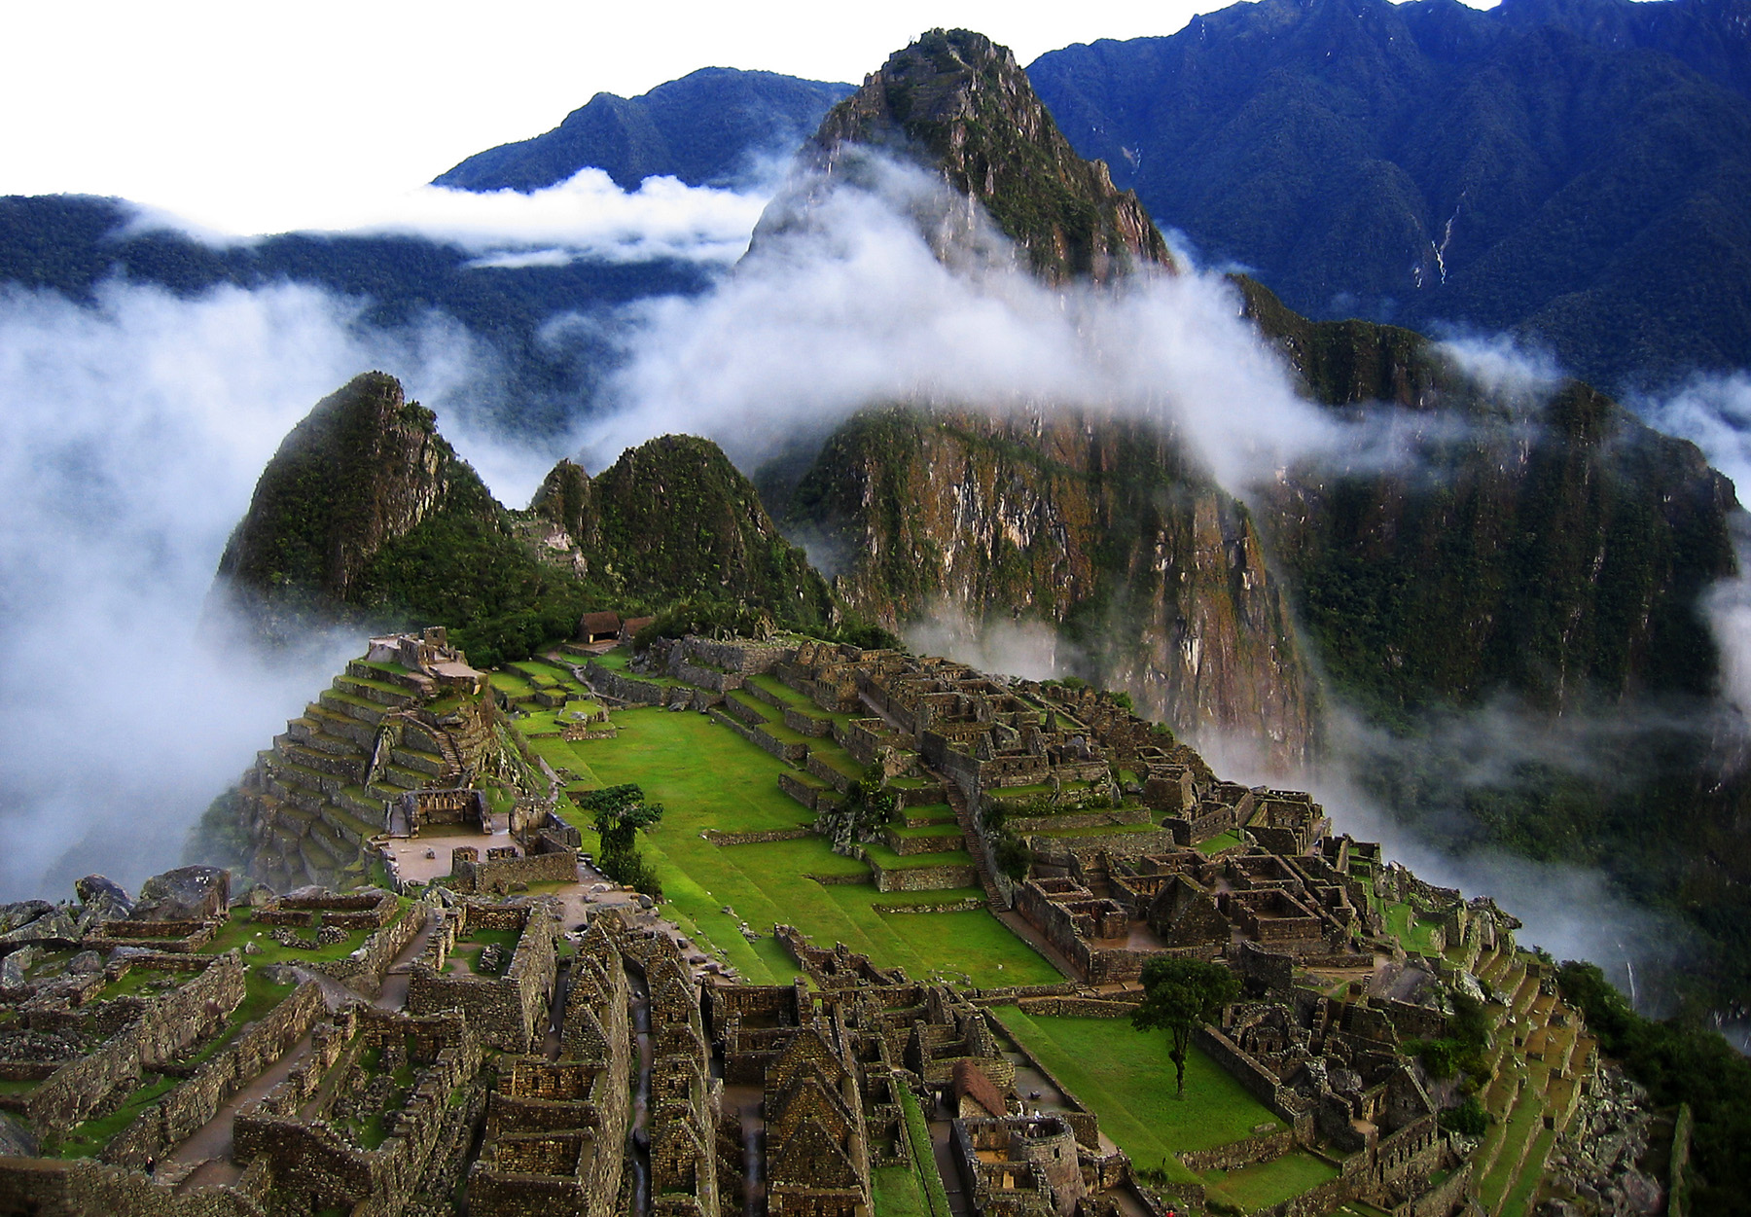
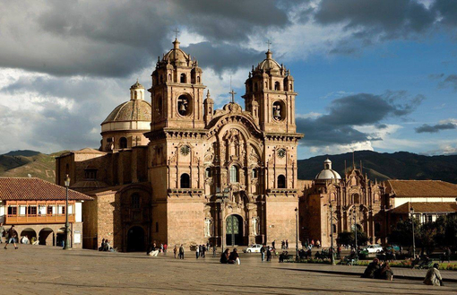
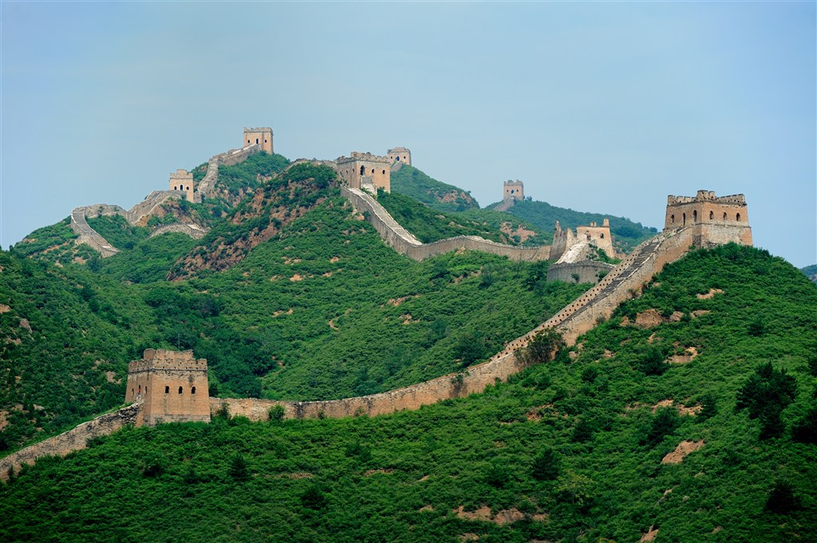
Go and explore and share!
The world is there waiting for you!

