Slide 1

感恩遇见，相互成就，本课件资料仅供您个人参考、教学使用，严禁自行在网络传播，违者依知识产权法追究法律责任。
更多教学资源请关注
公众号：溯恩高中英语
知识产权声明

Slide 2
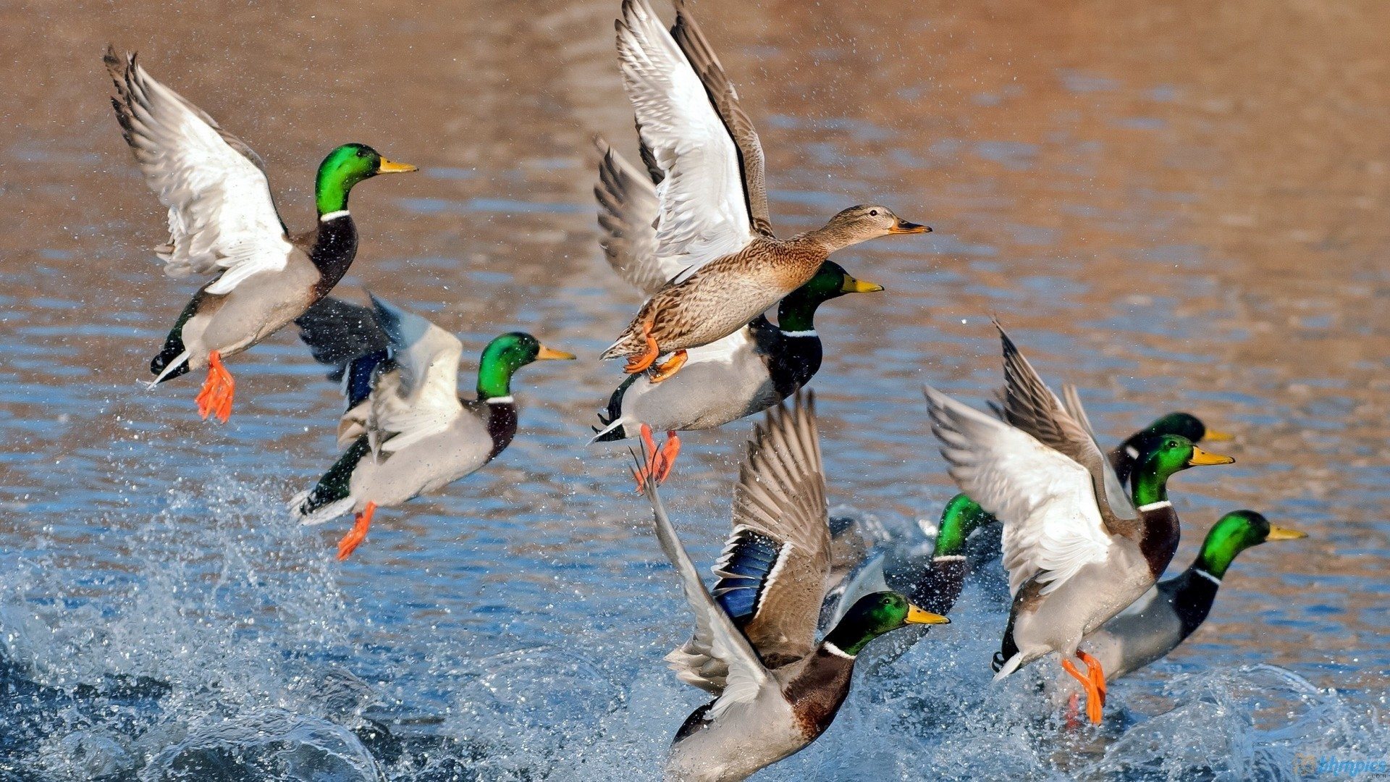
Continuation Writing
The First Hunting
桐乡市高级中学 沈凯瑜

Slide 3
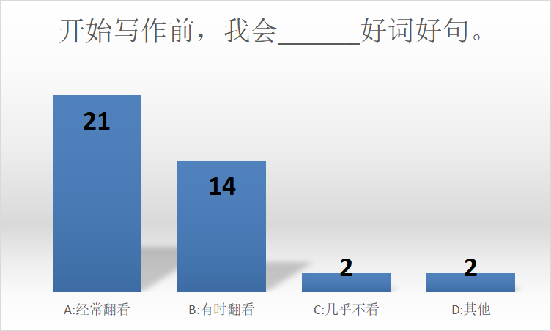

Let’s see the results...

Slide 4
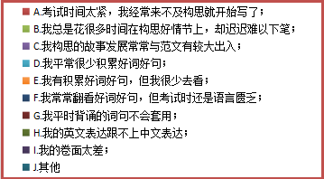
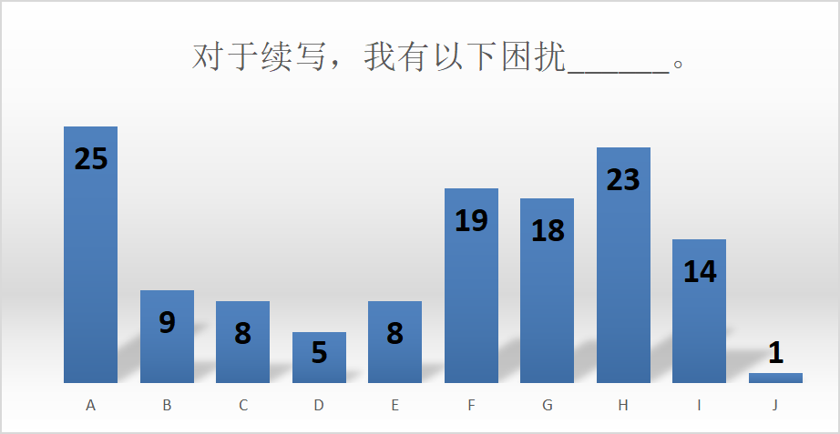
Let’s see the results...

Slide 5

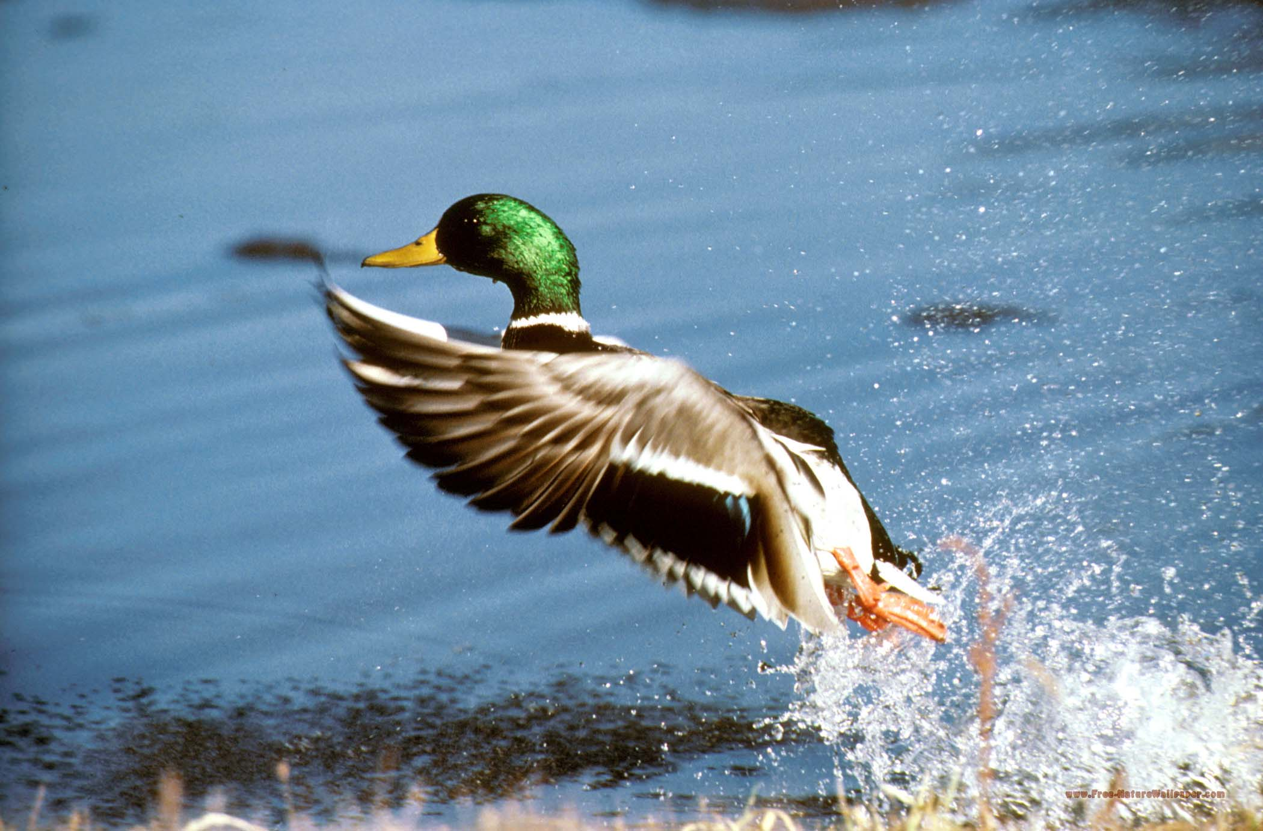
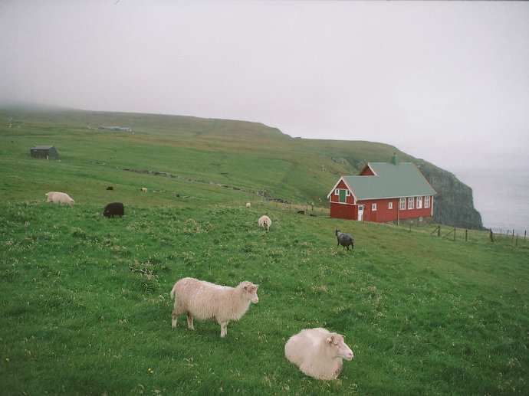
Contents
How to get logical and reasonable plots?
How to pursue a better continuation writing?

Slide 6
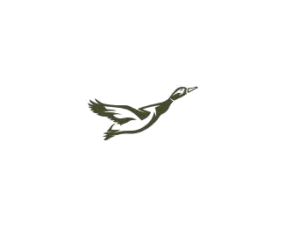
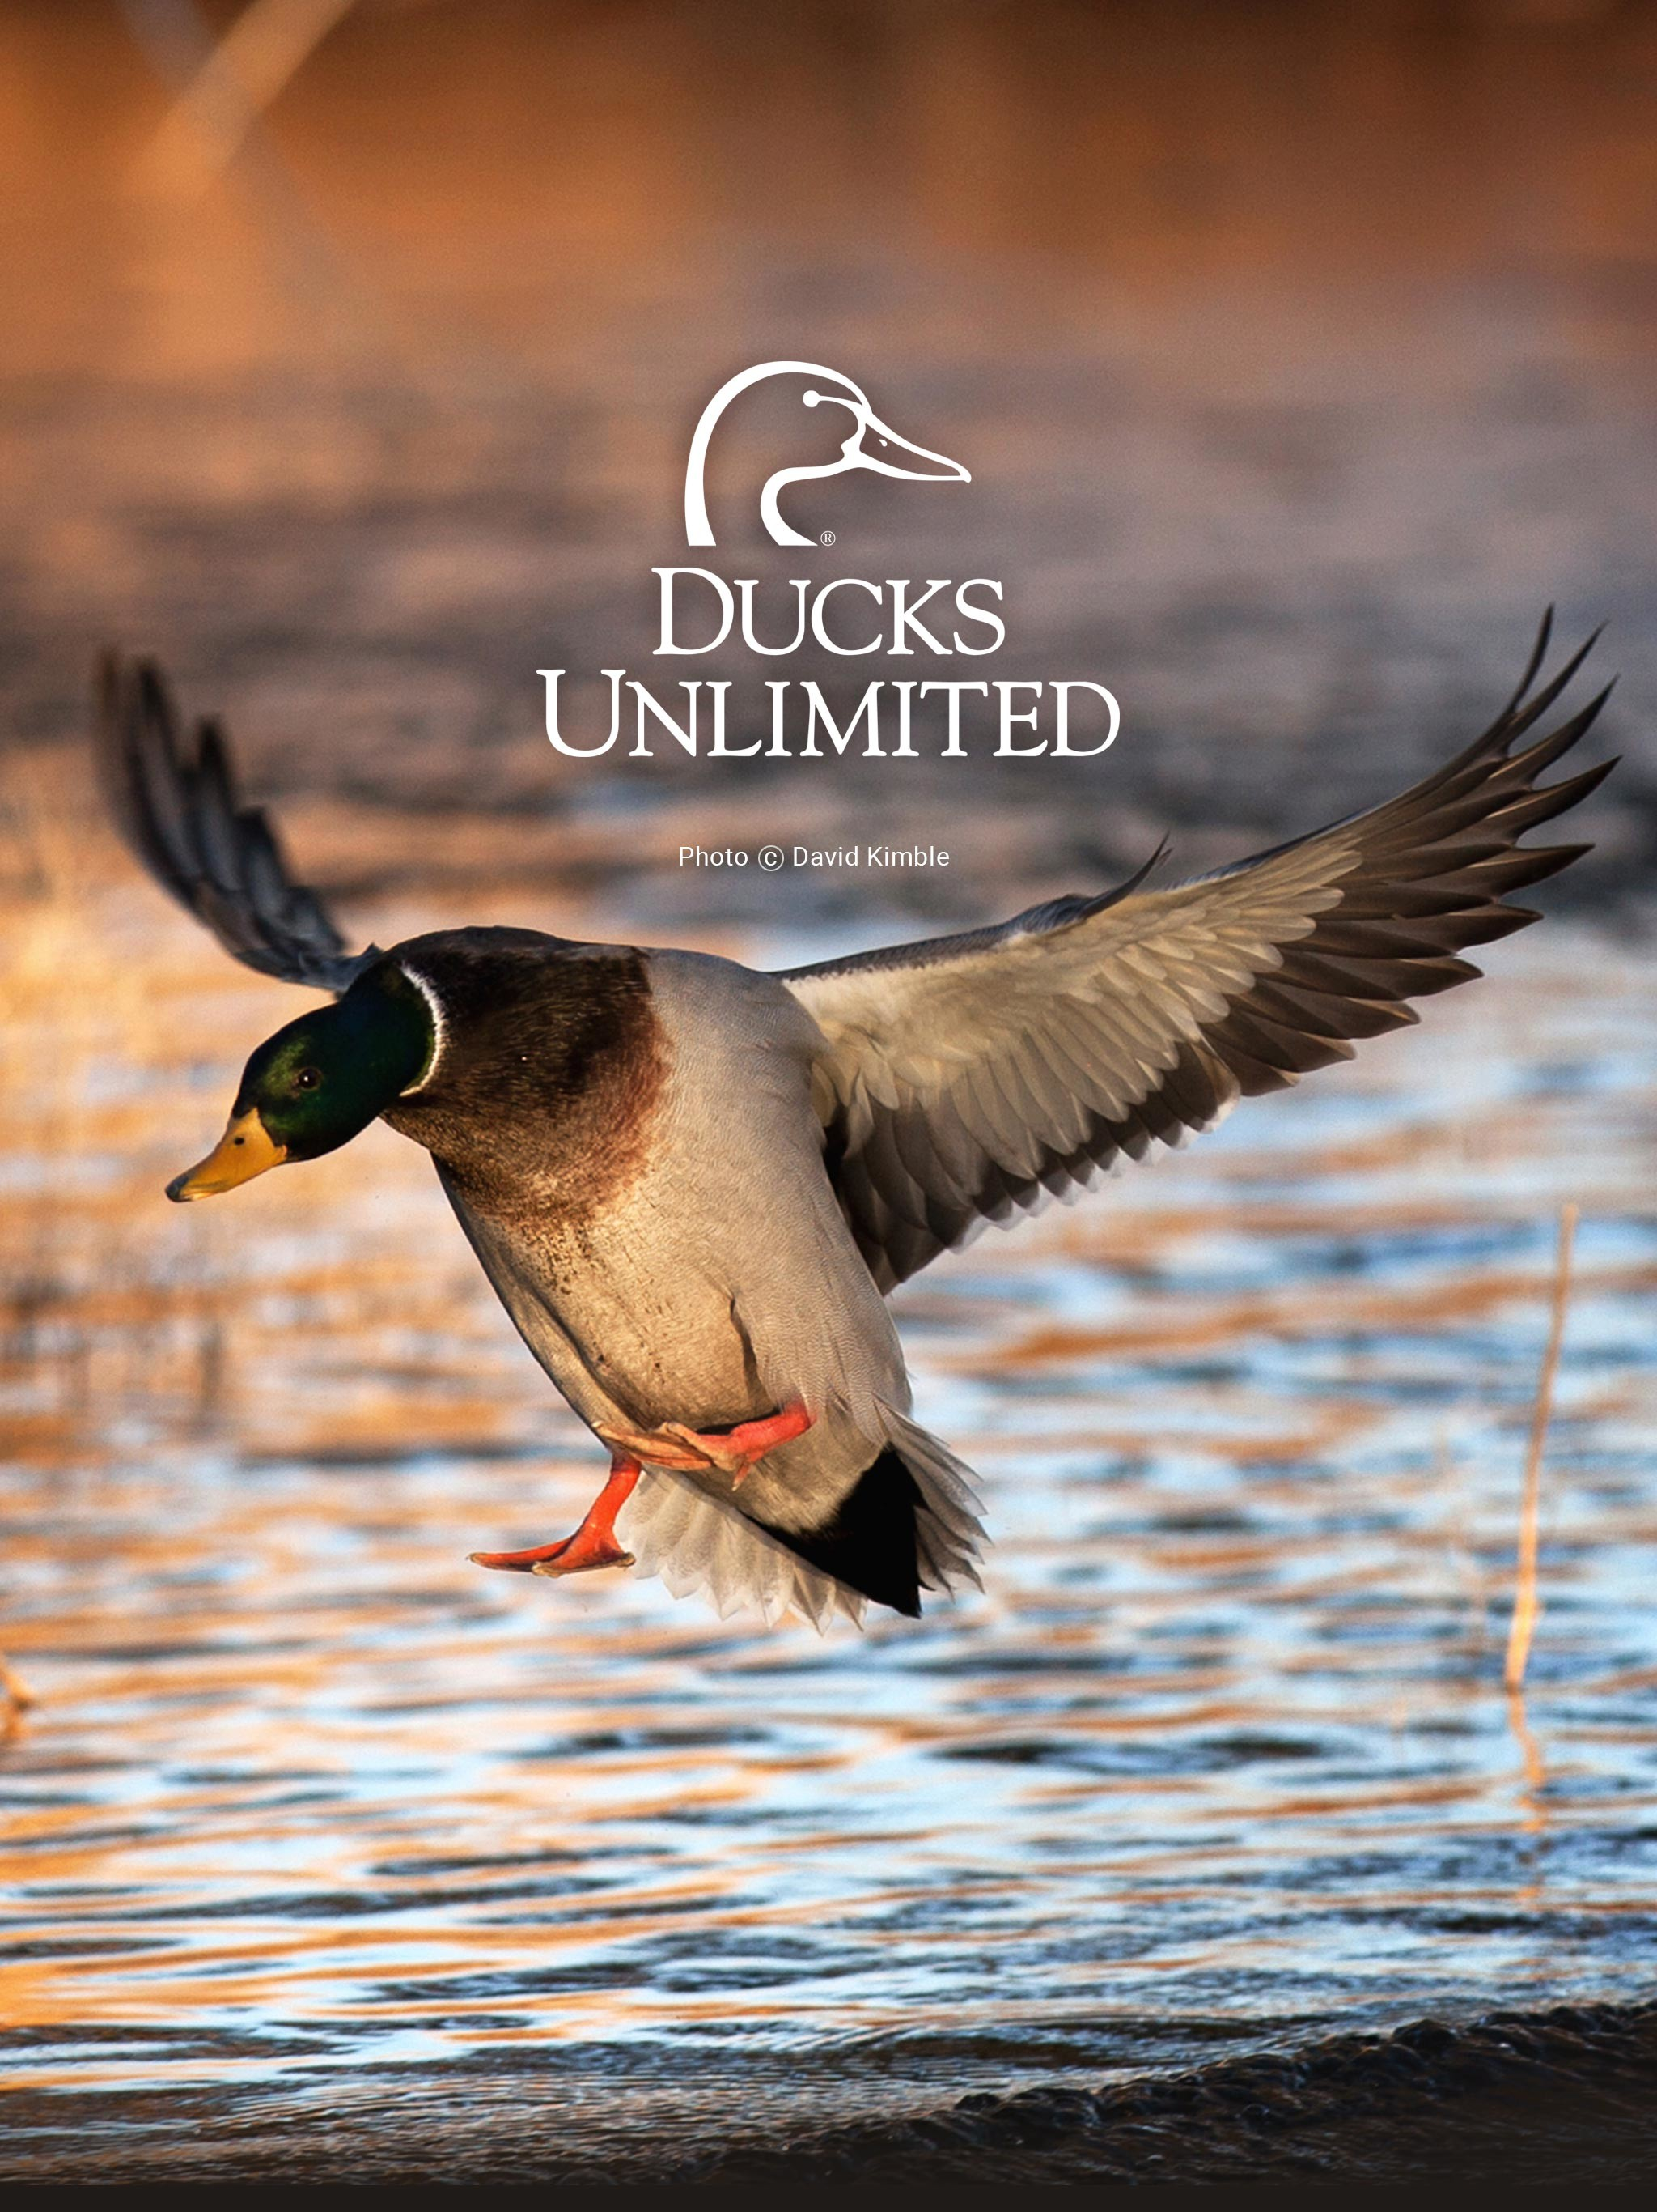
Activity 1: Get logical and reasonable plots
in a freezing morning
Time
a place facing the bay
Place
Jeremy & his father
Characters
go duck hunting
Event
Tip 1: Circle them while reading!

Slide 7
The underlined words:
gun
camera
duck
picture
hated
waited
shoot
flew
approval
tense
Read to raise questions
Para.2 To Jeremy’s surprise, his father was handing the camera to him.
Why did his father do so?
What was his father’s emotions?
What was Jeremy’s reaction?
What was Jeremy’s feelings?
Para.1 His father asked in a controlled voice, “Why didn’t you shoot?”
What was Jeremy’s reply?
How about his emotions?
Tip3: Make full use of the given words!
Tip 2: Infer backward!

Slide 8
Activity 2: Pursue a better continuation writing(LANGUAGE)
Let’s compare!
Different versions of the end:
Version 1: Jeremy and his father enjoyed the last red light from the sun and the peace of natural rather than hunting other animals.
Version 2: The sun highly rose in the sky, melting the ice and breaking the boundary between father and son.
Version 3: Though their task is hunting, but they brought nothing but get peace with the nature.
Version 4: For the later time, Jeremy never went hunting and he became a great photographer.

Slide 9
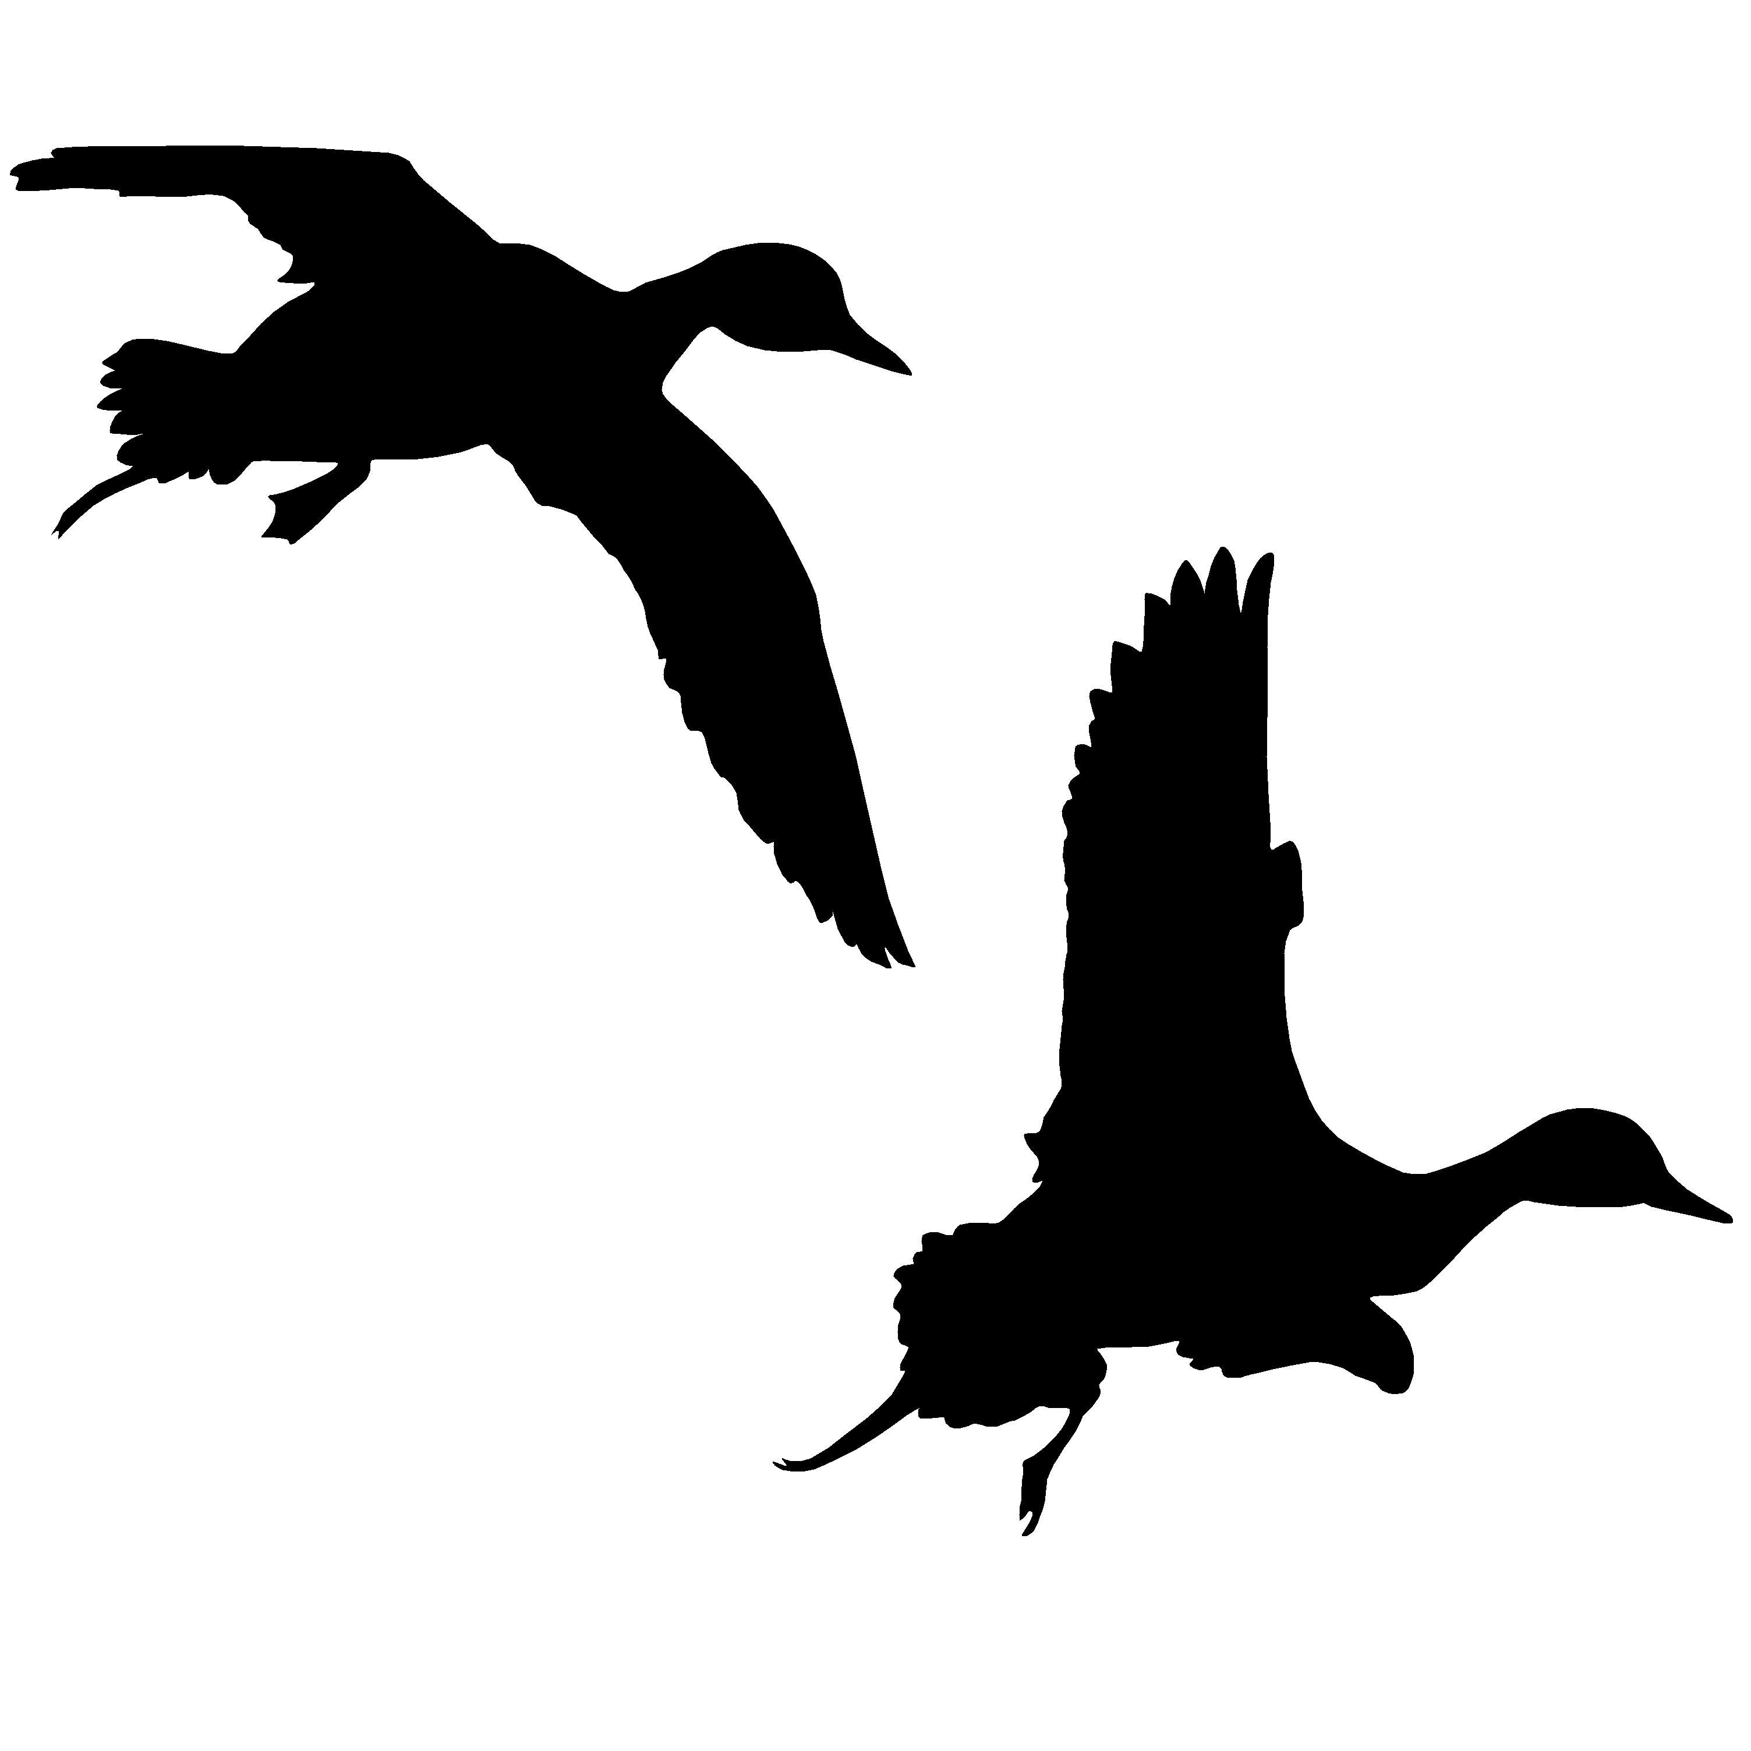
Let’s learn from the original text!

Slide 10
His father said, “All set, boy? ” and Jeremy nodded, picking up his gun with awkward gloved hands. His father pushed open the door and they went out into the freezing dawn together. Ordinarily Jeremy would take out his camera to record the scenery, but not this morning. This was the morning, particularly sacred(神圣的), when 14-year-old Jeremy would go duck hunting for the first time.
However, he hated it, and had hated the whole idea since his father bought him a gun. But he was determined to go through with it. He loved his father, and wanted his approval more than anything in the world.
They came to a narrow and hidden place facing the bay. Jeremy sat down nervously and waited. To reduce fear, he took a picture of his father against(以…为背景) the clean water. Then he put the camera hurriedly on the grass and picked up his gun.
Jeremy got his gun ready. “I’ll let you shoot first, ” his father said, loading his own gun. “You know, I've been waiting for a long time for this day. Just the two of us...” He broke off(突然停止), bending forward, eyes narrowed. “There's a small flight heading this way now. Keep your head down. I'll give you the word.”

Slide 11
The sun came out. Jeremy could see everything clearly: his father's face, tense and eager; the white frost on the gun. His heart was beating wildly. He prayed, “Don't let them come, please! ”
But they kept coming. "Four black,” his father said. “One mallard(绿头鸭). ”High above, Jeremy heard the pulsing whistle of wings as the flight began to circle. The mallard was leading, his feet dropping down, reaching for the silver-colored water. Closer, closer...
“Get set, ” his father whispered.
“Now! ”cried Jeremy's father. "Take them! ”
Jeremy felt his body obey. He stood up, holding the gun. In the same instant, the wild ducks saw the gunners and flew. “Shoot!” said something sharply in Jeremy's brain. But up went the mallard higher still, until suddenly he caught the full force of the wind and flew away, out of range.
Para1: His father asked in a controlled voice, “Why didn’t you shoot?”
Para2: To Jeremy’s surprise, his father was handing the camera to him.
Tip 4: Learn authentic English from the original text!

Slide 12
Let’s appreciate some well-written sentences!

Slide 13
1). Jeremy面对父亲质问时
A ripple of fear mingled with regret surging through him, sweat oozing from his forehead despite the freezing cold weather, Jeremy stuttered/stammered, “...”
Mind going blank and head drooping, Jeremy shuffled his feet awkwardly, remaining in silence. After a while, he mumbled, “...”
Thump! Thump! Thump! Jeremy’s heart palpitated violently. How could he answer it? His mind was in a daze.
“...” Jeremy murmured in a cracked/hoarse voice, his face drained of color and animation.
With face drained of color, Jeremy couldn’t utter a single word.

Slide 14
2). Jeremy坦言对狩猎的厌恶/对摄影的喜爱时
“I...I just didn’t have the guts to shoot. They were so, so cute and innocent.” Head drooping, he wasn’t dare to look into his father’s eyes.
Hard as he tried, everytime he made up his mind to shoot, conscience would sting him sharply. ”I just can’t make it!” Jeremy blurted, almost on the verge of collapse.
“Because I don’t want to kill creatures for fun!” Tears obscuring/blurring his vision, he realized he’d made a big mistake./ Suddenly, a deathly hush descended over the father and son.
“When I caught sight of the ducks, it instantly struck me that I was not born to be a hunter, but a photographer, maybe...” A chill of apprehension surged through his whole body.

Slide 15
3). Jeremy看到父亲递相机时
Widening his eyes, Jeremy stared at the camera incredibly.
The nagging anxiety gaving way to a tidal wave of joy, Jeremy’s face blossomed into clusters of flowers, with pleasure dancing around every cornor of his face.
Nothing had prepared Jeremy for the scene before his eyes. All the fear and sorrow had given way to bewilderment/ confusion mixed with a little bit of joy.

Slide 16
4). 父亲递过相机后
“You are right,” he patted Jeremy on the shoulder and sighed, “But you have to admit that’s the law of nature, without which humans would never be able to survive. Anyway, I respect your choice.”
“Am I not brave enough, dad?” “Of course not. You are brave for your determination to pursue your dream, and you are brave for your resolution to stay true to yourself. There are many ways to be brave in life.” father reassured him, and then locked him in a tight embrace.

Slide 17
5). 环境描写（含主题升华
Silence engulfed the two and the awkward atmosphere tortured Jeremy.
The crystal-clear bay mirrored the azure sky above, both of them shimmering and glistening. That special morning witnessed Jeremy and his father going back home with not a duck but their understanding and love for each other.
A chink of sunshine filtered through the heavy clouds, not only illuminating his father’s face, but also dispelling the gloomy atmosphere between them.
Jeremy excitedly shot the ducks, not with the gun but the camera -- a picture of soaring mallards above the silver-colored water was recorded permanently. So was the love and understanding between father and son.

Slide 18
Group work
Let’s revise and polish one of the student’s version.
Version 1
His father asked in a controlled voice, “Why didn't you shoot?” Jeremy kept silent, standing and shivering. “You know dear. If you want to be a remarkable duck hunter, this experience should be indispensable and significant to you!” Blamed by his father, Jeremy would not complain for he didn't want to argue with his father. But tears broke out of his lids and he shrieked, “I hated the duck hunting all the time, why I came there was just desire your approval! What I really cherished was camera but not gun!” After draining out these words, he returned to be silent, sobbing in low. At the extraordinary time, his father whizzed passed him.

Slide 19
Group work
Let’s revise and polish one of the student’s version.
Version 2
To Jeremy's surprise, his father was handing the camera to him. “Sorry, my son. I don’t know that you hate to shoot ducks, I shouldn’t demand you to do that." His father said mildly. “Now, do things which you like, We can take some photos and record this trip." Jeremy was touched and hurled himself toward his father. Everything paled into insignifican in comparison with father's love. Now, Jeremy was the happiest son in the world.

Slide 20
Group work
Please share your revised version!

Slide 21
The rest of the original text
His father asked in the same controlled voice. “Why didn’t you shoot?” Jeremy thumbed back the safety catch(保险机). They stood the gun carefully in the corner of the blind. “Because they were so alive,” he said, and burst into tears. He sat on the rough bench, face buried in his hands, and wept. All hope of pleasing his father and getting his approval was gone. He had had his chance, and he had failed. For a long moment, his father was silent. Then Jeremy felt him drop down beside him. “Here comes a single duck. Let’s try again.” Jeremy did not lower his hands. “It’s no use, Dad. I can’t shoot.” “Hurry,” his father said roughly. “You will miss him. Here.” Cold metal touched Jeremy. He looked up, unbelieving.

Slide 22
The rest of the original text
To Jeremy’s surprise, his father was handing the camera to him. “Quick,” he said softly. “He won’t hang around all day!” Jeremy’s father clapped his hands, a sound like a pistol(手枪) shot. The splendid bird soared(高飞), feet retracted(收回), wings flailing(用力摆动), white breast glistening (闪光). Then it was gone. Jeremy lowered the camera and exclaimed in delight, “I got him!” His father was radiant(喜气洋洋，容光焕发的). “Did you? That’s good.” He looked at his son, and Jeremy saw that there was no disappointment in his eyes, only pride and sympathy and love. “It’s okay, son. I will always love shooting. But that doesn’t mean you have to. Sometimes it takes as much courage not to do a thing as to do it.” He paused and said, “Could you teach me how to use that camera?”

Slide 23
Thanks！

