Slide 1


感恩遇见，相互成就，本课件资料仅供您个人参考、教学使用，严禁自行在网络传播，违者依知识产权法追究法律责任。
更多教学资源请关注
公众号：溯恩高中英语
知识产权声明

Slide 2




Listening
&
Choose a club！
JION US!
FANG HUI
2021.9.17

Slide 3


Student clubs

Slide 4


Which club do you want to choose? Why ?
________club
C
I enjoy discussing different questions.
I love dancing.
I prefer helping others.
I’m interested in plants and animals.
I’m fond of writing poems.
I am always curious about the space.
I’m keen on photographing.
I’m crazy about street dance.
I’m a huge fan of music.
Ballet Club
Music Club
Nature Club
Debate Club
Photo Club
Volunteer Club
Hip-hop Dancing Club
Literature Club
Science and Technology Club
enjoy love prefer like …
be interested in; be curious about;
be fond of; be keen on; be crazy about
to be a huge fan of…
L
U
B

Slide 5


01
Choose a school club

Slide 6

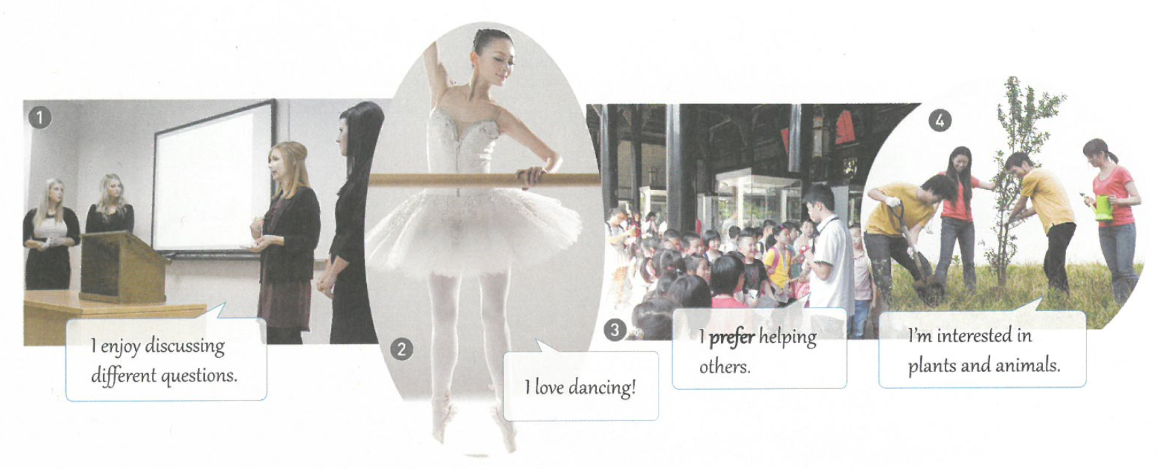
Match the photos with the names of the clubs.
2
4
Ballet Club _____ Nature Club _____
Volunteer Club _____ Debate Club _____
3
1

Slide 7

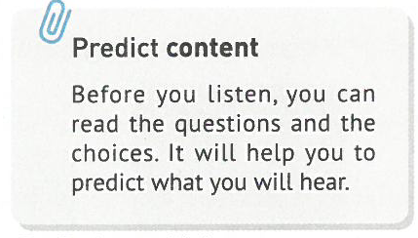





Listen to the first two conversations and choose the correct answers.
What are they learning about in Conversation 1?
The students are discussing ____ in Conversation 2.
Circle the two clubs where these two conversations happened.
A. Hearing. B. Sounds. C. Dogs.
“If you couldn’t hear the first one, it means you are not _______.
Dogs can hear very high frequency sounds, but people can’t.”
If you could hear the second one, you are____________________.”
a dog
A. schoolwork B. relationships C. dating
Our ears change when we get older. Children and young people can hear the second one, but most people older than 25 can’t.
younger than 25
Science Club. B. Ballet Club.
C. Nature Club. D. Debate Club.

Slide 8

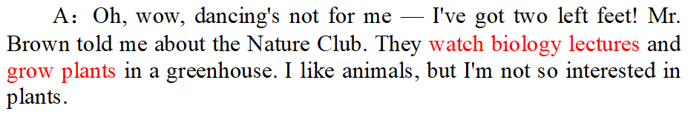
Tick the activities that happen in each club.
Ballet Club | Nature Club | Cartoon Club | Volunteer Club
learn new movements | listen to lectures | watch cartoons | help old people
watch dance programs | grow plants | write stories | clean up parks
make ballet clothes | work in a greenhouse | draw cartoons | give directions
When listen for the detailed information, it is important to carefully go over the choices.
√
√
√
√
√
√
√

Slide 9

2. Adam says that he likes ______ but is not so interested in _____.
stories, cartoons
animals, plants
making friends, cleaning up
Listening for details helps to get the conclusion.
3. Which club do you think is suitable for Adam? Why?
I think Adam should join the _________ Club because he says that he ____________________________.
Volunteer
would like to do something outdoors

Slide 10
02
Set up a student club

Slide 11
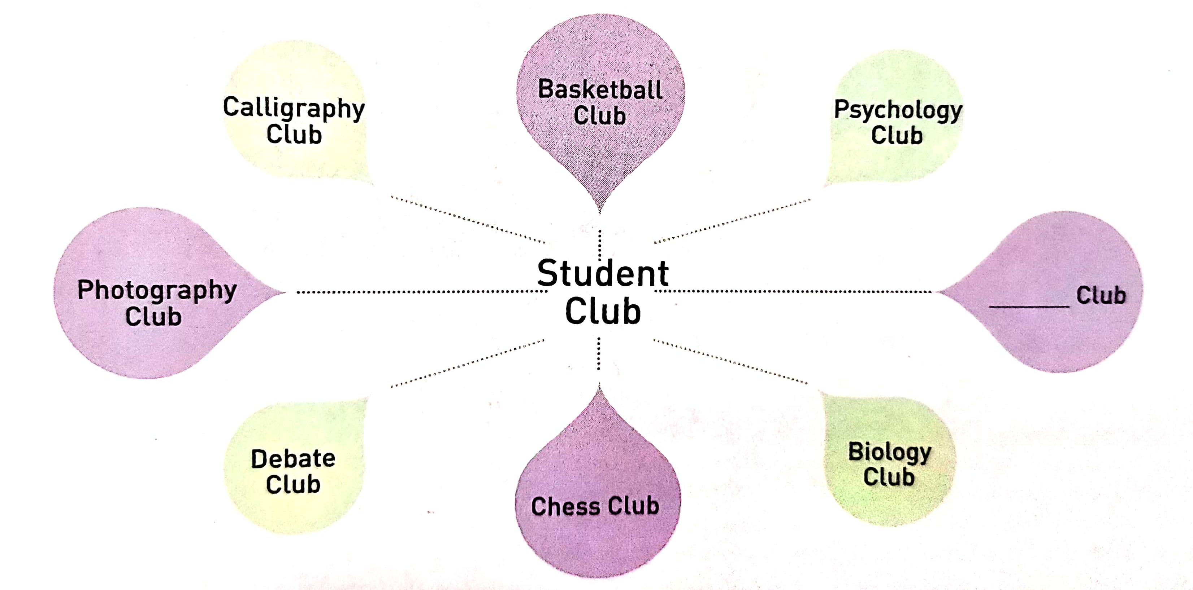

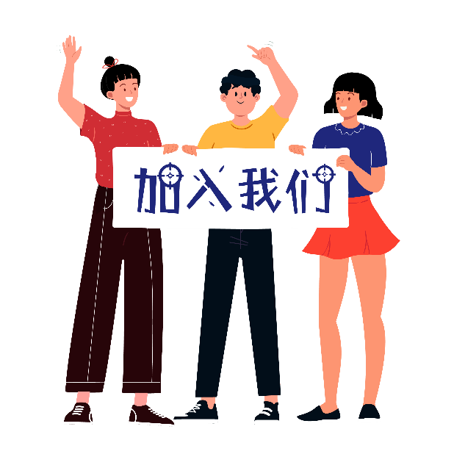
Work in groups and choose one of the clubs from below, or create a new club you think others would b e interested in joining.(P21)
Ballet Club
Music Club
Nature Club
Photo Club
Volunteer Club
Hip-hop Dancing Club
Literature Club
Science and Club
Cartoon club
…
Join us

Slide 12
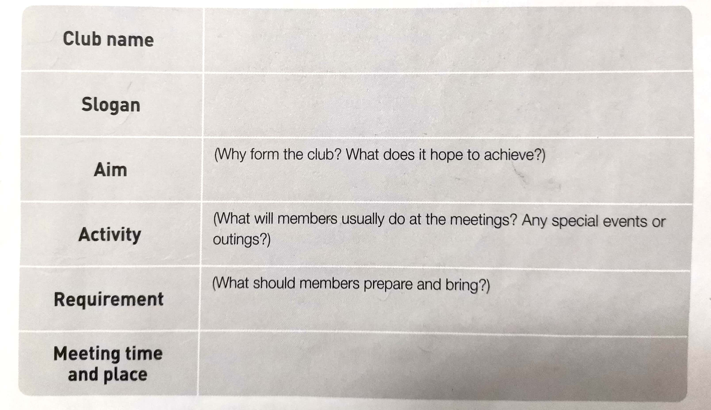



Decide on the following details of your club.(P21)
Design a slogan
(Make a poster)
Prepare an introduction.
Example:
Hello , everyone!
We’re very pleased to introduce our club to you. It’s called… our slogan is…, and our club aims to…
To be NO.1

Slide 13



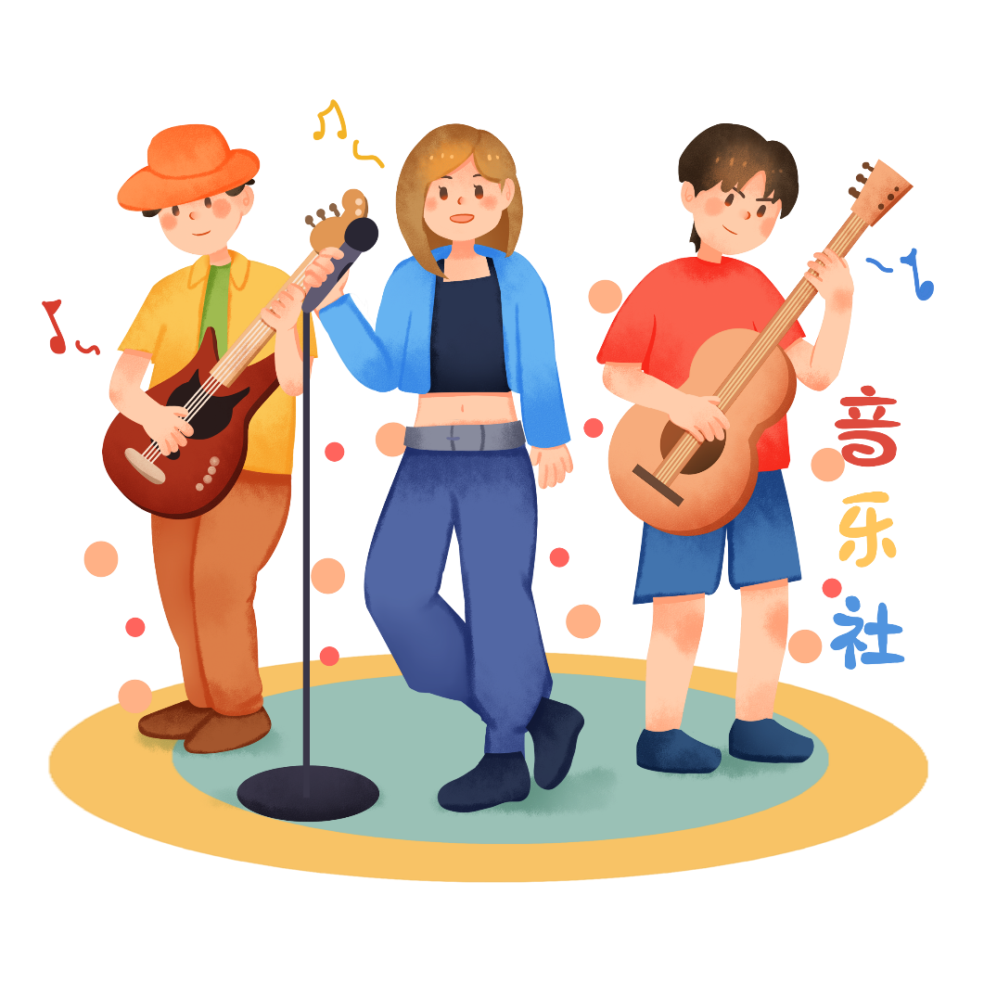

Slide 14


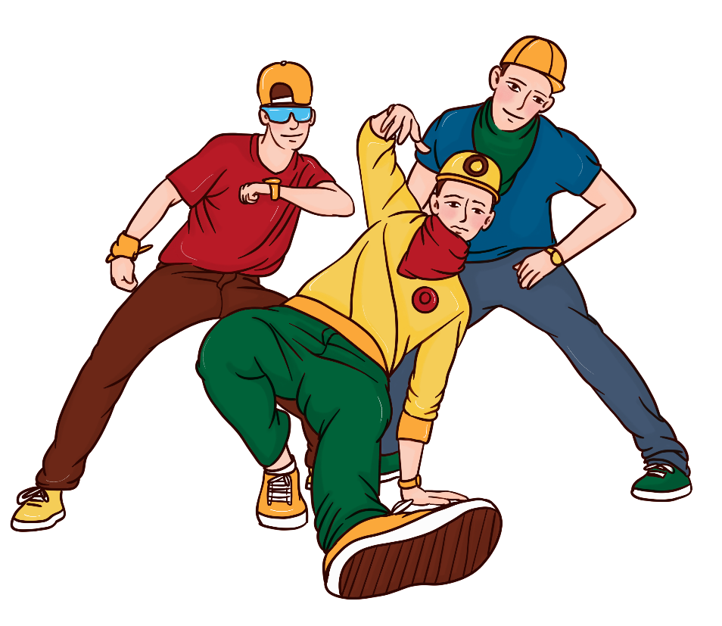

Slide 15
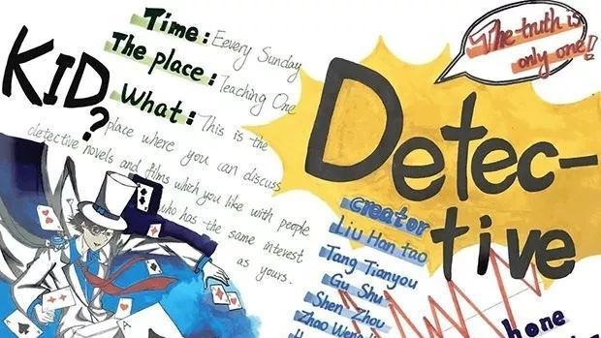
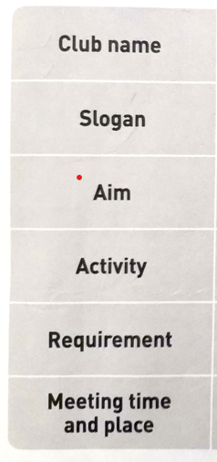
√
√
√

Slide 16




JOIN US
Choose one to introduce your club.
Choose one to show your poster.
Vote for the club you want to join.

Slide 17
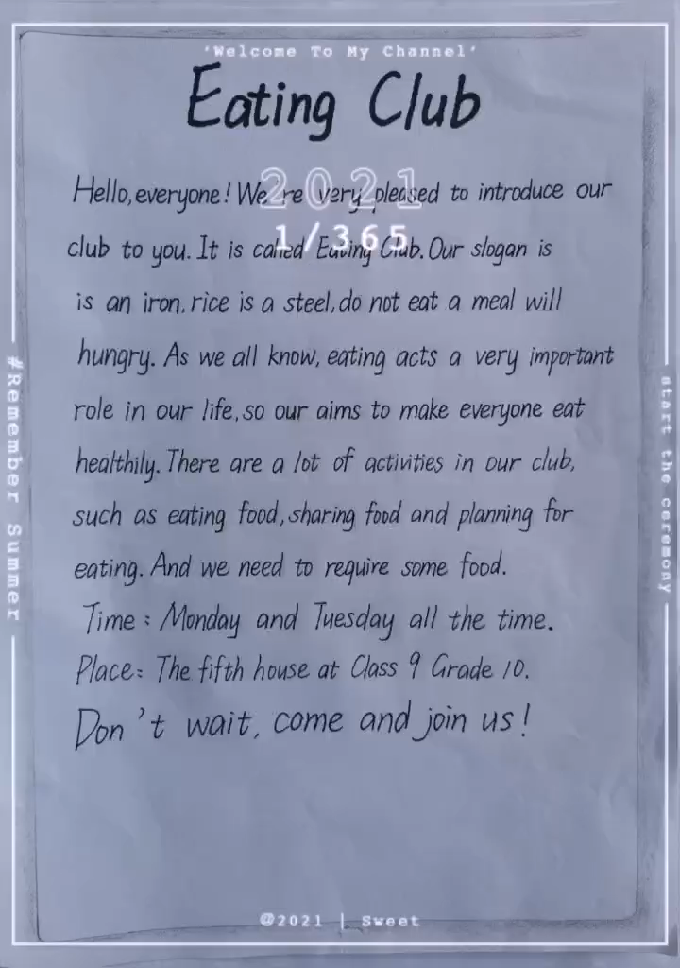
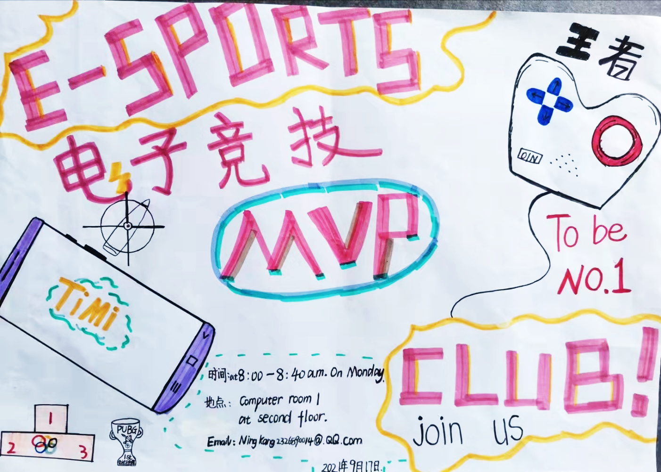

Slide 18


THANKS
Complete your poster and share with each other.

Slide 19


