Slide 1


感恩遇见，相互成就，本课件资料仅供您个人参考、教学使用，严禁自行在网络传播，违者依知识产权法追究法律责任。
更多教学资源请关注
公众号：溯恩高中英语
知识产权声明

Slide 2
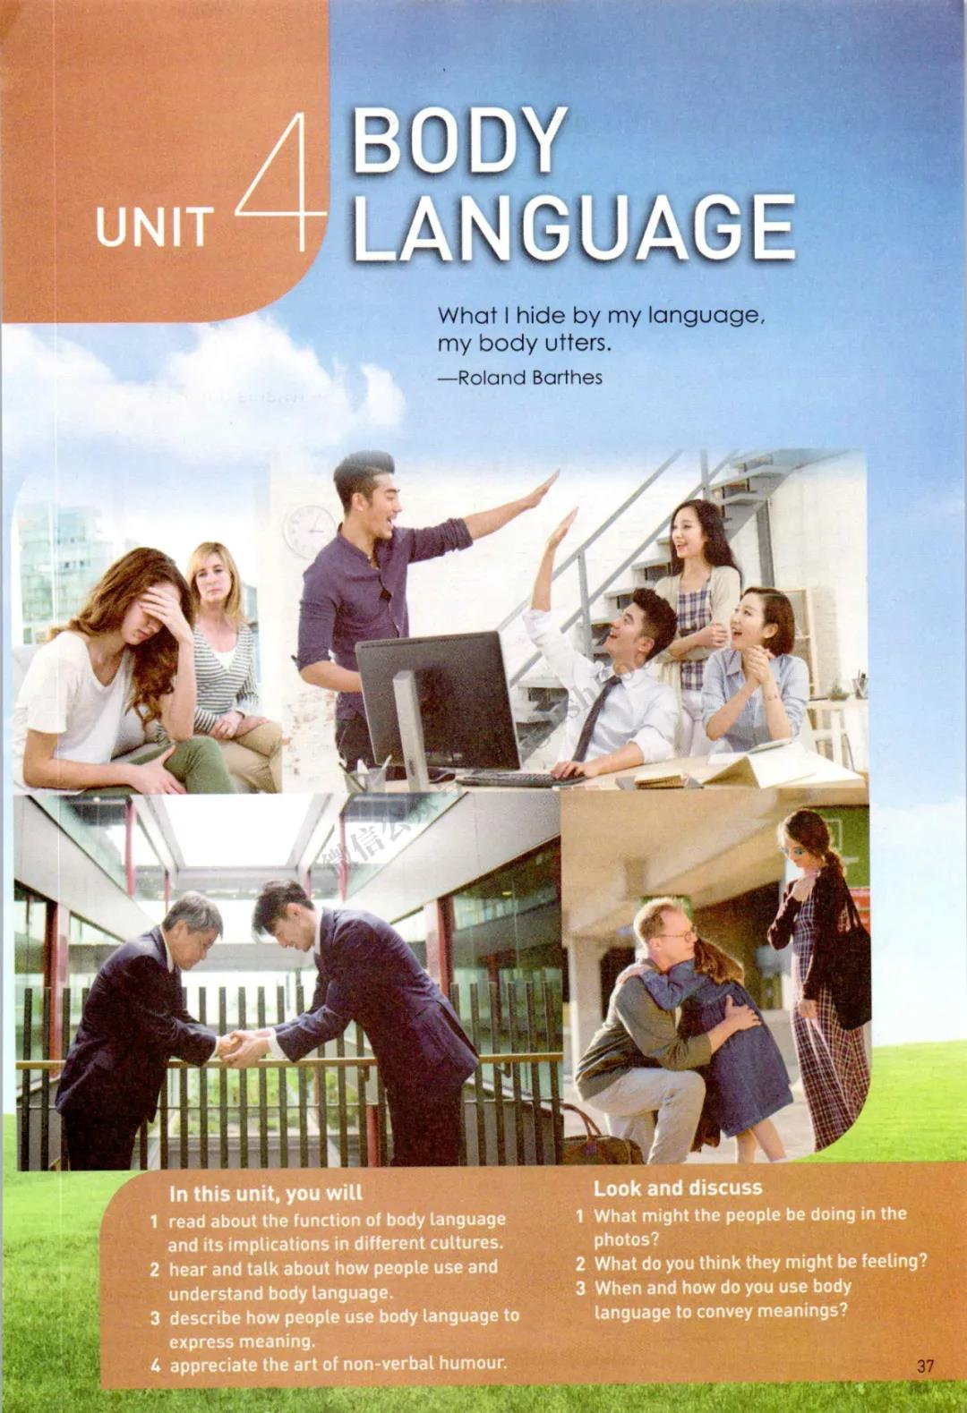
What I hide by my language, my body utters
－Roland Barthes
Unit 4 Body Language
Reading and Thinking
Understand body language
Listening to how bodies talk
杭州二中许丽君

Slide 3
Learning objectives
In this class, you will
1. read about the function of body language and its implications in different cultures;
2. practice making inferences by looking at the clues in the passage;
3. think critically about body language by relating it to your own culture and personal experiences.
4. get a better understanding of body language.
5. identify the feature of body language---cultural-specific.
6. develop the sense of cross-cultural communication.
7. summarize and retell the main idea of the passage.

Slide 4
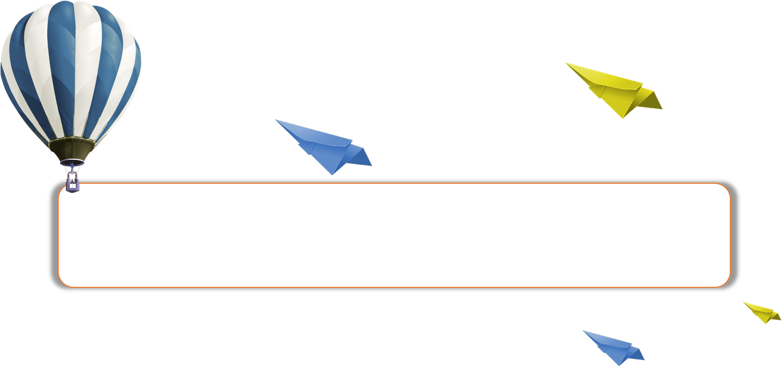
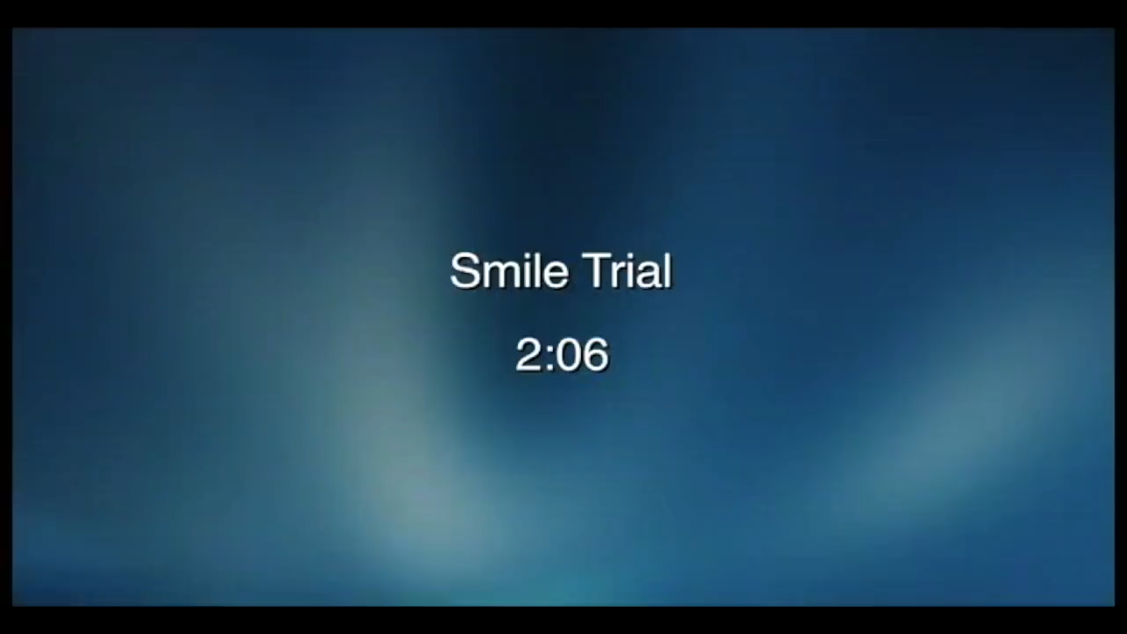
Lead in:
➢➢Enjoy a video
Let’s Watch the video Smile Trial

Slide 5

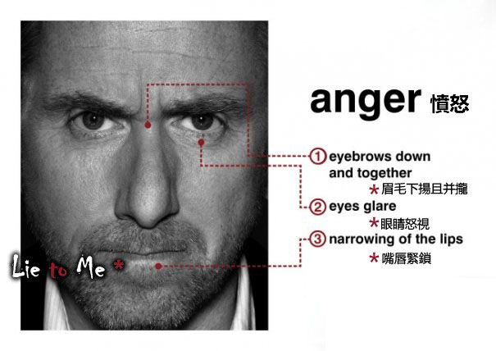
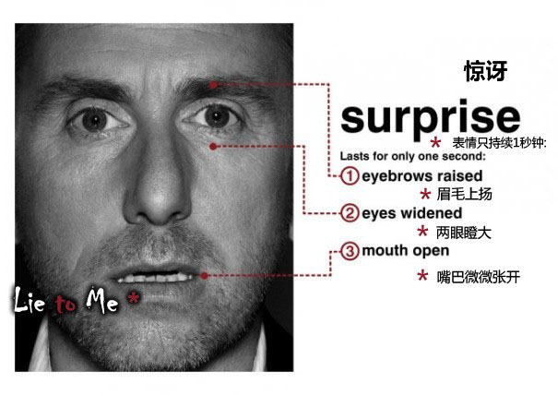
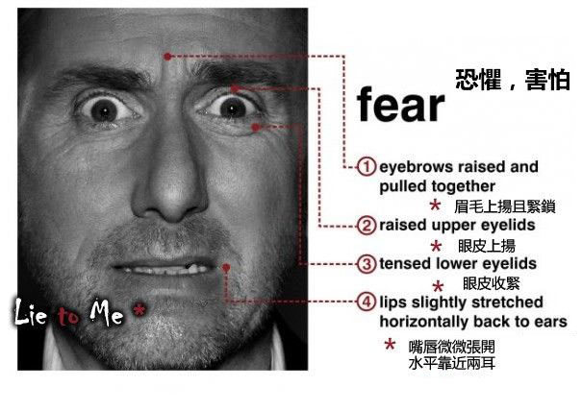

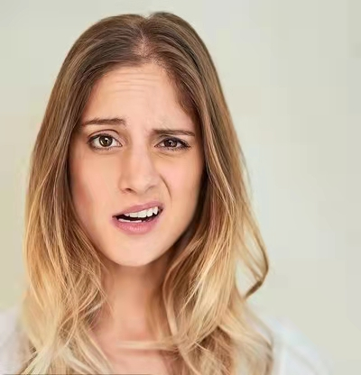
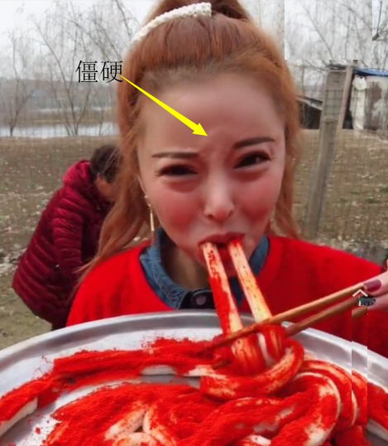
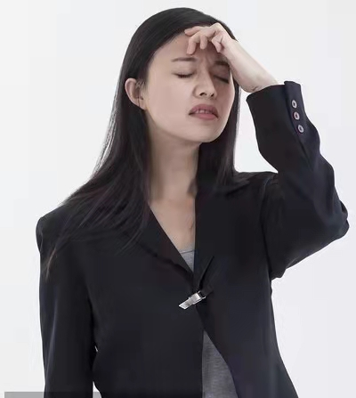
Lead in
Part 1
Pre-reading ：
Look at the following facial expressions, and try to tell us what they might be feeling.
happy
angry
sad
confused

Slide 6
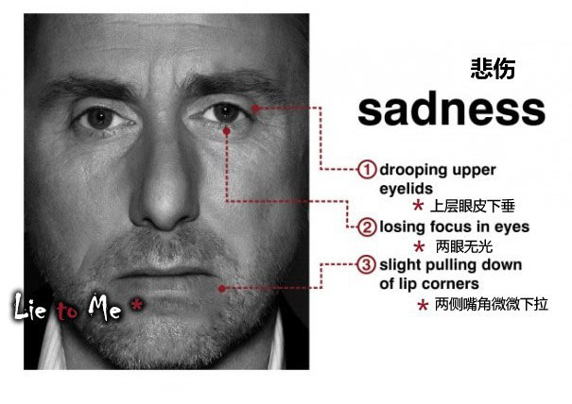
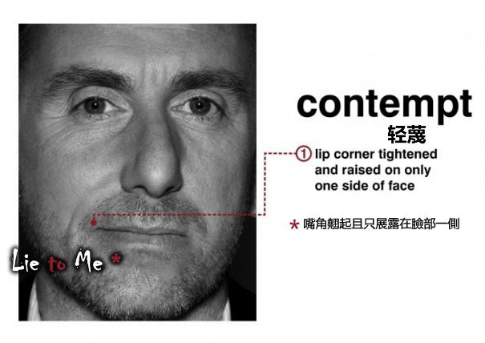
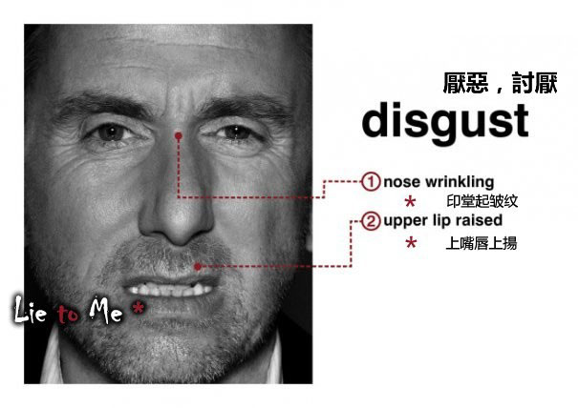
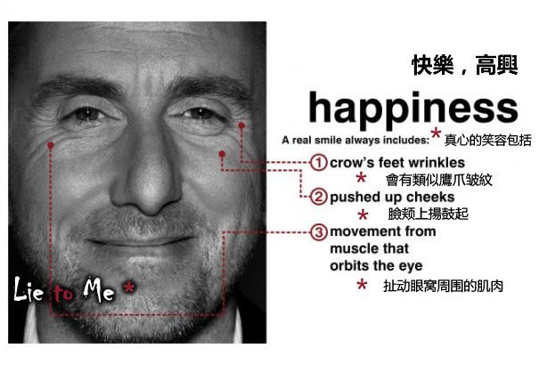
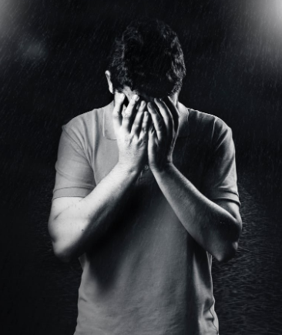
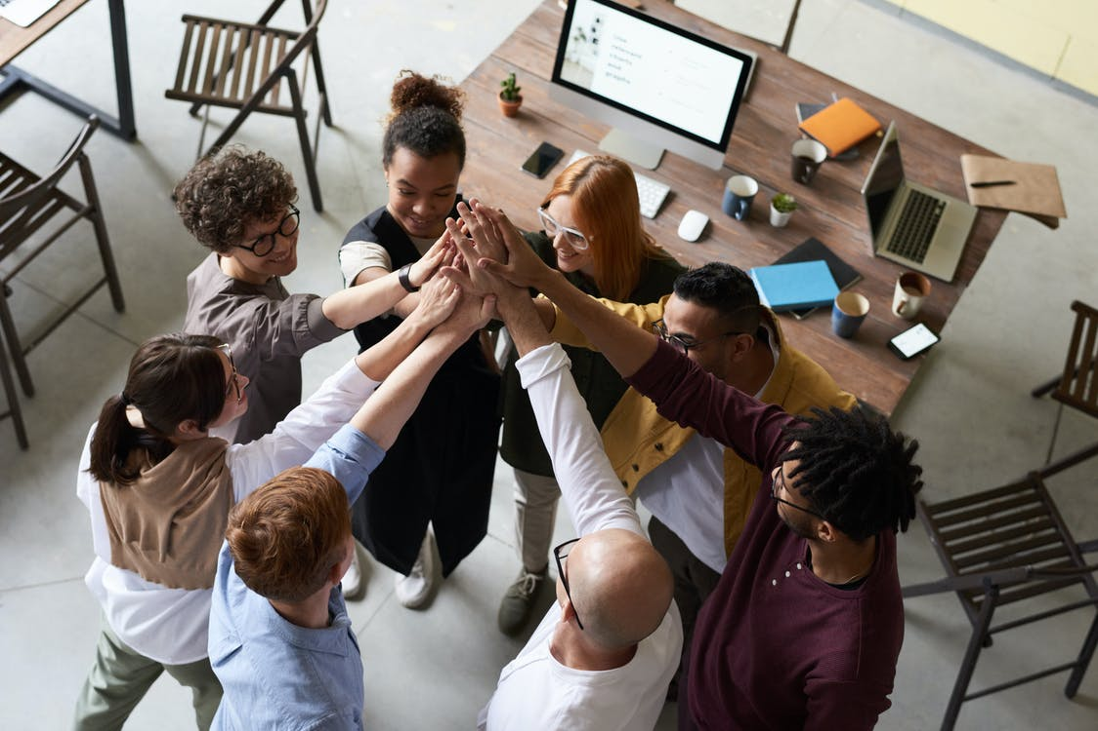
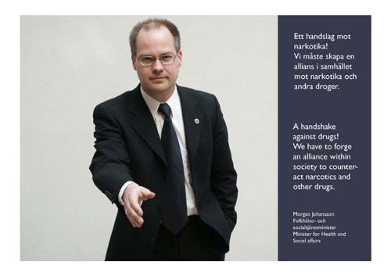
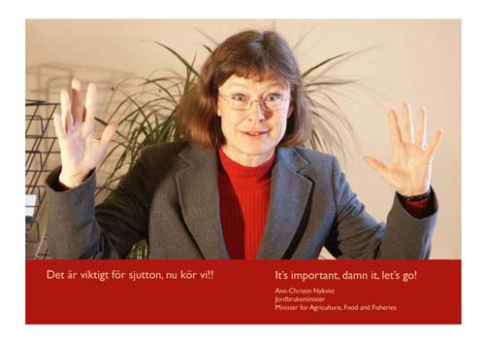
Lead in
Part 1
Pre-reading ：
Look at the following facial expressions, and try to tell us what they might be feeling.
depressed
happy
Nice to meet you!
I give up.

Slide 7
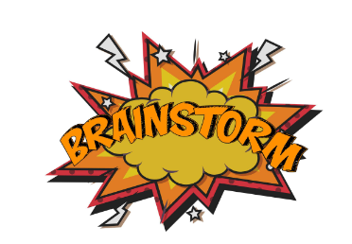
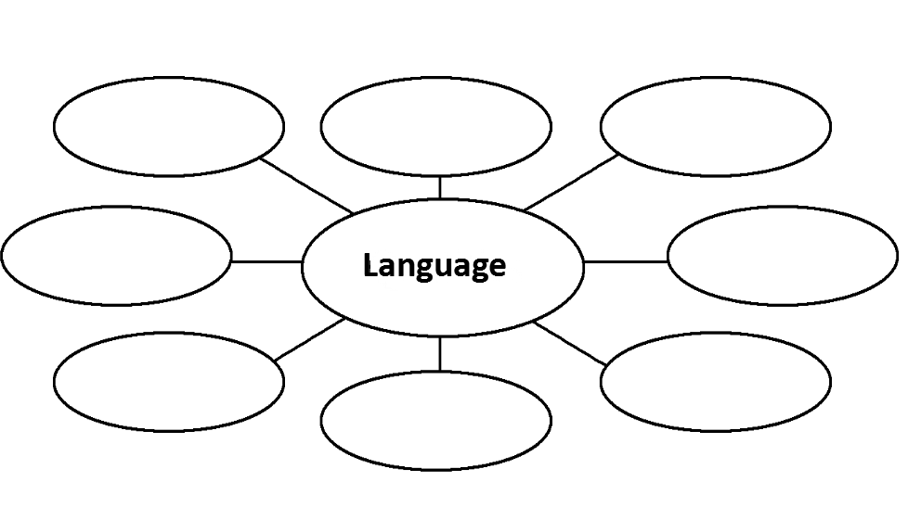
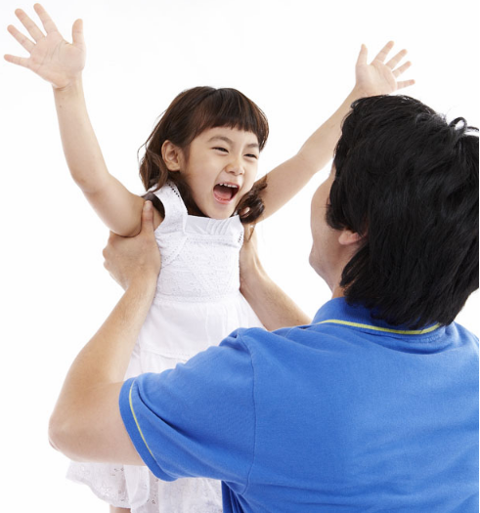
Part 1
Pre-reading ：Prediction
How many ways to communicate in daily life?

Slide 8

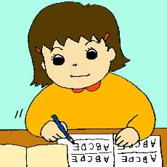
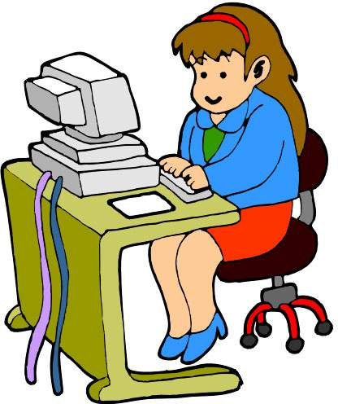
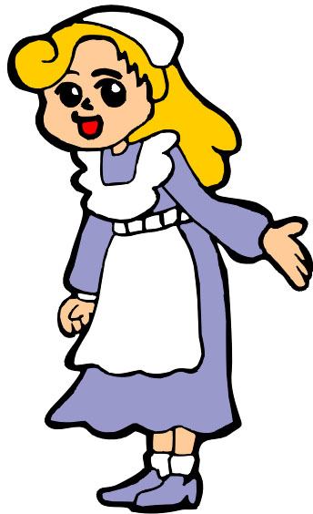
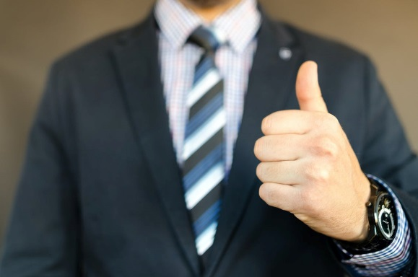
Part 1
Pre-reading ：Prediction
Ways of communication
Spoken
language
speaking
ringing
Written
language
writing
typing
facial expressions
Body
language
gestures(手、头、脸姿势)
postures (坐、站姿势)
speaking distance

Slide 9

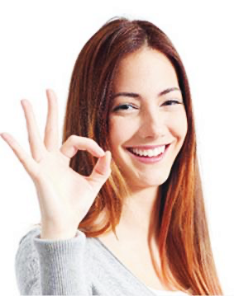
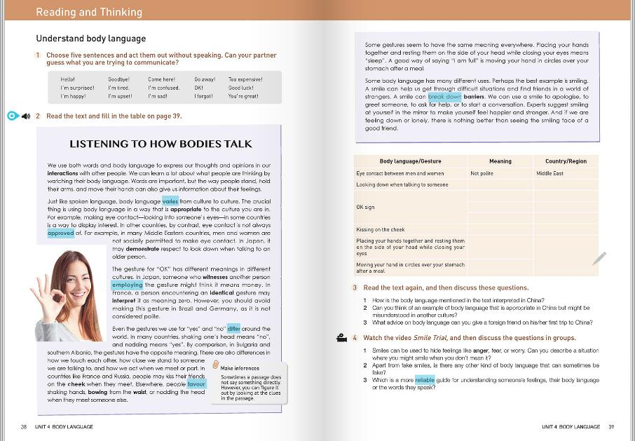
Prediction
Look at the title of the text. What do you think will be talked about in the text?
Look at the picture on this page. What do you think the young lady might want to convey with her body language?

Slide 10
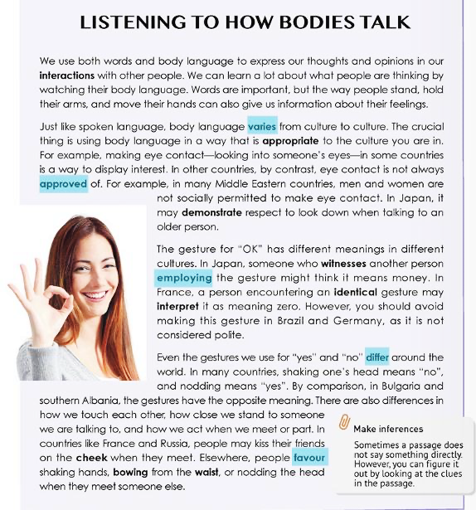
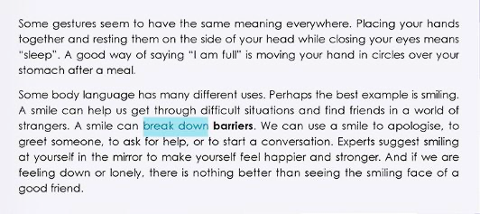
Checking prediction
Go through the whole text. See which of the predicted contents are mentioned in the text.
Meanings of the gestures for “OK”; different uses of body languages …

Slide 11
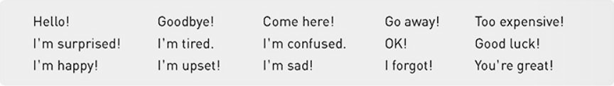
pre-reading : Warming up
Part 1
Warm-up
Choose five sentences and act them out without speaking.
How many types of body language do you find?
smile, mouth wide-open, …
facial expression:
gesture:
waving one’s hand, thumb up, …
What is the function of language?
One of the main functions of language is to communicate with people and understand them.
Suppose we are living in a silent world. How will you communicate with each other?
Written language; body language …

Slide 12
pre-reading : Warming up
Part 1
When and how do you use body language to convey meanings?
Body
language
say yes or no
say hello
show feelings
attract attention

Slide 13
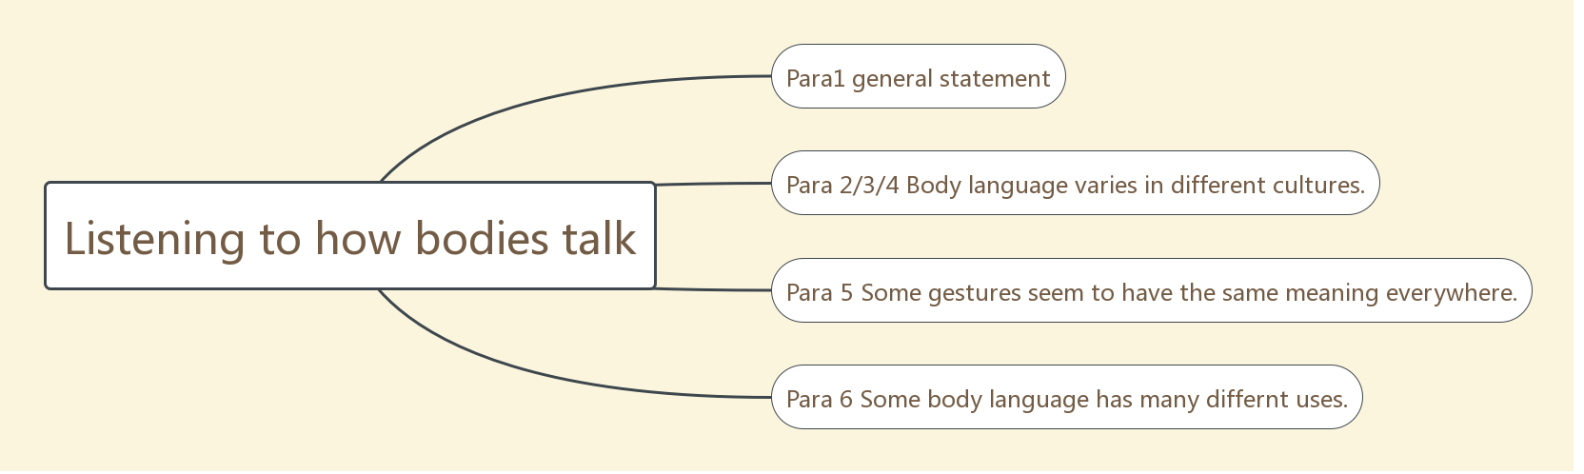
Part 1
pre-reading : read for structure
Scanning for the structure of the text.
Draw a mind map to show the structure of the text.

Slide 14
3. How is the whole passage and each paragraph is developed?
general
↓Example
specific
Part 1 (Para1)
总
｜
分
Introduction to body language
Part 2 (Para2-4)
Part 3 (Para 5)
Part 4 (Para 6)
Topic sentence Supporting idea 1 (contrast)
Supporting idea 2
Topic sentence
Supporting idea 1 (identical)
Supporting idea 2
Topic sentence
Supporting idea
(identical)

Slide 15
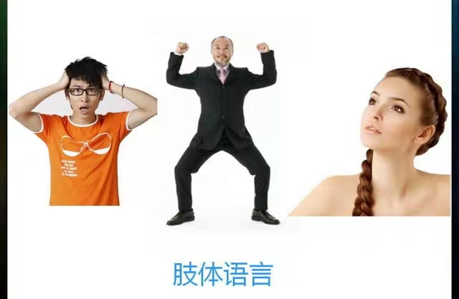
While-reading : read for main idea
Reading for main ideas
Work out the structure of the text according to the topic sentence in each paragraph.
Look at the picture on this page. What do you think the young lady might want to convey with her body language?

Slide 16
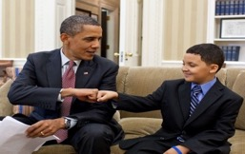
While-reading : read for main idea
Reading for main ideas
Activity 1 Read the text and summarize the main idea.
The passage tells us that body language plays an important part in our communication and while body language is cultural-specific, some gestures seem to have the same meaning everywhere.
Paragraph(s) | Main idea
1
Introduction to body language
2—4
Body language with different meanings in different cultures
5
Body language with the same meaning everywhere
6
Body language with different uses

Slide 17
While-reading : read for main ideas
Match the main idea of each part.
Part 1.
Some gestures seem to have the same meaning everywhere.
(Para.1)
Part 2.
Some body language has many different uses.
(Para. 2~4)
Part 3.
Body language plays an important role in daily communication.
(Para. 5)
Part 4.
Body language varies from culture to culture.
(Para. 6)

Slide 18

General Idea and its type::
Read for
Look through the text and find out the type of writing.
A. Narration
B. Exposition
C. Argumentation
Ⅰ.阅读课文，匹配段落大意
( )Para.1 ( )Para.2 ( )Para.3 ( )Para.4 ( )Para.5 ( )Para.6 | A．Body language varies in different cultures. B．Body language can show our feelings. C．The gestures for “yes” and “no” are different. D．The different meanings of “OK”． E．Smiling has many different uses. F．Some gestures with the same meaning.
【答案】1－6 BADCFE

Slide 19

While-reading : read for details
Ⅱ.阅读课文，判断信息正误
( )1.We can learn others’ feelings from their body language.
( )2.In Japan eye contact can show respect for others.
( )3.The gesture for “OK” is very popular in Brazil.
( )4.In Bulgaria nodding one’s head means “yes”.
( )5.Moving hands in circles over the stomach means “I am full”.
【答案】1－5 TFFFT

Slide 20
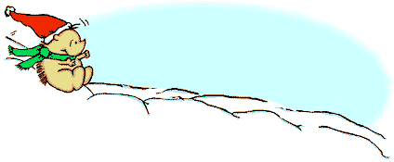

While-reading : read for details
Skimming
Reading Comprehension
Ⅳ.语篇解读
（ ）1．What does the passage mainly talk about？
A．Communication. B．Spoken language.
C．Body language. D．Different cultures.
C
( ) 2.How do we know what other people are thinking?
A．By doing researches on their palms.
B．By watching their body language.
C．By making eye contact with them.
D．By shaking hands with them.
（ ）3.Why do we use both words and body language?
A. To show how clever we are.
B. To show that we have learned a lot.
C. To express our thoughts and opinions.
D. To tell others we have a gift for performance.
B
C

Slide 21
While-reading : read for details
Skimming
Reading Comprehension
D
4．What can we learn from the passage？_____
A．In all countries, shaking the head means “No”．
B．A smile can get a person into difficult situations.
C．In Russia, people favour bowing from the waist when they meet someone else.
D．If a person moves his hand in circles over his stomach after a meal，that means he is full.
B
5．Which proverb can best describe the main idea of the passage？_____
A．Never too old to learn.
B．When in Rome，do as the Romans do.
C．Four eyes see more than two.
D．Every country has its own customs.
6．Which of the following can NOT be conveyed (传达) through the gesture of “smiling”？_____
A．Apology. B．Greeting.
C．Anger. D．Asking for help.
C

Slide 22
While-reading : read for details
Skimming
Reading Comprehension
A
( ) 7.What does the word “it” in “interpret it as meaning zero” refer to?
A．The gesture for “OK”.
B．A different culture.
C．Another person.
D．Money.
( ) 8.How does the author develop the passage?
A．By giving theories.
B．By using quotations.
C．By giving examples.
D．By showing the importance.
C
D
( ) 9.Which of the following has many different uses?
A．Moving hands. B．Holding arms.
C．Crying. D．Smiling.

Slide 23
While-reading : read for details
Reading for details
2. The passage can be divided into _____ parts. Fill in each blank with a key word to complete the main idea of each part.
three
use...to express...; can learn a lot...by…; important; can also give us information...
Para. | Main idea
Part 1 (Para.1） | ____________ to body language: ___________ or__________of body language
Part 2 (Para. 2-4) | Body language with _________meanings in __________ cultures
Part 3 (Para. 5 ) | Body language with the ________ meaning everywhere
Part 4 (Para. 6) | Body language with ___________ uses
Introduction
importance
function
different
different
same
different

Slide 24
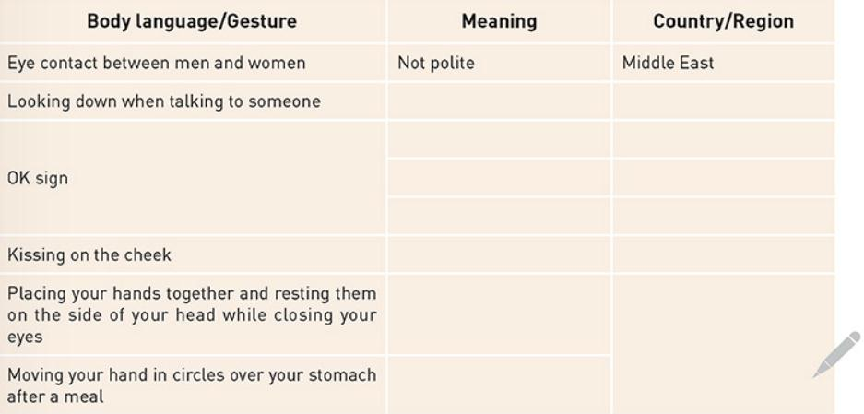

While-reading : read for details
Reading for details
Read the text and fill in the table on page 39.

Slide 25

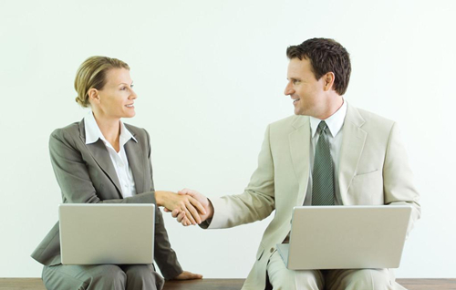
While-reading : read for details
Reading for details
Para.1
Paragraph 1:
We use both words and body language to express our thoughts and opinions in our interactions with other people. We can learn a lot about what people are thinking by watching their body language. Words are important, but the way people stand, hold their arms, and move their hands can also give us information about their feelings. (Paragraph 1)
communication

Slide 26
While-reading : read for details
Para.2
Reading for details
Paragraph 2:
Just like spoken language, body language varies from culture to culture. The crucial thing is using body language in a way that is appropriate to the culture you are in. For example, making eye contact—looking into someone’s eyes—in some countries is a way to display interest. In other countries, by contrast, eye contact is not always approved of. For example, in many Middle Eastern countries, men and women are not socially permitted to make eye contact. In Japan, it may demonstrate respect to look down when talking to an older person. (Paragraph 2)
be accepted

Slide 27
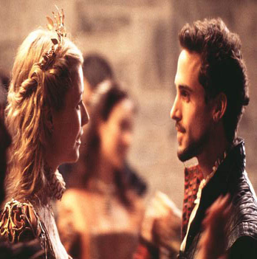
While-reading : read for details
Para.2
Reading for details
Read the text and fill in the table on page 39. (Para. 2)
Body language/
Gesture
Meaning
Country/Region
Interest
Some countries
Middle Eastern
countries
Not polite
Eye contact between men and women
Looking down when talking to someone
A sign of respect
Japan

Slide 28

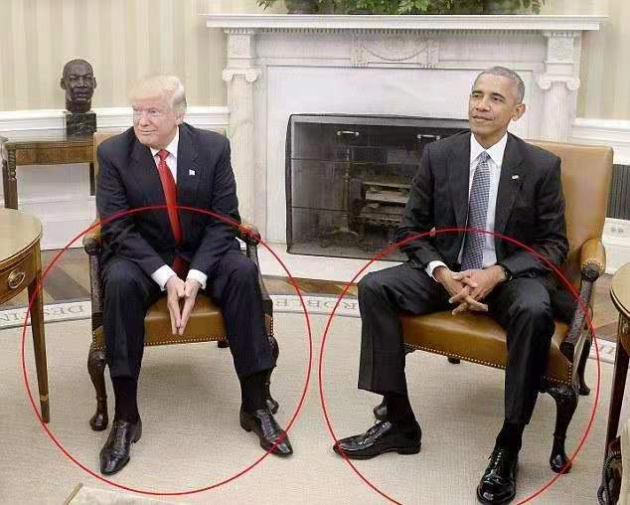
While-reading : read for details
Para.3
The gesture for “OK” has different meanings in different cultures. In Japan, someone who witnesses another person employing the gesture might think it means money. In France, a person encountering an identical gesture may interpret it as meaning zero. However, you should avoid making this gesture in Brazil and Germany, as it is not considered polite. (Paragraph 3)
use
see

Slide 29
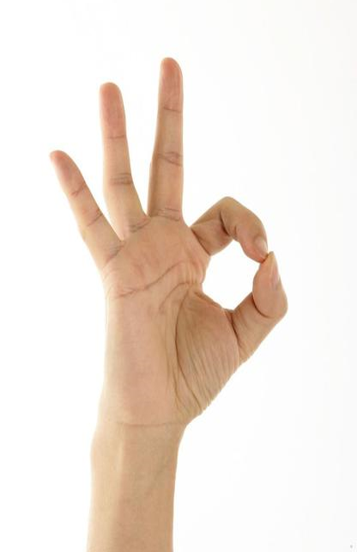
While-reading : read for details
Paragraph 3:
Para.3
Body language/
Gesture
Meaning
Country/Region
Money
Japan
Zero
France
Not polite
Brazil/Germany
Yes
China

Slide 30
While-reading : read for details
Paragraph 1-3
Ⅰ.配对练习：请从后面的七个选项中选出最恰当的一个补全句子。(In Paragraph 1-3)
1．We can learn a lot about what people are thinking by ________.
2．For example, ________－looking into someone’s eyes－in some countries is a way to display interest.
3．In Japan, it may demonstrate respect to look down when ________.
4．In France, a person ________ may interpret it as meaning zero.
5．However, you should avoid _____，as it is not considered polite.
A．making eye contact
B．talking to an older person
C．watching their body language
D．moving your hand in circles over your stomach
E．encountering an identical gesture
F．making this gesture in Brazil and Germany
G．seeing the smiling face of a good friend
【答案】1－5 CABEF

Slide 31
While-reading : read for details
Reading for details
Para.4
Paragraph 4:
Even the gestures we use for “yes” and “no” differ around the world. In many countries, shaking one’s head means “no”, and nodding means “yes”. By comparison, in Bulgaria and southern Albania, the gestures have the opposite meaning. There are also differences in how we touch each other, how close we stand to someone we are talking to, and how we act when we meet or part. In countries like France and Russia, people may kiss their friends on the cheek when they meet. Elsewhere, people favour shaking hands, bowing from the waist, or nodding the head when they meet someone else.

Slide 32



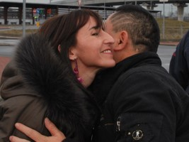
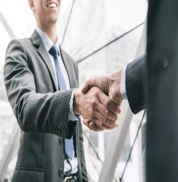
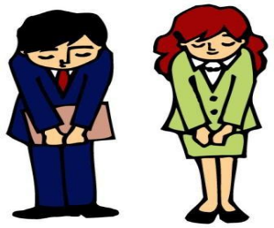
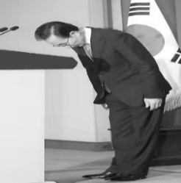
Paragraph 4
Para.4
Body language/
Gesture
Meaning
Country/Region
no
shake the head
Many countries
yes
Bulgaria & Southern Albania
nod the head
yes
Many countries
no
Bulgaria & Southern Albania
kiss on the cheek
to greet someone
France & Russia
to greet someone
elsewhere

Slide 33
While-reading : read for details
Paragraph 2-4
B
Q1.What does the second paragraph mainly tell us?
A. Different gestures mean differently in the same culture.
B. The same gesture means different things in different cultures.
C. Making eye contact means the same in different cultures.
D. We shouldn’t make eye contact with people in other cultures.
Q2.What do we disagree with according to Paragraph 3?
A. The gesture for “OK” means toilet in Brazil.
B. The gesture for “OK” means zero in France.
C. The gesture for “OK” means money in Japan.
D. The gesture for “OK” means impoliteness in Germany.
A
C
Q3.What can we know from Paragraph 4?
A. In Bulgaria shaking one’s head means “no”.
B. Nodding means “yes” in southern Albania.
C. In France people may kiss their friends on the cheek when they meet.
D. In Russia people prefer shaking hands when they meet.

Slide 34
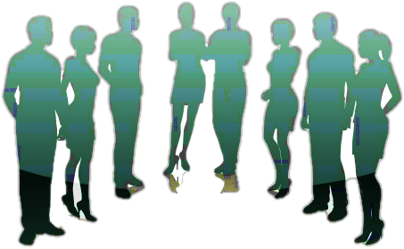
While-reading : read for details
Para.5
Paragraph 5:
Some gestures seem to have the same meaning everywhere. Placing your hands together and resting them on the side of your head while closing your eyes means “sleep”. A good way of saying “I am full” is moving your hand in circles over your stomach after a meal.

Slide 35
(Para5)
Para.5
Placing your hands together and resting them on the side of your head while closing your eyes
Moving your hand in circles over your stomach after a meal
Body language/Gesture
Meaninge
Country/region
food/restaurants
I’m sleepy
most places
I’m full

Slide 36

Paragraph 2-5
Para.2-5
Body language/Gesture | Meaning | Country/Region
Eye contact between men and women |  | Middle Eastern countries
Looking down when talking to someone | showing respect
OK sign |  | Japan
 |  | France
 |  | Brazil, Germany
 | friendliness | France, Russian
Placing your hands together and resting them on the side of your head while closing your eyes | sleeping
 | I'm full | everywhere
not socially permitted
Japan
money
zero
rudeness/impoliteness
Kissing on the cheek
everywhere
Moving your hand in circles over your stomach after a meal

Slide 37

While-reading : read for details
Reading for details
Para.6
Paragraph 6:
Some body language has many different uses. Perhaps the best example is smiling. A smile can help us get through difficult situations and find friends in a world of strangers. A smile can break down barriers. We can use a smile to apologise, to greet someone, to ask for help, or to start a conversation. …Experts suggest smiling at yourself in the mirror to make yourself feel happier and stronger. And if we are feeling down or lonely, there is nothing better than seeing the smiling face of a good friend.
Q：What different uses of smiling are mentioned in Paragraph 6? Find out the varied sentence structures used to show uses of smiling.

Slide 38
Paragraph 6:
Para.6
1. A smile can help us __________________________ and ___________in a world of strangers and___________________
get through difficult situations
find friends
can break down barriers.
apologize ,
to greet someone,
2. We can use a smile to________________________________
_________________________________.
to ask for help,
to start a conversation
3. Experts suggest smiling at yourself in the mirror to____________________________________________.
make yourself feel happier and stronger
4. ___________________________there is nothing better than ___________________________________.
If we are feeling down or lonely,
seeing the smiling face of a good friend

Slide 39
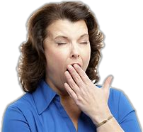
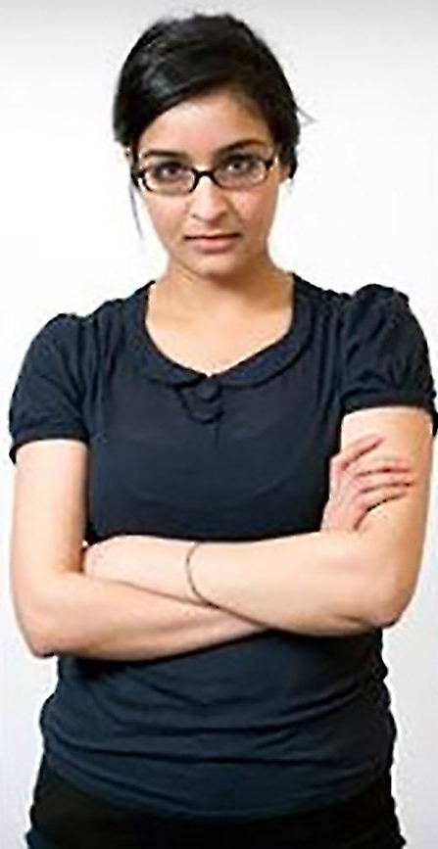
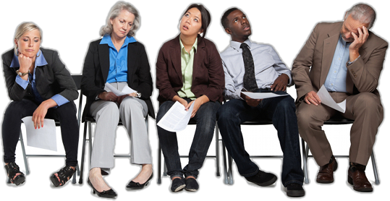
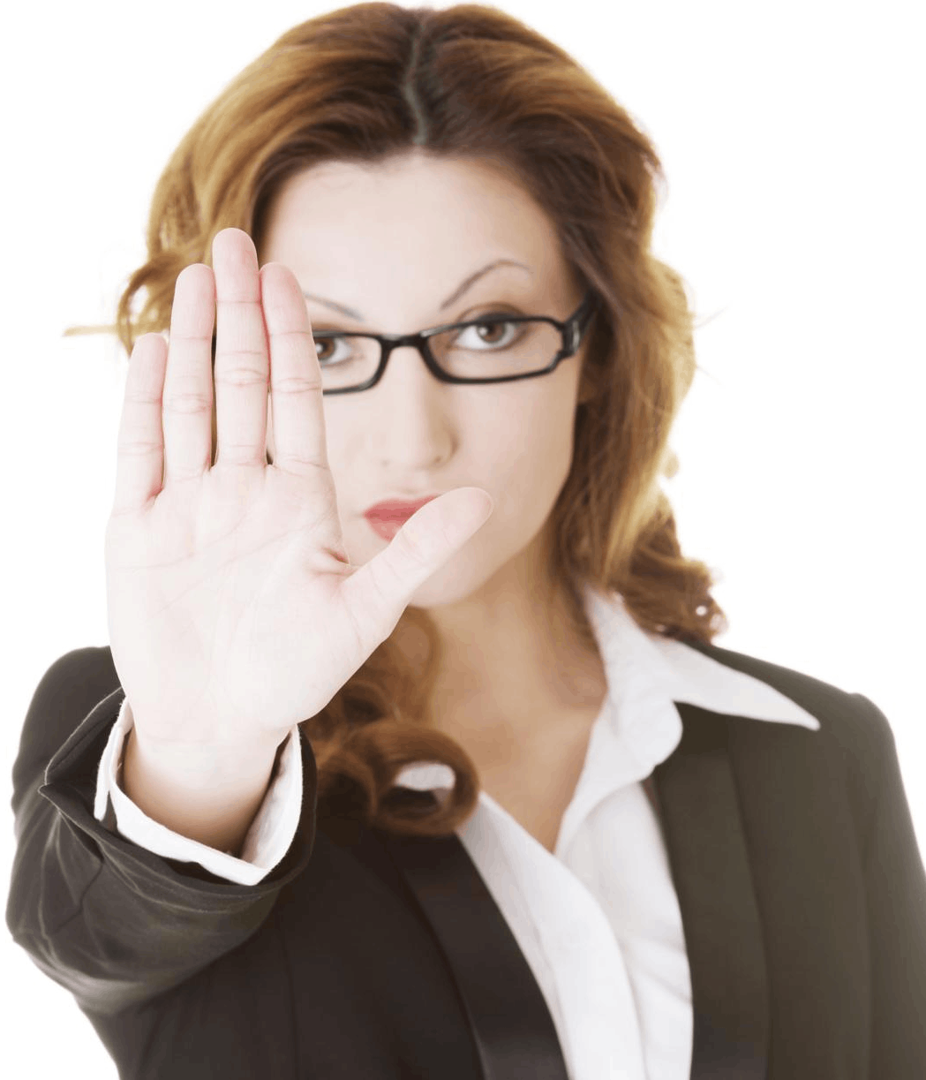
While-reading : Read for Reading Strategy
Read for thinking
Making inferences
Make inferences 推断
Sometimes a passage does not say something directly. However, you can figure it out by looking at the clues in the passage.

Slide 40
Post-reading : Further thinking
Further thinking
Read the text again, and then discuss these questions.
1. How is the body language mentioned in the text interpreted in China?
Some are the same in China. For example, people favour shaking hands, nodding the head or smiling when they greet someone else.
People favour shaking hands, nodding the head when they meet someone else.
2. Can you think of an example of body language that is appropriate in China but might be misunderstood in another culture?
Avoiding eye contact and lowering one's head may mean respect and shyness in China, whereas in some other countries they may be interpreted as rudeness.
In China, shaking one’s head means “no”, and nodding means “yes”. By comparison, in Bulgaria and southern Albania, the gestures have the opposite meaning.
3. What advice on body language can you give a foreign friend on his/her first trip to China?
Please pay attention to the social distance, which is different in China and in the West.

Slide 41
Post-reading : Further thinking
Match the body language with the meanings.
1 Looking up and making eye
contact
2 Leaning over to look at
one’s watch
3 Two friends leaning heads
together
4 Leaning forward and looking
at the teacher
5 Looking up, but no eye
contact, no expression
6 Looking away
7 Chin on hand, looking out the
window
8 Looking down, arms or legs
crossed
9 Frowning
10 Hair not brushed, red eyes
A very interested
B bored
C interested
D sad or worried
E distracted
F writing notes
G serious problems
H like they are
asleep
I daydreaming
J angry, afraid, or
experiencing
anxiety

Slide 42
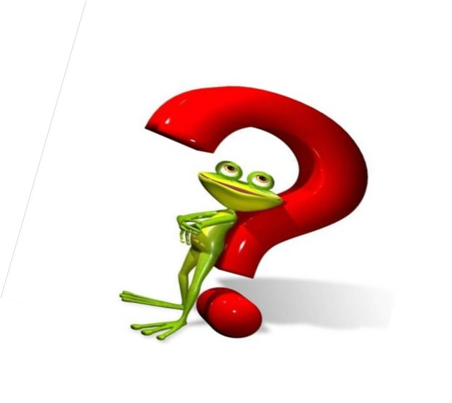
Post-reading : Further thinking
Read for thinking
What have you learned from this passage?
Body language is important in our daily life
It varies from culture to culture
It has different meanings in different cultures.
We should use body language in a way that is appropriate
the culture we are in.
When in Rome, do as Romans do.
How do you understand the title “Listening to how bodies talk”?
Learn about body language in different cultures and use it appropriately.

Slide 43
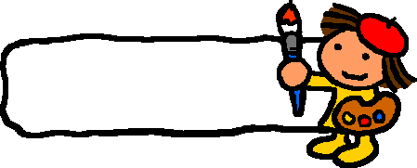
summary
Ⅰ.课文语法填空
Generally, body language 1. (employ) to express thoughts and opinions in people’s 2. (interact).We can learn a lot about 3. people are thinking by watching their body language. However, body language 4. (vary) from culture to culture and we should use body language in a way that is appropriate 5. the culture we are in.
is employed
interaction(s)
what
varies
to
to display
For example , in some countries, making eye contact is a way 6. (display) interest while in many Middle Eastern countries, it is not 7. (social) permitted between men and women. Also, the gesture for “OK” has different meanings in different cultures. Someone in Japan may think it means money but in France, a person 8. (encounter) the gesture may think it means zero. Despite the different meanings of above gestures in different cultures, some gestures seem to have the same meaning everywhere. For example, moving your hand in circles over your stomach after a meal is 9. good way of saying “I am full”.
Besides,some body language also has many different uses. The best example is smiling. It can help us to get through 10.__________(difficulty)situations and make us feel happier and stronger.
socially
encountering
a
difficult

Slide 44

Activity: Complete the summary with the words from the text.
We use both words and body language ___________( express) our thoughts and opinions in our interactions with other people. In some _________(country), making eye contact is a way to display interest; in other countries, it’s not always __________(approve) of. The gesture for “OK” has different meanings ___ different cultures. In Japan, it means money; in France, it _______(mean) zero; in Brazil and Germany, it is not considered ________(politely)
to express
countries
approved
in
means
polite
The gestures for “yes” and ”no” ________ (different) around the world. There are also differences in ____ we touch each other, how close we stand to someone______(us) are talking to, and how we act when we meet or part. “Sleep” gesture and “I’m full” gesture have the individually identical meanings in _____ world. Smiling has many different uses.
differ
how
we
the

Slide 45
Write a passage to introduce some body language. （80词左右）
summary
Important as words are, body language can also give us information about people’s feelings (要点1). However, some body language means differently in different countries(要点2). The meanings of some gestures, like making eye contact and “OK” vary from culture to culture while other gestures mean the same worldwide(要点3)．Some body language, like a smile, has many different uses(要点4)．

Slide 46


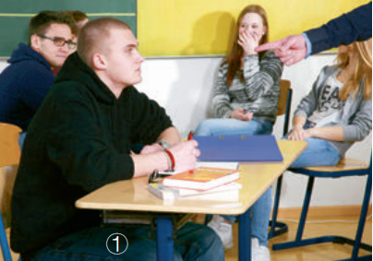

Group discussion
What are they doing？What is their body language telling you?

Slide 47

Watch the video Smile Trial, and then discuss the questions in groups. (P39, Ex. 4)
1. Smiles can be used to hide feelings like anger, fear, or worry. Can you describe a situation where you might smile when you don't mean it?
I smile at my parents after I fail in my final exams to avoid a scolding from them or their worry about me.
Sometimes I smile when I am impatient, but I know I shouldn’t be. For example, if I am riding a train and a baby starts crying, I may try to smile, because even though the baby’s crying is annoying, I know that it is not the baby’s fault and there is probably nothing that can be done.
2. Apart from fake smiles, is there any other kind of body language that can sometimes be fake?
Yes. For example, Chinese idioms “crocodile tears” and “a cat crying over a mouse’s death” mean that a person is in tears or crying with faked sadness or sympathy for another person.
There are “crocodile tears”. This is when a person fakes feeling sad or sympathetic for another person.

Slide 48

Discuss and Debate
3. Which is a more reliable guide for understanding someone's feelings, their body language or the words they speak?
Their body language is much more reliable than the words they say, because most people have trouble hiding their true feelings and ideas by their body language.
Debate:
Pros (正方)：…
Cons (反方): …

Slide 49

Writing:
你的美国笔友John下个月第一次来中国参加交换生活动，将在中国待两周时间。给你发e-mail，询问在中国期间与人交往注意哪些肢体语言含义和禁忌。请你给他回信，包含以下要点：
1.表示欢迎他的到来；
2.介绍中国常见肢体语言含义和禁忌；
3.期望对他有帮助。
注意：1.可增加细节，以使行文连贯；
2.字数：80词左右。
Q：What advice on body language can you give to a foreign friend on his/her first trip to China?
Dear John ,
I am glad to receive your email. _________________________________________________________________________________ yours,
Li Hua

Slide 50



