Slide 1

感恩遇见，相互成就，本课件资料仅供您个人参考、教学使用，严禁自行在网络传播，违者依知识产权法追究法律责任。
更多教学资源请关注
公众号：溯恩高中英语
知识产权声明

Slide 2


Slide 3
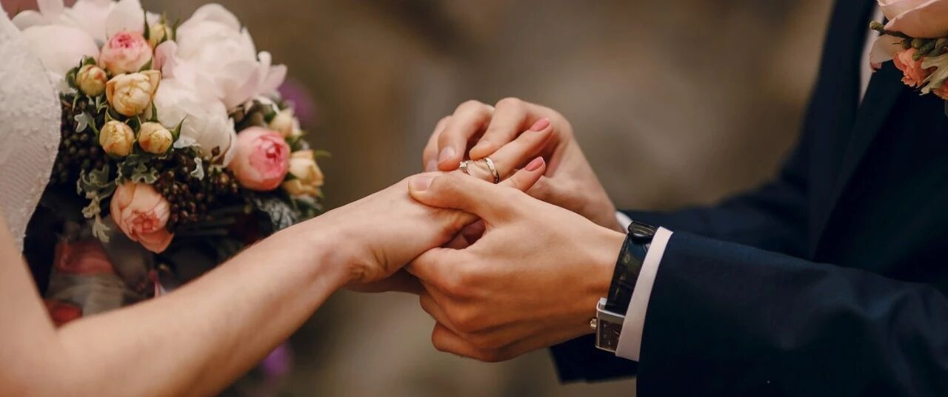
Continuation Writing
feedback on
The missing bluebird diamond ring

Slide 4
主要问题
1. 文章没读懂（ 去当铺卖戒指换钱来给丈夫治病？）
2. 词汇理解偏
3. 情节不连贯
4. 语言基本错误较多：时态混乱，词性误用，单词拼写错误等
5. 语言表达的积累严重不足
counter
第一段结尾与第二段首句不连贯
One such evening, as I reached for some cream for my
hands, I noticed my bluebird diamond wedding ring-
which I had worn for almost for a century-was missing!

Slide 5
第二节 读后续写 （满分25分）
阅读下列短文，根据所给情节进行续写，使之构成一个完整的故事。
It was July 2014. We were getting ready to move in a new house when my husband became very ill. He had to spend nine weeks in hospital, leaving me to do everything in our new home. By night fall, I was worn-out.
One such evening, as I reached for some cream for my hands, I noticed my bluebird diamond wedding ring-which I had worn for almost half a century-was missing! My finger was naked!
I was extremely shocked and sad. I looked in every drawer and in the car. No luck. My family told me to go back along the same route. That would be a task, for that day I had gone shopping, got my car fixed, and gone for an eye exam.

Slide 6
I sat, mind wandering back in time when I had first met my husband. I was five and one day, my dad took me to the town. On the way, we came upon a large herd of cattle. I waved to the youngest rider, who seemed to be nine, but he just turned away.
Next my memory travelled to my high school, The most exciting thing then was to dress up and walk the streets of our town with my classmates. It was on such a day that a black car went by and a passenger yelled, “ Girls, want a ride with us?” I could hardly believe it: among the people in the car was the boy who hadn’t responded to my wave 13 years before! But he wasn’t ignoring me now.
Our love affair began. He offered the ring a few months later. The diamond was small, but my future husband chose it for its perfection and shine.
My daydream passed. My daughter came and suggested I shop for a new ring. “Where do you want to go? ”She asked. “A pawn shop( 当铺)，” I said . I told her there was one close by.

Slide 7
注意：
1.所续写短文的词数应为150左右；
2.至少使用5个以上短文中标有下划线的关键词语；
3.续写部分分为两段，每段的开头语己为你写好；
4.续写完成后，请用下划线标出你所使用的关键词语。
Paragraph I
At the shop, we found five jewellery counters to look through. ______________________________________
______________________________________________
Paragraph 2
The shop assistant got a magnifying glass(放大镜) out and said，“It’s a bluebird.” ________________________
________________________________________________

Slide 8
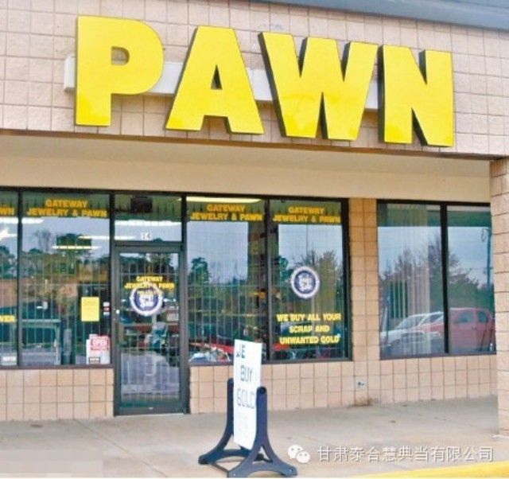
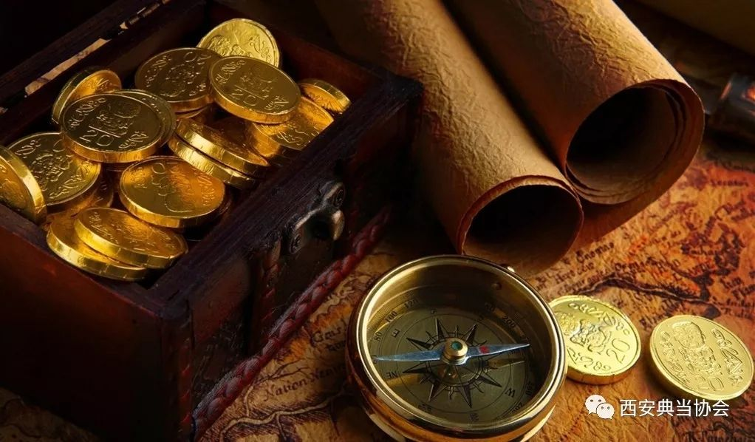
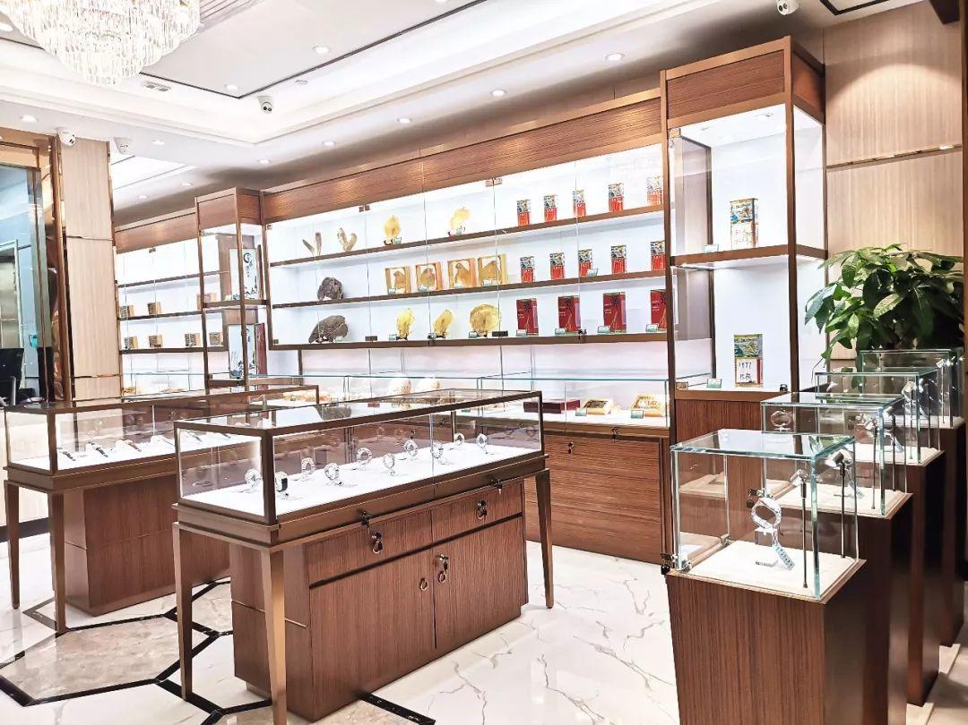
Cultural Background
Question: Why did I decide to go to a pawn shop to buy a new ring?
In some countries like the US, when people are short of money, many of them will choose to pawn their personal objects like the jewellery or even houses in exchange for money. The object will be returned to the owner if he or she pays back the money within an agreed period of time. If not, it can be sold. So people can always purchase almost everything in a pawn shop at a reasonable price or even a low price.
So “I” decided to buy a new ring in a pawn shop, in which the objects could meet people's various demands at a reasonable or even a low price.

Slide 9
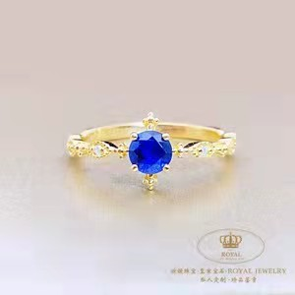
Read for plot
① It was July 2014. We were getting ready to move in a new house when my husband became very ill. He had to spend nine weeks in hospital, leaving me to do everything in our new home. By night fall, I was worn-out.
② One such evening, as I reached for some cream for my hands, I noticed my bluebird diamond wedding ring-which I had worn for almost half a century-was missing! My finger was naked!
③ I was extremely shocked and sad. I looked in every drawer and in the car. No luck. My family told me to go back along the same route. That would be a task, for that day I had gone shopping, got my car fixed, and gone for an eye exam.
④ I sat, mind wandering back in time when I had first met my husband. I was five and one day, my dad took me to the town. On the way, we came upon a large herd of cattle. I waved to the youngest rider, who seemed to be nine, but he just tumed away.
⑤Next my memory travelled to my high school, The most exciting thing then was to dress up and walk the streets of our town with my classmates. It was on such a day that a black car went by and a passenger yelled, “ Girls, want a ride with us?” I could hardly believe it: among the people in the car was the boy who hadn’t responded to my wave 13 years before! But he wasn’t ignoring me now.
⑥ Our love affair began. He offered the ring a few months later. The diamond was small, but my future husband chose it for its perfection and shine.
⑦My daydream passed. My daughter came and suggested I shop for a new ring. “Where do you want to go? ”She asked. “A pawn shop( 当铺)，” I said . I told her there was one close by.
my ____ husband & the_______ ring
sick
missing
memory
my ________
?
to show the ring was ___________to me.
important
What did the story focus on?

Slide 10
Read the theme
The ring was important to me.
my sick husband &the missing ring
theme?
was recovered
recovered
Para.2 The shop assistant got a magnifying glass(放大镜) out and said，“It’s a bluebird.” _____________________
Did I find the missing ring at last?

Slide 11
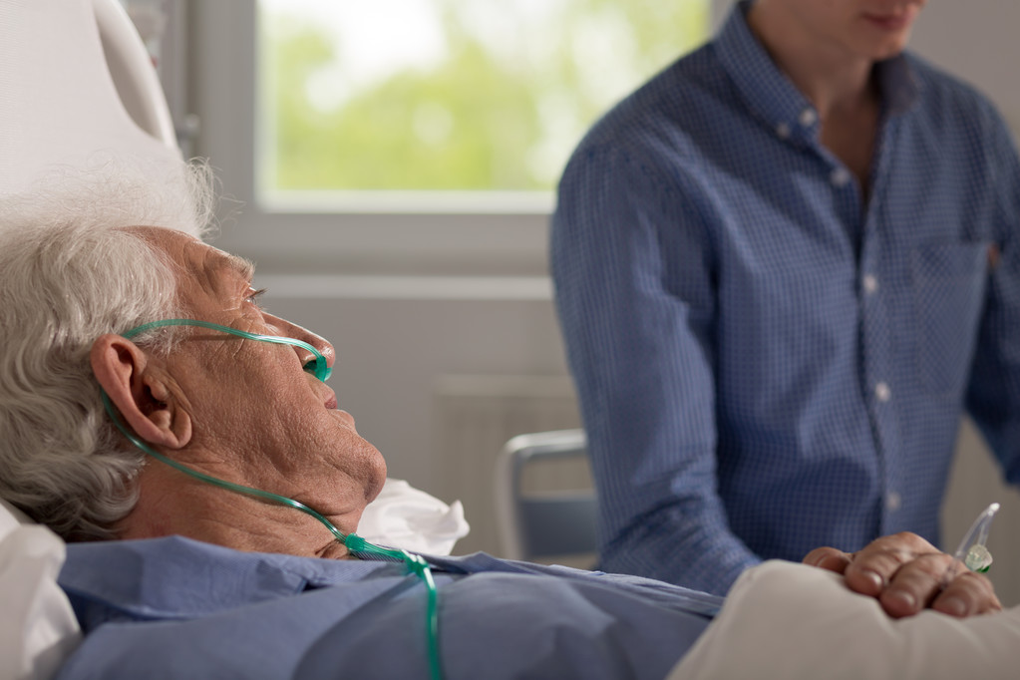
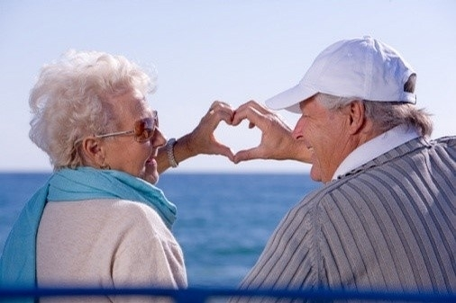
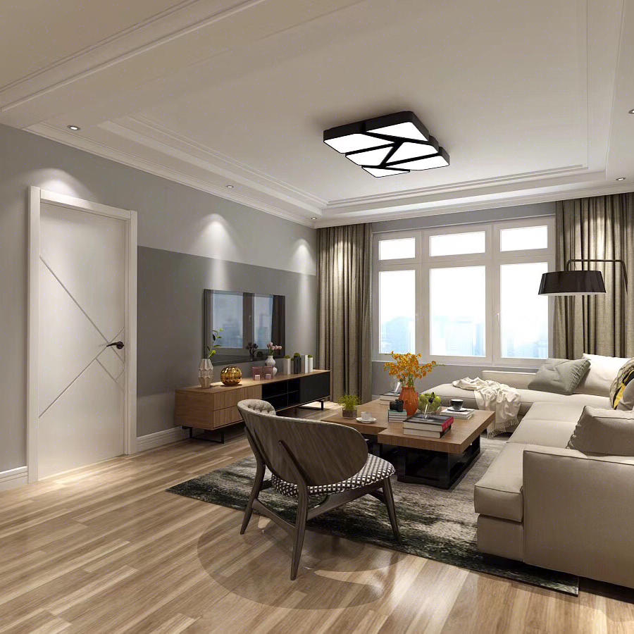
the theme ?
theme: love&hope
My missing wedding ring was recovered.
I believed my husband would recover too.
The ring brought hope for life.

Slide 12
Read the given sentences
Para.1 :At the shop, we found five jewellery counters to look through. _________________________________
启下
What was displayed in the jewellery counters?
What did we do?
How did I feel before finding the bluebird ring?
How did we find the bluebird ring?
I found my ring.
承上
Para.2 The shop assistant got a magnifying glass(放大镜) out and said，“It’s a bluebird.” _____________________
启下
How did I make sure it was mine?
How did I feel?
Did I get back my ring? How? What was the possible ending?

Slide 13
Words and expressions for writing
词汇积累
各种各样的
挑选vt.
失望的 adj. 更喜欢 vt.
代表;象征 n. vt.
发现
某物吸引某人注意力
闪亮的 adj.
......与......相似
激动的 adj.
向某人展示某物
various a variety of /varieties of
select choose(choose-chose-chosen) pick out
disappointed
prefer
symbol
symbolize represent
spot (spotted) discover
sth catch one's eye
(catch-caught-caught）
shiny/shining
be similar to
thrilled;excited
show sth to sb

Slide 14
Words and expressions for writing
拿起...
仔细查看
与......分享......
感动的adj.
以低价买某物
戴上戒指
紧紧拥抱对方
痊愈 vi.
词汇积累
pick ... up
look at/observe sth carefully
share sth with sb
moved ;touched
buy sth at a low price
wear the ring (wear-wore-worn )
slipped the ring on my finger(slip-slipped-slipped)
hug each other tightly(hug-hugged-hugged)
recover

Slide 15
Describe emotions vividly
I was disappointed.
I was ___ disappointed ___ I ______________.
(快哭了 so...that...)
So disappointed _____ that I was close to tears.
I tried to ____________________(抑制住泪水)
My heart ______(我心情沮丧) sink-sank-sunk
so
that
was close to tears
was I
hold/fight back tears
sank

Slide 16
Describe emotions vividly
I was thrilled/excited.
I was so thrilled that I ________________
——————————————（听见心脏在耳边跳动）
So thrilled was I that I could feel my
___________________. (听到心跳地厉害)
A ____ of excitement ____________ me. (surge:突发 a surge of+情绪n.; 控制住 take hold of)
I felt _________________. (我感到非常兴奋)
could feel my heart
pounding in my ears
heart beating wildly
surge
took hold of
a surge of excitement

Slide 17
Writing and Sharing
Para.1
1. What was displayed in the jewellery counters?
2. What did we do?
3. How did I feel before finding the bluebird ring?
4. How did we find the bluebird ring?

Slide 18
Language improvement
Para 1: At the shop, we found five jewellery counters to look through.
柜台里有各种各样的闪亮的戒指、项链(necklace)和手镯(bracelet)/珠宝。我们一个个柜台看过去，仔细挑选新的戒指。但是，我没有找到满意的戒指，我很失望。（描写）突然,我女儿发现一颗小小的特别闪耀的钻戒，这枚戒指和我丢失的戒指非常像。
Para.2: The shop assistant got a magnifying glass(放大镜) out and said, “It's a bluebird.”
我们很激动，询问戒指
上面是否是一只蓝鸟。

Slide 19
(1) 柜台里有各种各样闪亮的戒指、项链(necklace)和手镯(bracelet)。我们一个个柜台看过去，仔细挑选新的戒指。但是，我没有找到满意的戒指，我很失望。
There were ______________ shiny necklaces,
rings and bracelets. We __________ each counter carefully to _______ a new ring. However, ___________(find) a _________ ring, I was ______________________________________.
a variety of
looked at
select
not finding
satisfying
so disappointed that I was close to tears

Slide 20
(2) 突然，我女儿发现一颗小小的特别闪耀的钻戒，这枚戒指和我丢失的戒指非常像。（定语从句）
Suddenly, my daughter ______ a small but shiny diamond ring ___________________
_______________.
(3) 我们很激动，询问戒指上是否是一只蓝鸟。
(非谓语动词asking... 宾语从句)
We were so thrilled, _______________________
_____________.
spotted
which looked similar to
my missing ring
asking whether there was a
bluebird on it

Slide 21
Paragraph I
At the shop, we found five jewellery counters to look through. There were a variety of shiny necklaces, rings and bracelets. We looked at each counter carefully to select a new ring. However, not finding a satisfying ring, I was so disappointed that I was close to tears.Suddenly, my daughter spotted a small but shiny diamond ring which looked similar to my missing ring. We were so thrilled, asking whether there was a bluebird on it.

Slide 22
Writing and Sharing
Para.2
1. How did I make sure it was mine?
2. How did I feel?
3. Did I get back my ring? How?
4.What was the possible ending?

Slide 23
Language improvement
Para.2: The shop assistant got a magnifying glass(放大镜) out and said, “It's a bluebird.”
店员将戒指展示给我们看，我们拿起放大镜仔细观察那枚戒指，发现它是自己丢失的那枚婚戒因为上面刻有我的名字。我感觉非常激动（激动得心怦怦跳）。我分享这个戒指的故事，店员很感动。我最终以低价买回戒指。
我戴上戒指，泪水模糊了我的视线。不久后，丈夫痊愈出院,我们在新家开启了新生活。是这枚蓝鸟钻戒让我们意识到我们深爱着对方而且生活永远充满希望。
问题：为了呼应主题，呼应第一段背景，怎么结尾好？ （theme: love&hope&happy ending）

Slide 24
(1) 店员将戒指展示给我们看，我拿起放大镜仔细观察那枚戒指。当我发现它是上面刻有我名字的属于我的戒指，我激动得心怦怦跳。
(非谓语动词,宾语从句)
Then he _____________. I __________ the magnifying glass to _______ it. When I found
____________________________ with my name ________(carve 刻上) on it, ________________
________________________________________.
showed it to us
picked up
observe
that the ring was actually mine
carved
I was so thrilled
that I could feel my heart pounding in my ears.

Slide 25
(2) 我分享这个戒指的故事，店员很感动。 我最终以低价买回戒指。(定语从句)
I _______the story about my old ring ____ the shop assistant ______________________.Finally, I bought my old ring ____________.
(3) 在我戴上戒指的一瞬间，泪水模糊了我的视线。(slipped it on my finger; blurred my vision
the moment引导时间状语从句)
________________________________, tears blurred my vision.
shared
with
which made him moved
at a low price
The moment I slipped it on my finger

Slide 26
(4)不久后，丈夫痊愈出院,我们在新家开启了新生活。
Soon, my husband __________and we began our new life in the new house.
recovered

Slide 27
(6) 是这枚蓝鸟钻戒让我们意识到我们深爱着对方而且生活永远充满希望。
（ 强调结构 it is/was...that... ； 宾语从句）
It was the bluebird diamond ring that made us realize we loved each other deeply and life was alway full of hope.

Slide 28
Paragraph I
At the shop, we found five jewellery counters to look through. There were a variety of shiny necklaces, rings and bracelets. We looked at each counter carefully to select a new ring. However, not finding a satisfying ring, I was so disappointed that I was close to tears.Suddenly, my daughter spotted a small but shiny diamond ring which looked similar to my missing ring. We were so thrilled, asking whether there was a bluebird on it.

Slide 29
Paragraph 2
The shop assistant got a magnifying glass(放大镜) out and said, “It’s a bluebird.” Then he showed it to us. I picked up the magnifying glass to observe it. When I found that the ring was actually mine with my name carved on it, I was so thrilled that I could feel my heart pounding in my ears. I shared the story about my old ring with the shop assistant,which made him moved . Finally, I bought my old ring at a low price.The moment I slipped it on my finger, tears blurred my vision. Soon, my husband recovered and we began our new life in the new house. It was the bluebird diamond ring that made us realize that we loved each other deeply and life was alway full of hope.

Slide 30
Thank you!

