Slide 1


感恩遇见，相互成就，本课件资料仅供您个人参考、教学使用，严禁自行在网络传播，违者依知识产权法追究法律责任。
更多教学资源请关注
公众号：溯恩高中英语
知识产权声明

Slide 2



WELCOME

Slide 3
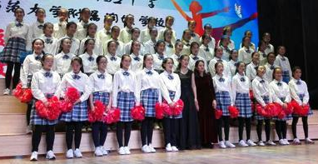

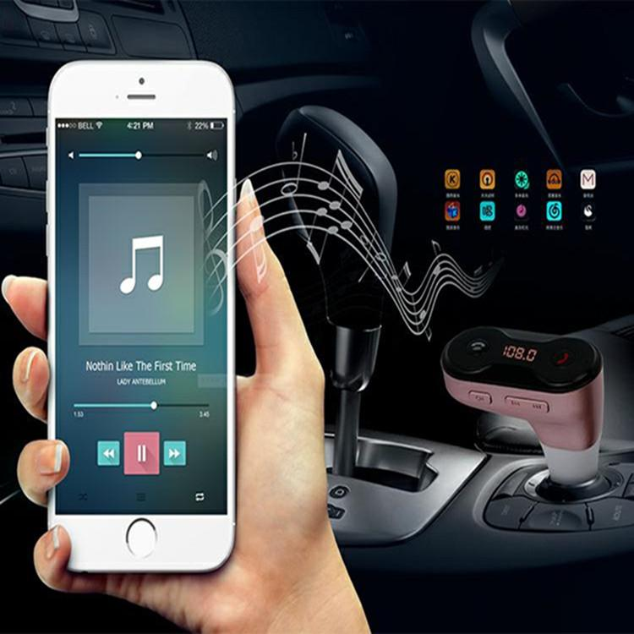


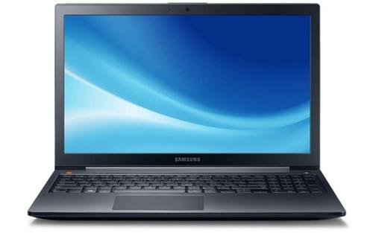


Lead-in
What are the ways for you to experience music?
way
Ways to Enjoy Music
...

Slide 4

The Virtual Choir

Slide 5
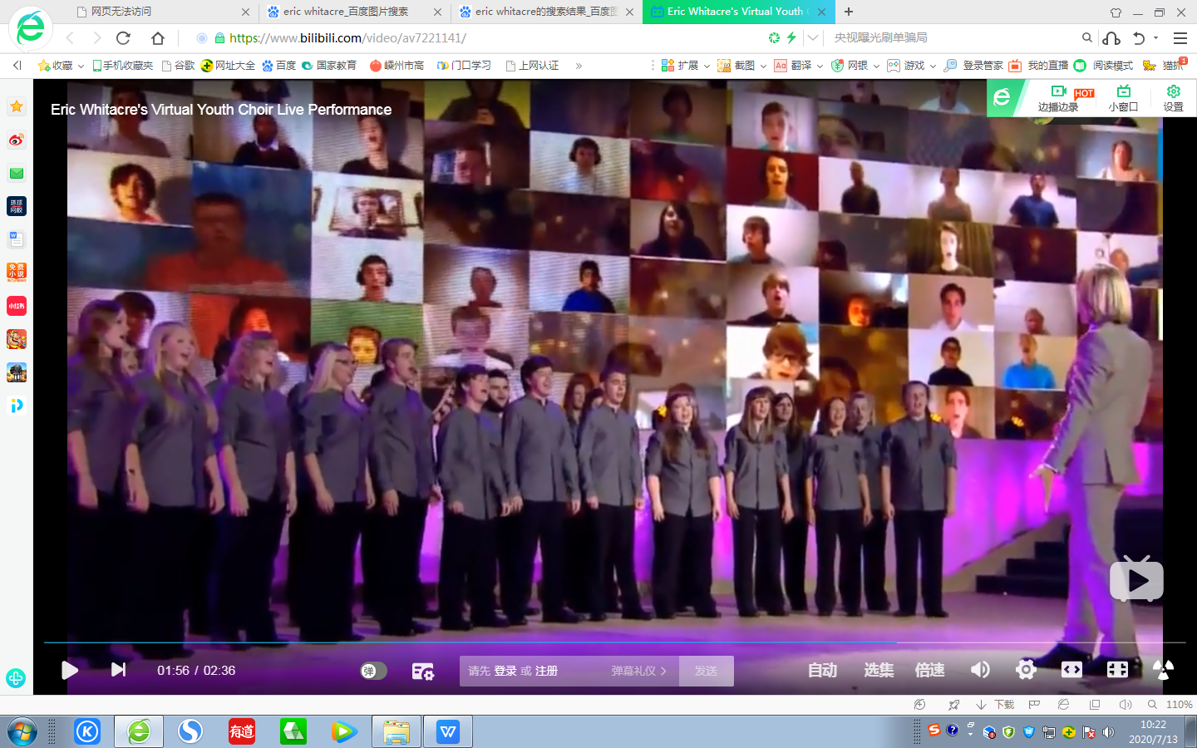
Prediction
Look at the title and picture, and think about what the text will focus on.
Topic
The Virtual Choir
…
What
Who
Where
How
Why

Slide 6
Skimming
What
Who
Para. 1
Introduction
Where
How
Para. 2
Creator
Why
The Virtual Choir
Para. 3
Creation
Para. 4
Influence

Slide 7
Scanning: Para.1
Scan
Scan a text to find specific information,
such as names, dates, and numbers.
What
video
Who
anyone
Introduction
Where
anywhere
record themselves
upload the videos
put …together into...
How
Why
Help connect
... together
Enable them to add...to...
Make them part of ...
Prove to be a positive influence on ...

Slide 8
Further-thinking
As one virtual choir member said, “Music helps me to ... forget my problems. With music, I become someone else.”
Why does the author use such a quote?
It is used to prove that the opinion is authentic and thus make it more convincing.

Slide 9
Scanning: Para.2
Circle the times in Para. 2 and try to find out what happened to Eric Whitacre.
This led to the creation of the virtual choir.
“It was like seeing color for the first time.”
popularity
Over the
next 10 years
His original compositions became quite popular
knowledge
Received a master’s degree in musical composition
1997
love
1995
Graduated from university
1988
Studied music at the University of Nevada
Jan. 2, 1970
Born in the USA

Slide 10

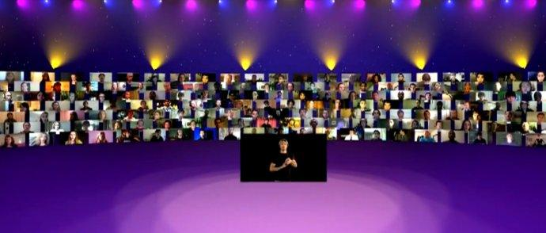
Scanning: Para.3
What else led to the creation of the virtual choir?
The inspiration from a girl
The participation of people
The development of the Internet
The efforts of Whitacre
185 singers from 12 countries
2,292 people from 80 countries
make contributions to charity
extraordinary
ordinary
the Virtual Youth Choir for UNICEF
(United Nations Children’s Fund)

Slide 11
The success of the virtual choir
The magic of music
The development of the Internet
The devotion of Whitacre
The efforts of ordinary people

Slide 12
Further-thinking: Para.4
The virtual choir is a wonderful way for people around the world to sing with one voice and thus make the world a better place.
How to understand “sing with one voice”?
Sing the same song
Share the same interest
Hold the same value
Work towards the same goal

Slide 13
Discussion
Why can the virtual choir make the world a better place?
Help connect ordinary people together.
Enable people to add their voices to …
Make people part of the global community.
a better place
Prove to be a positive influence on lives of…
Provide an opportunity to make contributions to...
…

Slide 14
Summary
Retell the whole text referring to the mind map below.
video
anyone
Para. 1
Introduction
anywhere
record, upload, put
Para. 2
Creator
connect, add, make, prove
The Virtual Choir
popularity, knowledge, love
Para. 3
Creation
Echo
Eric, people, Internet, music
Para. 4
Influence
one voice,
better place

Slide 15
The virtual choir
Voice together
Inspire each other
Realize the dreams
Tie ordinary people
Undertake responsibility
Achieve a sense of satisfaction
Lead the world to a better place
Wisdom comes from diligence, and greatness comes from the ordinary.
——Leo Tolstoy

Slide 16
Assignment
1. Write a summary of the passage referring to the mind map.
2. Search the Internet to get more information about the virtual choir.

Slide 17
THANK YOU

Slide 18
One possible version
People record themeslves and upload the videos onto the Internet, which are put together into one—— that is a virtual choir. Anyone from anywhere can take part in the virtual choir. It has a positive influence on ordinary people, for it connects them together, allows them to add their voices to others’ and thus makes them part of the global community. It was created by Eric Whitacre，who is popular, professional and loves music. The devotion of Eric, the efforts of people, the magic of music, as well as the development of the Internet lead to the success of the virtual choir. In a word, the virtual choir is a wonderful to make the world a better place.

