Slide 1

感恩遇见，相互成就，本课件资料仅供您个人参考、教学使用，严禁自行在网络传播，违者依知识产权法追究法律责任。
更多教学资源请关注
公众号：溯恩高中英语
知识产权声明

Slide 2
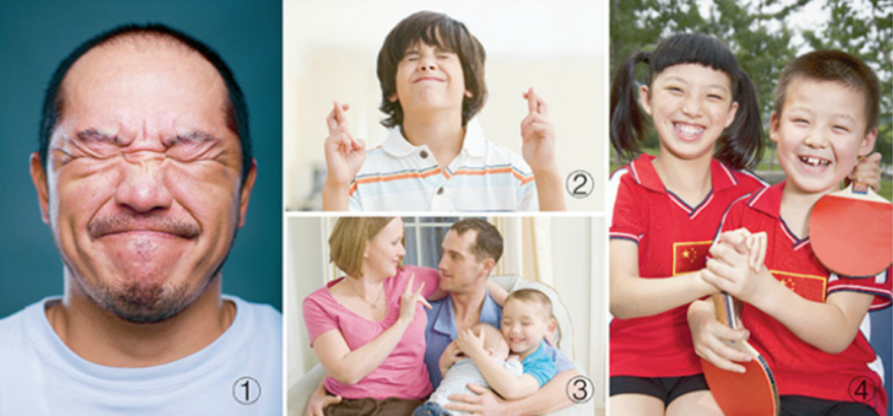
What I hide by my language, my body utters
－Roland Barthes
Unit 4 Body Language
Using language（1）
Explore body language
杭州二中许丽君

Slide 3
Learning objectives
In this class, you will
1. Understand some facial expressions and talk about body language;
2. Understand a conversation and learn to infer meaning for it;
3. Learn to ask for and make clarification
4. Use body language to express themselves;
5. Identify the inferred meaning of the speaker in conversations.
6. Practice listening to make inferences

Slide 4

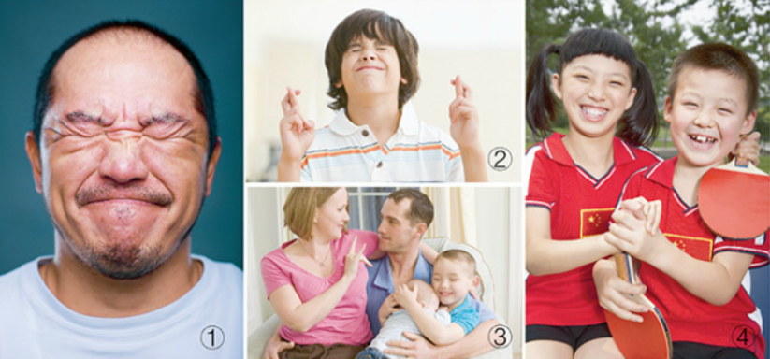
Lead in
Part 1
Explore body language:
Look at these photos and discuss what you think each person is communicating.

Slide 5
Lead in
Part 1
Explore body language:
Look at these photos and discuss what you think each person is communicating.
frown (皱眉), tightly shut eyes, tight-lipped
fingers crossed, eyes closed
He could be in great pain.
He could be upset.
He could be hoping for good luck.

Slide 6
Lead in
Part 1
Explore body language:
Look at these photos and discuss what you think each person is communicating.
hug, American Sign Language (hand gesture for love)
The woman in the photo is either deaf or is communicating with her husband who is deaf.
She is using American Sign Language, and the sign she is using means “I love you”.
smile, hold hands tightly
The two children seem quite happy.
Perhaps they have just won a table tennis match.

Slide 7
Part 2
Before Listening
Discuss when and where people need to use body language to communicate effectively.
People communicate
when
when
when
where
can’t speak
can’t hear well
not convenient
must be silent

Slide 8

Part 2
Before Listening
Q: When and where do people need to use body language to communicate effectively?
Body language often needs to be used in situations where people cannot talk to each other directly. This can include:
deaf people using sign language;
army soldiers on a mission;
…

Slide 9
Part 3
Listening for details
Listen to a conversation about body language. Then answer the following questions.
How did the man get the idea of using gestures to communicate?
2. What did the police leader tell his team by using gestures?
3. What did the woman say about the acting classes that she's been taking?
4. What did the man mean by saying "It's good you tried" at the end of the conversation?

Slide 10

Part 3
Listening for details
Listen to a conversation about body language. Then answer the following questions.
Woman: | What were you doing just now? What did those gestures mean?
Man: | Oh, I was just telling my friend over there to meet me for lunch down the street in twenty minutes.
Woman: | Oh, I get it, so you were sending him secret hand signals.
Man: | Yeah, we got the idea from an action movie last night and decided to try it out for fun.

Slide 11
Part 3
Listening for details
Listen to a conversation about body language. Then answer the following questions.
Man: | In the movie, the police were trying to enter a house, but they had to be really quiet so they could take the criminals by surprise. So the police leader used hand gestures to tell his team what to do. For example, he used this gesture to tell them how many bad guys were in the house. Then he gave instructions on who should go where, and what they should do. I thought it was pretty cool how they used hand gestures to communicate.

Slide 12
Part 3
Listening for details
Listen to a conversation about body language. Then answer the following questions.
Woman : | Well, you know, you can say a lot without speaking. I’ve been taking acting classes, and right now we’re learning how to use body language to express ourselves.
Man: | Wow, that’s cool. So you mean you’re not allowed to talk, right?
Woman: | Yes, and it’s really difficult if they want you to express something complicated without saying a word. But I’m slowly getting better at it, I guess.

Slide 13
Part 3
Listening for details
Listen to a conversation about body language. Then answer the following questions.
Man: | That reminds me of those Charlie Chaplin movies. I guess it’s not easy to tell a whole story only using body language.
Woman: | Yeah, he was a real master. Everyone in my class loves his movies. We actually had to watch some of his movies and act out some scenes. I was such an amateur!
Man: | Well, it’s good you tried. Now, by your body language, I can tell that you want to buy me lunch tomorrow. Am I right?

Slide 14
Part 3
Listening for details
Listen to a conversation about body language. Then answer the following questions.
How did the man get the idea of using gestures to communicate?
From an action movie
2. What did the police leader tell his team by using gestures?
He used gestures to tell them how many bad guys were in the house. then he gave instructions on who should go where, and what they should do
3. What did the woman say about the acting classes that she's been taking?
She said that right now they’re learning how to use body language to express themselves
4. What did the man mean by saying "It's good you tried" at the end of the conversation?
He meant that even though she wasn’t very good at it, her experience was still worthwhile.

Slide 15
Part 4
Listening for inferred meaning
Listen to the conversation again. Are the following statements correct inferences from the conversation?
Infer meaning
Sometimes things are not said directly, and so you must guess the meaning, relationship of the people, or context. You can do this by:
drawing conclusions from the background information you already have.
looking at clues that tell you the context.
using logic to work out the meaning.
F
1. The two speakers are married.
2. Making too many gestures in communication is not polite.
3. The police team were probably successful in catching the criminals.
4. Both speakers think body language is useful.
5. The woman is not very confident about her silent acting ability.
F
T
T
T

Slide 16
Part 5
Listening for language
Listen again and fill in the blank with what you hear.
Woman: What were you doing just now? _______1_______
Man: Oh, I was just telling my friend over there to meet me for lunch down the street in twenty minutes.
Woman: Oh, I get it, so _______2_______
Man: Yeah, we got the idea from an action movie last night and decided to try it out for fun. In the movie, the police were trying to enter a house, but they had to be really quiet so they could take the criminals by surprise. So________3_________. For example, he used his gesture to tell them how many bad guys were in the house. Then he gave instructions on who should go there and what they should do. I thought it was pretty cool how they used hand gestures to communicate.
Woman: Well, you know, ________4__________I have been taking acting classes, and right now we are learning how to use body language to express ourselves.
Man: Wow, that’s cool. So_______5________, right?
Woman: Yes, and it’s really difficult if they want you to express something complicated without saying a word. But I am slowly getting better at it, I guess.

Slide 17
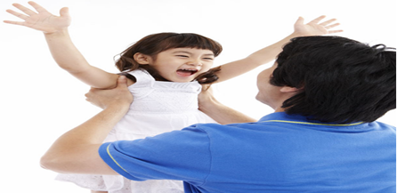
Part 5
Listening for language
Key:
What did those gestures mean?
you were sending him secret hand signals.
the police leader used hand gestures to tell his team what to do
you can say a lot without speaking.
you mean you are not allowed to talk

Slide 18

Part 6
Learn to ask for and give clarification.
Use the table below to clarify any misunderstandings or different answers.
Asking for and making clarification
What did you mean by ...? So you mean …？ So did that mean ...? What I don’t quite understand is ... Could you explain…? Could you give me an example? | In other words ... What I meant was ... What I was trying to say was ... Does that make sense? Is that clear? I can tell that ...

Slide 19
Part 7
Pronunciation:
Read the quotes and notice the pause after each sense group.
1. There are four ways, | and only four ways, | in which we have contact with the world. | We are evaluated and classified | by these four contacts: | what we do, | how we look, | what we say, | and how we say it.
— Dale Carnegie
2. If language was given to men | to conceal their thoughts, | then gesture's purpose | was to disclose them.
― John Napier
3. Body language is a powerful tool. | We had body language | before we had speech, | and apparently, | 80% of what you understand in a conversation | is read through the body, | not the words.
— Deborah Bull

Slide 20

Part 7
Pronunciation:
Read this passage. Then mark “I” where it needs a pause.
Life is a stage, and we are all actors. This is also true when you are in a foreign land. Acting can help you communicate even if you do not know the language. For instance, one day a Chinese lady who was babysitting her grandchild in America went to a supermarket to buy some beef. She was confused to see all kinds of meat there and did not know which ones were beef. She asked a clerk by putting both hands up and saying “Moo! Moo!" The lady got what she wanted even without saying a word of English.
Listen to the texts above and see how well you read.

Slide 21

1. Identify and interpret different types of body language;
2. Think about some classroom body language and write down their meanings.
3. Practise reading the passage, notice the pause.

Slide 22

Thank you!

