Slide 1


感恩遇见，相互成就，本课件资料仅供您个人参考、教学使用，严禁自行在网络传播，违者依知识产权法追究法律责任。
更多教学资源请关注
公众号：溯恩高中英语
知识产权声明

Slide 2
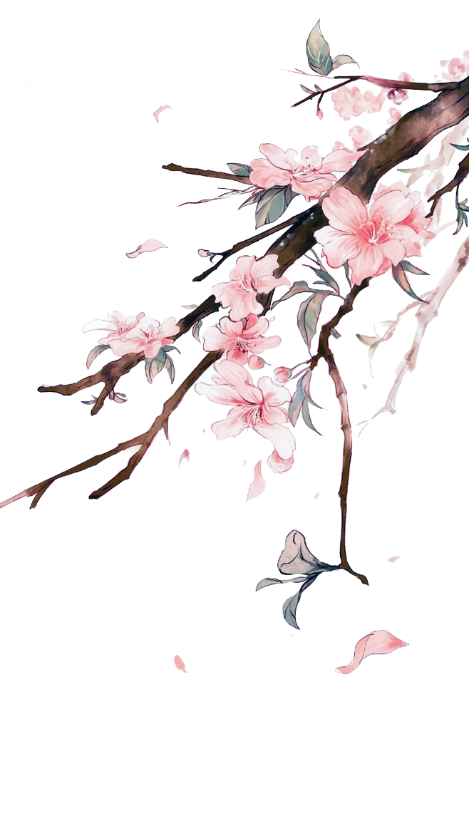


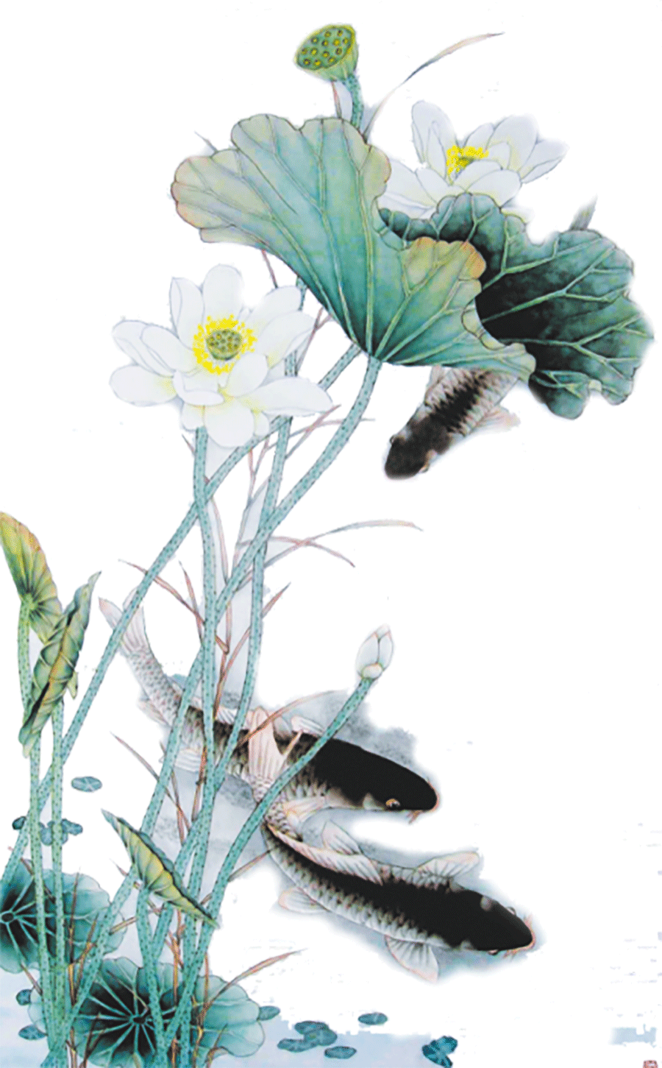


选择性必修Book3 Unit 5 Poems
Period 1 : Reading and Thinking
A Few Simple Forms Of English Poems
杭州二中树兰实验学校 郭合英

Slide 3



The Road Not Taken
（Robert Frost）
Two roads diverged in a yellow wood,
And sorry I could not travel both
And be one traveler, long I stood
And looked down one as far as I could
To where it bent in the undergrowth;
Then took the other, as just as fair,
And having perhaps the better claim,
Because it was grassy and wanted wear;
Though as for that the passing there
Had worn them really about the same,
And both that morning equally lay
In leaves no step had trodden black.
Oh, I kept the first for another day!
Yet knowing how way leads on to way,
I doubted if I should ever come back.
I shall be telling this with a sigh
Somewhere ages and ages hence:
Two roads diverged in a wood,and I—
I took the one less traveled by,
And that has made all the difference.
Appreciate a poem written by Robert Frost
The Road Not Taken
(未选择的路)

Slide 4





Activity 1: Pre-reading
According to the English translation to guess Chinese poems
and the writers.
Let’s have a competition!

Slide 5
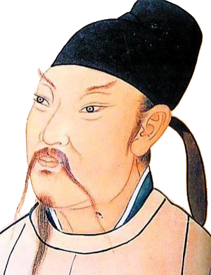
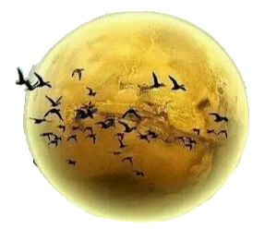
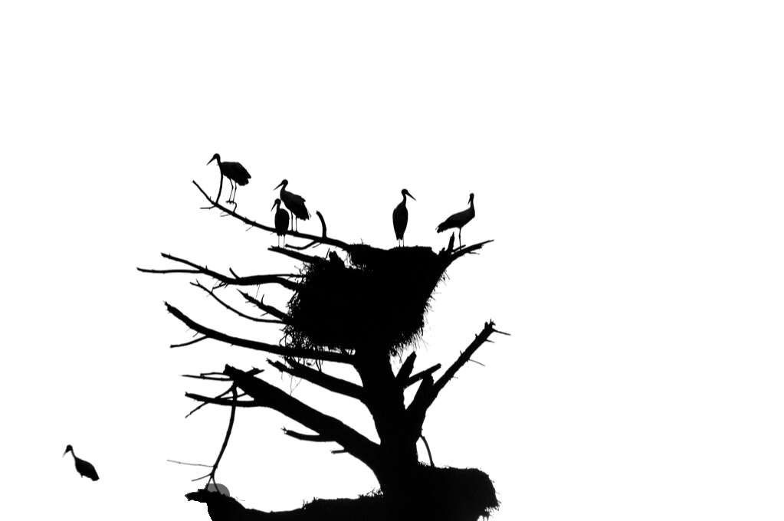
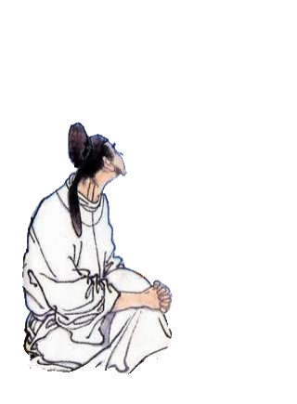

A bed, I see a silver light,
I wonder if it's frost aground.
Looking up, I find the moon bright;
Bowing, in homesickness I'm drowned.
床前明月光,疑是地上霜.
举头望明月,低头思故乡.
---李白《静夜思》
(许渊冲译)

Slide 6

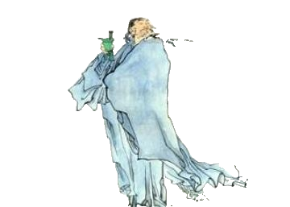
From a pot of wine among the flowers
I drank alone. There was no one with me --
Till, raising my cup, I asked the bright moon
To bring me my shadow and make us three.
花间一壶酒， 独酌无相亲。
举杯邀明月， 对影成三人。
----李白《月下独酌》
（许渊冲译）

Slide 7
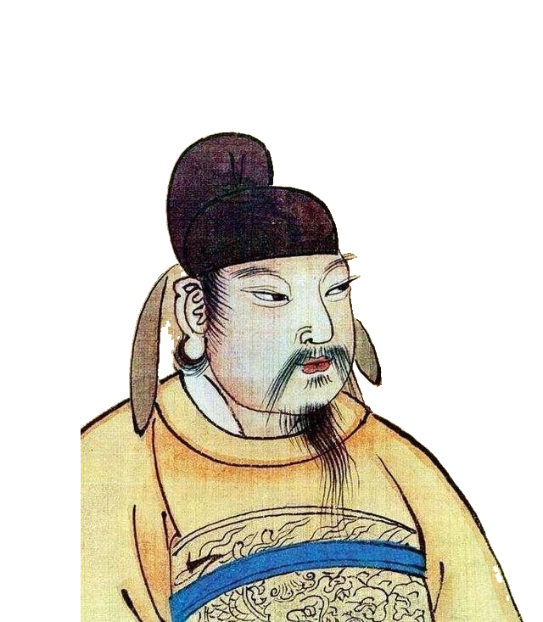
The carved rails and the marble steps must remain unchanged,
but not her beauty.
How much sorrow do I have?
It is like the spring flood of a long river flowing east!
雕栏玉砌应犹在，
只是朱颜改。
问君能有几多愁，
恰似一江春水向东流。
----李煜 《虞美人·
春花秋月何时了》
（许渊冲译）

Slide 8
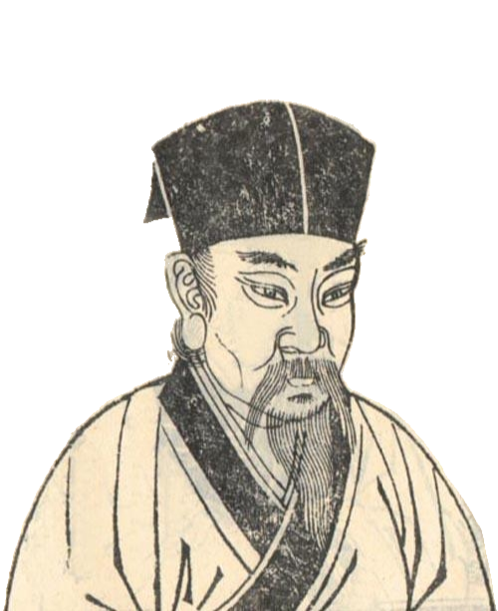
Men have sorrow and joy; they part or meet again;
The moon is bright or dim and she may wax or wane.
There has been nothing perfect since the olden days.
So let us wish that man
Will live long as he can!
Though miles apart, we'll share the beauty she displays.
人有悲欢离合，月有阴晴圆缺，此事古难全。
但愿人长久，千里共婵娟！
----苏轼《水调歌头》
（许渊冲译）

Slide 9
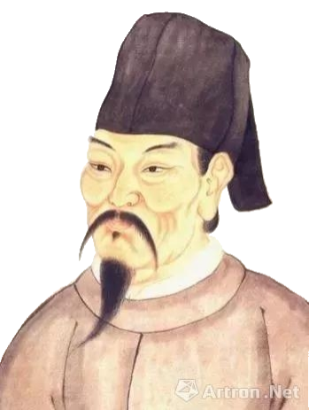
No dust is raised on the road wet with morning rain;
The willows by the hotel look so fresh and green,
I invite you to drink a cup of wine again;
West of the Sunny Pass no more friends will be seen.
渭城朝雨浥轻尘，
客舍青青柳色新。
劝君更尽一杯酒，
西出阳关无故人。
----王维
《送元二使安西》
（许渊冲、许明译）

Slide 10
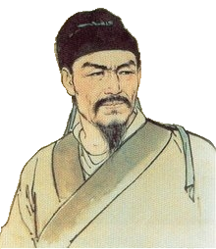


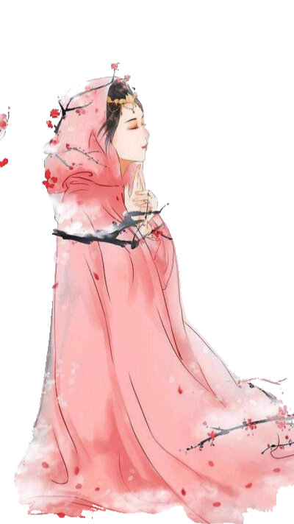
I look for her in vain.
When all at once I turn my head,
I find her there where lantern light
is dimly shed.
辛弃疾
众里寻他千百度，
蓦然回首，
那人却在灯火阑珊处。
---辛弃疾《青玉案·元夕》
(许渊冲译)

Slide 11
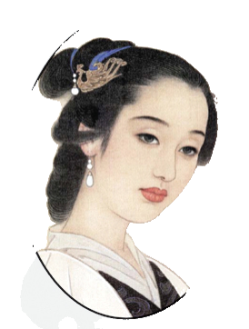
I often remember that sunset at Creek Pavilion:
Too drunk to know our way back home.
Turning the boat sound after a joyous day,
We blundered deeper into lotus' way.
Punt away!
Punt away!
We drive up a beachful of herons and gulls.
常记溪亭日暮，沉醉不知归路。
兴尽晚回舟，误入藕花深处。
争渡，争渡，惊起一滩鸥鹭。
---李清照《如梦令》
(龚景浩译)

Slide 12



Brainstorm
to express feelings
to recall an enjoyful or unpleasant incident
Why do you think people write poems?
to tell a story
Reasons to write poems
to ……
to miss/ honour someone
to have fun
Notes:
摄影图：https://ibaotu.com/sucai/17918692.html
字体：https://ibaotu.com/Font/quanbu-0/fd3ec5bed9eb4d4c1c47a4d692aba263.html
音乐：https://ibaotu.com/sucai/17853928.html
素材：https://ibaotu.com/sucai/18340967.html

Slide 13

Activity 2: While-reading
Skim to find out:
1. How is the text organized?
A. Topic—Argument—Explanation
B. Opinion—Discussion—Description
C. Main idea—comparison—supporting examples
D. Introduction—supporting examples--conclusion
2. What does the first passage mainly talk about?
A. The development of English poems. B. The reasons for writing poems.
C. The types of English poems. D. The origin of writing poems.
3. How many forms of poems does the passage talk about?
A. 5 B.2 C.6 D.4
4. Why do many children enjoy nursery rhymes?
A. Because they are to the point.
B. Because they are have s storyline.
C. Because they are usually the traditional poems or folk songs.
D. Because they have not only a strong rhythm but also a repetition in words.

Slide 14
Nursery rhyme:
Activity 3:
Carefully reading
Some of the first poems a young child learns in English are nursery rhymes. They are usually the traditional poems or folk songs. The language of these rhymes, like Poem A, is to the point but has a storyline. Many children enjoy nursery rhymes because they rhyme, have a strong rhythm, and often repeat the same words. The poems may not make sense and even seem contradictory, but they are easy to learn and recite. By playing with the words in nursery rhymes children learn about language.
1.What’s the features ?
2. How do the children learn about language?
3. Which sentence is true?
A. Nursery rhyme is the first poem for every
children.
B. All the nursery rhymes are contradictory.
C. Each each enjoys nursery rhyme.
D. Nursery rhyme don’t necessarily have
meanings.
to the point and have a storyline; strong rhythm;
a lot of repetition;
easy to learn and recite
By playing with the words
① A flexible line length
② Repeated phrases
③ Not always have
rhyming words
Notes:
摄影图：https://ibaotu.com/sucai/17918692.html
字体：https://ibaotu.com/Font/quanbu-0/fd3ec5bed9eb4d4c1c47a4d692aba263.html
音乐：https://ibaotu.com/sucai/17853928.html
素材：https://ibaotu.com/sucai/18340967.html

Slide 15
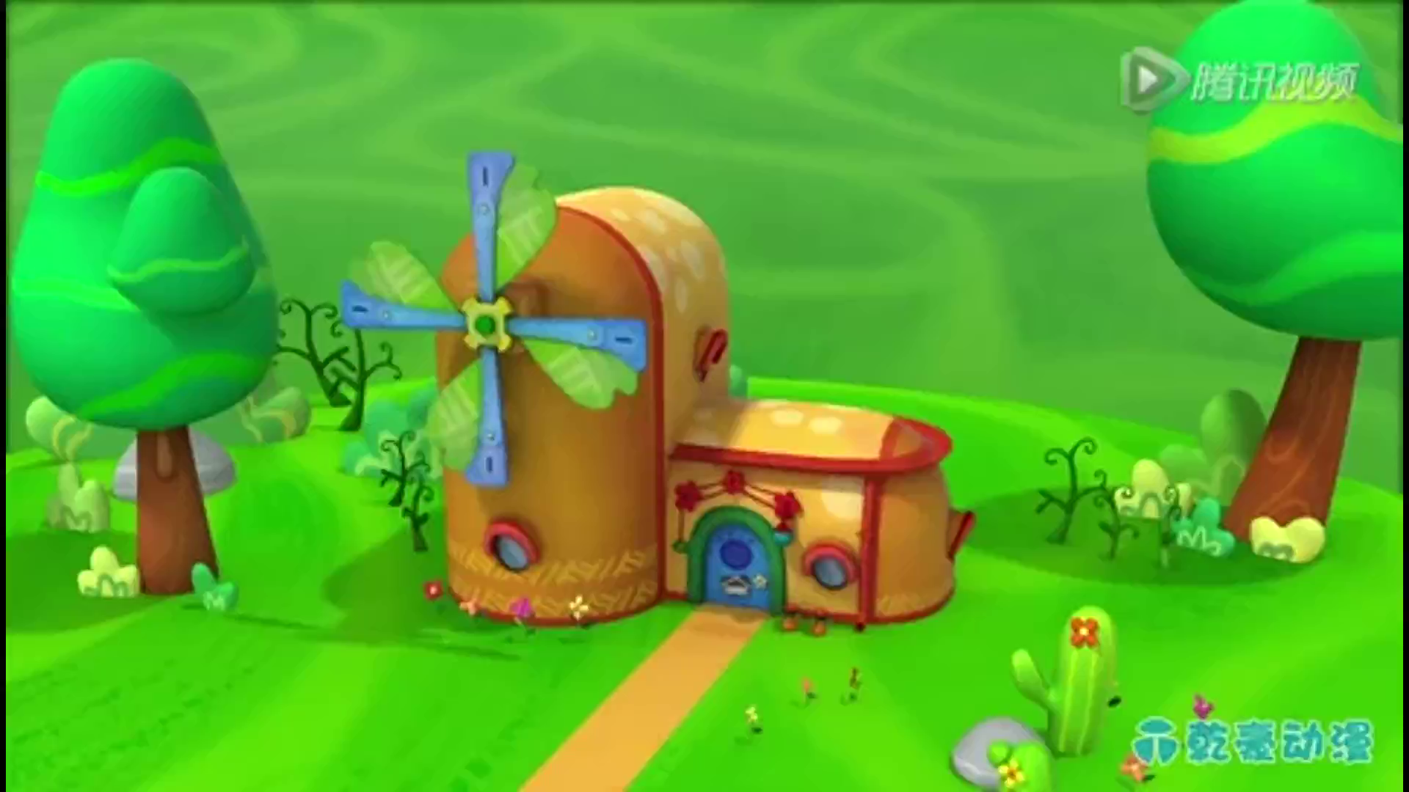
Carefully reading
Answer the questions:
What are distinctive features of different types of poems?
1. What’s the content about the nursery rhyme?
A
Hush, little baby, don’t say a word,
Papa’s gonna buy you a mockingbird.
If that mockingbird won’t sing,
Papa’s gonna buy you a diamond ring.
If that diamond ring turns to brass,
Papa’s gonna buy you a looking glass.
If that looking-glass gets broke,
Papa’s gonna buy you a billy-goat.
If that billy-goat won’t pull,
Papa’s gonna buy you a cart and bull.
Nursery rhyme(童谣)
father’s love
[ə:d]
2. What’s the baby’s father going to buy if the mirror gets broken?
A. a mocking bird B. a diamond ring
C. looking glass D. a billy-goat
[in]
[a:s]
3. Point out the rhyming words.
[əu]
见右边
[ul]
Notes:
摄影图：https://ibaotu.com/sucai/17918692.html
字体：https://ibaotu.com/Font/quanbu-0/fd3ec5bed9eb4d4c1c47a4d692aba263.html
音乐：https://ibaotu.com/sucai/17853928.html
素材：https://ibaotu.com/sucai/18340967.html

Slide 16
List
poem
B Mother
Hundreds of stars in the deep blue sky,
Hundreds of shells on the shore together,
Hundreds of birds that go singing by,
Hundreds of bees in the sunny weather,
Hundreds of dewdrops to greet the dawn,
Hundreds of bees in the purple clover,
Hundreds of butterflies on the lawn,
But only one mother the world over
Gorge Cooper
C life
Life can be good,
Life can be bad,
Life is mostly cheerful,
But sometimes sad.
Life can be dreams,
Life can be great thoughts;
Life can mean a person,
Sitting in court.
1. Translate the Poem C into Chinese.
What subject does Poem B write about?
生活可能美满，生活可能悲伤，
生活常常充满欢乐，但有时令人沮丧。
生活可能是梦想，生活可能是智囊，
生活可能是一个人坐在法庭之上。
Mother’s love
What’s the purpose of dewdrops in Poem B highlight?
2. What can life be full of ? How can we live happily ?
to extend greetings to the dawn
Life is full of a lot of uncertainty.
Life can be dirty,
Life can even be painful,
But life is what you make it,
So try to make it beautiful.
---By Langston Hughes
What do so many “hundreds of” in Poem B highlight?
Forms of poems | characteristics
List poems (B & C)
To strive for happiness
3. The original Poem C is missing a part, try to complete it.
① A flexible line length
② Repeated phrases
③ Not always have
rhyming words
Only one
Give students a few minutes to finish, then show the original poem to them.
Notes:
摄影图：https://ibaotu.com/sucai/17918692.html
字体：https://ibaotu.com/Font/quanbu-0/fd3ec5bed9eb4d4c1c47a4d692aba263.html
音乐：https://ibaotu.com/sucai/17853928.html
素材：https://ibaotu.com/sucai/18340967.html

Slide 17
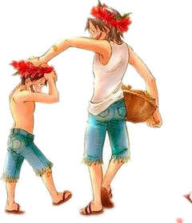
Cinquain
Analyze the characteristics of each line
one word (show the topoc)
Brother
Beautiful, athletic
Teasing, shouting, laughing
Friend and enemy too
Mine
two adjs (describe the character traits )
three verbs (describe actions )
four words (convey opinions or feelings )
one words (restate the topic) 结尾点题
Answer the questions:
1.What do the author mainly talk about?
Cinquain | characteristics
D
his /her brother
1. made up of 5 lines.
2. Do you think the writer like his/her brother? Please give a reason for your answer.
2.convey a strong picture.
Yes. The author shows his love to his/her brother in his words
3.convey a certain mood.
Notes:
摄影图：https://ibaotu.com/sucai/17918692.html
字体：https://ibaotu.com/Font/quanbu-0/fd3ec5bed9eb4d4c1c47a4d692ab
素材：https://ibaotu.com/sucai/18340967.html

Slide 18
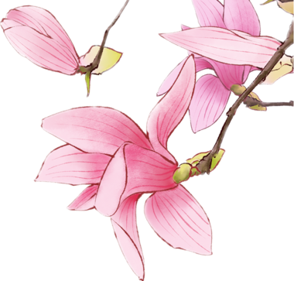
Haiku
1.Please mark out the 17 syllables of Haiku E.
E
A fallen blossom
Is coming back to the branch.
Look, a butterfly!
2.Choose the best answer
(5个音节)
（1）. What was it that fell on the branch?
A. a fallen blossom
B. a dead leaf
C. a delicate butterfly
D. a happy bird
（2）. Which sentence is true?
A. Haiku originates from Europe.
B. Haiku is popular with Japanese writers.
C. Haiku is a traditional form of Japanese
poetry with 17 rhythms.
D. Haiku show a clear picture and convey
a special feelings.
(7个音节)
(5个音节)
Haiku | characteristics
E
1. consist of 17syllables
2. a format of 3 lines
3. easy to write
4. to give a clear picture
5. to convey a special feeling
Notes:
摄影图：https://ibaotu.com/sucai/17918692.html
字体：https://ibaotu.com/Font/quanbu-0/fd3ec5bed9eb4d4c1c47a4d692aba263.html
音乐：https://ibaotu.com/sucai/17853928.html
素材：https://ibaotu.com/sucai/18340967.html

Slide 19
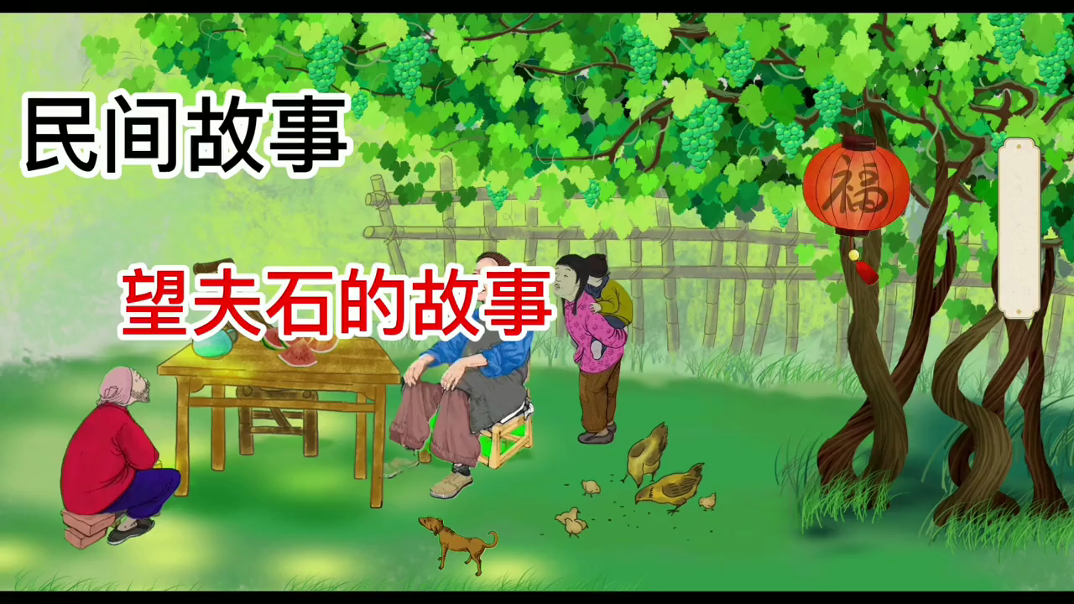
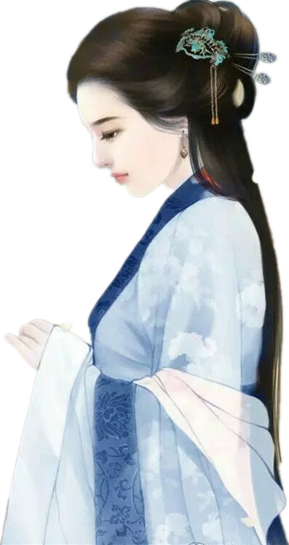
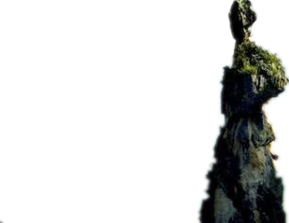
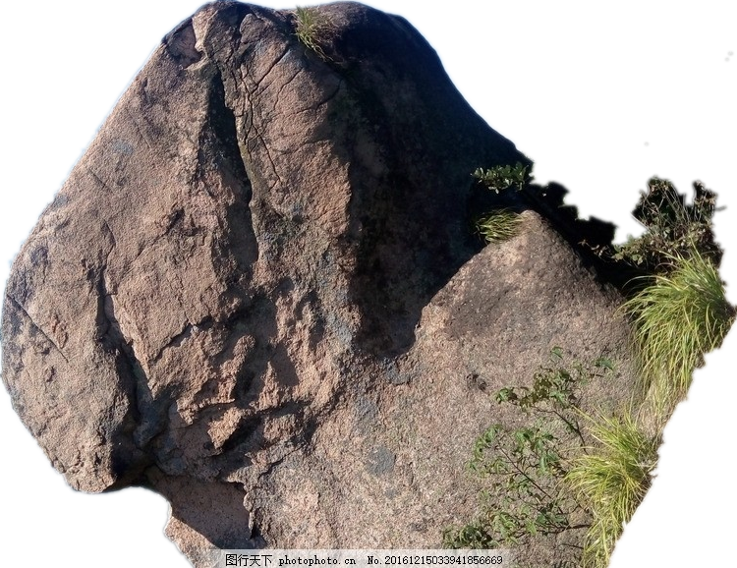
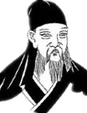
Poems from China
There is a beautiful legend.
望夫石
Translate the poem
into Chinese.
F
Where she awaits her husband
On and on the river flows
Never looking back
Transformed into stone
Day by day upon the mountain top
Wind and rain revolve.
Should the traveller return,
This stone would utter speech.
-----by Wang jian
望夫石
望夫处，江悠悠。
化为石，不回头。
山头日日风复雨，
行人归来石应语。
---王健
Notes:
摄影图：https://ibaotu.com/sucai/17918692.html
字体：https://ibaotu.com/Font/quanbu-0/fd3ec5bed9eb4d4c1c47a4d692aba263.html
音乐：https://ibaotu.com/sucai/17853928.html
素材：https://ibaotu.com/sucai/18340967.html

Slide 20
Poems from China
1. What are the feelings of the woman
from Poem F ?
望夫石
1. sorrow/sadness 2. loneliness
3. love 4. trust
F
Where she awaits her husband
On and on the river flows
Never looking back
Transformed into stone
Day by day upon the mountain top
Wind and rain revolve.
Should the traveller return,
This stone would utter speech.
-----by Wang jian
2. What rhetorical device (修辞手法)
is used in the sentence “This stone
would utter speech” ?
personification (拟人)
3. Which phrase in this poem conveys the
same meaning as “Wind and rain revolve” ?
Day by day
Notes:
摄影图：https://ibaotu.com/sucai/17918692.html
字体：https://ibaotu.com/Font/quanbu-0/fd3ec5bed9eb4d4c1c47a4d692aba263.html
音乐：https://ibaotu.com/sucai/17853928.html
素材：https://ibaotu.com/sucai/18340967.html

Slide 21
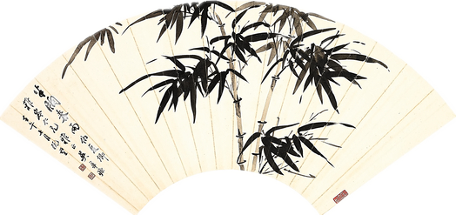
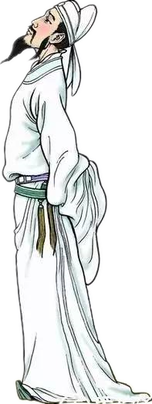
Activity 4: Post-reading
To put into practice what has been learned
（学以致用）
Which type do the poems belong to?

Slide 22




cinquain
list poem
2
I saw a fish-pond all on fire
I saw a fish-pond all on fire,
I saw a house bow to a squire,
I saw a person twelve-feet high,
I saw a cottage in the sky,
I saw a balloon made of lead,
I saw a coffin drop down dead,
I saw two sparrows run a race,
I saw two horses making lace,
I saw g girl just like a cat,
I saw a kitten wear a hat,
I saw a man who saw these too,
And said though strange they all were true.
1
Summer
Sleepy, salty
Drying, drooping, dreading
Week in, week out
Endless
Notes:
摄影图：https://ibaotu.com/sucai/17918692.html
字体：https://ibaotu.com/Font/quanbu-0/fd3ec5bed9eb4d4c1c47a4d692aba263.html
音乐：https://ibaotu.com/sucai/17853928.html
素材：https://ibaotu.com/sucai/18340967.html

Slide 23
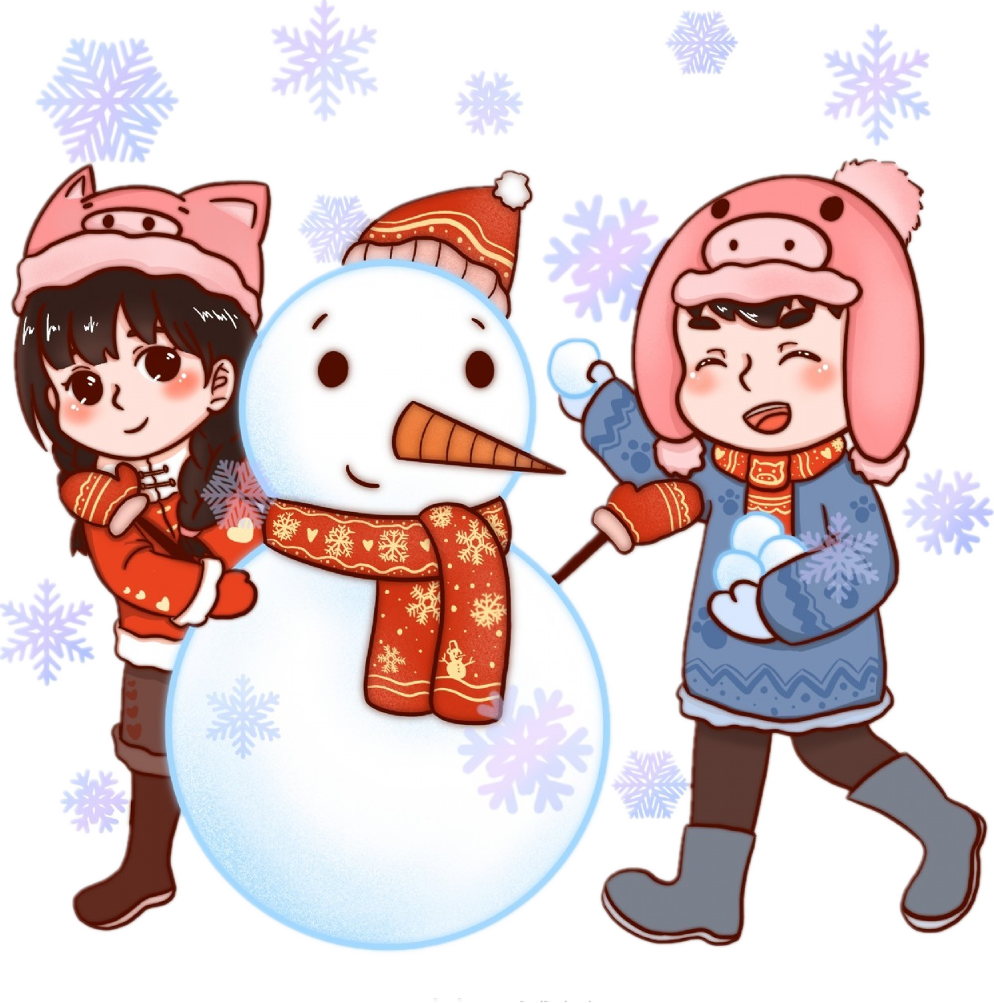
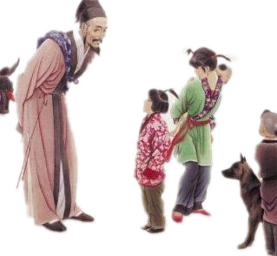
Haiku
3
Snow having melted,
The whole village is brimful
Of happy children.
(by Issa)
Tang poem
4
HOME-COMING
Old, I return to the homeland while young,
Thinner has grown my hair, though I speak the same tongue.
My children, whom I meet, do not know am I,
“Where are you from, dear sir?” they ask with beaming eyes.
(He Zhizhang)
Notes:
摄影图：https://ibaotu.com/sucai/17918692.html
字体：https://ibaotu.com/Font/quanbu-0/fd3ec5bed9eb4d4c1c47a4d692aba263.html
音乐：https://ibaotu.com/sucai/17853928.html
素材：https://ibaotu.com/sucai/18340967.html

Slide 24

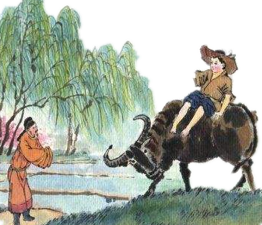
5
Nursery Rhyme
睡吧睡吧胖娃娃，
爸爸打猎顶呱呱；
剩下一张兔子皮，
回家好裹胖娃娃。
Bye, baby bunting,
Daddy’s gone a-hunting,
Gone to get a rabbit skin
To wrap the baby bunting in.
6
Tang poem---QING MING
A drizzling rain falls like tears on the Mourning Day;
The mourner's heart is going to break on his way.
Where can a wineshop be found to drown his sad hours?
A cowherd points to a cot 'mid apicot flowers.
(Du Mu)
Notes:
摄影图：https://ibaotu.com/sucai/17918692.html
字体：https://ibaotu.com/Font/quanbu-0/fd3ec5bed9eb4d4c1c47a4d692aba263.html
音乐：https://ibaotu.com/sucai/17853928.html
素材：https://ibaotu.com/sucai/18340967.html

Slide 25
Activity 5 summary
语法填空（根据课文内容和语法规则完成短文）
There are a variety of reasons for people to write poems. In the text, five kinds of poems 1. (introduce). Some poems convey some certain emotions 2. the readers, such as well-being and sorrow; Some leave a deep 3. (impress) on the readers. What’s 4. , we learn about some characteristics of poetry through the text. Nursery rhymes seem 5. （contradict) and sometimes senseless, but they can help children learn about language. List poems have a flexible line length and 6. （repeat） phrases. Cinquain, 7. (make) up of five lines, conveys a strong picture or a certain mood . Haiku is a Japanese form of poetry 8. (consist ) of 17 syllables with only three lines. It isn’t a 9. (tradition) English, but English writers are attracted to it. English speakers appreciate Tang poetry as well. With so many different forms of poetry 10______ （choose) from, students may eventually feel like composing poems of their own.
are introduced
to
impression
more
contradictory
repeated
made
consisting
traditional
to choose
Notes:
摄影图：https://ibaotu.com/sucai/17918692.html
字体：https://ibaotu.com/Font/quanbu-0/fd3ec5bed9eb4d4c1c47a4d692aba263.html
音乐：https://ibaotu.com/sucai/17853928.html
素材：https://ibaotu.com/sucai/18340967.html

Slide 26
Activity 6 核心词汇
【教材原句p.50 】Compared with other forms of literature such as the novel, drama, and the short story, what are the characteristics of poetry?
【核心词汇 】
compare…with…表示 “ 把……与……相比（同类相比）”
compare…to…表示“ 把……比做……（异类相比，比喻）”
compared with/to 与……相比,位于句首，多在句中作状语。
【句子翻译】
1. 我的书法不能与我父亲的相比。
2. 莎士比亚把人世比做舞台。
3. 与杭州相比上海大。
My handwriting cannot be compared with my father’s.
Shakespeare compared the world to a stage.
Compared with/to Hangzhou, Shanghai is large.

Slide 27
Activity 6 核心词汇
【教材原句p.50 】There are various reasons why people compose poetry.
【核心词汇 】compose vt. 构成；写作；使平静；排…的版；
vi. 组成;作曲;排字
常用短语：
compose oneself （to do sth.) 镇静下来; 冷静下来；
be composed of 由…组成; compose mail 写邮件 ; 撰写邮件
【句子翻译】
1. 写一篇文章来表达你在这个话题上的观点。。
2. 水由氢和氧组成。。
3. 当迷失在森林中时，他迫使自己冷静下来想出一个好办法。
Compose an essay to express your views on this topic.
Water is composed of hydrogen and oxygen.
He tried to compose himself to come up with a good idea when lost in forest.

Slide 28
Activity 6 核心词汇
【教材原句p.50 】Poets use many different forms of poetry to express themselves.
【核心词汇 】
express vt. 表示；表露；表达（思想感情） adj. 特快的，快递的
expression n.表情
常用短语：
express oneself 表达自己的想法 express appreciation/gratitude 表示感谢
express your emotions 表达自己的情绪
beyond expression 无法表达；无法形容 express train 特快列车
【句子翻译】
1. 我对他佩服得无法表达。
2.他觉得很难用英语来表达自己的想法。
3.这是一趟开往的上海的特快专列。
I admire him more than I can express.
He finds it very hard to express himself in English.
This is an express train for Shanghai.

Slide 29
Activity 6 核心词汇
【教材原句p.50 】The language of these rhymes，like Poem A，is to the point but has a storyline.
【核心词汇 】to the point 切题的；中肯的
常用短语：
off the point 跑题
come/get straight to the point 直奔主题/ 开门见山
【句子翻译】
1. 他的评论总是切中要害。
2.Noise is coming to the point where we can’t put up with it.
3.我希望你的发言直接了当。
His comment is always to the point.
噪音快到我们无法忍受的地步。
I hope your remarks come to the point.

Slide 30
Activity 6 核心词汇
【教材原句p.50 】The poems may not make sense and even seem contradictory...
【核心词汇 】make sense 讲得通；有意义；有道理,合乎情理
常用短语：
make sense of 明白；弄懂……的意思 in a sense 在某种意义上
in no sense 决不（位于句首时，句子用倒装语序）
【句子翻译】
1.他们试图明白这个乞丐在说什么。
2.这部电影对学生来说很有意义。
3.我们绝不允许这样的事情发生在学校。
They tried to make sense of what the beggar said.
The movie named “Changjinhu”makes sense to our students..
In no sense should such a thing be allowed to happen in our school.

Slide 31
Activity 6 核心词汇
【教材原句p.50 】Some rhyme(like B and C) while others do not.
【核心词汇 】while 然而（表示对比）
while常用意思
① 当……时候 ②然而 ③虽然，尽管 ④ 趁着……的时候 ⑤ 只要
【句子翻译】
1. 只要有空气和水,就会有生命。
2. 他在玩电脑而弟弟在写作业。
3. 虽然我能理解你说的话,但是我不能同意你.。
4. 趁热打铁。
There will be a life while there is water and air．
He is playing computer while his brother is doing his homework．
While I see what you said, I can't agree with you．
Strik while the iron is hot.

Slide 32
Activity 6 核心词汇
【教材原句p.51 】Another simple form of poem that amateurs can easily write is the cinquain, which is made up of five lines.
【核心词汇 】be made up of = be composed of = consist of 由……组成/ 构成
注意：① be made of 由……加工而成，可以看出原材料，但是通常已经改变形态了。
② consist of 无被动语态
【句子翻译】
1. 这个书架是由木头制成的。
2. "书店"一词是由"书"及"店"两字组成。。
3. 这是一个由46个学生组成的班级。
The bookshelf is made of wood.
The word "bookstore" is made up of the two words "book" and "store".
This is a class consisting of 46 students.

Slide 33

Activity 6 Homework
1. Review the characteristics of each kind of poem
2. Write a summary of about 60 words based on the text.

