Slide 1

感恩遇见，相互成就，本课件资料仅供您个人参考、教学使用，严禁自行在网络传播，违者依知识产权法追究法律责任。
更多教学资源请关注
公众号：溯恩高中英语
知识产权声明

Slide 2
Unit5 Working the Land
Discover useful structures s subject clauseubject clause
人教版 选择性必修 第一册

Slide 3

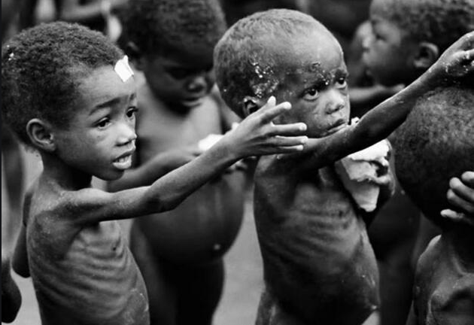
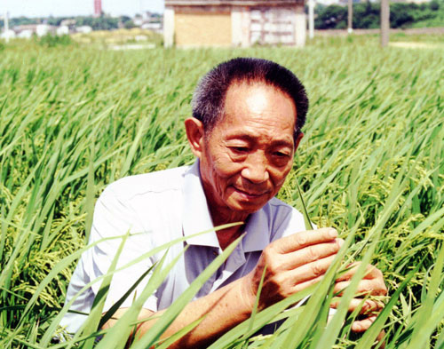
Lead-in
Lead in
Circle the simple subject in each sentence.
Time flies.
The boy didn’t attend school today.
You are a student.
To find the missing book is not easy.
Smoking is bad for you.
Driving too fast is dangerous.
Eat your dinner with a spoon.
My favorite older brother, who just started tenth grade, rides his bike to school.
More than 800 million people go to bed hungry every day.
His lifelong pursuit is to keep all the people away from hunger.
He considers himself a farmer because he continually works the land in his research.
Yuan’s innovation has helped to feed more people.

Slide 4
Lead-in
Underline the subject in each sentence.
Who will take part in the meeting has not been decided.
How he became a great scientist is known to us all.
What she said is true.
That he is still alive is a good news to us.
Where she is from is unknown.
We can see from these sentences that a sentence serves as subject, so we call it Subject Clause.

Slide 5
1. (P50)However, _________ concerned him most was _________ farmers
often had poor harvests and sometimes even had a serious shortage of food
to eat.
2. (P50)However, _________it was possible to develop a hybrid of
self-pollinating plants such as rice was a matter of great debate.
3. (P50)Today, _________ is estimated _________about
60 percent of domestic rice consumption in China is comprised of crops
generated from Yuan's hybrid strains, and his strains have allowed China's
farmers to produce around 200 million tons of rice per year.
4. (P51)_________impresses people most about YLp is his ongoing ability
to fulfil his dreams.
感知以下课文原句
what
that
whether
it
that
what

Slide 6
Feel the sentences in red.
1.However，what concerned him most was that farmers often had
poor harvests and sometimes even had a serious shortage of food to eat.
2.However，whether it was possible to develop a hybrid of
self- bollinating plants such as rice was a matter of great debate.
3.Today，it is estimated that about 60 per cent of domestic rice
consumption in China is comprised of crops generated from Yuan’s
hybrid strains，...
4.What impresses people most about Yuan Longping is his ongoing ability
to fulfill his dreams.
1. 以上加颜色部分在句中作 。
2. 1句和4句中的what在从句中作 。
3. 2句中的whether意为“ ”。
4. 3句中的it是 ，真正的主语是后面的 。
主语
主语
是否
形式主语
that引导的从句

Slide 7

Conjunctions
That the earth moves around the sun is well known.
Whether he will come or not is not known yet.
Who will be sent there has not been decided.
What you need is more practice.
Which one is the best is not clear.
When they will come hasn't been made public.
Where he has gone is a question.
Why there is gravity is hard to understand.
How he can earn a living in Britain remains a big problem.

Slide 8
Compare and Discover 1
1.That he will pass the exam is certain.
2.Whether he will pass the exam is uncertain.
that _______成分，____意义，
______省略。
whether _____成分，____意义，
译为_____。
不做
无
不能
不做
有
是否

Slide 9
Compare and Discover 2
1.Who will take part in the meeting has not been decided.
2. What she said is true.
3. Which book I shall choose hasn’t been decided.
主语
who在主语从句中充当 ______,
译为 ______。
what在主语从句中充当 ______,
译为 ______。
which在主语从句中充当 ______,
译为 ______。
谁
宾语
东西
定语
哪一

Slide 10
Compare and Discover 3
1. When they will start is not known yet.
2. Where she is from is unknown.
3. Why he was late is not important now.
4. How he became a great scientist is known to us all.
when在主语从句中充当 _______,
译为 ______。
where在主语从句中充当 _______,译为 ______。
why在主语从句中充当 _______,
译为 _______。
how在主语从句中充当 _______,
译为 _______。
状语
何时
状语
何地
状语
为什么
状语
怎样

Slide 11
Compare and Discover 4
1.Whoever leaves the room
last ought to turn off the lights.
whoever在主语从句中充当 ______, 译为 ______。
whatever 在主语从句中充当 ______, 译为 ______。
whichever在主语从句中充当 ______, 译为 ______。
主语
无论谁
2.Whatever he did was right.
主语
无论什么
3.Whichever of you comes in
will receive a prize.
无论哪个
主语

Slide 12
Summary
Usage of the Conjunctions
功能 | 连接词
不作成分 | that, whether
作主、宾、表、 | what, who, whom, wh+ever
作定语 | which, whose,
作状语 | when, where, why, how

Slide 13
Fill the blanks and Discover
1. is strange that the man should have stuck to
his silly ideas.
2.It is a pity we won't be able to go to the south
to spend our summer vacation.
3. occurred to me that I had left keys behind .
4. is said that he has gone to Shanghai.
(=He is said to have gone to Shanghai.)
5.It is known to all gunpowder was first invented by the Chinese.
It
that
It
It
that

Slide 14
句型 | 说明
It＋系动词＋形容词＋主语从句 | 常用于此句型的形容词有important，(un)likely，possible，necessary，natural，wrong等。
It＋系动词＋名词＋主语从句 | 常用于此句型的名词有a fact，an idea，an honour，a wonder，no wonder，a pity等。
It＋系动词＋过去分词＋主语从句 | 常用于此句型的过去分词有known，proved，said，decided，suggested，thought等。
It＋不及物动词＋主语从句 | 常用于此句型的动词有appear，happen，seem，occur，matter等。

Slide 15
It is very important that a student (should) learn English well.
学生学好英语很重要。
It is suggested that the meeting (should) be put off.
有人建议会议延期召开。
It depends on the weather whether they are going shopping today.
他们今天是否去购物还得看天气情况。
For example，it can be proved that China has more people than any other country in the world.
举例来说，中国人口比世界上其他任何国家的人口都多，这是可以得到证实的。
It is no wonder that your students have made such great progress.
难怪你的学生们进步这么大。

Slide 16
Practice1
Match the sentence parts, and then translate the completed sentences into Chinese. Pay attention to how the subjects are introduced differently.
A. What worries many
people
B. That the lifestyle is
slower and healthier
C. How we can find a
suitable solution to
produce sufficient food
while keeping the
environment safe
D. When these wheat
farmers will join this
pilot experiment
E. It amazed all of us that
1. ___ remains an unanswered
question.
D
C
2. ___ is an important topic for us
to research.
A
3. ___ is that these chemicals may
even cause cancer.
E
4. ___ these vegetables can even be
planted without any soil
through this new technology.
5. ___ is the reason why some
people prefer to live in the
country rather than in the city.
B

Slide 17
Practice2
Read the passage and underline all the subject clauses.
Grandma has been complaining about the vegetables sold in the supermarket, which have been grown using chemical fertilisers. That they look beautiful on the outside is obvious. However, what she is unhappy about is the lower nutritional value and reduced flavour. Now that both of my grandparents have retired from their jobs in the city, how they are going to spend their retirement is an important decision for them. Whether they can live a healthy life is the first thing they are considering. So they have made up their minds to move to the countryside, where they can live a green life.
1
2
3
4
P53 3

Slide 18
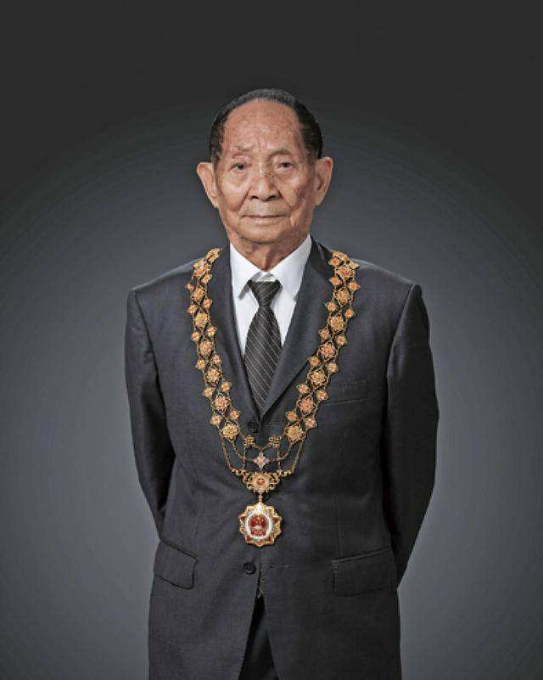
What qualities do you think make a person like Yuan Longping so successful?
Practice3
Work in groups. Have a discussion and prepare a presentation. The following points and expressions may help you.
 his/her determination to tackle the crisis of …
 his/her intense effort to overcome …
 his/her dream to develop …
 his/her love and care for …
 he/she succeeded in …
 he/she never gave up …
 he/she is devoted to …
 What impresses me most is that …
 What makes him/her a great … is that …
 It is important that …
 Whether … depends on …
 That … is his/her most important quality.

Slide 19
Possible version
When talking about Yuan Longping, the famous scientist in China, what impresses me most is that his determination to overcome the enormous difficulties troubling most people at that time. It is his most important quality that he is devoted to his career. Besides, that he never gives up learning and strives to realize his dreams deeply touches me. In my opinion, how he loves and cares for farmers drives him to go on and make great achievements.

