Slide 1


感恩遇见，相互成就，本课件资料仅供您个人参考、教学使用，严禁自行在网络传播，违者依知识产权法追究法律责任。
更多教学资源请关注
公众号：溯恩高中英语
知识产权声明

Slide 2
U5 Working the Land
Reading and Thinking
A Pioneer for All People
by Lily

Slide 3
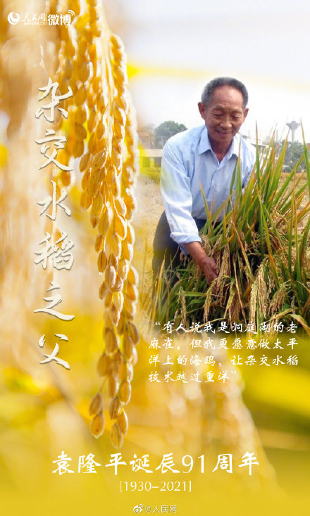
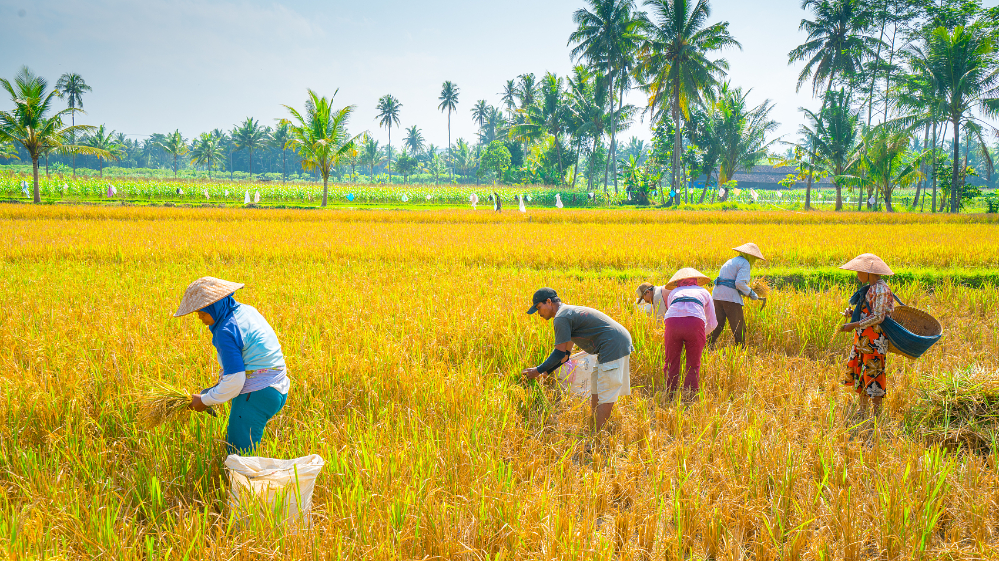
Whom would the season remind you of?
稻香弥漫，常忆袁公。

Slide 4
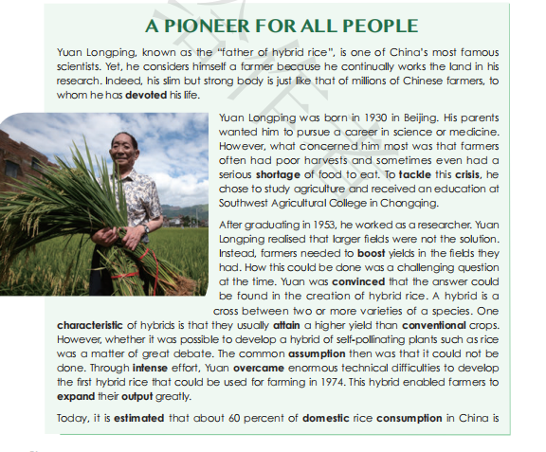
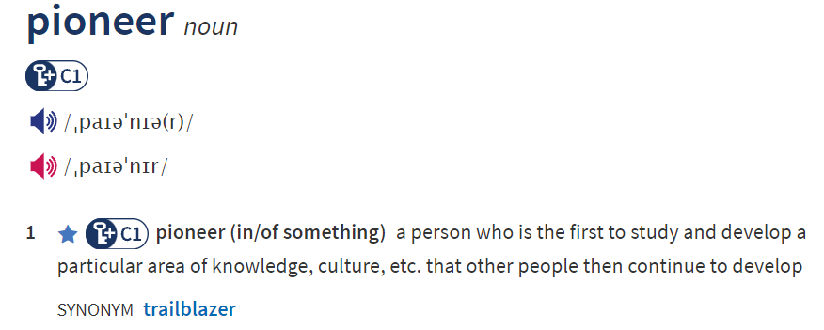
an article from a column about people in a magazine
If you were the editor, what will you write about this pioneer?

Slide 5
Possible Aspects
Q1: Who is the pioneer?
Q2: What does he do?
Q3: Why does he do so?
Q4: How did he do...?
Q5: What’ s the significance of his innovation?
Q6: What kind of person is he?

Slide 6
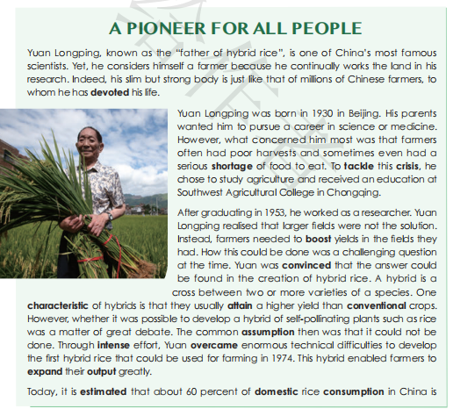
“father of hybrid rice”
“a famous scientist”
contrast
a farmer
slim but strong
continually work the land

Slide 7
Q: Why did YLP do these?
external motivation
crisis
a situation where there are a lot of problems must be dealt with
internal motivation
His concern and love about the country and the people before anything else.
His parents wanted him to pursue..... However,what concerned him most... he chose to...

Slide 8
Q: What did YLP do and How did he do it?
work as a researcher
realize that...
be convinced that
intense effort
overcome enormous technical difficulties
invisible factors
unconventional ideas
innovative spirit
unconventional
determination

Slide 9
This hybrid enabled farmers to expand their output greatly. (para3)
Q: What’s the significance of LP's contributions?
Today, it is estimated that about 60 percent of domestic rice consumption in China is comprised of crops generated from Yuan’s hybrid strains, and his strains have allowed China’s farmers to produce around 200 million tons of rice per year. Yuan’s innovation has helped feed not just China, but many other countries that depend on rice as well, such as India and Vietnam. Because of his invaluable contributions, Yuan Long ping has received numerous awards both in China and abroad.
it is estimated
60 percent
domestic
200 million tons
per year
not just
but many
such as
Because of
invaluable
extremely useful and valuable
Q: What’s the writer’s tone in showing LP's contributions?
objective

Slide 10
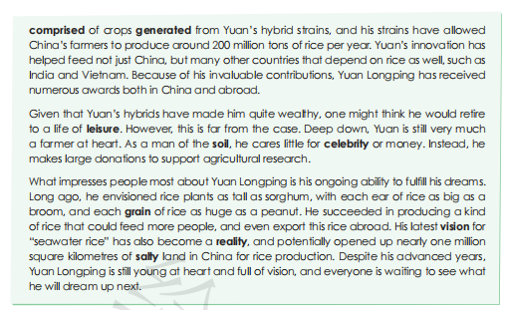
Q: What kind of person is the pioneer, YLP?
numerous awards and quite wealthy
stick to his original aims
retire to a life of leisure
a farmer at heart
a man of the soil
care little for celebrity or money
Yet, he considers him a farmer...because he continually works the land ...Indeed, ...is just like that of millions of Chinese farmers, to whom he has devoted his life. (para1)

Slide 11
What kind of person is the Pioneer, YLP?
persistent in pursuing his dream
What impresses people most about Yuan Long ping is his ongoing ability to fulfill his dreams. Long ago, he envisioned rice plants as tall as sorghum, with each ear of rice as big as a broom, and each grain of rice as huge as a peanut. He succeeded in producing a kind of rice that could feed more people at home and abroad. His latest vision for “seawater rice” has also become a reality, and potentially opened up nearly one million square kilometers of salty land in China for rice production. Despite his advanced years, Yuan Long ping is still young at heart and full of vision, and everyone is waiting to see what he will dream up next.
ongoing ability to fulfill his dreams.
a man with young heart and vision

Slide 12
What kind of person is the Pioneer, YLP?
What kind of person is a Pioneer?
knowledge: the basis for fulfill dreams
motivation: concern for the land and people
inspiration: the possibility for innovation
efforts: to put dream into practice
persistence: to stick to the dream
vision: to plan for the future
young heart and challenging spirit: to keep up
a man with

Slide 13
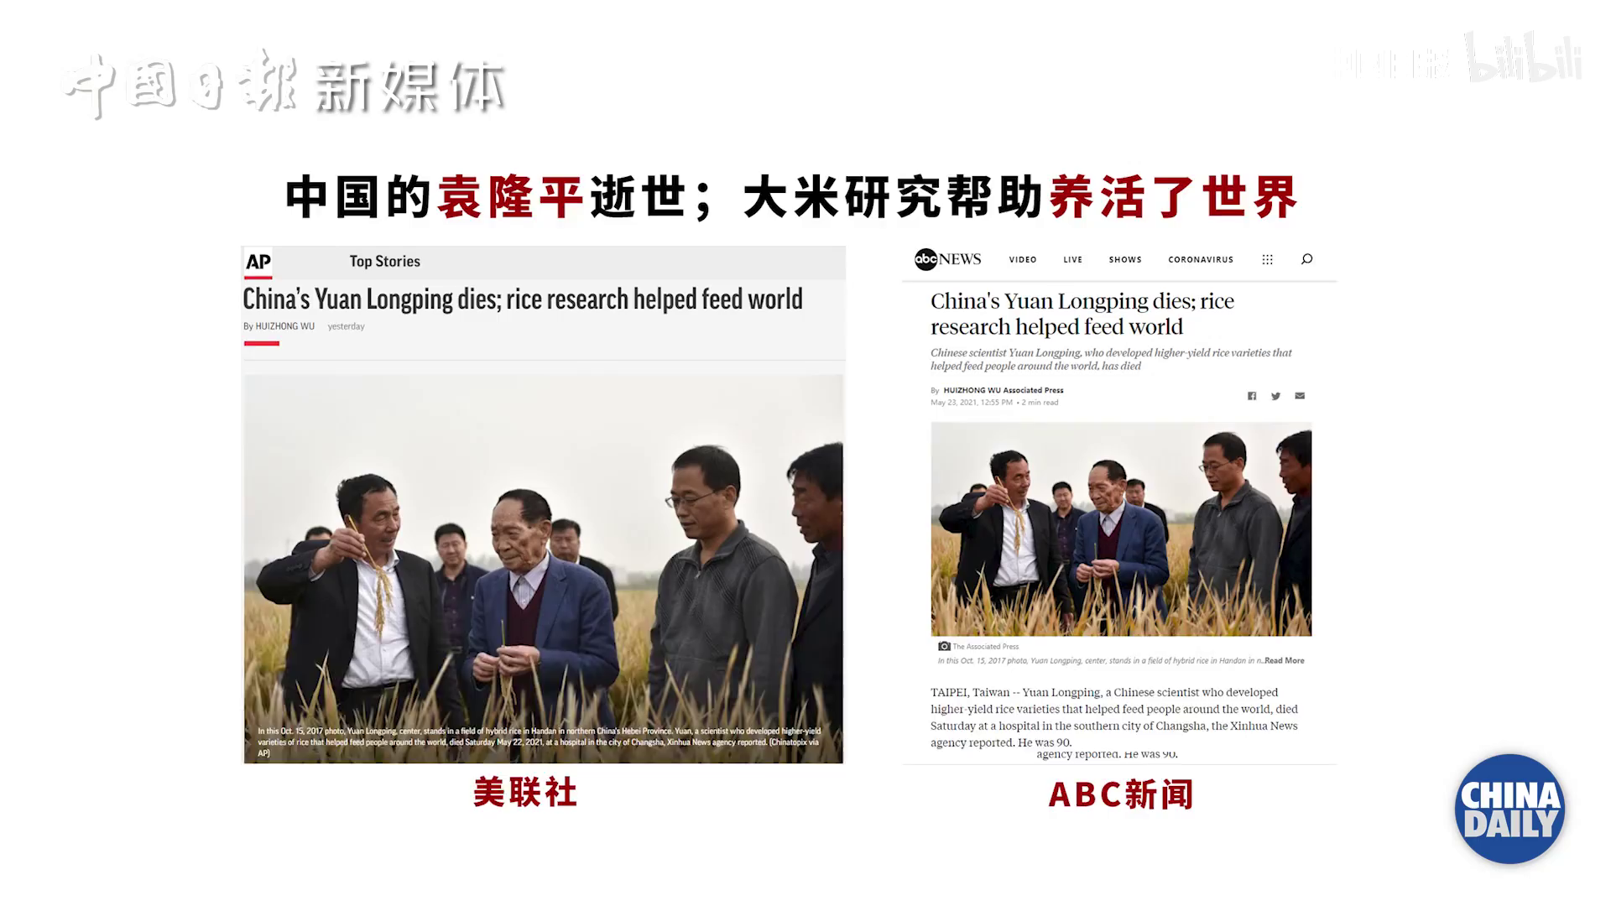
A Pioneer for All People
LP's contributions feed people and prevent human from hunger.
LP's spirit is inspiring for all people.

Slide 14
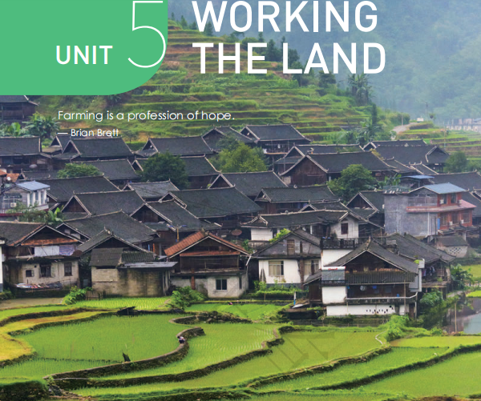
Would you choose to work the land?
What’s your lifelong pursuit?
What’s the relationship between the lifelong pursuit and working the land?
D
iscussion
My lifelong pursuit is to keep
all the people away from hunger.
----Yuan Long ping
working the land
lifelong pursuit

Slide 15
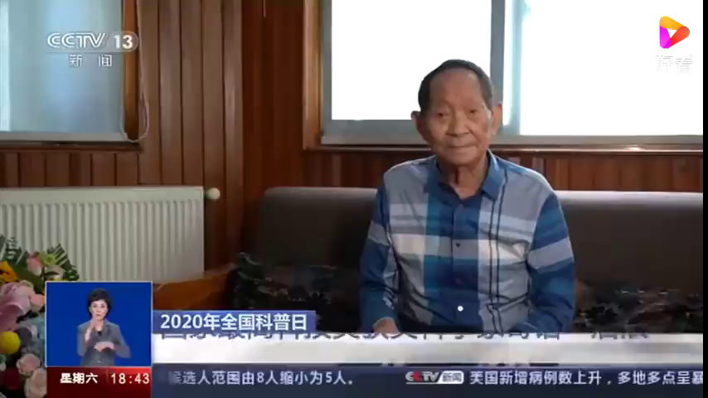
Chance favors the prepared mind.
What can we follow this pioneer?

Slide 16
THANKS
by Lily

