Slide 1

感恩遇见，相互成就，本课件资料仅供您个人参考、教学使用，严禁自行在网络传播，违者依知识产权法追究法律责任。
更多教学资源请关注
公众号：溯恩高中英语
知识产权声明

Slide 2

John Snow Defeats King Cholera
汤杰礼名师工作室 庞子凌
Unit 1 Science and scientists

Slide 3

Memory Test
watch a clip and write down the names as many as you can

Slide 4

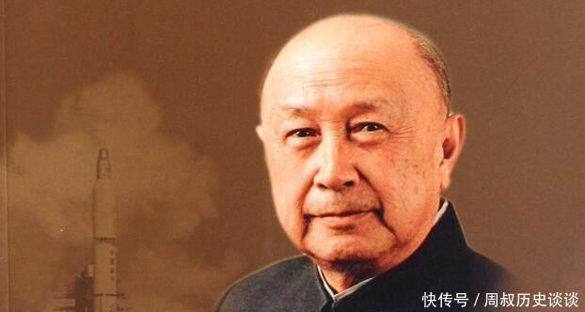
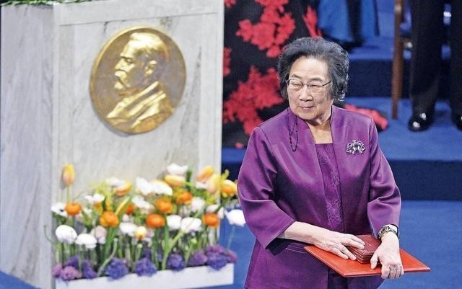
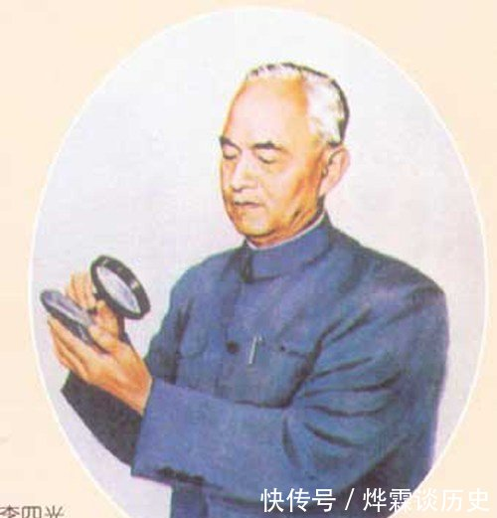

Memory Test
Warming-up
agriculture
space engineering
medicine
science
Latin: “knowledge”
geology
biology
-ology: “the study of”

Slide 5
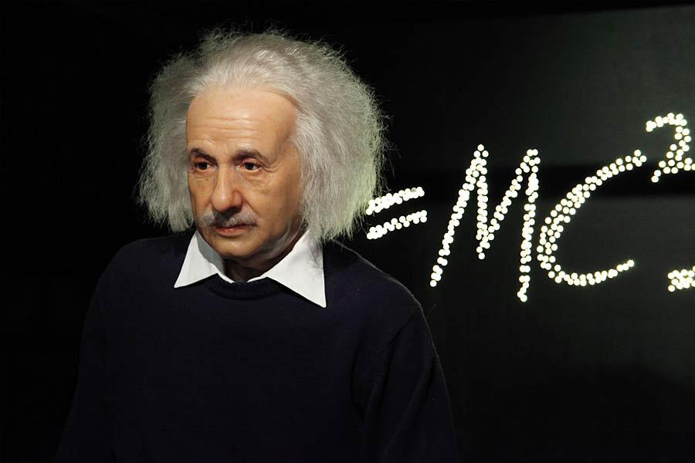
What is science?
Warming-up
“To raise new questions, new possibilities, to regard old problems from a new angle requires creative imagination and marks real advance in science.”--Albert Einstein
Science can be defined as the process of observing and __________ the world around us. Scientists aim to get __________ through a deciplined set of steps called scientific method.
questioning
knowledge
scientific method

Slide 6

Reading
stages of scientific research
analyse the results
ask a question
draw a conclusion
Order ?
collect data
find a problem
Pairwork
find supporting evidence
think of a method

Slide 7
Reading
Reading for prediction
John Snow Defeats “King Cholera”
According to the title, the story is going to tell us information about...
who John Snow is
what cholera is
how to defeat

Slide 8
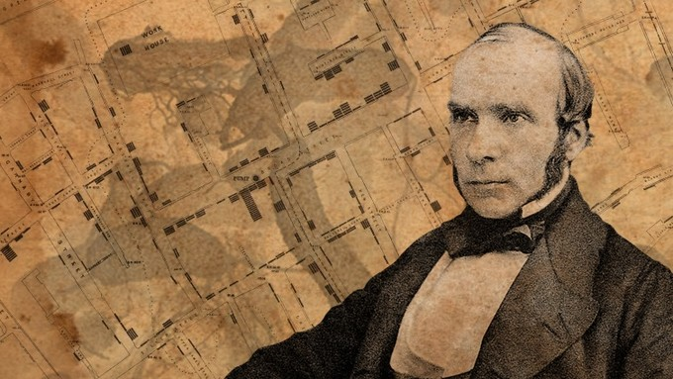
Reading
Reading for information
☑a British doctor
☑In time, he rose to become a famous doctor and even attended to Queen Victoria when she gave birth.
John Snow
expert/experienced/knowledgeable
☑The father of modern epidemiology

Slide 9
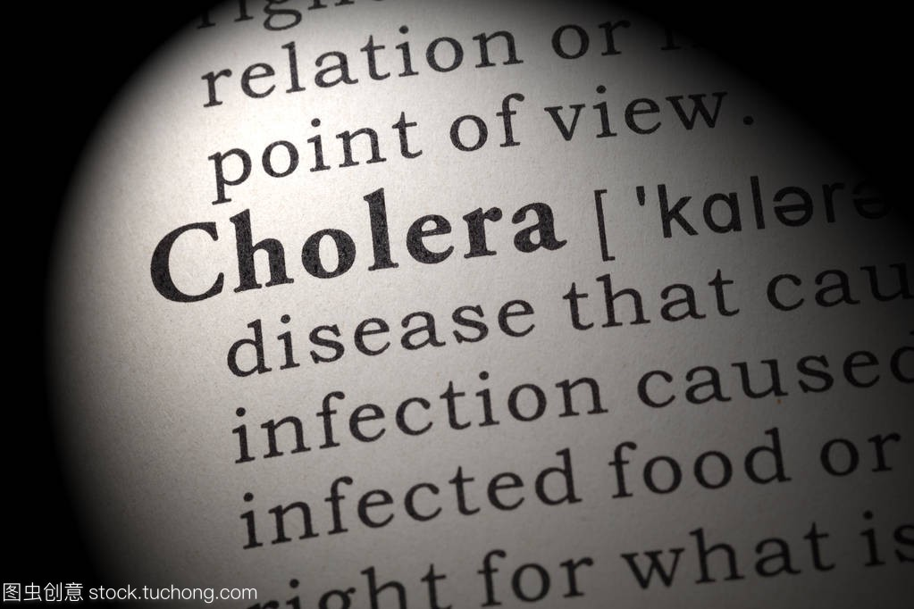
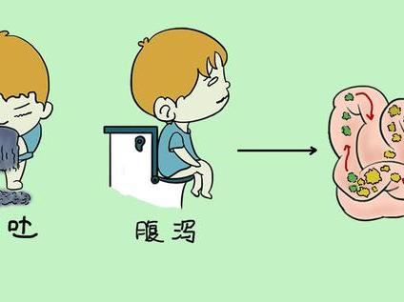
Reading
Reading for information
It used to be one of the most feared
diseases in the world.
deadly
uncontrollable
“King”
☑ cause severe diarrhoea, dehydration, and even death.
☑...no one knows how to prevent or treat cholera
It is still a problem. Fortunately, we know how to prevent it.
source?

Slide 10
Reading
Reading for information
was able to announce that...
7. draw a conclusion
a case of death away from Broad Street.
6. Find supporting evidence
John Snow suspected the water was to blame
5. analyse results
many death near the pump
some households no death
4. collect data
...began marking on the map
3. Think of a method
Why was cholera severer in 2 streets?
2. Ask a question
John Snow’s
hypothesis(猜想)
How does cholera spread?
1. Find a problem

Slide 11
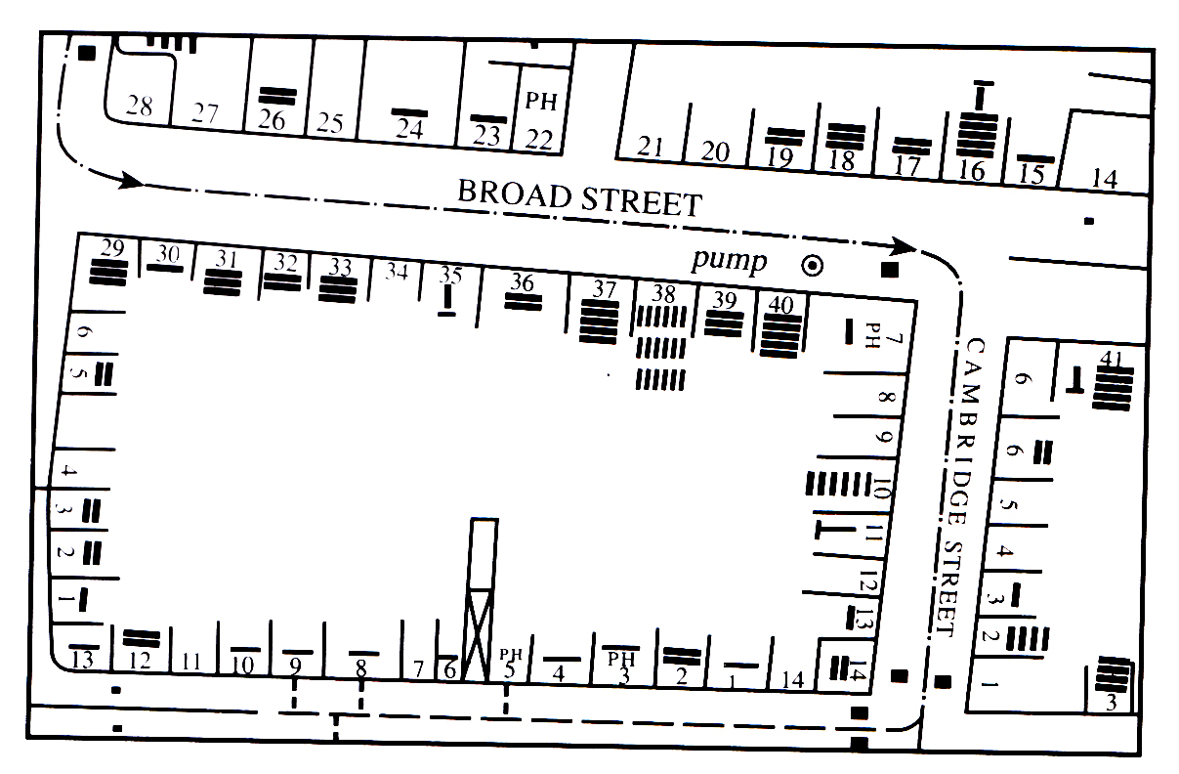
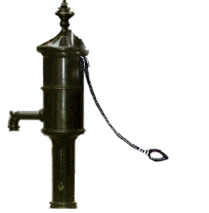

Para 4
water pump
beer pub
7
Note: ——1death PH: public house 30,31,…: numbers of houses

Slide 12
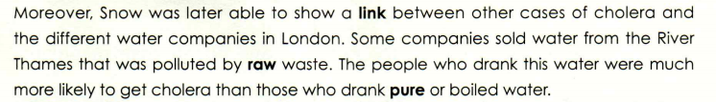

Reading for thinking
not purified
After the remove of the handle, the spread of cholera in this area was stopped.
How about other parts in London?
What measures might they take?
large in degree
☑The government might aske all the water companies to
provide clean water.
☑People might be educated not to drink raw water
but pure or boiled water.

Slide 13
Groupwork
Reading for thinking
What made John Snow succeed in preventing “King cholera” ? ( try to find supporting details from the text)
1.
2.
3.
4.
...

Slide 14
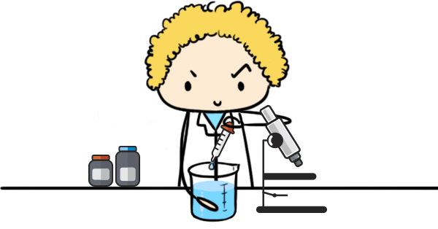
Reading for thinking
expert
As a young doctor, John Snow became frustrated.
In time, he rose to become a famous doctor.
determined
He never lost his desire to cholera once and for all.
careful/rigorous(严谨的)
He suspected.... He was able to announce...
curious/questioning mind
He discovered that in two particular streets...find out why
creative

Slide 15

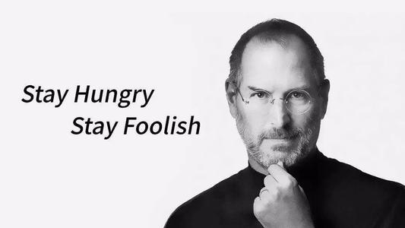
Reading for thinking
☑ The scientist is not a person who gives the right answers but the
one who asks the right questions.
☑ Science is a way of thinking much more than
it is a body of knowledge.
scientific
success
☑ The science of today is the technology of tomorrow.
scientific methods
scientific spirits

Slide 16
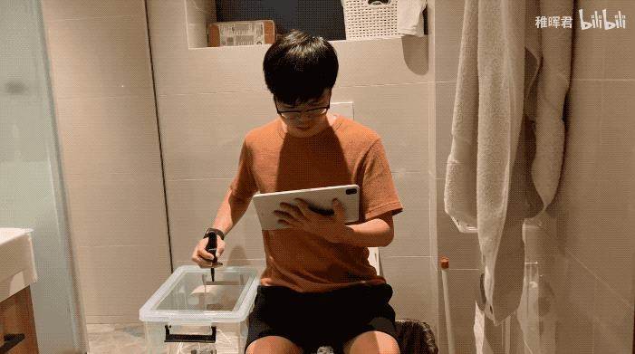
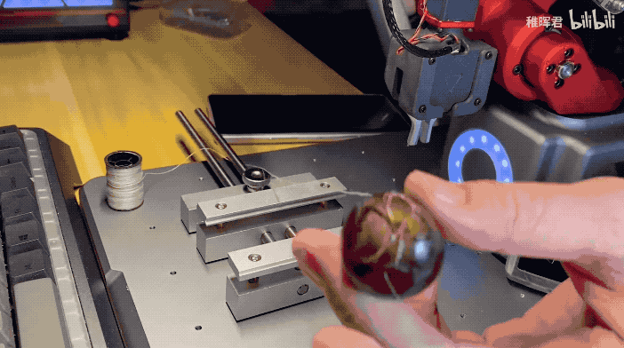
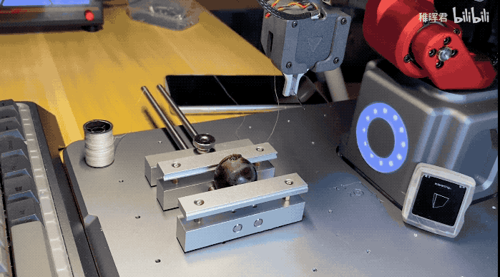
Your stage,
Your challenge.
华为“天才少年 ”独造神奇机器臂，远程操控缝合葡萄皮

Slide 17
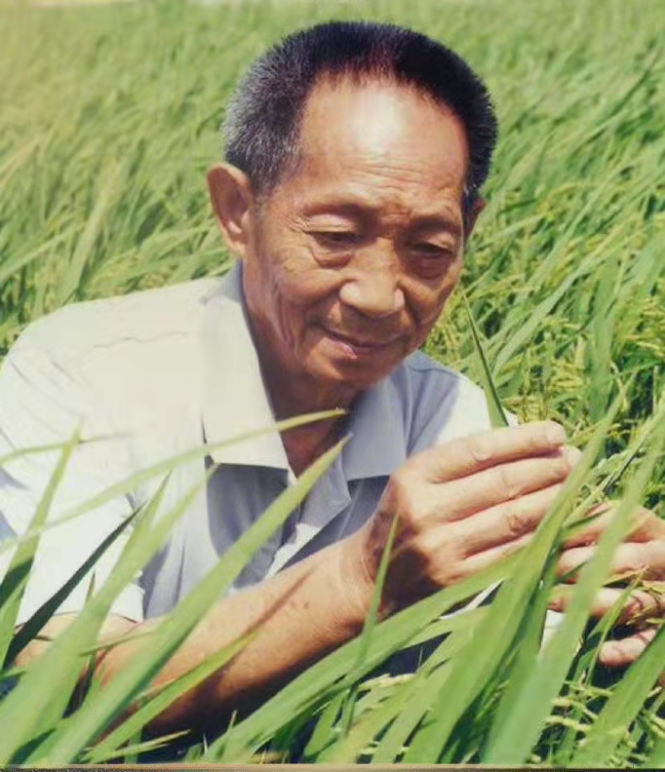
Homework
1. Decide on one scientist that you
admire most
2. Find out one of his most important
achievements
3. Write down the story
①You’d better give it a title.
②If possible,attatch some pictures.
Father of hybrid rice

Slide 18
Thank you !
汤杰礼名师工作室 庞子凌
Unit 1 Science and scientists

