Slide 1

感恩遇见，相互成就，本课件资料仅供您个人参考、教学使用，严禁自行在网络传播，违者依知识产权法追究法律责任。
更多教学资源请关注
公众号：溯恩高中英语
知识产权声明

Slide 2
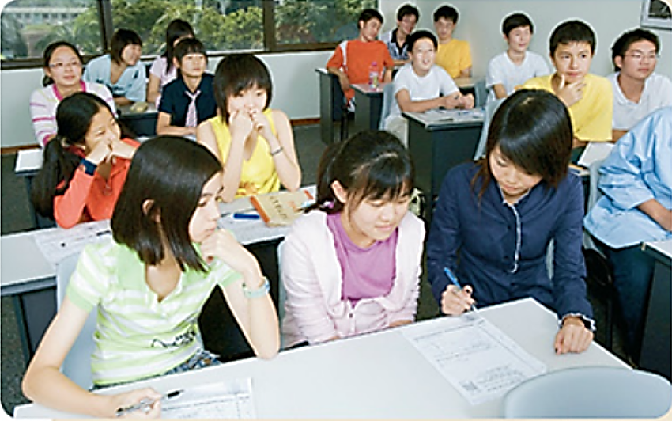
What I hide by my language, my body utters
－Roland Barthes
Unit 4 Body Language
Using language (2)
How do I know my students?
杭州二中许丽君

Slide 3
Learning objectives
In this class, you will
1. Understand some facial expressions and talk about body language;
2. Figure out the basic structure of the text;
3. Use body language to express yourselves;
4. Recognize the meanings of different classroom body language;
5. Have a good understanding of the body language in classroom;
6. Write a passage to describe the body language of the person in the drawing.

Slide 4

Part 1
Pre-reading ：Prediction
Predict what the text talks about from the photo and the title.
How Do I Know My Students?
From the photo:
It may be about stories between the teacher and the students in a classroom.
From the title:
It may answer the question asked in the title by introducing some good ways for the teachers to know the students.

Slide 5
pre-reading : Warming up
Part 1
Warm-up- Describe classroom body language
1. Look at the questions. Then read the text on page 44 and try to answer them
1. How does the teacher know what students are thinking?
By looking at their body language.
2. According to the teacher, what is some students' favourite activity?
Daydreaming.
3. What does the phrase “who knows what” mean?
It is impossible to tell what they are interested in.
4. Why does the teacher think body language is important?
Students’body language lets the teacher know when to adjust class activities, when to intervene, and when to talk to students individually, so they can all get the most out of school.

Slide 6
pre-reading : Warming up
Part 1
Q1: As a student, what different feelings have you ever experienced in class?
different feelings (meanings)
interested
amused
bored
distracted
troubled
anxious
Q2: What kind of body language are you aware of?
frown
daydream
lean forward
lower one’s head
look up and smile
…
body language

Slide 7
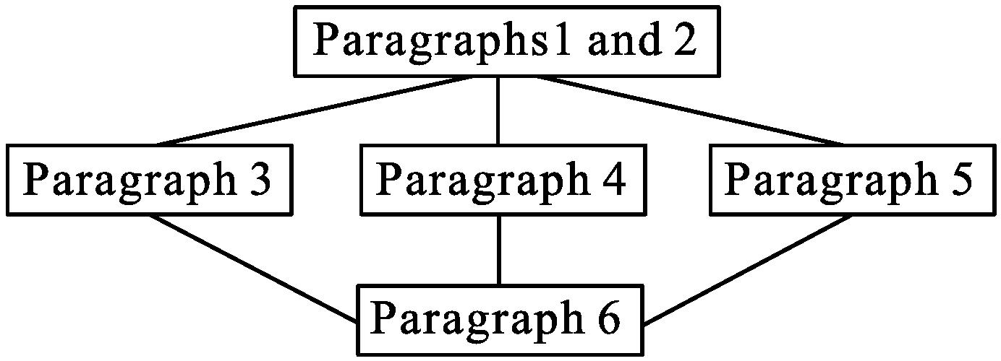
Part 1
pre-reading : read for structure
Scanning for the structure of the text.
Draw the mind map to show its structure.

Slide 8
General Idea and its type::
Read for
1. Read the passage quickly and summarize the main idea.
The passage mainly tells us that teachers can observe
students’ body language to adjust their teaching activities.
2. What is the text type of the passage?
A. Narration(记叙文).
B. Argumentative Essay(议论文).
C. Expository Writing(说明文).
D. Practical Writing(应用文).
答案: A

Slide 9


Q: How is the whole passage and each paragraph is developed?
The Outline of the Passage
P 1 & 2
Lead in the topic: Body Language by Q & A
P 3 & 4 & 5
Examples of body language & what they imply
P 6
Reconfirm the importance of body language

Slide 10
While-reading : read for main idea
Reading for main ideas
Read and divide the text into three parts.
Part | Purpose
1(Para____)
2(Para _____) | Recognise when students _______________
 | Recognise when students _______________
 | Distinguish when students _______________
3(Para____) | ________________________ is an important component of being a teacher.
①②
Introduction of the topic
are interested or bored
are distracted
③④⑤
are troubled
⑥
Reacting to body language

Slide 11

While-reading : read for details
Ⅰ.阅读课文，判断信息正误
( )1.It is not easy to recognise when students are interested in a lesson.
( )2.If a student has his head lowered to look at his watch, it implies he is bored.
( )3.Some students are amused by something else because they spend all their time looking anywhere but at me.
( )4.Students who are angry, afraid, or experiencing anxiety will nearly always wear a frown.
( )5.Reacting to body language is very important for a teacher.
【答案】1－5 FTTFT

Slide 12


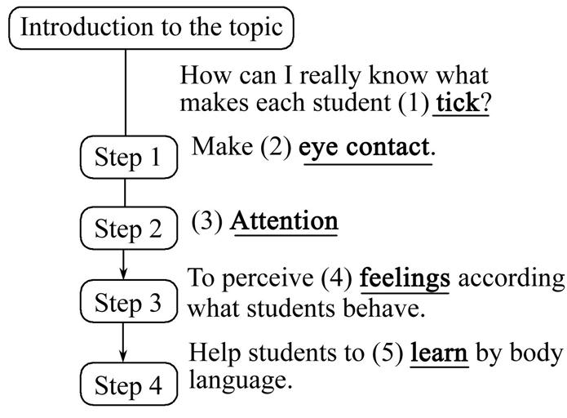
While-reading : read for details
Skimming
Reading Comprehension
Task 1 整体理解
1. Skim the passage and fill in the blanks

Slide 13
While-reading : read for details
Skimming
Reading Comprehension
Ⅱ.阅读课文，选择正确选项
( ) 1.How can the writer know what makes each student tick?
A．By having one-on-one conversations with each person.
B．By talking with some students.
C．By observing students’ body language.
D．By asking them to write a letter to the teacher.
C
( ) 2.When students are not interested in a lesson, they may ________.
A．look up and make eye contact
B．lean forward and look at the teacher
C．lower their heads and look at the watch
D．smile when the teacher makes a joke
C

Slide 14
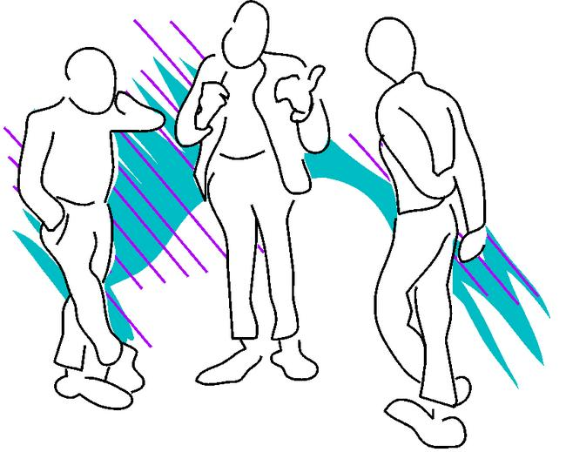
While-reading : read for details
Skimming
Reading Comprehension
( )3.When students have their arms crossed in front of their chests and their legs crossed, they may feel ________.
A．happy B．excited
C．shocked D．angry
D
A
( ) 4.Where is the text likely to be taken from?
A．A social magazine.
B．A science book.
C．A research report.
D．A health magazine.

Slide 15


While-reading : read for details
Para.1-2
Reading for details
HOW DO I KNOW MY STUDENTS?
As an educator, people often ask me how I know what is going on in the minds of my students. Many students are quite shy and don't speak all that much. At the same time, in a classroom of more than forty students, it is hard to have many one-on-one conversations with each person. So, how can I really know what makes each student tick?
My answer? I look at their body language.
P1
P2
1. Who is the author?
2. What kind of students do the author have?
3. What does the sentence “what makes each student tick” mean?
what makes sb. tick
Idiom
The things that motivate one or make one behave in a certain way.

Slide 16

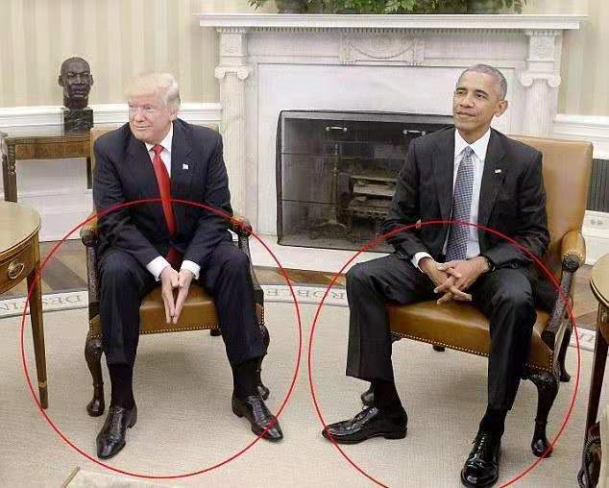
While-reading : read for details
Para.3
Paragraph 3:
P3
It is easy to recognise when students are interested in a lesson.
Body language of interest
Additional Implications
look up and make eye contact
smile
look confused
difficult
lean forward and look at me
really interested

Slide 17
While-reading : read for details
Para.3
Paragraph 3:
P3
It is easy to recognise when students are interested in a lesson.
Body language of no interest
Additional Implications
head lowered to look at watch
bored and counting down
two friends are leaning heads together
writing notes to each other
look up, but there is no eye contact.
eyes barely move, and always have the same distant expression on their faces.
they are asleep with their eyes open

Slide 18
While-reading : read for details
Reading for details
Para.4
Some students are amused by something else. They spend all their time looking anywhere but at me. Then again, some students' favourite activity is daydreaming. With their chins on their hands, they occupy themselves by staring out of the window or up at the ceiling. They are certainly interested in something, but who knows what. The main thing is reminding distracted students that they need to pay attention in class.
P4
Body language of distraction
Additional Implications
looking anywhere but at me
interested in or amused by something else
daydreaming
chins on their hands
staring out of the window or up at the ceiling

Slide 19

(Para5)
Para.5
While it is easy to perceive when students are interested, bored, or distracted, it is sometimes much harder to distinguish when students are troubled. ...
P5
food/restaurants
Body language of being troubled
Additional Implications
have arms crossed in front of chests and legs closed or crossed
angry, afraid, or anxious
always wear a frown
sad or worried

Slide 20
(Para5)
Para.5
P5
food/restaurants
Body language of being troubled
Additional Implications
hide their faces in their hands
embarrassed or ashamed
afraid of being called on by the teacher.
deeper issues at work: having serious conflicts with other students or at home
not brush hair and eyes are red from weeping

Slide 21

While-reading : read for details
Para 3-.5
P3-P5
How many feelings are mentioned in this part? What are they?
…
anxious
interested
different feelings
troubled
bored
distracted
amused

Slide 22

Paragraph 3-5
Para.3-5
Part 2 --Para3-5 Read and fill in the blanks
Students' body language | Meaning
looking up and making eye contact
lowering his head to look at his or her watch
two friends leaning heads together
looking up without eye contact, their eyes barely moving
looking anywhere but the teacher
with their chins on their hands, staring out of the window
looking at the ceiling
interested in a lesson
bored and counting down
writing notes to each other
daydreaming
daydreaming
distracted
distracted

Slide 23

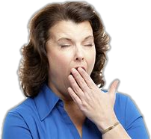
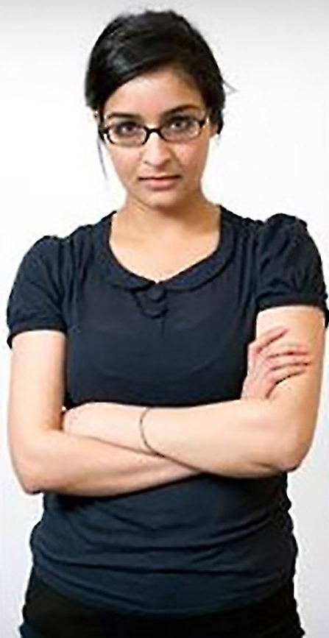
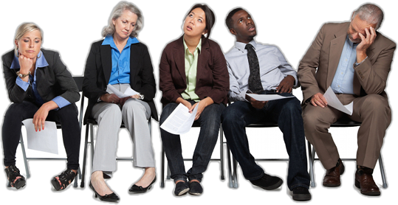

While-reading : read for details
Paragraph 6
Para.6
Reading for details
Ultimately, my duty is helping every student learn. Their body language lets me know when to adjust class activities, when to intervene, and when to talk to students individually, so they can all get the most out of school. Reacting to body language is an important component of being a teacher.
P6

Slide 24
While-reading : read for details
Para.3-6
Paragraph 3-6
Match the body language with the meanings.
1 Looking up and making eye contact A very interested
3 Two friends leaning heads together C interested
4 Leaning forward and looking at the teacher F writing notes
5 Lookng up, but no eye contact, no expression G serious problems
7 Chin on hand, looking out the window H like they are asleep
8 Looking down, arms or legs crossed I daydreaming
10 Hair not brushed, red eyes J angry, afraid, or
experiencing anxiety
C
F
A
H
I
J
G

Slide 25
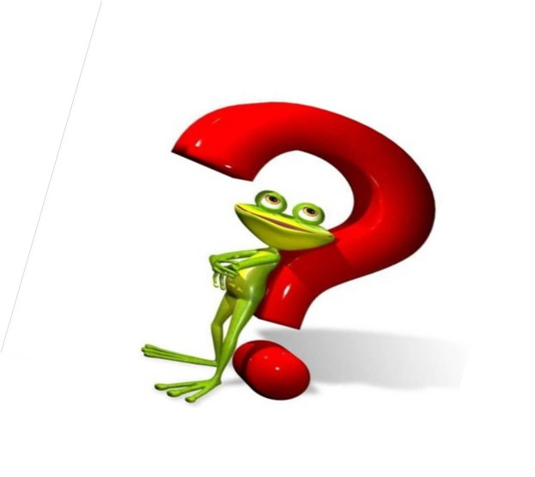
Post-reading : Further thinking
Further thinking
Read for thinking
Read again and answer the following question.
What different verbs does the teacher use to talk about students’ body language?
know, recognize, perceive, distinguish,
infer, inquire, assess

Slide 26
Post-reading : Further thinking
How are the verbs different?
know—
to have information about something
recognize—
to know who someone is or what something is, because you have seen, heard, experienced, or learned about them in the past
perceive—
to notice or become aware of something
distinguish—
to see or understand how one thing is different from another
infer—
to form an opinion that something is probably true because of information that you have
inquire—
to ask someone for information
assess—
to make a judgment about a person or situation after thinking carefully about it

Slide 27

summary
an
adjustments
their
are writing
distracted
who
crossed
from
to change
individually

Slide 28

Activity: Reread the passage and fill in the blanks.
(1) ________at students’ body language makes me know what makes each
student (2) ____. It is easy to (3) ________(识别)when students are interested in a
lesson through their body language. If I find students are (4) _______by something
else, I will (5) _______them to pay attention in class. It is hard to (6) __________(辨
别)when students are troubled. If they have (7) ________with other students or at
home, I will (8) _______and assess what is going on. Their body language makes me
know when to (9) ______class activities, when to (10) ________, and when to talk to
students individually.
Looking
tick
recognise
amused
remind
distinguish
conflicts
inquire
adjust
intervene

Slide 29


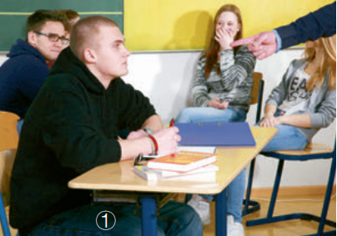
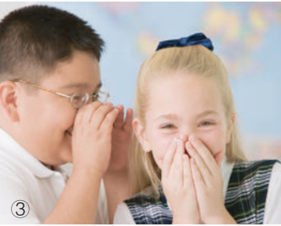
Group discussion
What are these people doing？What is their body language telling you?

Slide 30
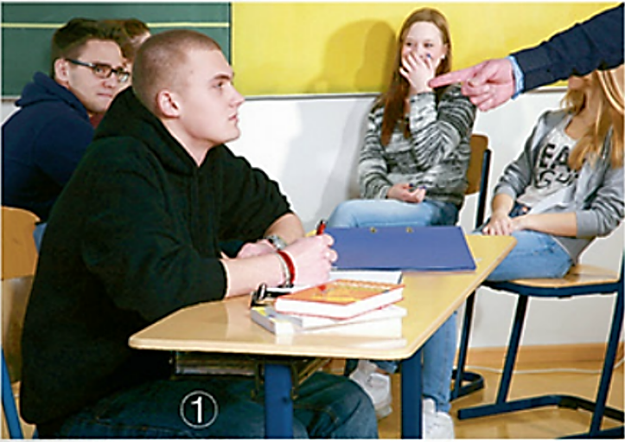

Practice describing classroom body language.
It looks like the teacher is pointing at a male student, who is looking up with a serious expression on his face. I think the teacher is scolding him for something. Meanwhile, the girl in the back of the photo is hiding her mouth with her hand, and from her eyes it looks like she is smiling. Perhaps she is happy that the other student is being scolded.

Slide 31


Practice describing classroom body language.
The boy is giving a fist pump and smiling. This is normally done when someone has just accomplished something good and wants to celebrate.

Slide 32
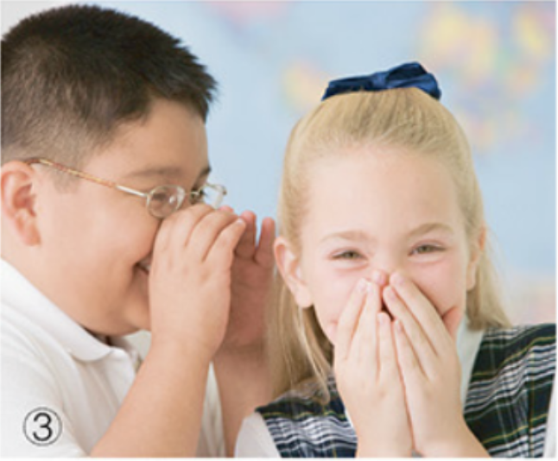
Practice describing classroom body language.
The boy is telling a joke to
the girl in secret, and she is
hiding her face because
she is laughing.

Slide 33
Writing:
what
As a teacher, I try to know 1. each student is thinking by watching their body language. Recognizing whether students are 2.__________(interest) in a lesson is easy. Most students tend to look up and make eye contact and sometimes they lean forward and look at me. If a student looks 3. at his watch, it implies he is bored. If two friends are leaning their heads together, they are 4. _________ (probable) writing notes to each other. Some students are easy to be 5.__________ (distract).Instead of looking at me, they spend all their time looking anywhere. Then again, some students prefer daydreaming. 6. their chins on their hands, they occupy 7. (them) by staring out of the window or up at the ceiling. In these cases, they should be reminded to concentrate.
Distinguishing when students are troubled is much 8.__________(hard).If students have their arms crossed in front of their chests and their legs 9. (close) or crossed, it shows they are angry, afraid, or experiencing anxiety.
Finally, it is my duty to help every student to learn and I adjust class 10._____ (activity) according to their body language. In my opinion, reacting to body language is an important component of being a teacher.
interested
down
probably
distracted
With
themselves
harder
closed
activities

Slide 34
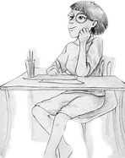
Writing Practice:
Write a passage to describe the body language of a person, and explain what his/her body language tells us.
looking up
Jessy
her eyes sparkling
her left mouth corner moving up
her chin resting on her left hand
holding a pen in her right hand
sitting with her legs casually crossed under the table, barefooted
She is thinking.
She must have got an interesting idea.
She is relaxed.
She enjoys writing and creating.
Implications

Slide 35

1. Think about some classroom body language and write down their meanings.
2. Describe classroom body language through writing.
3. Write a passage to describe the body language of the person in your drawing.

Slide 36

Thank You

