Slide 1


感恩遇见，相互成就，本课件资料仅供您个人参考、教学使用，严禁自行在网络传播，违者依知识产权法追究法律责任。
更多教学资源请关注
公众号：溯恩高中英语
知识产权声明

Slide 2







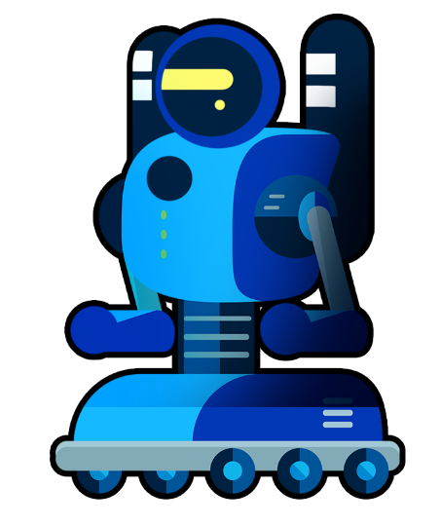
Unit 2 UL 2
Should We Fight New Technology?

Slide 3




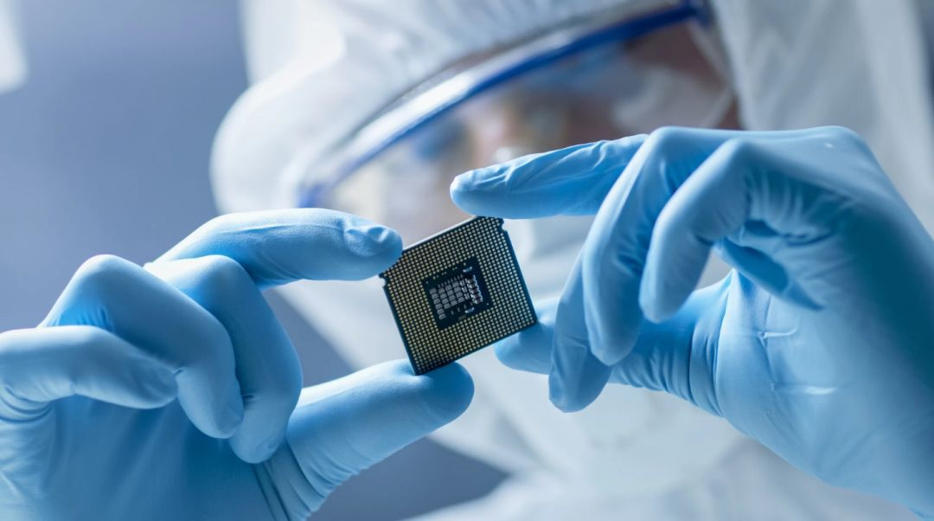
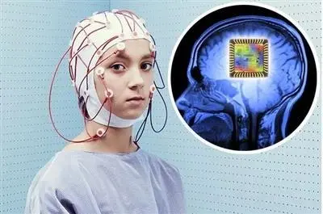

Lead in
Latest News: Elon Musk develops a technology designed to use a computer chip (芯片) inside the head to control the brain.

Slide 4

Lead in

Slide 5
Lead in
Are you willing to have the computer chip implanted (植入) inside your head？
Your point | Yes | No
Your reasons (Your arguments)

Slide 6
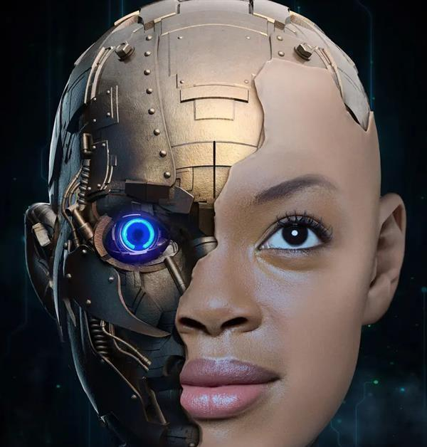
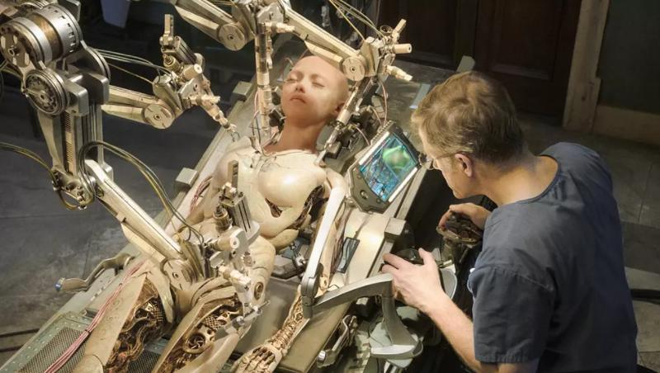
Lead in
Should We Fight New Technology？

Slide 7
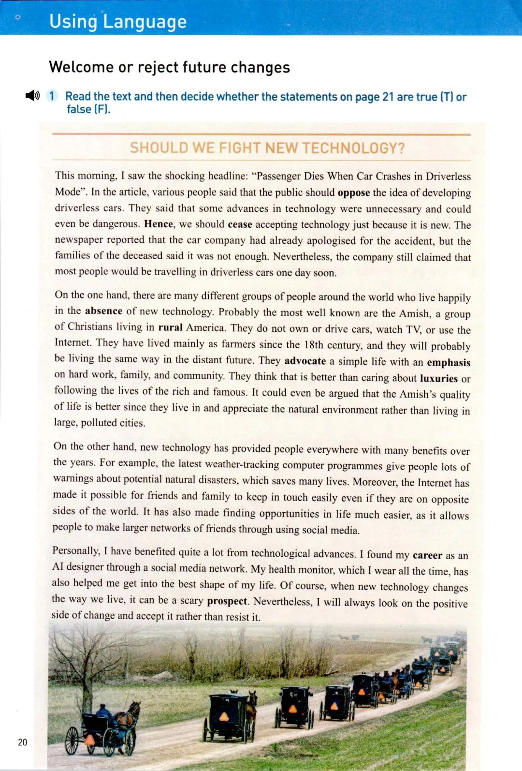

Activity 1 Read for structure
In which paragraph does the author:
describe the hot issue
give an opinion
discuss the life with new tech
discuss the life without new tech

Slide 8
Activity 1 Read for structure
describe the hot issue
In which paragraph does the author:
discuss the life without new tech
discuss the life with new tech
give an opinion

Slide 9
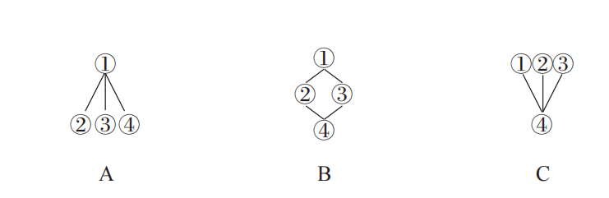
Activity 1 Read for structure
Structure ?
Signposts (标识性语言)

Slide 10
Activity 2 Read for details
the hot issue
Para.1 Introduction
a specific event/ accident
different opinions

Slide 11
Activity 2 Read for details
Para.1 Introduction
a specific event/ accident
oppose the idea of
different opinions
unnecessary
dangerous
Hence
cease...just because....new
Nevertheless
still claimed that...

Slide 12
Activity 2 Read for details
Para.2-3 Pros and Cons
Topic sentence
the Amish
give examples
weather-tracking
the Internet

Slide 13
Activity 2 Read for details
Para.2 Pros
the Amish
Topic sentence
give an example
advocate
simple
emphasis
is better than

Slide 14
Activity 2 Read for details
Para.3 Cons
weather-tracking
the Internet
Topic sentence
the latest
give examples
potential
make it possible
keep in touch
find ...easier
larger networks

Slide 15


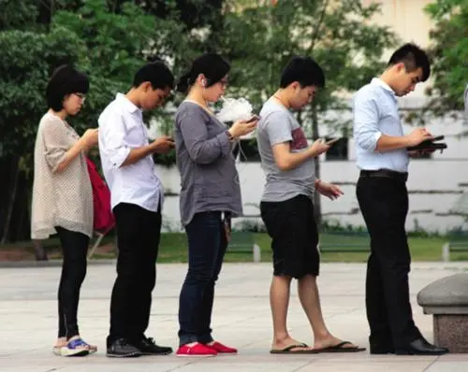
Activity 2 Read for details
Para.2-3 Pros and Cons
Topic sentence
give examples
make contrast

Slide 16
Activity 2 Read for details
Para.2-3 Pros and Cons
Critical thinking:
1. Which lifestyle do you prefer?
2. In your opinion, what is the advantage or disadvantage of life with/ without new technology?
3. What will be your answer to the question “Should We Fight New Technology ? ”

Slide 17
Activity 2 Read for details
Para.4 Own opinion
Topic sentence
give examples
(personal experience)
scary
positive
accept

Slide 18
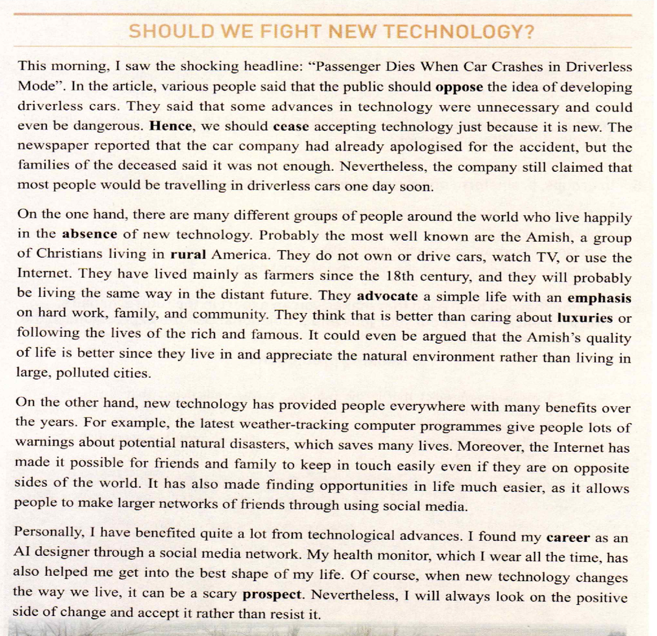
How to write an argumentative essay
Activity 3 Summary
a specific event
different opinions
Para.1 Introduction
Para.2 Pros
Topic
sentence
give
examples
make
contrast
Topic
Para.3 Cons
give examples
(personal experience)
Para.4 Own opinion
Topic sentence

Slide 19
How to write an argumentative essay
Activity 3 Summary
Tip 1: Organise clear and logic structure
Tip 2: Use signposts to list pros and cons & your opinion
Tip 3: Choose proper argumentative skills
(giving example/ making contrast)

Slide 20

Activity 4 Group Discussion
Should We Fight the Computer Chip Implanting?
Para.1 Introduction
a specific event
different opinions
Para.2 Pros
Topic
sentence
give
examples
make
contrast
Topic
Para.3 Cons
give examples
(personal experience)
Para.4 Own opinion
Topic sentence

Slide 21
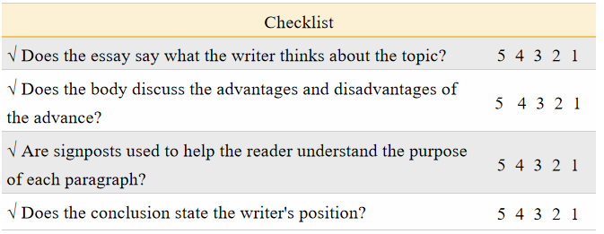

Evaluation
Exchange your draft with a partner. Use the checklist to help you comment on their arguments.

Slide 22

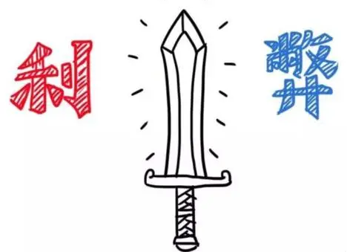
Evaluation
Every coin has two sides, and the new technology is no exception. Though technology is a double-edged sword, we should learn to stay positive and make the most of it.

Slide 23

Assignment
1. Polish your draft after class according to the check list.
2. Find more articles about new technology from the Internet.

