Slide 1

感恩遇见，相互成就，本课件资料仅供您个人参考、教学使用，严禁自行在网络传播，违者依知识产权法追究法律责任。
更多教学资源请关注
公众号：溯恩高中英语
知识产权声明

Slide 2
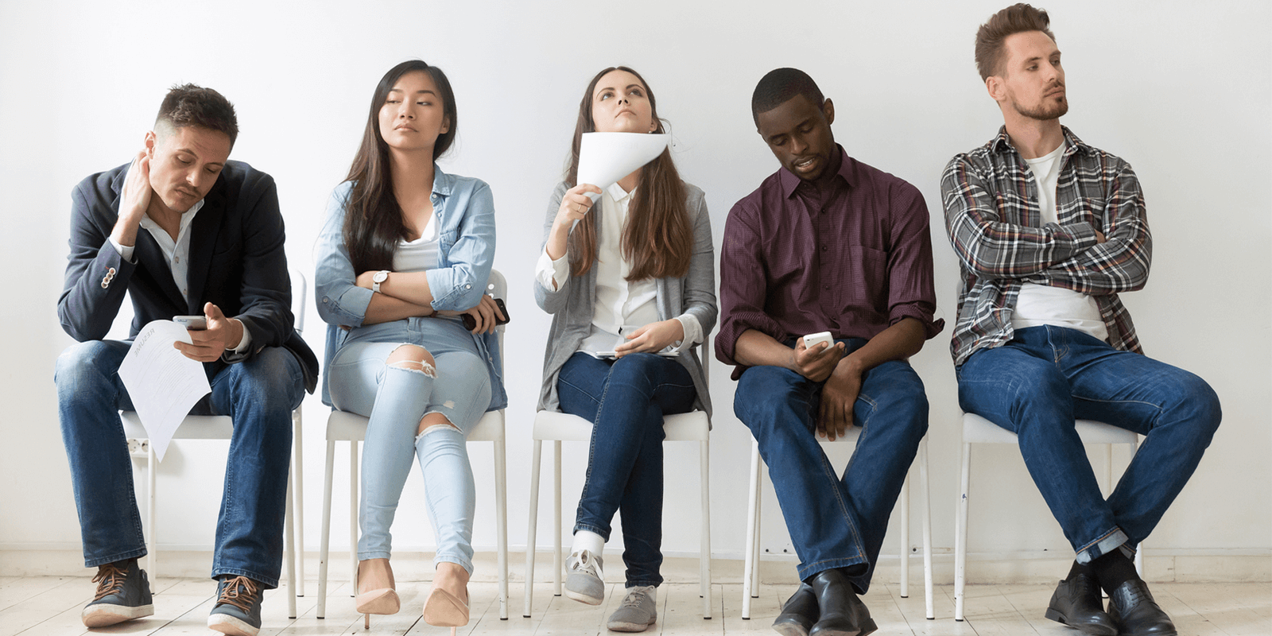

UNIT 4 BODY LANGUAGE
Reading and Thinking
暨阳分校 陈莹 2021/10

Slide 3

Act and guess
Hello! Goodbye! Come here! Go away! I'm surprised! I'm tired! OK! I'm happy! I'm sad! I forgot! You're great! Good luck!
Too expensive! I'm confused.

Slide 4
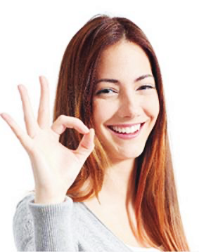
prediction
personification（拟人）
appeal to readers
what kind of question do you want to raise according to the title and picture?

Slide 5
structure
Underline the topic sentence in each paragraph.
Topic: body language
Para 1
Para 2
Para 3
Para 4
Para 5
Para 6
Words are important,but the way people stand, hold their arms, and move their hands can also give us information about their feelings.
Just like spoken language,body language varies from culture to culture.
The gesture for “OK” has different meanings in different cultures.
Even the gestures we use for “yes” and “no” differ around the world.
Some gestures seem to have the same meaning everywhere.
Some body language has many different uses.

Slide 6
structure
draw the structure of the text.
para1
para2,3,4
para5
para6
B
C

A
para1
para2
para3
para4
para5
para6
para1
para2,3,4
para5
para6

Slide 7
para1
para2,3,4
para5
para6
structure
Para 1 | …but the way people stand, hold their arms, and move their hands can also give us information about their feelings.
Para 2 | … body language varies from culture to culture.
Para 3 | The gesture for “OK” has different meanings in different cultures.
Para 4 | Even the gestures we use for “yes” and “no” differ around the world.
Para 5 | Some gestures seem to have the same meaning everywhere.
Para 6 | Some body language has many different uses.

Slide 8
Guided reading
What's the main idea of para1?
We use both words and body language to express our thoughts and opinions in our interactions with other people. We can learn a lot about what people are thinking by watching their body language. Words are important, but the way people stand, hold their arms, and move their hands can also give us information about their feelings.
Body language is of great significance.
introduction

Slide 9
Guided reading
Just like spoken language, body language varies from culture to culture. The crucial thing is using body language in a way that is appropriate to the culture you are in. For example, making eye contact-looking into someone's eyes-in some countries is a way to display interest. In other countries,
by contrast, eye contact is not always approved of. For example, in many Middle Eastern countries, men and women are not socially permitted to make eye contact. In Japan, it may demonstrate respect to look down when talking to an older person.
What
How
make eye contact
1.display interest
country/region
meaning
1.some countries
example&contrast
2.not approved of/not soically permitted
2.other countries/ many Middle Eastern countries
3. demonstrate respect
3.Japan

Slide 10
Self-guided reading
Part | What |  |  | How
para3 | body language | meaning | country/region
para4 | body language | meaning | country/region
para5 | body language | meaning | country/region
para6 | body language | use

Slide 11
Self-guided reading
Part | What |  |  | How
p3
p4
p5
p6
money
zero
impolite
Japan
France
Brazil and Germany
ok
example&contrast
shake one's head nod
no, yes
yes, no
in many countries
Bulgaria and southern Albania
example&contrast
kiss on the cheek
meet, part
France,Russia
shake,bow, nod
elsewhere
placing...
sleep
most places
example
moving...
I'm full
A smile can...We can use a smile to...
Experts suggest...there is nothing better than...
example
smile

Slide 12

The gesture for “ok” has different meanings in different cultures. In Japan, someone who witnesses another person employing the gesture might think it means money. In France, a person encountering an identical gesture may interpret it as meaning zero. However, you should avoid making this gesture in Brazil and Germany, as it is not considered polite.
Even the gestures we use for “yes” and “no” differ around the world. In many countries, shaking one’s head means “no”, and nodding means “yes”. By comparison, in Bulgaria and southern Albania, the gestures have the opposite meaning. There are also differences in how we touch each other, how close we stand to someone we are talking to, and how we act when we meet or part. In countries like France and Russia, people may kiss their friends on the cheek when they meet. Elsewhere, people favour shaking hands, bowing from the waist, or nodding the head when they meet someone else.
Make inferences
figure out the meaning with the help of clues in the passage

Slide 13
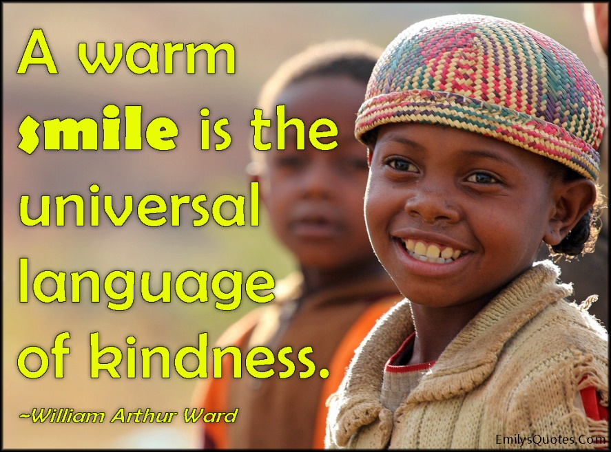
Thinking
Can you think of other uses of smile?
〇 A smile can...
〇 A smile can...
〇 We can use a smile to …
〇 Experts suggest smiling…
There is nothing better than seeing a smile.
show kindness.
always make a young man.
hide our embarrassment.
is beneficial to health.

Slide 14
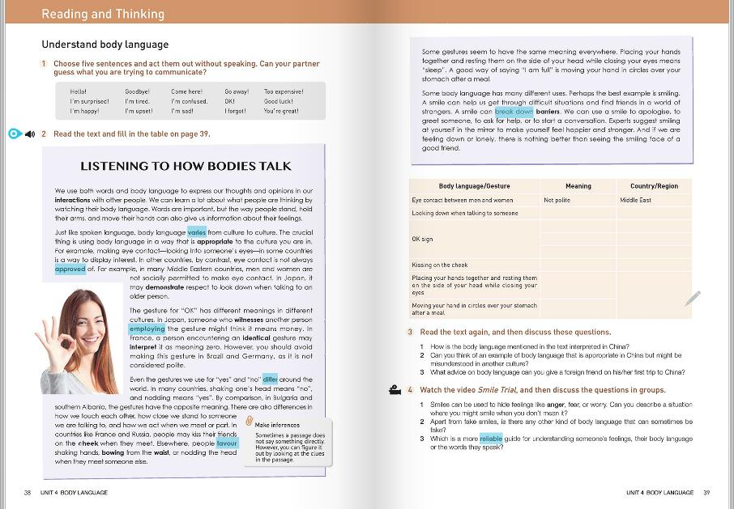
Critical thinking
What should we pay attention to when employing body language in this multicultural world?
1. learn different forms of body language in different cultures.
2.When in Rome, do as the Romans do.
3.Be open-minded. Understand and respect other cultures.
4.keep up and have confidence in our own culture.

Slide 15
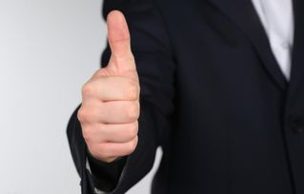
Many countries(like UK, Canada, New Zealand, Australia): to ask for a ride
Many countries(like China and America): to praise and encourage sb
In some Middle Eastern countries, like Iraq and Iran: to be rude
Greece: to make sb go away

Slide 16
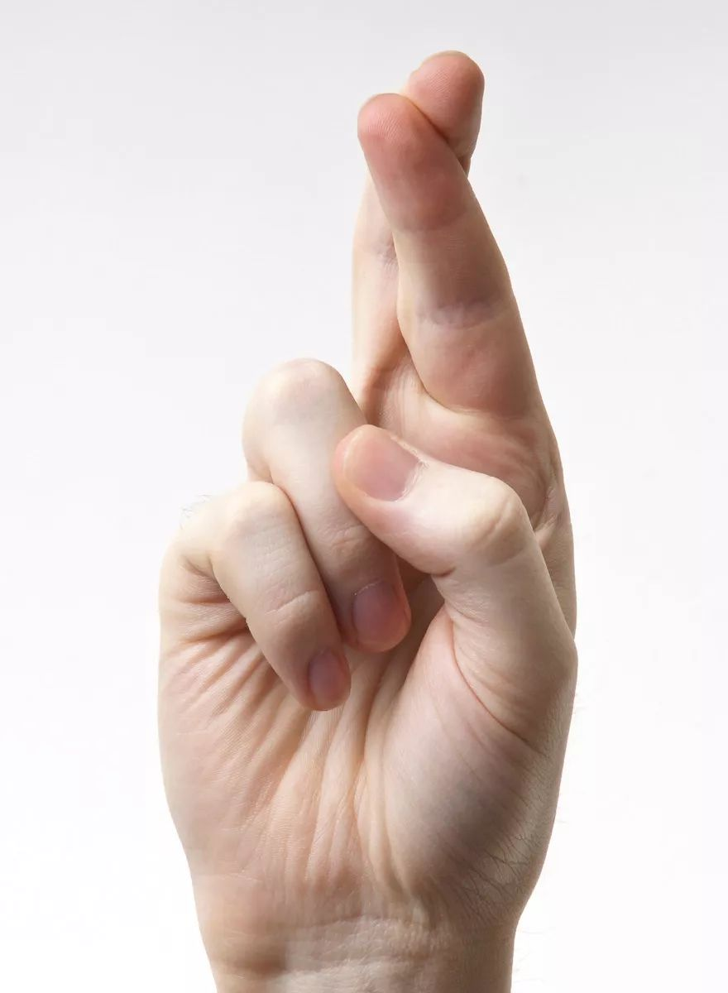
India: sth is completed
Many countries(like America, France, Mexico, Malaysia):
to pray for good luck
Netherlands: to swear
Australia: to expect, to look forward to sth

Slide 17
presentation
Search the internet and find out more examples.
The thumb-up gesture differs around the world. For example, in many countries.... In contrast/By comparison, ....However...
example/contrast

Slide 18

What I hide by my language, my body utters.
---Roland Barthes
Thanks!

