Slide 1

感恩遇见，相互成就，本课件资料仅供您个人参考、教学使用，严禁自行在网络传播，违者依知识产权法追究法律责任。
更多教学资源请关注
公众号：溯恩高中英语
知识产权声明

Slide 2

读后续写
Be Careful What You
Teach Them
2021高三 “五校联考”

Slide 3
Contents
Vivid Dialogue
Rhetoric (alliteration首韵, consonance尾韵)
Different Types of Ending

Slide 4
VIVID Dialogue
a. “I lose it,” she responded.
b. I leaned back in my chair and said, “I don’t believe you, Katie.”
c. “No, I just lose it,” she said.

Slide 5
“I just want to do something to help him.” She said.
“I just want to do something to help him,” She said.
But I refused immediately. “Your parents should know the truth.”
But I refused immediately, “Your parents should know the truth.”
I stroked my fingers through her hair, and whispered: “... .”
I stroked my fingers through her hair, and whispered, “... .”

Slide 6
FORMULA 1
1. “… ,” he said with a + ADJ. +N.(expression).
e.g. I said with a wide smile, “…”
2. “… ,” he said with/in N.(emotions)
e.g. “Why not?” I asked with confusion.
3. “… ,” he said, his voice + ADJ./ doing (独立主格)
e.g. “…,” Katie said, her voice trembling.
4. “… ,” he said in a ADJ.(low/gentle/trembling/cheery/determined) + voice/tone
e.g. I said in a gentle tone, “My dear…”

Slide 7
FORMULA 2
1. He V.ed (expressions/ actions)
e.g. I stroked my fingers through her hair, and whispered,“… .”
2. “… ,” he said, doing.
e.g. “… ,” she mumbled, burying her face into her hands and sobbing.
3. “… ,” he said, as if/ when/ as
e.g. She looked at me, biting her lips, as if thinking, “… .”

Slide 8
FORMULA 3
1. How to say: whisper, sigh, grin, exclaim, yell, fume, growl, mumble, sniff, stammer, swallow, repeat
e.g. “How gorgeous you are, my angel,” She murmured.
e.g. Katie joked, “I think it will pass my beauty to him.”
2. Why to say: promise, apologise, beg, agree, reply, add, demand, decide, declare, announce
e.g. Katie admitted, “It’s all my fault.”

Slide 9
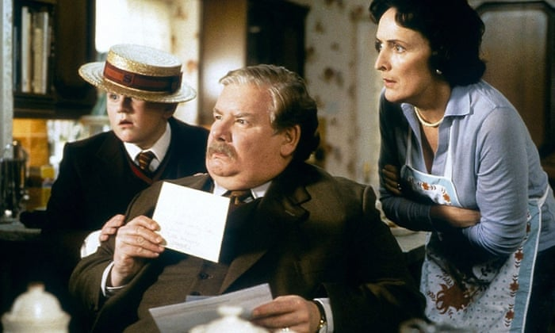
Scene 1：哈利波特收到霍格沃兹的信，但是弗农姨夫(Uncle Vernon)不给哈利波特和儿子达利(Dudley)看，但是两个小孩尤其是哈利波特一定要看，因为这是他出生以来第一次收到来信。
“I want to read that letter,” Dudley said _________.
“I want to read it,” said Harry _________, “as it’s mine.”
“Get out, both of you,” _________ Uncle Vernon, stuffing the letter back inside its envelope.
Harry didn’t move.
“I WANT MY LETTER!” he _________.
“Let me see it!” __________ Dudley.
“OUT” _________ Uncle Vernon, and he took both Harry and Dudley by the scuffs of their necks and threw them in to the hall, slamming the kitchen door behind them.
loudly
furiously
croaked
croak: to say in a low and rough voice
shouted
demanded
roared

Slide 10
Alliteration 首韵
It was at the moved instant that she know this man deserved her to rely on through thick and thin.
(2017高考)
Tom rushed at her, held her arms and looked at her from head to toe to make sure she was safe and sound.

Slide 11
Consonance 尾韵
Tom hugged Jane tightly and kissed her lovingly, apologizing constantly for his huge mistake.
Excited and thrilled, she spotted the helicopter land beside her on the open area.

Slide 12
Examples from students
1. Astonished and confused, I stood rooted to the spot and stared at the boy.
2. I began to recall Katie’s helpfulness and generousness.
3. Deeply moved and astonished, I told Katie what happened.
4. Surprised and stunned, I was even petrified, for I came to realize what had happened.
5. Shocked and annoyed, I grabbed the lunch-box, squeezed his wrist and scolded, “Are you stealing Katie’s lunch?”

Slide 13
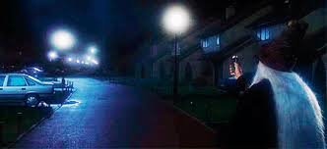
Scene 2 邓布利多从口袋里摸索银色打火机
Dumbledore found what he was looking for in his inside pocket. It seemed to be a silver cigarette lighter.
试译：他把打火机轻轻弹开(flick)，高举起来，咔哒(click)一声。
He flicked it open, held it up in the air and clicked it.

Slide 14
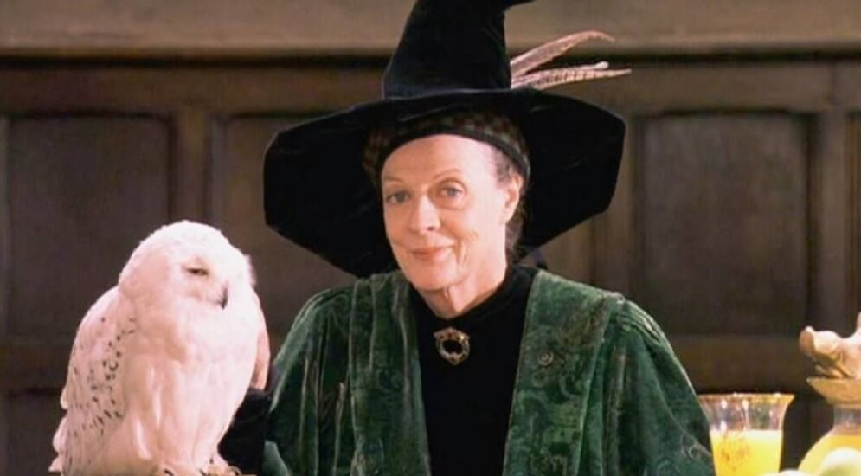
Scene 3 麦格教授听说邓布利多要把哈利波特寄养在“麻瓜”姨父家，感到震惊。
“You don’t mean —— you can’t mean the people who live here?” _____ Professor McGonagall, ______________________________________ (跳了起来，指着四号门牌). “Dumbledore —— you can’t. I’ve been watching them all day. You couldn’t find two people who are less like us. And they’ve got this son —— I saw him ___________________________________________________ (一路脚踢他妈妈，喊着要吃糖) Harry Potter come and live here!”
cried
jumping to her feet and pointing at number four
kicking his mother all the way up the street, screaming for sweets.

Slide 15
Implied ENDING以景结情
Bathed in the bright sunshine, in my sight, Katie was an angel full of love and joy arriving in the world.

Slide 16
Lesson 升华（点题式）
I felt again the power of helping others from the lovely girl, just as the say goes, “a rose in her hand, a flavour in mine.”
From this experience, Katie learned the true meaning and the proper way of helping others.

Slide 17
Mirror (Echo 首尾呼应)
Small body makes a great difference.
Katie is a small girl but with a big heart.

Slide 18
Happy ever after 自然式结尾
Since then, Katie’s parents would cook two boxes of homemade lunch. One for their daughter, the other for the ragged boy.
A few days later, I was gratified to find Katie coming to school with a double-deck lunch-box, smile on her face shining like a diamond.

Slide 19
P1: The problem was still unresolved the next week until I noticed a boy in the school canteen. He was silent sitting alone at a lunch table. He had messy hair and a thin face, always wearing his oversized coat and looking sad and shy. I thought I would go and sit with him for a while. As I walked toward him, I noticed the lunch bag on the table. The name on the bag said “Katie.” Now I understood what had happened. Later that day, I found Katie and talked to her about it.

Slide 20
P2: Katie asked me not to tell her parents. But I drove to Katie’s house that evening after I was sure that she was in bed. I have never seen parents so proud of their child. Katie didn’t care that she was misunderstood by her parents and teacher. But she cared about a little boy who was starved and scared. What a sweet girl she was! Later, Katie still bought lunch every day at school. And every morning, as she headed out the door, her mom handed her a delicious homemade lunch.

