Slide 1

感恩遇见，相互成就，本课件资料仅供您个人参考、教学使用，严禁自行在网络传播，违者依知识产权法追究法律责任。
更多教学资源请关注
公众号：溯恩高中英语
知识产权声明

Slide 2
S1U4 BODY LANGUAGE
Reading and Thinking
桐乡市高级中学 俞莺婕

Slide 3

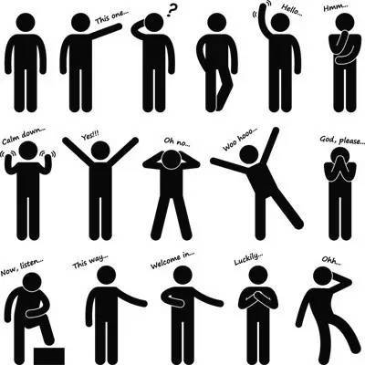
Activity 1 Get to know body language
What do you think is the function of language?
What can you do if your message doesn’t get across?
Which is more reliable in conveying messages, spoken language or body language?
What I hide by my language
my body utters.
----Roland Barthes

Slide 4
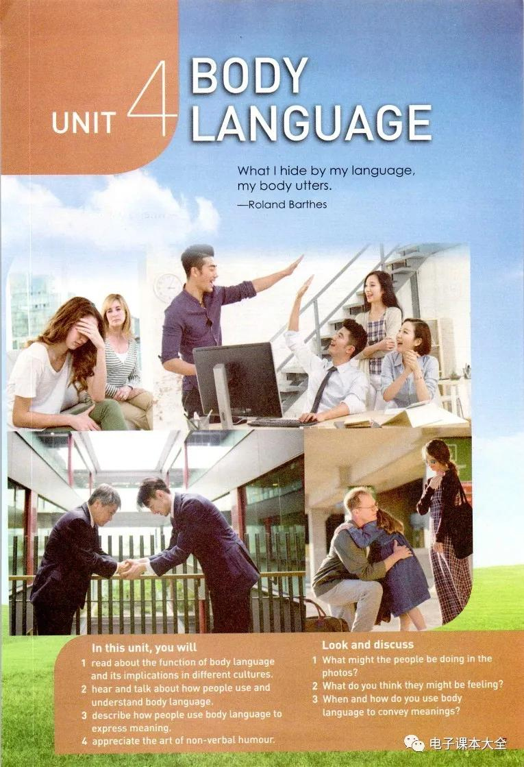
Q: What might they be doing and how do they feel?
Activity 1 Get to know body language
The girl is _________her face with her _____ , showing _______________________________
while the woman who sits next to her is __________ her lip corners, looking at her and showing __________.
covering
hand
frustration/
desperation/sadness...
drooping
concern
clapping hands/
giving each other a high-five
The men are _________________________ and the women are __________, all looking _________________ to _________ a success in the office.
laughing
delighted/cheerful
celebrate

Slide 5
Q: What might they be doing and how do they feel?
The men in business suits are _____
and _____________with each other, showing ________.
bowing
shaking hands
respect
This can be a family reunion occasion when the man is ________ his daughter and _________ her on the back, whispering _________________. Meanwhile, the girl and the woman might be weeping for____.
hugging
patting
“I miss you so much”
joy

Slide 6
Body language consists of...
facial expressions
gestures
postures
drooping one’s lip corners, laugh, weep for joy etc.
cover one’s face with one’s hand/ clapping hands/giving each other a high-five/shake hands/hug/pat ect.
sit next to sb/bow

Slide 7
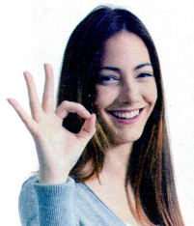
Read the title and the picture and discuss:
What do you want to know from the text?
Does the girl’s gesture have a universal meaning or does its meaning vary from countries?
What is the writing type of the text?
Activity 2 Make a prediction
What will bodies talk about?
How will bodies talk?
Why do we need to learn body language? / What is the function of body language?
An exposition.

Slide 8
Activity 3 Read for topic sentences
Read through the passage and locate the topic sentence(s) in each paragraph.
Para 1
Para 2
Para 3
Para 4
Para 5
Para 6
… but the way people stand, hold their arms, and move their hands can also give us information about their feelings.
Part 1
introduction to body language
Just like spoken language, body language varies from culture to culture.
Part 2
Body language with different meanings in different countries.
The gesture for “OK” has different meanings in different cultures.
1.Even the gestures we use for “yes” and “no” differ around the world.
2. There are also differences in how we touch each other, how close we stand to someone we are talking to, and how we act when we meet or part.
Part 3
Body language with the same meaning everywhere.
Some gestures seem to have the same meaning everywhere.
Part 4
Some body language has many different uses.
The function of body language.

Slide 9
Activity 4: Read for specific information
Paragraph 1
verbally
nonverbally
We use both words and body language to express our thoughts and opinions in our interactions with other people. We can learn a lot about what people are thinking by watching their body language. Words are important, but the way people stand, hold their arms, and move their hands can also give us information about their feelings.
postures
gestures
How do we communicate with each other?
What kinds of body languages are mentioned?/
How will bodies talk?
3. What will our body tell us?

Slide 10
Activity 4: Read for specific information
Read Para. 2-5 and fill in the form on Page 39.
Body language/ Gesture | meaning | Country/ region
Eye contact between men and women | not polite | Middle East
Looking down when talking to someone
OK sign
Kissing on the cheek
Placing your hands together and resting them on the side of your head while closing your eyes
Moving you hand in circles over your stomach after a meal
a sign of respect
Japan
money
Japan
zero
France
not polite
Brazil and Germany
a greeting
France and Russia
I’m sleepy.
everywhere
I’m full.

Slide 11
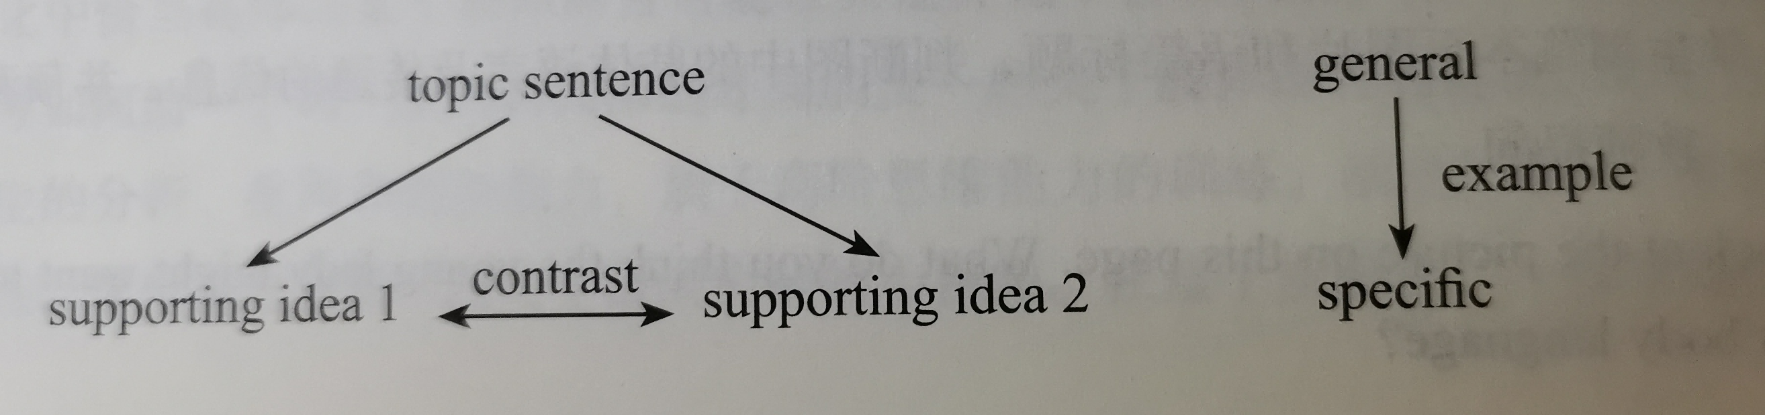
How does the writer support his ideas?
Can you find the logical relationships among the examples in Para. 2-4?
Can you draw a mind-map to show the structure of Para.2-4?
By making examples.
They are in contrast.

Slide 12
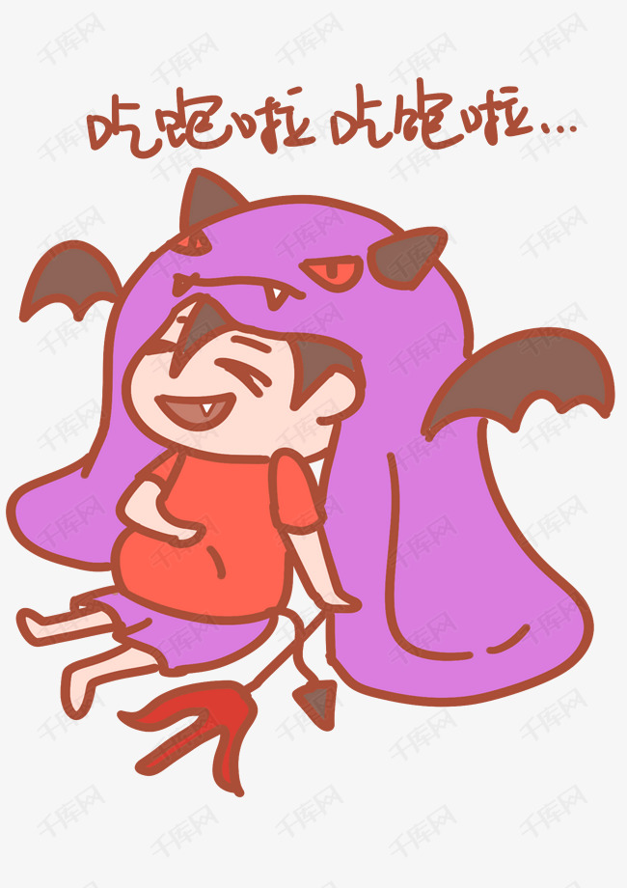
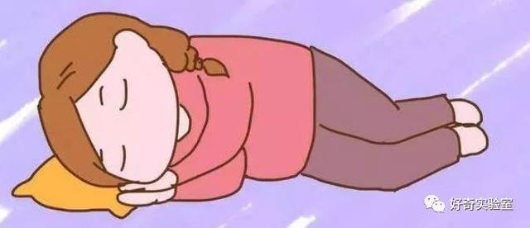
Activity 4: Read for specific information
Paragraph 5:
Some gestures seem to have the same meaning everywhere. Placing your hands together and resting them on the side of your head while closing your eyes means “sleep”. A good way of saying “I am full” is moving your hand in circles over your stomach after a meal.
Can you come up with other gestures that share the universal meanings?

Slide 13
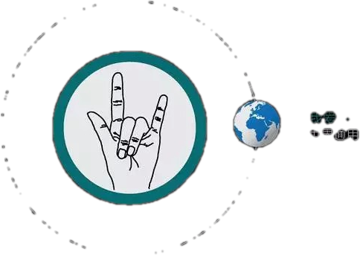
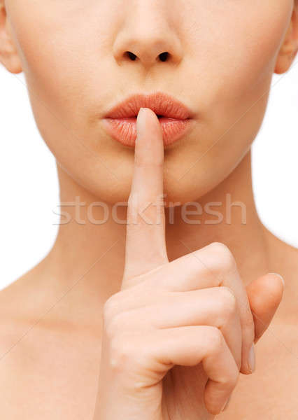
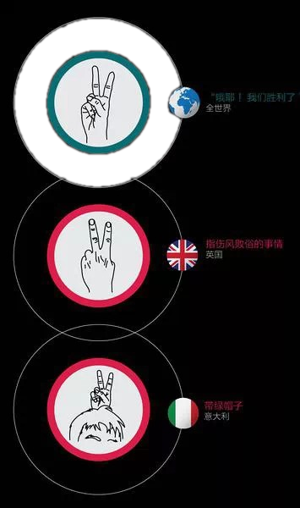
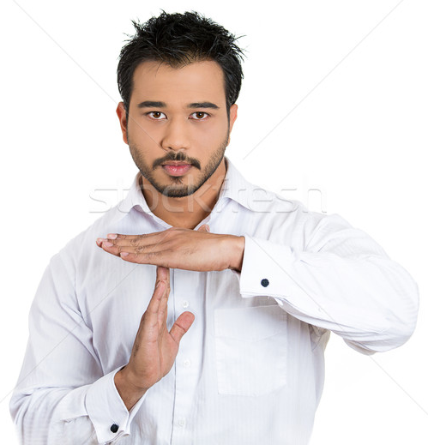
I love you!
hush
victory
pause

Slide 14
Activity 4: Read for specific information
Paragraph 6:
Some body language has many different uses. Perhaps the best example is smiling. A smile can help us get through difficult situations and find friends in a world of strangers. A smile can break down barriers. We can use a smile to apologise, to greet someone, to ask for help, or to start a conversation. …Experts suggest smiling at yourself in the mirror to make yourself feel happier and stronger. And if we are feeling down or lonely, there is nothing better than seeing the smiling face of a good friend.
What different uses of smiling are mentioned in Paragraph 6?
How does the writer tell us the different uses of smile?
Can you find out the varied sentence structures?

Slide 15
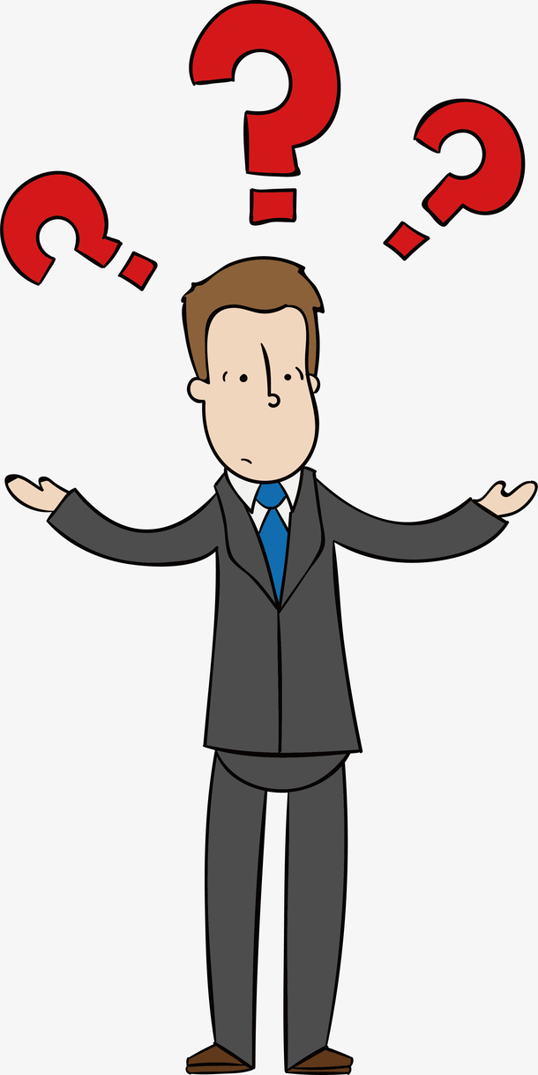
Activity 5: Reflection
What have you learned from this passage?
Body language is important in our daily life.
It varies from culture to culture.
We should respect different cultures.
We should apply appropriate body language according to different contexts.
Do you think the title “Listening to how bodies talk” is a good title? If so, how do you understand it? If not, how would you like to change it?

