Slide 1

感恩遇见，相互成就，本课件资料仅供您个人参考、教学使用，严禁自行在网络传播，违者依知识产权法追究法律责任。
更多教学资源请关注
公众号：溯恩高中英语
知识产权声明

Slide 2
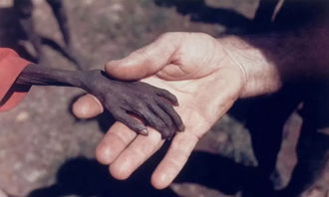
选择性必修Book 1
Unit 5 Working the land Using Language （1）
Explore the world hunger problem
杭州二中许丽君

Slide 3
Teaching objectives:
By the end of this period, you will be able to…
1. collect information and know about the problem of world hunger；
2. understand the content of listening texts；
3. talk with their peers about the causes of world hunger；
4. voice their opinions and sort out some possible solutions to world hunger problem;
5. learn how to present important facts with supporting evidence.

Slide 4

Lead in
Watch a short video and explore the present situation of world hunger problem.

Slide 5
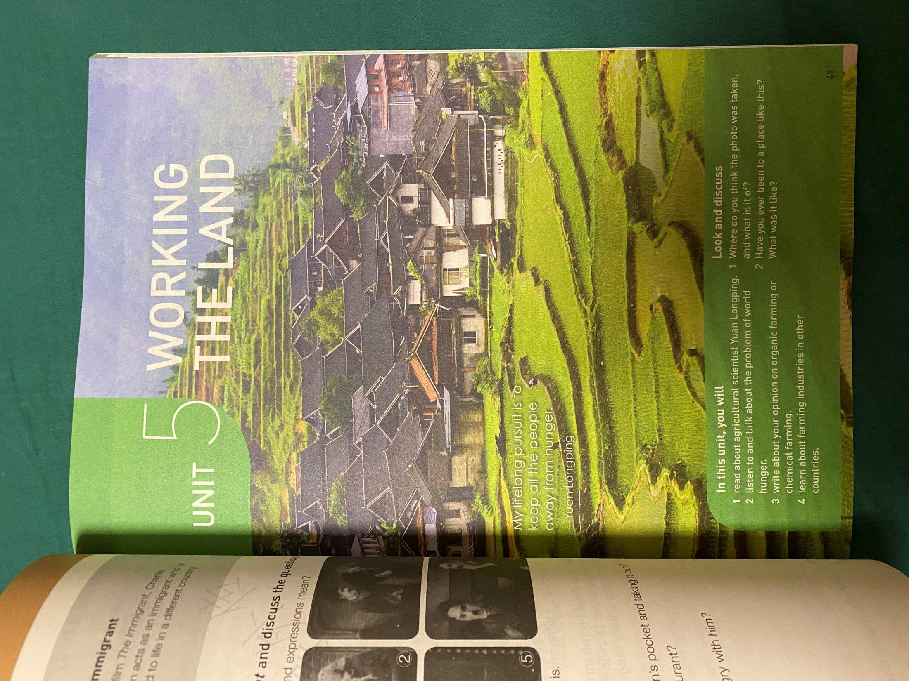
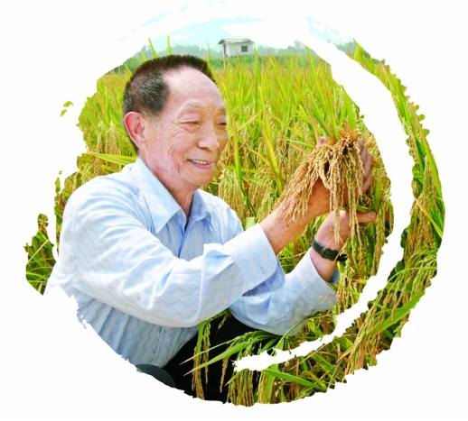
Lead in
He devoted all his life to growing the hybrid rice.
Do you still remember what motivated Yuan Longping to study agriculture?
What is his lifelong pursuit?

Slide 6
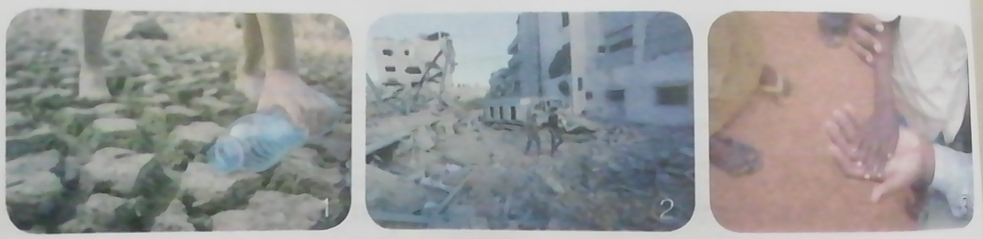
Lead in
In pairs discuss what you can see in the photos and how you think each photo relates to world hunger.
The world hunger problem is very acute.
The world hunger problem and how to solve it

Slide 7

Look＆discuss：
What can you see in the photos?
How do you think each photo relates to world hunger?
The first photo represents
the idea of drought. Either a
river or a lake bed has been exposed by receding waters, leaving behind cracked soil. A child is pouring water onto the ground. When there is drought, crops cannot grow and animals may die.

Slide 8
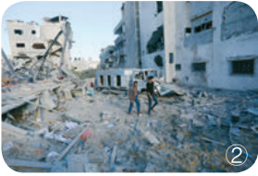
Look＆discuss：
What can you see in the photos?
How do you think each photo relates to world hunger?
The second photo represents
the idea of war.Hunger often
comes with war, as often people cannot farm, or they cannot work to earn money to buy food. And, even if they had money to buy food, the markets might be empty or closed.

Slide 9
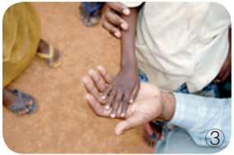
Look＆discuss：
What can you see in the photos?
How do you think each photo relates to world hunger?
The third photo represents
famine. The child in the photo is
a victim of famine, which is why
his/her arm and hand are so thin.
Famine is when the crops do not
grow and there is not enough food for everyone to eat. While famine can be caused by drought, some of the worst famines in world history had other sources, such as insects or diseases that destroyed the crops, or weather that was either too hot or too cool for the crops to grow properly.

Slide 10
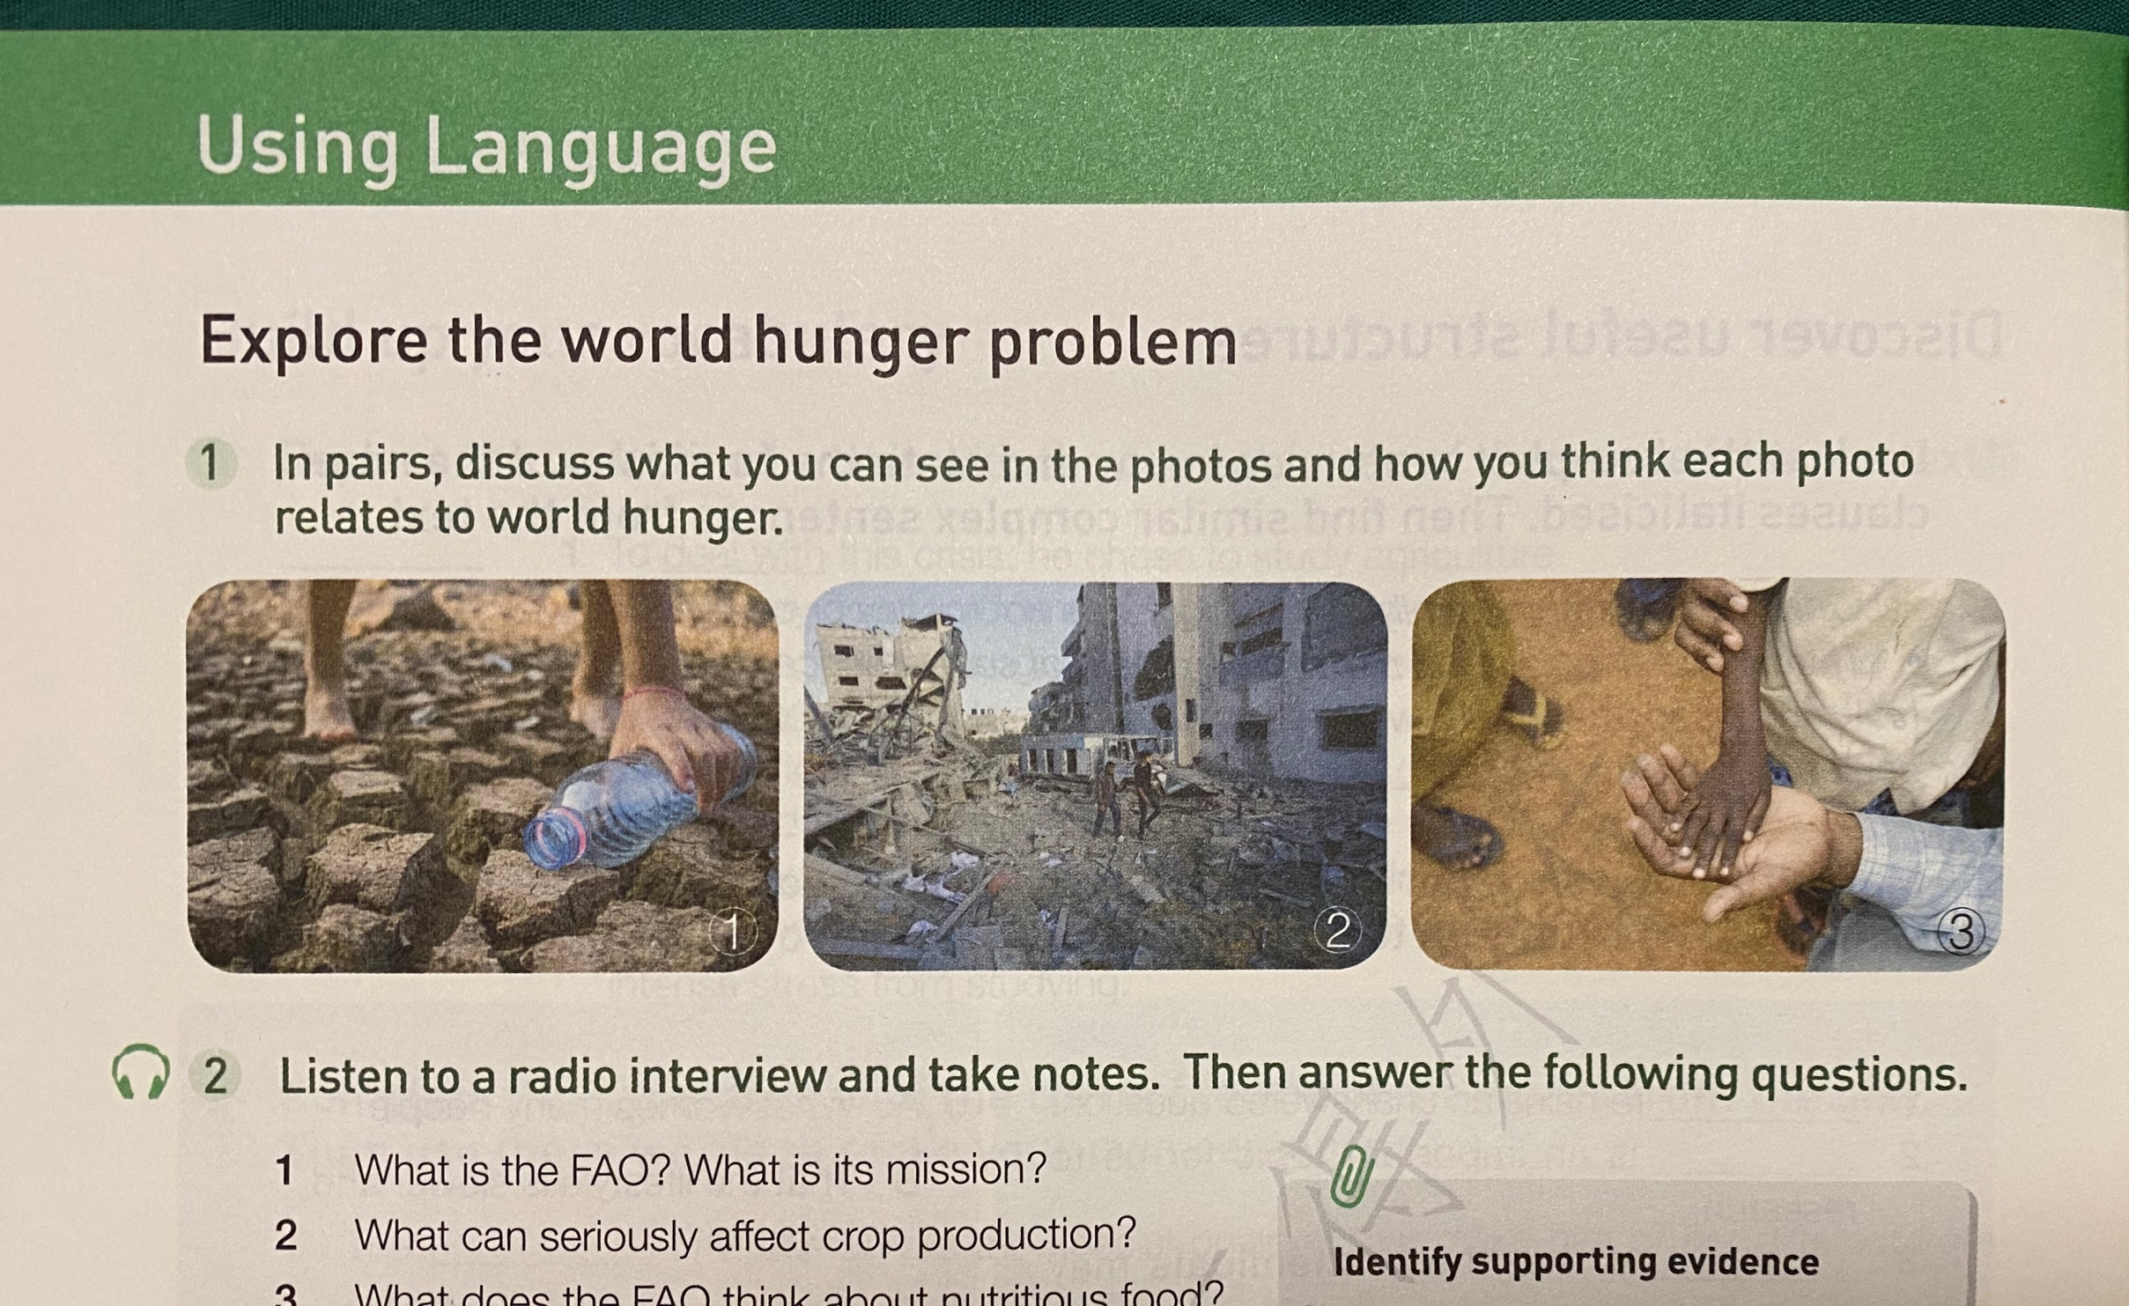
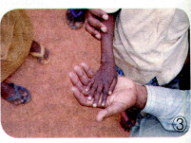
Lead in
Drought
When there is drought, crops cannot grow and animals may die.
War
Hunger often comes with war, as often people cannot farm to grow food or work to get money to buy food.
Famine
Famine can be caused by drought, insects or diseases, or too hot or too cool weather.

Slide 11
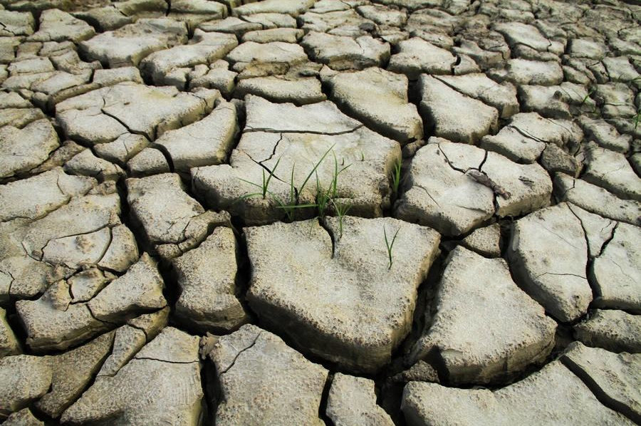
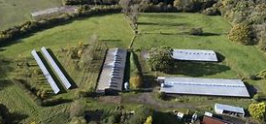
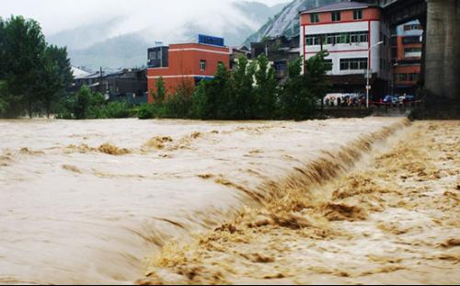
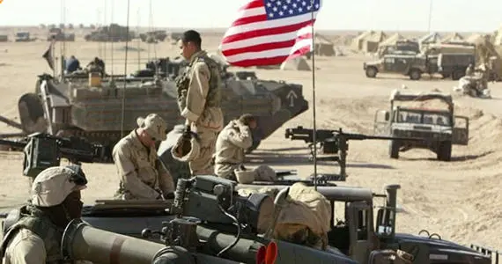
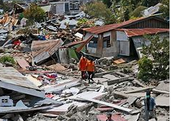
Lead in
What other causes may lead to the world hunger problem?
drought
natural disasters
Farmland used for not farming
flood
human activities
earthquakes
wars

Slide 12



Listen and answer
Listening and Speaking
What is the interview mainly about?
The FAO, the causes of world hunger and the ways to solve the problem of world hunger.
What causes of world hunger are mentioned?
Droughts, floods, climate change, poverty and war.

Slide 13
Listening and Speaking
Activity 1: Listen to a radio interview and take notes. Then answer the following questions.
1. What is the FAO? What is its mission?
FAO stands for Food and Agriculture Organization. Its aim is to eliminate world hunger.
2. What can seriously affect crop production?
Things like Droughts, floods, and climate change.
Note:
eliminate v. to put an end to or get rid of

Slide 14
Listening and Speaking
Activity 1: Listen to a radio interview and take notes. Then answer the following questions.
adj. 有营养的
3. What does the FAO think about nutritious food?
People need to eat enough nutritious food which many people can't afford or don't have access to. The FAO believes everyone should have the right to get healthy food.
使用或见到的机会或权利
Note:
nutritious: adj. containing many of the substances needed for life and growth 有营养的；营养丰富的

Slide 15
Listening and Speaking
vt. 减轻；缓解
Activity 1: Listen to a radio interview and take notes. Then answer the following questions.
4. What is the FAO doing to alleviate world hunger?
The FAO runs a project called Climate-Smart Agriculture, which helps countries to develop sustainable agriculture.
Note:
alleviate v. make (suffering, deficiency, or a problem) less
severe/more bearable
sustainable agriculture
It is about meeting the needs of the present, without sacrificing those of tomorrow—it’s farming that is environmentally sound, socially responsible, and profitable for farmers. Sustainable agriculture strives for the best long-term outcomes for forests, climate stability, human rights, and livelihoods.
https://www.rainforest-alliance.org/articles/what-is-sustainable-agriculture

Slide 16
Listening and Speaking
Activity 1: Listen to a radio interview and take notes. Then answer the following questions.
5. What does the FAO suggest countries do?
The FAO suggests that every country focus on making new achievements in agriculture which can benefit the whole world. Global conflict must be eliminated.

Slide 17

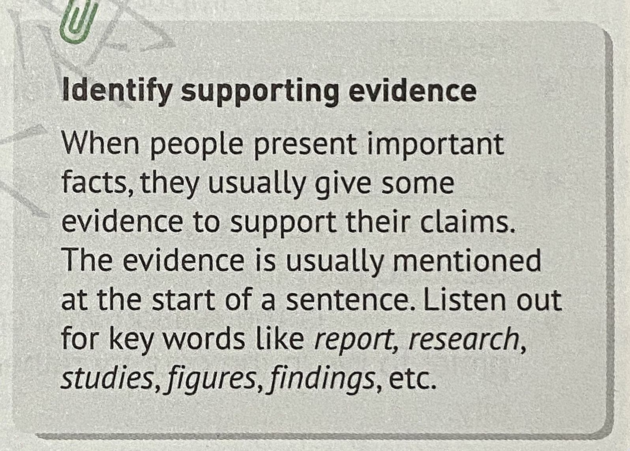
Listening and identify
Listening strategies
Activity 2:Listen again and identify how the speaker supports his facts. Match the supporting evidence with the facts.
the speaker's claims
facts/evidence
Key words:
report, research(es), studi(es), figure(s), finding(s)...

Slide 18

Listening strategies
Listen and match.
A wars can heavily affect food production and transportation.
Our aim is simple, to eliminate world hunger
1 According to our latest
figures, ...
And another factor is poverty
B (world hunger) stands at around 11% of the world's population.
2 There is strong evidence to
suggest that...
War directly leads to mass hunger
C many people just can't afford to eat well
3 Our research indicates that...

Slide 19
Post-listening-Think and share
Activity 3: Work in pairs. Discuss what we should do to improve this situation and help the people in hunger.
What are all the possible causes of world hunger that you can think of?
Droughts; floods; poverty; war.
What can people and countries do to help alleviate these causes?
With droughts, we can invent new forms of agriculture
that do not rely so much on water, and drought-resistant
crops; floods can often be prevented by the building of
dams and levees; poverty is best solved through
economic development and programmes that give
people more opportunities; war may be solved through
international negotiation.

Slide 20

Post- listening-Think and share
Activity 3: Work in pairs. Discuss what we should do to improve this situation and help the people in hunger.
What can we students do to alleviate world hunger?
Never waste food.
Buy food that supports the environment.
Educate people around to become aware of the problem and take action to help.

Slide 21
Post-listening-Think and share
Activity 3: Work in pairs. Discuss what we should do to improve this situation and help the people in hunger.
4. What should we do for the world hunger?
The UN
reduce climate change
The FAO
Climate Smart Agriculture
to develop sustainable agriculture
make new achievements
Every Country
eliminate global conflict
buy food that supports the environment
You and Me
?
never waste food

Slide 22


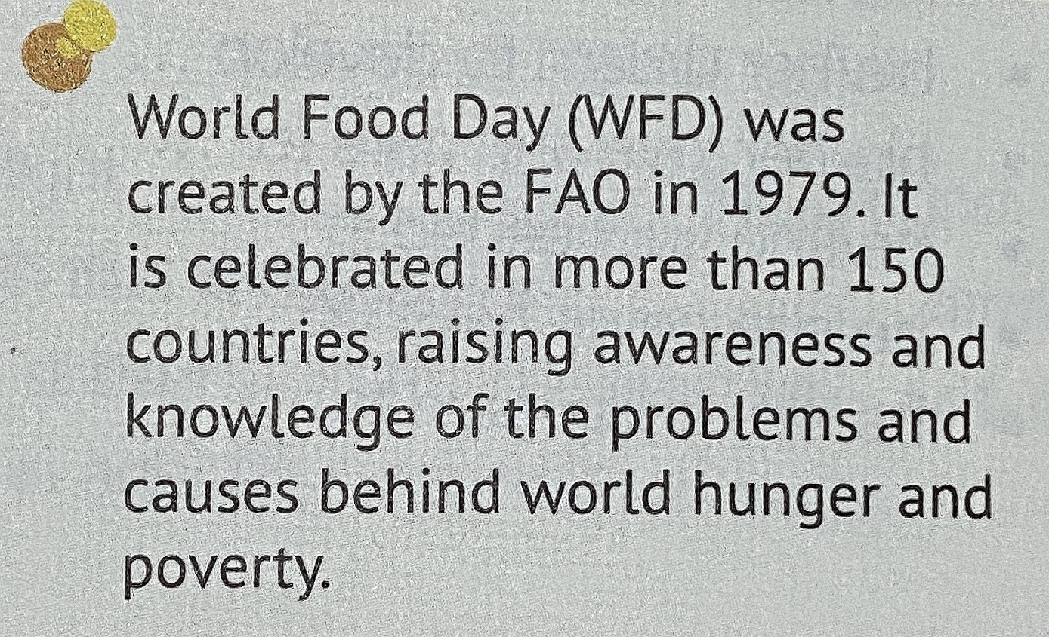
Post-listening-Think and share

Slide 23


Posting listening-Think and share
Work in groups to Brainstorm ideas for some school activities that celebrate World Food Day.
The world organizations devoted to the hunger problem.
Food and Agriculture Organization of the United Nations, FAO


Slide 24
Posting listening-Brainstorm and share
The world hunger problem and how to solve it
World Food Day(WFD) was created by the FAO in 1979. It is celebrated in more than 150 countries, raising awareness and knowledge of the problems and causes behind world hunger and poverty.
Brainstorm and talk
make a difference
individuals
experience hunger
Brainstorm ideas for some school activities that celebrate World Food Day.
food safety
value our food
Our actions are our future
food and environment
eliminate poverty
climate change

Slide 25
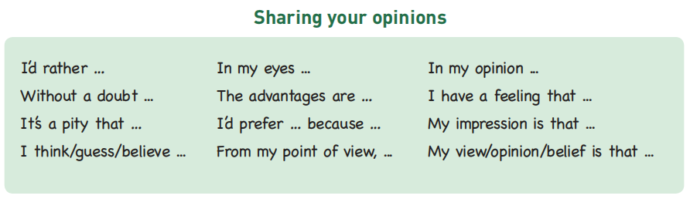
Post-listening-Brainstorm and share
Use the following expressions to help you communicate with your group members.
Useful expressions:

Slide 26

Homework
Prepare a speech for the coming WFD,
calling on people to help alleviate the problem of world hunger.
Your speech is supposed to include:
the information of world hunger;
what countries and individuals can do.

Slide 27

Teacher said class
Thanks for your listening and speaking
PPT template

