Slide 1

感恩遇见，相互成就，本课件资料仅供您个人参考、教学使用，严禁自行在网络传播，违者依知识产权法追究法律责任。
更多教学资源请关注
公众号：溯恩高中英语
知识产权声明

Slide 2
The Internet
Reading and Thinking

Slide 3
What online activities do you usually do?
Benefits
shopping online
1
surf the Internet
more convenient
6
2
more interesting
listen to music
take online classes
5
much easier
stream movies
3
chat online
4

Slide 4
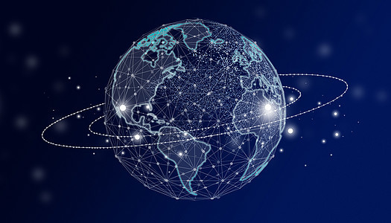
What is the function of the Internet?
connect
A worldwide network to _________ everything through computers, tablets, phones, watches, cameras and so on.

Slide 5
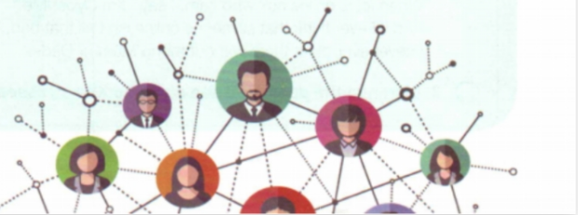
Reading for prediction
Make predictions: Look at the title and picture on P28.
Stronger Together :
How We Have Been Changed by the Internet
Read headlines:
Headlines usually include only key ideas or information from the text.
The writers use as few as possible words to catch the attention of the readers.

Slide 6

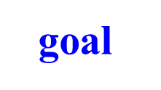


Main idea of each paragraph
1
Introduction
Benefits
Para 1 | _______of the Internet to our life
Para 2 | _________of Jan’s life
Para 3 | Jan’s _________to help others online
Para 4 | Jan's belief and next ______
Para 5 | The ________ why Jan helped others
2
Examples
IT club
Summary
narration

Slide 7


Para 1:What benefits do the Internet bring us?
Much has been written about the wonders of the world wide web. There are countless articles telling us how the Internet has made our lives more convenient. We no longer have to wait in line or carry cash around when we go shopping.
We can get the most updated information from large databases. We can download software, documents, and images whenever we need them. But the Internet has done much more for people than simply make life more convenient. People’s lives have been changed by online communities and social networks.
Whose lives have been changed?
People’s lives
have been changed by online communities and social networks.
reading tip1: contrast
reading tip2: transitional sentence

Slide 8
Specific example: take Jan for example
The Internet helped Jan deal with difficulty
being an English teacher
being out of work
Lonely and bored
surfed the Internet
joined an online group
Feel less lonely and bored
her career changed
her feelings changed
Jan’s life
■ _________ has been changed.

Slide 9
Specific example: take Jan for example
Example of a 59-year-old man
She started an IT club to help others
Example of a 61-year-old woman
being out of work
a helpless woman
start an IT club to help
a helpful woman
Jan’s social role
other people’s lives
________________ as well as _____________________has been changed.

Slide 10
Jan's belief and next goal
Jan's belief
It is highly important to bridge the digital divide and make sure that everyone has access to the Internet and knows how to use new technology.
more examples: bridge the gap between rich and poor;
have access to cleaner water/fresh air/library
Jan's next goal
Her next goal is to start a charity website.
selfless and warm-hearted

Slide 11
What can we learn from her experiences?
Inspirations from Jan and reasons
Q1: What can we learn from her experiences?
When we go through tough times, we can find help and support from others facing similar challenges online.
Q2:From the last sentence, what kind of person do you think Jan is?
understanding, kind. and helpful

Slide 12
Summary
General idea
Our lives have been changed
by the Internet.
Example 2
Many people have been changed by Jan and her friends through the Internet.
Example 1
Jan was changed by the Internet.
Example 3
Jan wants to change children in poor countries.
Conclusion
Jan's life has been greatly improved
by the Internet

Slide 13

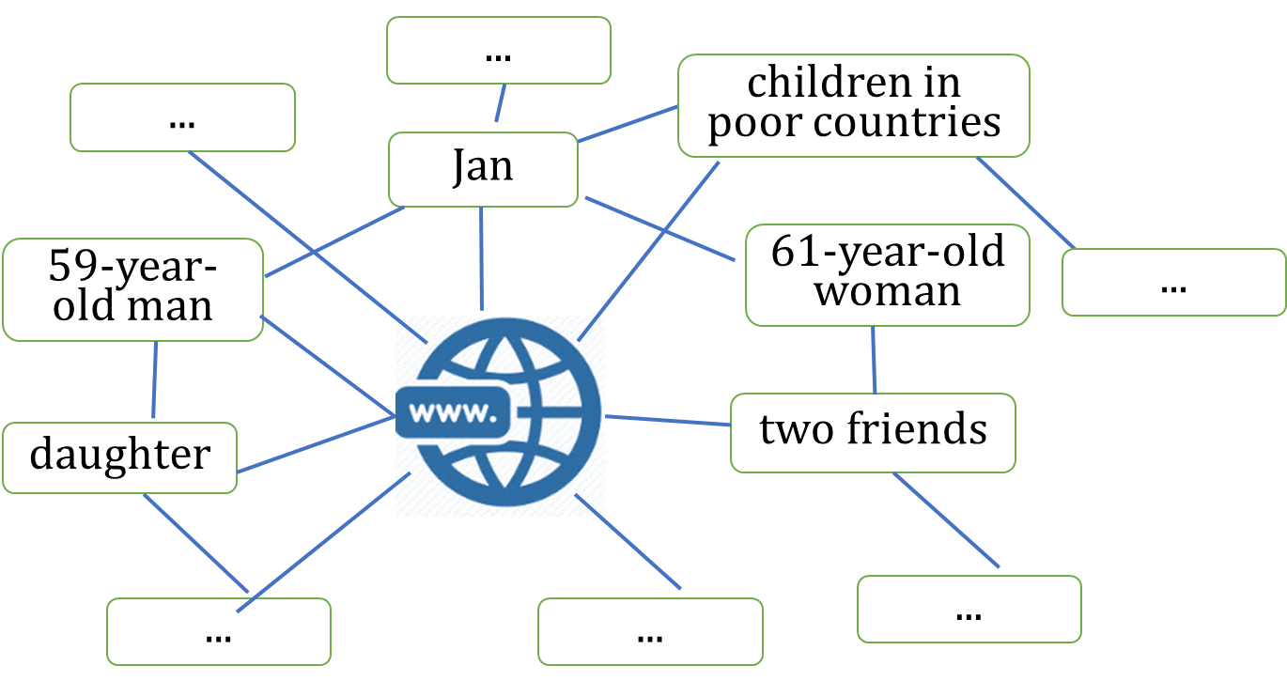
Stronger Together:
How We Have Been Changed by the Internet
If we are together, we’ll be stronger.
If everyone contributes , the world will be a better place.

Slide 14
Further thinking
What made Jan change?
diligent
determined
selfless
helpful
kind
understanding
easy-going
caring
…
■ the Internet
■online communities
■ social networks
■ Jan herself (her qualities)
...

Slide 15
Homework
Surf the Internet. Look for more information about Jan and her IT club, and then write an introduction in less than 150 words.

Slide 16
Thank you

