Slide 1


感恩遇见，相互成就，本课件资料仅供您个人参考、教学使用，严禁自行在网络传播，违者依知识产权法追究法律责任。
更多教学资源请关注
公众号：溯恩高中英语
知识产权声明

Slide 2


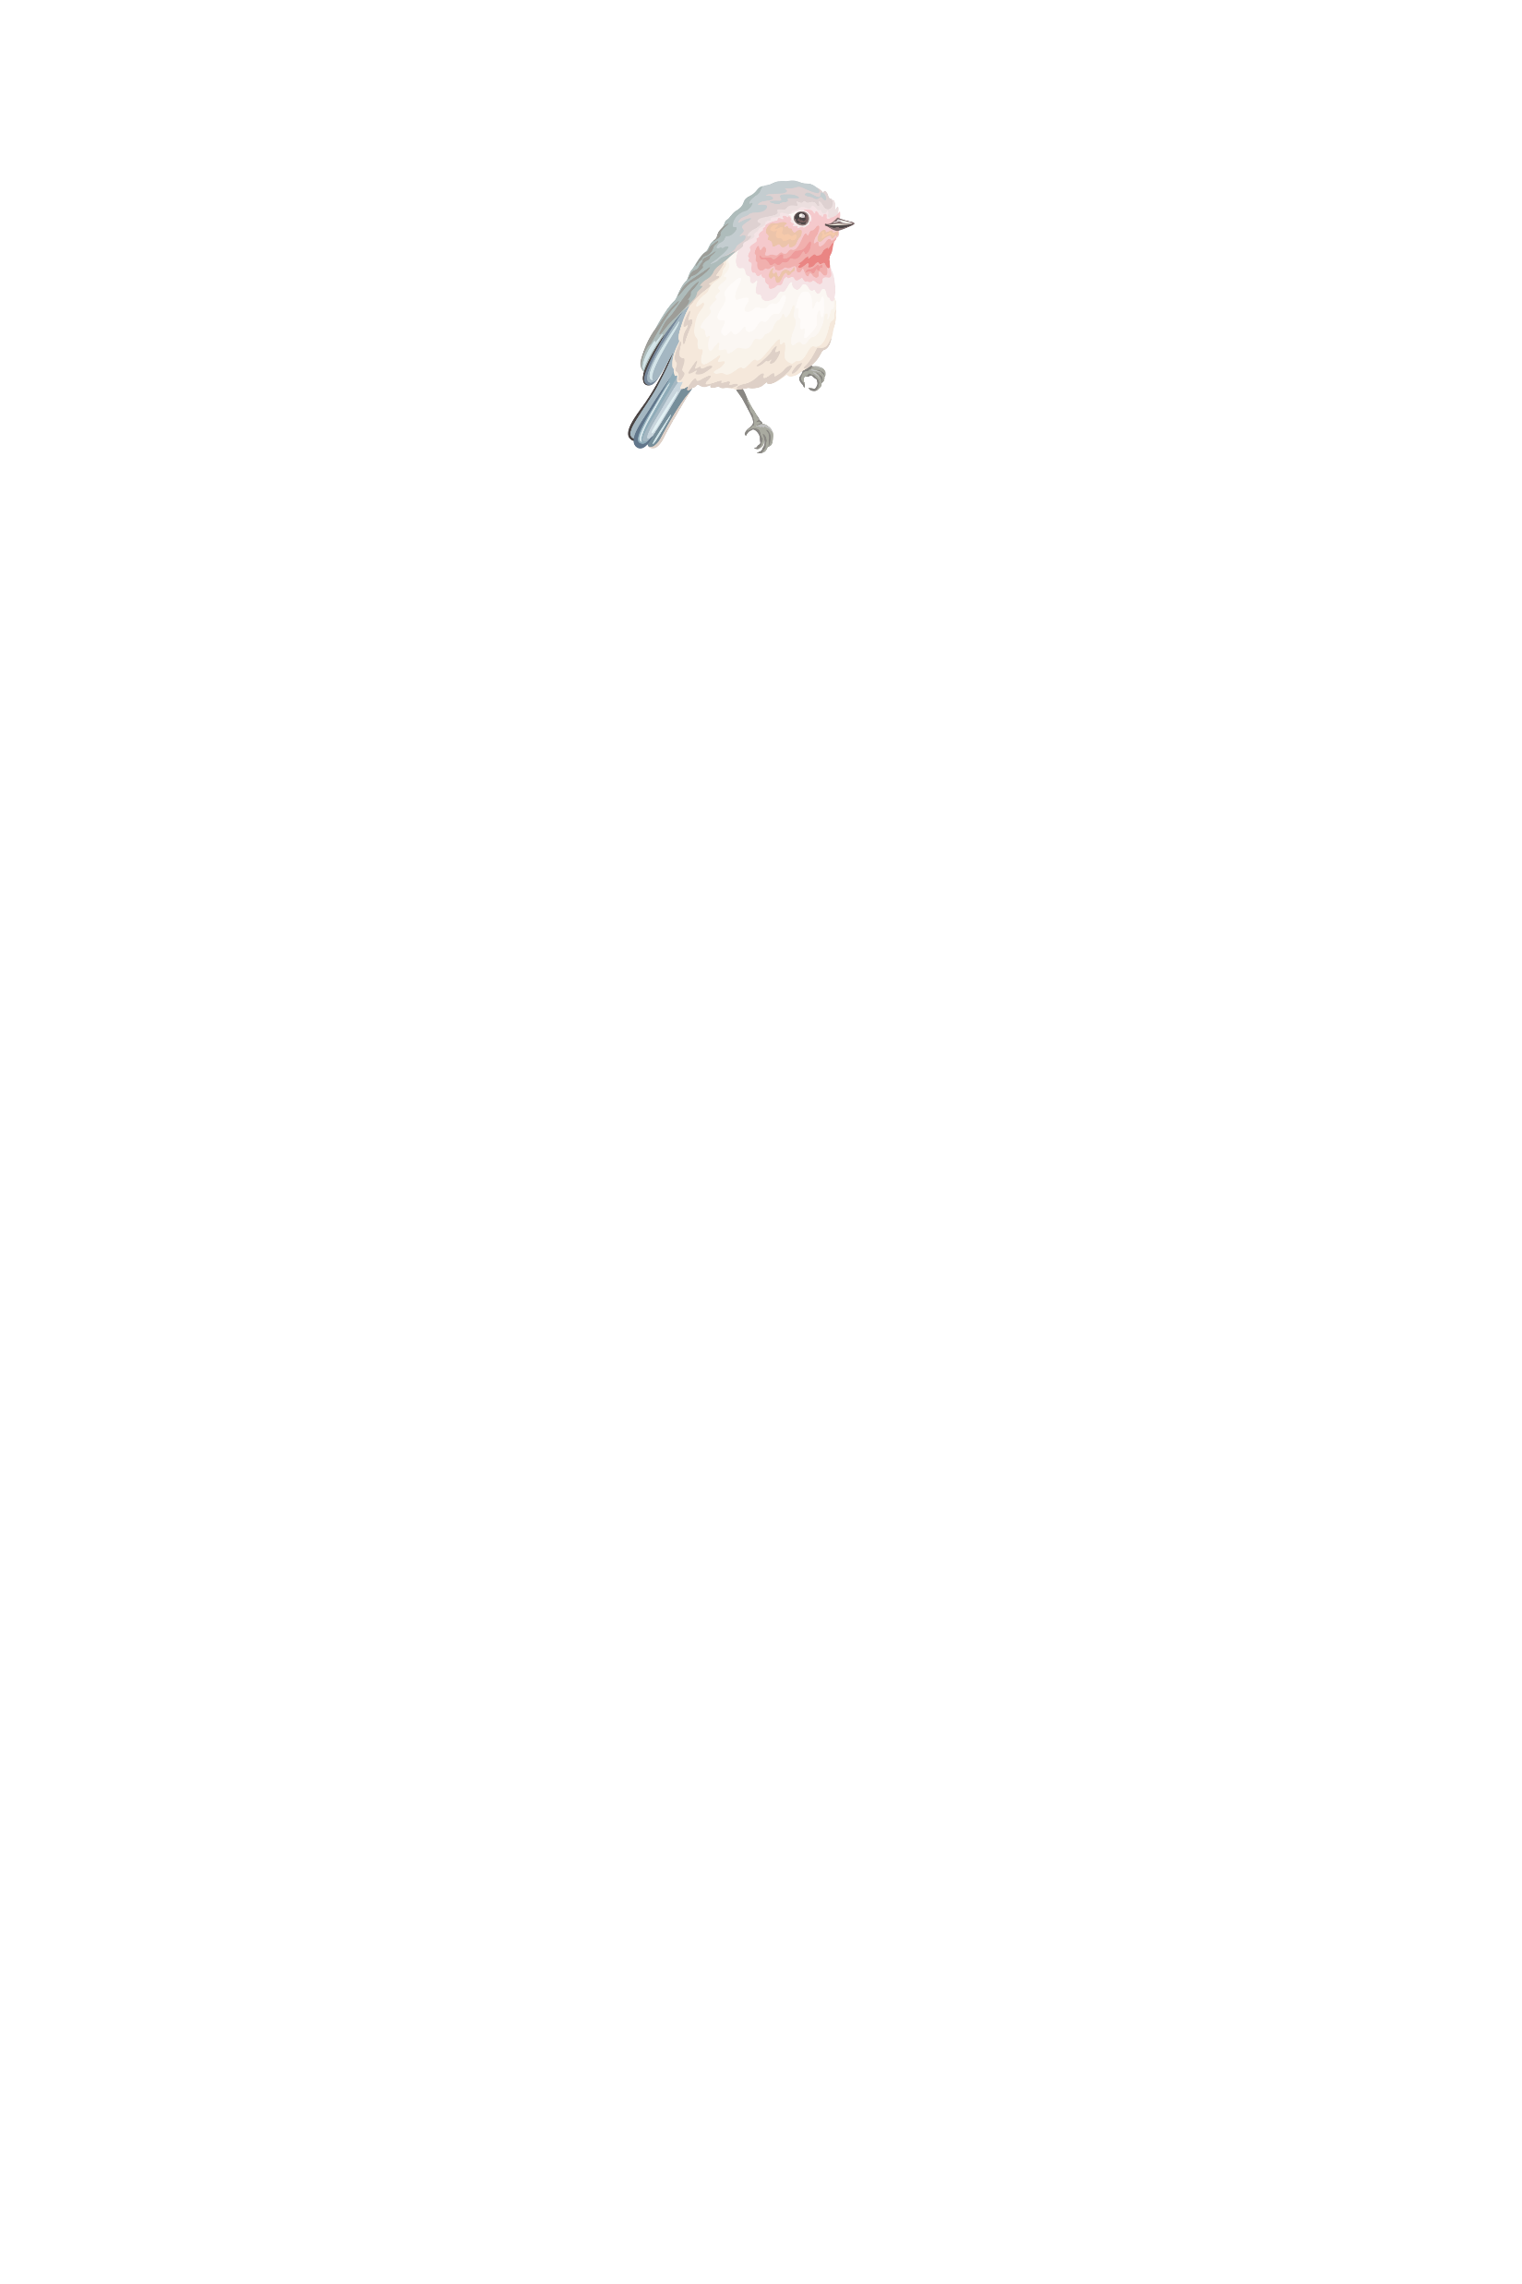



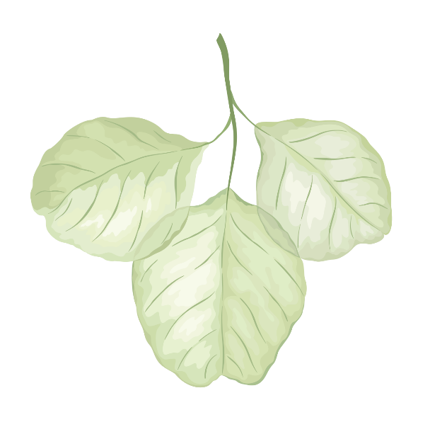

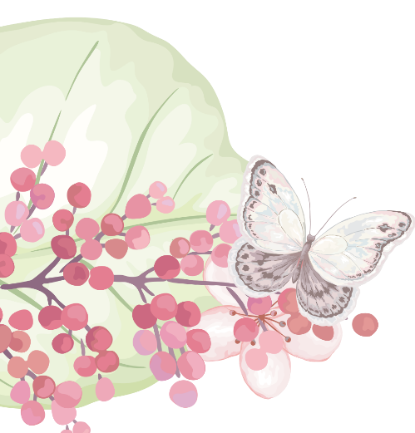
20211105湖丽衢联考读后续写
Watch Over Me
陈星可 浙江省天台中学

Slide 3
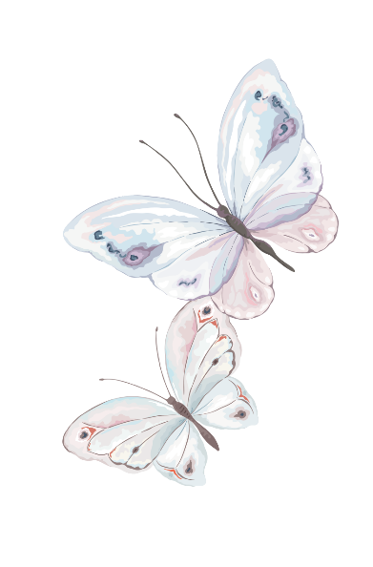
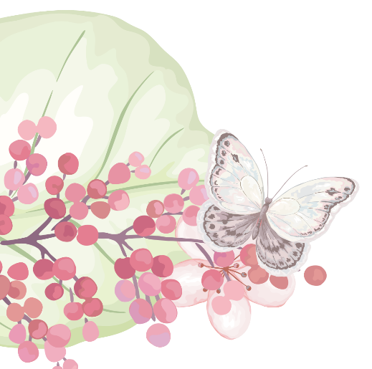
Contents:
PART
PART
PART
PART
01
02
03
04
文本研习
情节推断
语料积累
作品欣赏

Slide 4
试题呈现：
Watching Over Me
There is nothing more wonderful than the smell of the Adirondack air! It fills your lungs with purity and freshness that motivates a love for living. Every weekend in the summer, my father would plan a trip from our home in upstate New York to one of the splendid lakes nestled among the tall pines and thick forests of the Adirondack Mountains. There were no favorites; instead, each lake was an adventure to explore and enjoy.
One trip that I will never forget was a visit to Oneida Lake at the foothills of the mountains . After arriving at the lake beach area, we emptied the car of our picnic supplies, towels, blankets and beach chairs, carrying them through a wooded path that seemed like a forever distance. Once we located the perfect picnic spot, my dad, sister and I ran into the splashing waves with our beach ball, leaving my mother behind to “set up”. In the lake, we immediately played “monkey in the middle” for at least an hour, and then after retiring the ball, my father let us dive from his knee, throwing us up in the air and turning us over like thick pancakes on a grill. This timeless game went on and on as our begging

Slide 5
for “more, more” never stopped .
When we were finally tired of our games, my dad stopped to watch my older sister. She loved synchronized swimming (花样游泳) and started practicing skills that her team used in competition. My father, being an athlete himself, was absorbed in her show. I was sad that no one was playing with me; no one was watching me. I became bored and jealous watching her show off. I was in sulk (愠怒) and decided to swim by myself and try some of my sister’s skills on my own in deeper water, far from both of them. The waves were getting stronger, but I didn't care. I just wanted to do what my sister could do so that I could catch my father's attention.
Paragraph 1: As I took a breath to try a dive, a huge wave swallowed me.___ _______________________________________________________________
Paragraph 2: It was my dad!_______________________________________ _______________________________________________________________

Slide 6
Understanding the passage:
Every weekend in summer, Father would plan a trip to the lakes 1.________ in the Adirondack Mountains to 2.e__________ their purity, freshness and beauty. And one adventure 3.____ particular remains alive in my mind.
After we arrived at the beach and put everything 4.____ ____for the picnic, Dad, my sister and I had really a fun time 5.__________(play) “monkey in the middle” game and dad’s throwing us in the air. When we finally got 6._____ of the game, my dad stopped to 7._______ my older sister practising synchronized swimming skills. 8.__________ anyone watching me and playing with me, I was a bit bored and jealous. To catch my father’s attention, I decided to try someof my sister’s skills in the water 9.____ away from them.
Unluckily, a huge wave 10.____________ me...
nestled
explore
in
in place
playing
tired
watch
Without
far
swallowed

Slide 7
Language learning：
1.守护，保护， 看管
2.坐落于松树林间的湖
3.拿出车里的野餐用品
4.确定野餐的地方
5.飞溅的浪花
6.把某人抛到半空中（开心）
7.把...翻过来
8.对...感到厌倦
9.全神贯注于...
10.炫耀，展示
11.吸引某人的注意力
12.被浪吞没
1.watch over
2.the lake nestled among the pines
3.empty the car of the picnic supplies
empty the picnic supplies out of the car
4.locate the picnic spot
5. the splashing waves
6.throw sb. up in the air
7.turn... over
8.be tired of...
9.be absorbed in...
10.show off
11.catch sb’s attention
12.be swallowed/engulfed by the wave

Slide 8
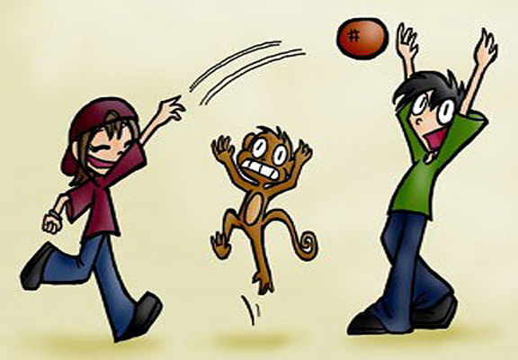
Language learning：
1.There is nothing more wonderful than the smell of the Adirondack air!
高级句式 “否定词+比较级”：表达最高级的意思。此句可以改写为
The smell of Adirondack is the most wonderful of all.
2. My father let us dive from his knee, throwing us up in the air and turning us over like thick pancakes on a grill.
采用了明喻的修辞手法，一般以like, as if, as though等为标志,增加了描写的画面感和生动性。
3.monkey in the middle
背景知识：过顶传球（儿童游戏，由两人抛传球，中间一人争抢）

Slide 9
Develop the story：
Paragraph 1:As I took a breath to try a dive, a huge wave swallowed me.
Paragraph 2: It was my dad!
巨浪吞没了我--- 我惊恐、害怕，在水中挣扎--- 自救失败，我后悔、绝望--- 有人出现，救起了我
爸爸把我救到了沙滩上--- 全家人安慰我，没有责骂我--- 我深感内疚，明白家人一直爱着我，虽然有时候并没有看/关注着我。

Slide 10
Develop the story：the first sentences
Paragraph 1:As I took a breath to try a dive, a huge wave swallowed me.
Paragraph 2: It was my dad!
Q1:How did I feel about the situation and what did I do?(心理活动+动作+情绪/感)
Q2:Did I manage to get out of water? How did I feel?(心理活动+动作+情绪情感)
My father came to my help.
逆推法
Q1:How did I feel after I got onto the beach?(心理活动+动作)
Q2:What did my family member do?(动作+情绪情感)
Q3: How did I reflect on the unprepared adventure?(内心想法+抽象名词+ watch)

Slide 11
Develop the story：underlined words （para1）
father
sister
waves
water
love
explore
carry
dive
watch
bored
1. I was struggling in the water, afraid that my life would end up here in the lake.
2. I tried to keep myself floating above the water, but the waves kept pulling me down under.
3. I felt desperate, like a tiny broken boat at the mercy of the angry waves.
4. My strength was running out and I was on the verge of giving up when someone swam close to me and took my hand, firmly.





1.How I regretted having been so willful as to leave my dad and dive into such a lonely place! Now, it was too late.
2.I felt a strong push from under and myself being carried up out of water.



Slide 12
Develop the story：underlined words （para2）

1.Father hugged me tightly and carried me back to a place where I could stand.
2.He had never taken his eye off me, even as he had the other eye on my sister.
3. Looking back the at the strong waves, I felt lucky to be back alive and ashamed of my childish jealousy of my sister.
father
sister
waves
water
love
explore
carry
dive
watch
bored




1. Seeing I was back on the beach, safe and sound, my sister heaved a sigh of relief.
2.Without his watching over me, without his loving me, I would not be the strong woman I am today.
3.I was well aware that dad’s love was actually always showered on me and stayed with me though sometimes he was not watching me.





Slide 13
Language accumulation-后悔、绝望
1.I immediately regretted having said this.
我马上就后悔说了这话。
2.He was deeply regretful for his outburst.
我为自己的大发雷霆懊悔。
3. I was stabbed with regret/remorse.
我因悔恨而心如刀割
4. If I hadn’t quarrelled with Peter, I wouldn’t be trapped here. 虚拟语气
=Hadn’t I quarrelled with Peter, I wouldn’t be trapped here.
要不是当初没有和Peter吵架，我就不会被困在这里了。
5. She was so desperate/hopeless that she gave up struggle in despair.
太绝望了，她放弃了努力/挣扎。

Slide 14
Language accumulation-后悔、绝望
6.Desperately, I sought help from my uncle, but in vain.
我绝望地寻求着帮助，但是无果而终。
7.Tony was suddenly thrown into a world of darkness and sank into hopelessness.
Tom被扔进了绝望的深渊。
8.My heart ached/sank, tears streaming down my cheeks.
我的心痛得绝望，泪如雨下。
9.His heart swelled with disappointment when…
他的心里满是失望，......。
10.The harsh words sent her into the depths of despair.
这尖刻的话语把我送进了绝望的深渊。

Slide 15
Language accumulation-害怕
1.A ripple/wave of fear ran/surged through him/his body.
一阵恐惧席卷他全身。
2.Devi sat on the side on a bench, paralyzed with fear.
Devi 坐在一长凳的边上，吓坏了。
3.Tremors wracked my body, and cold sweat trickled down my back.
我被吓得身体抖个不停，冷汗直流背下。
4. She was struck/ consumed/ overcome with fear when…
她被吓到了。
5.I froze with terror, too scared to move an inch.
我吓呆了，僵在那里动不了。
6.I felt a wave of fear wrap around me.
我感到一阵恐惧包围了我。

Slide 16
Language accumulation-害怕
7.Paula was seized by fear and was rooted to the floor.
Paula无比恐惧，双脚好像钉在了地上。
8.She was frightened out of her wits.
她吓得魂不附体。
9.He looked at the robber, his legs trembling/shaking.
他看着那劫犯，双腿抖个不停。
10.His face turned pale with fright.
他的脸吓得都白了。
11.His hair stood on end as he thought he saw a white figure coming towards him.
当他看到一个白影朝他走过来，他吓得头发都竖了起来。
12. The horrible scene made my blood run cold and struck fear into my heart.
那可怕的场面使我毛骨悚然，胆战心惊。

Slide 17
Language accumulation-波涛汹涌
1.The coastline was hidden behind the roaring waveswith almost no one to be seen.
海岸线已经退到汹涌的海浪的后边，岸边不见一人。
2. A huge wave whistled and approached us.
一阵海浪呼啸而来，逼近我们。
3. The big wind roared through our ears, and we were pushed away from the shore farther and farther.
大风在耳边咆哮， 把我们刮得离海岸越来越远。
4. All my senses told me that a big wave was about to come.
所有得感觉都指向一件事：大浪要来了。
5. The fierce waves showed no sign of dying down.
凶猛得海浪没有丝毫消退的迹象
7. The sea was rough that day and it was difficult to handle the bodyboard.
海面波涛汹涌，要把控好船只太难了。

Slide 18
参考范文：
As I took a breath to try a dive, a huge wave swallowed me. I choked and then a huge undercurrent swept me deeper beneath the waves. The very thought of dying filled me with a mad panic. I kicked my legs wildly, losing any hope for a breath. I remember trying to stand up, but the sandy bottom had disappeared. As I came up searching for the surface, struggling for oxygen, sputtering to clear my lungs, I felt a firm grasp on my arm and a pull to safety.
It was my dad! He hugged me tightly and carried me back to a place where I could stand. There was no scolding, just a big hug and smile because he knew I was all right. He had been watching me all along! He had never taken his eye off me, even as he had the other eye on my sister. He had protected me. Being told by someone that you are loved is great, but experiencing that love is awesome. Without his watching over me, without his loving me, I would not be the strong woman I am today.

Slide 19
下水作文：
As I took a breath to try a dive, a huge wave swallowed me. The wave seemed to be getting stronger and stronger, attempting to pull me deeper to the bottom of the lake. Struggling hard to keep myself floating, I kicked my legs desperately, but it didn’t work. I tried to call dad for help, but it was far away and my cry was swallowed by the roar of the wave. Every luck seemed to be going against me! Thinking that my life might end up here in the lake, I felt like a tiny broken at the mercy of the frightening wave. However, just as I was about to give up, I felt something warm took hold of my hand and held up my body.
点评：
1.本段的亮点是心理活动的细腻描写，把主人公的绝望心理刻画得很细腻，并且采用了比喻的修辞手法，很有画面感。
2. 两组but结构的句群把主人公的奋力自救的场景写得很有力度，非常powerful.
3.现在分词的多次但不重复的运用、struggle, desperately, in vain, swallow, go against,at the mercy of等高级结构和表达的使用，提高了文章的结构和语言档次，为得高分打下结实的基础。

Slide 20
下水作文：
It was my dad! “Don’t panic! Here I am.”dad comforted. He held me tightly and carried me to safety. Making sure that I was all right, all my family heaved a sigh of relief. Guilty about what I had done, I didn’t dare to look up to meet their eyes, but down at the ground, waiting for my father’s scolding. However, what greeted me was his warm hug and smile. I felt really blessed to be alive to smell the Adirondack air and well aware that dad’s love was actually always showered on me and stayed with me though sometimes he was not watching me. 100
点评：
1.形容词结构置于句首，把人物的心理活动描写和动作描写很好地结合起来。主语从句的运用使得句子的表达变得丰富起来。
2. feel blessed to do, be showered on,meet their eyes等高级表达的使用，展示了作者较高的语言文字驾驭能力。
3.文章结尾的收句是个点睛之笔，不但使用了高级的句子结构和语言，同时很好地把文章的要旨love和watch点出来。

Slide 21
THANK YOU

