Slide 1

感恩遇见，相互成就，本课件资料仅供您个人参考、教学使用，严禁自行在网络传播，违者依知识产权法追究法律责任。
更多教学资源请关注
公众号：溯恩高中英语
知识产权声明

Slide 2

Learning objectives:
After the class, the students will be able to:
1) get a better understanding of the Winter Olympics and the
characteristics of skiing, skating and the Skeleton by reading the
text and watching the video.
2) explore the charm of different cold sports as well as their
differences by appreciating their content, language and structures.
3) write a letter based on the topic, structure and language learned
in class.
4) deeply feel the honor to take part in the Olympics and the
importance of doing sports.
B1U3 Cool Cold Sports
Reading for writing

Slide 3
Vocabulary:
1. the Winter Olympic Games 冬奥会
2. win medals and honor for their country 为国家获得奖章和荣誉
3. sibling 兄弟姐妹
4. the Olympic spirit 奥运精神
5. originally 最初，一开始
6. compete with sb. in sth. 在某个体育项目与某人竞争
7. be considered to be/as... 被认为是。。。
8. princes and princesses 王子和公主们
9. graceful and highly skilled 动作优雅、技术高超
10. be named after ... 以。。。命名
B1U3 Cool Cold Sports
Reading for writing

Slide 4
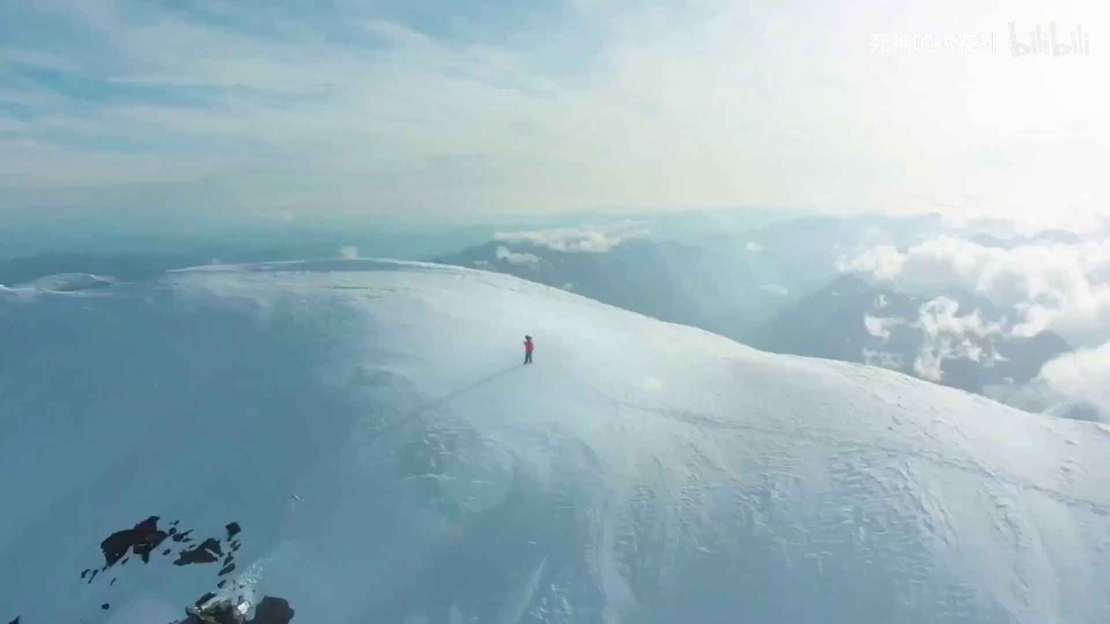

Slide 5
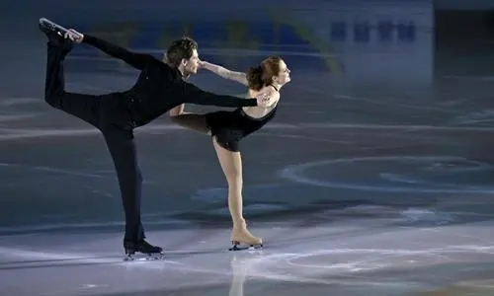
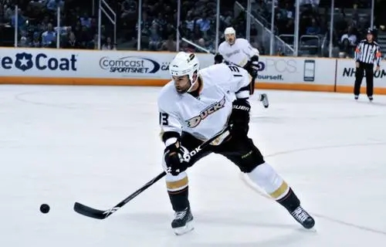
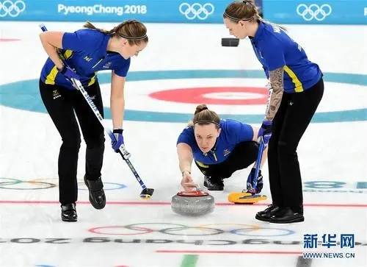
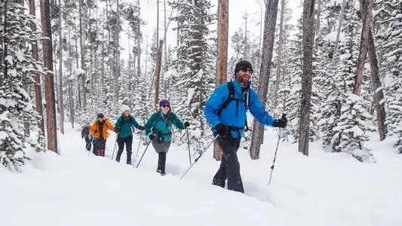
Lead-in
What kind of sports events are they ?
花样滑冰
（figure skating）
冰球
（ice hockey)
越野滑雪
（cross－country skiing）
冰壶（curling）

Slide 6
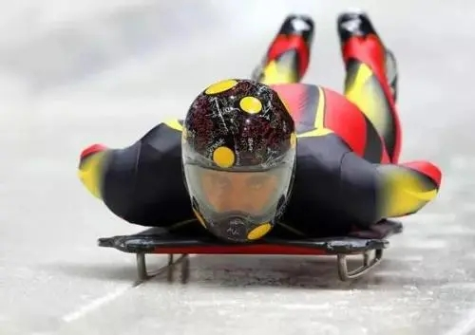
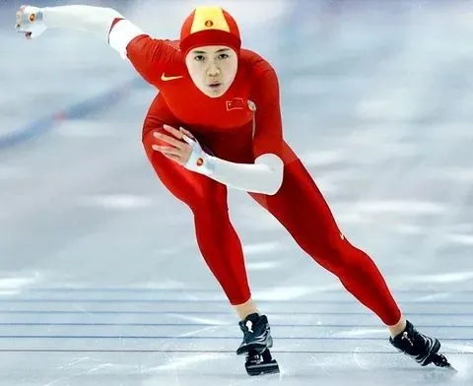
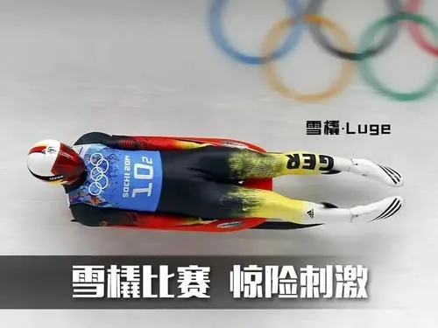
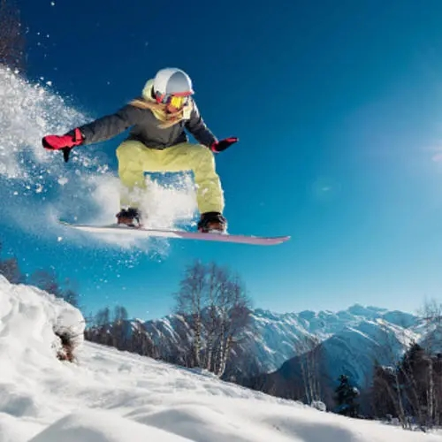
俯式冰橇（skeleton）
速度滑冰
（speed skating）
无舵雪撬 (luge)
滑板滑雪（snowboarding）

Slide 7
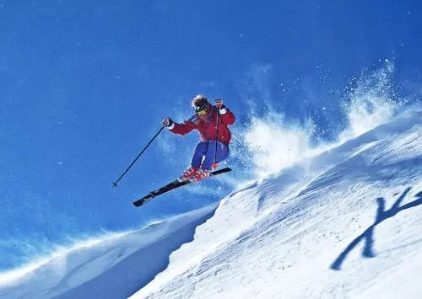
B1U3 Cool Cold Sports
Reading for writing
Jane

Slide 8
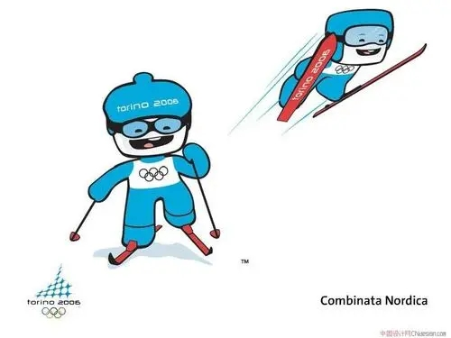
Reading Para.1: The Winter Olympic Games
Q1: What benefits will the Winter Olympic Games bring?
It’s a chance for athletes to win medals and honor.
... for audiences to get to know more about winter sports.
Q2: What is the “summer sibling” of the Winter Olympics?
Why do you think the writer uses that phrase?
The Olympic Games. The writer uses that phrase
because the two competitions are closely related,
like members of a family. “sibling”means a brother or sister.

Slide 9
Reading Paras. 2-4
Can you find any proper adjectives(形容词) to describe each sport?
Cold Sports | Features (特点)
Skiing
Skating
The skeleton
popular
①It is one of the most sports of the Winter Olympic Games.
②Skiers the downhill..., and in the cross-country ski races.
③Skiing was played in..., but now from all over
the world this sport...
compete in
popular
originally (at first)
athetes
compete in
Q: How does the writer describe figure-skaters?
attractive/charming
considered
②The figure Skaters are to be the stars of the Winter Olympic
Games, as they are and athletes.
graceful
highly skilled
stragest-named
① It is one of the sports of the Olympics.
② The Skeleton the shape of the metal sleds.
③ the luge(无舵雪橇)：
A person sits on the of the sled with the feet forward.
the skeleton(俯式冰橇): It is more .
A person lies on the on the sled, with the head .
is named after(以...名字命名)
unique/special
contrast
back
exciting and dangerous
stomach
pointing downhill

Slide 10
Thinking
What do they have in common?
1. Popular; attractive/charming; unique/special; cool/exciting...
2. One of the ...sports is...
3. ...was played originally(at first) in...but now...from all over the world
compete with sb. in...
4. ...be considered as...stars of..., ...graceful and highly skilled athletes...
5. ...be named after (以。。。命名)...
6. Contrast: A is...While B is more...
Cold Sports | Features (特点)
Skiing
Skating
The skeleton
cool/exciting/popular...＋supporting evidence
popular
①It is one of the most sports of the Winter Olympic Games.
②Skiers the downhill..., and in the cross-country ski races.
③Skiing was played in..., but now from all over
the world this sport...
compete in
popular
originally (at first)
athetes
compete in
They all share the Olympic Spirit: “Faster,
Higher and Stronger”.
considered
attractive/charming
②The figure Skaters are to be the stars of the Winter Olympic
Games, as they are and athletes.
graceful
highly skilled
They offer a chance for athletes to win
medals and honors and for audiences to get to
know more.
stragest-named
① It is one of the sports of the Olympics.
② The Skeleton the shape of the metal sleds.
③ the luge(无舵雪橇)：
A person sits on the of the sled with the feet forward.
the skeleton(俯式冰橇): It is more .
A person lies on the on the sled, with the head .
is named after(以...名字命名)
unique/special
contrast
back
...
exciting and dangerous
stomach
pointing downhill

Slide 11
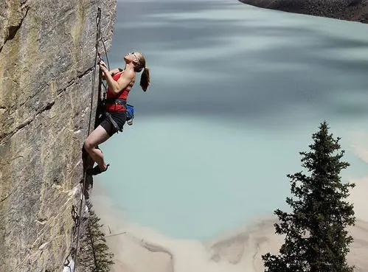
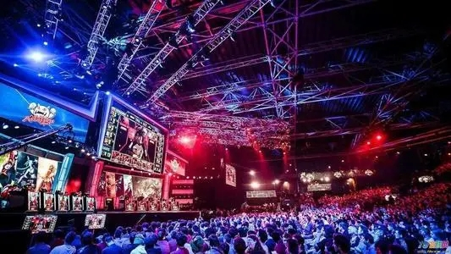
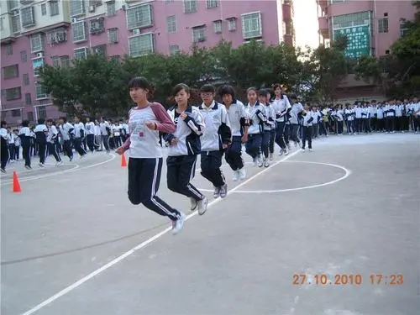
1. Popular; attractive/charming; unique/special; cool/exciting...
2. One of the ...sports is...
3. ...was played originally(at first) in...but now...from all over the world
compete with sb. in...
4. ...be considered as...stars of..., ...graceful and highly skilled athletes...
5. ...be named after (以。。。命名)...
6. Contrast: A is...While B is more...
Discussion & Sharing
Which sport or event do you think should be added to the Olympics? Why?
Rock Climbing
(攀岩)
E-sports
(电竞体育)
Rope Skipping
(跳绳)

Slide 12
Writing
Dear Sir/Madam,
My name is , and I’m a student in , China. I’ m writing to you to ask whether .
This sport... .
I think should be included as an Olympic sport because...
.
I would appreciate it if you can take my suggestion into consideration.
Yours,
Li Hua/...

Slide 13


Homework
Write a letter to the International Olympic Committee (IOC) based on your discussion according to the given structure.

Slide 14
Possible version
Dear Sir/Madam,
My name is Li Hua, and I’m a student in No.1 Senior High School, China. I’ m writing to you to ask whether Rock Climbing could be added to the Olympic Games.
This sport was originally played indoors, but now athletes from all over the world compete with each other odoors, close to nature. It is so exciting and charming. Besides, it also shares the Olympic Spirit “Faster, Higher and Stronger”, which offers a chance for athletes to win medals and honors for their country and for audiences to get to know more of the world as well.
I would appreciate it if you can take my suggestions into consideration.
Yours,
Li Hua

