Slide 1

感恩遇见，相互成就，本课件资料仅供您个人参考、教学使用，严禁自行在网络传播，违者依知识产权法追究法律责任。
更多教学资源请关注
公众号：溯恩高中英语
知识产权声明

Slide 2
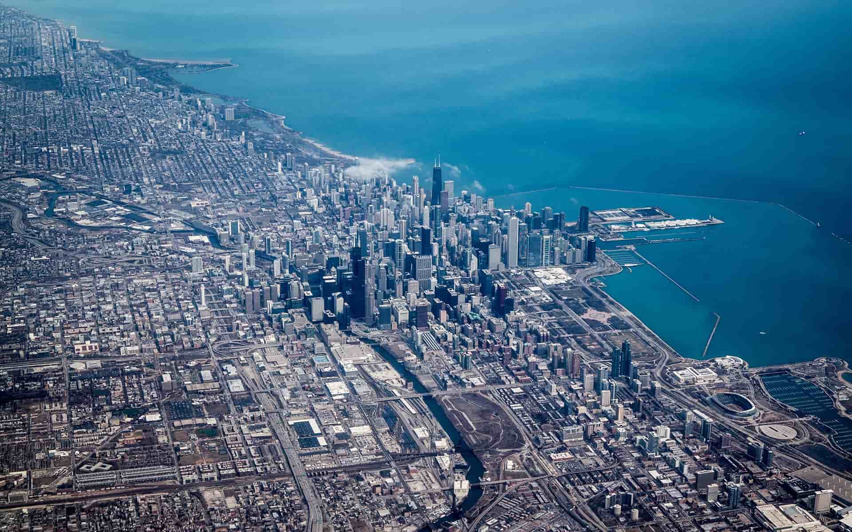
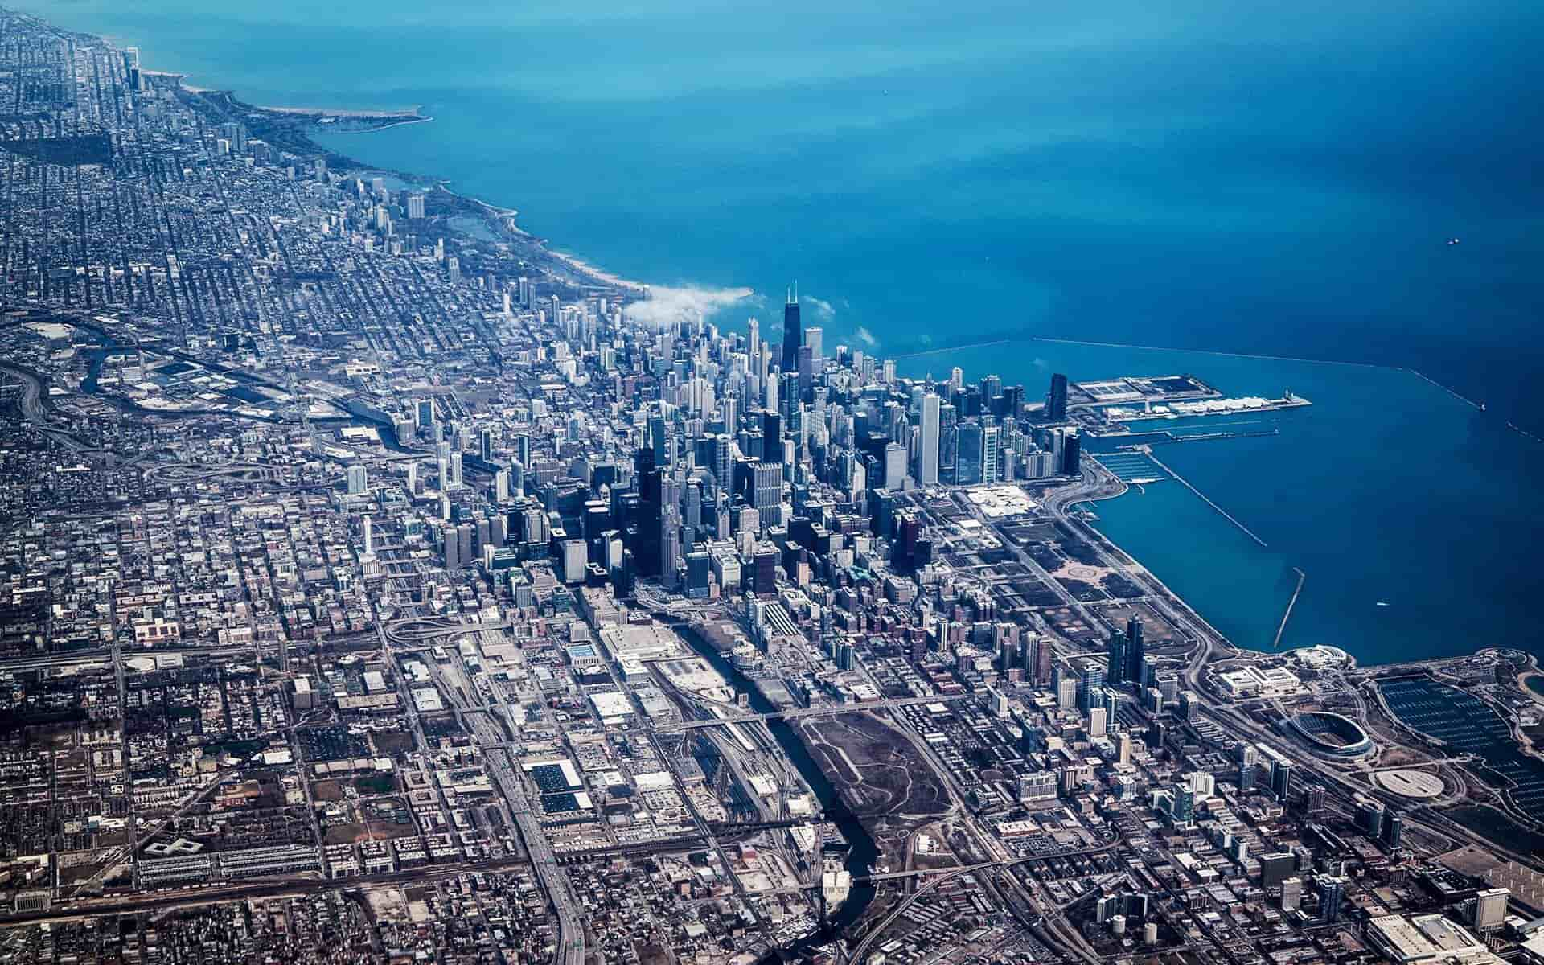
人教版老教材选修6 单词拓展
强基固本回归教材单词，
考前冲刺提升综合素养
——活用教材词汇，靶向高考写作
浙江省常山一中：吴俊峰

Slide 3

活用教材词汇，靶向高考写作
写
作
词
汇
——人教版 M6U1-Art
单词拓展
1. abstract 2. gallery 3. consequently 4. aim 5.conventional 6. typical 7. evident 8.adopt
9. humanistic 10.possess 11. superb 12. perspective 13. coincidence 14.shadow 15. ridiculous 16. controversial
17. attempt 18.on the other hand 19. landscape 20. specific 21.figure 22.carve 23. delicate 24. allergic
25.effectively 26.exhibition 27. aggressive 28.scholar 29. flesh 30. bunch 31. preference 32.appeal
33.fragile 34.reputation 35. civilization 36.visual 37.fragrant 38.permanent 39.committee

Slide 4



1.
abstract /ˈæbstrækt/ adj. 抽象的；深奥的 n. [C]摘要
抽象概念必须用例子来具体说明。
✍The abstract must be made concrete by examples.

Slide 5
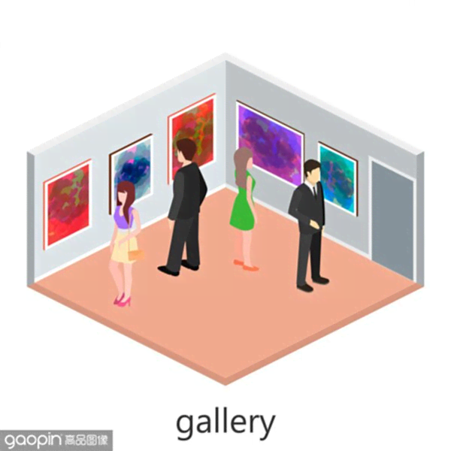
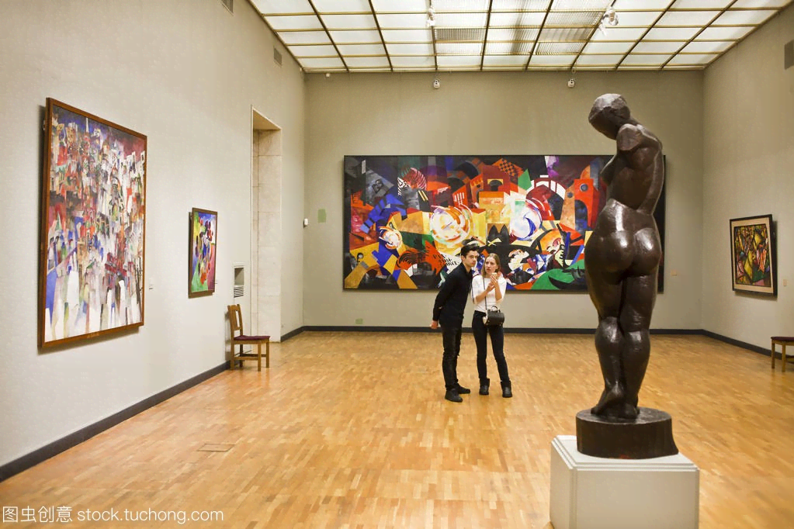
2.
gallery /ˈgælərɪ/ n. [C] 美术陈列室；画廊
1.美术馆收藏了2 000件现代艺术珍品。
✍1.The gallery houses 2000 priceless works of modern art.
2.中国民间文学作品展将于下周一至周五上午9点至下午6点在市美术馆举行。（应）
✍2.The exhibition of Chinese folk literature will be held in the City Gallery from next Monday to Friday, 9 am to 6 pm.
3.本周周一至周五，学校美术馆将举办国画作品展，主要展示我校学生的作品。昨天参观时，给我留下了深刻的印象。（2021年6月浙江卷应用文“ 参观国画展的宣传报道”）
✍3.A traditional Chinese painting exhibition, mainly showcasing our students’ works, is open to everyone this week from Monday to Friday at the school gallery. Yesterday when visiting there, I was greatly impressed.

Slide 6

3.
consequently /ˈkɒnsɪkwəntlɪ/ adv. 所以；因而
大多数人在学校表现不佳不是因为他们缺乏能力，而是因为他们觉得学校没有挑战性，因此失去了兴趣。（概）
✍Most performanced poorly in school not because they lacked ability but because they found school unchallenging and consequently lost interest.

Slide 7
4.
aim /eɪm/ n. [C] 目标；目的
1.为了促进不同文化之间的相互理解，本次演讲的主题是“我与中国的故事”，让参与者在展示自己的汉语口语能力的同时，分享在中国的精彩经历。（2020年1月浙江高考应用文“告知外国朋友中文演讲比赛”）
✍1.Aimed to promote mutual understandings between various cultures, the speech with the theme of“My story with China”, allows participants to demonstrate their oral Chinese skills as well as share amazing experiences in China.
mutual/ˈmjuːtʃuəl/ adj. 共同的；相互的，彼此的 demonstrate/ˈdemənstreɪt/ vt. 证明；展示
2.定于4月22日的“地球日”是一个旨在提高公众环保意识的年度活动。（应）
✍2.Earth Day, marked on 22 April，is an annual event aimed to raise public awareness about environmental protection.
3.旨在发展我们的兴趣并提高我们的技巧, 我写信真诚邀请您参加我们学校乒乓球队。（应）
✍3.Aiming at developing our interests and improving our skills, I am writing to sincerely invite you to join the table tennis team in our school.

Slide 8

5.
conventional /kənˈvenʃənl/ adj. 常规的；传统的；因循守旧的
1.传统艺术家们无意于如实地展现自然界和人物。
✍1.A conventional artist of this period was not interested in showing nature and people as they really were.
2.传统方法/循规蹈矩的行为（应、概）✍2.conventional methods/behaviour
3.根据传统观点
✍3.according to the conventional view
4.一个可敬的观念传统的已婚妇女。（续）
✍4.a respectable married woman with conventional opinions

Slide 9

6.
typical /ˈtɪpɪkl/ adj. 典型的；有代表性的；一贯的 (用于批评或抱怨)
1.她往空中挥挥双手说，“你一贯就是这个样子，是不是？” （续）
✍1.She threw her hands into the air. "That is just typical of you, isn't it?"
2.杰克又迟到了。让别人久等是他的一贯作风。
✍2.Jack is late again. It’s typical of him to keep others waiting.
=Typically, he always keeps others waiting.
3.在期末考试前，学生们经常看书到深夜。（应）
✍3.It is typical of students to stay up reading till late night before the final exam.
4.我们两人都有着共同的品质和美德，这些是美国演员的共同特点。
✍4.Both of us had the qualities and virtues that are typical of American actors.
5.年轻一代理所当然地认为父母应该满足他们的一切欲望，这是他们的典型特征。（应、概）
✍5.It is typical of the young generation to take it for granted that parents should meet whatever they desire.

Slide 10
7.
evident /ˈevɪdənt/ adj. 明显的；明白的
1.不言而喻，我们将永远不会有足够的资源来满足需求。（应、概）
✍1.It is self-evident that we will never have enough resources to meet the demand.
2.她一副志在必得的样子，显然这不是一次随意造访。（续）
✍2.She had a purposeful air, and it became evident that this was not a casual visit.
3.现代科学已经有了吸烟能导致许多种疾病的明确证据。（应、概）
✍3.Modern science has given clear evidence that smoking can lead to many diseases.
4.有足够的证据表明气候模式正在改变。（应、概）
✍4.There is ample/abundant evidence that climate patterns are changing.

Slide 11

8.
adopt /əˈdɒpt/ vt. 采用；采纳；收养
1.人们开始较少地关注宗教，而采用了一种更人道主义的态度对待生活。（概）
✍1.People began to concentrate less on religious themes and adopt a more humanistic attitude to life.
2.贫富差距使得政府必须采用动态的方案来解决这个问题。（概）
✍2.The gap between the rich and the poor makes it essential that the government adopt a dynamic solution to the problem.
3.经过再三考虑之后，当局决定采取措施来疏通拥挤的交通。（应、概）
✍3.After much deliberation, the authority decided to adopt measures to smooth the heavy traffic.
deliberation /dɪˌlɪbəˈreɪʃn/ n. 考虑；审慎；商议；细想

Slide 12
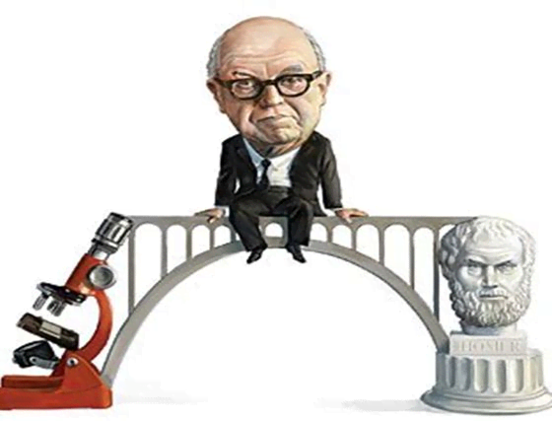
9.
humanistic /ˌhju:mə'nɪstɪk/ adj. 人道主义的
1.人文文化平衡了科学文化造成的精神危机。（概）
✍1.Humanistic culture balances the spiritual crisis caused by scientific culture.
2.申请者应具备良好的思想道德素质和较高的人文素养，具有较强的调查研究与决策、组织与管理、口头与文字表达能力。（应）
✍2.The candidates should have good moral and humanistic quality, and strong abilities in investigation and decision-making, organization and management, oral and written expression.
Scientific or Humanistic？

Slide 13

10.
possess /pəˈzes/ vt. 拥有；具有；支配
1.幸福不是期求所缺，而是享受所有。（应、续）
✍1.Happiness is not wishing for what we don't have, but enjoying what we do possess.
2.一些中国传统节日具有独特而深刻的意义，例如即将到来的纪念伟大诗人屈原的端午节。（应）
✍2.Some traditional Chinese festivals possess unique and profound meanings, such as the coming Dragon Boat Festival in memory of the great poet Qu Yuan.

Slide 14
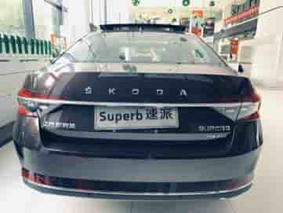
11.
superb /su:ˈpɜ:b/ adj. 卓越的；杰出的；极好的
1.很棒的饭菜/美好的夜晚/非凡的队伍/出色的演讲者（应、续）
✍1.a superb meal/evening /team/lecturer
2.宾馆的每个房间都能将海景尽收眼底。（应）
✍2.Each room of the hotel has a superb view of the sea.
3.他的表演精彩绝伦。（应、续）
✍3.His performance was absolutely superb.
4.在时间和金钱限制的情况下，访问在线大学博览会，一个极好的免费平台，帮助你了解你想要的大学。（2018浙江卷概要写作）
✍4.In case of limitation of time or money, accessing the online college fairs, a superb free platform, helps acquaint you with the colleges you desire.

Slide 15

12.
perspective /pəˈspektɪv/ n. [U]透视画法；[C]透视图；观点
1.从科学/生理学/心理学角度来说（概）
✍1.from a scientific/physical/ psychological + perspective/ angle
2.从健康的角度来看，一些简单的解决方案对我们的听力是有益的，比如戴耳塞，调低音量，限制使用和应用智能手机应用程序来监控。（概）
✍2.From a healthy perspective, some easy solutions can be beneficial to our hearing, such as wearing earplugs, turning down the volume, limiting the use and applying smart phone apps to monitor.
3.从科学的角度来看，麦当劳专门选择红色来激发人们的食欲，选择黄色则更容易识别标志。（概）
✍3.From a scientific perspective, McDonald specifically choose red to motivate people's appetite and yellow to recognize the logo easily.

Slide 16
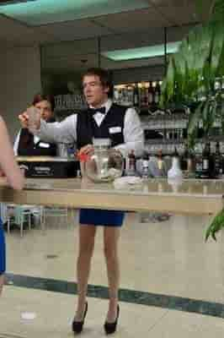
13.
coincidence _{/kəʊˈɪnsɪdəns/} n. [C; U] 巧合_{（的事）}；_{（事情、口味、故事等）}相合
1.巧合地;机缘巧合
✍1.by lucky coincidence
2.无巧不成书。（续）
✍2.No coincidences, no stories.
3.不知是机缘巧合还是精心设计，她的这一令人吃惊的宣布来的恰是时机。（续）
✍3.She has by coincidence or design made the bombshell announcement at a very opportune moment.
※ bombshell/ˈbɒmʃel/n. 炸弹；突发事件；引起震惊的人或事
4.真是无巧不成书，我的顶头上司就是被我在街上撞倒的那个人。（续）
✍4.What a coincidence: My immediate superior was the man I had knocked down on the street.

Slide 17
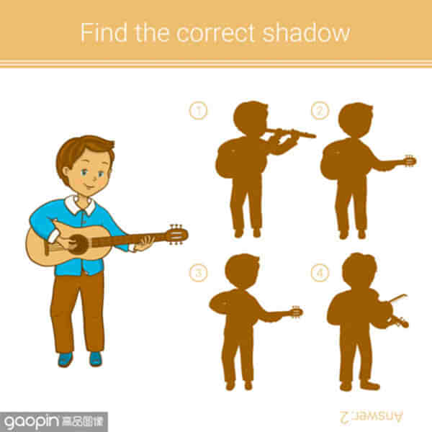

14.
shadow /ˈʃædəʊ/ n. [C; U] 阴影；影子
1.恐怖的阴影笼罩着我，我…（续）
✍1.A shadow of fear hanging over me, I...
2.一个高大模糊的身影映在灰白色的墙上。（续）
✍2.A tall, shadowy figure silhouetted against the pale wall.
※silhouette /ˌsɪluˈet/ n. 轮廓，剪影 v.照出影子；显出轮廓
3.不快乐的童年会给人的一生蒙上阴影。
✍3.An unhappy childhood would cast a shadow on one's whole life.

Slide 18

15.
ridiculous /rɪˈdɪkjʊləs/ adj. 荒谬的；可笑的
1.我觉得这简直太荒谬了。
✍1.I call it simply ridiculous.
2.“没有圣诞老人!”她喊道。“荒谬!不相信它。“这个谣言已经流传很多年了，它让我很生气。（续）
✍2.“No Santa Claus !” She shouted. “Ridiculous! Don’t believe it.” That rumor has been going around for years, and it makes me mad.

Slide 19

16.
controversial /ˌkɒntrəˈvɜ:ʃl/ adj. 争论的；争议的
1.颇有争议的话题/问题（应、概）
✍1.a highly controversial topic/issue
2.在有争议的问题上达成共识
✍2.reach consensus on the controversial issue
※ consensus /kənˈsensəs/ n. 共识
3.人们对这种变化有不同的看法，这是日常生活中不可避免的一部分，也是一个有争议的问题。（概）
✍3.People’s views are divergent on the change, which is an inevitable part of daily life and a controversial issue.
※ divergent /daɪˈvɜːdʒənt/ adj. 相异的，分歧的
※ inevitable /ɪnˈevɪtəbl/adj. 必然发生的

Slide 20
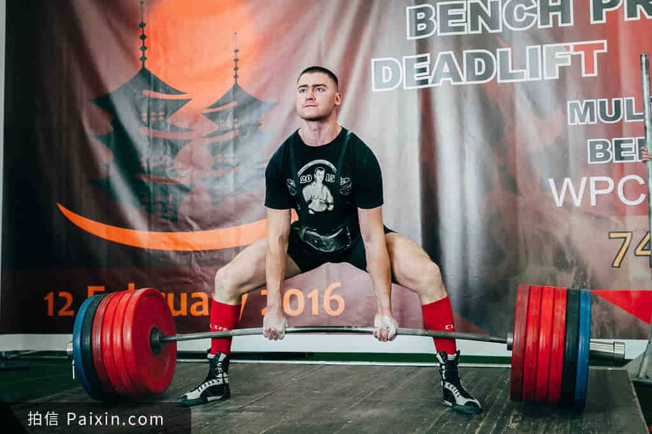
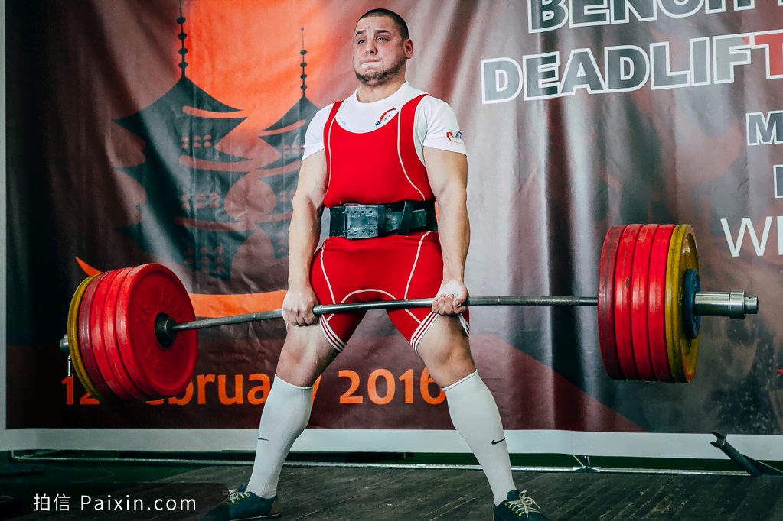
17.
attempt /əˈtempt/ vt. 尝试；企图n. [C; U]努力；尝试；企图
1.该提案试图解决一些人所说的无人驾驶汽车“死亡谷”问题。（概）
✍1.The proposal attempts to deal with what is called the “death valley”of autonomous vehicles.
2.经过无数次无果而终的尝试，我们都精疲力竭，垂头丧气。（续）
✍2.After countless fruitless attempts, we were all worn out, with heads drooping.

Slide 21


18.
on the other hand 另一方面
1.开始你自己的事业可能是一种获得经济独立的方法。 另一方面，它可能将你置于债务之中。
✍1.Starting your own business could be a way to achieving financial independence. On the other hand, it could just put you in debt.
2.一方面，人工智能让我们从密集的劳动和数据分析中解脱出来。另一方面，它可能会让我们面临自动武器的风险。（概）
✍2.On one hand, AI relieves us from intensive labor and data analysis. On the other hand, it may put us at the risk of autonomous weapon.

Slide 22

19.
landscape /ˈlændskeɪp/ n. [C] (常用单数)风景；景色
1.沿路的风景就像一幅美丽的山水画卷。（续）
✍1.The scenery along the journey is just like a breath-taking landscape painting.
2.爬上悬崖后，壮丽的景色展现在我们面前。我们在一个突出的狭窄岩石上匆匆架起一个帐篷过夜。（续）
✍2.The fantastic/ magnificent landscape unfolded before us/ greeted us after scrambling up the side of a cliff.We rigged up a shelter for the night on a narrow ledge.
※ scramble /ˈskræmbl/ v. （迅速而吃力地）爬 n. （尤指需要手脚并用的）艰难行走，攀登
※ magnificent /mæɡˈnɪfɪsnt/ adj. 高尚的；壮丽的；华丽的
※ cliff /klɪf/ n. 悬崖；绝壁
※ rig /rɪɡ/ v. 操纵；装配；装扮

Slide 23

20.
specific /spəˈsɪfɪk/ adj. 确切的；特定的
1.明确的指示/具体的信息
✍1.specific instructions /information
2.以普遍的观念而不是以特殊的例子为基础
✍2.based on general ideas rather than specific examples
3.你的计划/选择应该根据具体情况而定。（应、概）
✍3.Your plan /choice should depend on the specific situation.

Slide 24

21.
figure /ˈfɪgə/ n. [C] 画像；身材；数字
1.这个老妇人身材苗条，由于经常锻炼脸上没有一点儿皱纹。（续）
✍1.The old lady has her slim figure and is free of wrinkles by exercising a lot.
2.Susie穿一条黑色紧身连衣裙，把她的身材衬托得恰到好处。（续）
✍2.Susie wore a close-fitting black dress which made the most of her figure.
3.Margaret漂亮、迷人，体态优美。（续）
✍3.Margaret was good-looking and charming, and had a lovely figure.

Slide 25
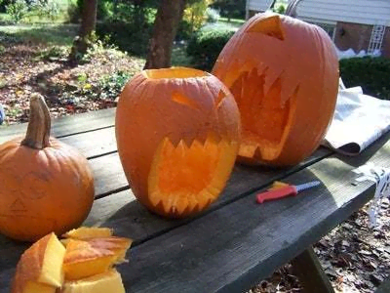
22.
carve /kɑ:v/ vt. 雕刻；刻记
这段刺激但又危险的经历永远铭刻在我们的脑海里。（续）
✍The exciting yet dangerous experience was deeply carved/engraved in our mind permanently.

Slide 26

23.
delicate /ˈdelɪkət/ adj. 脆弱的；容易生病的；精致的
1.清新的芳香/鲜美的味道/纤细的双手/微妙的平衡（应、续）
✍1.a delicate fragrance/flavour/hands/balance
2.她是个羞怯纤美的姑娘，长着一双蓝色的大眼睛。（续）
✍2.She was a shy, delicately pretty girl with enormous blue eyes.
3.空气里飘着淡淡的玫瑰花香。（续）
✍3.The delicate scent of roses hung in the air.

Slide 27

24.
allergic /əˈlɜ:dʒɪk/ adj. 过敏性的；对……过敏的；对…十分反感；厌恶
1.严重的过敏反应可能伴随药物的使用。（应、概）
✍1.Severe allergic reactions may accompany the use of the drug.
2.你可以看出他很讨厌做家务（续）
✍2.You could see he was allergic to housework.

Slide 28
25.
effectively /ɪˈfektɪvl ɪ/ adv. 有效地
合作在当今极具竞争和活力的社会是相当重要的。为了更高效更有效益地完成任务，我们有必要具备团队合作精神。（应、概）
✍Cooperation is of vital significance in the fiercely competitive and dynamic world. It’s essential for us to be equipped with teamwork spirits in order to complete our task efficiently and effectively.

Slide 29

26.
exhibition /ˌeksɪˈbɪʃn/ n. [U] 展览；[C]展览会
[正式用语]表现，显示（感情、品质或能力）
1.展出某物
✍1.put sth on exhibition/ on show/on display
2.面对危险她毫无惧色。（续）
✍2.She exhibited no fear in the face of danger.
3.我们在为本市的高中学生组织艺术展。（应）
✍3.We are organizing an art exhibition/fair for high school students in the city.
4.我校举办的中国传统美术作品展于5月1日至5日在活动中心举行，为期5天。昨天我有幸参观了它，并给我留下了深刻的印象。（2021年6月浙江卷应用文“ 参观国画展的宣传报道”）
✍4.The Chinese Traditional Art Exhibition held by our school fell on the Activity Center, lasting for 5 days, from May 1st to 5th. Yesterday I’m lucky to visit it , which impressed me a lot.

Slide 30

27.
aggressive /əˈgresɪv/ adj. 敢作敢为的；侵略的；好斗的
1.他突然意识到，这个咄咄逼人的男孩其实是一个非常孤独和善良的人，他有一个跟大家一样的愿望，希望有一个真正的朋友。（续）
✍1.It suddenly dawned on him that the aggressive boy was actually very lonely and kind in heart, who had the common desire for a true friend.
2.一旦被这种无礼行为感染，我们会变得更富有攻击性，更没创造力，工作表现变得更糟糕。（概）
✍2.Once infected with rudeness,we are more aggressive, less creative and worse at jobs.
3.一条危险的恶犬（续）
✍3.a dangerous aggressive dog

Slide 31

28.
scholar /ˈskɒlə(r)/ n. [C] 学者；聪颖勤奋的学生
1.如果萨姆在这儿，他会很激动见到那位著名的学者本人。（续）
✍1.If Sam were here, he would be so excited about meeting a famous scholar in the flesh.
2.我从来不是那种用功的好学生。（续）
✍2.I was never much of a scholar.

Slide 32

29.
flesh /fleʃ/ n. [U] 肉；肌肉；(the ～)肉体； in the flesh 活着的；本人
1.一想起它，我就心惊肉跳。（续）
✍1.It makes my flesh creep to think of it.
2.脚踝四周的皮肉肿胀起来了.（续）
✍2.The flesh around the ankle had swollen up.
3.一旦上了山，他就很容易被追上，狼的牙齿会把他撕咬得皮开肉绽。（2017年6月浙江省高考试题读后续写“狼口脱险”）
✍3.Once he hit the hill,he'd be easy caught up and the wolf's teeth would be tearing into his flesh.

Slide 33
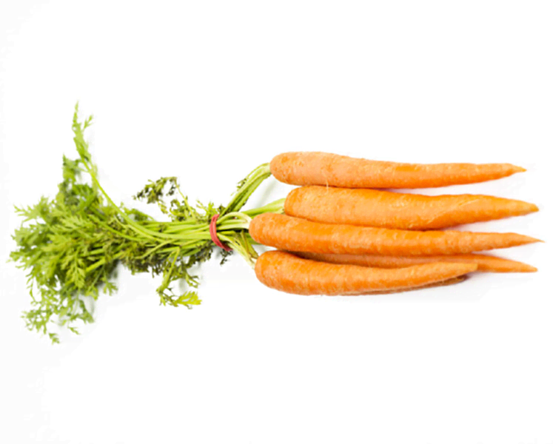


30.
bunch /bʌntʃ/ n. [C] 束；串(~ of sth)
1.马赫先生从抽屉里拿出一条链子，末端挂着一串钥匙。（续）
✍1.From the drawer Mr. Mach took out a chain, with a bunch of keys dangling at its end.
2.伊丽莎白手里拿着一大束玫瑰花，慢慢走向沃尔夫，舞台灯光灼热，汗珠顺着伊丽莎白的脸上滴下来。（续）
✍2.Clutching a big bunch of roses_{现在分词做伴随状语}, Elizabeth walked slowly towards Ms. Wolff，the stage lights blazing hot and beads of perspiration trickling down Elizabeth’s face_{两个独立主格结构}.

Slide 34
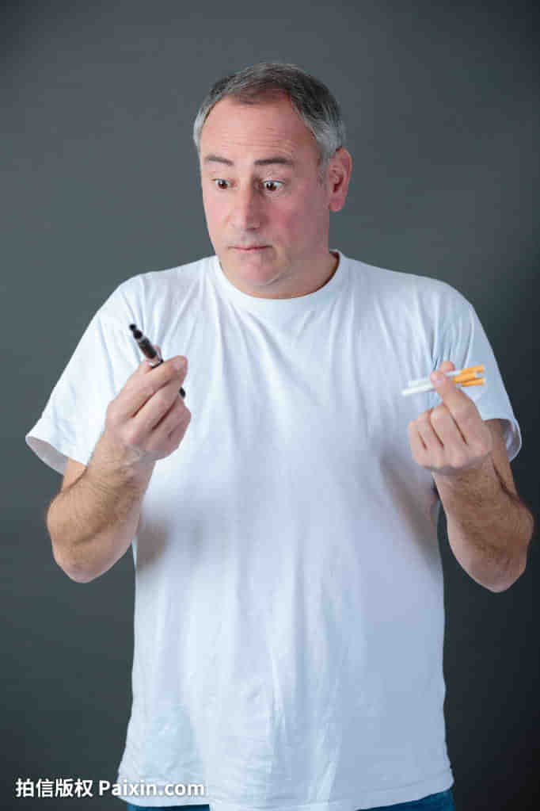
31.
preference /ˈprefrəns/ n. [U] 喜爱;偏爱 [C]偏爱的事物
1.我们优先录用有经验的申请人。（应）
✍1.We give preference to applicants with some experience.
2.其他要求包括良好的人际沟通能力，得体的举止和强烈的责任感。有类似活动经验者优先考虑。（应）
✍2.Other requirements include good interpersonal communication abilities, proper manners, and a strong sense of responsibility. Preference will be given to those experienced in similar activities.

Slide 35
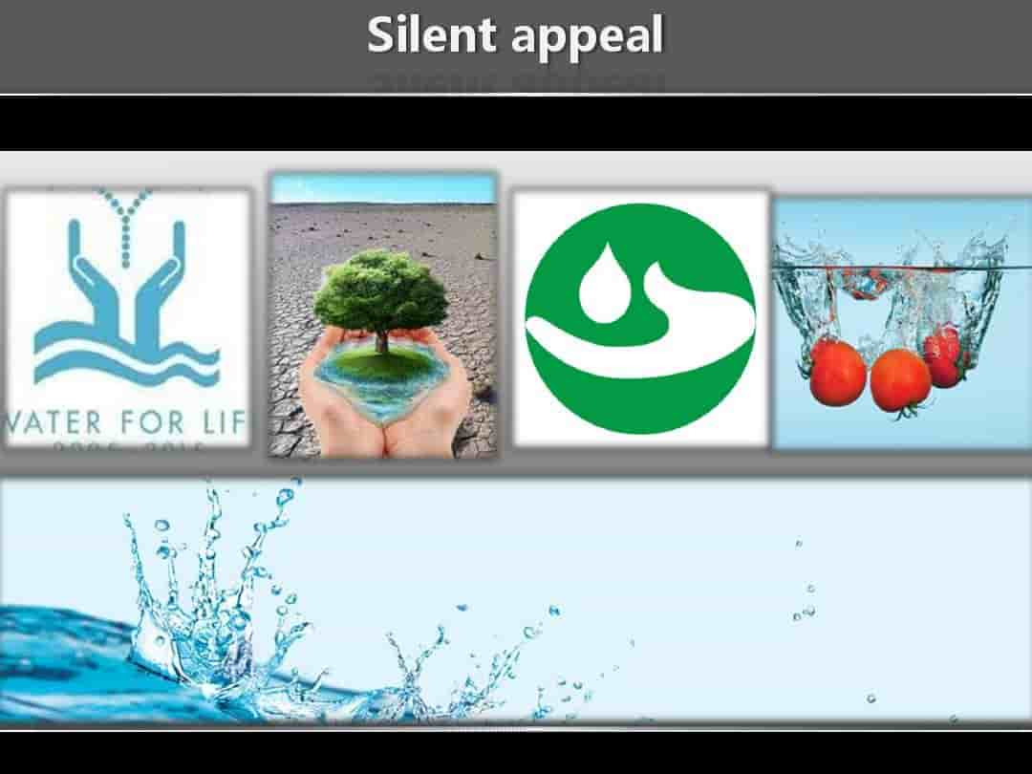
32.
appeal /əˈpi:l/ vi. 有感染力；呼吁；求助；上诉
1.政府呼吁公众为地震灾区捐款。（应）
✍1.The government appealed to the public for donation for the earthquake­hit areas.
2.中国高铁的速度比汽车快，价格比飞机低，广受人们青睐。（应、概）
✍2.It is the CRH’s higher speed than cars’ and lower price than planes’ that hold wide appeal for people.
3.“你真的愿意帮忙吗？”他满脸恳求地说。 _{（恳求的；可怜的；希望同情的）}（续）
✍3.“Would you really help?” he said with an appealing look.
4.她向他投去一种会融化坚冰的温柔恳求的表情。（续）
✍4.She gave him a soft appealing look that would have melted solid ice.

Slide 36
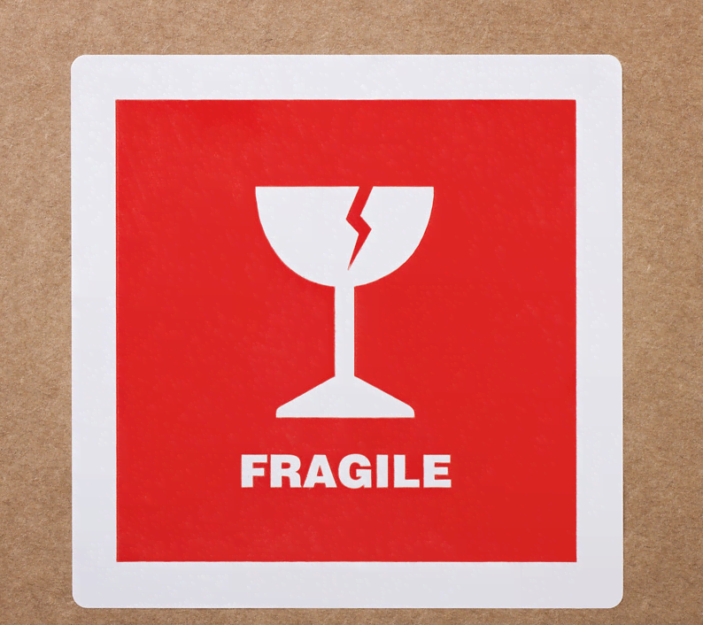

33.
fragile /ˈfrædʒaɪl/ adj. 精细的；易碎的；脆弱的
1.身体虚弱（续）
✍1.in fragile health
2.不牢固的关系（应、续、概）
✍2.a fragile relationship
3.他向后靠在他那把不结实的椅子上。（续）
✍3.He leaned back in his fragile chair.
4.当你走进艺术画廊，你感觉好像置身于一个精致的白色贝壳中。（应、续）
✍4.When you walk into the gallery, you feel as if you were inside a fragile, white seashell.

Slide 37

34.
reputation /ˌrepjuˈteɪʃn/ n. [C; U] 名声；名誉
1.她在同伴中的口碑甚佳。（应、续）
✍1.She enjoyed a high reputation among her fellows.
2.彭斯是个典型的苏格兰人，他以风趣和富有魅万而闻名。（应、续）
✍2.Typical of the Scotch, Burns had a reputation for being funny and charming.

Slide 38

35.
civilization /ˌsɪvəlaɪˈzeɪʃn/ n. [U]文明；文化；文明社会
1.这家博物馆以其种类繁多的艺术收藏品而闻名，它涵盖了世界各地5000多年的文明, 展示的不仅仅是视觉上的艺术乐趣。（应）
✍1.The reputation of this museum lies in the variety of its art collection, which covers more than 5000 years of civilization from many parts of the world, displaying more than just the visual delights of art.
2.作为一个由众多民族组成的国家，中国有着悠久的历史和文明，有着丰富的非物质文化遗产。（应）
✍2.As a country consisting of a great diversity of ethnic groups and with time-honored history and civilization, China abounds in intangible cultural heritages.

Slide 39
36.
visual /ˈvɪʒuəl/ adj. 视觉的；看得见的
1.演员们将青春与活力毫无保留的展现在观众眼前，为观众献上了一场视听盛宴。（应、续）
✍1.Actors showed youth and vitality without reservation in front of the audience, and presented an audio-visual banquet for the audience.
2.这么多美妙的画作进入我的视线，我完全沉浸其中。如果你错过了这个好机会，我敢说那将是一个很大的遗憾。这对你来说一定是一场视觉盛宴。（2021年6月浙江卷“ 参观国画展的宣传报道”）
✍2.So many wonderful paintings came into my sight that I was totally immersed in it. I bet it will be a big pity if you miss the great chance. And it must be a big visual feast for you.
3.考虑到这场视觉盛宴是品尝我们文化的黄金机会，我强烈推荐每一个艺术爱好者来享受它。（2021年6月浙江卷“ 参观国画展的宣传报道”）
✍3.Considering the visual feast is golden opportunity to have a taste of our culture, I highly recommend every art lover come and enjoy it!

Slide 40
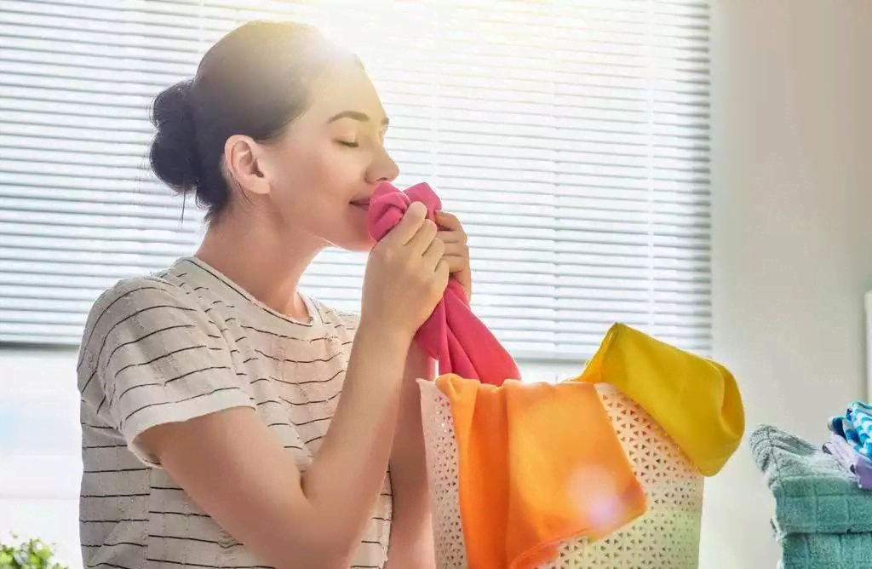
37.
fragrant /ˈfreɪgrənt/ adj. 香的；令人愉快的
1.芬芳的微风轻轻抚摸着我的脸庞，仿佛抚慰着我所有的的疲惫和恐惧。（续）
✍1.The fragrant breeze gently touched my face, as if comforting all the tiredness and terror along the trip.
2.迎面而来的是一阵香甜的气息。（续）
✍2.A sweet fragrance greeted him.
3.森林里凉爽芬芳，漫步其中让我心情平静。（续）
✍3.The forest was cool and fragrant,and the walk through it calmed my spirits.

Slide 41
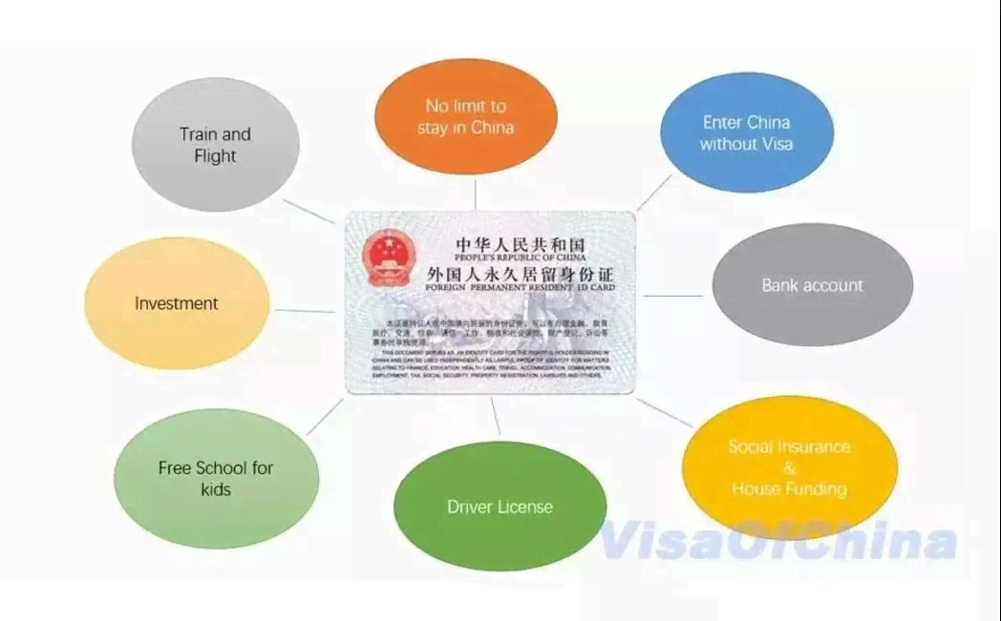
38.
permanent /ˈpɜ:mənənt/ adj. 永久的；持久的
1.固定工作/终身职工
✍1.permanent job/ staff
2.长期的紧张状态（应、概）
✍2.a permanent state of tension
3.厚重的、长年锁着的大门（续）
✍3.the heavy, permanently locked gate
4.饮酒过量可能造成永久性脑损伤。（概）
✍4.Heavy drinking can cause permanent damage to the brain.

Slide 42

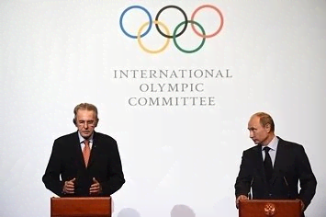
39.
39.committee /kəˈmɪtɪ/ n. [C] 委员会
组委会是如此的体贴和关心，他们安排了合理的赛道，每500米设置红旗和标志，让参赛者知道他们跑了多长时间，并得到鼓励。（应）
✍So thoughtful and caring was the committee that they arranged a reasonable racing track, along which red flags and signs were set every 500 meters, enabling competitors to know how long they had run and got encouraged.

Slide 43

活用教材词汇，靶向高考写作
写
作
词
汇
——人教版 M6U2- Poems 单词拓展
1. poetry 2. tick 3.hush 4. convey 5. concrete 6. diamond 7. flexible 8. cottage
9. sparrow 10. kitten 11.run out of 12. tease 13. salty 14. droop 15. dread 16. endless
17.branch 18.melt 19. brimful 20. await 21.revolve 22. utter 23. sorrow 24. bare
25.stem 26. appropriate 27. sponsor 28.blank 29. darkness 30.let out 31. load

Slide 44

1.
poetry /ˈpəʊɪtrɪ/ n. [U]诗（总称）；诗意；优雅的气质
1.在诗歌中你会欣赏人类情感共鸣，并通过诗歌的表达享受语言多样性。（应、概）✍1.In poetry, you'll admire echoes of human emotions and enjoy linguistic diversity through poetic expression.
echo /ˈekəʊ/ v. 反射；重复；回声n. 回音；共鸣；效仿
linguistic /lɪŋˈɡwɪstɪk/ adj. 语言的；语言学的
linguistic and cultural barriers 语言和文化上的障碍
2.她一举一动都很优美。（续）
✍2.There was poetry in all her gestures.
3.音乐系在一幢诗般美丽的大楼里。（续）
✍3.The music department is housed in a building which is pure poetry.

Slide 45


2.
tick /tɪk/ vt. 给……标记号；发出滴答声
时间一分一秒地过去了，母亲还没回家，这使我很担心她。（续）
✍Time ticking away_{(独立主格结构)}, Mother hadn't been home yet, making me worry about her.
ticktock /ˈtɪkˌtɒk/
n. 滴答声 vi. 发出滴答声

Slide 46


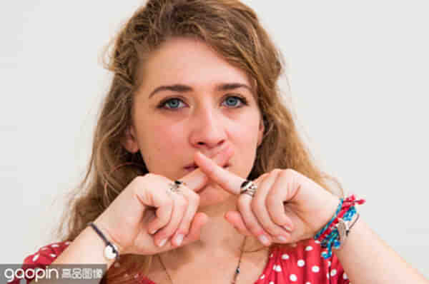
3.
hush /hʌʃ/ v. 安静；停止说话 n. 寂静，安静
1.空气中充满了焦急和期待的寂静。（续）
✍1.The air was heavy with the hush of suspense and expectancy.
suspense /səˈspens/ n. （对即将发生的事等的）担心；焦虑
2.房间变得/弥漫着死一般的沉寂。
✍2.A deathly hush fell over / pervaded the room as he walked in.
pervade/pəˈveɪd/ vt. 遍及；弥漫（续）

Slide 47

4.
convey /kənˈveɪ/ v. 传达；运送; 传达（信息），表达（思想）
我很荣幸站在这里，代表所有的交换生，向阿什维尔学院亲爱的老师和同学们表达我们衷心的感谢。（应）
✍It's my privilege to stand here, on behalf of all the exchange students, conveying our heartfelt gratitude to the dear teachers and fellow students of Ashville College.
privilege /ˈprɪvəlɪdʒ/ n. 特权；优待

Slide 48
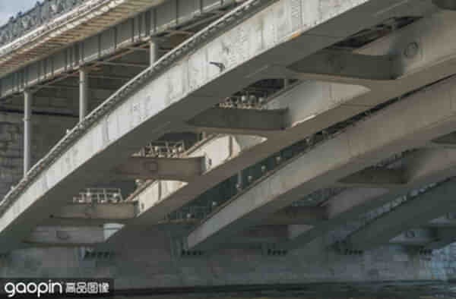
5.
concrete /ˈkɒŋkri:t/ adj. 具体的（而非想象或猜测的）n.混凝土；具体物
1.确凿的证据/具体的建议/确实的证明
✍1. concrete evidence/proposals/proof
2.结合具体的事物来思考要比抽象思考容易些。（应、续、概）
✍2.It is easier to think in concrete terms rather than in the abstract.

Slide 49
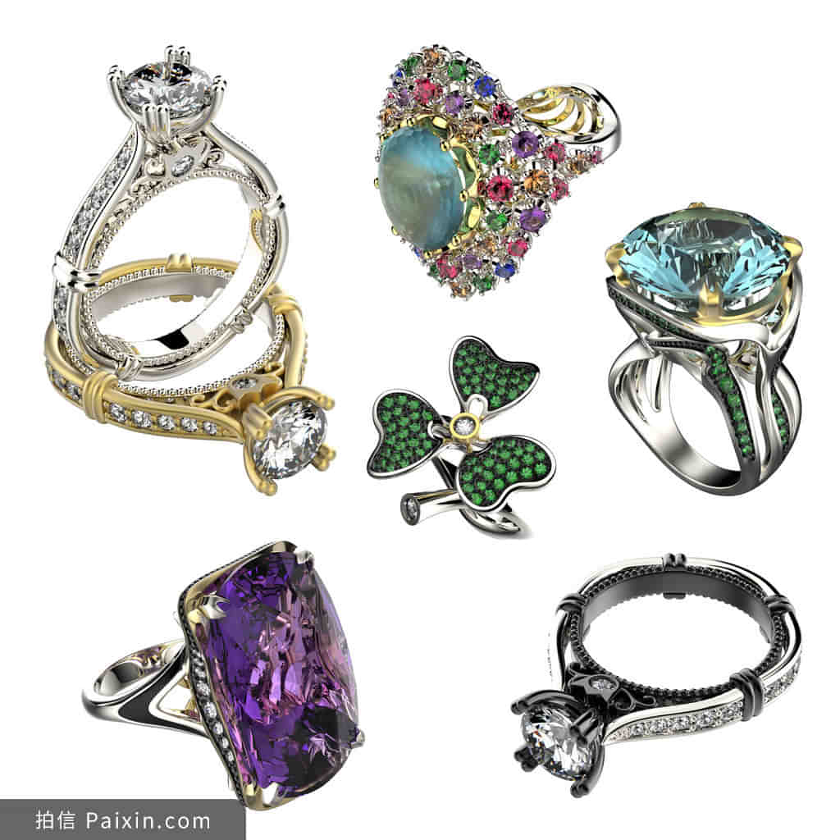
6.
diamond /ˈdaɪəmənd/ n. [U] 钻石
1.星星像钻石一样熠熠生辉。（续）
✍1.The stars sparkled like diamonds.
sparkle['spɑːkəl] n. 闪耀；火花；活力 v.闪耀；发光
2.他的微笑闪耀像钻石。（续）
✍2.His smile shines like diamonds.
3.“为什么不……?玛丽亚神秘地小声对我说，她眼睛像可爱的钻石一样闪闪发光。“爸爸说我们不能……”我犹豫地说（续）
✍3.“Why not….?”Maria whispered to me mysteriously with her eyes shining like lovely diamonds. “Dad said we can’t …” I said hesitantly.

Slide 50
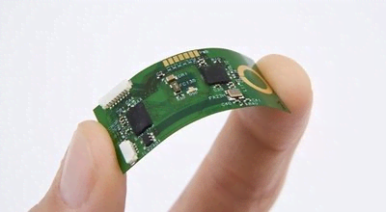
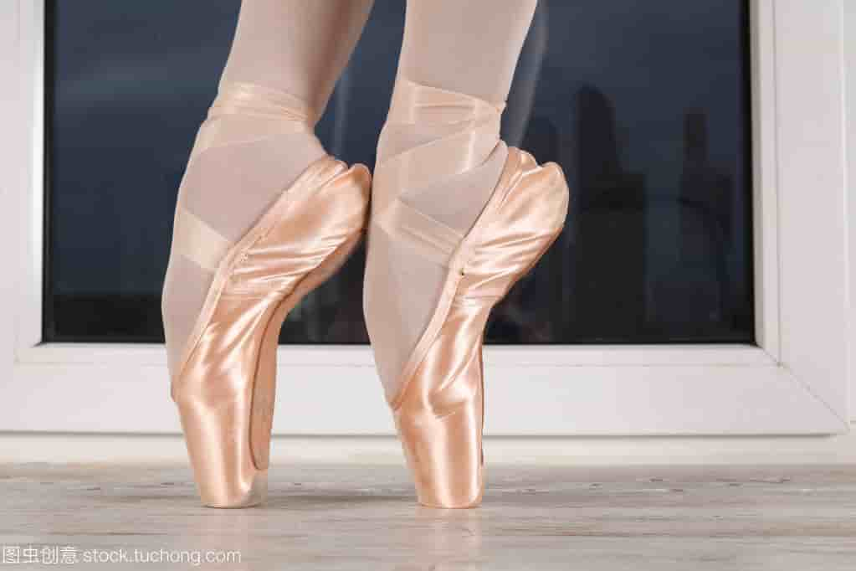
7.
flexible /ˈfleksəbl/ adj. 灵活的；可弯曲的；柔顺的
1.灵活的计划表（应）
✍1. a flexible schedule
2.优秀的求职者必须具备灵活处理问题的能力。（应）
✍2. Good job candidates must show a flexible approach to problems.

Slide 51
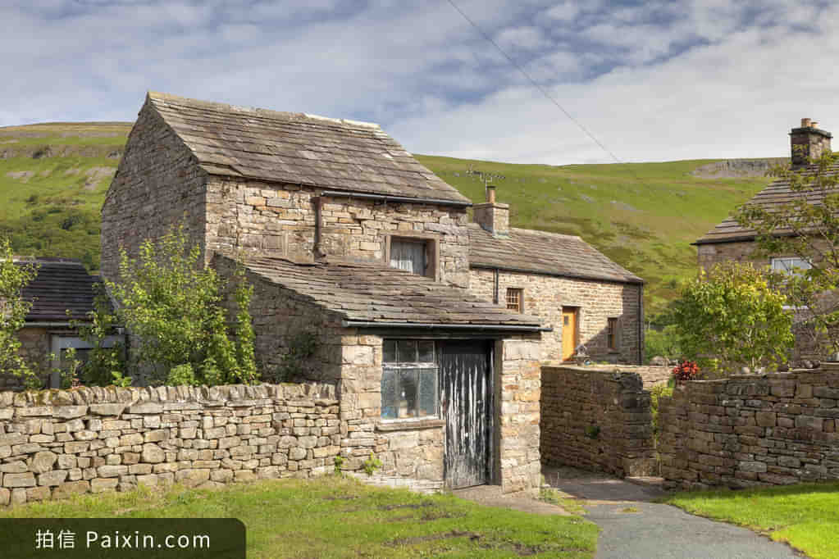
8.
cottage /ˈkɒtɪdʒ/ n. [C] 村舍；小屋
这真是一个令人愉快的地方，蜿蜒的街道和漂亮的小屋。（续）
✍It is truly delightful place with its winding streets and pretty cottages.

Slide 52
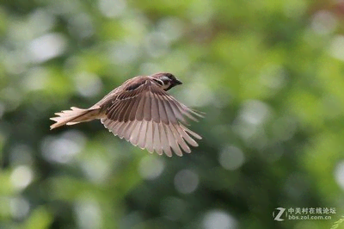
9.
sparrow /ˈspærəʊ/ n.[C] 麻雀
麻雀忒儿一声飞了（续）
✍With a flap of its wings the sparrow flew off.
flap /flæp/ （上下或左右）拍打，振（翅），拍击

Slide 53
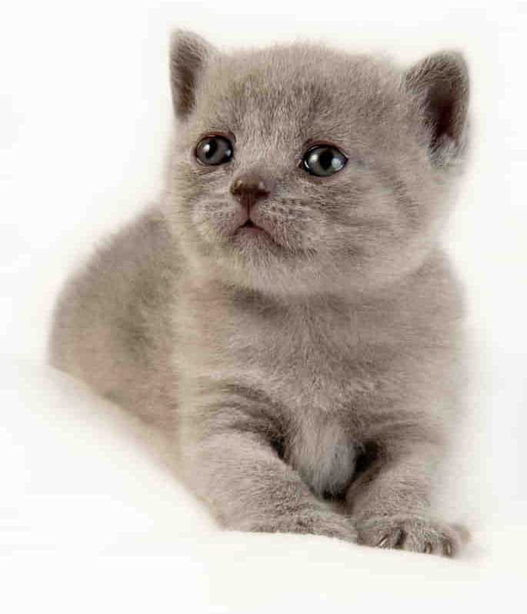
10.
kitten /ˈkɪtn/ n.[C] 小猫
1.猫竖起耳朵，骄傲地对我喵叫，好像在宣布他的胜利。（续）
✍1.The kitten pricked up his ears and miaowed at me proudly as if to announce his victory.
prick /prɪk/ up one’s ears（动物，尤指马或狗）竖起耳朵
miaow /miˈaʊ/ n. （猫叫声）喵 v. （猫）喵喵叫
2.小猫舒服地卧在她怀里，起劲地打着呼噜。
✍2.The kitten had settled comfortably in her arms and was purring enthusiastically.
purr /pɜː(r)/ （猫）呼噜声;（机器等）轰鸣声（续）

Slide 54

11.
run out of 用完（不及物动词词组+of, 无被动）
熊像噩梦般一直萦绕着我们，我们一点点地向它投面包，直到面包也没有了。
✍While it was looming like a dark cloud, we threw the bread at the bear a little at a time until it had run out.
loom/luːm/ v. 令人惊恐地隐现；（不祥之事）似将发生

Slide 55

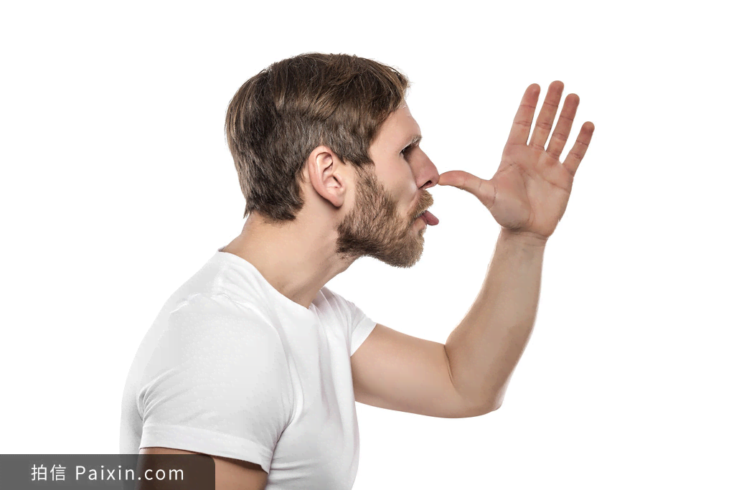
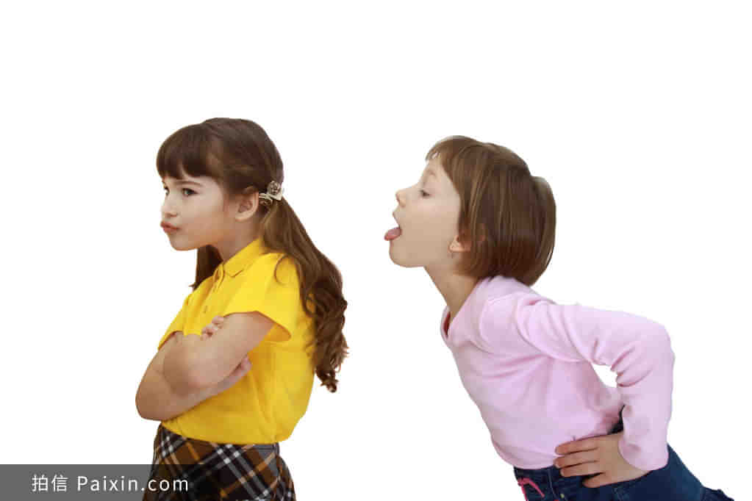
12.
tease /ti:z/ vi. & vt. 取笑；招惹；戏弄
1.别不高兴，我只是在逗你玩。（续）
✍1. Don't get upset─I was only teasing.
2.侮辱性地/故意地逗弄（续）
✍2. tease sb insultingly/ willfully
/ɪn'sʌltɪŋli/
3.取笑某人的秃头/笨拙的步伐。（续）
✍3. tease sb about bald head / clumsy walk

Slide 56
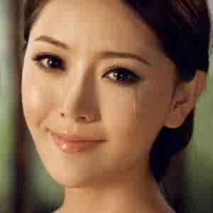
13.
salty /ˈsɔ:ltɪ/ adj. 含盐的；咸的
咸咸的、温暖的泪水从她苍白的脸颊流下，落到她肿胀干燥的嘴唇上。（续）
✍Salty,warm tears streamed down her pale cheeks to her swollen dry lips.

Slide 57
14.
droop /dru:p/ vi. (因疲倦或沮丧等而)下垂；萎靡
1.她太疲倦了，眼睑开始往下垂，打起了呵欠，昏昏欲睡起来。（续）
✍1.So exhausted was she that her eyelids were beginning to droop, yawning and drowsing.
drowse /draʊz/ v. 打瞌睡；昏昏沉沉地消磨（时光）n. 瞌睡；假寐----drowsy /ˈdraʊzi/ adj. 昏昏欲睡的
2.詹姆斯低头捂脸，，十分内疚。（续）
✍2.James hid his face in his hands and drooped his head, feeling guilty.
3.听到这坏消息，我们情绪低落下来/精神委靡不振。（续）
✍3.Our spirits drooped when we heard the bad news.
4.经过无数次无果而终的尝试，我们都精疲力竭，垂头丧气。（续）
✍4.After countless fruitless attempts, we were all worn out, with heads drooping.
5.“对不起，我应该接受你的建议。”我喃喃地说，低着头。乔如释重负地轻笑着说:“你安全了。这就够了。”（续）
✍5.“I’m sorry, and I should have taken your advice,” I murmured, head drooping. Joe chuckled in relief, “You are safe. That’s enough.”
chuckle /ˈtʃʌkl/ v. 咯咯的笑

Slide 58

15.
dread /dred/ v. /n.非常害怕；极为担心(+doing )
1. 这是他一直最担心的时刻。（续）
✍1.This was the moment he had been dreading.
2. 害怕他发现秘密，我们终日惶恐不安。
✍2.We lived in dread of him discovering our secret.
3.她莫名其妙地害怕学校。（续）
✍3.She has an irrational dread of school.
/ɪˈræʃənl/ adj. 不合理的；无理性的；荒谬的（续）
4.很大的错误/坏消息/讨厌的天气/可怕的孤独（应）
✍4.dreadful mistake/news /weather /loneliness
5.咄咄逼人的冷风像一只无家可归的狗渴望着美味的骨头一样呼啸。（续）
✍5.The bullying wind was howling dreadfully like a homeless dog hungry for a delicious bone.
bully /ˈbʊli/ v. 欺负；威吓

Slide 59

16.
endless /ˈendlɪs/ adj. 无穷的；无止境的
1.汽车川流不息，鱼贯而过。（续）
✍1.Cars filed past in an endless stream.
2.我听够了他们无休止的争吵。（续）
✍2. I've had enough of their endless arguing.

Slide 60
17.
branch /brɑ:ntʃ/ n. [C] 枝条；支流；部门
1.暴风雨把一根树枝从树干上刮了下来, 突然划过车窗。（续）
✍1.The storm split a branch off from the main trunk, which whipped across the car window.
2.她的头撞到一根低矮的树枝上。（续）
✍2.She bumped her head against a low branch.
3.够不到那树枝，让人干着急。他感到自己滑了一下，便一把抓住另一根树枝。（续）
✍3.The branch was tantalizingly out of reach. He felt himself slipping and clutched at another branch.
/ˈtæntəlaɪzɪŋli/ adv. 逗人地；…得令人着急

Slide 61

18.
melt /melt/ _{（melted; melted, molten）} vi.融化；溶化；软化
1.屋里的紧张气氛开始缓和。（续）
✍1.The tension in the room began to melt.
2.她那信任的微笑使他的心变软了。（续）
✍2.Her trusting smile melted his heart.
3.听到这些话，斯科特觉得内心的疑虑/焦虑消失了。（续）
✍3.When hearing these words, Scot felt his inner doubts/anxiety melt away.
4.年轻人们散开了，消失在夜色中。（续）
✍4.The youths dispersed and melted into the darkness.
disperse /dɪˈspɜːs/ v. 分散；传播 adj. 分散的

Slide 62

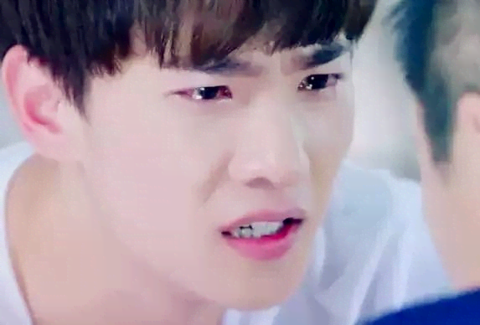
19.
brimful /ˈbrɪmfʊl/ adj. 盈满的；满到边际的
1.她精力充沛，热情洋溢。（应、续）
✍1.She was brimful of energy and enthusiasm.
2.盈满的眼泪（续）
✍2.With eyes brimful of tears

Slide 63
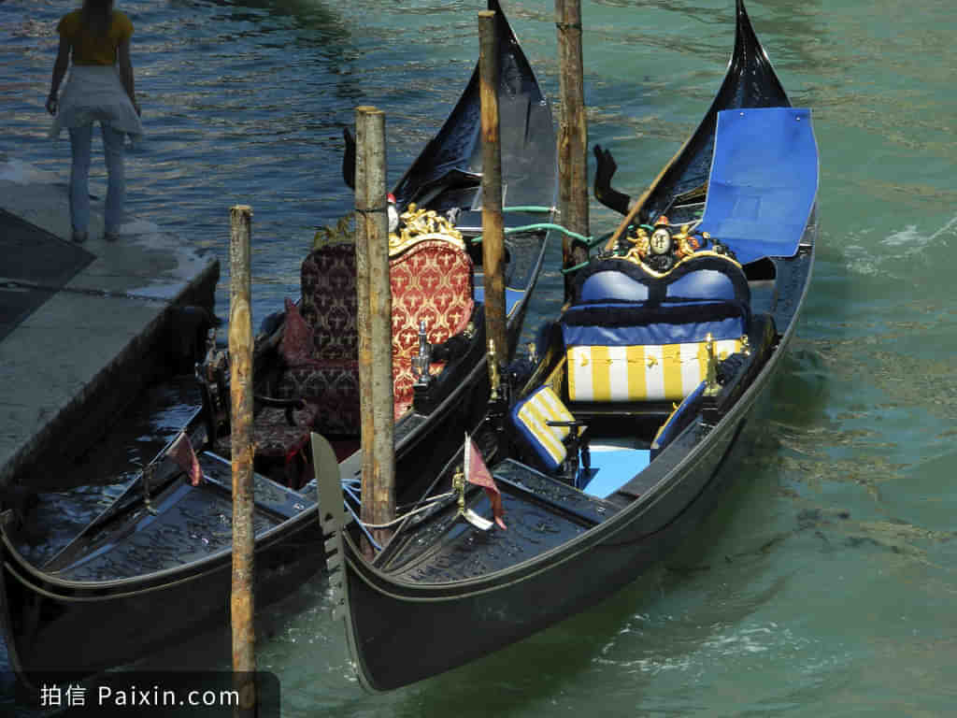
20.
await /əˈweɪt/ vt. 等候；期待
1.随着期待已久的汉语演讲比赛的开始，……（应）
✍1.With the long-awaited Chinese speech contest drawing,...
2.爸爸终于修好了货车，一个奇妙的58天假期展现在我们面前，等待着我们去享受、探索和拥抱。（续）
✍2.Dad finally managed to fix the van and a fantastic 58-day vacation was unfolded before us, awaiting us to enjoy, explore and embrace.

Slide 64

21.
revolve /rɪˈvɒlv/ v. （使）旋转; 围绕 (某个主题)
1.这场讨论围绕如何发展具体的演讲技巧和提高你的英语口语水平。（应）
✍1.The debate revolves around how to develop specific presentation techniques and improve your spoken English level.
2.辩论围绕着这一流行病将如何改变我们的社会展开。（应）
✍2.the debate revolves around how the pandemic will change our society.

Slide 65




22.
utter /ˈʌtə/ vt. 说；发出（声音）adj. 完全的；彻底的
utterly /ˈʌtəli/ adv. 完全地
1.萨姆气得一句话也说不出来。（续）
✍1.Filled with fury, Sam was unable to utter a single word.
2.我和我的妻子完全绝望了。（续）
✍2.My wife and I were in utter despair.
3.他嗤笑了一声。（续）
✍3.He uttered a snorting laugh.
snort /snɔːt/ （表示气愤或被逗乐）喷鼻息，哼

Slide 66
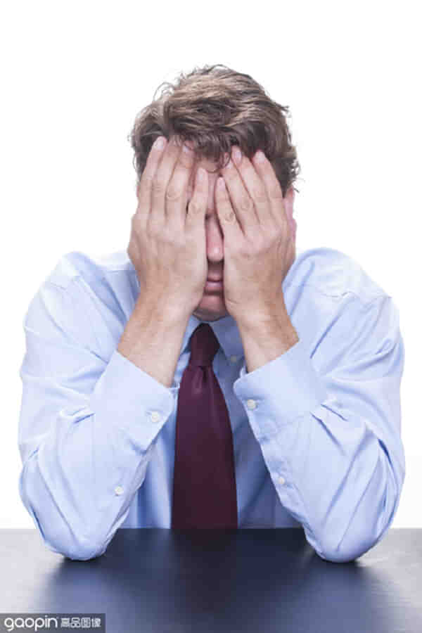
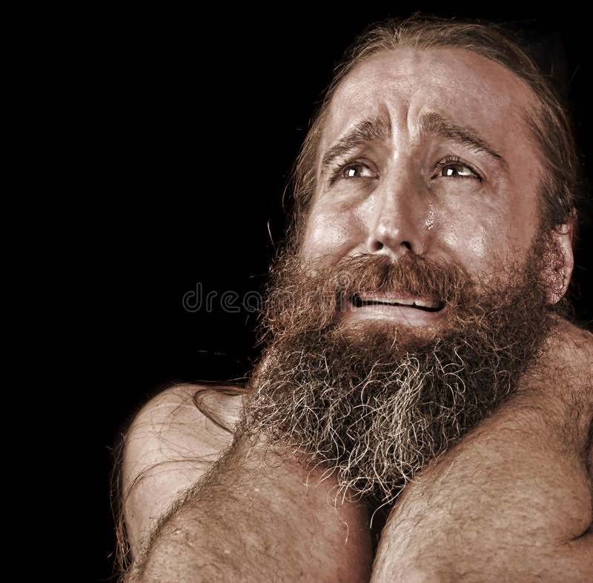
23.
sorrow /ˈsɒrəʊ/ n. [U] 悲伤；悲痛；懊悔
1.从那以后他们一直沉浸在悲伤中。 （续）
✍They have been immersed in the deep sorrow since then.
immerse /ɪˈmɜːs/ 深陷于，沉浸在
2.一阵悲伤的心情涌入我的脑海,我哽咽欲泣,眼泪不知不觉从脸上落下。
✍As the sorrows went through my mind, I felt a lump in my throat, tears gathering and flowing down my face.
lump /lʌmp/ n. 块，块状；肿块

Slide 67
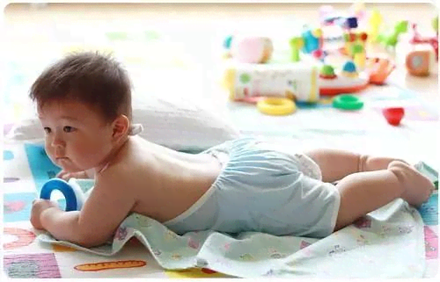
24.
bare /beə/ adj. 赤裸的；光秃的；稀少的；最少的
1.她喜欢光着脚走来走去。（续）
✍1.She likes to walk around in bare feet.
2.…一棵扭曲的老树，它的树枝很多是脆弱而光秃的。（续）
✍2....an old, twisted tree, many of its branches brittle and bare.
brittle /ˈbrɪtl/ adj.易碎的，脆弱的

Slide 68
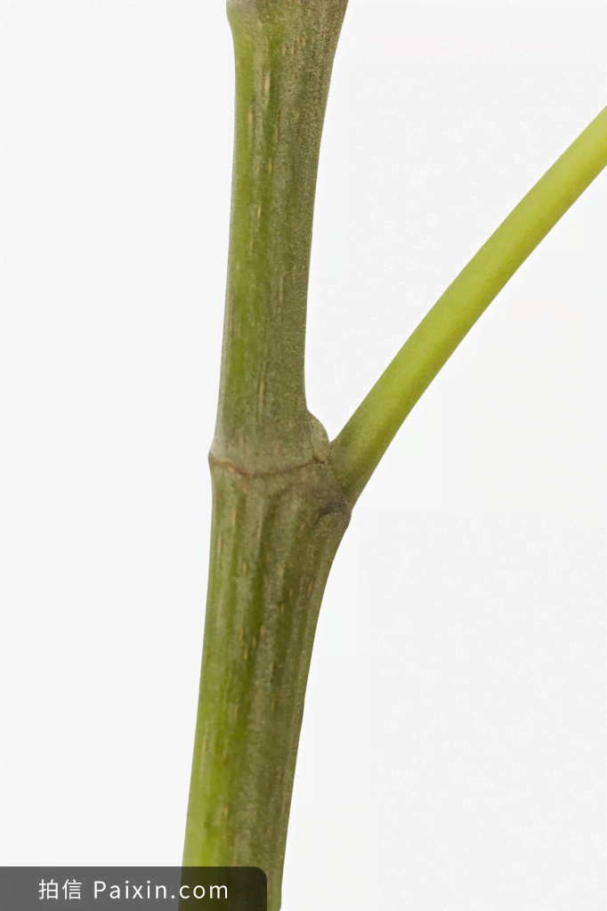

25.
stem /stem/ n. 茎；干；血统 v. 来自于...; 起源于...
我所有的问题都源于粗心/缺乏自信。
✍All my problems stem from carelessness/ diffidence.
diffidence/ˈdɪfɪdəns/ 缺乏自信；胆怯（应、续）

Slide 69

26.
appropriate /əˈprəʊpriət/ adj. 适当的；正当的
1.恰如其分的反应/ 恰当的措施（应续概）
✍1.an appropriate response/measure
2.定期进行适当的锻炼对身体健康是必要的。（应）
✍2.Taking appropriate exercise regularly is essential good health.
3.缺乏适当的训练也可以解释他们写不好的原因。
✍3.A lack of proper training can also account for their failure to write appropriately.

Slide 70

27.
sponsor /ˈspɒnsə/ n. 赞助人；主办者；倡议者 vt. 发起；倡议
请问你们能赞助我开展我校的“帮助有困难的人”活动吗？（应）
✍Would you please sponsor my school’s campaign “Help the Needy”?

Slide 71

28.
blank /blæŋk/ n. 空白 adj. 空白的；空虚的；单调的
1.由于害怕落在后面，他感到心跳加剧，大脑一片空白。（续）
✍1.Fearing to fall behind, he felt his heart pounded frantically and his mind went blank.
frantically /ˈfræntɪkli/ adv. 疯狂似地
2.她木然地盯着我。（续）
✍2.She stared at me with a blank expression on her face.

Slide 72
29.
darkness /ˈdɑ:knɪs/ n. [U] 黑暗；漆黑
1.黑暗弥漫开来，将他笼罩, 使他迷失方向。
✍1.Darkness spread, wrapping around him and disorientating him.
wrap /ræp/ vt. 包；缠绕；隐藏；掩护
disorientate/dɪsˈɔːriənteɪt/ v. （使）迷失方向
2.电源故障使一切陷入黑暗。（续）
✍2.A power failure plunged the house into darkness.
plunge /plʌndʒ/ v. 使突然地下落；骤降
3.黑暗如漆黑的墨汁流淌在大地上。
✍3.Darkness as black as ink flowed over the land.
4.黑暗象一条蛇似的潜入森林。
✍4.Darkness crept into the forest like a snake.
creep /kriːp/ -crept- crept /krept/vi. 爬行；蔓延

Slide 73
29.
darkness /ˈdɑ:knɪs/ n. [U] 黑暗；漆黑
5.黑暗轻轻地哼着摇篮曲。
✍5.Darkness gently hummed a lullaby.
hum /hʌm/ v. 哼（曲子）；发低哼声
lullaby /ˈlʌləbaɪ/ n. 摇篮曲；催眠曲
6.暮色消失在黑暗中。
✍6.Twilight merged into darkness.
merge /mɜːdʒ/ vt. 合并；吞没)
twilight /ˈtwaɪlaɪt/ n. 黄昏，暮色 adj. 朦胧的
7.立刻，一片漆黑笼罩着森林。
✍7.Immediately, an utter darkness ruled the forest.

Slide 74
30.
let out 发出；放走；泄露；出租
1.发出短暂的咯咯声/嘎嘎大笑起来/惊恐的叫声/沮丧的叹息声/痛苦的尖叫/悲愤的吼叫（续）
✍1.let out a brief cackle/ a loud guffaw/ a cry of horror / a groan of dismay/ a scream of pain/ a bellow of tearful rage
cackle /ˈkækl/ （禽，尤指母鸡或鹅）咯咯叫；咯咯地笑
guffaw /ɡəˈfɔː/ 哄笑；狂笑; 哈哈大笑
groan /ɡrəʊn/ 呻吟
dismay /dɪsˈmeɪ/ n. 沮丧，灰心；惊慌
bellow /ˈbeləʊ/ （公牛等）吼叫；（对某人）大声吼叫
2.获胜队的支持者把帽子抛向空中 发出胜利的欢呼声。（应、续）
✍2.Throwing their hats into the air; the fans of the winning team let out loud shouts of victory.
3.目前尚不清楚是谁泄露了秘密。
✍3.It remains unknown who let out the secret.

Slide 75

31.
load /ləʊd/ n. 负担；负荷物（尤指沉重的）v.装载；承载
1.上传/下载（应、续、概）
✍1.upload/ download
2.带着沉重的愧疚和极大的恐慌（续）
✍2.with a heavy load of guilt and panic
3.如释重负，我开车回到家——沿着蜿蜒曲折的道路行驶，沿途风景如画，令人赏心悦目。（续）
✍3.Taking a load off my mind, I drove back home — a lovely drive along winding roads rich in the picturesque scenes that delighted beauty-loving eyes.
winding /ˈwaɪndɪŋ/adj. 蜿蜒曲折的
picturesque [,pɪktʃə'resk] adj. 生动的；图画般的

Slide 76

活用教材词汇，靶向高考写作
写
作
词
汇
——人教版 M6U3-A healthy life
单词拓展
1. cigarette 2. abuse 3. stress 4. obesity 5. adolescent 6. due 7. tough 8. accustom
9. bad-tempered 10. automatic 11. mental 12. effect 13. lung 14. pregnant 15. pregnant 16.strengthen
17. resolve 18.relaxation 19. desperate 20. weaken 21.ashamed 22. comprehension 23. in spite of 24. slippery
25.at risk 26. inject 27. needle 28. spill 29. embarrassed 30. awkward

Slide 77
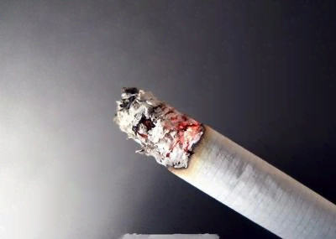
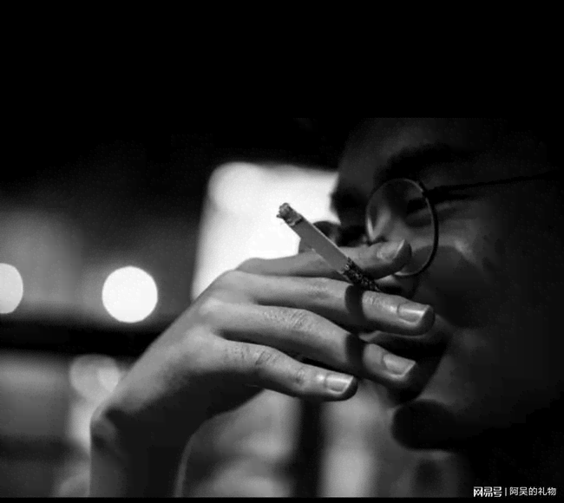
1.
cigarette /ˌsɪgəˈret/ n. [C] 香烟；纸烟
他点燃了一支香烟，烟头发着红光。（续）
✍He lit a cigarette, the end of which glowed red.
glow /ɡləʊ/v. 发出微弱而稳定的光

Slide 78

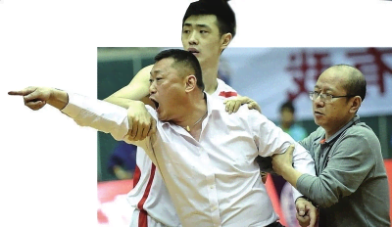
2.
abuse /əˈbju: z/ n. [U]滥用；虐待vt. 滥用；虐待
她破口大骂起来...（续）
✍She let loose a stream of abuse at…
She screamed abuse at ...

Slide 79

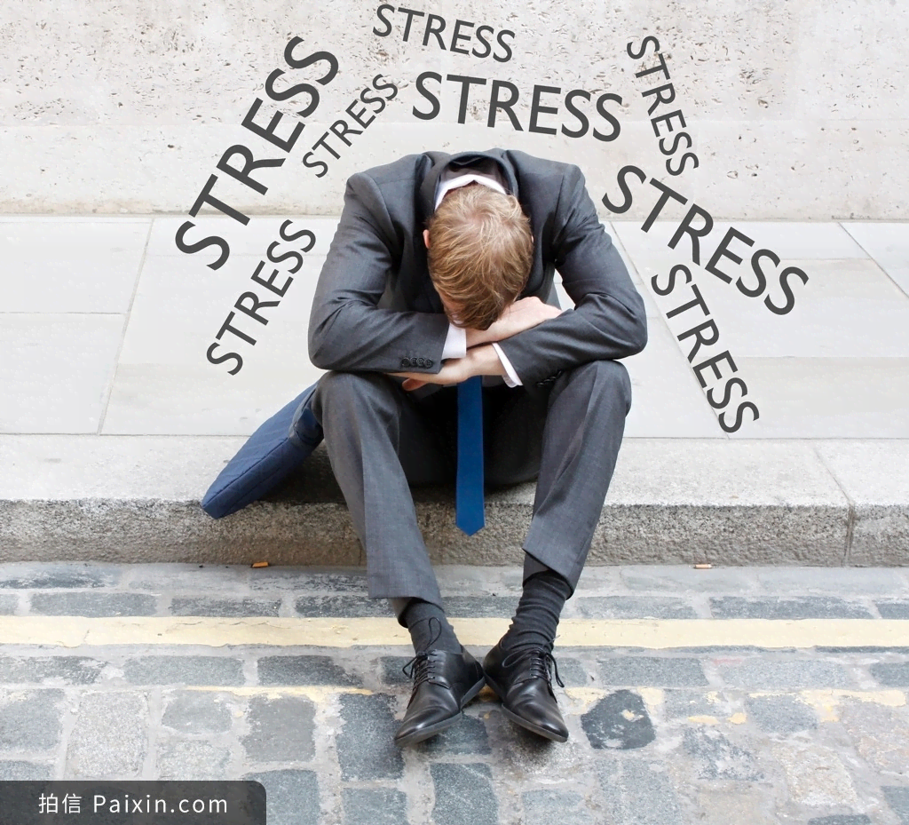
3.
stress /stres/ n. 压力；重音 v. 加压；紧张；强调；重读
1.她承受不了...的生活压力和紧张。（续）
✍1.She failed to withstand the stresses and strains of ...life.
strain /streɪn/ n. 张力；拉紧
2.“你需要更多的练习，”老师强调说。（续）
✍2."You need more practice," the teacher emphasized/ stressed _{（强调）}

Slide 80

4.
obesity /əʊ'bi:sətɪ/ n. （过度）肥胖；肥胖症
一个缺点是，孩子们会过分沉溺于电脑屏幕中，不愿意运动，从而导致肥胖等问题。（应）
✍One drawback is that children become immersed in their screen time and reluctant to do exercise, resulting in problems such as obesity.

Slide 81


5.
adolescent /ˌædəˈlesnt/ n. 青少年adj. 青春期的
1.青少年生长/青少年健康
✍1.adolescent growth/ health
2.引导我们度过青春期（应、续、概）
✍2.navigate us get through adolescence

Slide 82
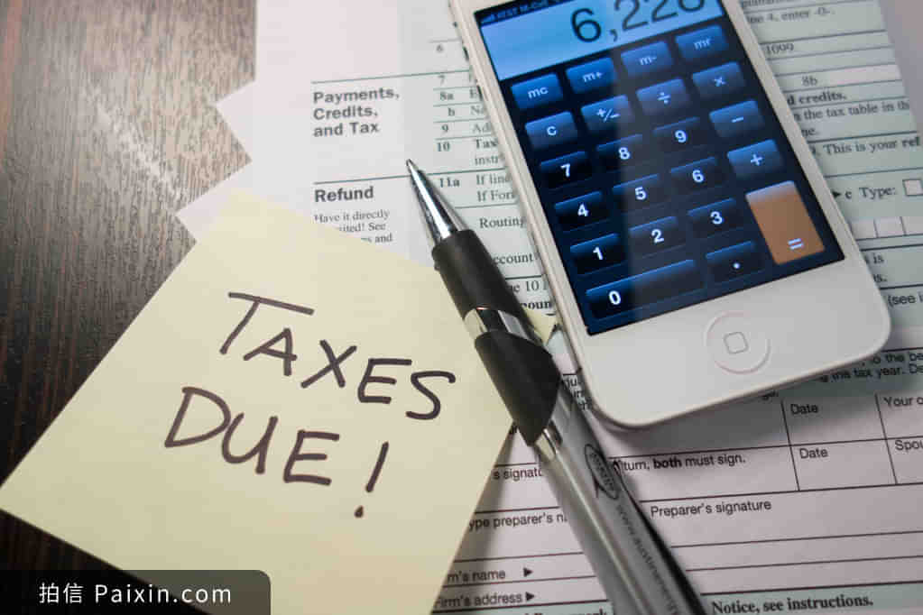
6.
due /dju:/ adj. 欠款的；预定的；到期的；恰当的
1.我刚刚接到通知要参加一个重要会议，所以我会安排我的朋友李雷来接你。他将等待你在适当的时候在到达出口。如果有必要，你可以打13955667788跟他联系。（应）
✍1.I've just been asked to attend an important conference, so I will arrange for my friend Li Lei to pick you up. He will be awaiting you in due time_{（适时地）}at the arrival exit. You can contact him at 13955667788 if necessary.
2.当局/所有学生早该重视增强节俭意识了。（应、概）
✍2.It is high time that authorities / all students paid due attention to enhancing awareness of frugality.
frugality /fruˈɡæləti/ n. 俭省，节俭

Slide 83

7.
tough /tʌf/ adj. 困难的；强硬的
强者之所以是强者，是因为在生活中不甘示弱，奋勇前进。弱者之所以是弱者，是因为在生活中犹豫不决，畏缩不前。（续）
✍The strong are not strong before they experience toughly, and the weak are always weak when they are full of fear and negativity.

Slide 84
8.
accustom /əˈkʌstəm/ vt. 使习惯于
1.教室里惯有的低语声又在沉闷的空气中响起。（续）
✍The accustomed classroom murmur rose upon the dull air once more.
2.由于我们在实践过程中可能会遇到很多问题，所以我们确实花了一段时间来习惯垃圾分类。 （应）
✍Since we may meet with many problems during the practical process, it did take us a period of time to accustom ourselves to garbage classification.

Slide 85

9.
bad-tempered /ˌbædˈtempəd/ adj. 脾气暴躁的；易怒的
1.耍小孩脾气； 发了一顿脾气（续）
✍1.throw a temper tantrum
/ˈtæntrəm/ n. （尤指儿童）耍脾气，使性子
2.脾气暴躁 （续）
✍2.hair-trigger temper
adj. 一触即发的

Slide 86
10.
automatic _{/ˌɔ:təˈmætɪk/} adj. 自动的 autonomous _{/ɔːˈtɒnəməs/} adj. 自主的
1.你知道，如果你反反复复做同一件事情，你就会自动地做它。（应、续、概）
✍1.If you do the same thing over and over again, you begin to do it automatically.
2.在过去的一年里，我们在大家的无私帮助下，适应了新的环境和文化冲击，成为了更加自主的学习者。（应）
✍2.The past year witnessed how we adapted to the new surroundings and culture shock, and became more autonomous learners with the unreserved help of all of you.

Slide 87

11.
mental /ˈmentl/ adj. 精神的；智力的
1.当局早该重视增强学生的身心健康了。（应、概）
✍1.It is high time that authorities paid due attention to enhancing students’ mental and physical health.
2.保持身心健康
✍2.keep mentally and physically healthy

Slide 88
12.
effect /ɪˈfekt/ n. 结果；效力
1.引人注目的影响/长期效应（应、续、概）
✍1.dramatic/ long-term effects
2.这幅画的总体效果气势磅礡。（续）
✍2.The overall effect of the painting is overwhelming.
3.她的话对我们有一种魔力般的作用。（续）
✍3.Her words had a magical/ negative/ positive effect on us.

Slide 89

13.
lung /lʌŋ/ n. 肺
“我要在情况变得更糟前离开！”他叫嚷着顿足走出了卧室，砰地关上门。（续）
✍"I'm going before things get any worse!" he screamed at the top of his lung as he stomped out of the bedroom, slamming the door.

Slide 90
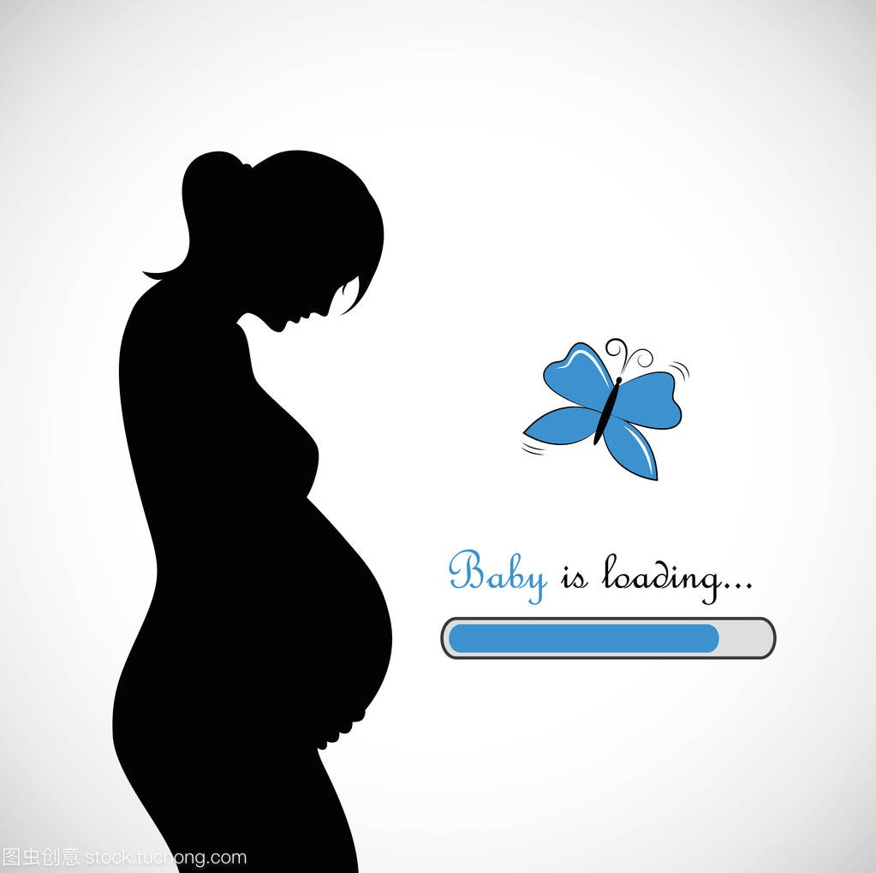
14.
pregnant /ˈpregnənt/ adj. 怀孕的； 饱含；充溢着
1.耐人寻味的停顿/心照不宣的沉默（续）
✍1. a pregnant pause/silence
2.她的沉默里充满了批评之意。（续）
✍2.Her silences were pregnant with criticism.

Slide 91
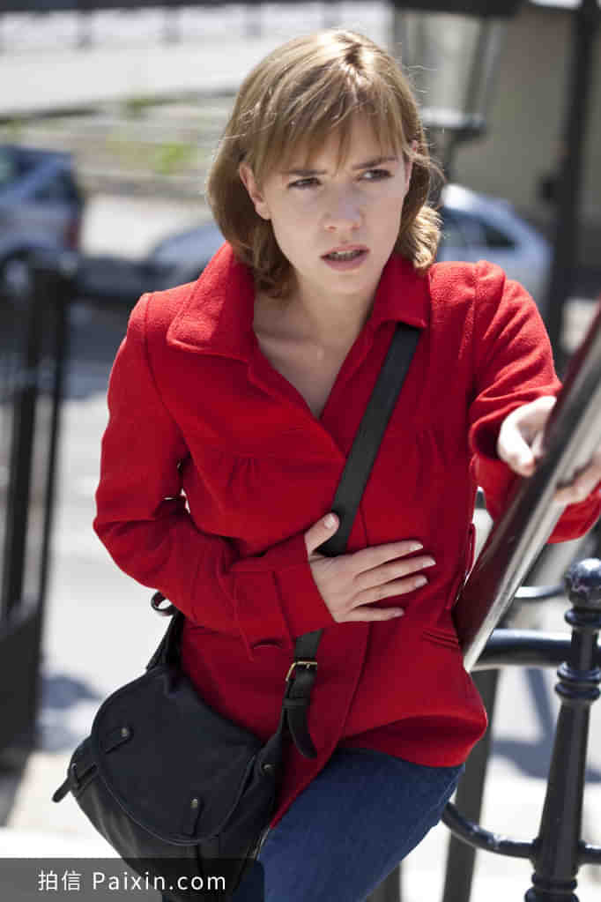
15.
breathless /ˈbreθl ɪ s/ adj. 气喘吁吁的；屏息的
1.呼哧呼哧喘气（续）
✍1.be puffing_{/pʌf/} and panting _{/pænt/}
2.夏日午后的闷热（续）
✍2.the breathless heat of a summer afternoon
3.我有点胸闷,我的内心狂跳不已。（续）
✍3.I was a little breathless and my heartbeat was bumpy and furious.
4.科林身体起起伏伏，哭得喘不过气来。（续）
✍4.Colin was heaving with great breathless sobs.
heave /hiːv/ vt. 使起伏（续）

Slide 92

16.
strengthen /ˈstreŋθn/ vt. 加强；巩固；使坚强 vi. 变强
1.也许对你坚定决心会有所帮助。（应、续、概）
✍1.It might help you strengthen your resolve.
2.弘扬中华传统美德有助于增强文化软实力，增强文化自信。（应）
✍2. Carrying forward traditional Chinese virtues helps to improve cultural soft power and strengthen our cultural confidence.

Slide 93
17.
resolve /rɪˈzɒlv/ n. 决心；决定v. 决定；溶解 vi. 解决
1.解决问题╱争端╱冲突╱危机（应、概）
✍1.resolve an issue/a dispute/a conflict/a crisis
2.我看着那张单子，感到决心开始动摇。（续）
✍2. I looked at the list and felt my resolve weakening.
3.谁也动摇不了他的决心.（续）
✍3. No one could stir him from his resolve.
/stɜː(r)/ v. 搅拌 stir sb from sth 使某人远离某事
4.我咬紧牙关，决心一寸一寸地靠近它。（续）
✍4.With jaws clenched, I resolved to keep edging closer, inch by inch.
clench /klentʃ/ v. （表愤怒、决心或不安时）攥紧（拳头等），咬紧（牙齿等）

Slide 94
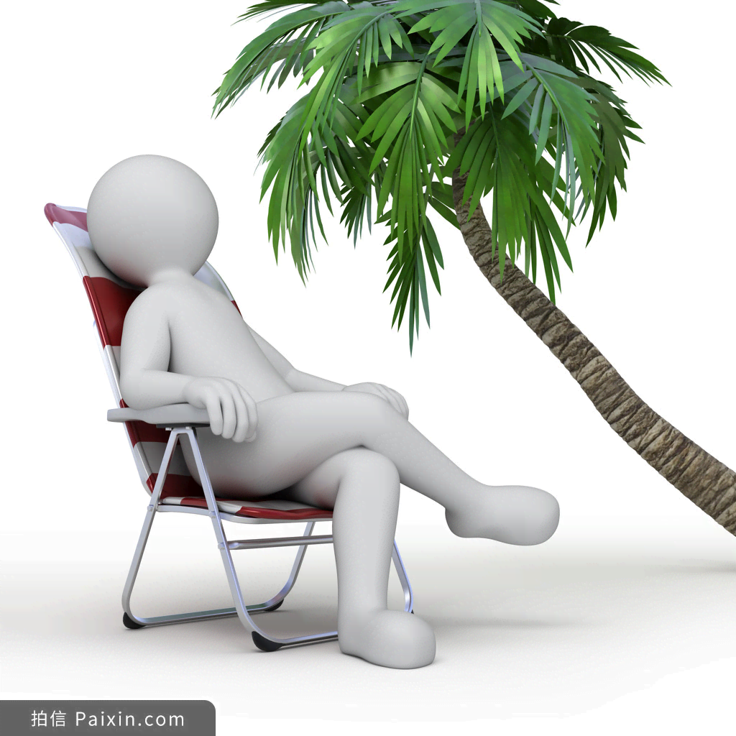
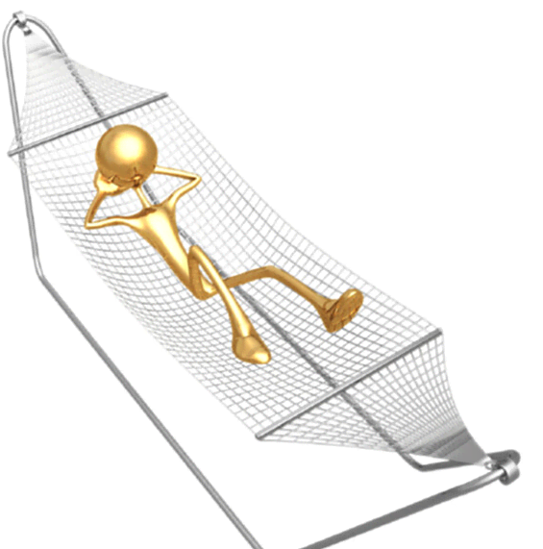
18.
relaxation /ˌri:lækˈseɪʃn/ n. [U] 放松；松弛
1.学习放松技巧。（应、续、概）
✍1.Learn relaxation techniques.
2.享受甩掉压力的放松吧！（应、续、概）
✍2.Enjoy the relaxation of burning off stress!
3.人人都需要一些休息和放松的空闲时间。（应、续、概）✍3.Everyone needs some free time for rest and relaxation.

Slide 95
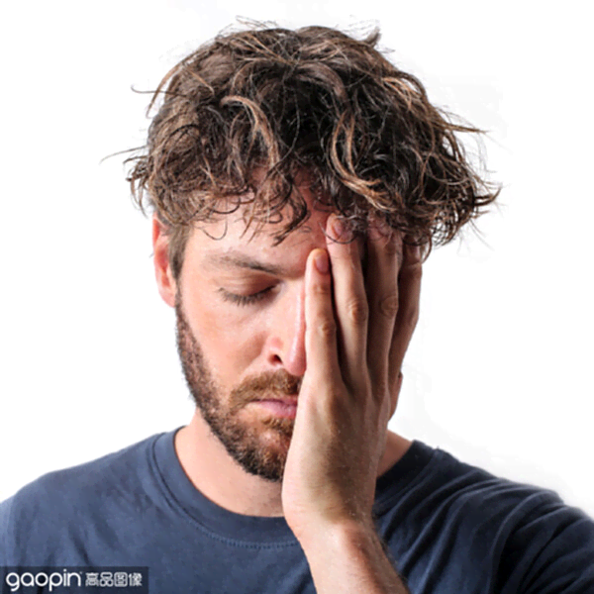
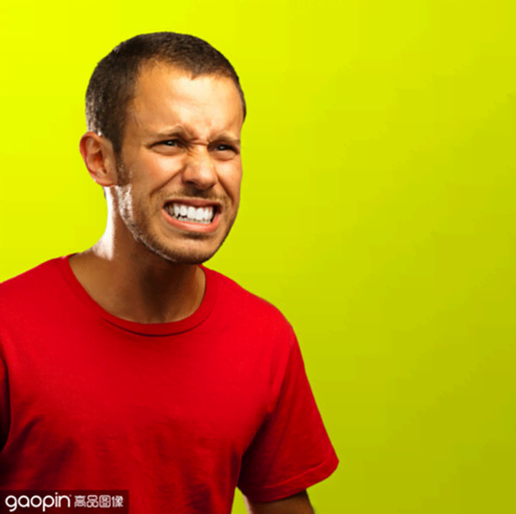
19.
desperate /ˈdespərət/ adj. 绝望的，拼命的
1.他深深地吸了口气，竭尽全力保持镇定。（续）
✍1.He took a deep breath, desperately trying to keep calm.
2.她无法抑制她那不顾一切的愤怒。 （续）
✍2.She couldn’t restrain her desperate anger.
restrain /rɪˈstreɪn/ vt. 抑制，控制
3.他如此绝望，以至于借酒浇愁。（续）
✍3.So desperate was he that he drowned sadness in wine.

Slide 96

20.
weaken /ˈwi:kən/ v. （对某事的决心）动摇；减弱
什么也不能削弱他继续下去的决心。（应、续）
✍Nothing could weaken his resolve to continue.

Slide 97
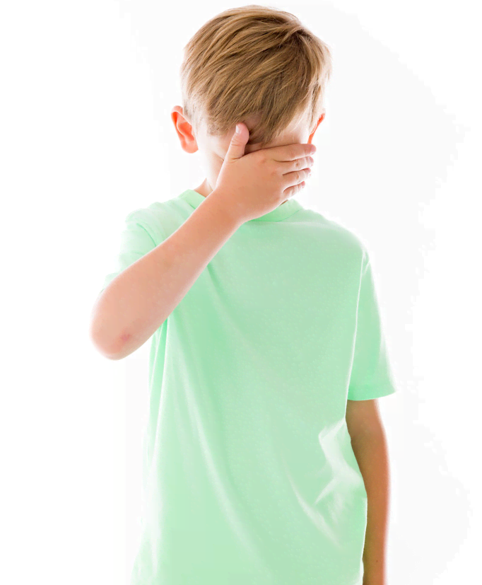
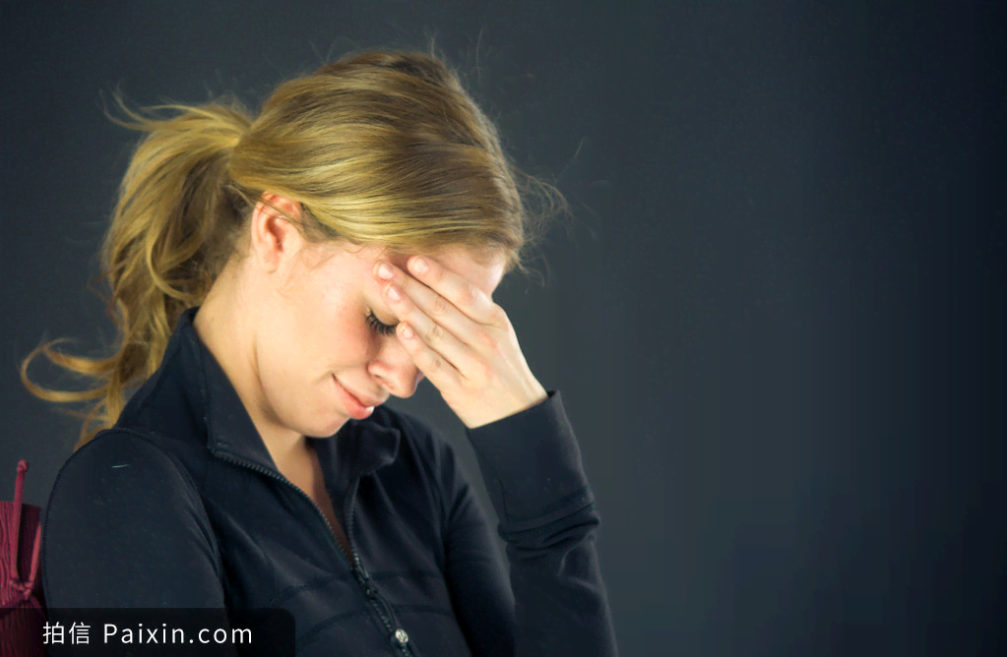
21.
ashamed /əˈʃeɪmd/ adj. 感到惭愧或羞耻的_{(不用于名词前)}
1.尽管我们之间有分歧，但是我并不耻于承认我爱我的父亲，有着一个普通的小男孩对父亲的深爱。（续）
✍Despite our gaps, I am not ashamed to admit that I loved my father with the usual passion of a young boy for his father.
2.她是如此羞愧以至于脸如充血般发烫。（续）
✍So ashamed was she that she could feel the blood rush to her face.
3.我感到羞愧又自责，推开门准备真诚地向母亲道歉。（续）
✍Ashamed and self-blamed/condemned, I pushed the door open, ready to sincerely apologize to my mother.

Slide 98
22.
comprehension _{/ˌkɒmprɪˈhenʃn/} _{n. 理解（力）} comprehensive _{adj. 综合的；有理解力的}
1.这完全超出了她的理解力。（应、续）
✍1.This was utterly beyond her comprehension. utterly /ˈʌtəli/ adv. 完全地；绝对地
2.他们带着一样恍然大悟、惊奇、松了一口气的表情相互看了看。（续）
✍2.They turned to one another with the same expression of dawning comprehension, surprise, and relief.
3.为了庆祝即将到来的端午节，我真诚地邀请你们到我家来，不仅一起享受这个节日，而且帮助你们更多地理解中国文化的内在美。（应）
✍3.To celebrate the upcoming Dragon Boat Festival, I sincerely invite you to my home to not merely enjoy the festival together, but also help you gain more comprehension about the inner beauty of Chinese culture.
4.综合素质/综合评价（应、概）
✍4. comprehensive quality/ evaluation
5.随着中英科技文化的交流，我们在全球视野、专业技能和英语语言能力方面形成了综合能力。（应）
✍5.With Sino-British scientific technology and culture being exchanged, we have developed the comprehensive capability in global vision, professional skills and English language competences.

Slide 99
23.
in spite of 不顾；不管 =despite
1.尽管经历了人生的跌宕起伏，她从没有屈从命运的摆布。（续）
✍1.In spite of ups and downs, she never takes her fate lying down.
take sth lying down 甘心忍受
2.尽管表面看似镇静，我内心却非常慌乱。（续）
✍2.In spite of my outward calm I was very shaken.
outward 向外的；外面的
3.尽管他很失望，他还是勉强露出一丝淡淡的微笑。（续）
✍3.In spite of his disappointment, he managed / forced a weak smile.

Slide 100



24.
slippery /ˈslɪpərɪ/ adj. 滑的
1.天开始下大雨，路面很滑。（续）
✍It was beginning to rain hard and the ground /the path was wet and extremely slippery.
2.他的手汗津津的。（续）
✍His hand was slippery with sweat.
3.林深苔滑。（续）
✍The forest is thick and the moss is slippery.
moss /mɒs/ n. 苔藓；泥沼

Slide 101

25.
at risk 处于危险中
高强度的音乐对我们的听力造成威胁，这会对我们的感觉细胞造成永久性的破坏，导致无法治愈的听力损失。（应、概）
✍Loud music can cause a threat to / endanger/ threaten our hearing // put our ears at stake/ at risk/ in danger, which can do permanent devastate to our sensory cells, resulting in incurable hearing loss
devastate /'devəsteɪt/ (utterly destroy)

Slide 102

26.
inject _{/ɪnˈdʒekt/} vt. 注射；注入; 增添 instil /instill _{/ɪnˈstɪl/} v. 逐渐灌输/培养
1.注入动力（应、续、概）
✍1.inject/ instill + vigor/dynamism+ into
/ˈvɪɡə/ ; /ˈdaɪnəmɪzəm/
2.逐步树立信心╱守纪律╱产生恐惧
✍2.instil confidence/discipline/fear into sb
3.他的发言给整个活动增添了一丝幽默的气氛。（续）
✍3.His comments injected a note of humour into the proceedings.

Slide 103
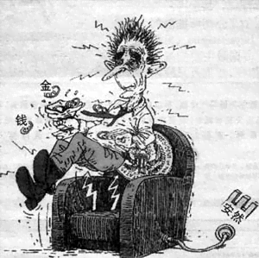
27.
needle /ˈni:dl/ n. 针；（注射器的）针头
1.如坐针毡；焦躁不安；手脚发麻（续）
✍1.pins and needles
2.我们一直坐立不安地等着听她是否得到那份工作的消息。（续）
✍2.We're on pins and needles waiting for the news whether she got the job.
3.在这个城市里找一个人无异于大海捞针。（续）
✍3.Searching for one man in this city is like looking for a needle in a haystack.
haystack /ˈheɪstæk/ n. 干草堆
4.静得连针掉在地上都能听见。（续）
✍4.It was so quiet that you might hear a pin drop.
pin /pɪn/n. 大头针，别针，针 vt. 将……用针别住

Slide 104

28.
spill /spɪl/（spilt, spilt） v. 溢出；洒落
1.门开了，人们涌上街道。（续）
✍1.The doors opened and people spilled into the street.
2.她突然控制不住她的感情了。（续）
✍2.Her emotions suddenly spilled over.
3.我思如泉涌奋笔疾书。（续）
✍3.My thoughts spilled out and my pen started to dance.

Slide 105

29.
embarrassed /ɪmˈbærəst/ adj. 尴尬的；陷入困境的
1.她递给我一支烟，我尴尬得手足无措。（续）
✍1.Then she offered me a cigarette and I felt so embarrassed and awkward.
2.她尴尬得呆住了。 （续）
✍2.Embarrassment rooted her to the spot.
3.看到他们难堪的样子她不禁喜形于色。（续）
✍3.She couldn't disguise her glee at their embarrassment.
glee /ɡliː/ n. 快乐
disguise /dɪsˈɡaɪz/ vt. 掩饰
4.她窘得满脸通红。（续）
✍4.Her face glowed with embarrassment.

Slide 106

30.
awkward /ˈɔ:kwəd/ adj. 局促不安的；笨拙的
1.一阵令人尴尬的沉默。（续）
✍1.There was an awkward silence.
2.亚力山德拉穿着她那件丢弃的衣服，显得臃肿而又笨拙。（续）
✍2.Alexandra looked plump and awkward in her cast-off clothing.
plump /plʌmp/adj. 饱满的；胖乎乎的
cast-off /ˈkæst ɔːf/ adj. 遭遗弃的；丢失的
3.他试着跳舞，但是太笨拙，太别扭。（续）
✍3.He tried to dance, but he was too clumsy and awkward.
4.她笨重地摔了一跤，摔断了踝关节。（续）
✍4.She fell awkwardly and broke her ankle.

Slide 107

活用教材词汇，靶向高考写作
写
作
词
汇
——人教版 M6U4-Global warming
单词拓展
1. consume 2. renewable 3. greenhouse 4. graph 5. random 6. phenomenon 7. subscribe 8. oppose
9. quantity 10. tend 11. result in 12. trend 13. catastrophe 14. mild 15. range 16. even if
17. glance 18.steady 19. widespread 20. on the whole 21.economical 22. average 23. existence 24. on behalf of
25.individual 26. advocate 27. put up with 28.electrical 29. appliance 30. casual 31. circumstance 32.refresh 33.contribution 34.commitment

Slide 108

1.
consume /kənˈsju:m/ vt. 消费；消耗；使充满（强烈的感情）；使...着迷
1.电力工业消耗大量的矿物燃料（应/概）
✍1.The electricity industry consumes large amounts of fossil fuels.
2.长时间工作的人的生活方式有可能随着时间的推移而恶化，例如由于饮食不良或饮酒增加。（概）deteriorate /dɪ'tɪərɪəreɪt/ v. 恶化，变坏--deteriorated adj. 恶化的；已变质的
consumption/kənˈsʌmpʃn/
✍ 2.It was possible that the lifestyle of people working long hours deteriorated over time, for example as a result of poor diet or increased alcohol consumption.
3.蜡烛燃烧自己，照亮别人。（应、续）
✍ 3.A candle lights others and consumes itself.

Slide 109
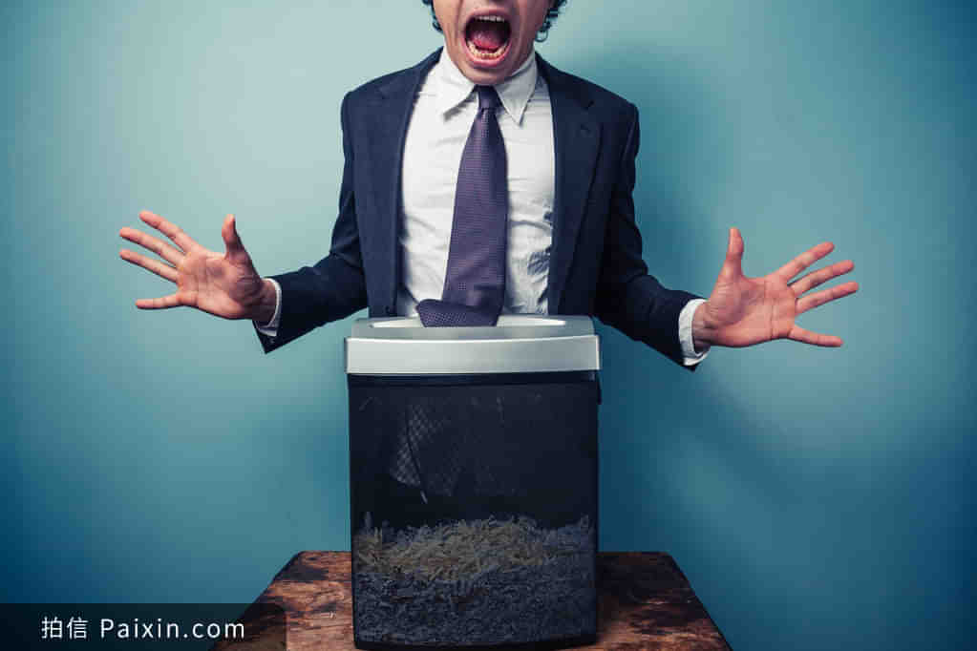
1.
consume /kənˈsju:m/ vt. 消费；消耗；使充满（强烈的感情）；使...着迷
4.席琳深感内疚。（续）
✍4.Celine was consumed with guilt.
5.迈克无比愤怒。（续）
✍5.Rage consumed Mike.
6.篮球令他着迷。consuming .adj 令人着迷的
✍6.Basketball is his consuming passion.
Consumed by work

Slide 110

2.
renewable /rɪˈnju:əbl/ adj. 能再生的；可更新的
1.像风力和太阳能这种用之不竭的能源（应、续、概）
✍1.renewable sources of energy such as wind and solar power
2.这份工作许可证不能延期。（应）
✍2.The work permit is not renewable.
3.感觉神清气爽，恢复精神。（续）
✍3.feel refreshed and slightly renewed.

Slide 111


3.
greenhouse /ˈgri:nhaʊs/ n. [C] 温室；花房
低碳生活方式减少温室气体排放，节约资源。（应、概）
✍A low-carbon lifestyle reduces greenhouse gas emissions and saves resources.

Slide 112


4.
graph /gra:f/ n. [C] 图表；坐标图；曲线图
这张图表的数据清楚地描述了未来环境的趋势（应、概）
✍The data of this graph makes a clear presentation of the future environmental tendency.

Slide 113
5.
random /ˈrændəm/ adj. 胡乱的；任意的
1.随机抽样/选择（应、续、概）
✍1.a random sample/selection
2.我坐在地上，从书架上随便拿了几本书。（续）
✍2.I sat down on the floor and pulled a few books off the shelf at random.
3.让我惊讶的是，随意的善意举动对收到的人来说意味着什么。（续）
✍3.It amazed me what random actions of kindness could mean to the people who received it.

Slide 114
6.
phenomenon /fɪˈnɒmɪnən/ n. 现象
(pl. phenomena)
毫无疑问,地球是在变暖,而地球变暖正是人类活动导致而成的,并非是一种无规律的自然现象。（应、概）
✍There is no doubt that the earth is becoming warmer and that it is human activity that has caused this global warming rather than a random but natural phenomenon.
我相信，在我们的共同努力下，浪费粮食的现象将消失。
✍I am convinced that，with our joint efforts, the phenomenon of wasting food will disappear.

Slide 115
7.
subscribe /səbˈskraɪb/
1.他们一致赞成是人类的存在和任意的能源消耗才造成了这一现象。（应、概）
✍1.Without disagreement, they subscribe to the view that it is humans' existence and their random energy consuming that result in this phenomenon.
2.爱丁堡旅游的名额已经满了。（应、概）
✍2. The tour of Edinburgh is fully subscribed.
3.他向当地慈善机构捐了一大笔钱。（应、续）
✍3.He subscribed a large sum of money to the local charity.
同意
捐赠
订阅
(签署)文件

Slide 116

8.
oppose /əˈpəʊz/ vt. 反对；与（某人）较量
opposed /əˈpəʊzd/ adj. 反对的；对立的
反对
✍be opposed to (doing) sth.
=be against sth./object to (doing) sth.
with clenched fist concept of oppose sign

Slide 117
9.
quantity /ˈkwɒntəti/ n. [C;U] 量；数量
随着更多的森林被毁，每年有大量肥沃的泥土被冲走。（应、概）
✍With more forests being destroyed, huge quantities of good earth are being washed away each year.
quantity作主语时谓语用单数还是复数？
1. 若单独用quantity作主语，谓语动词用单数。
It is used to emphasize that the quantity is very large. 它用于强调数量很大。
2. 若用于a great (large, small) quantity of…结构，其后主要接不可数名词，但有时也接复数名词；这类结构用作主语时，其谓语的数原则上与其中的名词的数保持一致。
There are a small quantity of apples in the house. 房子里有少量的苹果。
A large quantity of food was on the table. 大量的食物摆在桌上。
3. 若该结构变成(large) quantities of…这样的形式，则当它用作主语时，其谓语动词一律用复数。
Large quantities of rice have been destroyed in the flood. 大量的庄稼在洪水中被毁坏了。
【注意】 mass的用法同quantity用法相同。

Slide 118

10.
tend /tend/ vi. 趋向；易于；照顾--tendency
1.这意味着更多的热量被困在大气层中,从而引起全球温度上升。（概）
✍1.It means that more heat energy tends to be trapped in the atmosphere causing the global temperature to go up.
2.救护车上的救护人员在照料受伤者。（续）
✍2.Ambulance crews were tending to_{（介词）} the injured
3.我紧张时总爱唠叨。（续）
✍3.I have a tendency to talk too much when nervous.

Slide 119
11.
result in 导致
consequence /ˈkɒnsɪkwəns/ n. [C] 结果；后果；影响
他学习刻苦。因此,他轻松地通过了考试。（应、续）
✍①He had been hard-working at his study. As a consequence/result, he passed the exam easily.
✍②As a consequence/result of his hard work, he passed the exam without any difficulty.
✍③His passing the exam with ease resulted from/was due to his hard work at his study.
✍④His hard work at his study resulted in/led to his passing the exam effortlessly.

Slide 120

12.
12.trend /trend/ n. [C] 趋势；倾向；走向
13.catastrophe /kəˈtæstrəfi/ n. [C] 大灾难；浩劫
福斯特博士认为气温升高5度的趋势可能是一场大灾难。（概）
✍Dr Foster thinks that the trend which increases the temperature by 5 degrees would be a catastrophe.

Slide 121
14.
mild /maɪld/ adj. 温和的；温柔的；淡的
1.她略带吃惊地看着他。（续）
✍1.She looked at him in mild surprise.
2.春日阳光融融温暖（续）
✍2.the mildness of sunny spring day
3.福里斯特通常态度温和，和蔼可亲，不善言辞。affable /ˈæfəbl/ adj. 和蔼可亲的（续）
✍3.Forrest was normally mild-mannered, affable, and untalkative.
4.身体免疫系统变得如此脆弱，以至人们经常因为轻微的疾病而变得非常虚弱。（概）
✍4.So weak does the body's immune system become that the person often becomes very ill from usually mild sicknesses.

Slide 122

15.
range /reɪndʒ/ n. [C]种类；范围 vt. 漫游；来回走动
1.他四处漫步，寻找绘画的灵感。（续）
✍1.He ranges far and wide in search of inspiration for his paintings.
2.他看见谁，就对谁吼叫。（续）
✍2.He shouted angrily at anyone within range.
3.她的目光在屋子里来回扫视。（续）
✍3.Her eyes ranged the room.
4.这个节目受众很广，老少皆宜。（应）
✍4.The show had a large audience, ranging from children to grandparents.
Free range, outdoor bred cute pink piglet

Slide 123
15.
range /reɪndʒ/ n. [C]种类；范围 vt. 漫游；来回走动
5.处于压力下的人更容易发挥自己的全部潜能。（应、续、概）
✍5.People under stress tend to develop their full range of potential.
6.近年来，压力被认为是一系列医疗问题的一个原因。（应、概）
✍6.Recently stress has been regarded as a cause of a whole range of medical problems.
7.除了这些传统的活动，我们有更多的选择，如旅行和拜访我们的亲戚或朋友。（应）✍7.In addition to these traditional activities, we have a wider range of choices such as travelling and visiting our relatives or friends.

Slide 124

15.
range /reɪndʒ/ n. [C]种类；范围 vt. 漫游；来回走动
我们学校每天都会产生大量的垃圾，如剩饭、废物和塑料瓶，这带来了广泛的环境问题以及资源的浪费。 因此，现在是我们立即采取行动改变情况的时候了。（应）
✍Our school produces a lot of rubbish every day, such as leftover food, waste and plastic bottles, which brings a wide range of environmental problems as well as the waste of resources. Therefore, it’s time that we took immediate action to change the situation.
The shooting range

Slide 125
16.
even if/though 即使
1.即使我们开始减少温室气体的含量,在(未来)几十年或几个世纪内,气候仍会持续转暖。（应、概）
✍1.Even if we start reducing the amount of greenhouse gases, the climate is going to keep on warming for decades or centuries.
2.即使你英语流利，在英国你也许还是会遇到语言困难。（应、概）
✍2.Even if you're fluent in English, you may experience linguistic difficulties in the UK.

Slide 126

17.
glance /glɑ:ns/ vi. 看一下；扫视n. [C] 一瞥
1.她从眼角瞥了他一眼。（续）
✍1.She shot/ cast him a sideways glance.
2.他一眼看出了问题所在。（续）
✍2.He could tell what was wrong at a glance.
3.乍一看问题似乎很简单。（续）
✍3.At first glance the problem seemed easy.
4.我只匆匆浏览了下报纸。 （续）
✍4.I only had time to glance at the newspapers.

Slide 127

18.
steady /ˈstedi/ adj. 平稳的；持续的；稳固的
1.我们虽然缓慢但是在稳步前进。（续）
✍1.We are making slow but steady progress.
2.雨不紧不慢地下着。（续）
✍2.The rain fell steadily.
3.电梯微微一晃又稳下来，接着门开了。（续）
✍3.The lift rocked slightly, steadied, and the doors opened.
4.稳如泰山，十分可靠（续）
✍4.as steady as a rock

Slide 128

19.
19. widespread /ˈwaɪdspred/ adj. 分布广的；普遍的
20. on the whole 大体上；基本上
总的说来，地球变暖是引起极大关注的一个现象。（应、概）
✍On the whole global warming is a phenomenon that arouses widespread concern.

Slide 129

21.
economical /ˌi:kəˈnɒmɪkl/ adj. 节约的；经济的
1.他的手势简练，言语通常是温和的。（续）
✍1.His gestures were economical, his words generally mild. 独立主格结构
2.电动车无污染，无噪音，而且经济。（应、概）
✍Electric cars are clean, quiet, and economical.
an economical hotel

Slide 130
22.
average /ˈævərɪdʒ/ adj. 平均的 n.平均数；平均水平；一般水准
1.学生平均每天要花三个小时来完成作业，但是如果遇到难题，完成作业的时间就得延长。（应）
✍1.On average, students have to spend 3 hours finishing homework every day, but if we are stuck by difficult questions, the time will be extended.
2.他的学业表现远超同学，但是他仍然十分谦虚，而且乐于助人。（续）
✍2.His academic performance is well above average, but he is still humble and helpful.

Slide 131

23.
existence /ɪgˈzɪstəns/ n. 生存；存在；(尤指艰难或无聊的）生活
这家人在狭小的公寓里艰难度日。cramped /kræmpt/ adj. 狭窄的（续）
✍The family endured a miserable existence in a cramped apartment.

Slide 132

24.
on behalf of 代表……一方；作为……的代言人
1.我很荣幸站在这里，代表所有的交换生，向阿什维尔学院亲爱的老师和同学们表示衷心的感谢。（应）
✍1.It's my privilege to stand here, on behalf of all the exchange students, to extend our heartfelt gratitude to the dear teachers and fellow students of Ashville College.

Slide 133
25.
individual /ˌɪndɪˈvɪdʒuəl/ n. 个人；个体 adj. 单独的；个别的
1.地球是每个人的家园，自愿保护环境是我们的义务。（应、概）
✍1.The earth is home to every individual, and it’s our duty to protect the environment voluntarily.
2.为了我们的环境和生活，我们应该学会分类垃圾，并养成这样做的习惯。每个人都可以发挥作用，让我们为地球带来一个更光明的未来!（应、续）
✍2.For the sake of our environment and life, we are expected to learn to sort the rubbish and make it a habit. Every individual can make a difference and let’s bring a brighter future for the planet!

Slide 134

26.
advocate /ˈædvəkeɪt/ vt. 拥护；提倡；主张
1.提倡社会服务和志愿贡献的精神（应/续/概）
✍1.advocate the spirit of social service and voluntary contribution
2.我们提倡循环利用纸张和塑料。（应/概）
✍2.We advocate recycling papers and plastics.

Slide 135
27.
put up with 忍受；容忍
1.众人拾柴火焰高。我们不必去忍受污染。（应）
✍Together, individuals can make a difference. We do not have to put up with pollution.
2.他太喜怒无常了 我不知道她为什么要忍受他。（应、续）
✍He's so moody - I don't know why she puts up with him.
房子凌乱我能忍受，但我讨厌房子不干净。（应、续）
✍I can put up with the house being messy, but I hate it if it's not clean.

Slide 136

28.
28.electrical /ɪˈlektrɪkl/ adj. 电的；与电有关的
29.appliance /əˈplaɪəns/ n. 用具；工具；器具
在你不使用电器时，把它关掉。（应、概）
✍Switch an electrical appliance off so long as you are not using it .

Slide 137
30.
casual /ˈkæʒuəl/ adj. 随便的；漫不经心的；偶然的
1.我们会一起吃顿大餐，随便聊聊。（应）
✍1.We’ll have a big feast together, chatting casually.
2.她的穿着随意而不失雅致。（续）
✍2.She dresses with casual elegance.
3.他讲话时试图显得不在乎，但我知道他心里着急。（续）
✍3.He tried to sound casual, but I knew he was worried.

Slide 138
31.
circumstance /ˈsɜ:kəmstəns/ n. 环境；情况 (多用复数形式)
1.在任何情况下，青少年都不应盲目跟从大众媒体上的负面信息。（续）
✍Under no circumstances should youngsters follow_{部分倒装} negative information on mass media blindly.
2.我们身陷绝境，都不知道自己能不能活着回去。（续）
✍Our circumstances are so desperate that it is uncertain whether we will ever return alive.
3.无论我们的环境如何，我们通常仍然有梦想和希望。（续）
✍Whatever our circumstances, we generally still have dreams and hopes .

Slide 139


32.
refresh /rɪˈfreʃ/ vt. 使恢复；使振作
1.在合适的时间度过适宜的假期可以让你的身心焕然一新。（应、续、概）
✍1.The right vocation at the right time can refresh your body and mind.
2.近年来，让濒危语言重获活力的举措越来越多。initiative /ɪˈnɪʃətɪv/n.主动权；积极性（概）
✍2.Initiatives to refresh endangered languages have become more numerous in recent years.

Slide 140
33.
contribution /ˌkɒntrɪˈbju:ʃn/ n. [C] 贡献；捐款；捐赠; 稿件；作品
1.记住,你的贡献是很有价值的。（应、续）
✍1.Remember - your contribution counts!
2.这些措施将会对减少工业事故起重要作用。（应、概）
✍2.These measures would make a valuable contribution towards reducing industrial accidents.
3.所有五月份的投稿必须在星期五之前收到。
✍3.All contributions for the May issue must be received by Friday.

Slide 141

34.
commitment /kəˈmɪtmənt/ n. [C; U] 承诺；交托；信奉
1.她已承诺不饮用瓶装水。（应）
✍1.She has made a commitment to going bottle-free.
2.我目前劳累过度，承担的事情太多了。（应、续）
✍2.I’m overworked at the moment — I’ve taken on too many commitments.

Slide 142

活用教材词汇，靶向高考写作
写
作
词
汇
——人教版 M6U5-The power of nature
单词拓展
1. volcano 2. erupt 3. ash 4. alongside 5. equipment 6. appoint 7. evaluate 8. burn to the ground
9. wave 10. fountain 11. absolute 12. suit 13. make one’s way 14. potential 15. sample 16. candidate
17. threat 18.tornado 19. precious 20. fog 21.rainbow 22. unconscious 23. shoot 24. tremble
25. sweat 26. anxious 27. panic 28.vary 29. diverse 30. spectacular 31. bathe 32. bathe
33.appreciation 34.peak

Slide 143

1.
volcano [vɔl'keinəu] n. 火山 crater ['kreitə] n. 火山口；弹坑
lava ['lɑ:və] n. （火山喷出的）熔岩
1.火山从火山口喷出熔岩。（续）
spit /spɪt/-spit -spit v. 吐痰；吐口水；吐出；发出劈啪声
✍ 1.The volcano spit out _{拟人} lava from its mouth.
2.它是一座休眠的火山，从云中俯冲到大海。（续）
dormant/ˈdɔːmənt/ adj. 休眠的；静止的；睡眠状态的；隐匿的
plunge /plʌndʒ/ v. 使突然地下落；纵身跳向; 猛冲向；骤降；（使）陷入
✍2.It’s a dormant volcano that starts in the clouds and plunges down to meet the sea _{夸张}.

Slide 144
2.
erupt [i'rʌpt] vi. （指火山）爆发；(愤怒、激情、喜悦等)迸发
eruption [i'rʌpʃən] n. 火山爆发；（战争等）爆发
1.哈哈大笑/嚎啕大哭/勃然大怒 （续）
hysterical /hɪˈsterɪkl/ adj. 歇斯底里的；情绪狂暴不可抑止的
fury /'fjʊərɪ/n. 狂怒；暴怒--furious /ˈfjʊəriəs/ adj. 激烈的；狂怒的; 玩命的; 迅猛的
✍1. erupt into hysterical laughter/ tears/ fury
2.一阵突然的绝望（续）
✍2. an eruption of despair

Slide 145

3.
ash [æʃ] n. 灰；灰末
1.她所有的梦想都化为泡影。（续）
✍1.All her dreams had turned to ashes_{比喻}.
2.他掸掉了袖子上的烟灰。（续）
✍2.He brushed the cigarette ash from his sleeve.
3.他像长生鸟一样，从选举惨败的灰烬中重新崛起。
phoenix /ˈfiːnɪks/ n. 凤凰；死而复生的人
to rise like a phoenix from the ashes (= to be powerful or successful again) 雄起如再生的凤凰
✍ He had risen, like a phoenix, from the ashes of_{比喻} electoral disaster.

Slide 146

4.
alongside [ə'lɔŋ'said] adv. 在旁边；沿着边 prep. 沿着……的边
与 ……并肩一起，合作；与……同时，共存
1.一辆警车在我们旁边停了下来。（续）
✍1.A police car pulled up alongside us.
2.尼克赶上了我，并排骑车前进。（续）
✍2.Nick caught up with me and rode alongside.
3.过了一会儿，他们发现了一只他们以为的一只狗在一个骑自行车的人旁边奔跑。当他们走近时，才发现原来是只狼。（续）2017.06浙江高考 读后续写
✍3.A bit later，they spotted what they，too，assumed was a dog running alongside a man on a bike．As they got closer，they realized that the dog was a wolf．

Slide 147
5.
equipment [i'kwipmənt] n. 设备；装备
1.这家五星级酒店是新建的，有最新的设备和漂亮的装饰。（应）
✍1.The five-star hotel is newly built, with the latest equipment and beautiful decorations.
2.同时，你也可以带上相机，捕捉美好的瞬间和美丽的风景。（应）
✍2.Meanwhile, you may equip yourself with a camera to capture pleasant moments and the beautiful scenery.
3.具备良好的英语口语能力，我相信我能满足你的基本要求。（应）
✍3.Equipped with excellent spoken English, I’m sure I can meet with your essential requirements.

Slide 148

6.
appoint [ə'pɔint] vt. 任命；委派; 确定（时间、地点）
1.全体人员均按规定时间召集到场。（应）
assemble /əˈsembl/ v. 集合，聚集；收集；装配；组装
✍1.Everyone was assembled at the appointed time.
2.她急匆匆地赶去赴约。（续）
✍2.She dashed off to keep an appointment.

Slide 149

7.
evaluate [i'væljueit] vt. 评估；评价；估计
1.该技术满足本评估标准的某些条件，但是有一些重大的缺点。（概）
fulfill /fʊlˈfɪl/ vt. 履行；实现；满足
criteria /kraɪ'tɪərɪə/ n. 标准，条件（criterion 的复数）
✍1.The technique fulfills some of the requirements of this evaluation criteria, but has some significant drawbacks.
2.他们抽取了一些产品样本以作评估。（概）
✍2. They took some samples of products for evaluation.

Slide 150


8.
burn to the ground 全部焚毁
大火在房子上面缭绕，比以往任何时候都窜得更高了，整个村庄完全被火焰和滚滚浓烟吞没了, 最终被夷为平地。（续）
curl /kɜːl/ v. 卷曲；成拳曲状；蜷缩；呈螺旋（或卷曲）状移动；（使）旋绕；缭绕
engulf /ɪnˈɡʌlf/ vt. 吞没；吞食，狼吞虎咽； 使陷于
✍Fires curled over the house, dancing_{拟人} higher than ever, and the whole village was completely engulfed in flames and heavy smoke, burnt to the ground eventually.

Slide 151


9.
wave [weiv] n. 波浪；波涛 vi. 波动；起伏；挥手
1.挥手让某人停车/ 向某人挥手道别； 挥舞某人的手/胳膊/衬衫（续）
✍1.wave sb to stop/ wave goodbye to sb；wave his hands/arms/blouse crazily/ madly/ wildly
2.歉疚和恐惧一阵阵涌上她的心头。（续）
✍2.Guilt and horror flooded her in waves.
3.一阵恐慌传遍人群。（续）
✍3.A wave of panic spread through the crowd.
4.树枝在微风中摇曳。（续）
✍4.The brunches were waving in the breeze.
5.小船任由汹涌的波涛摆布，很快就被吞没了。（续）at the mercy of 受…支配；任凭；听命于
✍5.The boat was at the mercy of the boiling waves, and was soon swallowed up.

Slide 152

10.
fountain ['fauntin] vi. & vt. 泉水般地喷出或涌出 n. 喷泉；源泉
1.社会生活是作家智慧的源泉。（应、续）
✍1.Social life is the fountain of wisdom of writers.
2.水从喷泉中涌出。（续）
spring/sprɪŋ/n. 春天；弹簧；泉水；活力；跳跃
v. 生长；涌出，涌现；跃出sprang /sprung- sprung
✍2.Water sprang from the fountain.

Slide 153
11.
absolute ['æbsəlju:t] adj. 绝对的；完全的 → absolutely ['æbsəlju:tli]
1.充满信心；绝对信任；万籁俱寂；绝对真实；无上权力；绝对权威（应、续、概）
✍1.absolute confidence/ trust/ silence/ truth / power/ authority
2.他宣称道：“我为自己的所作所为感到兴奋不已。”（续）
✍2.“I'm abutesolly thrilled to have done what I've done,” he declared.
3.这所小房子里寂静无声。似乎过了几个世纪，父亲转向我们，“你们碰过我的花，对吗?”一阵恐惧袭上我的心头。（续）
✍3.An absolute silence ruled the small house_{隐喻}. After what seemed several centuries_{夸张}, Dad turned to us, “You have touched my flowers, right?” A beam of fear swept over me_{隐喻}.

Slide 154
12.
suit [sju:t, su:t] n. 一套外衣；套装vt. 适合；使适宜
1.你最好选择那些你感兴趣并适合你的活动。（应、概）
✍1.You'd better choose the interesting activities which suit you.
2.很快，其他的兄弟姐妹也纷纷效仿。（续）
✍2.Soon, the other siblings followed suit_{跟着做；学样}.
3.一位年轻的女士向他走来。她身材修长苗条; 她的金发从耳朵后梳; 她的嘴唇和下巴有一种温柔的紧致，穿着古绿色的衣服，她就像春天般走来。（续）
blonde /blɒnd/ adj. 亚麻色的；金色的；白皙的；白肤金发碧眼的
✍3.A young lady was coming toward him. Her figure was long and slim; her blonde hair lay back from her ears; her lips and chin had a gentle firmness, and in her pale green suit she was like springtime coming alive_{比喻}.

Slide 155
13.
make one’s way 前往；克服困难艰难地或想方设法去某地
1.尽管发生了大洪水，但救援队仍然艰难地向灾区进发。（续）
✍1.There being a big flood_{独立主格结构}, the rescue team still made their way to the disaster area.
2.努力辟出一条路挤进；推进；摸索着前进； 蜿蜒而行；艰难地进入； 慢慢前行（续）
✍2.fight / nudge nudge[nʌdʒ]vt.(用肘)轻推 / feel / wind / crack / inch_{夸张} one's way
长城像一条巨龙，在中国北方蜿蜒盘旋。（续）
经过这么多年的努力，你终于跻身进演艺圈了。（续）
✍The Great Wall winds its way across north China like a huge dragon.
✍After all your years of struggling, you've finally been able to crack your way into the show business.

Slide 156
14.
potential [pəu'tenʃəl] n. 潜在性；可能性；潜能 adj. 可能的；潜在的
actual ['æktʃuəl] adj. 实在的；实际的
1.潜在的客户/问题/危险（应、续、概）
✍1.potential customers/ problems/ danger
2.学校引进了许多先进的教学设备。这些设备有利于发掘学生的潜能。（应）
✍2.Our school brought in quantities of advanced teaching equipment, which helps to dig out students' potential.
3.学校力图因材施教，并帮助每位学生发挥他们的全部潜能。（应）
✍3.The school strives to treat students as individuals and to help each one to achieve their full potential.
4.首先，我们需要弄清实际的问题和潜在的问题。（应、续、概）
✍4.First we need to identify actual and potential problems.

Slide 157

15.
sample ['sɑ:mpl, 'sæ-] n. 样品；样本
1.抽样调查；随机抽选（应、续、概）
✍1.a sample survey/ a random sample
2.我们把分析基于842名参与者的血液样本和饮食问卷调查。（应、概）
✍2.We based our analysis on blood samples and diet questionnaires from 842 participants.
3.调查覆盖了有代表性的一些学校。（应、概）
✍3.The survey covers a representative sample of schools.

Slide 158

16.
candidate ['kændideit, -dət] n. 候选人；候补者
1.我认为我是秘书工作的合适人选，所以我写信推荐自己。（应）
✍I am writing to recommend myself as a qualified candidate for the job of secretary.

Slide 159
17.
threat [θret] n. 恐吓；威胁；构成威胁的人或物；（不好的）征兆
1.交通问题不仅影响我们日常生活，而且对人们的生命安全构成重大威胁。（应、概）
✍1.Traffic issues not only affect our everyday life, but also pose a major threat to_{比喻} people's life security.
2.未来威胁人类的不是外星人，也不是罕见的疾病，而是气候变化（应、概）
✍2.It's neither aliens nor a rare disease that will threaten the human race in the future, but climate change.
3.乌云密布预示暴雨将至。（续）
✍3.The gathering dark clouds threatened_{预示(坏事) 可能发生} an approaching thunderstorm.

Slide 160
18.
tornado [tɔ:'neidəu] n. 龙卷风 hurricane ['hʌrikən] n. 飓风；风暴
typhoon [tai'fu:n] n. 台风 thunderstorm ['θʌndəstɔ:m] n. 雷暴
1.半夜，暴风雨/台风停了，乌云散了，繁星照耀夜空。（续）
✍1. At midnight the thunderstorm/typhoon quieted_{拟人}, the clouds parted_{拟人} and stars shone through the dark.
2.爱丽丝抬头一看，王后站在他们面前，交叉着胳膊，皱着眉头，就像一场暴风雨。（续）
✍2. Alice looked up, and there stood the Queen in front of them, with her arms folded, frowning like a thunderstorm_{比喻}.

Slide 161
19.
precious ['preʃəs] adj. 贵重的；珍贵的
1.在经历了这段冒险的旅程后，他们意识到他们之间的爱可以战胜生活中的一切困难。（续）2016.10浙江高考卷 读后续写
✍1. After this life-risking journey, they realized the precious love between them could conquer every difficulty in life.
2.我们平静下来后，当地人告诉我们，由于人类活动和气候变化，这些熊正在失去家园和食物。在回家的路上，我查看了相机里珍贵的照片，陷入了沉思。（续）2020.06浙江高考卷
✍2. After we calmed down, the locals told us that the bears were losing their homes and food because of human activities and climate changes. On the way back home, I checked the precious pictures in the camera, lost in thought.

Slide 162

20.
fog [fɔɡ] n. 雾 v.(fogged, fogging) 使模糊；使(玻璃表面)起雾；(喻)使困惑
1.森林/小镇被厚厚的雾笼罩着。（续）
✍1.The forest/town was covered in a thick blanket of fog.
2.她周围一片热蒸汽，窗玻璃也起了雾。（续）
drift /drɪft/ vi. 漂流；气流；流动
✍2.Hot steam drifted about her, fogging up the window.
3.挡风玻璃开始起雾。（续）
✍3.The windscreen was starting to fog up.
4.她凝视着他, 脑子里一团雾水。（续）
✍4.She stared at him, confusion fogging_{比喻} her brain_{独立主格结构}.

Slide 163

21.
rainbow ['reinbəu] n. 彩虹
1.月亮/阳光在瀑布溅起的水雾中映出了一道彩虹。（续）
✍1.The moon/sunlight was casting a rainbow through the spray from the waterfall.
2.摄像机忠实地记录了它的宏伟壮丽。如果说有什么不同的话，那就是他们没有完全捕捉到那些高耸入云、色彩如彩虹般闪闪发光的建筑物，那些穿着怪异、头发怪异、脸上涂着彩绘的人们。（续）
✍2.The cameras haven’t lied about its magnificence. If anything, they have not quite captured the sparkling buildings in a rainbow of tones that tower into the air, the oddly dressed people with fantastic hair and painted faces.
3.不经历风雨，怎能见彩虹（续）
✍3.How can we see the rainbow without going through rainstorm?

Slide 164

22.
unconscious [,ʌn'kɔnʃəs] adj. 失去知觉的；未察觉的
1.听到一声尖叫后，我冲到楼下，却看到我的女主人躺在地上，不省人事，周围都是她的客人。（续）_{only＋不定式”结构在句中作结果状语，表示出人意料的结果}
✍1.Having heard a scream, I rushed downstairs only to see my hostess lying unconscious on the floor, surrounded by her guests.
2.那年轻人仰面倒下，不省人事。（续）
flop /flɒp/v. 沉重下坠，笨拙移动；（因疲惫而）猛然扑通坐下；沉重地躺下
✍2.The young man flopped back, unconscious.
3.起初，这只狗被撞到失去知觉，但后来靠饮用悬崖底部溪流中的水活了下来。（续）
✍3.The dog had initially been knocked unconscious but had survived by drinking water from a fresh stream at the base of the cliff.

Slide 165
23.
shoot [ʃu:t] vt. 射中；射伤 ---- shot [ʃɔt] n. 射击；枪炮声
“射出” 弓箭、子弹等
① 射出、射击
“射出”箭、子弹等导致受伤或死亡
② 射中、射死
射出
（基本义）
摄影机等 “射出”的光线而捕捉的镜头
③ 拍摄
“射出”篮球、足球等
④ 射门、投篮
某人、某物从某处快速地“射出”
⑤ (使) 快速移动

Slide 166
23.
shoot [ʃu:t] vt._{-shot-shot} 射中；射伤 ---- shot [ʃɔt] n. 射击；枪炮声
1.vi & vt (使) 快速移动；（使朝某方向）冲，奔，扑，射，飞驰
扒手迅速地将手伸进了她的包。（续）
✍The pickpocket shot his hand into her bag.
飞机掠过天空。/ 车急速向前开。（续）
✍A plane shot across the sky. / The car shot forward.
他猛地伸出手去抓她。（续）
✍His hand shot out to grab her. / He shot a hand and gripped his wrist.
火不断从房顶蹿上来。（续）
✍Flames were shooting up through the roof.
他再一看，注意到火苗从抛锚的汽车底部喷射出来。（续）_{2016·全国新课标I完形填空}
✍One more look and he noticed flames shooting out from under the disabled vehicle.

Slide 167

23.
shoot [ʃu:t] vt. _{-shot-shot}射中；射伤 ---- shot [ʃɔt] n. 射击；枪炮声
2.n [C] 嫩枝；新芽
玫瑰正抽出新芽。 （续）
✍The rose is putting out new shoots.
3.（枪或其他武器）射击；发射
害怕极了，我和埃利尝试了所有我们知道的防熊措施。我们对着熊大吼，狠狠敲击锅罐，朝着空中发射了空的霰弹。（续）2020.07浙江高考卷 读后续写
✍Terrified, Elli and I tried all the bear defense actions we knew. We yelled at the bear, hit pots hard, and fired blank shotgun shells _{猎枪弹} into the air.
他张弓射了一箭。（续）
✍ He shot an arrow from his bow.

Slide 168

23.
shoot [ʃu:t] vt. _{-shot-shot}射中；射伤 ---- shot [ʃɔt] n. 射击；枪炮声
4. 剧痛跳窜
背部的一阵剧痛（续）
✍a shooting pain in the back
疼痛顺着她的胳膊窜了上来 （续）
✍The pain shot up her arm.
5.突然把…投向; 瞥
她从眼角瞥了他一眼。（续）
✍She shot/ cast him a sideways glance.
她很生气，瞪了他一眼。（续）
✍She shot an angry glance at him. / She shot him an angry glance.

Slide 169
23.
shoot [ʃu:t] vt. _{-shot-shot}射中；射伤 ---- shot [ʃɔt] n. 射击；枪炮声
6. 拍摄
充分利用这次和北极熊近距离邂逅的机会，我拍了几张它的照片。（续）2020.07浙江高考卷 读后续写
✍Making the best of this close encounter, I shot some pictures of the bear.
我决定尝试拍摄一只狐狸从灌木丛中偷窥的一个更自然的镜头。（续）
peering /pɪərɪŋ/ v. 仔细看，端详，凝视
✍ I decided to try for a more natural shot _{照片; (电影的) 连续镜头}of a fox peering from the bushes.

Slide 170
23.
shoot [ʃu:t] vt. _{-shot-shot}射中；射伤 ---- shot [ʃɔt] n. 射击；枪炮声
7. 射门；投篮
他本该射门，不该传球。（续）
✍He should have shot instead of passing.
放学后，我们就在车行道上打篮球。（续）
✍After school we'd be on the driveway shooting baskets _{(= playing basketball ) .}
泰勒一脚低射，把球射入网角。 （续）
✍Taylor scored with a low shot into the corner of the net.
当我正要射门的时候脚下滑了一下，一脚踢空。（续）
✍My feet slipped as I was about to shoot and I missed the ball.
她设法跳起投篮，正好越过他们的头顶，射入网中。（续）
✍She managed to shoot jump shots just over their heads and into the net.

Slide 171

24.
tremble ['trembl] vi. 摇晃；摇动；颤抖
1.在微风中摇曳的树叶（续）
✍1.leaves trembling in the breeze
2.她激动得声音颤抖。（续）
✍2.Her voice trembled with excitement.
3.突然，我看到她的嘴唇开始颤抖，眼泪开始从她的脸颊流下。（续）
✍3.Suddenly, I saw her lips begin to tremble and tears begin to flow down her cheeks.
4.父亲试图掩饰他的愤怒，但是那颤抖的声音使他无法平静下来（续）
conceal/kənˈsiːl/ vt. 隐藏；隐瞒
✍4.Father tried to conceal his anger, but the trembling voice failed him_{拟人.}

Slide 172

25.
sweat [swet] n. 汗 vi. 出汗
1.满头大汗; 汗流浃背（续）
✍1.sweating profusely
profusely/prəˈfjuːsli/ adv. 丰富地; 大量地
--bleeding profusely 血流如注
2.他的手汗津津的。（续）
✍2.His hand was slippery with sweat.
3.汗湿的头发粘在前额和脖子上（续）
soak/səʊk/ v. 浸泡；渗透
✍3.sweat-soaked hair sticking to one's forehead and neck

Slide 173
26.
anxious ['ænkʃəs] adj. 忧虑的；不安的
anxiety [æŋ'zaiəti] n. 担心；焦虑；渴望
1.被告知辅导中心可以给学生提供帮助，我急于想从您那儿得到一些帮助。（应）
✍1.Having been told the Learning Center provides help for students, I'm anxious to get help from you.
2.突然之间，我所有的焦虑、疲惫和不快都像火山一样爆发了。（续）
✍2.Dramatically, all my anxiety, exhaustion and displeasure erupted like a volcano.
3.所有美好的回忆涌上心头，她忍不住哭了起来:“要不是我和汤姆吵了一架，走开跑远，我就不会被困在这个可怕的地方，面临着死亡的危险。” 她不停地后悔，然后满眼泪花地睡着了。
✍ 3.All the fantastic memory crowded in and she couldn't help crying, "Hadn't I quarrelled with Tom, walked away and climbed to the high place, I wouldn't be trapped in this awful place, confronted with the danger of dying.” She regretted with endless anxiety, and then became asleep with shining tears in her eyes.
(内心冲突的刻画)内心独白(往昔对比+虚拟语气使用+旁边描写是常见技巧之一)

Slide 174

27.
panic ['pænik] v. _{panicking/ panicked} 惊慌 n. 惊慌；恐慌
1.人们因枪声而感到恐慌。（续）
✍1.The crowd panicked at/over/about the sound of the guns.
2.没有必要陷入恐慌中，这次考试没有你们想象的那样难。（应、续）
✍2.There's no need to get into a panic_{使陷入惊慌状态}. The exam is not as difficult as you imagine.
3.他冲了进来，看上去惊慌失措。（续）
✍3.He dashed in, looking panic-stricken.
4.他开始恐慌起来。（续）
✍4.Panic began to boil in his stomach_{比喻}.
5.当她以为自己把票弄丢了时，她着实惊慌起来。（续）
✍5.She got into a real panic when she thought she'd lost the tickets.

Slide 175
28.
vary from … to … 由……到……不等
1.教育孩子的观念和做法因文化的差异而有所不同。（应、概）
✍1.The conceptions and practices of child education vary from culture to culture.
2.人的爱好和选择各不相同。（应、概）
✍2.Tastes and preferences vary from individual to individual.
3.马来西亚是一个多种族和多文化的国家，因多种多样的美食而闻名。（应、概）
✍3.Malaysia, a multiracial and multicultural country, is famous for its varieties of delicious food.

Slide 176
29.
diverse [dai'və:s] adj. 多种多样的；不同的
diversity [dai'və:səti] n. 多种多样；多样性
1.这所学校致力于发展学生教育的多样性。（应）
✍1.The school is committed to developing the diversity in education of the students.
2.我们应该保护生物的多样性。（应、概）
✍2.We should preserve the biological diversity.
3.许多当代公司都在强调要致力于多元化和包容性，远程办公在整个行业越来越不成问题。（概）telecommuter /ˌtelikəˈmjuːtə/ 在家上班族; 远程工作者
✍3.With many contemporary companies stressing commitments to diversity and inclusion, telecommuters are becoming increasingly unproblematic across the board_{整个行业}.

Slide 177

30.
spectacular [spek'tækjulə] adj. 引人入胜的；壮观的 ；令人惊叹的
spectacle /ˈspektəkl/ n. 壮观；盛大的演出；精彩的表演；壮观的场面
1.壮丽的景色/ 了不起的成就/ 壮观的烟花表演（应、概）
✍1.spectacular scenery/ achievement / fireworks displays
2.他那扑救的动作令人叹为观止。（续）
✍2.He made a spectacular save.
3.夕阳西斜，异常壮观。（续）
✍3.The sunset was a stunning spectacle.
4.狂欢节游行场面热烈，蔚为大观。（续）
✍4.The carnival parade was a magnificent spectacle.

Slide 178
31.
bathe [beið] vi. 洗澡；游泳；
（尤为柔和、令人愉悦的光线）撒满覆盖；使沐浴（在光线里）
1.月光下的乡村沐浴在一片银辉之中。（续）
✍1.The moon bathed the countryside in a silver light.
2. 沐浴在中午温暖的阳光下，阿萨德不禁微笑，很高兴他朴素的诚实收获了这么大帮的朋友!（续）
✍2.Bathed in the warm noon sunshine, Asad couldn’t help smiling, glad that his simple honesty was rewarded with such a large circle of nice friends!
3.法哈德请阿萨德吃了一顿午餐，“你应得的，诚实的孩子。”整个房间沐浴在幸福之中，空气清新。（续）
✍3.Fahad treated Asad a lunch, "You deserve it, honest boy." The whole room was bathed in happiness, with air being sweet.

Slide 179

32.
arouse [ə'rəuz] vt. 激发；唤醒某人
1.引起某人强烈的兴趣/好奇心/愤怒/怀疑（应、续、概）
✍1.arouse sb's intense interest/ curiosity/ anger/ suspicions
2.激发竞争精神 （应、续、概）
✍2.arouse the competitive spirit
3.激起学生们对水资源的危机意识（应、概）
✍3.arouse students' awareness of water crisis
4.引起广泛关注（应、概）
✍4.arouse widespread concern

Slide 180

33.
appreciation [ə,pri:ʃi'eiʃən] n. 欣赏；感激；感谢
1. 承蒙鼎力相助，不胜感激，谨备薄礼，敬请笑纳。（应）
✍1.Please accept this gift in appreciation of all you've done for us.
2.如果您能给我这个机会，我将不胜感激。（应）
✍2.I'd appreciate it if you could give me the opportunity.
3.人群低声赞叹着。（续）
✍3.The crowd murmured in appreciation.
4.缺乏对尝试和错误的欣赏。（应、续、概）
✍4.There's a lack of appreciation for trial and error.

Slide 181

34.
peak [pi:k] n. 山顶；顶峰 = summit
1.在他看来，山峰就像一只巨大的拳头，大拇指笔直地竖着。（续）
✍1.The peak looked to him exactly like a giant fist, with the thumb sticking straight up_{比喻}.
2.在陡峭的积雪中，对老人来说上山很艰难。当他们到达山顶时，老人发出了惊奇和难以置信的喜悦的叫声。（续）
✍2.The journey up the hill was hard for their old bodies in the steep snow. As they got to the peak of the hill, the old man gave a cry of wonder and incredible joy.
3.上午8、9点钟之间是交通高峰期。（应、续）
✍3.Traffic reaches its peak between 8 and 9 in the morning.
4.她正处在事业的巅峰。（续）
✍4.She's at the peak of her career.

Slide 182

THANKS FOR LISTENING!
语块理论
从浅表的零碎信息的获取到深层次的理解、应用和产出
输出理念
从被动式学习转向主动的有意义的建构
协同效应
从简单机械模仿转向内涵协同发展

