Slide 1
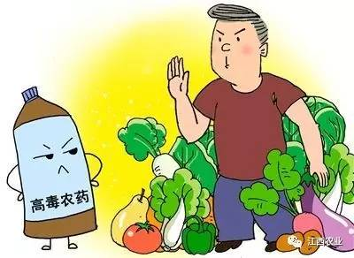
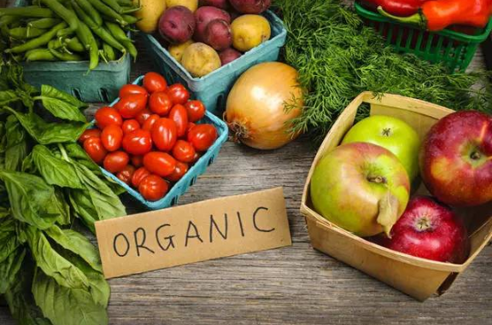
Unit 5 Working the Land
Using Language (2)
Chemical Versus Organic Farming
杭州二中许丽君

Slide 2
Learning objectives
By the end of this period, students will be able to…
1. know the difference between chemical farming and organic farming.
2. work out the content, structure and language features of the text;
3. know the writing skills of an argumentative essay, such as illustrating, giving examples or making contrast;
4. write your opinion in an essay about chemical farming or organic farming.

Slide 3
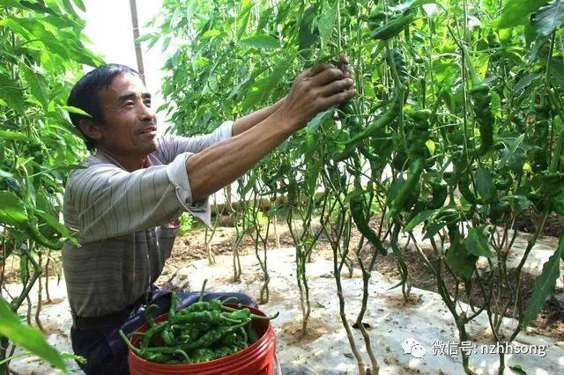
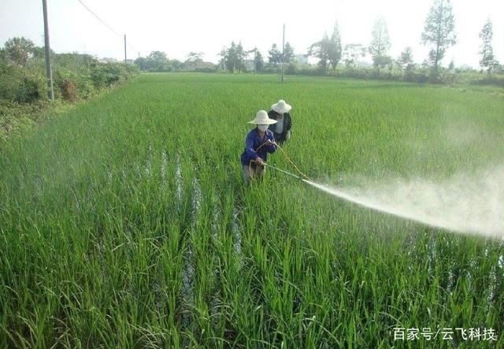
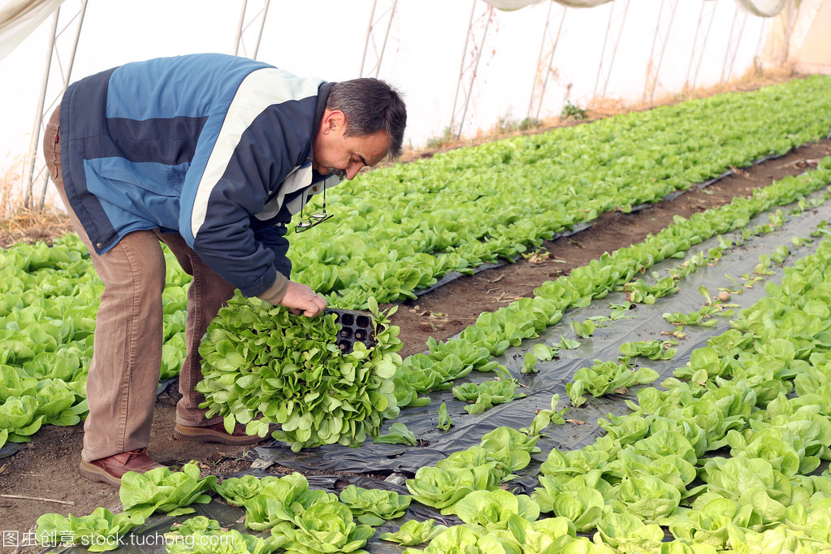
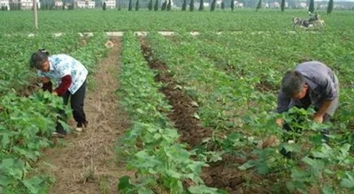
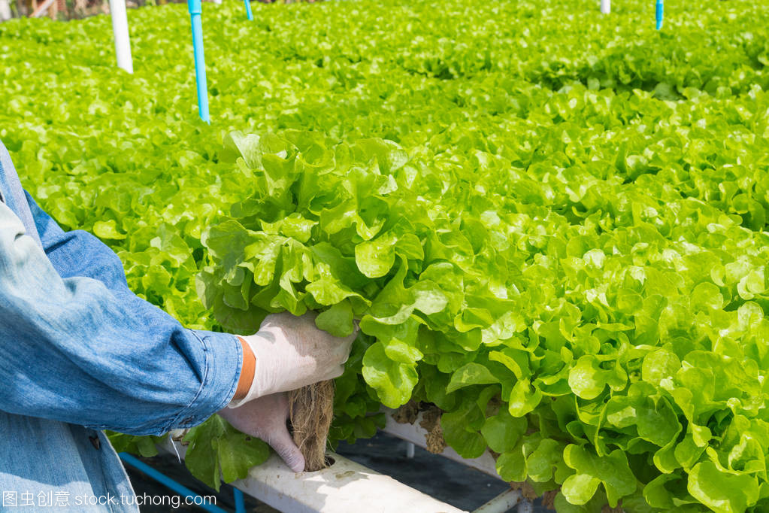
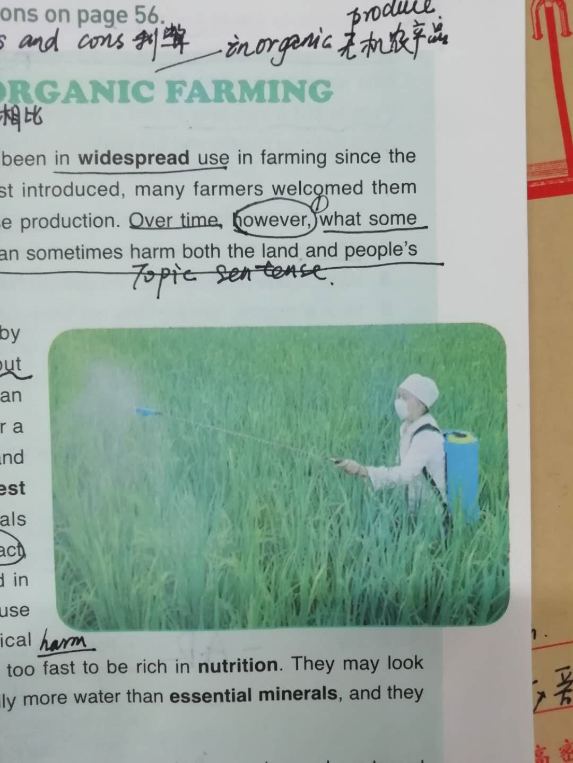
Pre-reading
Make a judgement: which is chemical farming and which is organic farming.
organic farming
organic farming
chemical farming
organic farming
organic farming
chemical farming

Slide 4
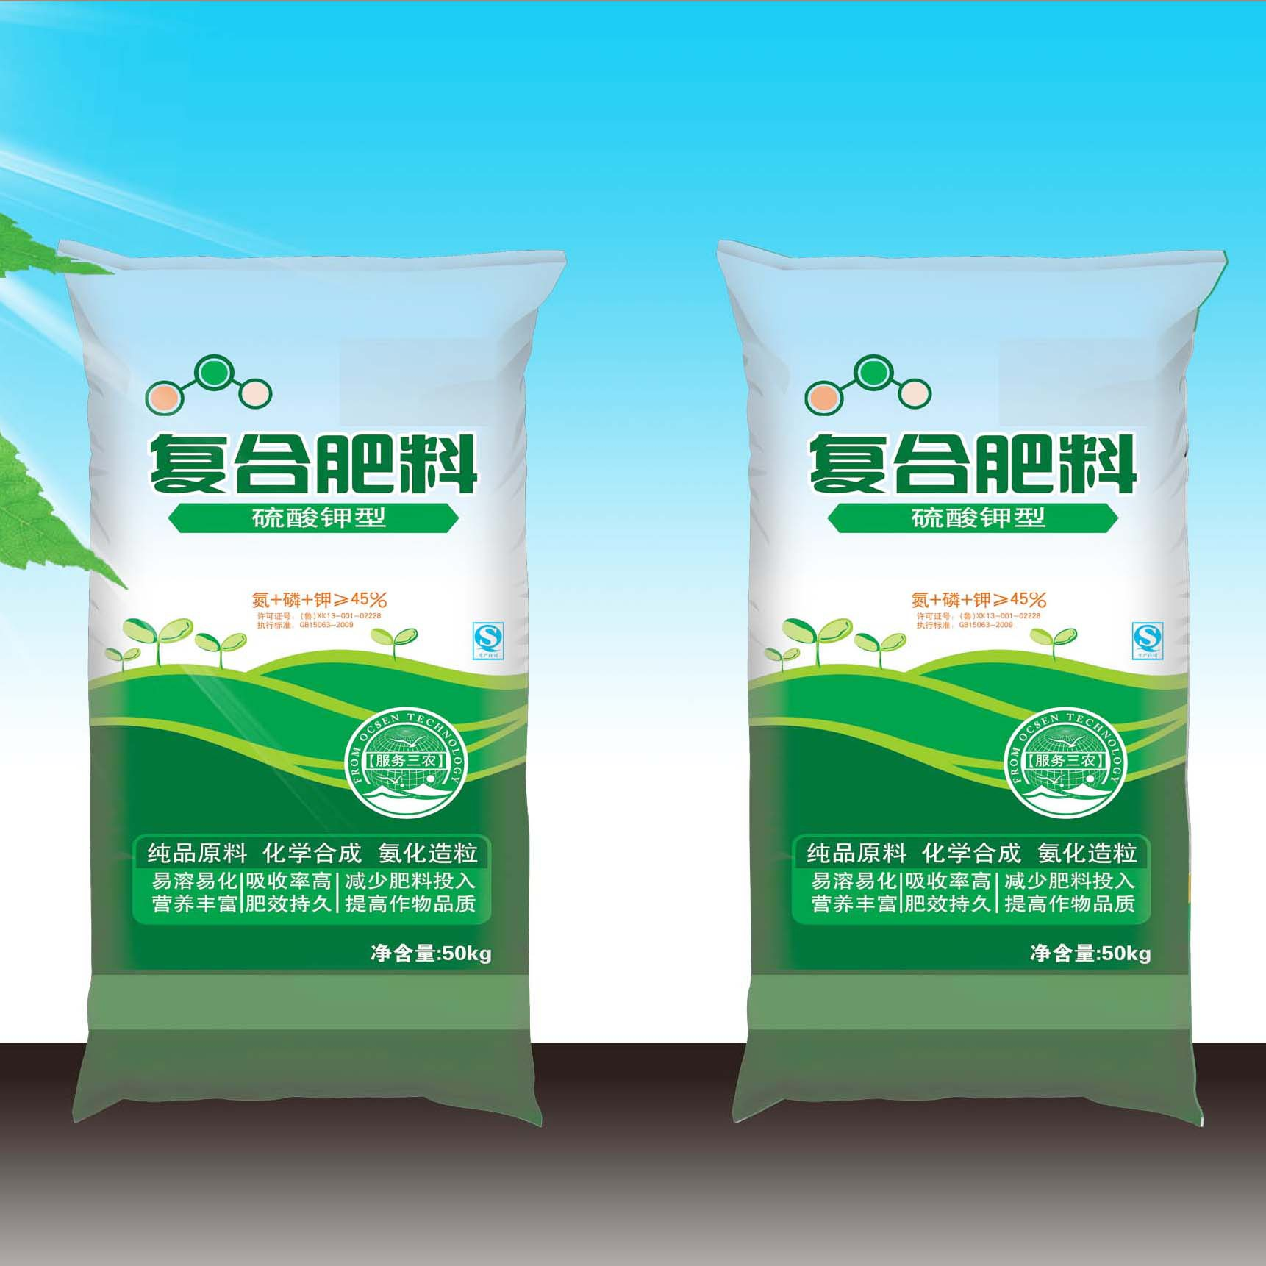
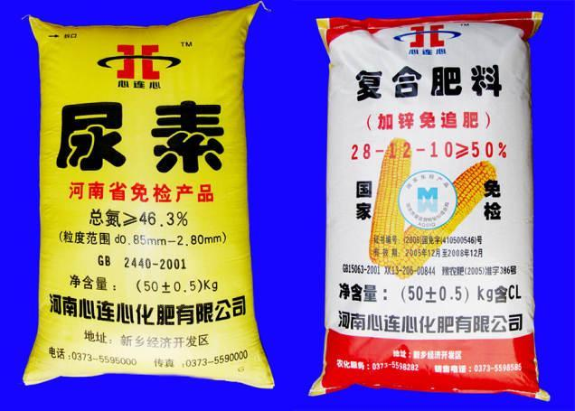
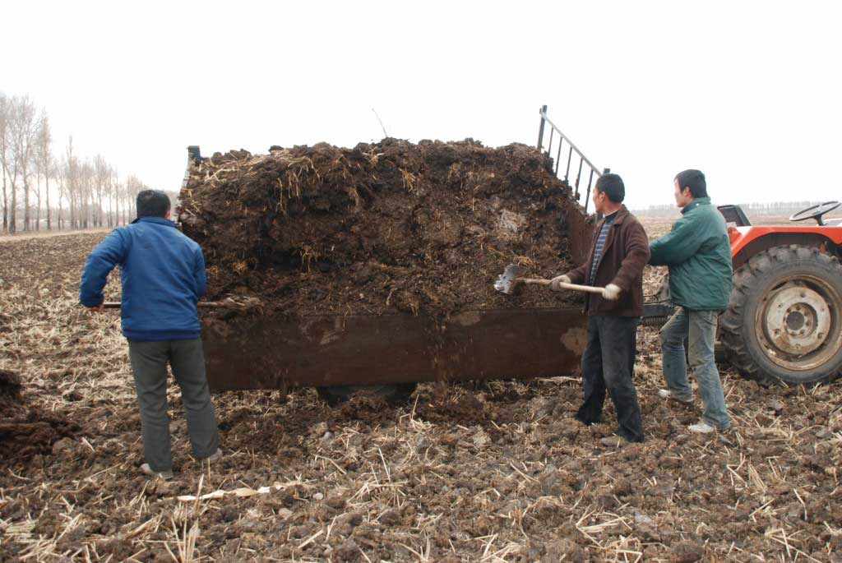
Pre-reading
What is the substance we put on the soil to make crops grow?
It is fertilizer.
What kind of fertilizers do farmers use?
natural fertilizers
chemical fertilizers
Natural waste from animals and dead plants

Slide 5
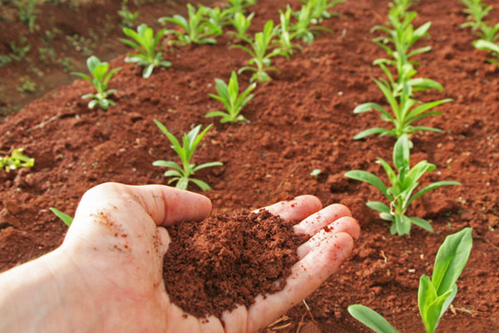
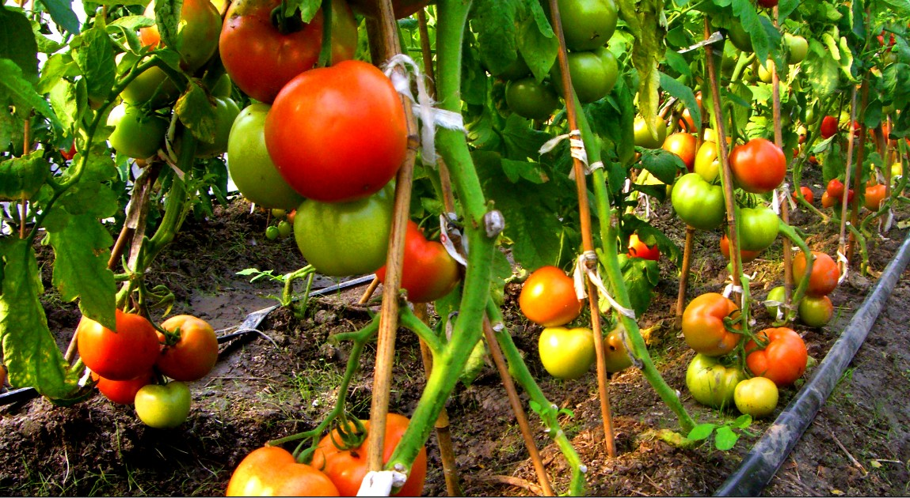
Pre-reading:
Think＆discuss
What’re the advantages of organic farming?
Do you usually eat organic food? Do you think organic food are more healthy?
What are the disadvantages of using chemical fertilizers?
Organic Farming

Slide 6
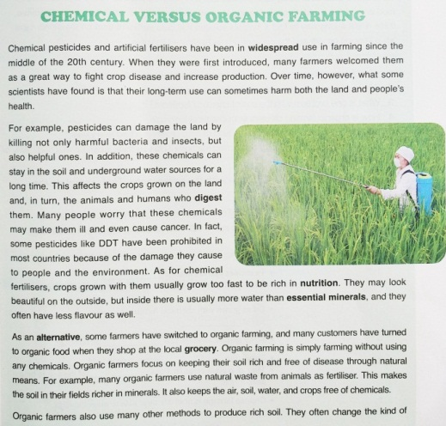
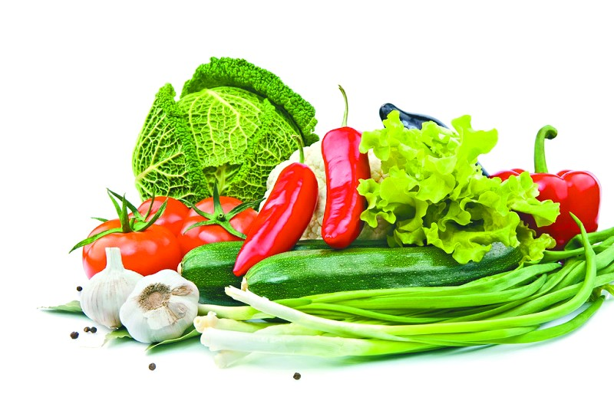

Pre-reading: prediction
CHEMICAL VERSUS
ORGANIC FARMING
Read the text, check your prediction and answer the questions:
What is chemical farming?
What is organic farming?

Slide 7

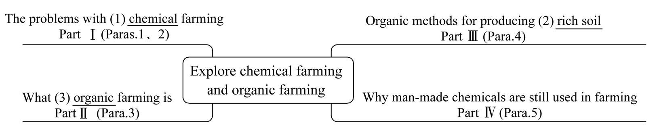
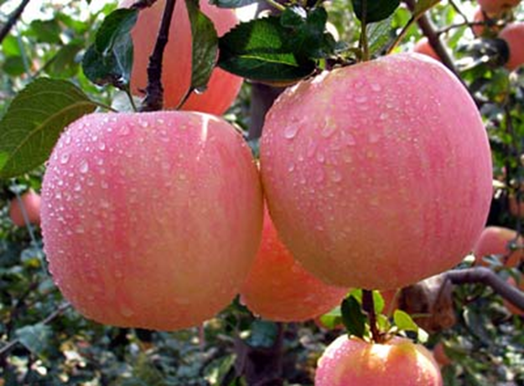
while-reading:
Task 1 整体理解

Slide 8
while-reading:
Read the text and then Match the main idea with each paragraph.
Chemical farming
Para. 1-2
Para. 3
Para. 4
Para. 5
A. What organic farming is
B. Why man-made chemical are still used in farming
C. Organic methods for producing rich soil
D. The problems with chemical farming
Organic
farming
Thinking

Slide 9
while-reading:
advantage
Chemical farming
disadvantages
Chemical farming
Vs
Organic farming
advantages
organic farming
disadvantage
My choice/attitude

Slide 10
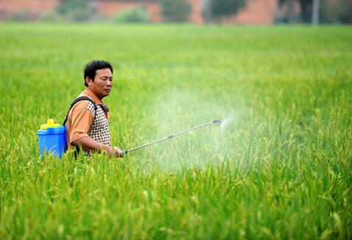
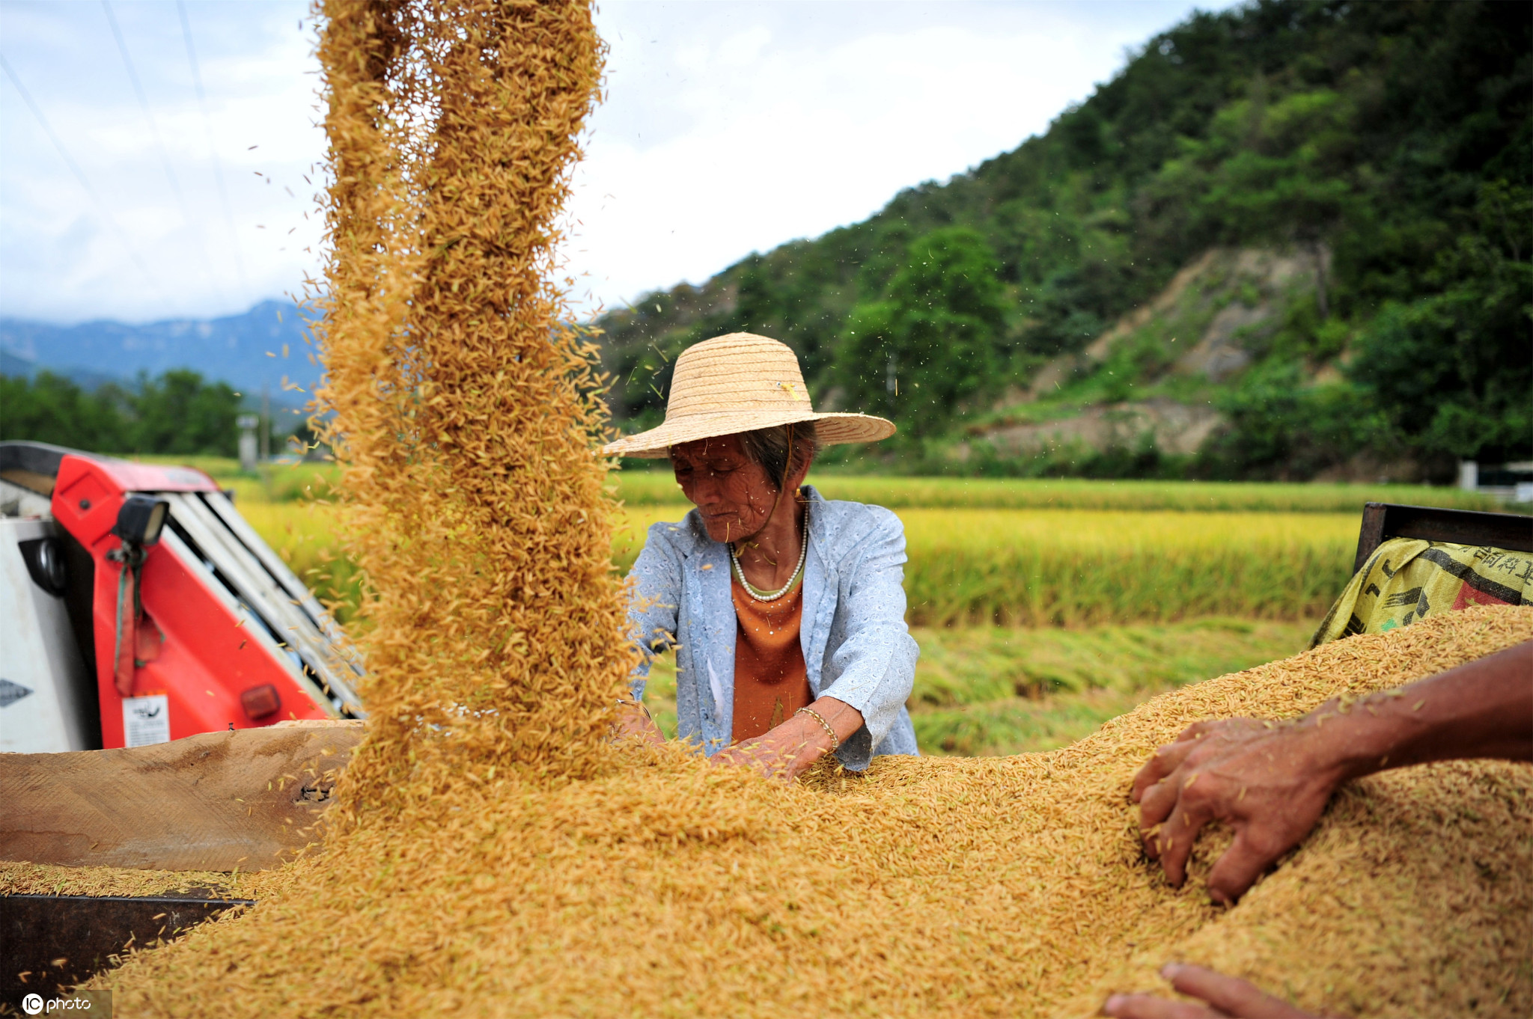
while-reading:
(Para1)
1. Why did many farmers welcome the introduction of chemical farming?
Advantages:
Many farmers welcomed them as a great way to fight crop disease and increase production.

Slide 11
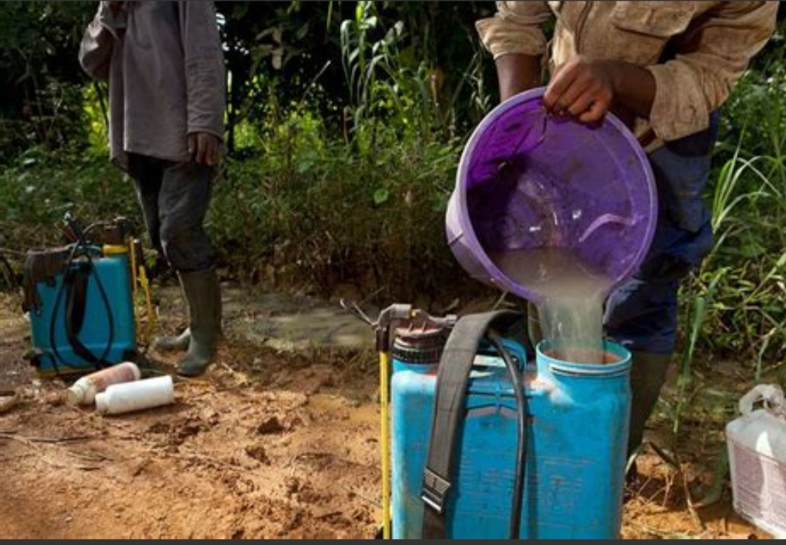
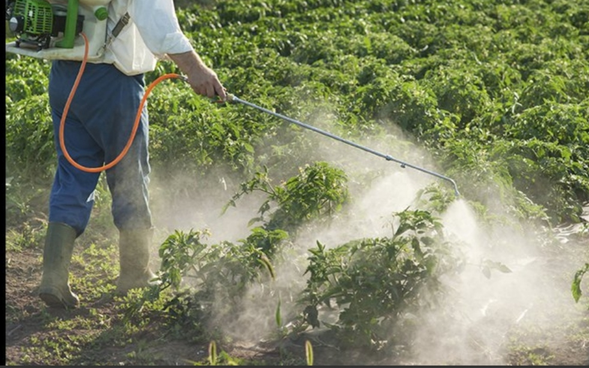
while-reading:
(Para1)
2. What concerns many people about the use of pesticides?
Disadvantages:
Their long-term use can sometimes harm both the land and people’s health.

Slide 12
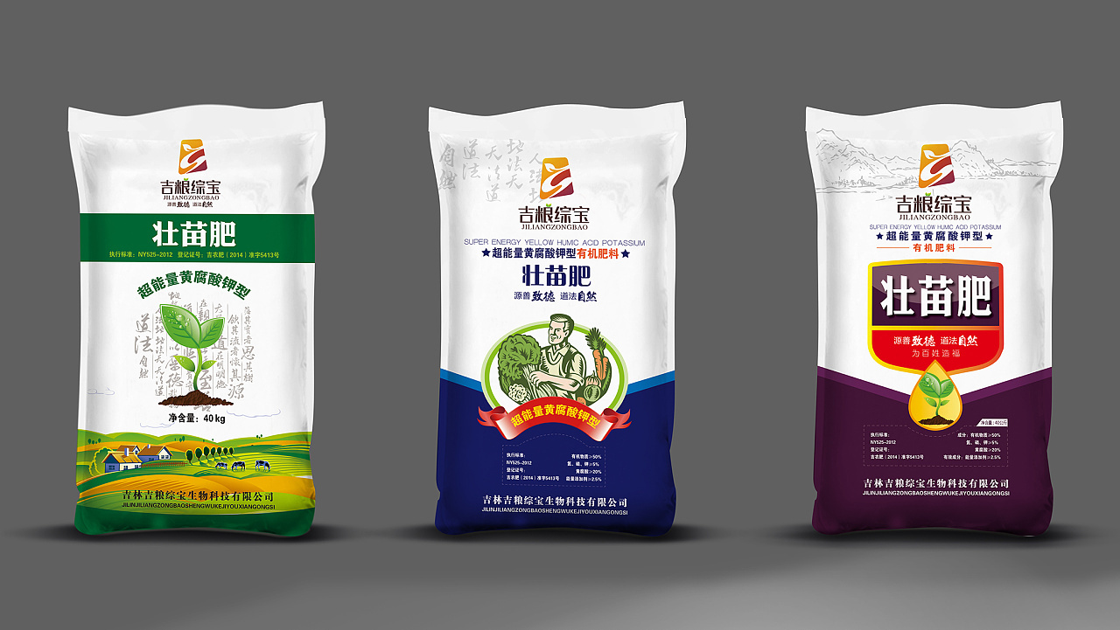
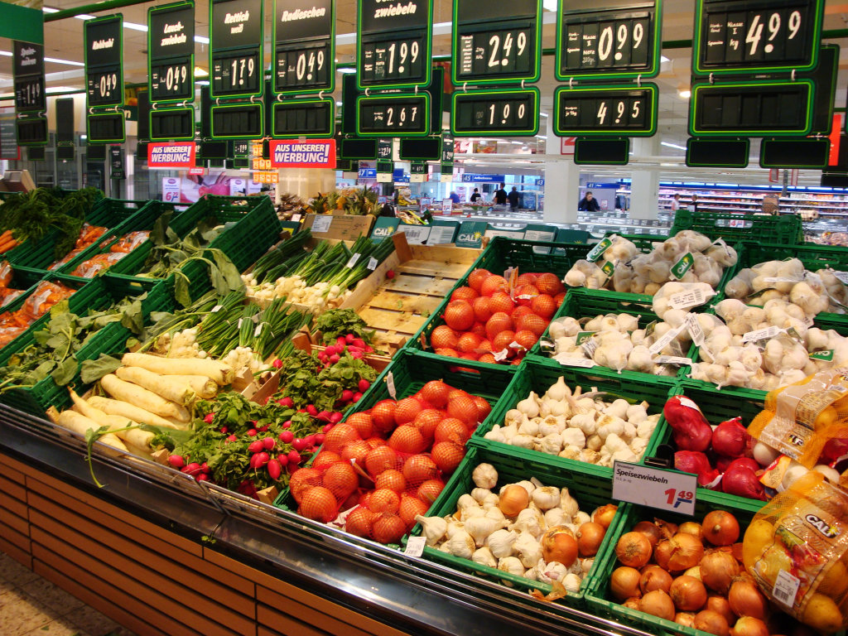
3. What is one problem with the use of chemical fertilisers? (Para2)
while-reading:
(Para2)
Disadvantages:
Crops grown with them usually grow too fast to be rich in nutrition.

Slide 13
while-reading:
(Para.1-2)
chemical farming
Advantages | Disadvantages
1. 2. | harming the land: killing harmful __________________ as well as _____________ harming people’s health: These chemicals may make people _____and even _______________ Crops grow too fast to be ___________________.
fight crop disease
bacteria and insects
the helpful ones
increase production
ill
cause cancer
rich in nutrition

Slide 14

while-reading:
Para 3
As an alternative, I’d like to switch to organic farming!
What is organic farming and how is it different from chemical farming?
Organic farming is simply farming without using any chemicals.
Organic farmers focus on keeping their soil rich and free of disease through natural means.

Slide 15
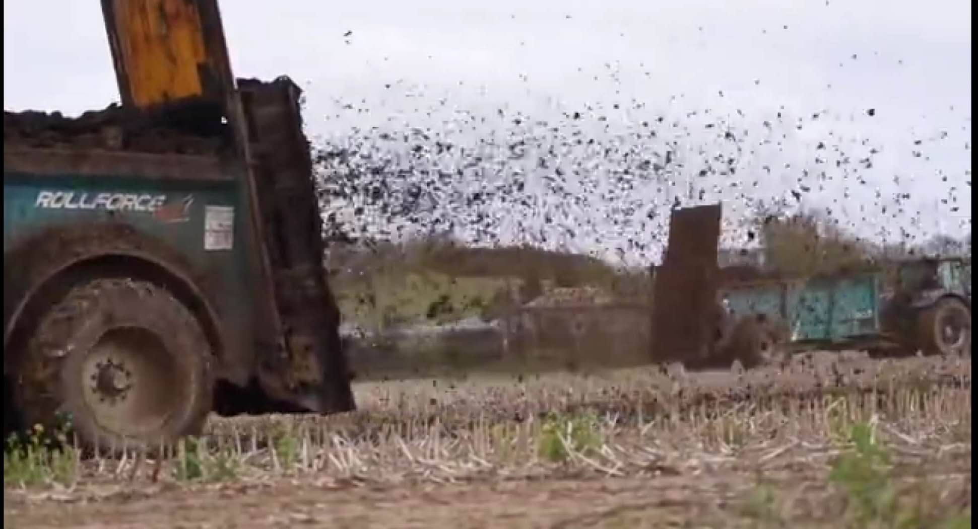
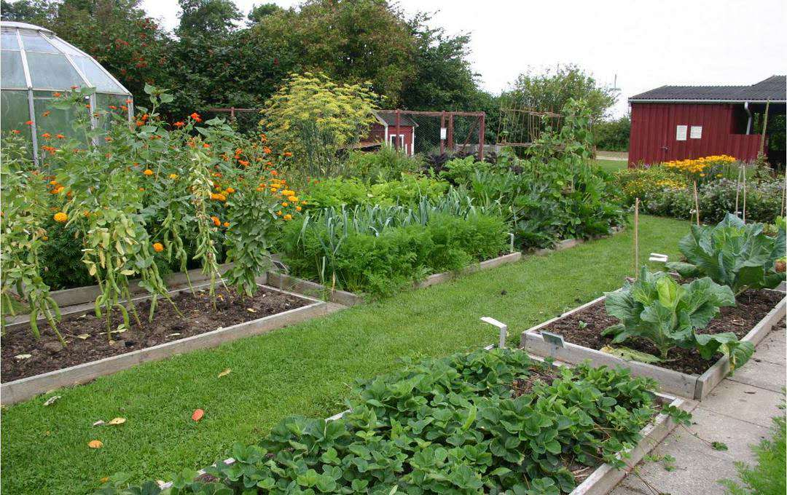
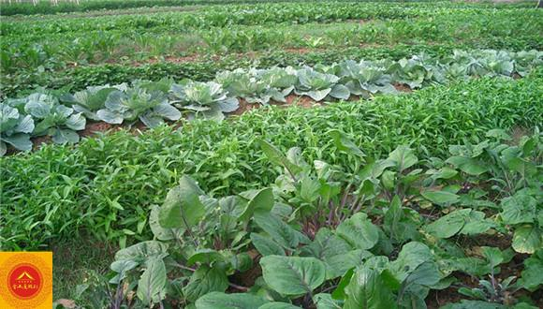
while-reading:
(Para3&4)
What are the organic methods mentioned in the text?
1. use natural waste from animals as fertilizer.
2. change the kind of crop grown in each field every year.
3. plant diverse crops that use different depth of soil to keep it rich.

Slide 16
while-reading:
Match the methods with its purpose(Para3&4)
Methods Purposes
use natural waste from animals as fertilizer
to put important minerals back into the ground
change the kind of crop grown in each field every year.
to keep the soil rich
plant diverse crops that use different depth of soil to keep it rich.
to make the soil in the fields richer in minerals

Slide 17
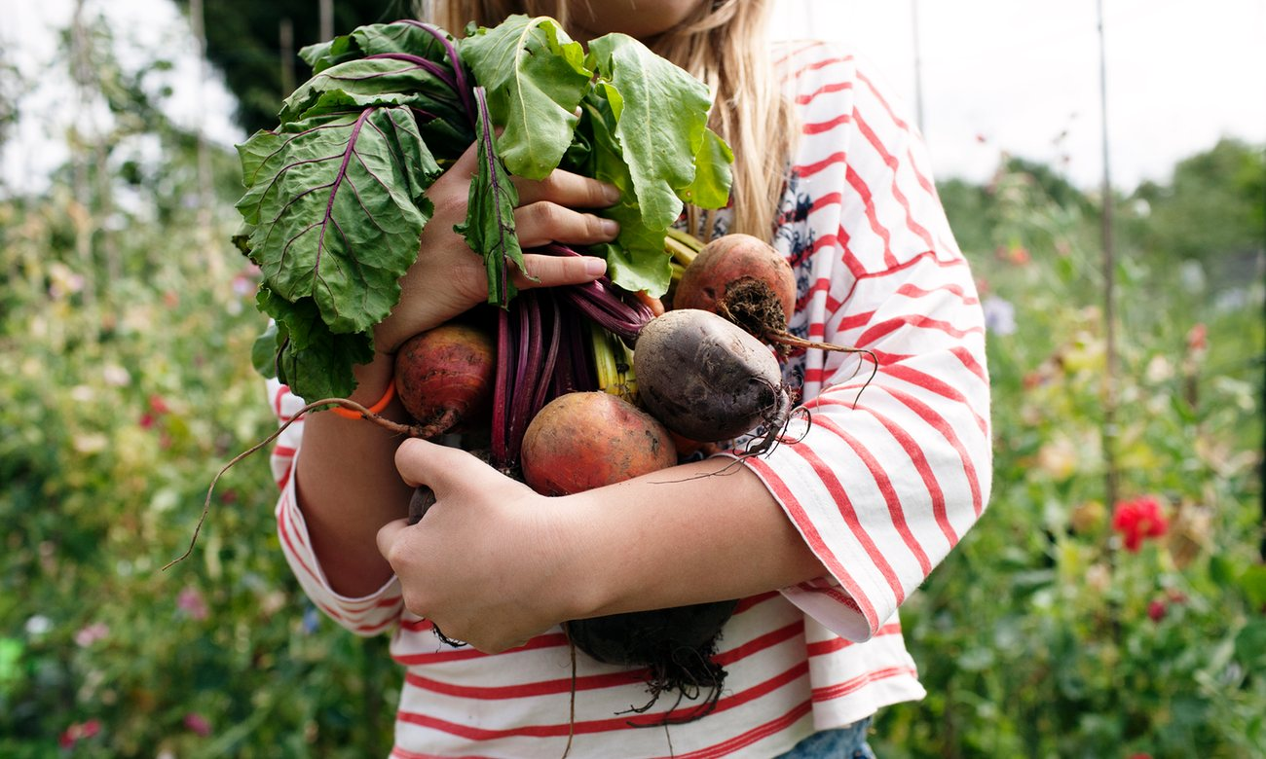
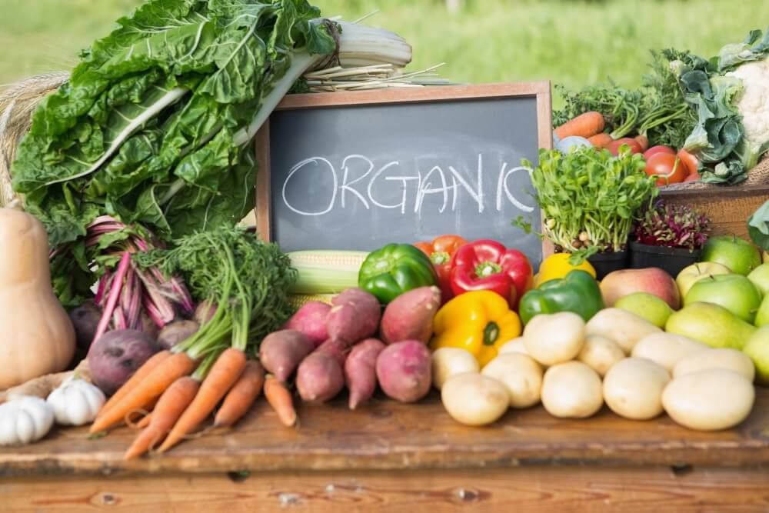
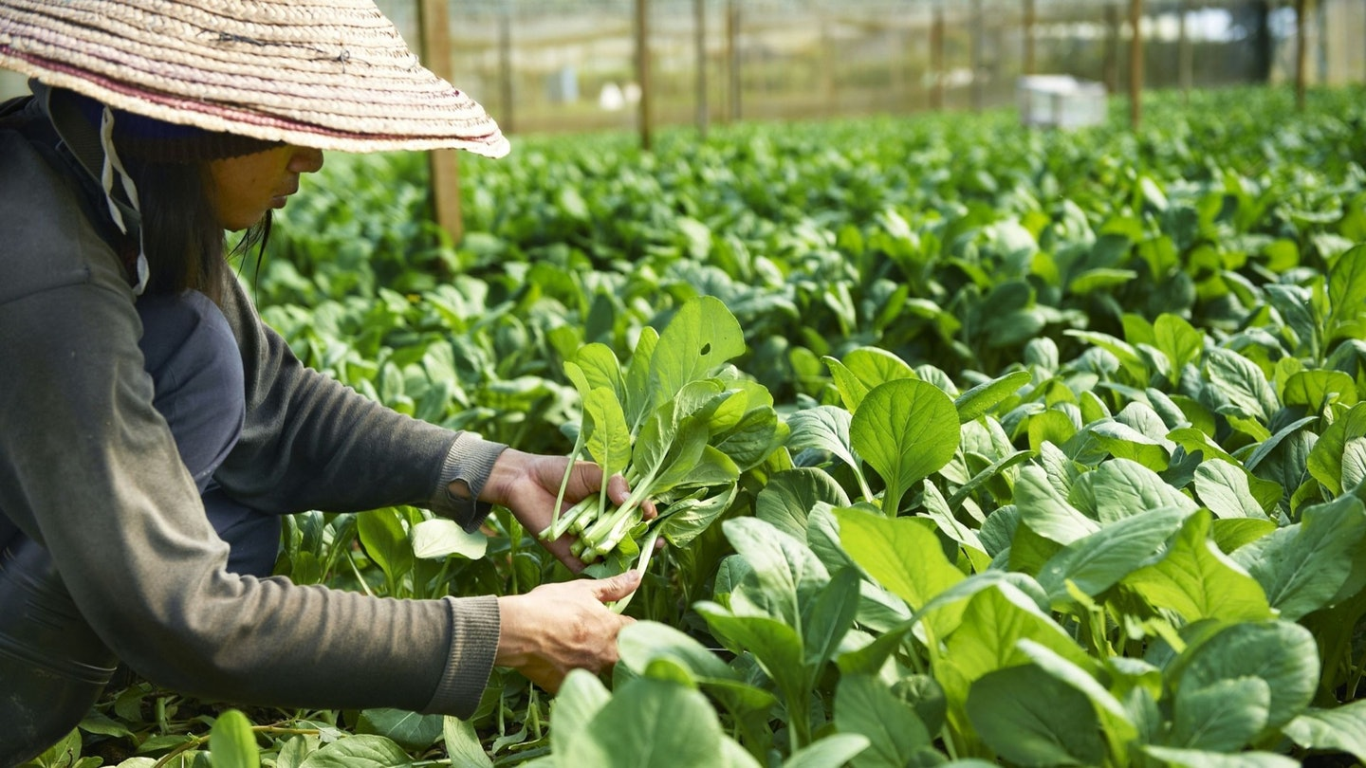
What's the goal of using different organic farming methods?
while-reading:
（Para.4）
The goal of using different organic farming methods is to grow good food while avoiding damage to the environment or to people's health.

Slide 18
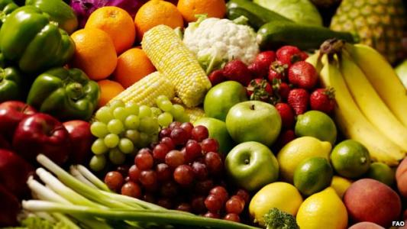
while-reading:
（Para.5）
Why can’t we stop the use of man-made chemicals in agriculture
entirely?
A. Organic farming cost us a lot of money.
B. Organic farming can meet people’s need.
C. Chemical farming brought us huge profit.
D. Chemical farming helps serve the need for food.

Slide 19
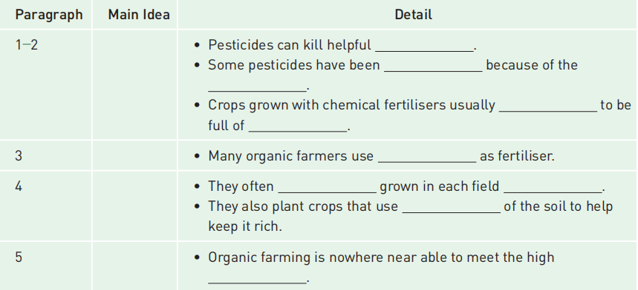
while-reading:
bacteria and insects
prohibited
damage they use
grow too fast
nutrition
natural waste from animals
change the kind of crop
every year
different depths
demand for food around the world

Slide 20
Divide and summarize
while-reading:
Part 1 : para1 & para2
Part 2 : para 3
Part 3: para 4
Part 4: para 5
bacteria and insects
Pesticides can kill helpful__________.
Some pesticides have been _________ because of the_________________.
Crops grown with chemical fertilisers usually _____________to be full of___________
The problems with chemical farming
prohibited
damage they caused
What organic farming is
grow too fast
nutrition
Organic methods for producing rich soil
natural waste from animals
Many organic farmers use_________________________as fertiliser
change the kind of crop
every year
Why man-made chemicals are still used in farming
They often____________________ grown in each field______________
They also plant crops that use_______________of the soil to help
keep it rich.
different depths
Demand for food around
the world
Organic farming is nowhere near able to meet the high ___________________

Slide 21
while-reading:
Ⅰ.阅读课文，判断信息正误
( )1.Chemical pesticides and artificial fertilisers can fight crop disease and increase production.
( )2.Pesticides can damage the land by only killing harmful bacteria and insects.
( )3.Chemical fertilisers make crops grow fast to be rich in nutrition.
( )4.Organic farmers keep their soil rich and free of disease through natural means.
( )5.Organic farming serves the high demand for food around the world.
【答案】1－5 TFFTF

Slide 22
while-reading:
Ⅱ.阅读课文，选择正确选项
( )1.Why did many farmers welcome the introduction of chemical farming?
A．They can fight crop disease and increase production.
B．They harm both the land and people’s health.
C．They can help produce rich soil.
D．They are not expensive.
A
D
( )2.What concerns many people about the use of pesticides?
A．Pesticides can damage the land.
B．Chemicals can stay in the soil for a long time.
C．Pesticides can kill harmful bacteria and insects.
D．Chemicals may make people ill and even cause cancer.

Slide 23
while-reading:
A
( )3.Why do organic farmers change the kind of crop grown in each field every few years?
A．It helps put important minerals back into the ground.
B．It can avoid damage to the environment.
C．It can help increase output.
D．The writer didn’t tell us.
( )4.Why can’t we stop the use of man-made chemicals in agriculture entirely?
A．Organic farming cost us a lot of money.
B．Organic farming can meet people’s need.
C．Chemical farming brought us huge profit.
D．Chemical farming helps serve the need for food.
D

Slide 24
Post-reading:
Fill in the table according to the passage
Farming | Benefit | Problem | Solution
Chemical farming
Organic farming
fight crop disease and increase production
sometimes harm both the land and people’s health
switch to organic farming
make the soil rich; keep the air, soil, water and crops free of chemicals
still a long way to find a suitable solution
cannot meet the need
Benefits — Problems — Solutions

Slide 25
Post-reading:
【完美成篇】
In terms of the development of modern agriculture, chemical agriculture and organic agriculture are two key words, over which there are various opinions.
It is obvious that using chemical fertilisers has many disadvantages. Above all, there is no doubt that the chemicals staying inside the crops can lead to cancer or other illnesses. Besides, the vegetables grow so fast that they contain little nutrition.
Organic foods are becoming increasingly popular with customers. There are many reasons for this. The first one is that as people are richer, they attach great importance to health. Secondly, organic produce simply uses natural fertilisers, making vegetables and fruit tasty and nutritive. Moreover, the produce grows in clean water and never uses pesticides, which is beneficial for our health.
As a saying goes, health is the first wealth, so it is wiser to choose organic food.

Slide 26
Reread the passage and fill in the blanks.
With the development of society, chemical pesticides and artificial fertilisers
have been in (1)__________ use in farming for many years. They can help fight
crop (2)_______ and increase production. However, they can cause many problems
(3) ______. For instance, pesticides can kill (4)_______ bacteria and insects and crops grown with chemical fertilisers usually grow (5) _______to be full of nutrition. As a result, many people worry they may make them ill and even cause cancer.
widespread
disease
as well
helpful
too fast
To tackle this problem, farmers use natural waste as (6) ________ and they often
change the kind of crop grown in each field every year and they also plant diverse
crops that use different (7)______ of soil to help keep it rich. But organic farming is
nowhere near able to (8)_____ the high demand for food. Therefore, there is still a
long way to find a (9)_______ solution that puts sufficient food on the dinner table
while keeping people and the environment as (10)_______ as possible.
fertiliser
depths
meet
suitable
healthy

Slide 27
Post-reading:
Ⅱ.概要写作
(根据教材语篇内容写一篇60词左右的内容概要)
参考范文
Though chemical pesticides and artificial fertilisers have been used widely in the world,(要点1)scientists found using them for long can harm the land and people’s health as well.(要点2) To solve the problem,organic farming comes into being.(要点3) However,organic farming can’t meet the high demand for food around the world,so a suitable solution will have to be found.(要点4)

Slide 28

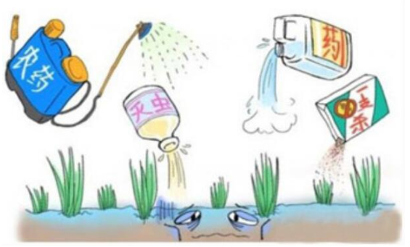

Writing:
Write an argumentative essay giving your opinion on chemical or organic farming.
发表议论就是通过议论或说理来表达作者的见解和主张，作者对某一问题持有一种看法，为了使读者同意自己的看法，提出若干理由，试图说服别人。
发表议论时，我们要注意三个要素：论点、论据、论证。

Slide 29

Writing:
Write an argumentative essay.
支持有机农业
文体：议论文
明确体裁话题
以现在时为主、兼顾过去时、将来时；第一、三人称
确定时态人称
开头：介绍农业发展概况和有机农业的出现。
展开论述：分层次介绍化学农业和有机农业的区别，有机农业的优势。
结尾：总结观点，提出建议。
布局文章架构
1.化学农业的缺点。
2.有机农业的优点，人们对健康的重视和选择有机农业的理由。
列出核心要点

Slide 30
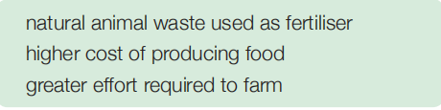
writing:
1. Discuss these questions in groups.
• Is the author of the passage for or against organic farming? How do you know?
• What other disadvantages of chemical farming did the author not list?
• How might the following items be problems and how important are they for organic farming?
• What other disadvantages of organic farming can you think of ?

Slide 31
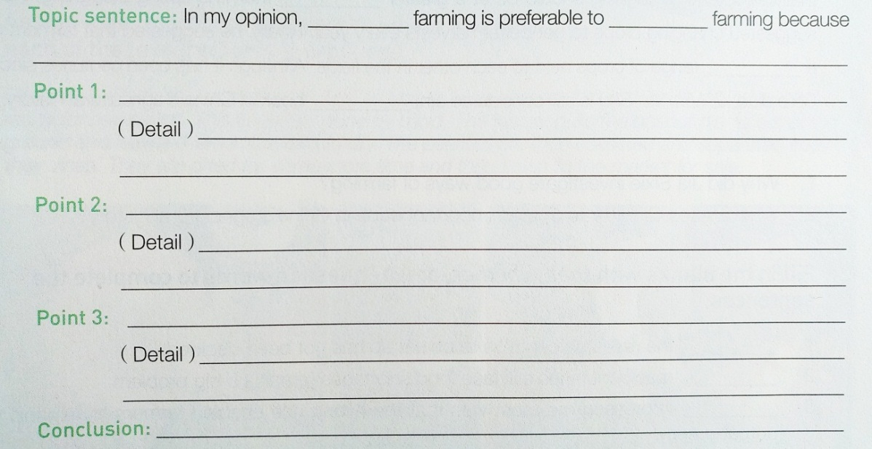
writing:
2. Decide whether your group supports chemical farming or organic farming.
Opinion
Body
* argument /topic sentence
* supporting details
Rephrase the opinion

Slide 32
Homework
1. Use your outline to write a short essay giving your opinion on the topic.
2. Polish your drafts and share with your partners.

Slide 33
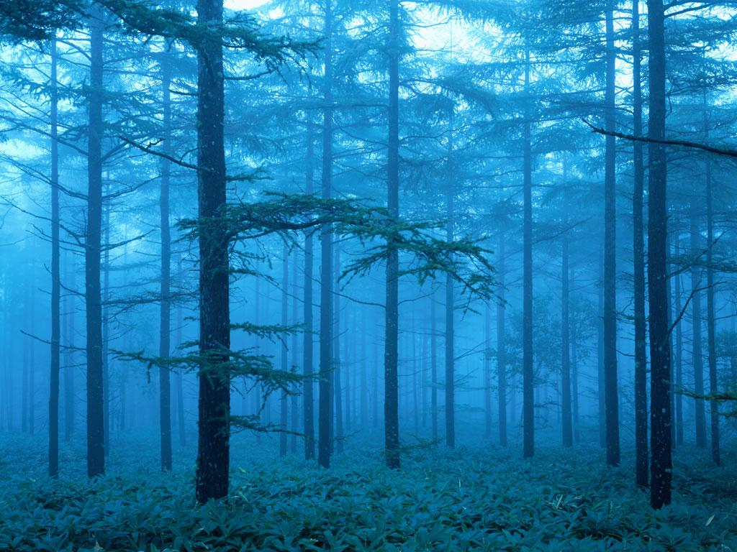
Thank you for attending!
Goodbye

