Slide 1

感恩遇见，相互成就，本课件资料仅供您个人参考、教学使用，严禁自行在网络传播，违者依知识产权法追究法律责任。
更多教学资源请关注
公众号：溯恩高中英语
知识产权声明

Slide 2


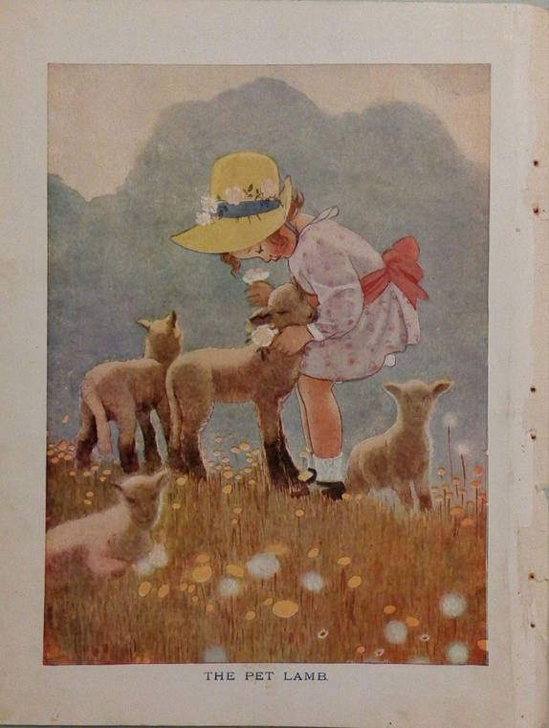
20211119台州一模读后续写讲评My Pet Lamb
陈星可 浙江天台中学

Slide 3


Language Learning
& Story Understanding
1
2
Plot Designing
& Sentence Constructing
Contents
3
Language Accumulation
4
Story Writing & Appreciating

Slide 4
Read and Understand
THE PET LAMB
Almost all the possessions had been sold to buy food and clothing for the family. At last, nothing was left but the pet lamb, Daisy. At the thought of parting with the little creature, Mrs. Grant’s felt sad because the children loved it very much. Having struggled hard, she had to make up her mind to sell the lamb. But she could not ask any child to go for the butcher. Finally, she went herself with a heavy heart, dragging her leaden feet, and bargained with the butcher for the sale of Daisy.
While the children were all playing with the lamb, the butcher and his boy came to the door. “You see I am here for the lamb,” said the butcher in a loud voice. Hearing this, one child ran to her mother’s side, and asked what was happening in alarm. Mrs. Grant gently pushed the child aside, bent down and was about to tell the truth.
“That’s my lamb now, Charlie!” said the butcher’s boy in a playful tone, going up to Daisy with a rope in his hand.
“No, it is not your lamb. It is ours!” said Charlie, placing himself in front of it.

Slide 5
Read and Understand
But the boy, pushing him aside, threw a rope round Daisy’s neck, and began to drag the little creature away. The poor lamb bleated very sadly. The cry of grief which fell upon the mother’s ears was too much for her, and her heart sank within her. In a moment, begging with tearful eyes, the children were all around their mother with voices choking with sobs for their little pet.
“Pray tell your boy to stop a moment,” she said in husky (沙哑的) tones to the butcher.
The boy, at a word from the butcher, stopped dragging the lamb, and the little creature stopped its bleating.
In a trembling voice, Mrs. Grant explained to them how badly off they were after their father died. She also added that the kind butcher had given the money for Daisy. With this money, she could buy her children bread to eat.
Para 1: But the more she explained, the stronger her children begged for Daisy. __________________________________________________________________
Para 2: The butcher, who had been watching all, was touched in his heart._____ __________________________________________________________________

Slide 6
Read and Understand
Mrs. Grant __________(stick) in a dilemma. After her husband passed away, her family was _____ _____ (=poor) and she had sold all the possessions to keep the family away from ________(hungry) and cold. Now she had no ______________ but to sell the pet lamb, which her children had been devoting their love to, _____ the butcher.
When the butcher and his boy came for the lamb, Charles stopped himelf in front of the lamb, trying to prevent it from ___________(take) away. And the bleating of the lamb made Mrs. Grant’s heart sink with her voice __________(choke) with sobs.
With no _______ to disappoint her children, Mrs. Grant asked the butcher to stop the deal and would like to return the money, ______ was badly needed though.
was stuck
badly off
hunger
choice/ alternative
to
being taken
choking
heart
which

Slide 7
Learn Langauge
1.一想/看/听到
2.与...分手
3.苦苦挣扎/纠结
4.去叫/请屠户
5.拖着好像灌了铅的双腿
6.与...讨价还价
7.惊恐地
8.拦在某人的前面
9.把...推到一边
10.用绳子套住羊羔的脖子
11.哽咽；泣不成声
12.贫穷的,缺少...的
13.心被触动了
1.at the thought/ sight/ sound of...
2. part with...
3.struggle hard
4.go for the butcher
5.drag one’s leaden feet
6.bargain with...
7.in alarm, in shock
8. place oneself in front of sb.
9.push... aside
10.throw the rope around the lamb’s neck
11.choke with sobs
12.be badly off
13.be touched in one’s heart

Slide 8
Learn Langauge
1.Finally, she went herself with a heavy heart, dragging her leaden feet, and bargained with the butcher for the sale of Daisy.
2.The cry of grief which fell upon the mother’s ears was too much for her, and her heart sank within her. In a moment, begging with tearful eyes, the children were all around their mother with voices choking with sobs for their little pet.
3.Mrs. Grant explained to them how badly off they were after their father died. She also added that the kind butcher had given the money for Daisy.
1.运用动作链(went+ dragging+ bargained)有助于画面和情节的推进；
2.借助于动词drag, bargain,形容词heavy, leaden等的运用来侧面描写主人公的情绪、情感。
表示“难过、伤心”的多角度描写：声音(the cry of grief, voices choking with sobs)、身体部位表现(heart sank, tearful eyes)等。
不同的“说”：say, explain, add等等。

Slide 9
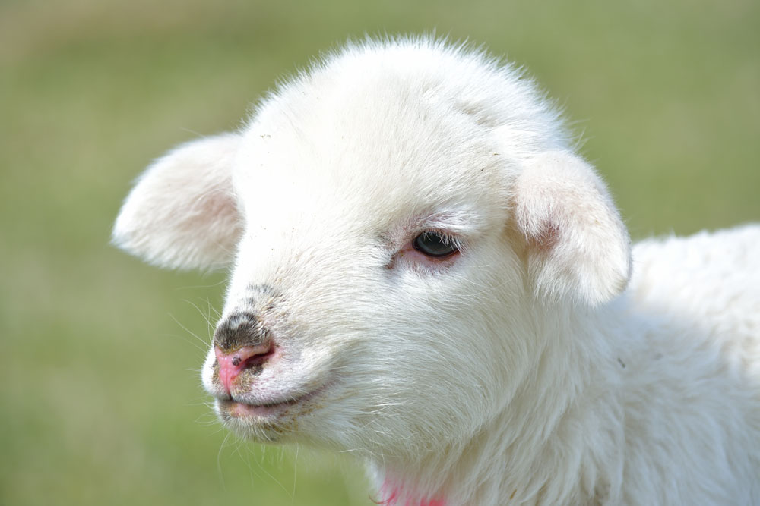
Design the plot
情节1：
情节2：
1.孩子们为小羊羔求情 ，宁愿少吃少穿也想留下小羊羔--- 妈妈举棋不定，纠结中--- 孩子们转而向屠户的孩子求助；
2.屠户看到这一切心里触动--- 决定留下小羊羔，也留下钱，帮助她们度过难关---一家人感动。
1.孩子们为小羊羔求情 ，宁愿少吃少穿也想留下小羊羔--- 妈妈不忍心孩子们的爱心，转而向屠户求助：留下小羊羔，退回收下的钱；
2.屠户看到这一切心里触动--- 决定留下小羊羔和钱，并且让儿子一起来陪伴小羊羔---一家人感动，庆幸家人和羊羔都可以度过难关。

Slide 10
Design the Plot-- Q & A
Para 1: But the more she explained, the stronger her children begged for Daisy. __________________________________________________________________
Para 2: The butcher, who had been watching all, was touched in his heart._____ __________________________________________________________________
Q1:Whom did they beg for Daisy? And how did they beg for Daisy?
Q2:How did Mrs. Grant and the boy each react to their begging?
Q3:What did Mrs. Grant eventually decide to do?
In para 1, the butcher was not involved in the incident.
Who and what?
逆推法
Q1:What was in the butcher’s mind about the situation?
Q2:How did he deal with the dilemma in a heart-warming way?
Q3:How did the story end?/ How did the Grant family feel about the butcher’s proposal?

Slide 11
Construct sentences--Q & A
Para 1: But the more she explained, the stronger her children begged for Daisy.
Q1:Whom did they beg for Daisy? And how did they beg for Daisy?
They begged their mother, promising that they would rather go hungry or suffer from cold to keep Daisy, their warm comfort.
“No!- No! No!” they dashed to Daisy and threw their arms around her, begging “Please, mother! We would rather go hungry than lose her!”
They even promised to go with less food and no clothes as long as their mother agreed to keep Daisy.
With tearful eyes, they gathered around their mother, begging not to let Daisy go.
Desperately, they hugged the pet lamb tightly, looking at their mother with eager eyes.

Slide 12
Construct sentences--Q & A
Para 1: But the more she explained, the stronger her children begged for Daisy.
Q2:How did Mrs. Grant and the boy each react to their begging?
Well aware that if she didn’t sell the lamb, her family would suffer bitterly and would probably end up freezing or starving to death, Mrs. Grant closed her eyes, tears silently falling out of the corners of her eyes.
Caught in a dilemma, Mrs. Grant felt torn. Her children’s begging softened her heart, but a look at the skinny children and their wornout clothes made her heart tight.
Hearing this, Mrs. Grant was in great sorrow, her heart bleeding. After all, she clearly knew that the children had devoted so much love to Daisy and that Daisy was more than a pet lamb to them.

Slide 13
Construct sentences--Q & A
Para 1: But the more she explained, the stronger her children begged for Daisy.
Q3:What did Mrs. Grant eventually decide to do?
Having struggled hard, she turned to the butcher and decided that she would not sell daisy and would return the money.
At last she handed back the money, saying, "I cannot sell it just now, sir. Wait until another time. I must try to keep up a little longer."
She knew her children liked the pet lamb, but what mattered most at the moment was to feed their stomachs and keep them warm. Decision made, she signalled to the boy to take Daisy away.
Her children could go without a pet lamb for quite a while, but never could they survive longer than that without food and clothes. So she had no choice but to let her children down this time.

Slide 14
Construct sentences--Q & A
Para 2: The butcher, who had been watching all, was touched in his heart._____
Q1:What was in the butcher’s mind about the situation?
“I should never make money at the cost of the poor children’s only comfort,” he thought. “Maybe I can do something to help them out.”
He should never make money by depriving the children of their only source of joy. His mind working fast, an idea popped up.
When Mrs. Grant took out the money and gave it back, he just waved his hand and announced, “I will not rob the children of their pet!”

Slide 15
Construct sentences--Q & A
Para 2: The butcher, who had been watching all, was touched in his heart._____
Q2:How did he deal with the dilemma in a heart-warming way?
Approaching the children and the pet lamb, he announced that he would buy the lamb with the money he had paid Mrs. Grant, but he would give the lamb back to them as a present for their loving heart.
He approached the children, patted them on the shoulders gently and promised that he would buy Daisy from their mother and then gave it back to them as a gift.
Gently patting the pet lamb, he said that the children could keep Daisy and that he would be glad to witness Daisy growing up with them and his boy.
He explained that the lamb would stay with them and the money would also remain to carry them through the tough days ahead.

Slide 16
Construct sentences--Q & A
Para 2: The butcher, who had been watching all, was touched in his heart._____
Q3:How did the story end?/ How did the Grant family feel about the butcher’s proposal?
At the wise uplifting decision, the children danced happily around the lamb in circles. And Mrs. Grant threw an appreciative look at the butcher, delighted that both her family and the pet lamb luckily survived thanks to the butcher’s gentle heart.
The word left the children standing stunned. Then, looking up at him, one asked seriously, “Sir, do you really mean that?”
Hearing this, all the children gathered round and stroked the pet, their little hearts filled with joy.

Slide 17
Construct sentences--underlined words
pet lamb
butcher
children
money
love
play
choke
buy
gently
tearful
They even promised to go with less food and no clothes as long as their mother agreed to keep the pet lamb.
She clearly knew that Daisy was more than a pet lamb to her children.
She turned to the butcher and decided that she would not sell daisy and would return the money.
He announced that he would buy the lamb with the money he had paid Mrs. Grant, but he would give the lamb back to them as a present .
The thought of being able to survive the hard times and keep the lamb, she expressed her gratuitude with her voice choking with sobs.
Thinking that they could no longer play with Daisy, Charlie cried his heart out.
He patted them on the shoulders gently and promised that he would buy Daisy and then gave it back to them as a gift.
With tearful eyes, they hugged the pet lamb tightly, as if it would disappear at any moment.

Slide 18
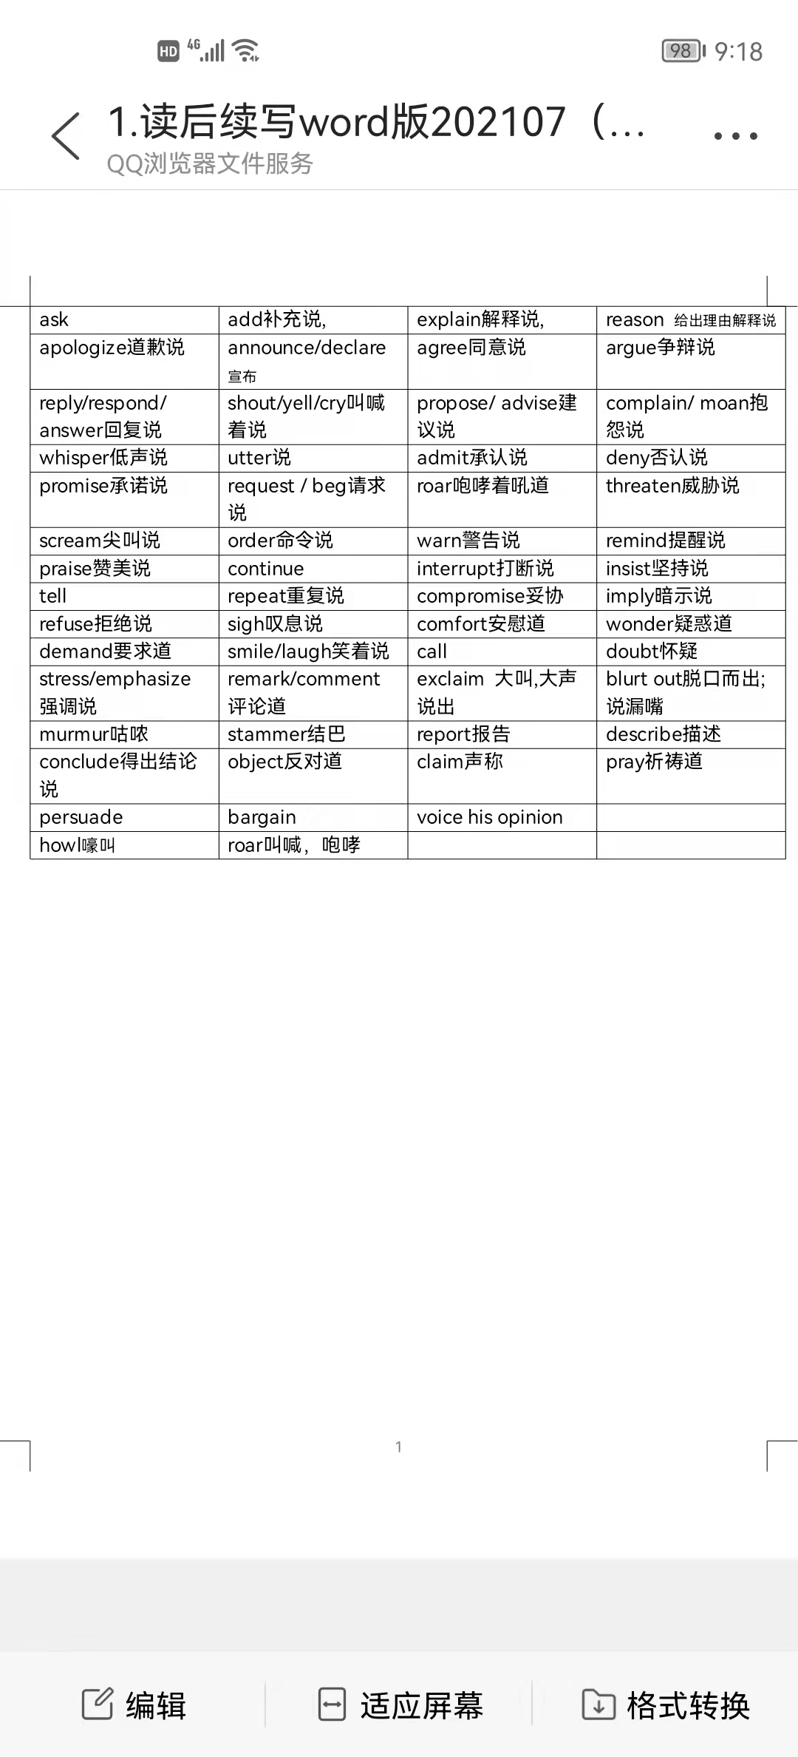
Accumulate Language--不同的“说”

Slide 19
Accumulate Language--不同的“说”
1.Back home, he ___________ repeatedly that he should not have been so stubborn as to make such a disaster.
2. In order not to be heard by other people, she _________ the news to me.
3. When Teacher ________ him that he should not be here so late, he _________ that he didn’t do it on purpose.
4. He _______ that what he did was right despite storms of objections from his team.
5. Gathering Carrie into her arms, mother ________ that everything would be all right with her comapny.
6. Though worried, we all _________ that he would be back, safe and sound.
7. He ___________ that every time he was to go to sleep, his teammate turned on the music.
apologized
whispered
criticized
explained/ argued
insisted
comforted
prayed
complained

Slide 20
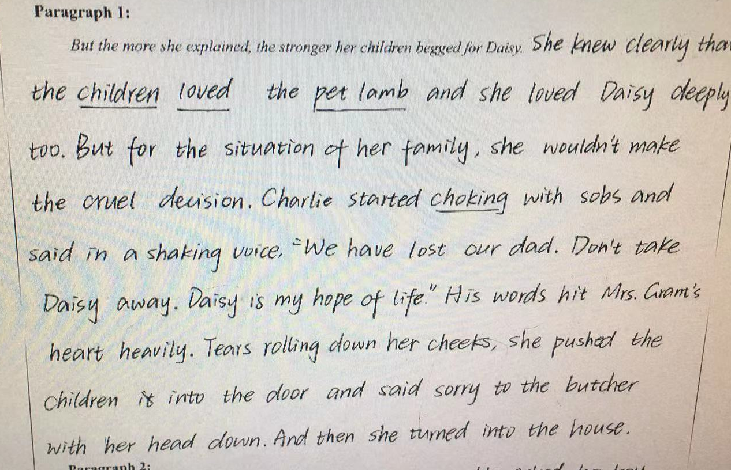
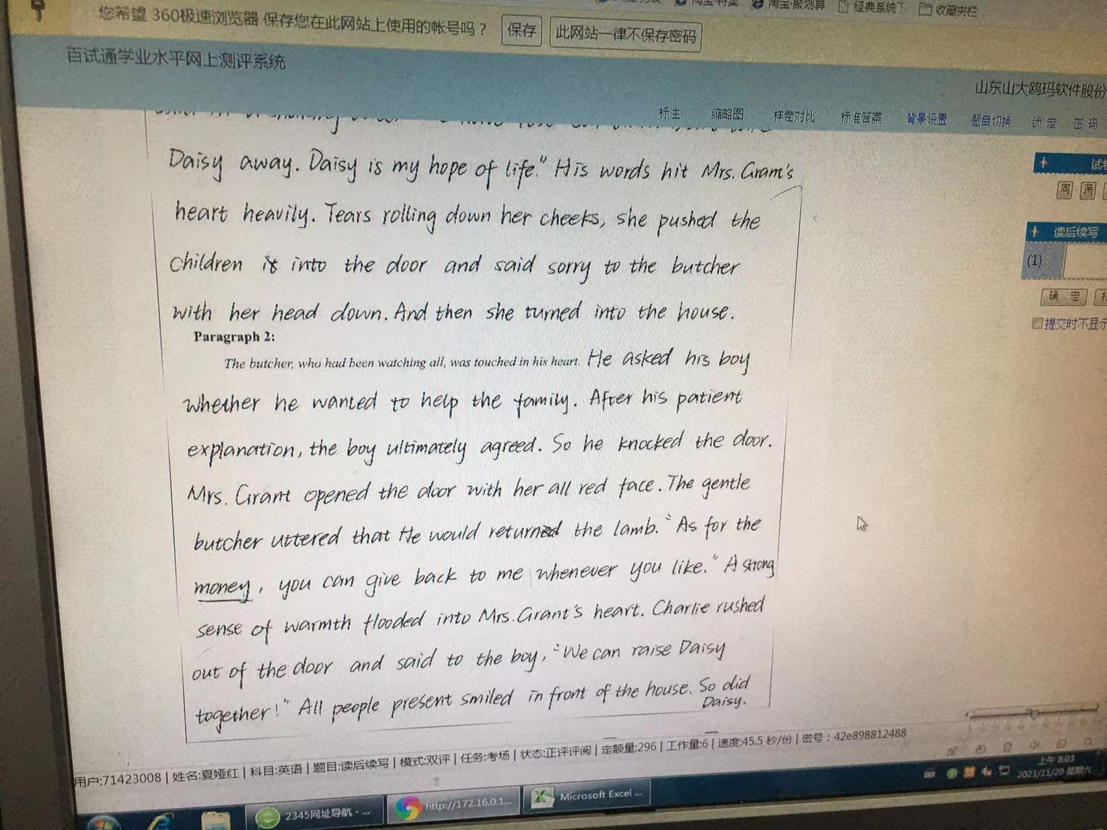
考场作文点评
1、该文较好地完成了写作的要求。情节简练，与原文的衔接自然；情节之间的过渡也比较自然，给读者留下一种“简单又不简单”的印象。
2、第一段表达比第二段要出彩些。虚拟语气but for和独立主格结构的运用，为文章提升了档次；心理活动描写、无灵主语句、各种感官的综合运用等展示了作者良好的语言功底。
3.第二段稍微显得逊色。语言表达方面有一些错误，情节的推进也可以更加紧凑。但是ultimately,
As for the money等都是
本段表达方面的亮点;
We can raise the lamb
together，So did Daisy
是思维上的一个亮点。
特别感谢夏娅红老师提供学生作品素材！

Slide 21
参考范文：
But the more she explained. the stronger her children begged for Daisy. “No!- No! No!” they dashed to Daisy and threw their arms around her, begging “Please, mother! We would rather go hungry than lose her!” Hearing this, Mrs. Grant was in great sorrow, her heart bleeding. After all, she clearly knew that the children had devoted so much love to Daisy and that Daisy was more than a pet lamb to them; she was, in their eyes, a family member! Having struggled hard, she turned to the butcher and decided that she would not sell daisy and would return the money. （90words）

Slide 22
The butcher, who had been watching all, was touched in his heart. When Mrs. Grant took out the money and gave it back, he just waved his hand and announced, “I will not rob the children of their pet!” He approached the children, patted them on the shoulders gently and promised that he would buy Daisy from their mother and then gave it back to them as a gift. The word left the children standing stunned. Then, looking up at him, one asked seriously, ”Sir, do you really mean that?” The butcher just replied as seriously, ”I mean every word of it. She is OUR Daisy. My boy and I will come to see her occasionally.” Hearing this, all the children gathered round and stroked the pet, their little hearts filled with joy. (120 words)

Slide 23
下水作文：
But the more she explained. the stronger her children begged for Daisy. With tearful eyes, they hugged the pet lamb tightly, and even promised to go with less food and no clothes as long as their mother agreed to keep the lamb. Well aware that if she didn’t sell the lamb, her family would probably end up freezing or starving to death, Mrs. Grant closed her eyes, tears silently falling out of the corners of her eyes. Sensing that their mother was still hesitant about what to do, the poor children turned to the butcher’s boy and begged him not to take it away. They clearly knew that the lamb’s life was at the mercy of the boy and his father -- the butcher. 110
The butcher, who had been watching all, was touched in his heart. The pet was their only warm comfort. He should never make money by depriving the children of their only source of joy. His mind working fast, an idea popped up. Approaching the children and the pet lamb, he announced that he would buy the lamb with the money he had paid Mrs. Grant, but he would give the lamb back to them as a present for their loving heart. At the uplifting words, the children danced happily around the lamb in circles. And Mrs. Grant threw an appreciative look at the butcher, delighted that both her family and the pet lamb luckily survived thanks to the butcher’s gentle heart.

Slide 24
下水作文：
But the more she explained. the stronger her children begged for Daisy. With tearful eyes, they hugged the pet lamb tightly, and even promised to go with less food and no clothes as long as their mother agreed to keep the lamb. Well aware that if she didn’t sell the lamb, her family would probably end up freezing or starving to death, Mrs. Grant closed her eyes, tears silently falling out of the corners of her eyes. Sensing that their mother was still hesitant about what to do, the poor children turned to the butcher’s boy and begged him not to take it away. They clearly knew that the lamb’s life was at the mercy of the boy and his father -- the butcher. 110
Plot 1:向妈妈请求
Plot 2:妈妈的反应
Plot 3:向男孩请求

Slide 25
The butcher, who had been watching all, was touched in his heart. The pet was their only warm comfort. He should never make money by depriving the children of their only source of joy. His mind working fast, an idea popped up. Approaching the
children and the pet lamb, he announced that he would buy the lamb with the money he had paid Mrs. Grant, but he would give the lamb back to them as a present for their loving heart. At the uplifting words, the children danced happily around the lamb in circles. And Mrs. Grant threw an appreciative look at the butcher,
delighted that both her family and the pet lamb luckily survived thanks to the butcher’s gentle heart. 107
Plot 1:如何被触动
Plot 2:如何解决难题
Plot 3:家人的反应

Slide 26
Thank you

