Slide 1

感恩遇见，相互成就，本课件资料仅供您个人参考、教学使用，严禁自行在网络传播，违者依知识产权法追究法律责任。
更多教学资源请关注
公众号：溯恩高中英语
知识产权声明

Slide 2






Unit 1 Science and Scientists
Reading and Thinking
John Snow Defeats “King Cholera”

Slide 3

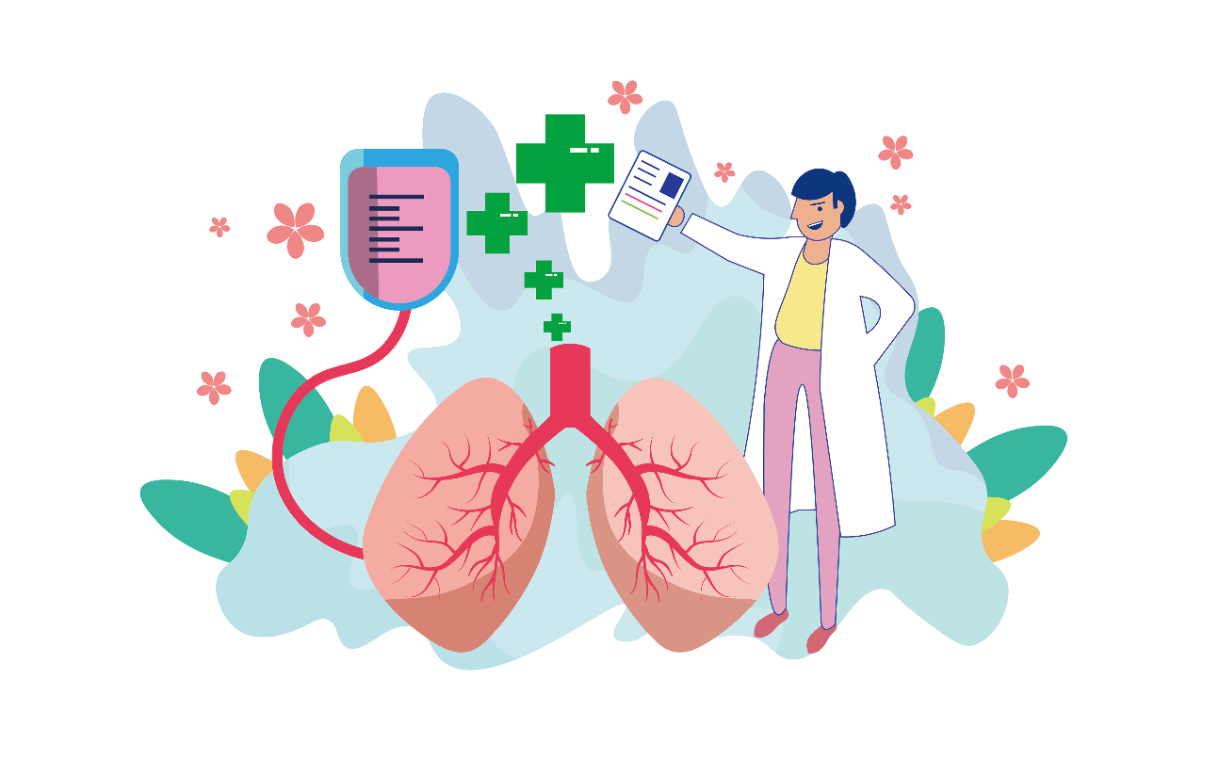

Learning objectives
By the end of this class, students will
get information about how John Snow defeated cholera;
summarize the stages of scientific research;
talk about the significance and contribution of John’s work

Slide 4
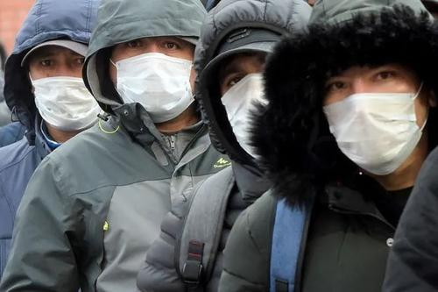
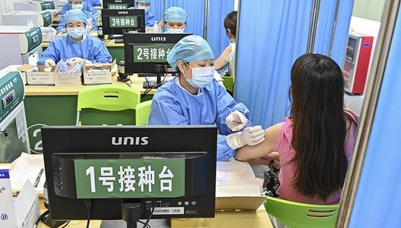
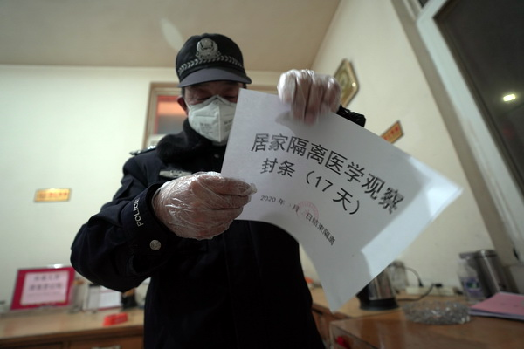
Lead in
Are you familiar with these situations ?
Positive measures are taken to fight against Covid-19.
Mask up
Get vaccinated
Self-isolation

Slide 5
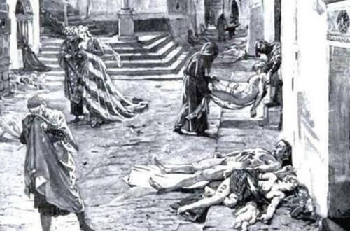
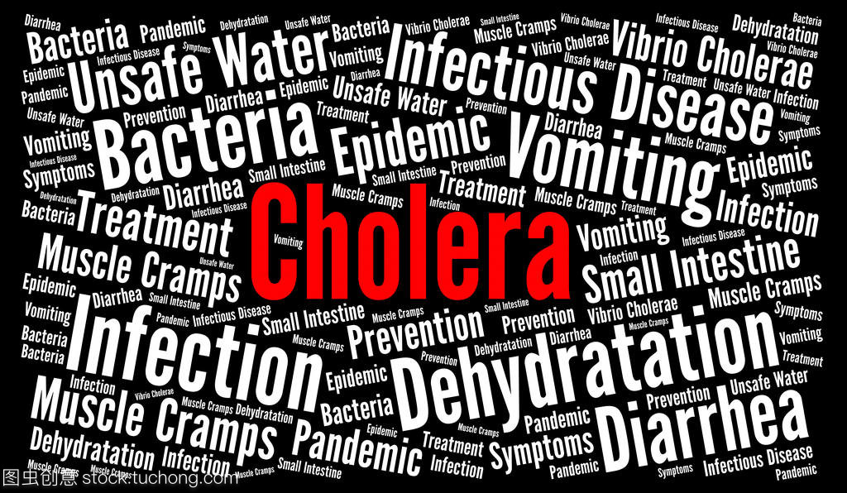
Besides coronavirus, what other kinds of epidemics(流行病) do you know?
Lead in

Slide 6
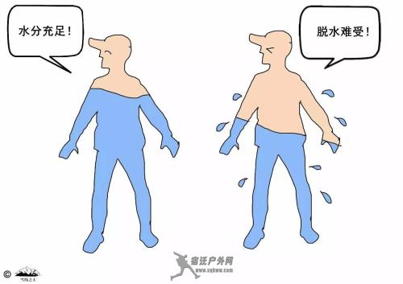
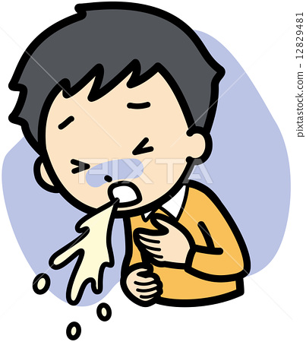
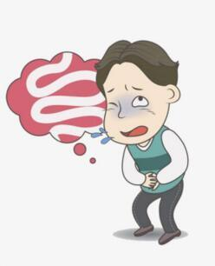
Cholera
loss of liquid (缺水)
severe vomiting (呕吐)
diarrhea (腹泻)
It begins in the stomach and a severe case can lead to death without immediate treatment.

Slide 7
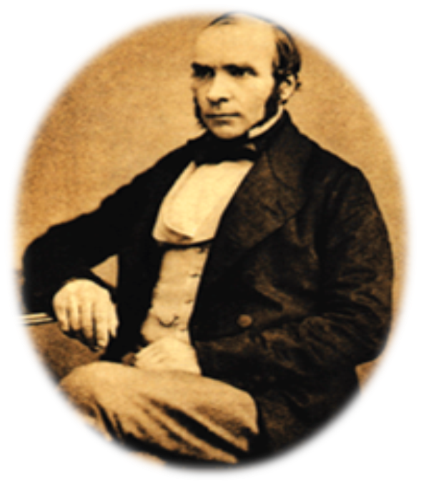
1. Who was John Snow? 2. What is King Cholera? 3. How did John Snow defeat King Cholera?
Pre-reading
John Snow Defeats “King Cholera”
Who ?
How ?
What ?

Slide 8
Activity 1 Read for the main idea and check predictions
John began his study by marking on the map & the process.
How
Para1
How
He needed to prove the second theory was correct.
Para 2
John Snow made great contributions to modern epidemiology.
Para 3
Para 4
Who
What
John Snow want to use his knowledge to solve colera.
Para 5
He finally found out that dirty water was the cause of cholera.

Slide 9
Activity 2 Read for stages
Put the seven research stages in order.
analyze the results
draw a conclusion
collect data
think of a method
ask a question
find a problem
find supporting evidence

Slide 10
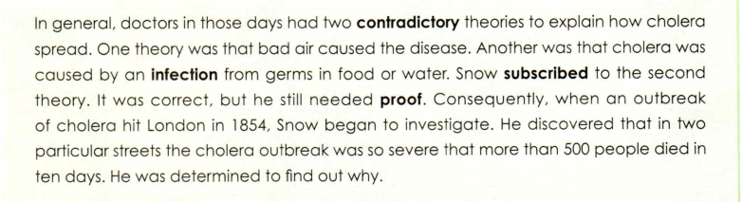
Activity 2 Find the seven stages in Para.2 & 3
Stage 1 find a problem
Para.2
contradictory
subscribe to
proof
to agree with or support an opinion, a theory, etc.

Slide 11
Activity 2 Find the seven stages in Para.2 & 3
Stage 2 ask a question
Para.2
investigate
to carefully examine the facts or find out the truth or how it happened
determined

Slide 12
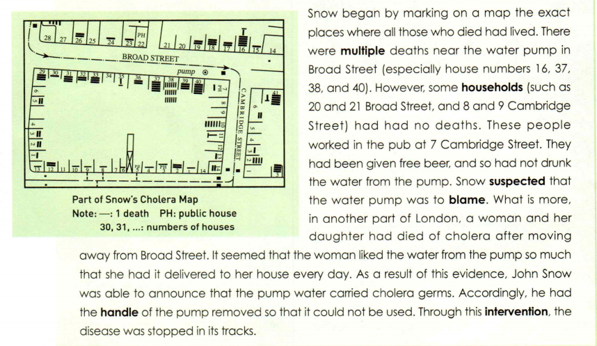
Activity 2 Find the seven stages in Para.2 & 3
Stage 3 think of a method
Para.3
mark
exact

Slide 13
Activity 2 Find the seven stages in Para.2 & 3
Stage 4 collect data
Para.3

Slide 14

Activity 2 Find the seven stages in Para.2 & 3
Stage 5 analyze the results
Para.3
multiple
However
no deaths
suspect
the water pump was to blame

Slide 15
Activity 2 Find the seven stages in Para.2 & 3
Stage 6 find supporting evidence
Para.3
What’s more

Slide 16
Activity 2 Find the seven stages in Para.2 & 3
Stage 7 draw a conclusion
Para.3
As a result of this evidence,...
announce

Slide 17
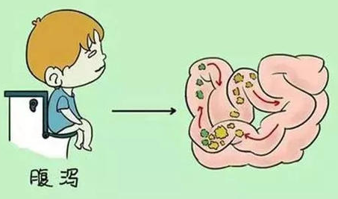
Activity 3 Read for detailed information in Para.1
the most feared diseases
What? It's one of in the world, because it causes
severe diarrhoea, dehydration
and even death.
When?
In the early 19th century
Cholera
Where?
Europe
What results?
Millions of people died from the disease

Slide 18
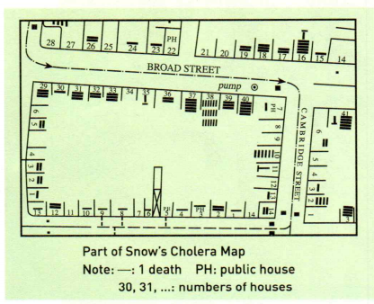
Activity 3 Read for detailed information in Para.2 & 3
What kind of map is it?
What does “-” mean?
What does “PH” mean?
Where is the pump?

Slide 19
Activity 3 Read for detailed information in Para.2 & 3
A
It was believed that
cholera was caused
by _______ or germs in _____________.
C
Many deaths occurred
near the __________
in Broad Street.
D
The pump water carried____________.
water pump
cholera germs
bad air
food or water
Some people _______
drunk the water from
the pump, and lived.
had not
E
handle
Snow had the_______ of the pump removed.
B
marked on
Snow __________
_______the places where people who
_____ had lived.
A woman and her
daughter died in another part of London after ____________ ______________.
a map
died
drinking water
from the pump
Steps in the research

Slide 20
Activity 3 Read for detailed information in Para.2 & 3
theories
evidence
conclusion
A
It was believed that
cholera was caused
by _______ or germs in _____________.
C
Many deaths occurred
near the __________
in Broad Street.
D
The pump water carried____________.
water pump
cholera germs
bad air
food or water
Some people _______
drunk the water from
the pump, and lived.
had not
E
handle
Snow had the_______ of the pump removed.
B
marked on
Snow __________
_______the places where people who
_____ had lived.
solution
A woman and her
daughter died in another part of London after ____________ ______________.
a map
died
drinking water
process
Research method
from the pump

Slide 21
Activity 3 Read for detailed information in Para.4 & 5
1. What caused the outbreak of cholera in London?
A. Bad air B. Water infected by raw waste
C. Polluted air D. Water polluted by the air
2.Why was John Snow called the father of modern epidemiology?
He helped people know how to prevent cholera.
He transformed the way scientists study diseases in use of map and statistics.

Slide 22

Activity 4 Group discussion
What qualities and scientific spirits do they have in common?
strong sense of social responsibility
creativity
critical thinking
passionate
questioning mind
courage to face difficulties
knowledgeable
committed

Slide 23

The Story of Colera

Slide 24
Thank you

