Slide 1

感恩遇见，相互成就，本课件资料仅供您个人参考、教学使用，严禁自行在网络传播，违者依知识产权法追究法律责任。
更多教学资源请关注
公众号：溯恩高中英语
知识产权声明

Slide 2
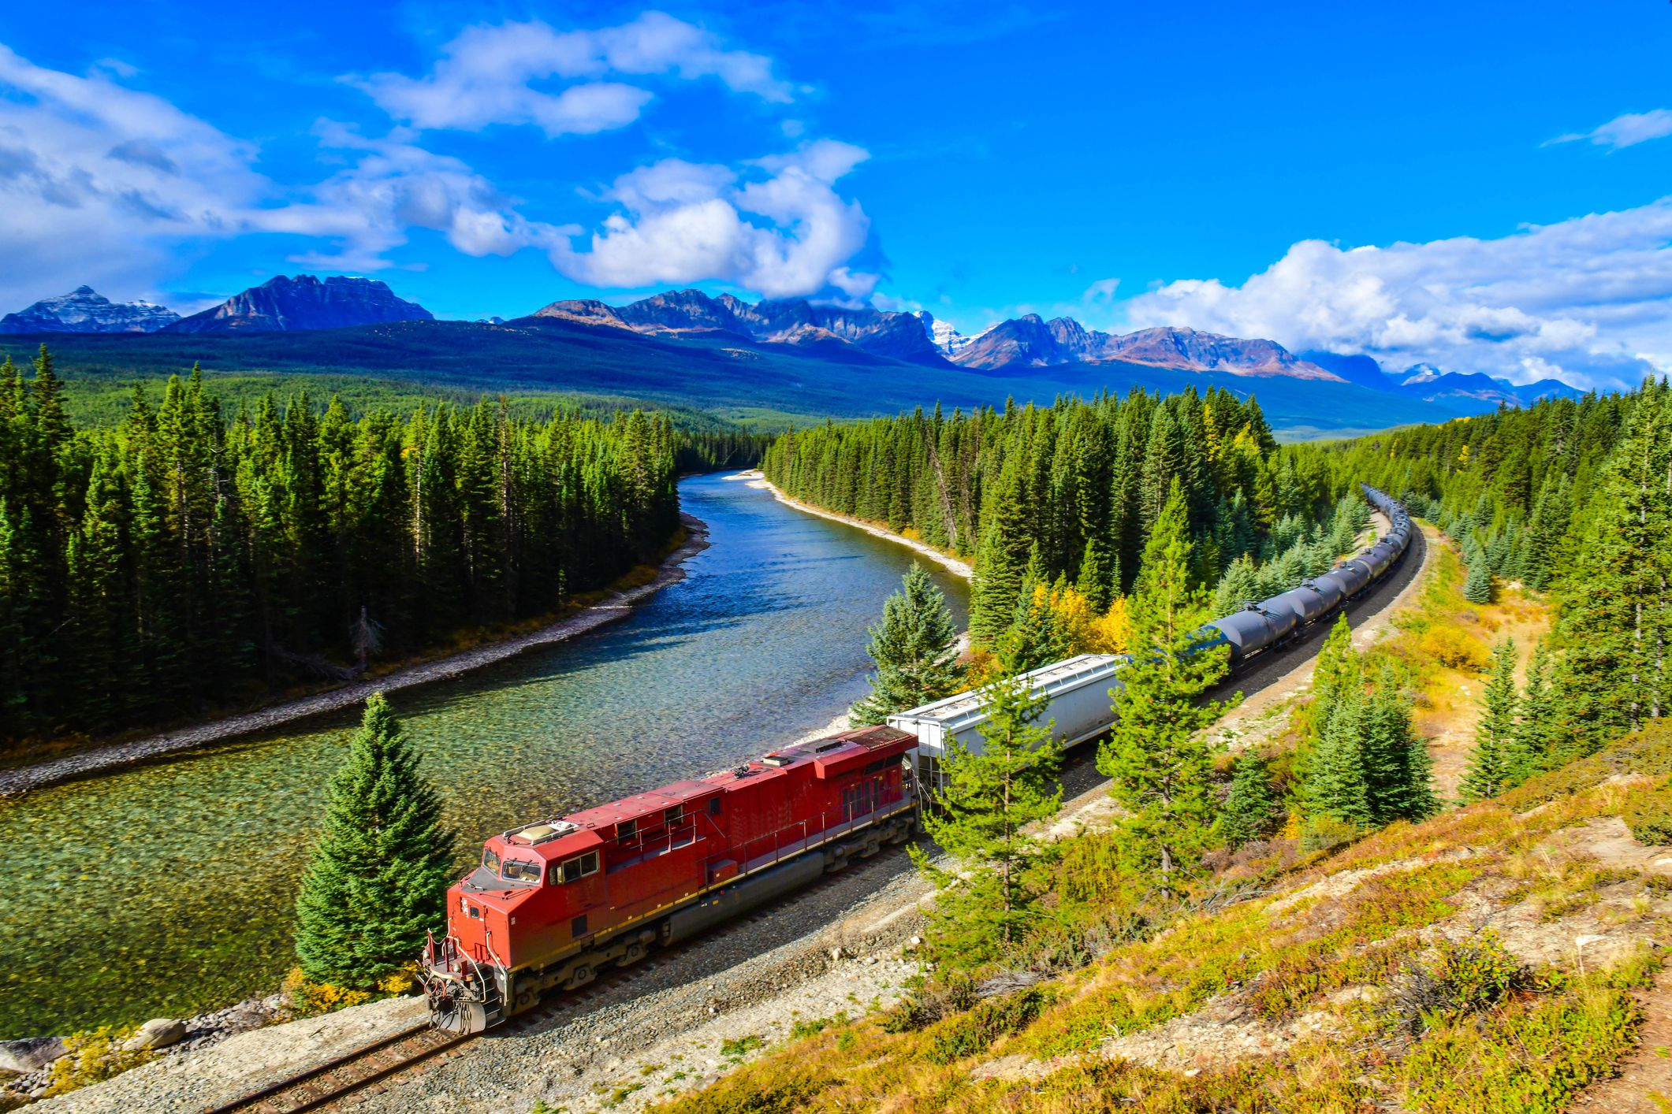
Unit4 Using Language
Write about a rail journey across Canada
浙江省龙游县第二高级中学 邱筠
浙江省衢州第三中学 邱赛仙

Slide 3
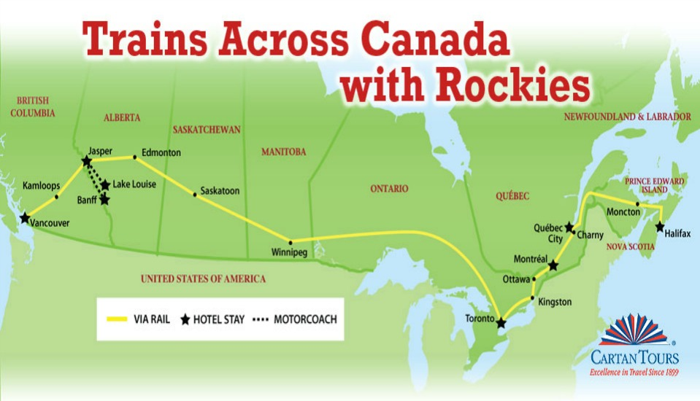
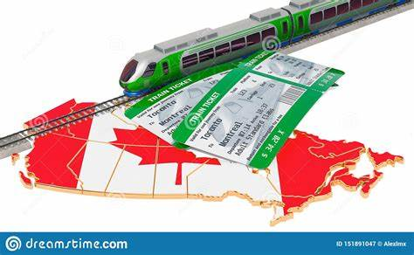
Seeing the true north via rail: Vancouver and the heart of Canada
Seeing the true north via rail: Toronto and Montreal
What will the passage probably talk about?
It will probably talk about the next leg of their trip.
one part of a journey or race
the Prairie

Slide 4
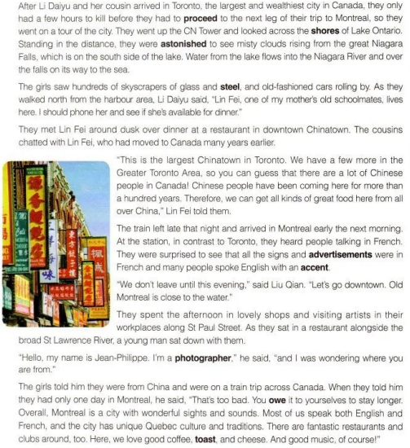

Reading and understanding Divide the passage into three parts
Paragraphs 1~4: Li Daiyu and
Liu Qian's experience in Toronto
Paragraphs 5~9: Li Daiyu and
Liu Qian's experience in Montreal
Paragraph10:Their time spent on the train towards Halifax

Slide 5
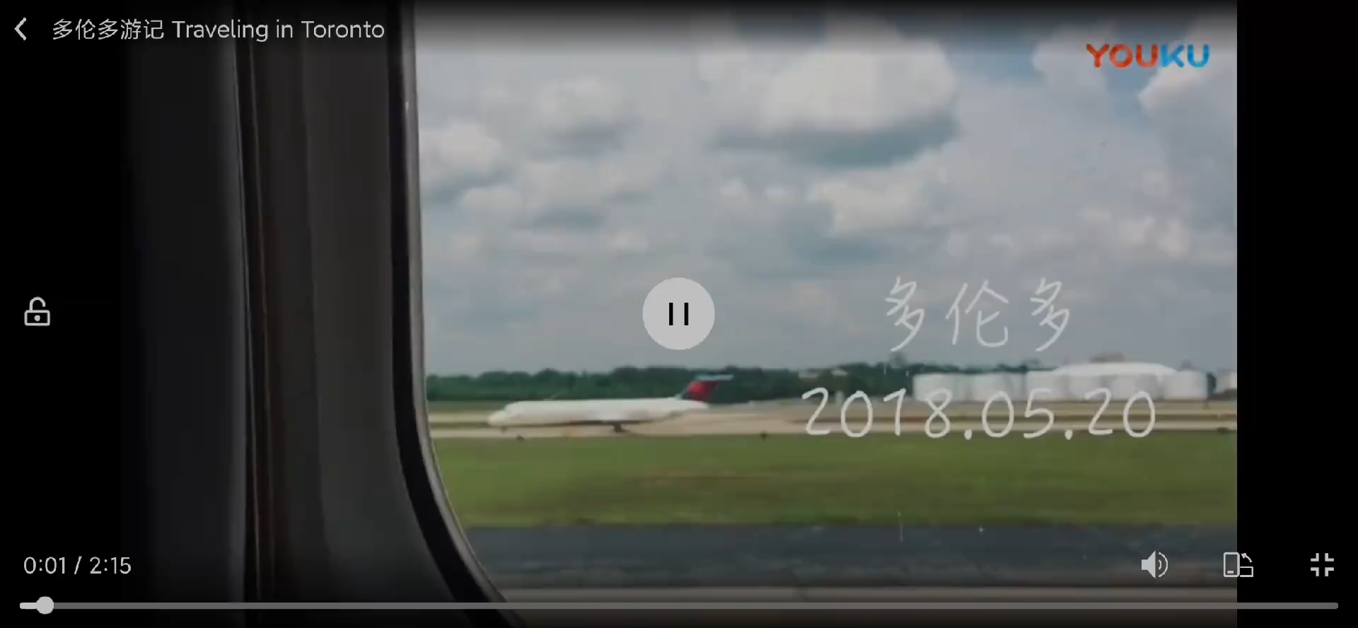
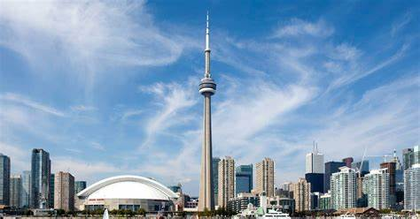
What did the girls see or do in Toronto?
Can you find what has been mentioned about Toronto?
the largest and wealthiest city in Canada;
went up the CN Tower;
saw misty clouds rising from the Niagara Falls;
skyscrapers of glass and steel;
old-fashioned cars;
met Lin Fei in Chinatown

Slide 6
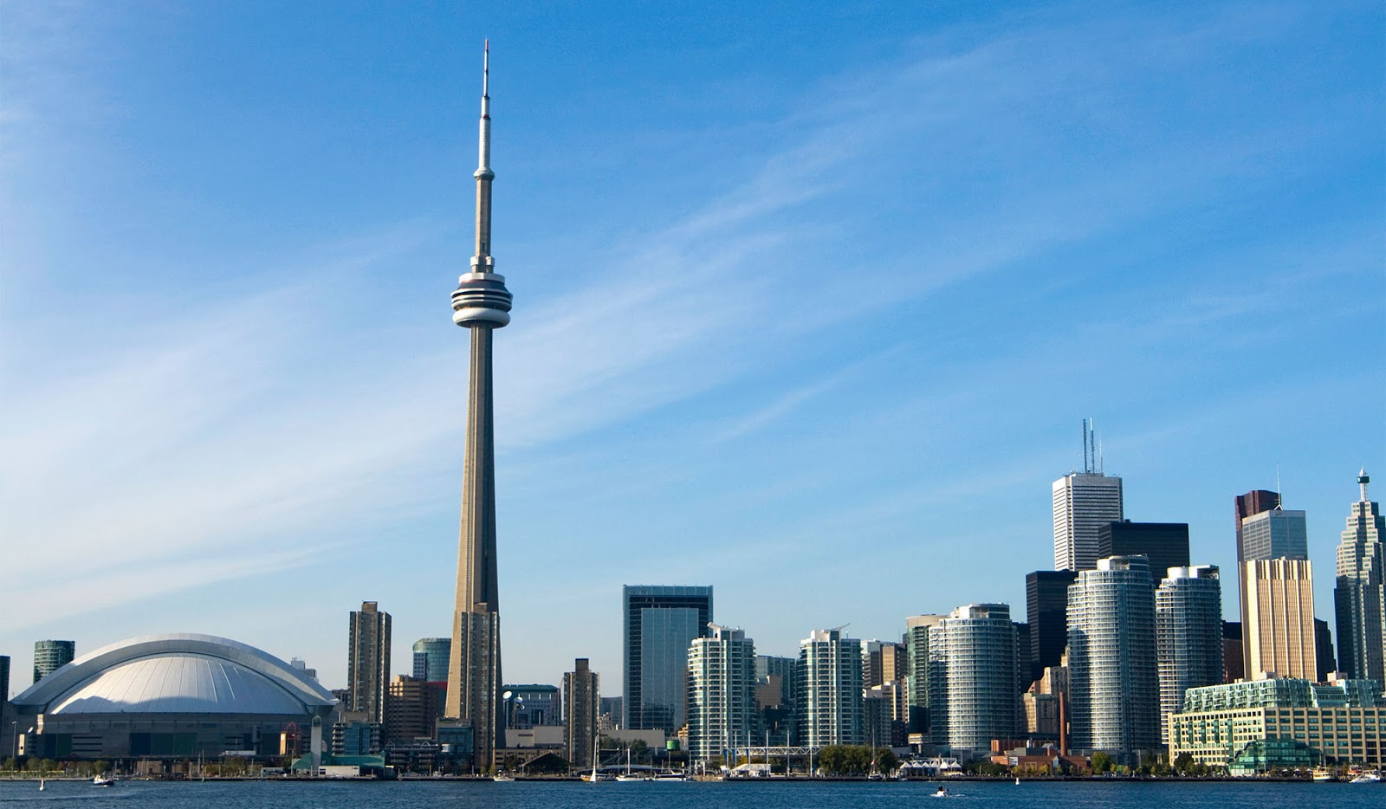
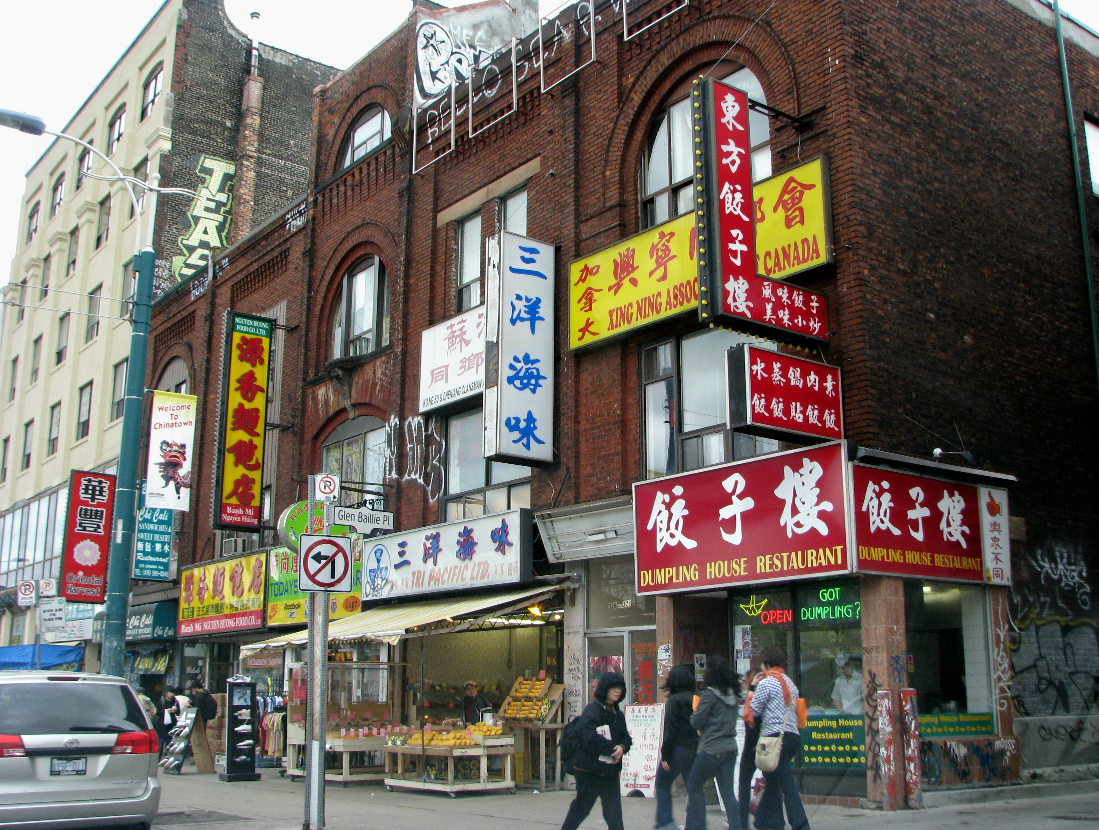

Answer the questions
1. What did the girls see when they went up the CN Tower?
2. Why was it possible to get all kinds of good Chinese food in Toronto?
They saw misty clouds rising from the great Niagara Falls.
Because there are a lot of Chinese people there.

Slide 7
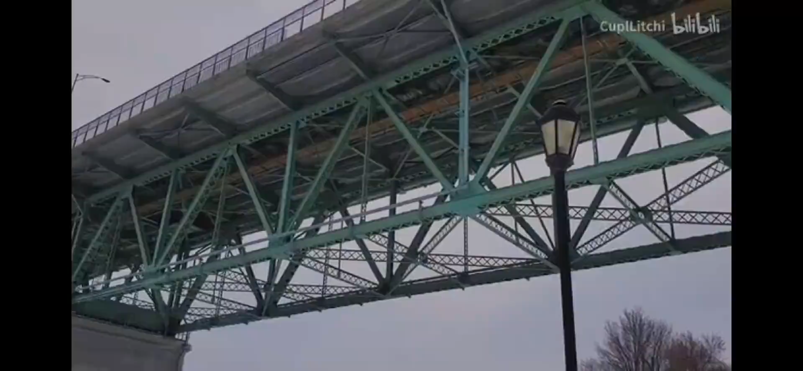
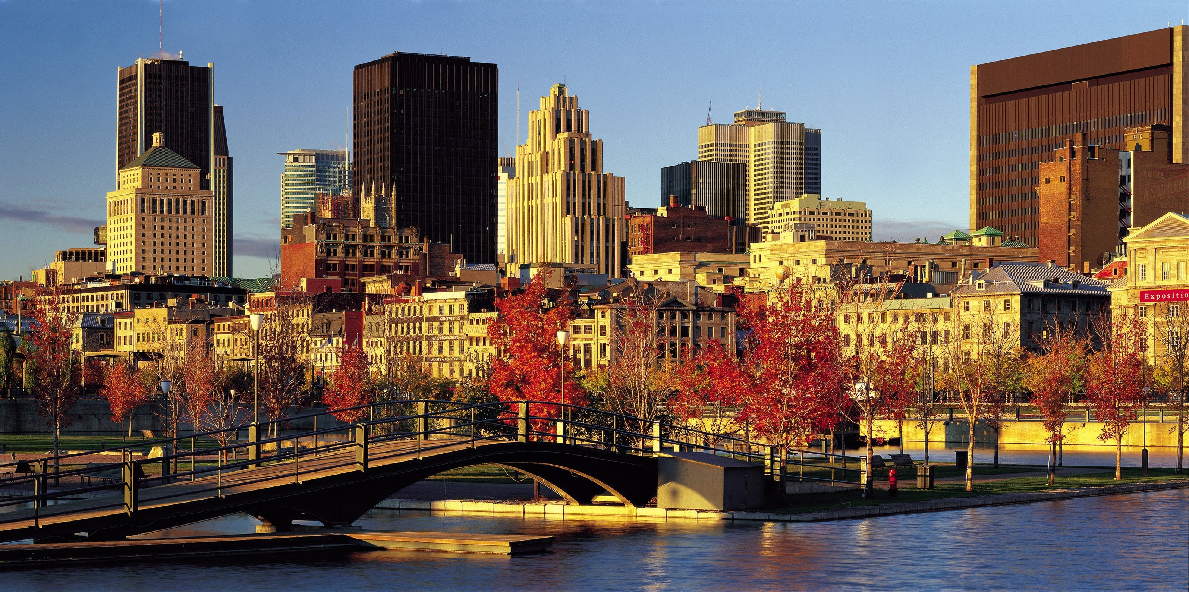
What did the girls see or do in Montreal?
Can you find what has been mentioned about Montreal?
signs and ads in French;
people speak English with an accent;
visited lovely shops;
visited artists in their workplaces along St Paul Street;
met Jean Philippe in a restaurant alongside the St Lawrence River;
unique Quebec culture and traditions

Slide 8

Make out their route and what they experienced at each place.
1.took a boat ride out into the bay;
visited an island; took a hike in a forest
7.a land of forests and lakes; rolling hills; bushes and maple trees; the wide stretch of Lake Huron
8.the largest and wealthiest city in Canada; went up the CN Tower; saw misty clouds rising from the Niagara Falls; skyscrapers of glass and steel; old-fashioned cars; met Lin Fei in Chinatown
Vancouver
Ontario
Toronto
Winnipeg
2.took the train; mountains and forests looked massive; blue water took their breath away
6.an urban area
Lake Louise
5.amazed by the open country; went through two wheat-growing provinces; a bunch of farms
9.signs and ads in French; people speak English with an accent;visited lovely shops and artists in their workplaces along St Paul Street;met Jean Philippe in a restaurant alongside the St Lawrence River;unique Quebec culture and traditions
The Prairie
Montreal
3.took a coach through the Canadian Rockies; spectacular mountain peaks; creatures
Jasper
4.center of Canada’s oil and gas drilling industry; freezing cold in winter; large shopping malls
Edmonton

Slide 9
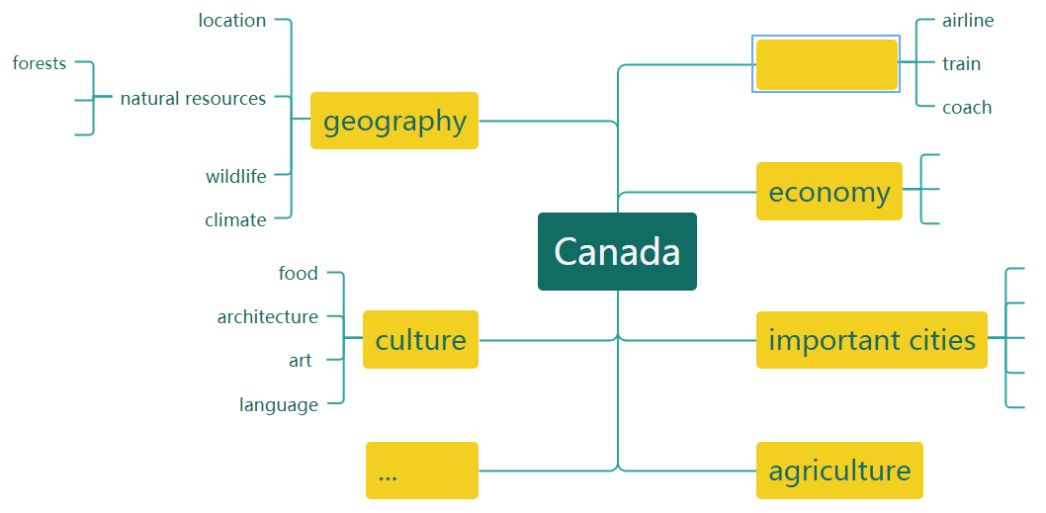

What do you know about Canada from their trip?

Slide 10
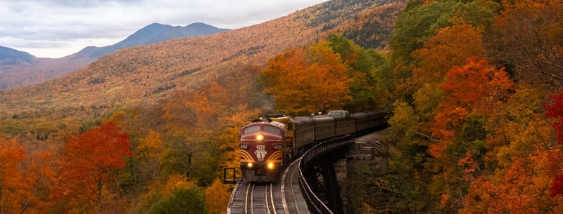
Find out the sentences that show their emotions.
Did the girls enjoy the trip?
The next day was clear and mild, and they were pleased to see the beautiful mountains looking out over the city. Later, they took a pleasant hike in a forest just a short distance away.
...where the blue water literally took their breath away with its exceptional beauty.
Looking at the beautiful scenery, they both agreed that it was the most awesome journey they had ever taken. In addition to seeing spectacular mountain peaks...
However, they did not anticipate seeing such an open country, and were truly amazed.
Standing in the distance, they were astonished to see misty clouds rising from the great Niagara Falls,...
They were surprised to see that all the signs and advertisements were in French and...
Overall, Montreal is a city with wonderful sights and sounds.
There are fantastic restaurants and clubs around, too.
...

Slide 11
What type of writing is it? How do you know?
Seeing the true north via rail:
Toronto and Montreal
title:visiting places;
transptation
a travel journal
who,when,where, what,how
during their first day;
the next day;
after another day on the train;
night came again;
when they woke up the next morning;
after Li Daiyu and her cousin arrivedin Toronto...
in chronological and spacial order
...the blue water literally took their breath away with its exceptiona beauty.
The train thundered on, through the rolling hills.
The bushes and maple trees outside their windows were red, gold, and orange, and their was frost on the ground, confirming that autumn has arrived in Canada.
That night the train was speeding along... towards... and down to... towards...
vivid descriptions

Slide 12

Writing Write an email to your parents
Discuss: If you were the girls’ parents, what would you most care about when your girls are travelling in Canada?
safety; Do they enjoy the trip? When will they come back?
Imagine that you are Li Daiyu. Use the map on P45 and your notes, write an email to your parents telling them about your trip.
Dear Mum and Dad,
_____________________________________________________________________.
We started in Vancouver,_______________________________________________. Then,________________________________________________________________.
From there, we________________________________________________________.
_____________________________. Then after we__________________________, we went on to ________________________________________________________.
Finally,___________________________________________________________.
Love,
Daiyu

Slide 13

Exchange your draft with a partner.
Use the checklist to help you assess your partner's draft.
Then take your draft back and revise it according to your partner's comments.
 Does the writer start the email with an appropriate greeting?
 Is the email well-organised and coherent?
 Does the writer make use of discourse markers to express different relationships between ideas?
 Are the descriptions of people and places interesting?
 Does the writer end the email in a natural way?

Slide 14

Possible version
Dear Mum and Dad,
Thank you so much for allowing me to go on this journey! It has been such a wonderful trip so far. Everything is going on well and I am really enjoying the trip!
We started in Vancouver, where we went shopping for gifts and then went hiking. Unfortunately, it rained the first day we were there, but then it became clear after that. Then we took a train to Lake Louise in the Canadian Rockies, and then a coach through the Rockies to Jasper. The scenery was spectacular-massive forests and mountains, beautiful blue lakes, and all kinds of animals. We even saw a grizzly bear! From there, we took a long-distance train to Toronto. We were amazed by how empty and wide the Canadian Prairie was. It just stretched on and on, as far as the eye could see.

Slide 15
But then after we passed Winnipeg we were in a land of lakes and hills. It was all so beautiful. Toronto was amazing. We went to the CN Tower and were surprised because we could see clouds rising from the Niagara Falls across the lake. Then we had dinner in Chinatown with Lin Fei (she says “Hi!”). From there we travelled to Montreal where we went shopping in the old town. Then we stopped at a restaurant where we met a cool guy named Jean-Philippe. He's a photographer. He told us all about Montreal and its culture. Did you know that nearly everyone there speaks French? Luckily, many of them speak English as well. Finally, we caught the train to Halifax.
It has been a great trip, filling us with so many happy memories. We plan on spending about a week here getting rested up from our journey, and then we'll fly home.
Love,
Daiyu

Slide 16


Homework
Explore more about Canada and compare Chinese and Canadian culture.

